Slide 1
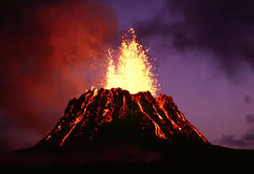
Volcanoes
By: Patrick Mason

Slide 2
Geographic Question
Description: Model that ascertains multiple buffer zones for active volcanos in the United States that are most likely to erupt near cities with large populations (we are using 300,000 or over but the user may specify a different population amount).

Slide 3
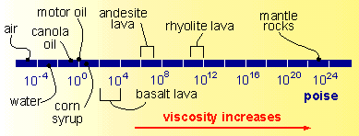
Viscosity of Volcanoes
http://www.earth.northwestern.edu/people/seth/202/lectures/Comp/magviscosity_web3.htm
High viscosity lavas flow slowly and cover small areas.
High viscosity lavas have gas pressure build up = violent eruptions.
Low viscosity lavas flow more rapidly and cover many miles.
Low viscosity lavas allow gases to escape = less violent eruptions.
Example: (Blowing through a straw, it's easier to get water to bubble than a milk shake)

Slide 4
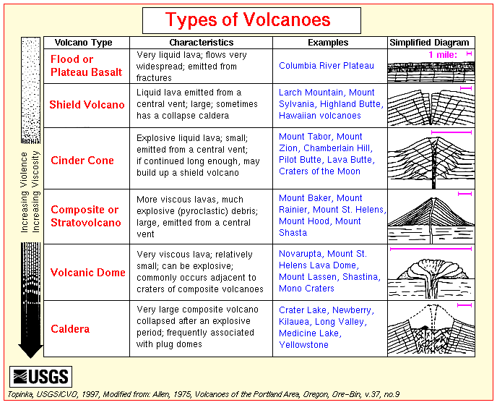
http://www.explorevolcanoes.com/types-of-volcano.html

Slide 5
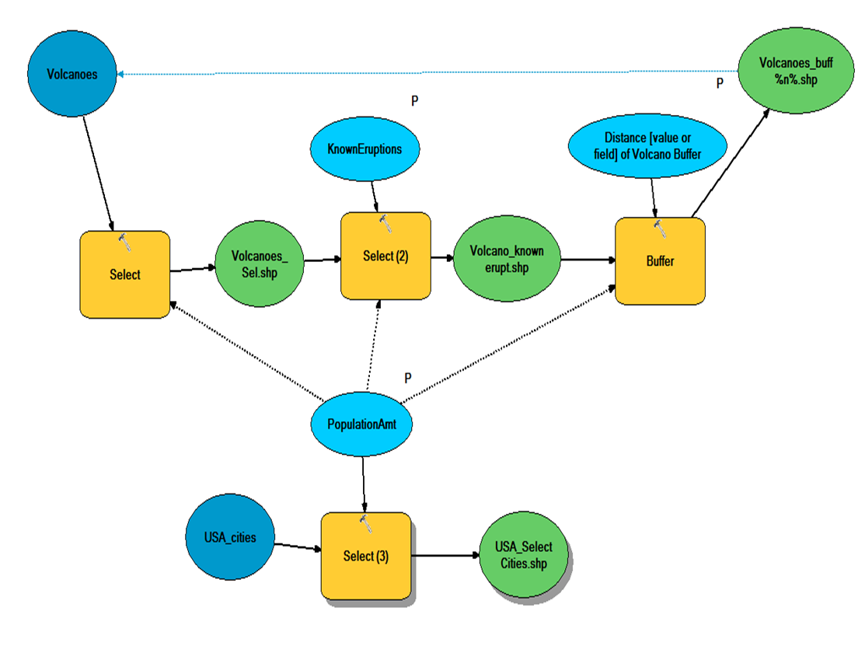
ModelBuilder Project

Slide 6
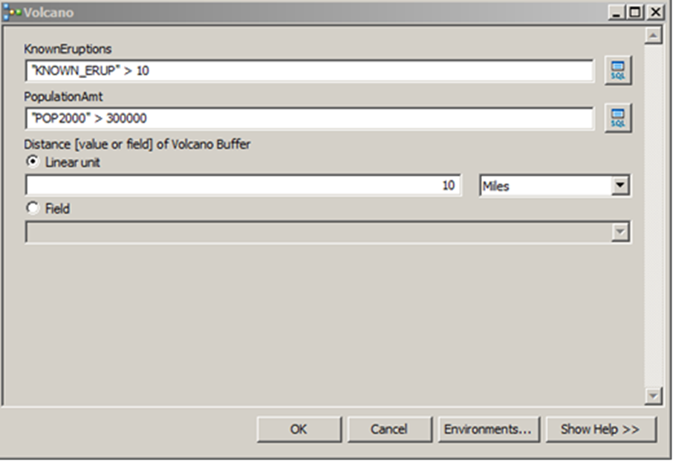

Slide 7
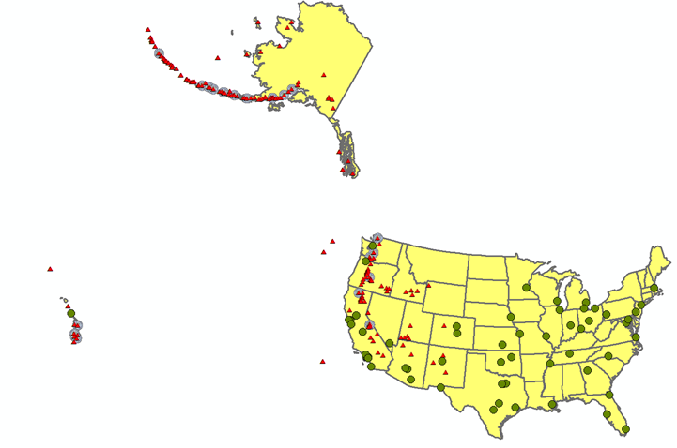
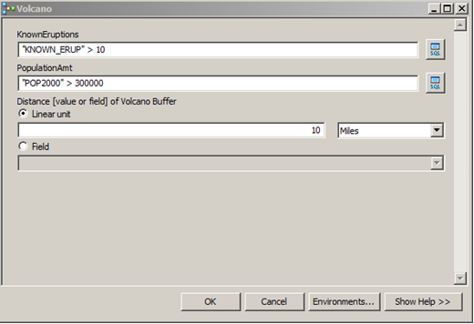

Slide 8
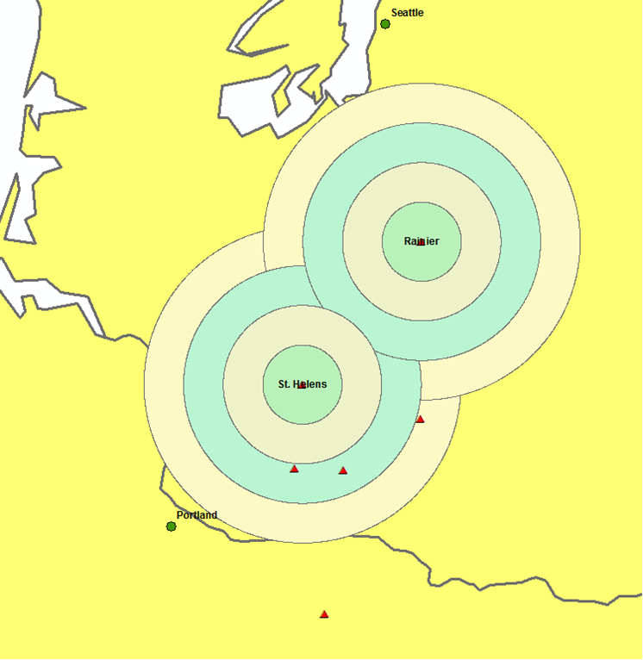

Slide 9
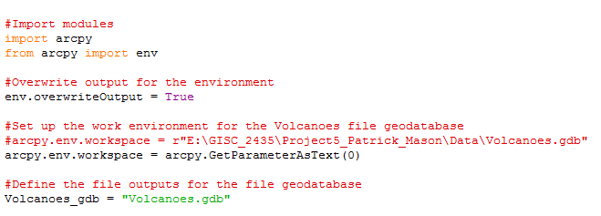
Import Modules, Overwrite Outputs, and Set up Work Environment

Slide 10
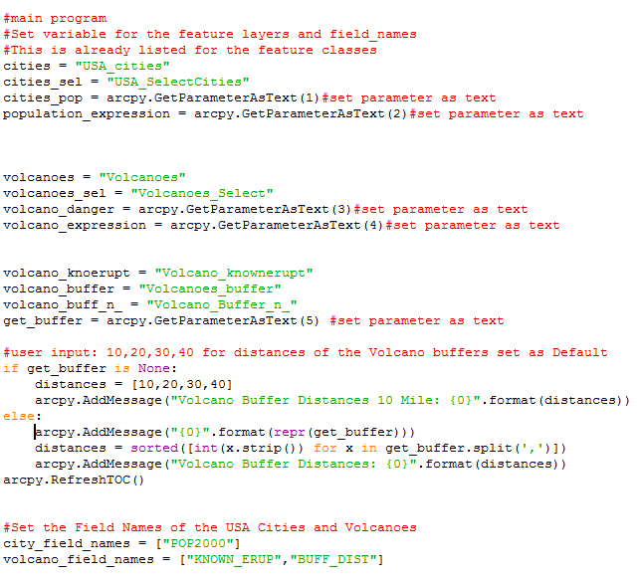
Define Variables, Feature layers, and Fields Names

Slide 11
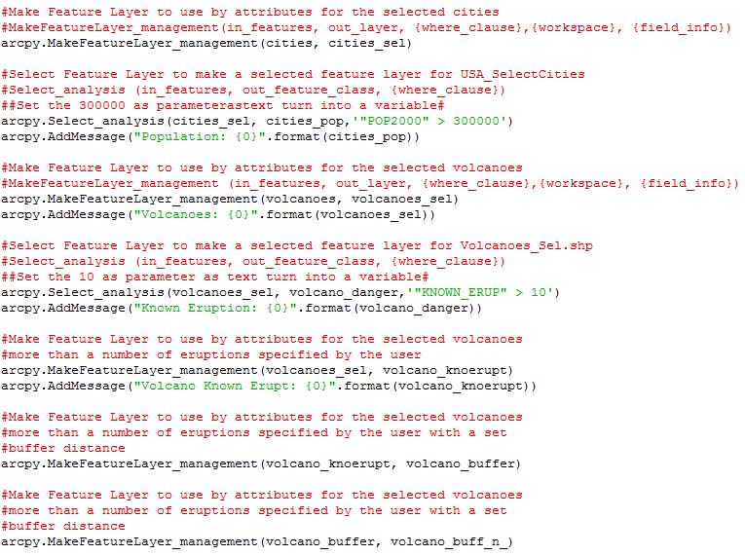
Make Feature Layers and Select Analysis

Slide 12
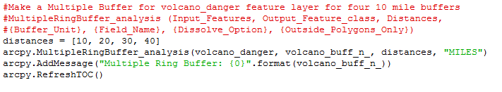
Make Multiple Buffer Rings

Slide 13
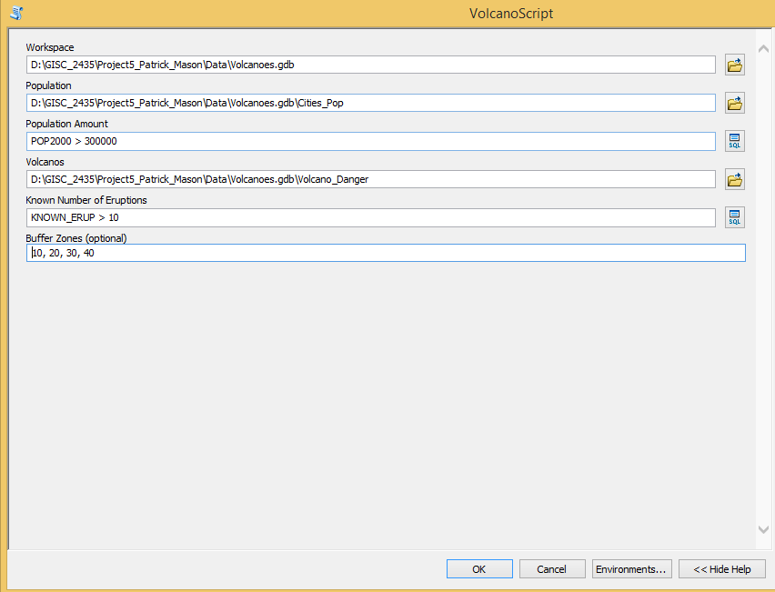
These values are set with the Default Values, but the User can change the parameters to whatever they choose.

Slide 14
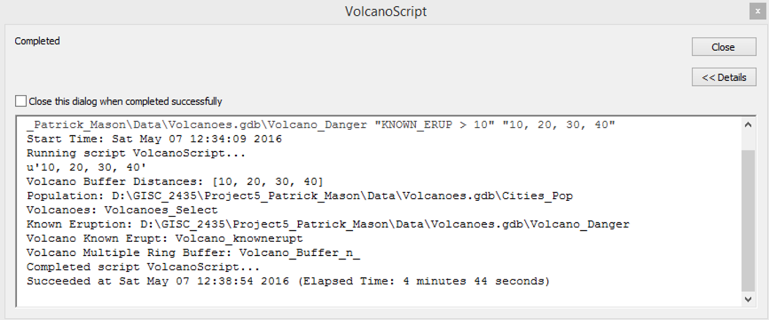
Volcano Script Running inside ArcMAP

Slide 15
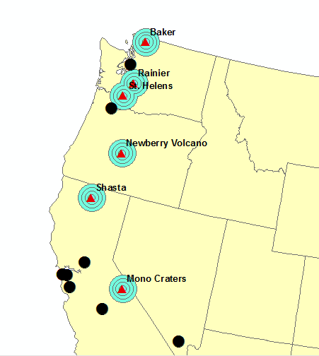

Slide 16
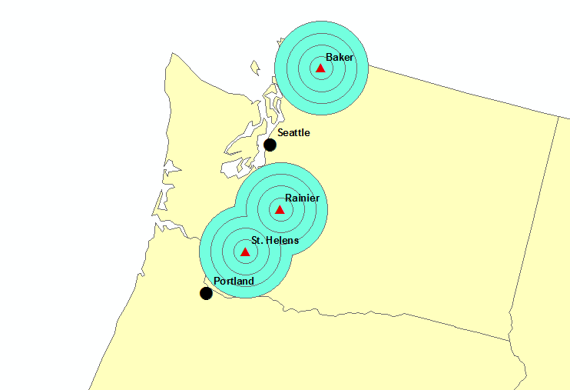
Result using the script instead of model from ModelBuilder
Cities (Seattle and Portland) most in danger of volcanoes (Mount Saint Helens and Mount Rainer) since 1980

Slide 17
Volcano_Danger Table
20 records total with “KNOWN_ERUP” > 10 (Default)
Sort Ascending by KNOWN_ERUP

Slide 19
City_Pop Table
57 records total with “POP2000” > 300000 (Default)
Sort Ascending by POP2000

Slide 21
Volcano_Buff_n_ Table
4 records total with 10, 20, 30, 40 Miles (Default)
Sort Ascending by POP2000

Slide 23
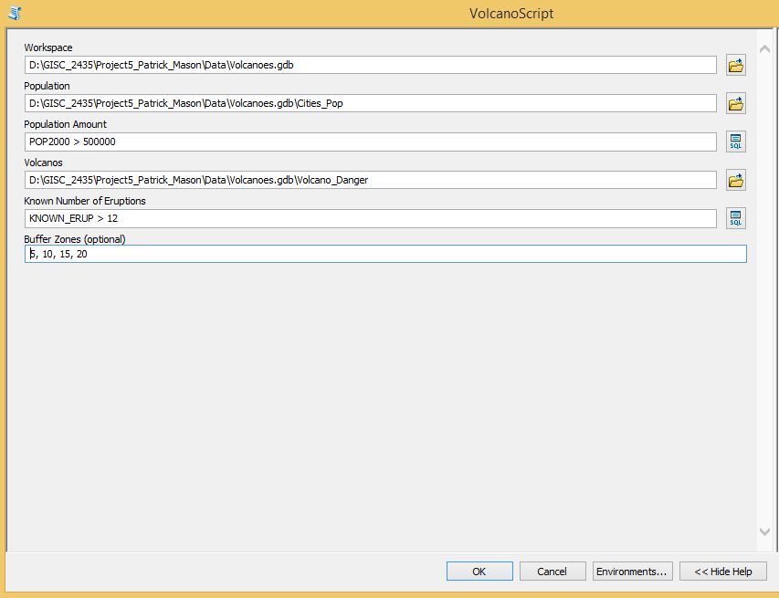

Slide 24
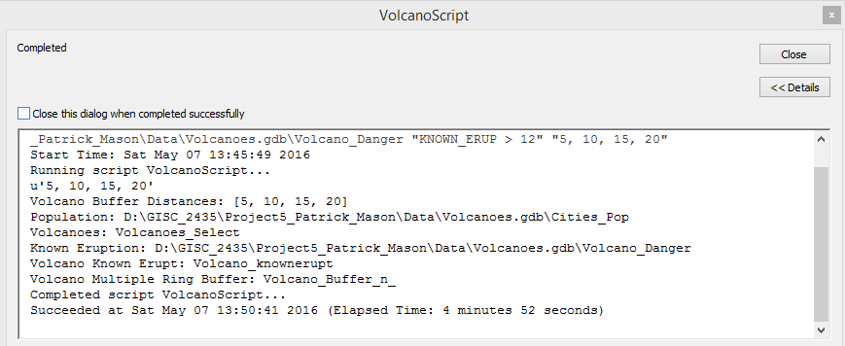

Slide 25
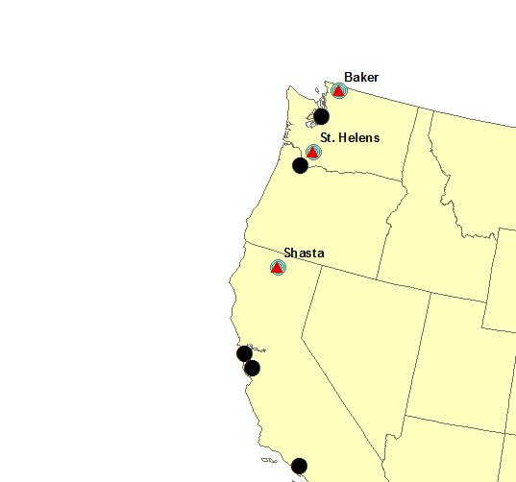

Slide 26
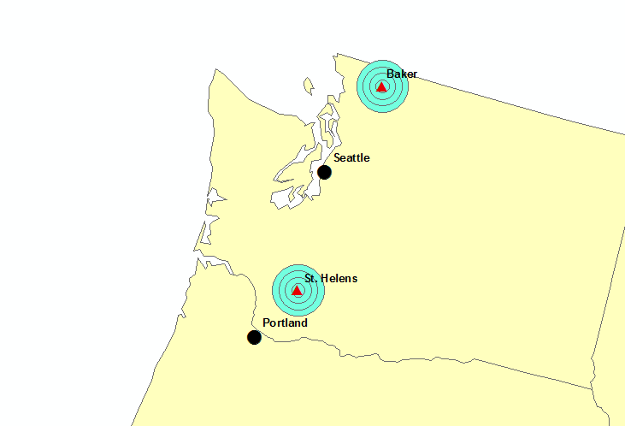
Result using the script instead of model from ModelBuilder
Cities (Seattle and Portland) most in danger of volcanoes (Mount Saint Helens) since 1980

Slide 27
Volcano_Danger Table
14 records total with “KNOWN_ERUP” > 12 (User)
Sort Ascending by KNOWN_ERUP

Slide 28
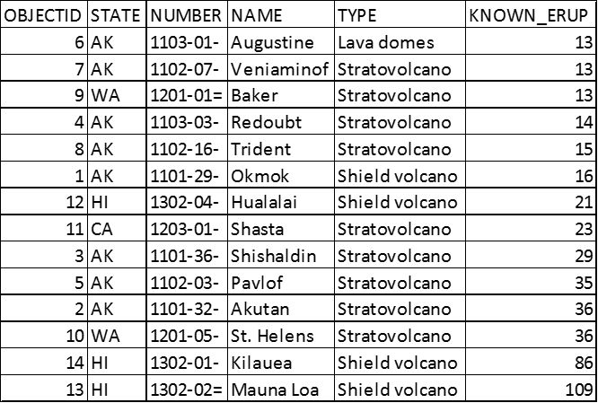

Slide 29
City_Pop Table
29 records total with “POP2000” > 500000 (User)
Sort Ascending by POP2000

Slide 31
Volcano_Buff_n_ Table
4 records total with 5, 10, 15, and 20 Miles (Default)

Slide 33
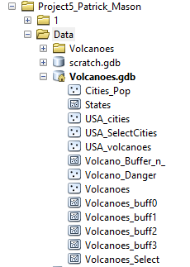

Slide 34
Lessons Learned
GetParameterAsText
Make feature layer
Select Analysis
AddMessage
Multiple Buffer Rings
Help File

