Slide 1
CASE ASSIGNMENT PRESENTATION
Creative Tooling
Patrick Klie
Lead Engineer, Creative Tooling interview
8 April 2026
Part 1: Decoration Preview Service · Part 2: Tool Consolidation Strategy
30-Minute Presentation
Engineering · Design · Senior Leadership
Notes:
This presentation has two parts. First, I will walk through a concrete service I designed for designers: a decoration preview platform that shortens feedback loops from hours to minutes.
Second, I will step up a level and show how I would consolidate a fragmented creative-tooling landscape into a shared platform over time.
I will keep the first part to about ten minutes, the second part to about twenty, and leave ten minutes for questions.

Slide 2
Today's Agenda
Two-part presentation · 30 minutes total
Part 1
Part 2
Decoration Preview Service
Tool Consolidation Strategy
~10 minutes
~20 minutes
The problem & solution vision
The challenge & vision
System architecture (C4)
Target architecture
API design & security
5-phase 18-month roadmap
Scalability & design principles
Handling legacy tools & resistance
Implementation & summary
AI strategy & success metrics
Creative Tooling Lead Engineer — Case Assignment
Overview
Notes:
The agenda is deliberate. I start with a real technical problem and a concrete architecture so you can see how I think as an engineer.
Then I move into platform strategy, migration sequencing, and change management, because the Lead Engineer role is not only about building systems. It is also about choosing what to build first, how to earn trust, and how to move an organization without breaking it.

Slide 3




Part 1 · Decoration Preview Service
The Problem
Designers wait hours for 3D previews of their 2D artwork
Every preview request blocks the creative iteration cycle
Hours
Designer frustration
Average wait time per preview
Hours of waiting
Slow iteration
Per preview request
Feedback loops broken
Creative momentum lost
vs. seconds needed to stay in flow
Creative Tooling Lead Engineer — Case Assignment
Part 1: Decoration Preview Service
Notes:
The core problem is not just rendering speed. It is creative interruption.
When designers wait hours for a preview, the cost is not only elapsed time. It is broken flow, slower iteration, and weaker collaboration because feedback arrives too late.
So the design goal for this service is to remove waiting from the designer experience, not just to optimize infrastructure metrics.

Slide 4




Part 1 · Decoration Preview Service
Solution Vision
An async, cloud-native rendering service that never blocks the designer
Designers submit → system processes → result delivered — no waiting required
Async First
Cloud Native
Secure by Default
100× Scalable
Submit & continue working. No blocking.
AWS-native — scalable, resilient, managed.
KMS encryption, pre-signed URLs, VPC isolation.
100 to 10,000+ renders/day with auto-scaling.
Creative Tooling Lead Engineer — Case Assignment
Part 1: Decoration Preview Service
Notes:
My solution vision is an async, cloud-native service that lets designers submit work and immediately continue with the rest of their job.
That leads to four design constraints: it has to be asynchronous, secure by default because the artwork is sensitive, operationally simple, and able to scale without redesign.
The point is not technology for its own sake. The point is to preserve creative momentum.

Slide 5
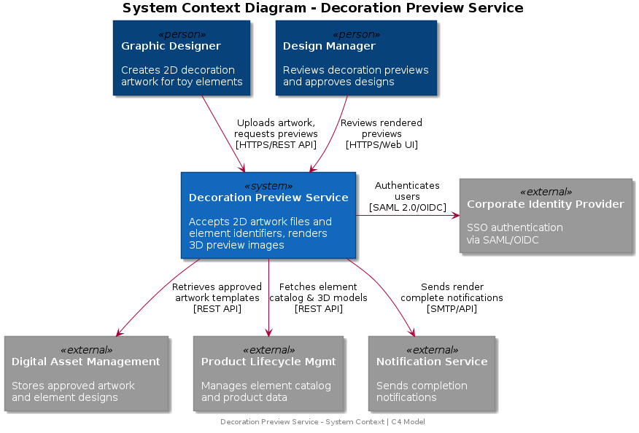
Part 1 · Architecture
C4 Context Diagram
System Context — Who uses it and what does it connect to?
Primary Actors
Graphic Designers
— Upload artwork, review previews
Design Managers
— Review & approve designs
External Systems
Digital Asset Mgmt
— Artwork templates
Product Lifecycle Mgmt
— 3D element models
Corporate IdP
— SSO authentication
Notification Service
— Render completion
Creative Tooling Lead Engineer — Case Assignment
Part 1: Decoration Preview Service
Notes:
At the context level, the service sits between people doing creative work and systems that already own adjacent domains.
Designers and design managers are the primary users. Existing enterprise systems remain the source of truth for templates, 3D models, identity, and notifications.
That separation matters because it keeps the preview service focused on one job: transforming input artwork into fast, trustworthy visual feedback.

Slide 6
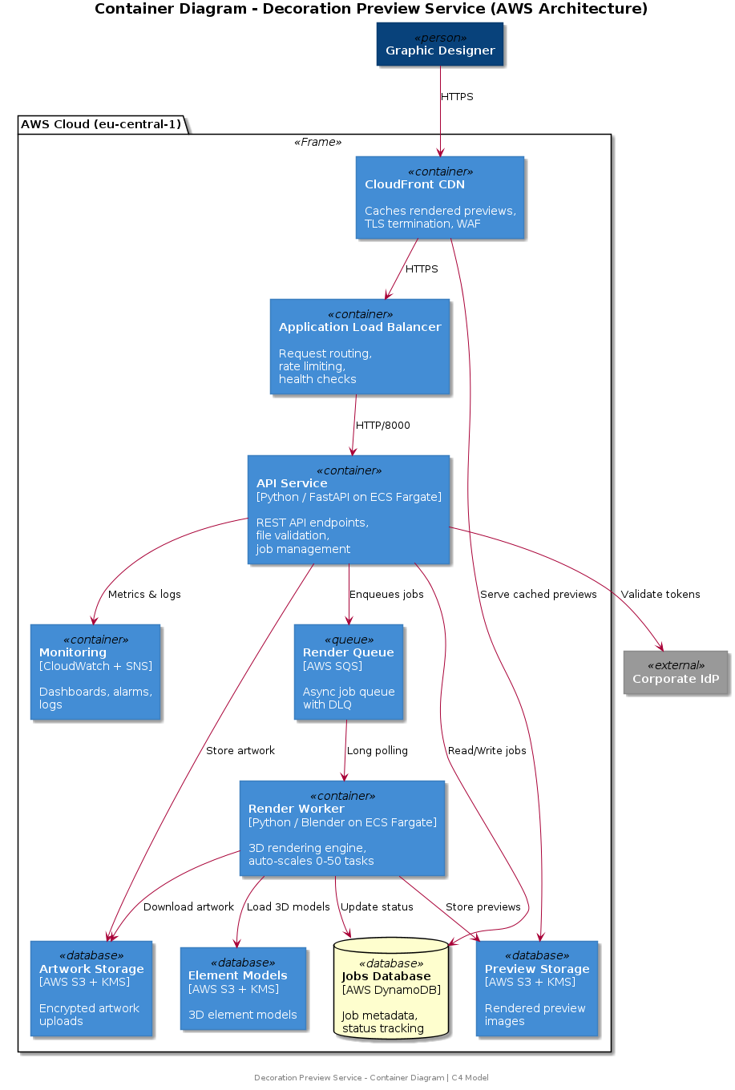
Part 1 · Architecture
C4 Container Diagram
AWS Infrastructure
CloudFront + WAF
Edge caching, DDoS protection, 1h TTL
API Service
FastAPI on ECS Fargate (2-10 tasks)
SQS Queue + DLQ
KMS encrypted, 10min visibility
Render Workers
0-50 ECS tasks, queue-driven scaling
S3 Buckets (×3)
Artwork, Elements, Renders
DynamoDB
Job tracking, GSI, TTL cleanup
CloudWatch
Dashboards, alarms, 30d logs
Creative Tooling Lead Engineer — Case Assignment
Part 1: Decoration Preview Service
Notes:
At the container level, I split the architecture into a thin API layer, an asynchronous queue, rendering workers, persistent state, and an edge layer for delivery and protection.
That decomposition gives clean scaling boundaries: the API scales on request load, workers scale on job backlog, and the storage layers remain independently managed.
It also means a slow or expensive render never blocks the request path.

Slide 7

Part 1 · API Design
Five RESTful Endpoints
/api/v1/render
Async Render Lifecycle
POST
Submit artwork + element_id for rendering
202 Accepted
GET
/api/v1/render/{job_id}/status
200 OK
1
POST /render → validates file & element_id
Poll render progress (0-100%)
2
Artwork stored in S3 (KMS encrypted)
3
Job created in DynamoDB (PENDING)
/api/v1/render/{job_id}/preview
4
Message enqueued to SQS → 202 returned
GET
Retrieve pre-signed S3 URL (1-hour expiry)
200 OK
5
Designer keeps working — not blocked
6
Worker polls SQS → renders → uploads to S3
7
GET /preview → pre-signed URL via CloudFront
GET
/api/v1/elements
200 OK
List available elements from catalog
/api/v1/render/{job_id}
DELETE
Cancel or delete a render job
204 No Content
Pydantic validates all requests before reaching the queue
Creative Tooling Lead Engineer — Case Assignment
Part 1: Decoration Preview Service
Notes:
The API is intentionally small. Five endpoints are enough to express the user journey: submit, poll, retrieve, list, and cancel.
I prefer this submit-and-poll model here because it is resilient, easy to secure, and a good fit for work that can take seconds or minutes.
Even if the rendering engine changes later, that contract remains stable for clients.

Slide 8







Part 1 · Security
Defense in Depth — 6 Layers
Encryption (KMS)
Authentication
All S3 buckets, DynamoDB, and SQS encrypted with AWS KMS Customer Managed Keys with annual rotation. TLS 1.2+ enforced on all connections. Pre-signed URLs with 1-hour expiry for preview access.
API key auth via X-API-Key header (current). Roadmap: OIDC/SAML SSO with corporate IdP, JWT tokens with short expiry, per-element and per-team RBAC authorization.
Network Isolation
Least-Privilege IAM
Render workers in private subnets with no public IP. VPC endpoints for S3, DynamoDB, SQS, and ECR — traffic never leaves AWS backbone. Security groups restrict API to port 8000 from ALB only.
API role: S3 read/write artwork, DynamoDB read/write, SQS send. Render role: S3 read artwork, S3 write renders, SQS consume. CI/CD: ECR push and ECS deploy only.
WAF Protection
Audit & Compliance
Rate limiting: 1,000 req/IP per 5 min. AWS Managed Rules for SQLi, XSS. Request body size limits. CloudFront absorbs DDoS at edge. Optional geo-blocking for corporate regions only.
CloudTrail for all API calls. S3 access logging per artwork file. Structured JSON logs with correlation IDs, 30-day retention. VPC Flow Logs for network audit. SOC 2 ready.
STRIDE threat model applied — pre-release artwork classified as Confidential with High breach impact
Creative Tooling Lead Engineer — Case Assignment
Part 1: Decoration Preview Service
Notes:
Security is layered because the content is high-value and potentially pre-release.
I start with encryption, network isolation, WAF protection, application authentication, least-privilege IAM, and auditability. None of those alone is enough.
In practice, what I want is defense in depth: if one layer is misconfigured or bypassed, the blast radius stays contained.

Slide 9
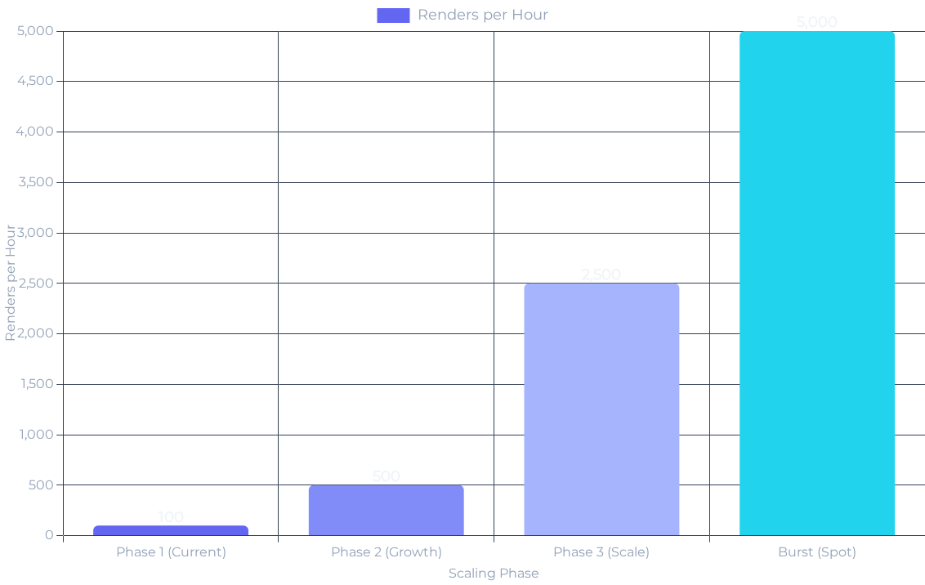
Part 1 · Scalability
Scaling from 100 to 10,000+ Renders/Day
Performance Targets
API p99 latency
< 500ms
Render completion
< 120s
Concurrent renders
200+
Upload size limit
50 MB
Auto-Scaling Triggers
API: CPU > 70% → scale 2-10 tasks
Workers: Queue depth → scale 0-50 tasks
Scale-to-zero when idle for 10 min
Alarm: CPU >85%, Queue >100, DLQ >0
Phase 1
Phase 2
Phase 3
~$200/mo
~$800/mo
~$3-5K/mo
2 API + 1-5 workers
4 API + Spot workers + Redis
GPU + Multi-region + Batch
Creative Tooling Lead Engineer — Case Assignment
Part 1: Decoration Preview Service
Notes:
For scalability, I focus on two things: predictable response time at the API edge and elastic throughput in the rendering tier.
The service should comfortably handle modest early adoption, but the architecture should also survive success. That is why I chose managed services and queue-driven worker scaling.
The cost model is staged as well, so we do not overbuild before the business case is proven.

Slide 10





Part 1 · Engineering
10 Design Principles — Top 5
01
02
03
04
05
Async by Default
Separation of Concerns
Fail-Fast Validation
Idempotency
Design for Failure
POST returns 202 immediately. SQS decouples submission from processing. A 5-min render never blocks a 200ms API call.
Unique job_id prevents duplicates. SQS visibility timeout stops double-processing. S3 keys are deterministic.
API, JobStore, FileValidator, RenderWorker — each owns one domain. Infra split into 5 CDK stacks by domain.
File type, size, MIME validated before queueing. Pydantic schema enforced at API layer. Invalid requests never reach SQS.
DLQ captures 3× failed messages. ECS health checks restart unhealthy tasks. ALB routes around failures. Self-healing.
Applied Patterns:
Factory
Repository
Strategy
Observer
CQRS
Event-Driven
IaC (CDK)
Creative Tooling Lead Engineer — Case Assignment
Part 1: Decoration Preview Service
Notes:
These design principles show the engineering posture behind the system.
Async by default protects user experience. Separation of concerns keeps the code maintainable. Fail-fast validation protects downstream systems. Idempotency protects correctness. Designing for failure protects operations.
I want the architecture to be understandable under pressure, not just elegant on a whiteboard.

Slide 11
Part 1 · Implementation
What's Built & Why
56 Tests Passing
88% Coverage
5 CDK Stacks
4 ADRs Documented
Component
Status
Notes
Tech Stack Decisions
FastAPI Service
✅ Built
5 endpoints, Pydantic, async
FastAPI
Async-native, auto-docs, Python ecosystem
SQS + DLQ
✅ Built
KMS encrypted, 3× retry
SQS
Managed, durable, scales with ECS auto-scaling
Render Workers
⚡ Stubbed
Pillow overlay (Blender in prod)
ECS Fargate
S3 / CloudFront
KMS, versioning, CDN delivery
Serverless containers, no EC2 management
✅ Built
CloudFront
DynamoDB + GSI
Global CDN, integrates natively with S3
✅ Built
On-demand, TTL, PITR
DynamoDB
GPU Rendering
⚡ Stubbed
Architecture ready, cost-controlled
Serverless, low-latency job state lookups
Live demo endpoint: http://decoration-preview-alb-1021450355.eu-central-1.elb.amazonaws.com/
Creative Tooling Lead Engineer — Case Assignment
Part 1: Decoration Preview Service
Notes:
This slide is where I separate target architecture from current implementation maturity.
What is already built is the API surface, the main infrastructure definition, and the overall service skeleton. What is still stubbed is the true rendering engine and some full production wiring.
That is intentional. For a case assignment, I would rather show clear interfaces, disciplined scope, and an upgrade path than pretend every production detail is already done.

Slide 12



Part 1 · Summary
Key Decisions & Competencies
Technical Decisions
Competencies Demonstrated
System Architecture
Security Design
Async over sync
Scalability Planning
API Design
Async Patterns
Frees designers from waiting — core UX win
Cloud Native (AWS)
Pragmatic Scoping
Technical Communication
AWS-native stack
Managed services reduce ops burden
Security first
Pre-release designs require defense-in-depth
Creative Tooling Lead Engineer — Case Assignment
Part 1: Decoration Preview Service
Notes:
The key decisions are straightforward. Use async because user experience demands it. Use AWS managed services because they reduce undifferentiated operational work. Treat security as a first-order requirement, not an afterthought.
More broadly, this part of the presentation is meant to demonstrate how I connect product need, system design, and pragmatic delivery.

Slide 13






Part 2 · Tool Consolidation Strategy
A Fragmented Landscape
Current State
Desktop App A
Desktop App B
No shared auth
Ad-hoc Script 1
Knowledge Silos
Tech Stack X
Tech Stack Y
Python
Expertise locked in individuals
Ad-hoc Script 2
Knowledge silos
Cloud Service A
Cloud Service B
Bash
Mature
Early Stage
No unified UI
Legacy Tool
Bus factor risk
No Shared Services
Undocumented
Auth, data, UI duplicated per tool
Bus Factor Risk
One departure = lost capabilities
Creative Tooling Lead Engineer — Case Assignment
Part 2: Tool Consolidation Strategy
Notes:
The second half zooms out from one service to the broader tooling landscape.
This is the pattern I see often in creative organizations: multiple tools, different stacks, duplicated infrastructure, uneven ownership, and a lot of tacit knowledge living inside a few people.
The technical problem is fragmentation. The organizational problem is fragility.

Slide 14




Part 2 · Vision
Unified Platform-as-a-Service
One platform. Shared infrastructure, auth, data, and UI patterns.
Before
After
• Fragmented tools
• Modular platform
• Duplicate infrastructure
• Shared services layer
• Knowledge silos
• Collective ownership
• No shared auth
• Unified authentication
→
Shared Services
Common Auth
Consistent UI
Team Knowledge
Creative Tooling Lead Engineer — Case Assignment
Part 2: Tool Consolidation Strategy
Notes:
My proposed end state is not one giant monolith. It is a modular platform with shared services where common capabilities are built once and reused.
That means tools can remain specialized where they should be, while auth, observability, data access patterns, and UI primitives become consistent.
The payoff is faster delivery, lower operational overhead, and less bus-factor risk.

Slide 15













Part 2 · Architecture
Target Platform Architecture
Tools Layer
Preview Service
Desktop App
Script Utilities
AI Features
Tools
Each tool is a module — plug in or out
Shared Services Layer
Shared Services
Reused across all tools — no duplication
Authentication
Asset Mgmt API
Common UI Library
Observability
Infrastructure
Managed AWS services — low ops overhead
Infrastructure Layer
AWS ECS
S3 + CloudFront
DynamoDB + Redis
CloudWatch
Creative Tooling Lead Engineer — Case Assignment
Part 2: Tool Consolidation Strategy
Notes:
Architecturally, the platform separates tool modules from shared services and infrastructure.
That structure is important because it avoids two common mistakes: letting every tool reinvent the same foundations, or forcing every workflow into a single application that fits none of them well.
I want modularity at the tool layer and standardization at the service layer.

Slide 16




Part 2 · Strategy
Migration Philosophy
“ No big bang. Designer-first. Always an escape hatch. ”
Designer First
Phased Approach
Always Rollback
Zero Disruption
Every decision prioritises designer workflow continuity
18-month roadmap — no single disruptive cutover
Every phase has an instant rollback mechanism
Blackout periods respected during product launches
Creative Tooling Lead Engineer — Case Assignment
Part 2: Tool Consolidation Strategy
Notes:
The migration philosophy is as important as the target architecture.
No big bang, designer first, always an escape hatch. Those are not slogans. They are operating constraints.
If the people using the tools feel change is being done to them instead of with them, even the right architecture will fail.

Slide 17
Part 2 · Roadmap
18-Month Migration Roadmap
1
2
3
4
5
6
7
8
9
10
11
12
13
14
15
16
17
18
P0
Foundation
P1
Quick Win
P2
Low-Risk
P3
Critical Legacy Tool
P4
Desktop Migration
P5
AI Integration
Phase 0
Phase 1
Phase 2
Phase 3
Phase 4
Phase 5
Foundation
Quick Win
Low-Risk
Legacy Tool
Desktop
AI
Months 1–2
Months 3–4
Months 5–6
Months 7–10
Months 11–16
Months 12–18
Creative Tooling Lead Engineer — Case Assignment
Part 2: Tool Consolidation Strategy
Notes:
The roadmap is phased because sequencing is strategy.
You do not start with the hardest legacy tool. You start by building trust, then prove value with a visible win, then consolidate low-risk areas, and only then take on the critical migrations.
That pacing lowers both technical and social risk.

Slide 18
Part 2 · Phases 0 & 1
Build Trust Before You Build Systems
Phase 0
Foundation
Phase 1
Quick Win
Months 1–2
Months 3–4
Zero disruption. Build infrastructure and relationships.
Launch the Preview Service. Prove platform value.
Establish designer advisory board
Launch Preview Service as first platform tool
Set up AWS infrastructure
Designers see immediate value
Create shared service layer
Demonstrate ROI to stakeholders
Build trust with design team
Build confidence in migration approach
Platform ready. Designers informed, not surprised.
First platform tool live. Credibility established.
Creative Tooling Lead Engineer — Case Assignment
Part 2: Tool Consolidation Strategy
Notes:
Phase zero is about trust and foundations. Before asking teams to migrate, I would establish the shared services layer, the delivery model, and the feedback channels.
Phase one then uses the preview service as a credibility move: something useful, visible, and low-friction that demonstrates the platform approach in practice.
This is how you earn permission to do the harder work later.

Slide 19
Part 2 · Phases 2 & 3
Consolidation Begins
Phase 2
Low-Risk Migration
Phase 3
Critical Legacy Tool
Months 5–6
Months 7–10
Consolidate scripts and utilities. Low risk, visible progress.
Highest Risk Phase
Reverse-engineer the undocumented tool. Zero regression.
Migrate ad-hoc scripts to shared platform
Standardize APIs and data formats
Capture input/output pairs from production
Move to shared infrastructure
Shadow mode — run old and new in parallel
3-stage rollout: 10% → 50% → 100%
Instant rollback at every stage
Multiple tools unified. Developer productivity up.
Legacy tool replaced without a single regression.
Creative Tooling Lead Engineer — Case Assignment
Part 2: Tool Consolidation Strategy
Notes:
Once the first win is live, I would consolidate scripts and low-risk utilities to reduce obvious duplication and improve developer productivity.
Then I would tackle the critical undocumented legacy tool with a very different posture: heavy validation, shadow mode, and rollback at every stage.
The point is not speed at all costs. The point is progress without loss of trust.

Slide 20




Part 2 · Phase 3
Safe Legacy Tool Replacement
Poorly documented. Business-critical. Can't break it.
Capture
Shadow Mode
Record production input/output pairs as behavioral test cases
Graduated Rollout
Validate & Retire
High Risk
No documentation, no tests, active usage
→
Run new implementation in parallel — compare outputs
→
→
10% → 50% → 100% — monitor at each step
Only retire old tool after 100% validation
Prove it works before replacing it.
Creative Tooling Lead Engineer — Case Assignment
Part 2: Tool Consolidation Strategy
Notes:
For the highest-risk legacy replacement, I would treat observed behavior as the specification.
That means capturing real input-output pairs, running the new system in parallel, measuring divergence, and only increasing traffic when the evidence supports it.
A disciplined migration here is better than a heroic rewrite.

Slide 21



Part 2 · Phase 4
Desktop Migration (Months 11–16)
Change Management
Phase 4
Desktop Migration
Migrate desktop apps without disrupting familiar workflows.
Change Champions
Preserve familiar UI/UX patterns
Designers from the team lead adoption internally
Gradual feature parity — no big bang
Designer-led beta testing
Rollback available throughout
Muscle Memory Preserved
Shortcuts, layouts, and workflows carried forward
Blackout Periods
No migrations during product launch windows
Designers adopt voluntarily, not by mandate.
Creative Tooling Lead Engineer — Case Assignment
Part 2: Tool Consolidation Strategy
Notes:
Desktop migration is where many transformation programs fail because they underestimate habit and muscle memory.
My approach would preserve familiar workflows first, then improve around them. I would use designer-led beta programs, phased parity, and strict avoidance of launch-window disruption.
Adoption should feel chosen, not imposed.

Slide 22



Part 2 · Phase 5
AI Strategy (Months 12–18)
Tier 1 — Low Risk, High Value
Low Risk
Smart search
Auto-tagging
Start here
AI as amplification, not replacement
Measured, tested, designer-vetoed
Tier 2 — Medium Complexity
Medium Risk
A/B test every feature
Design variations
Anomaly detection
Measurable ROI per feature
Proven demand
Designer veto on AI suggestions
Tier 3 — Experimental
Measured
Text-to-design
Style transfer
Only if ROI proven
Creative Tooling Lead Engineer — Case Assignment
Part 2: Tool Consolidation Strategy
Notes:
I would treat AI as a later phase and a product capability, not a branding exercise.
The ordering matters: start with low-risk, high-value assistance such as smart search or tagging, measure usage and trust, and keep a clear designer veto.
Only after demand and ROI are proven would I move into more generative or experimental territory.

Slide 23
Part 2 · Change Management
Meeting Designers Where They Are
Designer Concern
Our Response
“I'll lose my workflow”
Preserve shortcuts, layouts, and muscle memory — we studied them first
“What if the new tool breaks?”
Instant rollback — old tool stays live throughout migration
“I wasn't consulted”
Designer advisory board from Day 1 — co-designed, not imposed
“Not during our launch!”
Blackout periods enforced — no migrations during key launch windows
“AI will replace me”
AI amplifies, never replaces. Designer veto on all AI suggestions
Creative Tooling Lead Engineer — Case Assignment
Part 2: Tool Consolidation Strategy
Notes:
This slide addresses resistance directly because resistance is usually rational.
People worry about losing speed, breaking workflows, being excluded from decisions, or being displaced by automation. Those concerns should be answered concretely with rollout design, governance, and rollback, not just optimism.
Change management is part of engineering leadership here.

Slide 24



Part 2 · Success Metrics
How We Know It's Working
99.9%
NPS >50
30%
40%
Uptime SLA
Designer Satisfaction
Faster Iteration Cycles
Cost Reduction
Technical
Experience
Business
Business
Category
Metric
Target
Measurement
Technical
API response time
< 2 seconds
P99 latency (CloudWatch)
Technical
Render time
< 30 minutes
Job completion time
Experience
Weekly active users
80% WAU
Platform analytics
Experience
Voluntary adoption
90% per phase
Adoption tracking
Business
Iteration cycle speed
+30% faster
Design team survey
Business
Infrastructure cost
–40%
AWS Cost Explorer
Creative Tooling Lead Engineer — Case Assignment
Part 2: Tool Consolidation Strategy
Notes:
Success metrics need to balance system health, user adoption, and business impact.
If uptime is good but nobody adopts the tools, the program is failing. If adoption is high but cost or reliability are out of control, the program is still failing.
So I measure across technical performance, user satisfaction, workflow improvement, and financial efficiency.

Slide 25



Lead Engineer — Creative Tooling
Build with engineers.
Design with designers.
Deliver for the business.
Technical Excellence
Designer Empathy
Strategic Delivery
Questions & Discussion
Thank you for your time
Notes:
To summarize: I would lead with a concrete product win, use it to establish a platform model, and then scale that model through disciplined migration and designer-centered change management.
The theme across both halves is the same: build credible systems, keep the user workflow central, and deliver change in a way the organization can absorb.
I am happy to go deeper on architecture, migration execution, or how I would prioritize the first six months in the role.

