Slide 1
CUSTOMER USE CASE | VALIDATED 7 OCT 2026
One authenticated Copilot Studio agent on every SharePoint site
Microsoft 365 Agents SDK vs. SharePoint channel + Agent link - built, deployed and tested with 4 users, 3 sites, 2 agents and 2 harnesses
15
persona x site test runs
45
web-part test cells
0
extra site permissions with the SDK web part

Slide 2
THE USE CASE
What the customer built - and what they observed
Customer setup
Customer observations
1
Agent deployed to Site A with the Copilot Studio SharePoint channel
Chat works from any site with the Agent link web part
2
On Site B, Site C and others: an Agent link web part points to that agent
Removed from the agent -> "You don't have access to this agent"; re-added -> access restored
3
Users are added (shared) on the agent
Users must have access to Site A, even when chatting from another site
4
Users get access to Site A, Site B and every site that shows the agent
Same behaviour with and without an M365 Copilot license
Their question: do you see any concerns or potential issues with this approach?
Copilot Studio x SharePoint | Microsoft 365 Agents SDK
2

Slide 3



ANSWER AT A GLANCE
Valid approach - with one structural dependency to manage
Works
Depends on Site A
Not today
Standard-harness agent + Agents SDK web part on any number of sites. Silent Entra SSO, the agent knows the user, Copilot Studio sharing enforced (revoke and re‑grant verified).
Customer pattern (SharePoint channel + Agent link): every user needs Read on the .agent file in Site A. Verified: that file alone is enough - the site can stay closed.
Agents SDK calls to GitHub Copilot harness agents fail with "This action doesn't support agents built with the GitHub Copilot harness". Their embed code is not authenticated.
Bottom line for the customer: keep the SharePoint-channel pattern if no-code matters, but host the agent in a dedicated, locked-down site or library and grant one security group Read on the .agent file. Use the Agents SDK web part when you want no host-site dependency, inline/branded chat or several agents per page.
Copilot Studio x SharePoint | Microsoft 365 Agents SDK
3

Slide 4
TWO PATTERNS, ONE RUNTIME
Same runtime - the Agent link adds a hop through Site A
SharePoint channel + Agent link (customer)
Agents SDK web part (this implementation)
Site B / C page
Agent link card
Copilot pane
in SharePoint
Copilot Studio
api.powerplatform.com
Any site page
SPFx web part, inline chat
connection string
Copilot Studio
Agents SDK API
reads .agent file
(user needs Read)
sign-in
token
Site A (host)
Copilot Studio Agents <agent>.agent
Agent
sharing check
Microsoft Entra ID
MSAL, SPA app
Agent
sharing check
Host-site dependency - every user needs Read on the .agent file
No host site - nothing to read in any other site
Under the hood: the .agent file written by the SharePoint channel holds copilotStudioMetadata { botSchema, environmentID, hostnameSuffix: api.powerplatform.com, transport: rest } - the runtime the Agents SDK client calls directly. That is why sharing, revocation and licensing behave the same.
Copilot Studio x SharePoint | Microsoft 365 Agents SDK
4

Slide 5
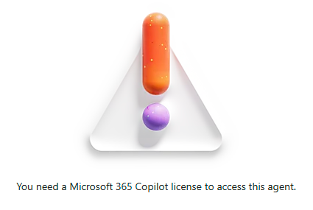
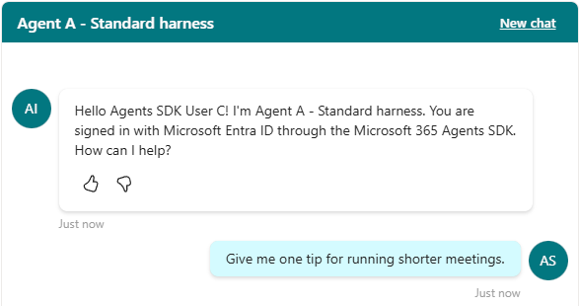
HEAD-TO-HEAD ON SITE B
Does the user need Site A? Only the pattern changes
# | User | State | Agent link | Agents SDK
1 | User A | Shared, Read on Site A, no Copilot license
2 | User C | Not shared, no Site A access
3 | User C | Shared, no Site A access
4 | User C | Shared, Read on only the .agent file
Test 3 - Agent link
"You need a Microsoft 365
Copilot license to access
this agent."
WORKS
WORKS
BLOCKED
BLOCKED
BLOCKED
WORKS
WORKS
WORKS
Test 3 is the customer's Site A dependency. The Agent link says "You need a Microsoft 365 Copilot license to access this agent" - misleading, because unlicensed User A works. The Agents SDK web part works for the same user without any Site A access.
Fix for the customer pattern: grant Read on only the .agent file (test 4) - Site A itself can stay Access Denied.
Test 3 - Agents SDK web part: works, greets User C by name
Copilot Studio x SharePoint | Microsoft 365 Agents SDK
5

Slide 6
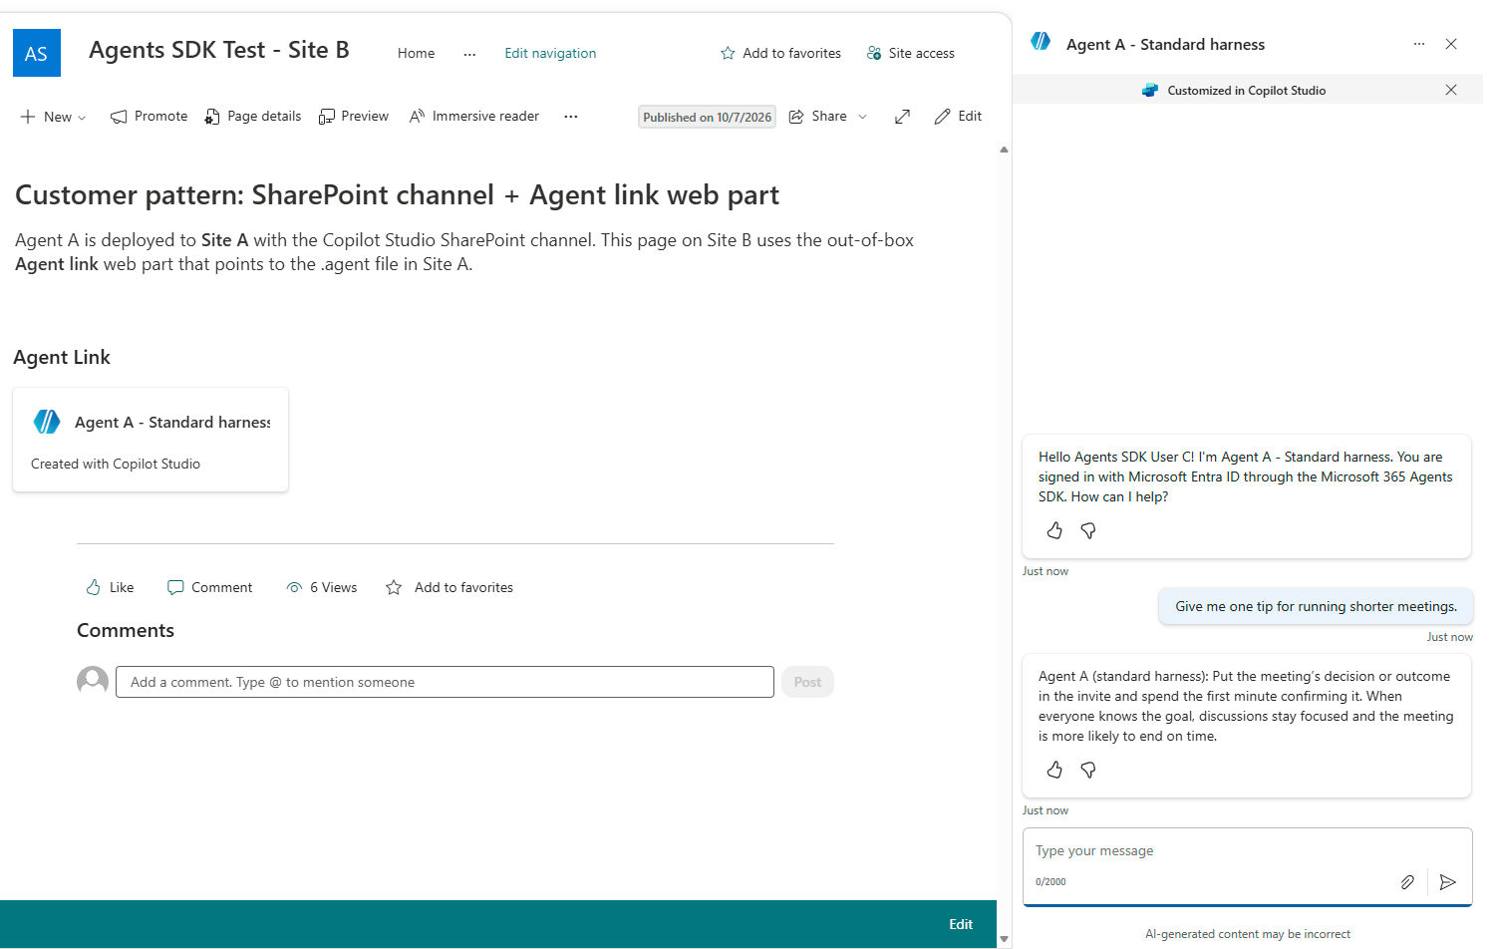
LEAST-PRIVILEGE FIX FOR THE CUSTOMER PATTERN
Grant Read on the .agent file - not on the whole host site
Dedicated host
Deploy the agent to a dedicated, locked-down "agent host" site or library with no other content.
One group, two places
Share the agent with an Entra security group and grant that group Read on just the .agent file.
Few editors
Members with Edit can delete or rename the .agent file and break every Agent link - keep Edit to a few owners.
Help desk note
"You need a Microsoft 365 Copilot license" usually means the user cannot read the .agent file.
Test 4 - Read on only the .agent file: Agent link works, Site A still Access Denied
Copilot Studio x SharePoint | Microsoft 365 Agents SDK
6

Slide 7
COMPARISON
SharePoint channel + Agent link vs. Agents SDK web part
Aspect | SharePoint channel + Agent link | Agents SDK web part
Effort | No code | One-time SPFx package, Entra app, app catalog
Host-site dependency | Yes - Read on the .agent file; one host site at a time | None - each page stores the connection string
Sharing and revocation | Enforced (customer test) | Enforced (verified incl. revoke and re-grant)
M365 Copilot license | Not required; consumes Copilot Studio capacity | Not required; consumes Copilot Studio capacity
Experience | Card on the page opens the Copilot side pane | Inline chat, themable, several agents per page
Error when access is missing | Misleading license message | Agent's own access message or explicit errors
Governance | Host-site editors can delete or rename the .agent file | Central versioned package; per-page configuration
GitHub Copilot harness | SharePoint channel not available | Not supported by the client library
Copilot Studio x SharePoint | Microsoft 365 Agents SDK
7

Slide 8
ANSWERING THE CUSTOMER
Concerns and recommendations for the customer pattern
HIGH
Single point of failure
HIGH
Over-permissioning
Archiving Site A, changing its permissions or deleting/renaming the .agent file breaks the agent on every site.
Granting Site A to every agent user exposes Site A content. Grant Read on only the .agent file instead (verified).
MEDIUM
Two permission systems
MEDIUM
Misleading error
Copilot Studio sharing plus SharePoint file permission - drive both from one Entra security group.
An unreadable .agent file shows "You need a Microsoft 365 Copilot license" although unlicensed users work.
MEDIUM
Capacity, not licenses
LOW
One deployment site at a time
Agents in SharePoint consume Copilot Studio capacity - plan and monitor capacity or pay-as-you-go.
Moving the host means undeploying, redeploying and re-pointing every Agent link.
Copilot Studio x SharePoint | Microsoft 365 Agents SDK
8

Slide 9
THE AGENTS SDK IMPLEMENTATION
One SPFx package and one Entra app serve every site
SPFx web part
SPFx 1.21.1, deployed tenant-wide from the app catalog
Why MSAL, not the SPFx token provider?
MSAL.js with its own SPA app
SPFx AadTokenProvider cannot obtain CopilotStudio.Copilots.Invoke: the SharePoint first‑party app is not preauthorized by the Power Platform API (AADSTS65002). Microsoft treats this as by design (issue sp‑dev‑docs #10775).
So the web part uses its own single-tenant SPA app with delegated CopilotStudio.Copilots.Invoke and tenant-wide consent, created by New‑AgentsSdkSpaApp.ps1.
acquireTokenSilent, then ssoSilent with the SharePoint user as login hint; popup fallback
Agents SDK client
@microsoft/agents-copilotstudio-client 1.9.1, called with the connection string
Bot Framework Web Chat
4.19.1 with the Fluent theme, bundled - no CDN, no SharePoint API-access approvals
Tested: silent SSO for MFA users (no prompts); anonymous call to the connection string returns HTTP 401.
Copilot Studio x SharePoint | Microsoft 365 Agents SDK
9

Slide 10
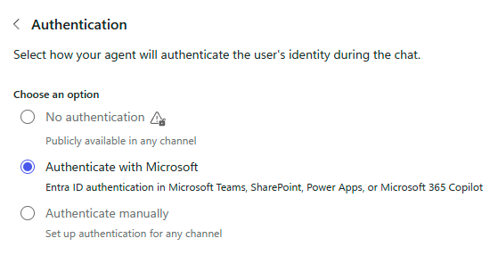
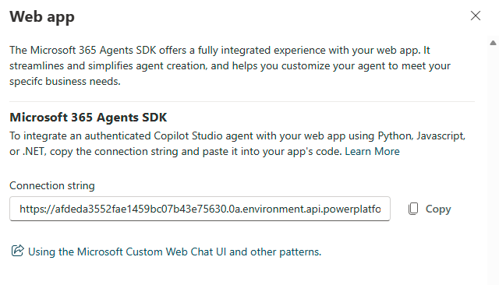
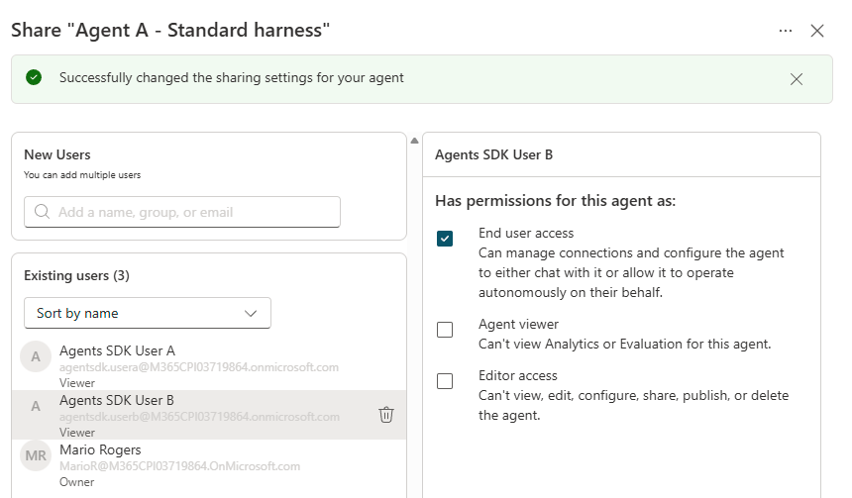
BUILD IT - PART 1
Copilot Studio and Microsoft Entra ID
1
Standard agent, Microsoft auth, publish
2
Copy the Agents SDK connection string
3
Share with users or security groups
4
Register one Entra SPA app for the tenant (scripted, idempotent)
az login --tenant <tenant>.onmicrosoft.com --allow-no-subscriptions
.\scripts\New-AgentsSdkSpaApp.ps1 -TenantId <tenant>.onmicrosoft.com -SharePointRootUrl https://<tenant>.sharepoint.com
# Power Platform API / CopilotStudio.Copilots.Invoke + SPA redirect = SharePoint origin + tenant-wide consent
Copilot Studio x SharePoint | Microsoft 365 Agents SDK
10

Slide 11
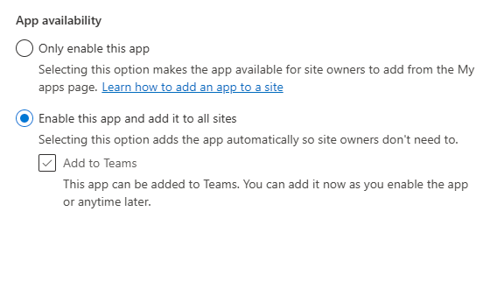
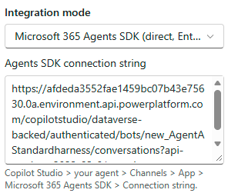
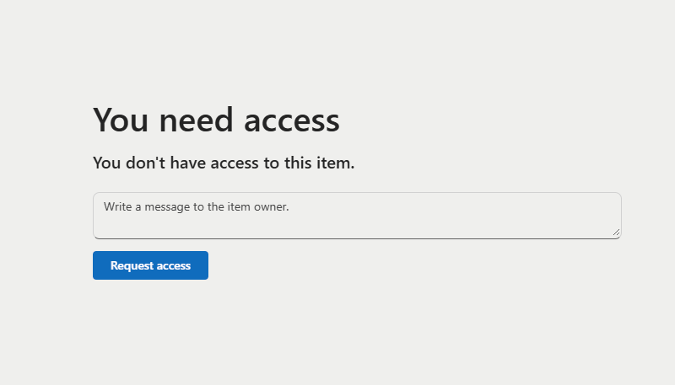
BUILD IT - PART 2
Package once, deploy tenant-wide, add to any page
5
Build the package with tenant defaults - Node 22, everything bundled
.\scripts\Build-SpfxPackage.ps1 -AppClientId <appClientId> -Version 1.0.1.0 -NodePath <node22-folder>
# output: spfx-copilot-agent\sharepoint\solution\copilot-studio-agent-webpart.sppkg
6
App catalog: enable for all sites
7
Add web part, paste connection string
8
Grant site access (Visitor is enough)
9
Validate: greeting shows the user's name, footer shows the signed-in UPN, unshared users are blocked, anonymous calls get 401.
Copilot Studio x SharePoint | Microsoft 365 Agents SDK
11

Slide 12
PERMISSION TEST DESIGN
4 users x 3 sites x 2 agents, plus the maker as control
Persona | Agent A (standard) | Agent B (GitHub) | Site A | Site B | Site C
User A | Shared | Shared | Visitor | Member | Owner
User B | Shared | - | Member | Visitor | No access
User C | - | Shared | No access | Member | Visitor
User D | - | - | Visitor | No access | Member
MarioR (maker) | Owner | Owner | Owner | Owner | Owner
Each site page hosts 3 web parts
Agent A via Agents SDK
Agent B via Agents SDK
Agent B via hosted embed (comparison)
How it was tested
Edge + Playwright, one profile per user
MFA with a software TOTP
A greeting and a question per chat
Screenshot + JSON result per web part
Licensing: no tester had a Microsoft 365 Copilot or Copilot Studio license - Microsoft 365 E5 without Teams only.
Copilot Studio x SharePoint | Microsoft 365 Agents SDK
12

Slide 13
RESULTS
Sharing decides who chats; site access decides who sees it
Persona | Site | Page | Agent A via SDK | Agent B via SDK | Agent B embed
User A | A | OK | WORKS | NOT SUPPORTED | ANSWERS (no auth)
User A | B | OK | WORKS | NOT SUPPORTED | ANSWERS (no auth)
User A | C | OK | WORKS | NOT SUPPORTED | ANSWERS (no auth)
User B | A | OK | WORKS | NOT SUPPORTED | ANSWERS (no auth)
User B | B | OK | WORKS | NOT SUPPORTED | ANSWERS (no auth)
User B | C | DENIED | - | - | -
User C | A | DENIED | - | - | -
User C | B | OK | BLOCKED - not shared | NOT SUPPORTED | ANSWERS (no auth)
User C | C | OK | BLOCKED - not shared | NOT SUPPORTED | ANSWERS (no auth)
User D | A | OK | BLOCKED - not shared | NOT SUPPORTED | ANSWERS (no auth)
User D | B | DENIED | - | - | -
User D | C | OK | BLOCKED - not shared | NOT SUPPORTED | ANSWERS (no auth)
MarioR | A | OK | WORKS | NOT SUPPORTED | ANSWERS (no auth)
MarioR | B | OK | WORKS | NOT SUPPORTED | ANSWERS (no auth)
MarioR | C | OK | WORKS | NOT SUPPORTED | ANSWERS (no auth)
Agent A via SDK works for every shared user on every site they can open (any permission level)
Unshared users get "You don't have access to talk to this bot" on every site
Agent B via SDK is rejected for everyone, including the owner
Agent B embed answered unshared users and a signed-out browser
Revocation and re-grant took effect on the next page load
Copilot Studio x SharePoint | Microsoft 365 Agents SDK
13

Slide 14
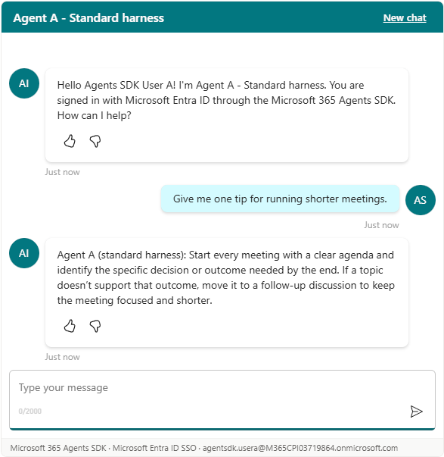
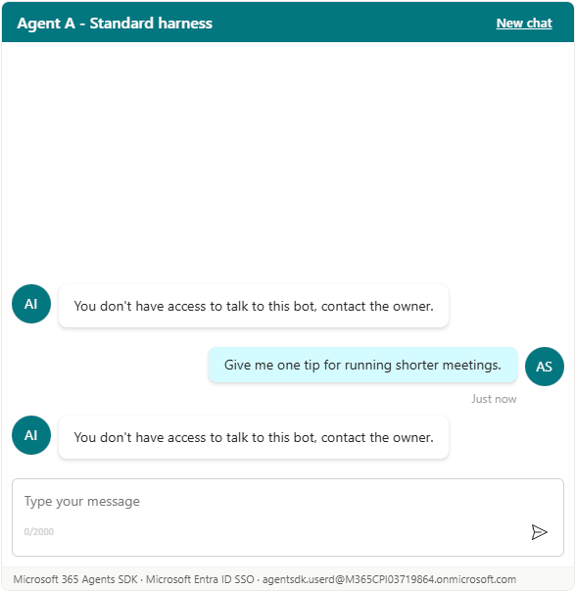

EVIDENCE
Agents SDK web part - screenshots from the automated runs
User A: greeted by name and answered
User D (not shared): blocked
User B right after revocation
Silent SSO - the footer shows the signed-in UPN
"You don't have access to talk to this bot"
Same block; re-granting restored access
Copilot Studio x SharePoint | Microsoft 365 Agents SDK
14

Slide 15
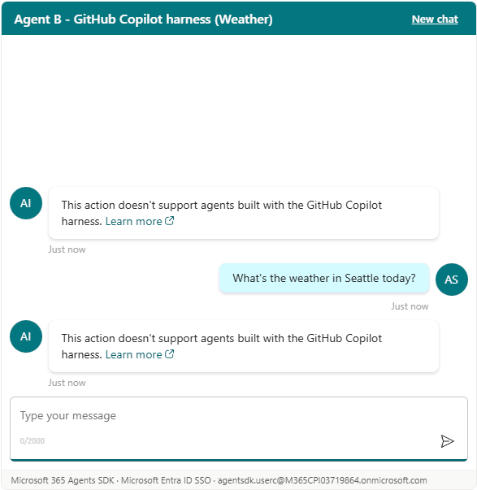
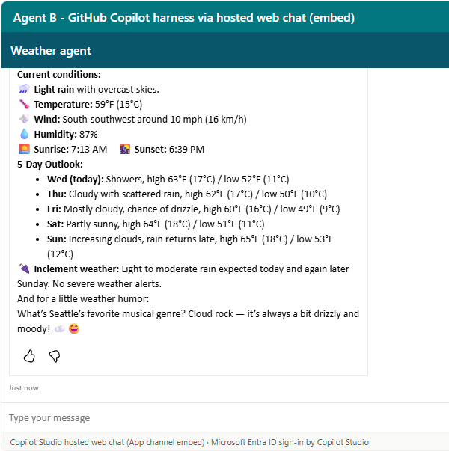
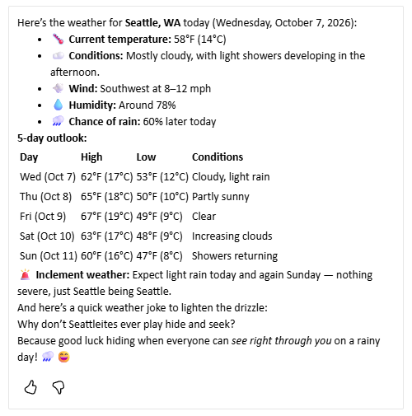
GITHUB COPILOT HARNESS
Weather agent: not reachable via the SDK, embed not secured
Agents SDK: not supported (yet). Every request, even the owner's, failed with "This action doesn't support agents built with the GitHub Copilot harness." The client supports standard‑harness agents only.
App-channel embed: not secured. It answered users the agent was not shared with and a signed-out browser (anonymous Direct Line token). Treat the existing button and embed on the root site as public.
Via Agents SDK
Embed answering an unshared user
Embed answering a signed-out browser
Copilot Studio x SharePoint | Microsoft 365 Agents SDK
15

Slide 16

RECOMMENDATIONS
What to tell the customer
Their pattern is valid and supported - keep it if no-code matters most.
Host the agent in a dedicated, locked-down site or library; keep Edit rights minimal.
Use one security group for Copilot Studio sharing and Read on the .agent file - not on Site A.
Plan Copilot Studio capacity; unlicensed users consume it.
Choose the Agents SDK web part to remove the host-site dependency or to embed chat inline.
Keep SharePoint-facing agents on the standard harness; retire the unauthenticated GitHub-harness embed.
Web pages (tutorial, use cases, test scenarios, customer use case): https://patmeh1.github.io/copilot-studio-agents-sdk-sharepoint/
Source code and guide: https://github.com/patmeh1/copilot-studio-agents-sdk-sharepoint

