Slide 1
A Comprehensive Survery on Geometric Deep Learning
Cao et al., 2020, IEEE Access

Slide 2
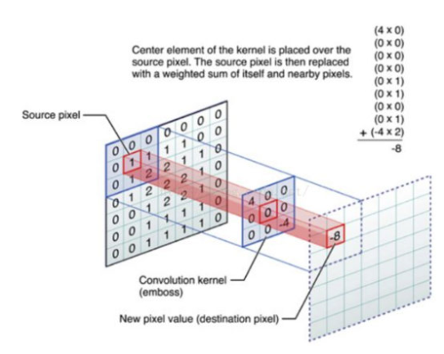
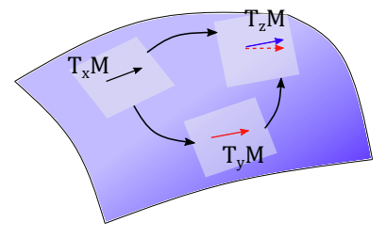
The Paper
Intro
Background
Methods
Graphs
Manifolds (meshes)
Applications
Future Work and Open Problems
Conclusion
Cao et al., A Comprehensive Survery on Geometric Deep Learning, 2020, IEEE Access
Yang et al., PFCNN: Convolutional Neural Networks on 3D Surfaces Using Parallel Frames, 2020, CVPR

Slide 3
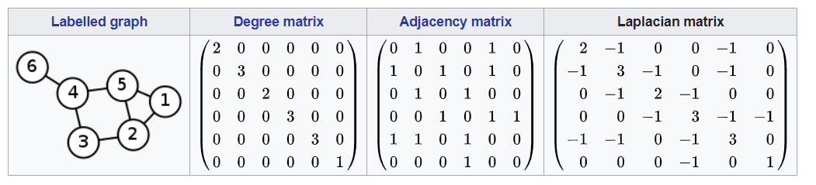
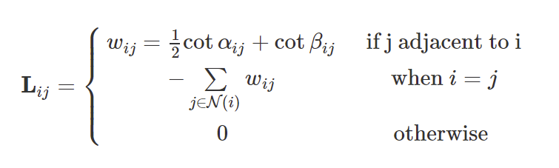


Background
https://en.wikipedia.org/wiki/Laplacian_matrix
D
A
L = D - A
Normalized Laplacians
Cotan formula for mesh Laplacian

Slide 4
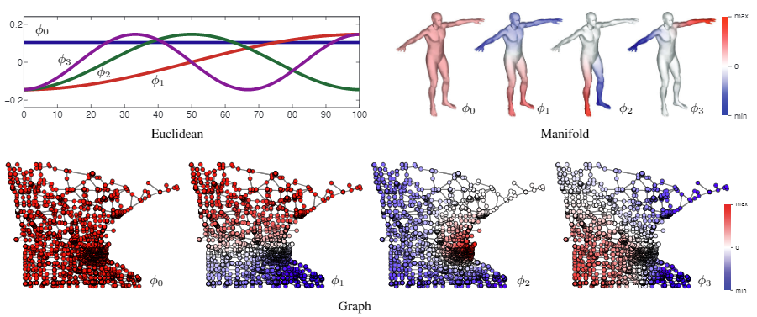


Background
$$x_{G}^{∗}g=IFFT\left(FFT\left(x\right)⊙FFT\left(g\right)\right)=x_{G}^{∗} ∗g$$
Bronstein et al., Geometric deep learning: going beyond Euclidean data, 2016, IEEE Signal Process. Mag.

Slide 5

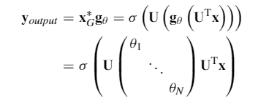


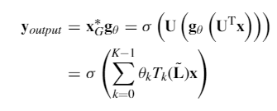


Methods: Graphs
Spectral methods
All use spectral conv. Trick
SCNN
Smooth SCNN
ChebNet
GDN
CayleyNets
Spatial methods
GNN
GraphSage
DCNN
PATCHY-SAN
LGCN
MoNet

Slide 6
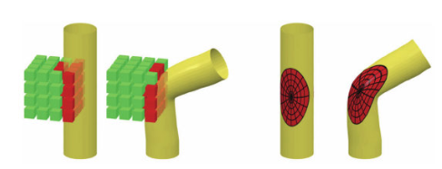
Methods: Manifolds (meshes)
Extrinsic vs. Intrinsic

Slide 7
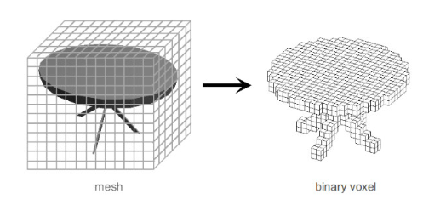
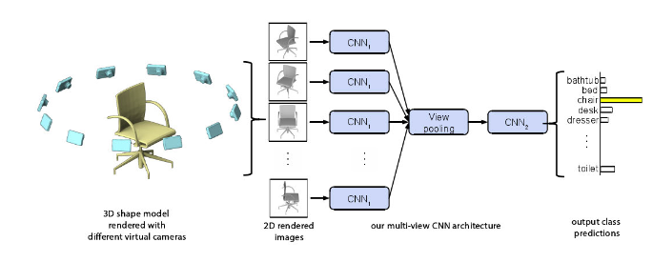
Methods: Manifolds (meshes): Extrinsic
Voxel-based
Multi-view CNN

Slide 8
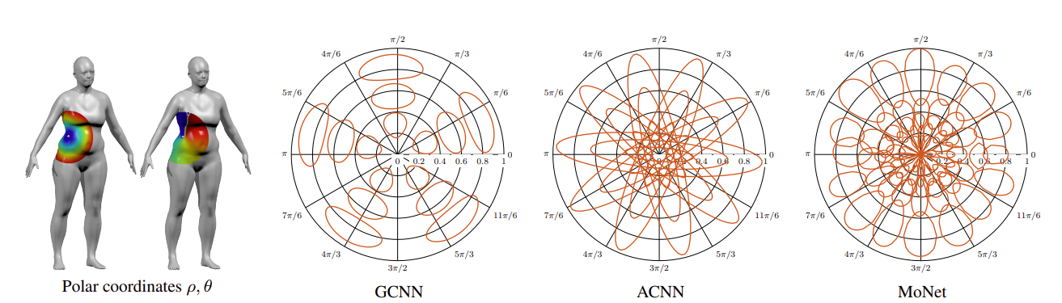



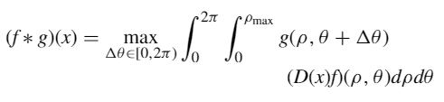


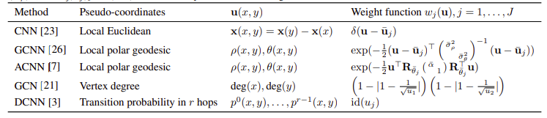
Methods: Manifolds (meshes): Intrinsic
Monti et al., Geometric deep learning on graphs and manifolds using mixture model CNNs, 2017, CVPR

Slide 9
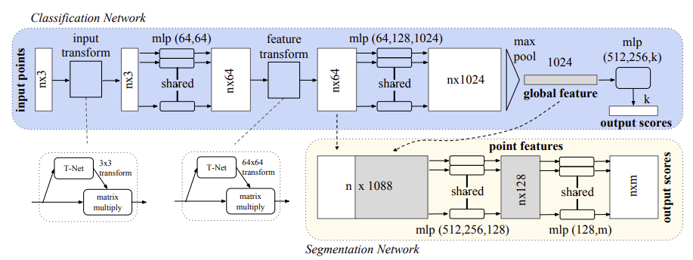
Methods: Manifolds (meshes): Intrinsic
Qi et al., Pointnet: Deep learning on point sets for 3d classification and segmentation, 2017. CVPR
PointNet: Just work on points – forget connectivity
PointNet++: Add multi-scale approach to improve results

Slide 10
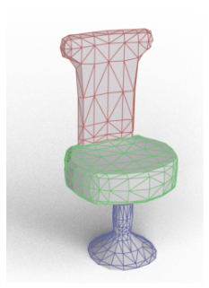
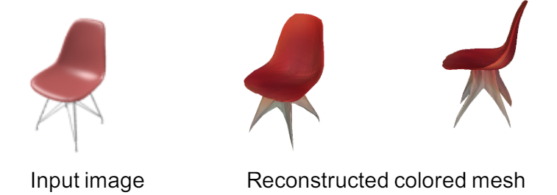
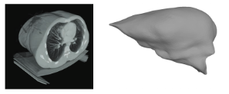
Applications
Hanocka et al., MeshCNN: A Network with an Edge, 2019, ACM Trans. Graph.
Computer Vision and 3D Shape Analysis
Shape classification
Shape correspondence
Shape segmentation
Others
Our own
Wang et al., Pixel2Mesh: 3D Mesh Model Generation via Image Guided Deformation, 2020, PAMI
Wickramasinghe et al., Voxel2Mesh: 3D Mesh Model Generation from Volumetric Data, 2020, MICCAI

Slide 11
Future Work and Open Problems
Computation costs
Hard to batch
Hard to take advantage of GPU
Deeper architectures
Hard to avoid features averaging out
Dynamic graphs
Scalability / Generalization
Causal reasoning

