Slide 1
Recent Results on Data Depth and Outlier Removal in 2D
Pat Morin
School of Computer Science

Slide 2
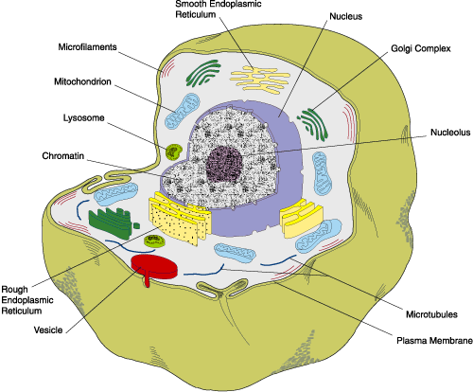
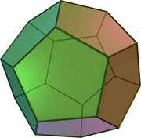
Outline
Output sensitive computation of Tukey depth
A centerpoint theorem Alpha-wedge depth
Outlier removal algorithms
More open problems

Slide 3
Output-Sensitive Computation of Tukey Depth

Slide 4
Tukey (Halfspace) Depth
Definition: The Tukey depth of p wrt S is
  depth(p,S) = min {|h S| : h is a closed halfplane with p  h}
Computing the Tukey depth of a point p wrt a point set S is easily done in O(n log n) time by sorting the points of S radially around p.
A reduction from Set-Equality proves that this algorithm is optimal
Or is it...

Slide 5
Parameterizing with respect to k
What if depth(p,S)=k?
Can we find an algorithm whose running time is a function of k and n?
Chan's 2D Feasible-LP with Violations algorithm + Chan's extended optimization technique implies an O(n + k(n/k)^{e} log n) time algorithm [with an astronomical leading constant!]

Slide 6
An O(n + k log k) algorithm
Partition plane into 3 convex cones A, B, and C centered at p
  depth(p,S)  min{ |A ∩ S|, |B ∩ S|, |C ∩ S|}
Compute the minimum number of points of S contained in any halfplane containing A (and B and C)
Run all three processes in parallel and stop when the first (smallest) one finds the solution

Slide 7
Output-Sensitive Tukey Depth (Cont'd)
A
depthA(p,S) ≥ |A|+l
depthA(p,S) can be found by scanning |A|+4l points
These points can be found in O(n + l log n) time using a heap
l
l
l
l
B
C

Slide 8
Output-Sensitive Tukey Depth (Summary)
An O(n + k log k) time Tukey depth algorithm
A similar (but more complicated) approach gives an O(n + (n-k) log (n-k)) time algorithm for finding the MAX-CLIQUE in an interval graph

Slide 9
Open Problem (Depth Computation)
Open Problem 1: Can similar results be obtained for other depth measures? (Oja, convex-hull peeling, simplicial, Delaunay,...)

Slide 10
-Wedge Depth

Slide 11
-Wedge Depth
For Tukey (halfplane) depth the defining shape is a halfplane
The Centerpoint Theorem says that for any set S of n points there exists a point of Tukey depth at least n/3
What if we substitute halfplane with wedge (cone) of base angle ?

Slide 12
0 <  < 180
For any 0 <  < 180, there exist point sets of arbitrary size for which there is no point of -wedge depth greater than 1.
Take n points on a line...

Slide 13
180 <  < 240 (Lower Bound)
For any  < 240, there exists a point set of size n such that no point has -wedge depth greater than n/3
The standard Tukey-depth example works for  up to 240

Slide 14
240 <  < 360
For any  < 360 there exists point sets of size n such that every point in the plane has -wedge depth at least n/2.
Take two clusters each of n/2 points separated by a large distance

Slide 15
240 <  < 360 (Upper Bound)
For any point set S and any 240 <  < 360 there exists a point of -wedge depth at least n/2
Proof: Take 3 concurrent halving lines that meet at 60 degree angles

Slide 16
Summary (-Wedge Depth)
A full centerpoint theorem for -wedge depth:
  1 for 0 <  < 180
  n/3 for 180 <  < 240
  n/2 for 240 <  < 360
Modifications of Lo and Steiger's ham-sandwich algorithm yield a linear time algorithm for computing a centerpoint

Slide 17
Open Problems (Centerpoint Theorems)
Open Problem 2: Prove an -wedge depth centerpoint theorem for points in 3D. (Only partial results so far. Different definitions of “wedge” are possible.)
Open Problem 3: Prove a centerpoint theorem for Oja depth.
  Best upper-bound: (7/36)n² (1/5.14)n²
  Best lower-bound is (1/9)n²

Slide 18
Removing Outliers

Slide 19
Outlier Removal Algorithms
Given a point set S we want to find a subset S', |S'|=c so that f(S\S') is optimized.
Examples:
  f(X) = diameter of X
  f(X) = area/perimeter of bounding box of X
  f(X) = area/perimeter of convex hull of X
These problems have all previously been considered in the context of k-clustering (where c=n-k).
Previous algorithms are fast for small values of k

Slide 20
Minimizing the Diameter
Repeat c+1 times:
  Compute the diameter p and q of S
  Delete p and q and Mark each of p and q's c remaining furthest neighbours
Let X be the set of all (at most c+1) marked or deleted points
Use the existing algorithm of Aggarwal et al to solve the problem optimally for X
Algorithm runs in O(n log n + cn + c⁷) time and finds optimal set of outliers to remove for S

Slide 21
Minimizing Area of Convex Hull
Sketch of Algorithm:
  Enumerate all possible combinatorial types of solutions
  For each solution type use divide-and-conquer with dynamic programming to find the optimal solution of that type
Running time:

Slide 22
Summary (Outliers)
O(n log n) time algorithms for diameter- and convex hull area-based outlier removal (for any constant c)

Slide 23
Open Problems
Open Problem 4: For diameter, give O(n log n) time algorithm for 3D. (The only thing missing is the finishing-up step.)
Open Problem 5: For convex hull area, reduce the dependence on c (but keep the O(n log n) running time)
Open Problem 6: Find an efficient algorithm to remove c outliers in order to minimize the variance of the resulting set

