Slide 1
The Social Network Graph:Unveiling connections
TEAM MEMBERS
A24126510122-B.Geetesh
A24126510132-G.Chandu
A24126510142-K.Joshnavi
A24126510152-P.Adarsh

Slide 2
PROBLEM STATEMENT
Design a program to model a social network using graph data structures (Adjacency List or Adjacency Matrix). Each user in the network is represented as a node, and friendships between users are represented as edges.
Requirements
Add Friends: Allow users to create friendships with other users.
Suggest Mutual Friends: Recommend friends to a user based on mutual connections using BFS or DFS traversal.Shortest
Connection Path: Find the shortest path of connections between any two users, showing how they are linked in the network.

Slide 3
OBJECTIVE
• Model a social network using graph data structures.
• Allow users to add and manage friendships.
• Suggest mutual friends using BFS/DFS traversal.
• Find the shortest connection path between users.
• Demonstrate practical use of graph algorithms.

Slide 4
ALGORITHM
*Start the program.*
Create an empty graph using an *Adjacency List* or *Adjacency Matrix* to store user connections.
Each *user* in the network is represented as a *node*.
Each *friendship* between two users is represented as an *edge* connecting the nodes.
When a new user joins, add a *new node* to the graph.
To make two users friends, add an *edge* between their nodes (both directions for undirected graph).

Slide 5
Display the list of all users and their friends using the adjacency list.
To find *mutual friends*, take all friends of a user’s friends.
Remove users who are already direct friends or the user itself.
The remaining users are suggested as *mutual friends*.
For exploring connections or suggesting mutual friends in multiple levels, use *BFS (Breadth First Search)* or *DFS (Depth First Search)* traversal.
BFS visits all users level by level starting from a given user.
DFS explores one path deeply before backtracking to explore others.
To find the *shortest connection path* between two users, apply *BFS* since it finds the shortest path in an unweighted graph.
Start BFS from the source user and mark all visited nodes

Slide 6
Keep track of each node’s *parent* to reconstruct the connection path later.
When the destination user is found, stop the search.
Trace back from the destination to the source using the parent list to get the path.
Display the shortest path showing how the two users are connected.
If no path exists, display that the users are not connected.
The process can be repeated for any pair of users in the network.
End the program

Slide 7
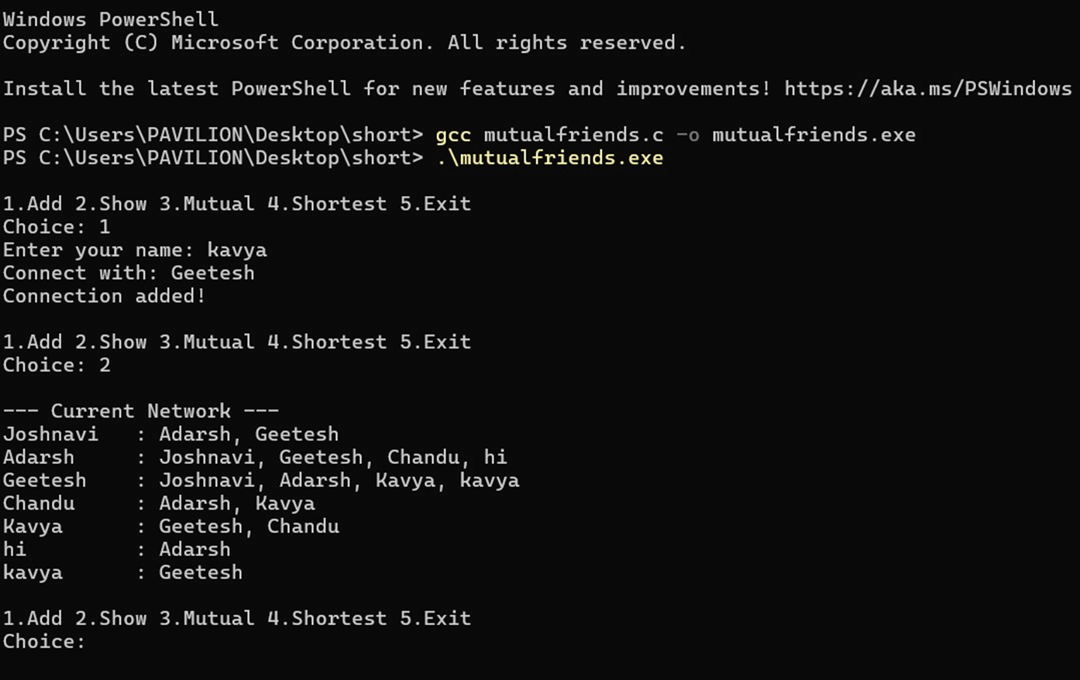
IMPLEMENTATI0N

Slide 8
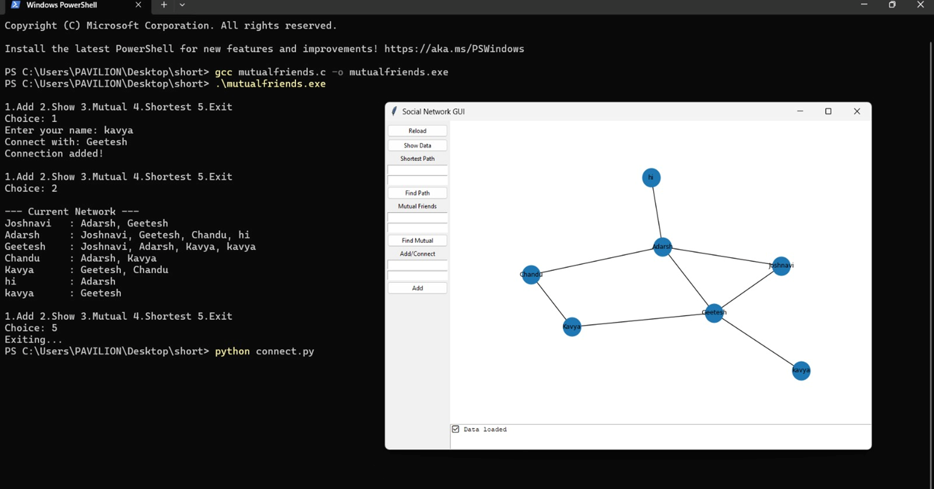

Slide 9
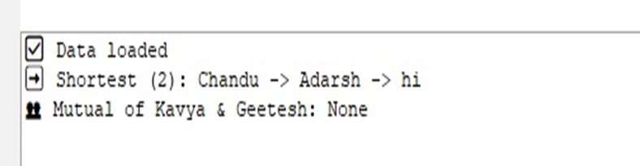
RESULT
• The Social Network Graph program was successfully developed using graph concepts.
• It allows users to add new friends, view mutual friends, and find the shortest connection path between two users.
• The project shows how graphs can represent real-world social networks.
• Using BFS and DFS algorithms, the system can explore user connections easily.
• The program helps understand how people are linked and how friend suggestions work on social media platforms.

Slide 10
• Overall, the project meets all objectives and demonstrates the practical use of graph data structures in everyday applications.
CONCLUSION
The Social Network Graph project was successfully designed and implemented using graph concepts.
It clearly shows how users in a social network can be represented as nodes, and their friendships as edges.
By using BFS and DFS algorithms, the program can easily find mutual friends and the shortest path between users.
This project helps understand the working of real-world social media networks like Facebook or Instagram.

Slide 11
It also demonstrates the importance of graph data structures in connecting and analyzing relationships between people.
THANK YOU

