Slide 1


SAVEETHA SCHOOL OF ENGINEERING
SAVEETHA INSTITUTE OF MEDICAL AND TECHNICAL SCIENCES
COURSE CODE:
CSA1672-Data warehousing and Data Mining for Web Data Mining
TOPIC:
TEXT MINING AND NATURAL NATURAL LANGUAGE PROCESSING
USING NAIVE BAYES AND SVM
FACULTY NAME:Dr.PORKODI
BY P.S.S.RAM CHAND
REG NO::192225113

Slide 2
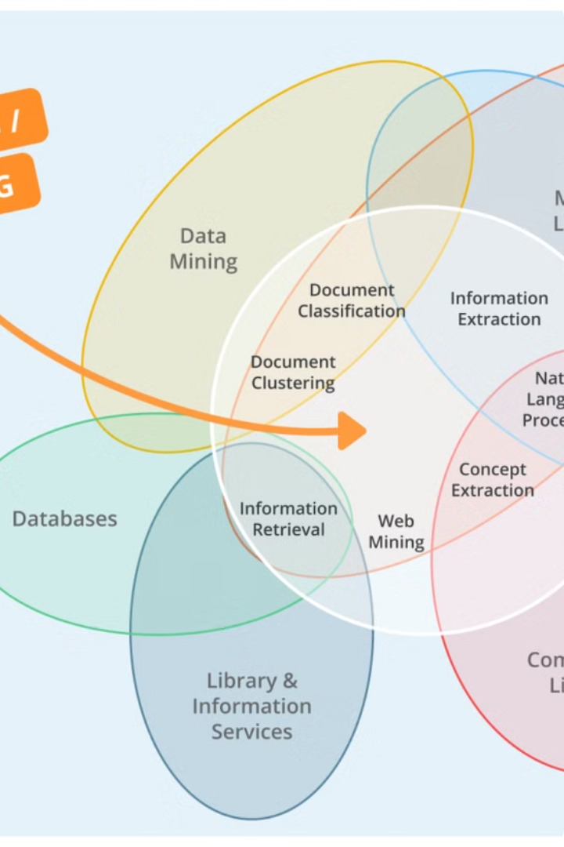

Introduction to Text Mining and Natural Language Processing
Text mining and natural language processing (NLP) are powerful tools for extracting valuable insights from unstructured text data. These techniques enable researchers and analysts to efficiently process and understand large volumes of text, from customer reviews to social media posts.
by Patnala Ramchand
192225113

Slide 3
Overview of Naive Bayes and SVM Algorithms
Naive Bayes
Support Vector Machines (SVM)
Naive Bayes is a simple and efficient probabilistic classifier that applies Bayes' theorem to make predictions. It's particularly effective for text classification tasks due to its ability to handle high-dimensional feature spaces.
SVM is a powerful supervised learning algorithm that can be used for both classification and regression tasks. It finds the optimal hyperplane that maximizes the margin between classes, making it a robust choice for text mining applications.

Slide 4
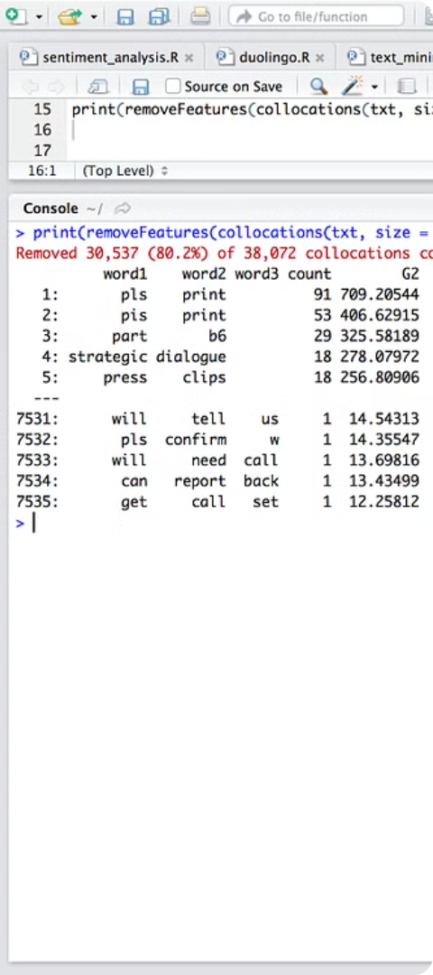
Text Mining using Naive Bayes in R
1
Data Preprocessing
Clean and preprocess the text data, including tokenization, stop word removal, and stemming or lemmatization.
2
Feature Extraction
Convert the text data into a numerical format, such as a term-document matrix, that can be used as input to the Naive Bayes model.
3
Model Training and Evaluation
Train the Naive Bayes classifier and evaluate its performance using metrics like accuracy, precision, recall, and F1-score.

Slide 5

Text Mining using SVM in R
1
Data Preparation
Preprocess the text data and convert it into a format suitable for SVM, such as a term-document matrix or a feature vector.
2
SVM Model Training
Train the SVM model, selecting appropriate kernel functions and hyperparameters to optimize its performance.
3
Model Evaluation
Evaluate the SVM model's performance using metrics like accuracy, precision, recall, and F1-score, and compare it to other text mining techniques.

Slide 6
Comparison of Naive Bayes and SVM for Text Mining
Naive Bayes
Support Vector Machines (SVM)
Comparison
Naive Bayes is simple, efficient, and can handle high-dimensional data. It makes strong independence assumptions but often performs well in practice, especially for text classification tasks.
The choice between Naive Bayes and SVM for text mining depends on the specific task, data characteristics, and computational resources available. Both algorithms have their strengths and can be used effectively in different scenarios.
SVM is a more sophisticated algorithm that can capture complex relationships in the data. It performs well with sparse, high-dimensional features and is less sensitive to irrelevant features than Naive Bayes.

Slide 7
Text Mining using Naive Bayes in WEKA
1
Data Importation
2
Preprocessing
Load the text data into WEKA, converting it into a format that can be processed by the Naive Bayes classifier.
Preprocess the text data in WEKA, including tokenization, stop word removal, and stemming or lemmatization.
3
Model Training
4
Model Evaluation
Train the Naive Bayes classifier in WEKA, using the preprocessed text data as input.
Evaluate the performance of the Naive Bayes model in WEKA using metrics like accuracy, precision, recall, and F1-score.

Slide 8
Text Mining using SVM in WEKA
1
Data Importation
2
Preprocessing
Load the text data into WEKA, converting it into a format that can be processed by the SVM classifier.
Preprocess the text data in WEKA, including tokenization, stop word removal, and feature selection or transformation.
3
Model Training
4
Model Evaluation
Train the SVM classifier in WEKA, selecting appropriate kernel functions and hyperparameters to optimize its performance.
Evaluate the performance of the SVM model in WEKA using metrics like accuracy, precision, recall, and F1-score.

Slide 9
Conclusion and Key Takeaways
Versatility of Algorithms
Importance of Preprocessing
Both Naive Bayes and SVM are powerful algorithms that can be effectively applied to a variety of text mining tasks, from sentiment analysis to topic modeling.
Proper data preprocessing is essential for achieving high-quality results in text mining, regardless of the algorithm used.
Comparison and Evaluation
Continuous Learning
Comparing the performance of different text mining algorithms and evaluating their strengths and weaknesses is crucial for selecting the most appropriate approach for a given task.
As text mining techniques and tools continue to evolve, it's important to stay up-to-date with the latest developments and best practices in the field.

Slide 10
THANKYOU
ALL

