Slide 1
Programming Models for IoT and Streaming Data IC2E Internet of Things Panel
Judy Qiu
Indiana University

Slide 2
Event Processing Programming Models
Query Based
Complex Event processing
SQL like languages
Programming APIs
Queries or the Programs run on a continuous stream, unlike Hadoop where your data is static for the Batch processor
Need to address diverse streams – Unbounded sequence of events
Examples
Video Camera frames
Tweets
Laser scans from a robot
Log data

Slide 3




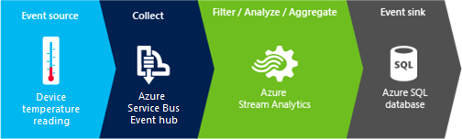
Distributed Stream Processing Frameworks (DSPF)
Aurora – Early Research System
Borealis – Early Research System
Apache Storm
Apache S4
Apache Samza
Google MillWheel
Amazon Kinesis
LinkedIn Databus
Facebook Puma/Ptail/Scribe/ODS
Azure Stream Analytics
Will discuss 2 Apache Storm projects at Indiana University

Slide 4
I: IoTCloud
Framework to connect devices to cloud services
IoTCloud consists of
a set of distributed nodes running close to the devices to gather data
a set of publish-subscribe brokers to relay the information to the cloud services
a distributed stream processing framework (DSPF) coupled with batch processing frameworks in the Cloud
Uses OpenStack environment
Improving fault-tolerance and quality of service for especially guarantees on maximum response time

Slide 5
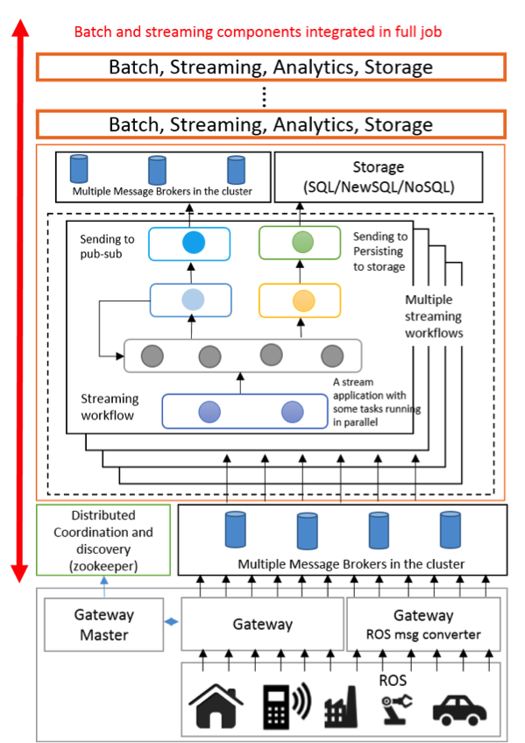
IoTCloud Architecture
Built on Apache Storm, RabbitMQ, Hbase ………

Slide 6
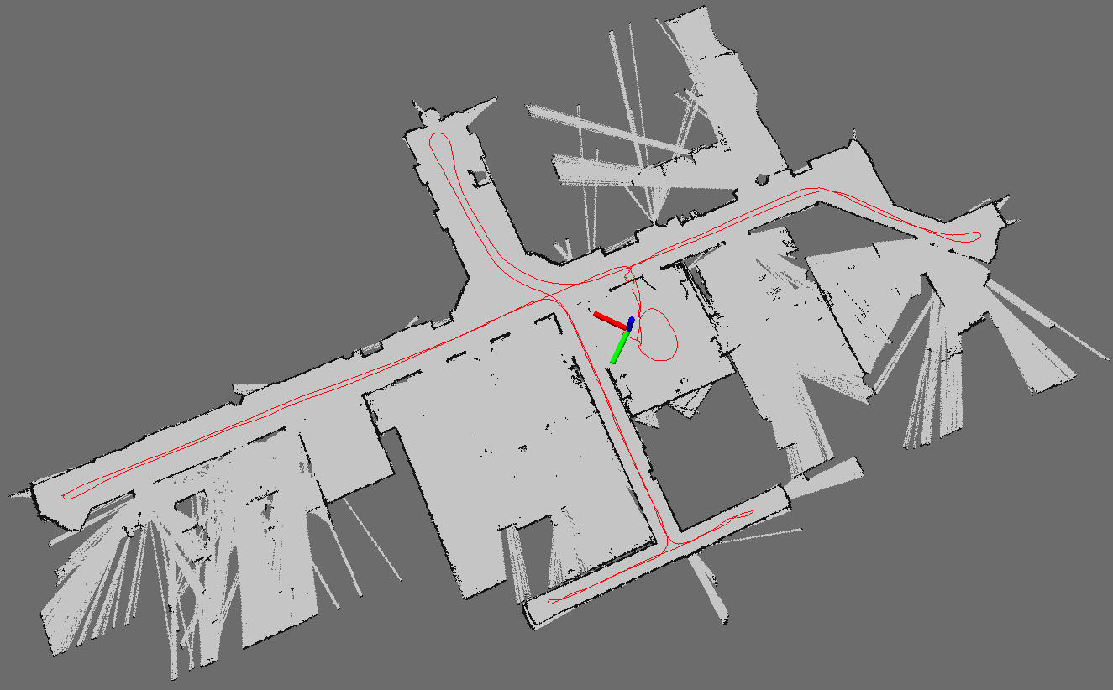
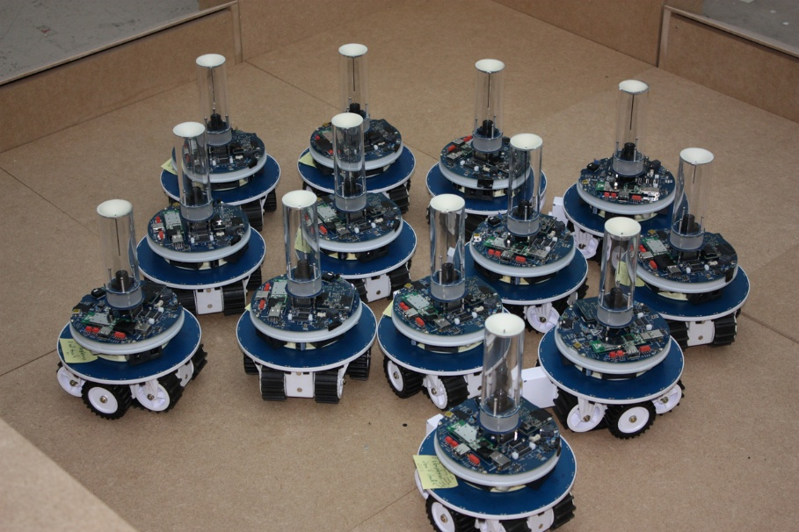
IoTCloud Applications
Particle Filtering Based SLAM
N-Body Collision Avoidance
Using parallel algorithms inside Storm for performance performance
Response Time better with RabbitMQ
Map Built from Robot data
Robots need to avoid collisions when they move

Slide 7
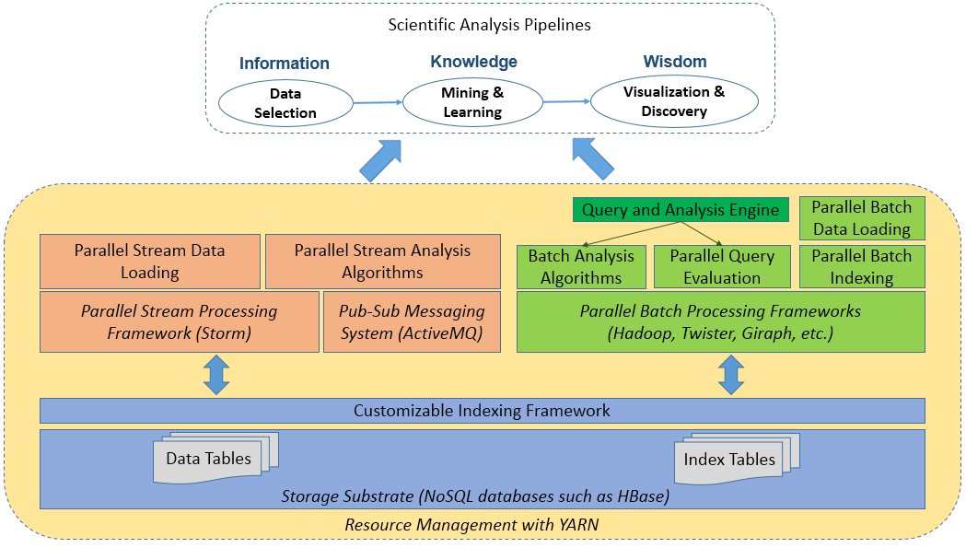
II: Batch and Streaming Analysis for Social Media Data
Streaming analysis module
Batch analysis module
Storage substrate

Slide 8
Streaming Analysis
Non-trivial parallel stream processing algorithm with novel global synchronization and cluster-delta data transfer to achieve scalability
Clustering of social media streams: real-time processing of 10% Twitter (“Gardenhose”)
Recent progress in learning data representations and similarity metrics
High-dimensional vectors: textual and network information
Expensive similarity computation: 43.4 hours to cluster 1 hour’s data with sequential algorithm
Online K-Means with sliding time window and outlier detection
Group tweets as protomemes: hashtags, mentions, URLs, and phrases
Xiaoming Gao, Emilio Ferrara, Judy Qiu. Parallel Clustering of High-Dimensional Social Media Data Streams. To appear at 15th IEEE/ACM International Symposium on Cluster, Cloud and Grid Computing (CCGRID 2015).

Slide 9
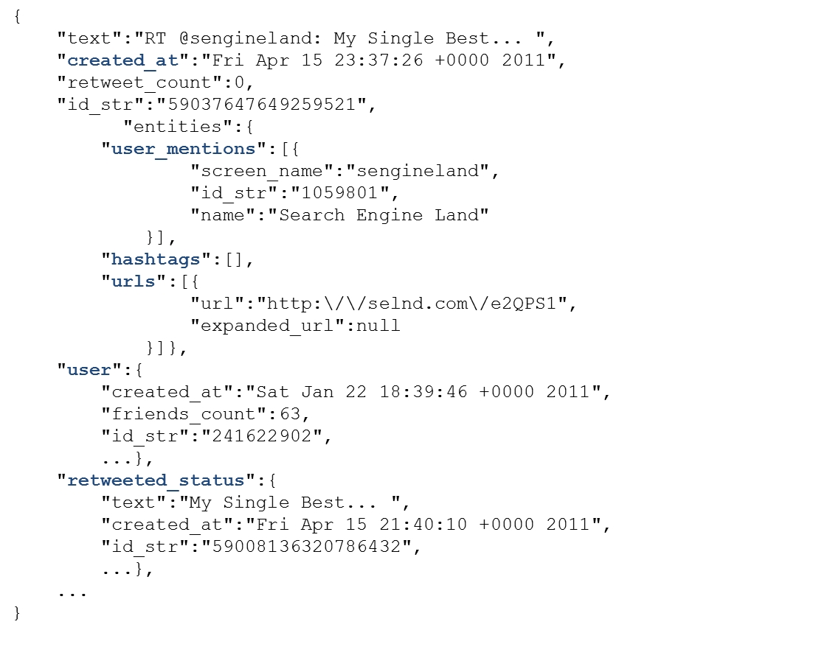
Social media data – an example data record

Slide 10
Sequential clustering algorithm
Final step statistics for a sequential run over 6 minutes data:
Time Step Length (s) | Total Length of Centroids’ Content Vector | Similarity Compute time (s) | Centroids Update Time (s)
10 | 47749 | 33.305 | 0.068
20 | 76146 | 78.778 | 0.113
30 | 128521 | 209.013 | 0.213
120 clusters, time window length: 6 steps, outlier: 2 standard deviation
Notes:
120 clusters, time window length: 6 steps, outlier: 2 standard deviation

Slide 11
Parallelization with Storm - challenges
DAG organization of parallel workers: hard to synchronize cluster information
Sparsity of high-dimensional vectors make any synchronization expensive
Data point 1:
Data point 2:
Content_Vector: [“step”:1, “time”:1, “nation”: 1,
“ram”:1]
Diffusion_Vector: …
…
Content_Vector: [“lovin”:1, “support”:1, “vcu”:1,
“ram”:1]
Diffusion_Vector: …
…
Centroid:
Content_Vector: [“step”:0.5, “time”:0.5, “nation”: 0.5, “ram”:1.0, “lovin”:0.5,
“support”:0.5, “vcu”:0.5]
Diffusion_Vector: …
…
Cluster
Cluster-delta synchronization strategy reduces message traffic and synchronization overhead

Slide 12
Solution – enhanced Apache Storm topology
Worker Process
ActiveMQ
Broker
Clustering Bolt
SYNCINIT
CDELTAS
…
Clustering Bolt
Protomeme Generator Spout
…
PMADD
OUTLIER
SYNCREQ
Synchronization Coordinator Bolt
tweet stream
Worker Process
Clustering Bolt
…
Clustering Bolt
Bootstrap Information
Sequential or Parallel Batch Clustering Algorithm

Slide 13
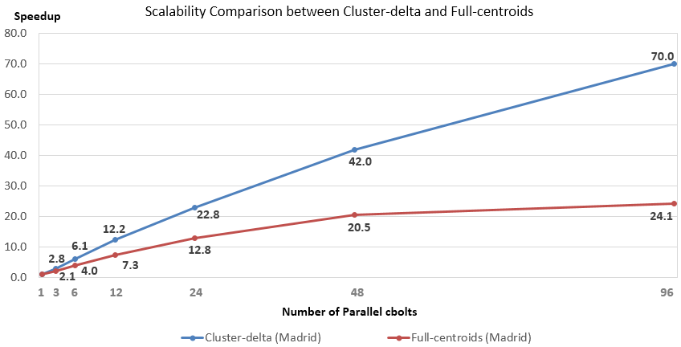
Scalability comparison
1 hour’s data for testing, first 10 mins for bootstrap
33 mins to process 50 mins’ data (better than real time) with Cluster-delta method due to decreased message sizes compared to full-centroid approach

