Slide 2
Complex Event Processing
John Plummer, Jeff Johnson

Slide 3
Agenda
Introduction
What is CEP ?
Typical Application and Architecture
Event Query Languages
Event Processing Examples
NEsper
BizTalk RFID
Demo
Notes:
[JP]

Slide 4
What is CEP ?
“Complex Event Processing (CEP) is a set of techniques and tools to help understand and control event-driven Information Systems”
Lets look at some of the concepts...
Notes:
[JP]
CEP is usually applied to extracting and analyzing information from any kind of distributed message-based system
Any kind of Information System from the Internet to the mobile phone is driven by events

Slide 5
Conceptual Description
Event examples:
Church bells ringing, appearance of a man in a suit, a woman in flowing white gown and people throwing confetti !!
A complex event is inferred from simple events
A wedding is happening
System Examples
RFID events
Notes:
[JP]
References:
Definition: http://en.wikipedia.org/wiki/Complex_event_processing
RFID: http://www.rfidjournal.com/article/view/1196
Simple Events such as church bells ringing, the appearance of a man in a tuxedo and a girl in a flowing white gown, people throwing rice—and infers a complex event is occurring: someone is getting married. So the job of CEP is to take simple event-oriented data, apply sets of event processing rules to those events in real time, and, through that processing, determine which complex events companies need to act on. In other words, CEP separates the wheat from the chaff.
RFID: CEP might be used to detect theft in a warehouse by gleaning unusual movements of products from the billions of RFID reads that will occur daily. Or it might detect a delayed shipment, because tags were scanned when they left a manufacturing facility but a day later failed to be scanned at a cross-docking facility.

Slide 6
What is a Complex Event ?
An event that can only happen if lots of other events happened
ie Car in Showroom that you like is only there because of a number of previous events
- events in inventory control of factory and dealer
- shipping events
- customs events
- etc
Notes:
[JP]
So what do we mean by a Complex Event, well we saw from the conceptual description events are key, but
The thing about the car sample is that when you see exactly what you want in the showroom you dont ask how or why.
However, if you dont see the model, make or colour you want you can get an explanation about allocation quotas, factory backlogs or other events that affect the causal history leading to the even you wanted, which was the specific car
Reference: David Luckham – The Power of Events

Slide 7
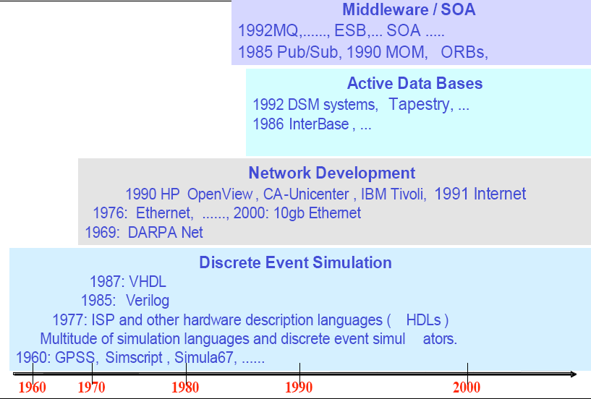
History of Event Processing
http://complexevents.com/wp-content/uploads/2008/02/1-a-short-history-of-cep-part-1.pdf David Luckham
Notes:
[JJ]
[Reference] http://complexevents.com/wp-content/uploads/2008/02/1-a-short-history-of-cep-part-1.pdf, David Luckham
[Notes]
Event processing has been around for over 50 years in different forms – so what’s new?
4 main eras
Discrete Event Simulation started in 1960s
Modelling and simulation of physical systems eg. Weather, avionics
Events used to model interactions within the system. Discrete ticks representing progress of real time
Simulator schedule flow of events. Specific languages evolved such as Simula and other HW verification languages
Networks
Transmitting packets of data – protocols developed to control the sequence, ordering, processing etc of the events. TCP, Ethernet etc
Active DBs in late 1980s
Databases that could detect change and raise events/triggers (ECA) Event condition Action
Platform for some real-time applications
Middleware/MOM/SOA era
Teknekron founded in 1985 (TIBCO) – layer in between to facilitate application to application integration
Pub/Subcribe models
ESB
CEP inherits many of these characteristics but is distinct.

Slide 8
What is an Event ?
Oxford Dictionary defines an event as “something that happens or is thought of as happening”
In CEP an “event” is an object that is a record of an activity in a system. It signifies the activity and has three features:-
Form: Form of an event is an object, may have attributes or data components. Can be as simple a string or more often a series of data items
Significance: Events signifies an activity.
Relativity: An activity is related to other activities by time, causality and aggregation. Events have the same relationship to one another as the activities they signify.
Notes:
[JP]
Relativity:-

Slide 9
Examples of Events
Order Process
Class InputEvent { Name NewOrder; EventId E_Id; Customer Id; OrderNo OrdNo; Order (CD x, Book ...); Time T; Causality (Id1, Id2); } | Class OutputEvent { Name CDOrder; EventId E_Id1; Customer Id; OrderNo OrdNo; SubOrder O_Id1; Order (CD x, Book ...); SubOrders (O_Id2, ...); Time T1; Causality (E_Id); }
Notes:
[JP]
Example of a NewOrder message being received by the Order Process
The Message would be in some standard format such as XML containing data fields for the order number, customer, types of goods etc
The Events form is similar to the message but contains extra data fields such as Time of generation, time of arrival and relation to other events
Can be confusing as an Event looks just like a message. In fact generating is message is another way of generating an event that signifies an activity. However, dont ignore the other aspects of an event. Remember, the form of an event may be messages, but events ALSO have significance and relativity. Event processing is different from message processing because it must deal with the relationship between events
Note: Maybe use a Class diagram to show relationships between the input/output
Try and bring out the realtion from a Time/Causality perspective via highlight etc

Slide 10
Event Models
Streaming
Large, dense data streams
Eg. Financial trading information
000’s of events / second
Non-Streaming
Business events
Eg. New Order,
BAM
Time
Notes:
[JJ]
[Notes]
Need to look at the different types of underlying event models that might be encountered
Streaming where there a very high volumes of different events occurring
Density of data stream
Continuous in flow/nature
Non-Streaming more ad-hoc and periodic
May still be high volume
More discrete in flow than continuous
We will look at both of these models and demonstrate CEP using a streaming event model.

Slide 11
How Events are Created
We need to be able to create events that signify the activities that are happening in the system.
Observation Step: Access and Observe the activities at any level and it MUST NOT change system behaviour (ie it must be benign)
Adaptation Step: Observations need to be transformed into event objects that can be processed by CEP (typically via Adapters)
Sources can be from:-
IT Layer (components, MOM, databases etc)
Instrumentation (heartbeats, network mgmt, application etc)
CEP (events created by CEP in course of processing events)
Notes:
[JP]

Slide 12
Time, Causality and Aggregation
The Three most common and important relationships between events:-
Time:
this is a relationship that orders events
ie: event A happened before event B
Cause:
This is a dependence relationship between activities in a system
ie: if the activity that signified event A had to happen in order for the activity that signified event B, then A caused B
Aggregation:
this is an abstraction relationship
ie: if Event A signifies an activity that consists of the activities of a set of events, B1, B2, B3 then A is an aggregation of all the events in B.
Notes:
[JP]
These are the three most common and important relationships between events
Time: requires a clock in system and reading from clock is enteres into timestamp. Timestamp is taken at time at which activity (and event) happened according to that clock.
Maybe multiple clocks and there maybe a a time relationship depending on if clocks are synchronised for example

Slide 13
Typical Application and Architecture

Slide 14
CEP – Part of Event Driven Architecture
EDA Definition:
Notable thing happens in business
Event might signify a problem, opportunity, threshold, variance etc
Event pushed to all interested parties
Characteristics:
Loose coupling – creator of event no knowledge of consumption
Event Processing styles
Simple Event Processing – event occurs; action initiated
Stream Event Processing – stream of ordinary and notable events; filtered to raise significant business event
Complex Event Processing – notable and ordinary events; different event types, longer time spans. Correlation may be causal, temporal or spatial
Notes:
[JP] ?
Event-driven architecture (EDA) is a software architecture pattern promoting the production, detection, consumption of, and reaction to events.

Slide 15
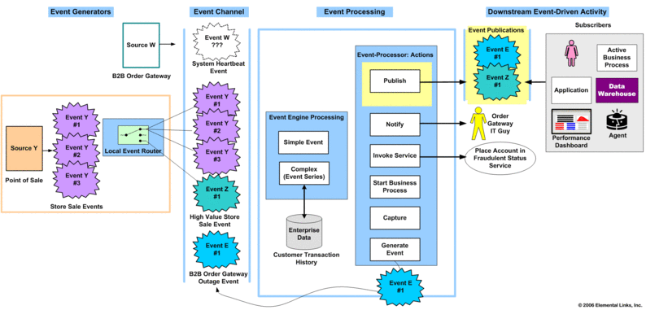
Example EDA Architecture
http://elementallinks.typepad.com/bmichelson/2006/02/eventdriven_arc.html
Notes:
[JP]?
Shows three complex event processing flows for multichannel consumer electronics retailer. In the first flow, top left hand corner, a business-to-business order gateway is supposed to be emitting System Heartbeat events every 15 minutes. The System Heartbeat events inform IT operations the gateway is up and running. The absence of a heartbeat event indicates a failure. If the order gateway is down, business customers are likely to place an order with a competitor.
The complex event engine tracks the timestamp of the last received System Heartbeat event. If 15 minutes have elapsed, the event processing actions associated with non-arrival are initiated. In this case, the order gateway IT guy is immediately notified (paged) and a new B2B Order Gateway Failure event is generated.
This new B2B Order Gateway event is deposited into the event channel. When the B2B Order Gateway Failure event is received by the simple event engine, a publishing action is performed. The enterprise problem management system subscribes to this event for resolution tracking.
The second and third flows show two variations of fraud detection. Both flows originate with the point-of-sale application shown at the bottom left hand corner. For every store sale, an ordinary Store Sale event is generated (Event Y, occurrences 1-3). These events are evaluated by a local event router, producing High Value Store Sale events (Event Z, occurrence 1) for transactions more than $1,500. All of the Store Sale events, ordinary and notable (high value), are deposited in the event channel.
In the first fraud detection flow, the complex event engine checks for multiple transactions (ordinary store sale events) by the same customer (credit card), over a short amount of time (10 minutes), at different locations over a large distance (20 miles). If these conditions are met, the place account in fraudulent status service is invoked.
In the second fraud detection flow, on receipt of a High Value Store Sale event, the complex event engine does an inquiry on the customer’s past purchases to determine if this purchase should be marked suspicious. [d] If the current purchase amount deviates more than 50 percent from largest historical purchase, the event (Z, occurrence 1) is published as suspicious. A customer advocate team subscribes to these events and places calls to registered cardholders.

Slide 16
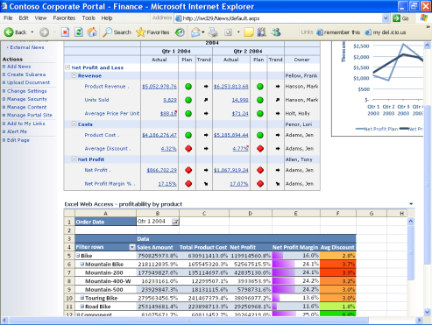
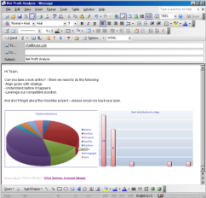
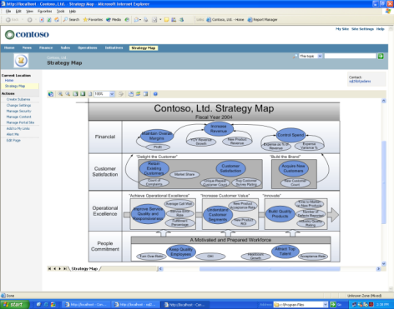
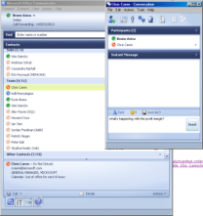
Typical CEP Applications
BPM Monitoring, BAM, report exceptions
Finance (trade analysis, detect fraud, risk analysis)
Network (SLA monitoring, intrusion detection)
Sensor (RFID, air traffic, schedule & control)
Notes:
[JP]

Slide 17
CEP Comparison to traditional App
CEP engines are like a RDBMS turned upside down
Store queries and run data through them
Continuous execution model, rather than when a query is submitted
Event pattern languages
Event stream queries
SQL – standard query language
Data generally more static
Complex queries rarer
Not suited to 000’s queries / second
Triggers can respond to events but relatively slow
Notes:
[JJ]
Compare CEP to traditional applications and RDBMS
RDBMS use SQL design for data which is fairly static and complex queries that are less frequent
If application must fire a query 10 times/second, because data is changing, this does not scale well if 000s of queries per second required.
Triggers are possible but complex condition checking not easy
In-memory db’s more suitable but not optimised for real-time query results and event stream analysis models
DataBlitz example of in-memory database http://www.sigmod.org/sigmod/sigmod99/eproceedings/papers/rastogi_dem.pdf

Slide 18
CEP Platform Characteristics
Event sampling
Parsing
Matching
Transformation
Enrichment
Routing
Storing
Notes:
[JJ]
What are some of the characteristics of a CEP Platform
Given the event models that we have looked at then need to
- Sample from event streams
- Process events / messages in real-time (or near)
- Process dense event streams
- High throughput – large volumes of messages/second
- Low latency – respond in real-time
Complex computations – detect patterns amongst events, filter, join event streams
Enrichment of data
Store historical data and information
Route events
Therefore this requires an underlying standard query language implementation – lets look at that in some more detail....

Slide 19
Generalised Event Language
Notation:
Xi, Yi – Events need order number, so can understand order
Xi(a) – Event need attributes, so we can compare values and match etc or compare specific events within the set Xi(a)=Yi(b)
T - time interval important
Operators:
Logical operators: “and”, ”or” and “not”.
Time operator: “within T (Z)”.
Sequence operator: “->”.
Example expressions:
“X and Y” within T(40 seconds)
“A -> B” (event B has to arrive after A)
http://dist.codehaus.org/esper/CEP_MasterThesis_PaulDekkers_200709.pdf
Notes:
[JJ]
Maybe mention RAPIDE from David Luckham and link this back to the earlier slides around

Slide 20
Important Operators
Time
Within n seconds (...)
Sequence of Events – insider trader detection
Within 10 days (sellShares(amount>10000) -> stockPriceChange(..) )
“->” operator significance
Detects where larger share sales have occurred after significant price change, which might indicate insider trading
http://dist.codehaus.org/esper/CEP_MasterThesis_PaulDekkers_200709.pdf
Notes:
[JJ]
Walkthrough example on slide

Slide 21
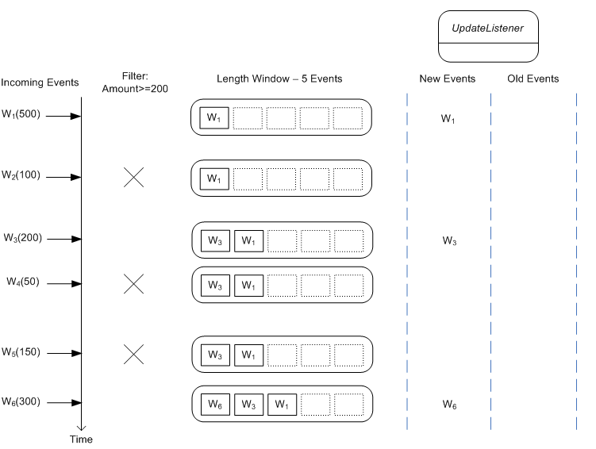
Filter Sliding Window Example
select * from Withdrawal(amount>=200).win:length(5)
Events are filtered into the sliding window
http://www.espertech.com
Notes:
[JJ]
Shows a filter that selects withdrawal events with an amount value of 200 or more.
Event stream is flow in from LHS
Transactions where amount > 200 are put into window
Slides because this will update over time
Sliding windows are useful to aggregate and then perform further queries

Slide 22
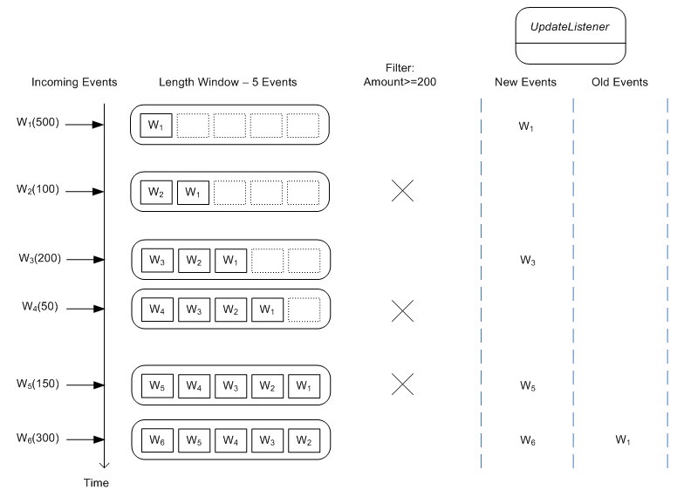
Filter events within the window
select * from Withdrawal.win:length(5) where amount >= 200
Events passed onto the Listener are filtered
http://www.espertech.com
Notes:
[JJ]
The difference here is that we are allowing any event into the sliding window, but then only alerting the listeners based on a filter criteria – in this case >= 200
The where-clause applies to both new events and old events. As the diagram below shows, arriving events enter
the window however only events that pass the where-clause are handed to update listeners. Also, as events
leave the data window, only those events that pass the conditions in the where-clause are posted to listeners as
old events.

Slide 23
SOA and CEP
CEP / EDA augments and enhances SOA
Event-Driven SOA
Notable event occurs that can trigger a service invocation
Service Generation of Events
Service invocation generates an event which is dispatched to all subscribers who have registered an interest
Notes:
[JJ]
You might now be asking yourself how does CEP talk to SOA ?

Slide 24
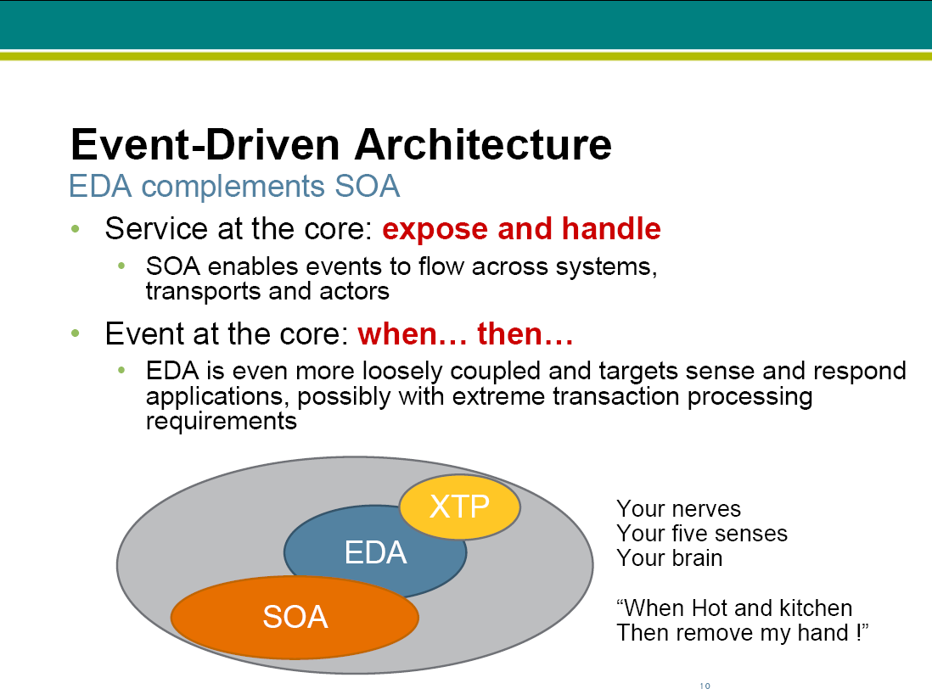
SOA and CEP
http://dist.codehaus.org/esper/NYJavaSIG_May_30_2007.pdf

Slide 25
Event Processing Examples
Nesper
BizTalk RFID
Notes:
[JJ]

Slide 26
CEP Example - NEsper
Notes:
[JJ]

Slide 27
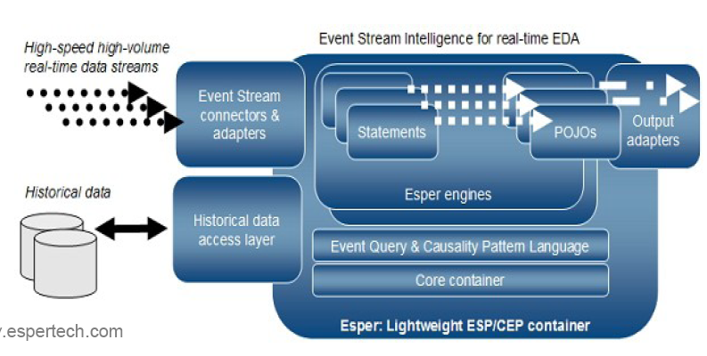
(N)ESPER Architecture
Listeners
http://www.espertech.com
Notes:
[JJ]
Esper—a Java technology ESP/CEP container
• Lightweight and embeddable
• Open source
• Convergence of ESP and CEP
• Project background
• Release 1.0 announced in June 2006
• NEsper for .NET
• Commercial liability, support and services available EsperTech Inc.

Slide 28
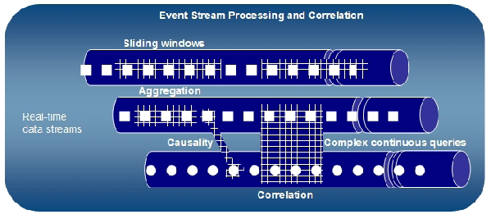
ESP and CEP
Sliding windows, Aggregation, Causality
http://www.espertech.com
Notes:
[JJ]

Slide 29
NEsper & BAM Demo
Notes:
[JJ]

Slide 30
Contextual Architecture
Demo Scope
BizTalk BAM
BAM Portal
NEsper
Event Streams
Filtered Events
BizTalk RFID
RFID Events
WCF, WF, BizTalk BAM Events
Notes:
[JJ]

Slide 31
Market Data Feed Scenario
1s window
10s Windows
Data Feed A
Detect an event rate fall off. Checking if count in a 10 second window is < 75% of the average count.
Alert raised if detected and BAM event written
Data Feed B
select event count in 1 sec window. Insert into TicksPerSecond
TicksPerSecond
Notes:
[JJ]

Slide 32

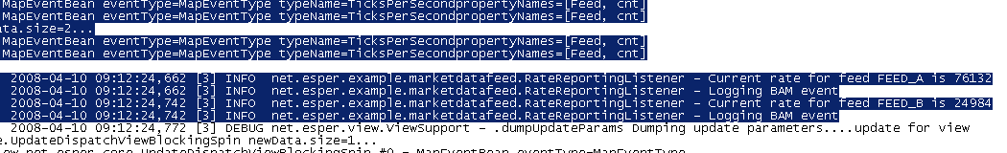
Market Data Feed
Run the simulation
2 threads
Drop probability 60%
10 second interval
Notes:
[JJ]

Slide 33
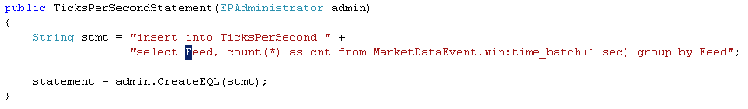
Populate TicksPerSecond Feed
Selects the event count from the Market Data Event stream in 1 second windows
Inserts the number of ticks per second in the Ticks Per Second feed
Notes:
[JJ]

Slide 34
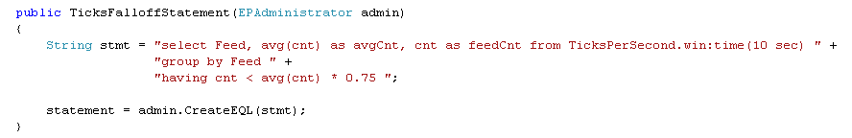
Detecting a Fall Off in Rate
EQL statement to detect fall-off rate
Selects from TicksPerSecond which has 10 second ‘windows’ of counts
Checks if count is < 75% of average count – indicating a fall off
Notes:
[JJ]

Slide 35
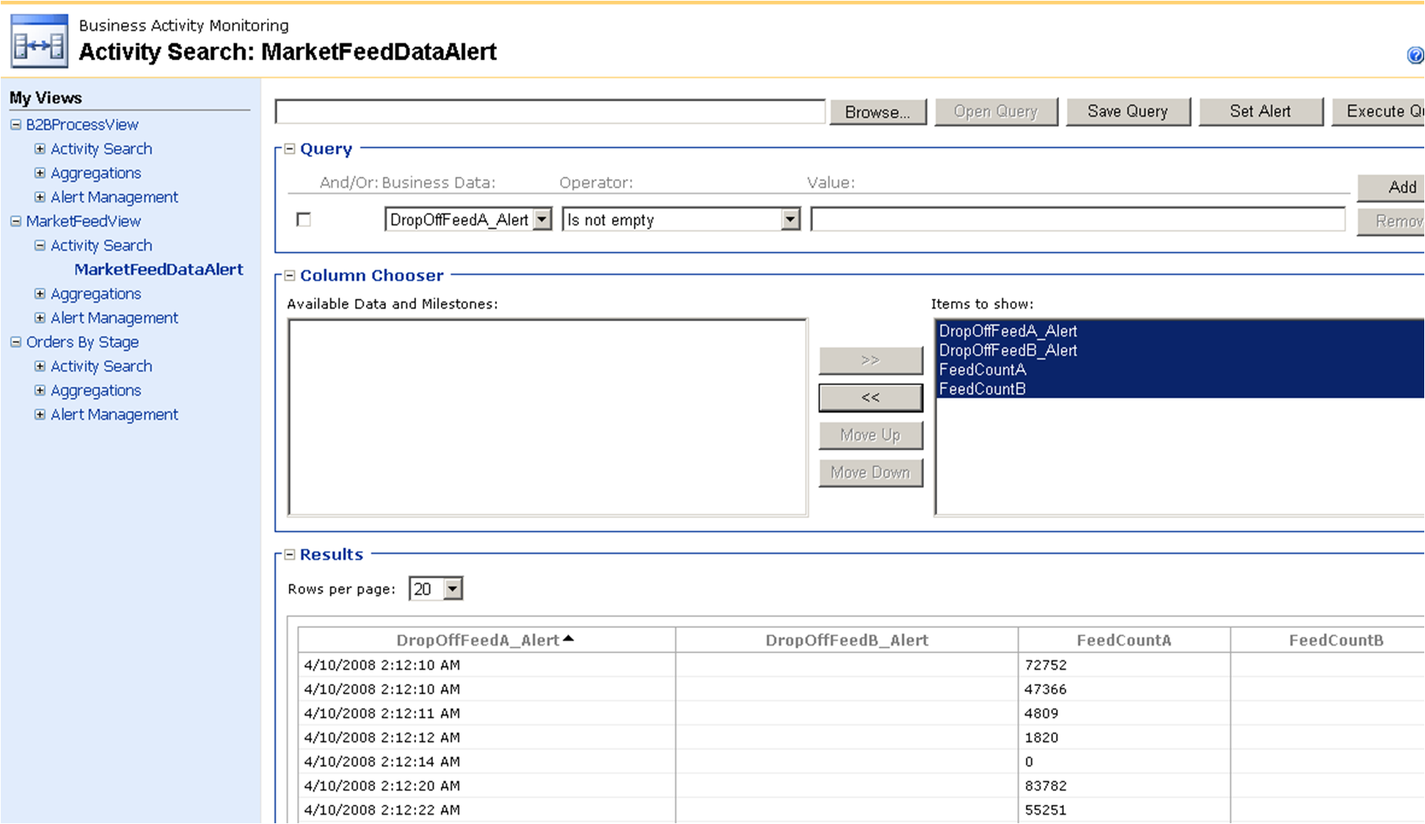
BAM Event Data
Notes:
[JJ]

Slide 36
Event Feed Rates
Notes:
[JJ]

Slide 37
BizTalk Server R2
RFID Event Processing
Notes:
[JP]

Slide 38
BizTalk RFID
Support services for RFID at the edge
Device plug-n-play and management
Filtering / transformation / aggregation, data cleansing and validation
Reacting to RFID events
Alerts (HW / SW) & tag processing rules
Inferring business relevant information
Integration of RFID into business process server
RFID events as ‘messages’ in BizTalk
Standards based interop through XML Web services
Commands can be ‘pushed’ using connector architecture
Notes:
[JP]

Slide 39
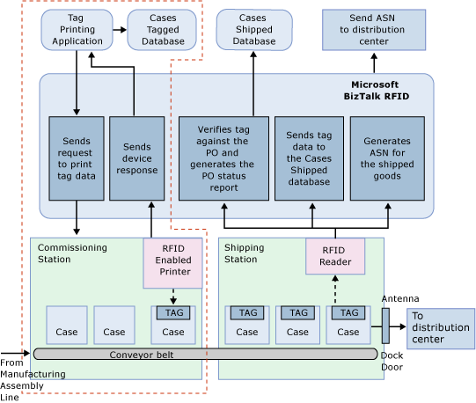
Example Flow
Notes:
[JP]
Manufacturing assembly component
Print RFID tag on a component

Slide 40
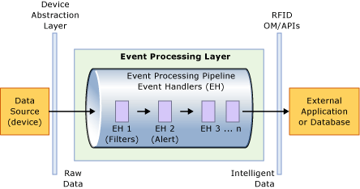
Event Processing Engine
Notes:
[JP]

Slide 41
BizTalk RFID Event Processing
Application model for Synchronous and Asynchronous event processing
Declarative specification of an Event Processing Tree
Design and Deployment separation
Notes:
[JP]
Composed of Event Processing pipeline segments
Leaf nodes are event sources
Each pipeline has a list of event handlers
Event Handler is custom code
Invoked in the context of an event
3rd party extensibility mechanism
Built in UI experience for managing event handlers

Slide 42
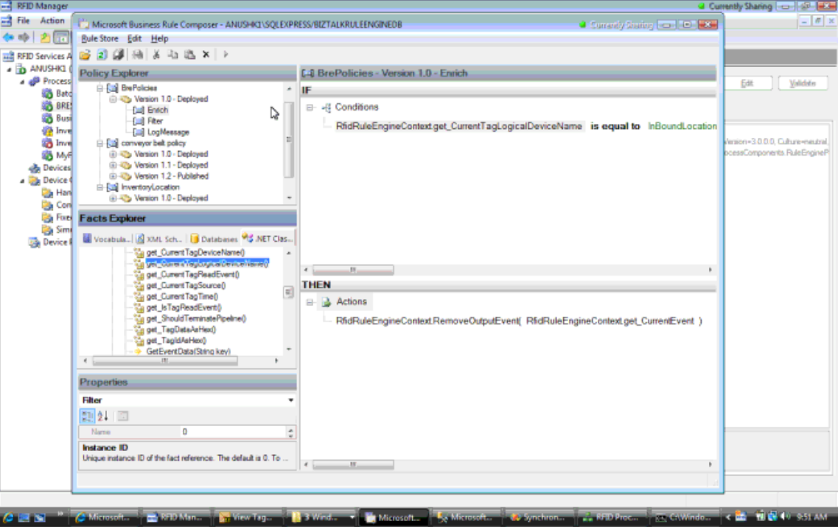
BRE Event Handler
Notes:
[JP]

Slide 43
Summary & Q&A
Defined CEP and history
Relationship To SOA
Types of challenges of CEP
Provide demonstration of event stream processing integrated to BizTalk BAM
Review event processing capabilities in BizTalk RFID
Notes:
[JP]

