Slide 1
Service Oriented Architecture
Dr.S.Swamynathan
Department of Information Science and Technology
College of Engineering Guindy Campus
Anna University
Chennai, INDIA
Email: swamyns@annauniv.edu

Slide 2
Overview of the syllabus
SOA characteristics
Principles of service orientation
Web service and its role in SOA
Service oriented analysis
Service oriented design
SOA platforms
SOA support in J2EE and .NET
SOA standards
Service composition (BPEL)
Security in SOA

Slide 3
Prerequisite for understanding SOA
Basic knowledge of object orientation
Understanding of web technologies
Basics of java programming
Basics of internet programming
Software Paradigms

Slide 4
Overview of the content
Current trends
Software paradigms
Application architecture
Web based systems
2-tier and 3-tier architecture
Web based technologies
component based systems

Slide 5
Current trends …
Internet based solution
Complexity of the software
Growth in hardware mobile and other smart devices
Demand for novel / customized services

Slide 6
Software paradigms…
Procedure oriented
Object-oriented
Component based
Event-driven
Logic based
Aspect-oriented
Service oriented

Slide 7
The monolithic mainframe application architecture
Separate, single-function applications, such as order-entry or billing
Applications cannot share data or other resources
Developers must create multiple instances of the same functionality (service).
Proprietary (user) interfaces

Slide 8
The distributed application architecture
Integrated applications
Applications can share resources
A single instance of functionality (service) can be reused.
Common user interfaces
Bottom-up approach
Real world scenario

Slide 9
Web based systems …
Client-server model
Client side technologies
Server side technologies
Web client, Web servers
Application servers

Slide 10
Basic idea of Tiers
Thick client
Request
Web server
Response
Tier 1: GUI interactions with the user and basic validations
Application server
Database server
Tier 2: Application logic, Transaction Management, Calls to the database server
Tier 3: Database processing

Slide 11
2-tier architecture
Presentation
Logic
Business
Logic
Business
Logic
Business
Logic
Database
Driver
Presentation / Business Layer
Tier Boundary
Data Layer
Database

Slide 12
Two tier architecture
  Deployment costs are high
  Database driver switching costs are high
  Business logic migration costs are high
  The client has to recompile if the BL is changed
  Network performance suffers

Slide 13
N-Tier architecture
Presentation
Logic
Tier Boundary
Business
Logic
Business
Logic
Business
Logic
Database
Driver
Tier Boundary
Data Layer
Database

Slide 14
N-Tier architecture
  Deployment costs are low
  Database switching costs are low
  Business migration costs are low
  A firewall can secure parts of the deployment
  Each tier can vary independently
  Communication performance suffers
  Maintenance costs are high

Slide 15
Presentation tier technologies
At client or server?
Property
Microsoft Technology
Sun Technology
Client
HTTP (Web) based
HTML browser (Internet Explorer)
HTML browser (Netscape Navigator)
ActiveX Controls
Java Applets
Non-HTTP based
COM clients
CORBA clients
Communication Protocol between client and server
DCOM
RMI, IIOP
Server
For creating dynamic Web pages
ISAPI, ASP
NSAPI, Servlets, JSP
Other pages
HTML, XML
HTML, XML

Slide 16
Business tier technologies
Purpose
Microsoft Technology
Sun Technology
Transaction handing, Business Objects
COM, MTS
EJB (Session Beans)
Queuing and Messaging
MSMQ
IBM’s MQSeries, Java Messaging Service (JMS)
Database access
ADO, OLE, ODBC
JDBC, J/SQL (via Entity Beans)

Slide 17
Microsoft Web Technologies
Presentation Tier
HTML Browser
HTML Browser
COM Client
ActiveX Control
Firewall
ASP
ISAPI
DCOM
DCOM
HTML/XML pages
DCOM
Business Tier
MTS Transactional Components
MSMQ Queuing Services
ADO/OLE/ODBC Database Access
Database Tier
Database
Database

Slide 18
Sun’s Web Technologies
Presentation Tier
HTML Browser
HTML Browser
CORBA Client
Java Applet
Firewall
Servlet
JSP
RMI/IIOP
RMI/IIOP
HTML/XML pages
RMI/IIOP
Business Tier
EJB Session Beans
EJB Entity Beans
JDBC / SQL/J
MQSeries/Java Messaging Service (JMS)
Database Tier
Database
Database

Slide 19
Component World …
Justification for component
Interface
Implementation
Reusability
standards

Slide 20
Interface and Implementation
Eject
Actual implementation in terms of voltages, signals, currents etc.
External world (a user of the audio system)
Skip
- Volume +
- Bass +
Interface
Implementation

Slide 21
Technologies for implementing components
RMI / EJB
CORBA
COM, DCOM, COM+
Limitations
Web services (XML based standards)

Slide 22
Basic model of distributed system
Service Registry
find
Publish
Service Requestor
Service provider
Bind

Slide 23
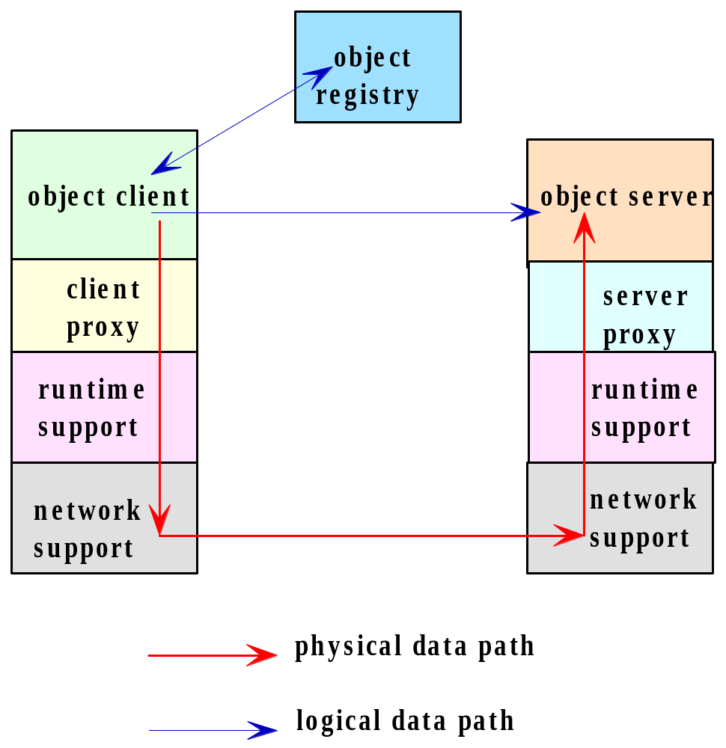
An Archetypal Distributed Objects System

Slide 24
Distributed Object Systems / Protocols
The distributed object paradigm has been widely adopted in distributed applications, for which a large number of mechanisms based on the paradigm are available. Among the most well known of such mechanisms are:
~ Java Remote Method Invocation (RMI),
  ~ the Common Object Request Broker Architecture (CORBA) systems,
  ~ the Distributed Component Object Model (DCOM),
  ~ mechanisms that support the Simple Object Access Protocol (SOAP).

Slide 25
RMI architecture
Web server
Client Browser
HTTP
Applets
HTML pages
HTML
Java applets
Application server
Object Implementation
Stub
JRMP / IIOP
Skeleton

Slide 26
CORBA architecture
Web server
Client Browser
HTTP
Applets
HTML pages
HTML
Java applets
Application server
Object Implementation
Client ORB
IIOP
Server ORB

Slide 27
DCOM architecture
Web server
Client Browser
HTTP
ActiveX
HTML pages
HTML
ActiveX Controls
Application server
Object Implementation
Proxy
DCOM
Stub

Slide 28
Limitations of Components
Tightly coupled
Cross language/ platform issues
Interoperability issues
Maintenance and management
Security issues

Slide 29
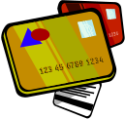
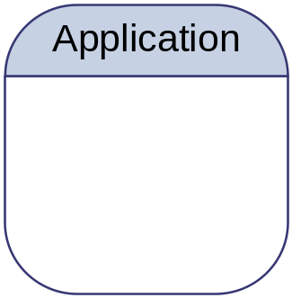

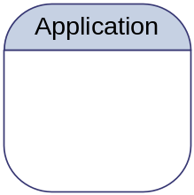
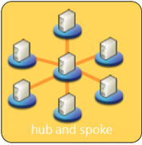
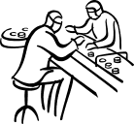

Application Centric
Business scope
Narrow Consumers
Limited Business Processes
Finance
Integration
Architecture
bound to EAI vendor
Supply
Manufacturing
Distribution
Redundancy
Overlapped resources
Overlapped providers
EAI ‘leverage’ application silos with the drawback of data and function redundancy.
Business functionality is duplicated in each application that requires it.

Slide 30
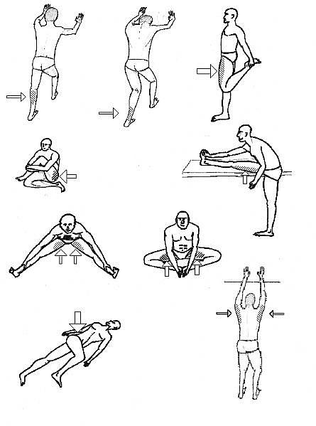

Goal - Service Centric

Slide 31
What are services?
A service is
  Autonomous unit of automated business logic
  Accessible to other systems
A service represents
  Business process
  Sub process
  Activity (process step)
    (or multiple)

Slide 32
What is Service Architecture?
A collection of services
services
classified into types
type
type
type
arranged into layers
Governed by architectural
patterns and policies
identification
granularity
dependency
source:TietoEnator AB, Kurts Bilder

Slide 33
SOA Defined
SOA is a software architecture model
in which business functionality are logically grouped and encapsulated into self contained,distinct and reusable units called services that
represent a high level business concept
can be distributed over a network
can be reused to create new business applications
contain contract with specification of the purpose, functionality, interfaces (coarse grained), constraints, usage

Slide 34
SOA Defined
SOA is a software architecture model
in which business functionality are logically grouped and encapsulated into self contained,distinct and reusable units called services that
represent a high level business concept
can be distributed over a network
can be reused to create new business applications
contain contract with specification of the purpose, functionality, interfaces (coarse grained), constraints, usage
Services are autonomous, discrete and reusable units of business functionality exposing its capabilities in a form of contracts. Services can be independently evolved, moved, scaled even in runtime.

Slide 35
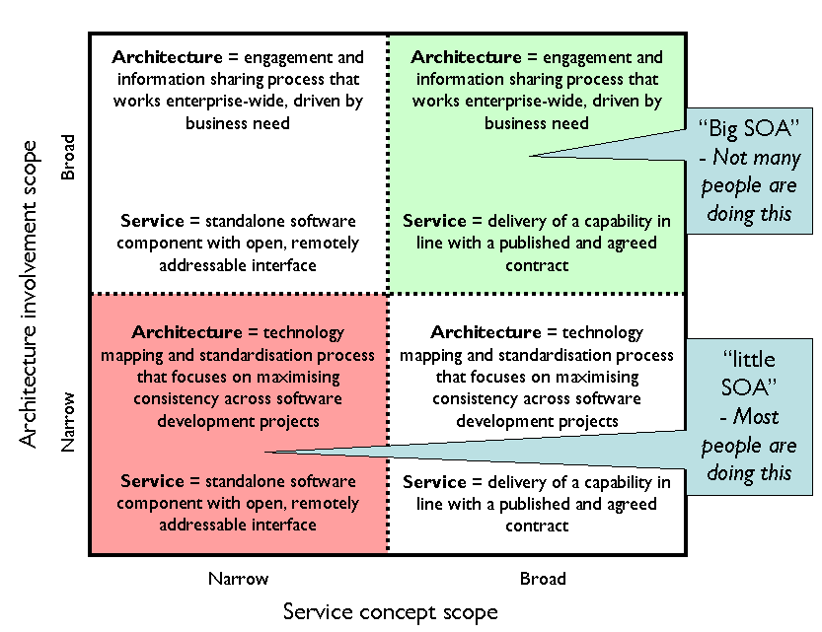
Big (outer) vs. Little (inner) SOA
Notes:
Inner SOA : is Software Architect activity and describes on how applications are designed as segments of business functionality that are isolated behind explicit service boundaries. This is a software development centric view of what “service” is - a standalone software component with some kind of remotely addressable invocation interface (e.g.REST, WS-* interface). Architecture is viewed as software design. SOA tenets are more relaxed, for example explicit service boundaries are often not effective for performance reasons.
Outer SOA:is about business alignment and represent Enterprise Architect activity how to connect disparate systems across application, department, corporate and industry boundaries. Big SOA cares about connecting heterogeneous systems that may originate from different vendors or silo applications. Big SOA services expose usually publicly services that are accessible for chaining, orchestration and enables situational (composite) applications to be build. In "big SOA", organizations have a much broader view of what a "service" is. In this broader view a service isn't something you build; it's something that is experienced by a consumer. This view, therefore, is really about realizing that delivering a service requires all sorts of IT competencies (design, development, integration, testing, deployment, admin, operations and change management) to be integrated together across the lifecycle of an investment that is packaged up as a service.

Slide 36
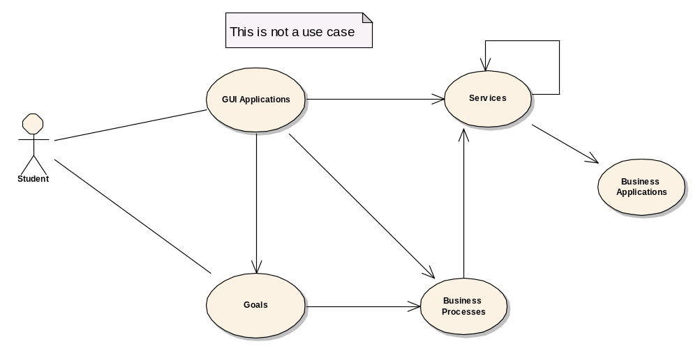
Service Relationships
orchestrate / are composed of
invokes
uses
participates
in
exposes
help users
achieve
are realized by (partially)
has
supported
by

Slide 37
Why SOA?
Heterogeneous cross-platform
Reusability at the macro (service) level rather than micro(object) level
Interconnection to - and usage of - existing IT (legacy) assets
Granularity, modularity, composability, componentization
Compliance with industry standards

Slide 38
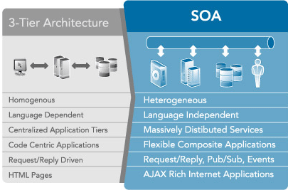
SOA is an evolutionary step
for architecture

Slide 39
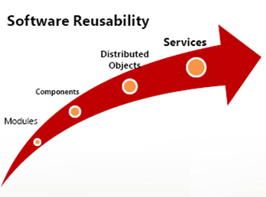
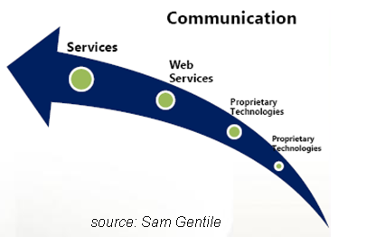
SOA is an evolutionary step
in reusability and communication
Notes:
Services have become the dominant consideration in architecture
and are going to be with us for a very long time

Slide 40
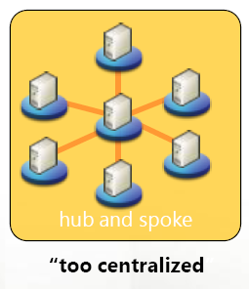
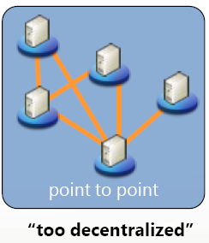
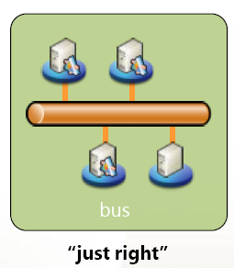
SOA is an evolutionary step
in distributed communications
EAI
Project-ware
SOA
source:Sam Gentile

Slide 41
Features of SOA
Self- describing Interface (WSDL)
Message communication via formally defined XML
Services are maintained in a registry
Each service has a Quality Of Service
Applications adapt to changing technologies
Easy integration of applications with other systems
Leverage existing investments in legacy applications

Slide 42
Service Architecture Composition
Service architectures are composed of
  Services
    Units of processing logic
    Example: Credit card Service
  Messages
    Units of communications between services
    Needed for services to do their job
  Operations
    Units of Work
    Example: Determine Cost of Attendance
  Processes
    Composed / orchestrated groups of services
    Example: Financial Aid Disbursement

Slide 43
SOA principles
Service Encapsulation
Service Loose coupling
Service Contract
Service abstraction
Service Documentation
Service reusability
Service composability
Service autonomy
Service optimization and Discovery
Service statelessness

Slide 44
Encapsulation

Slide 45
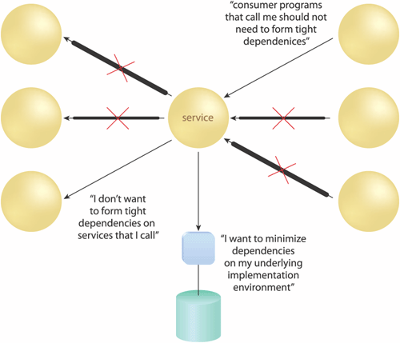
Loose Coupling
“Service contracts impose low consumer coupling requirements and are themselves decoupled from their surrounding environment."
Create specific types of relationships within and outside of service boundaries with a constant emphasis on reducing (“loosening”) dependencies
between
  Service contract
  Service implementation
  Service consumers
Source: Thomas Erl

Slide 46
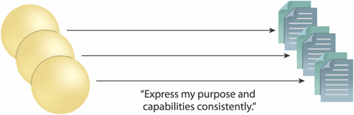
Standardized Service Contracts
“Services within the same service inventory are in compliance with the same contract design standards."
Services use service contract to
  Express their purpose
  Express their capabilities
Use formal, standardized service contracts
Focus on the areas of
  Functional expression
  Data representation
  Policy
Source: Thomas Erl

Slide 47
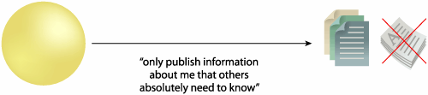
Abstraction
“Service contracts only contain essential information and information about services is limited to what is published in service contracts”
Avoid the proliferation of unnecessary service information, meta-data.
Hide as much of the underlying details of a service as possible.
  Enables and preserves the loosely coupled relationships
  Plays a significant role in the positioning and design of service compositions
Source: Thomas Erl

Slide 48
Documentation

Slide 49
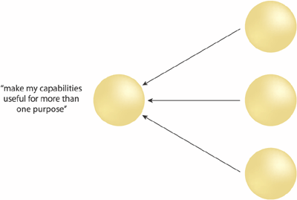
Reusability
“Services contain and express agnostic logic and can be positioned as reusable enterprise resources."
Reusable services have the following characteristics:
  Defined by an agnostic functional context
  Logic is highly generic
  Has a generic and extensible contract
  Can be accessed concurrently
Source: Thomas Erl

Slide 50
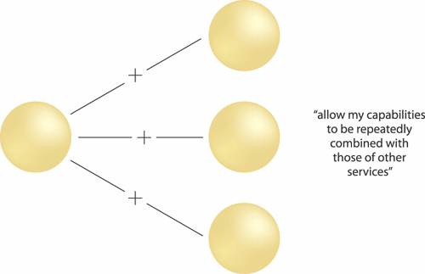
Composability
"Services are effective composition participants, regardless of the size and complexity of the composition."
Ensures services are able to participate in multiple compositions to solve multiple larger problems
Source: Thomas Erl

Slide 51
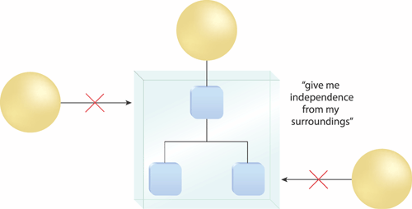
Autonomy
"Services exercise a high level of control over their underlying runtime execution environment."
Represents the ability of a service to carry out its logic independently of outside influences
To achieve this, services must be more isolated
Primary benefits
  Increased reliability
  Behavioral predictability
Source: Thomas Erl

Slide 52
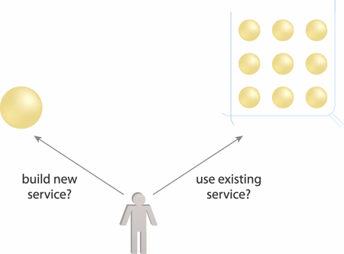
Discoverability
"Services are supplemented with communicative meta data by which they can be effectively discovered and interpreted."
Service contracts contain appropriate meta data for discovery which also communicates purpose and capabilities to humans
Store meta data in a service registry or profile documents
Source: Thomas Erl

Slide 53
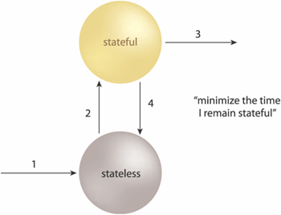
Statelessness
"Services minimize resource consumption by deferring the management of state information when necessary."
Incorporate state management deferral extensions within a service design
Goals
  Increase service scalability
  Support design of agnostic logic and improve service reuse
Source: Thomas Erl

Slide 54
Applying SOA - Governance
Governance is a program that makes sure people do what is ‘right’
In conjunction with software, governance controls the development and operation of software
  Goal: Establish SOA organization governance (SOA Board) that governs SOA efforts and breaks down capabilities into non-overlapping services

Slide 55
Applying SOA - Governance
Policies
  Codification of laws, regulations, corporate guidelines and best practices
  Must address all stages of the service lifecycle (technology selection, design, development practices, configuration management, release management, runtime management, etc.)

Slide 56
Applying SOA - Governance
Processes
  Enforce policies
  System-driven processes (code check-in, code builds, unit tests)
  Human-driven process (requests, design reviews, code reviews, threat assessment, test case review, release engineering, service registration, etc.)

Slide 57
Applying SOA - Governance
Metrics
  Measurements of service reuse, compliancy with policy, etc.
  Organization
  Governance program should be run by SOA Board, which should have cross-functional representatives

Slide 58
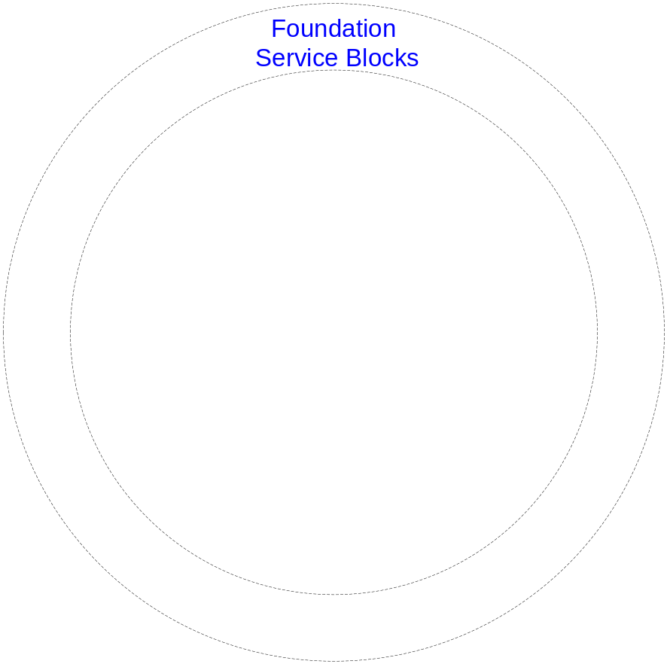
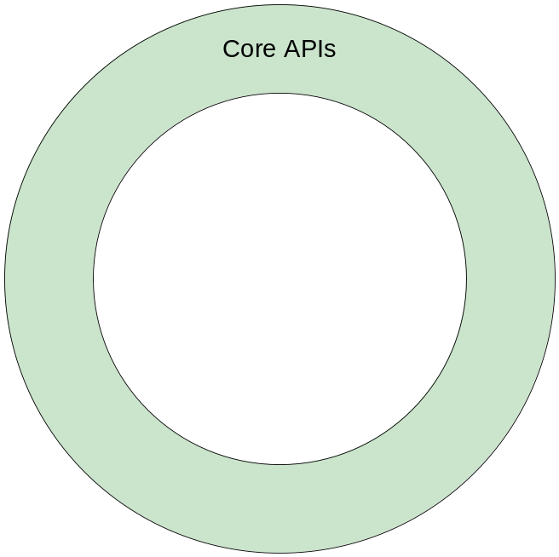
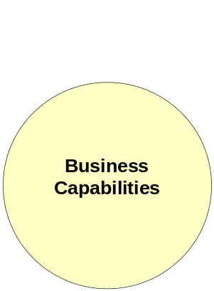
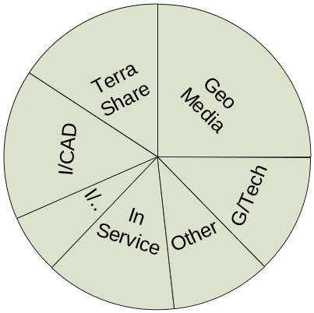
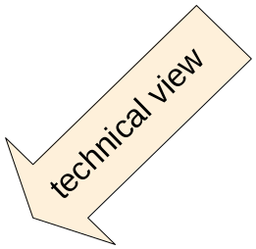
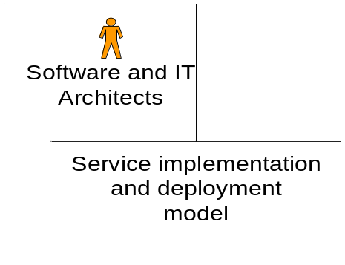
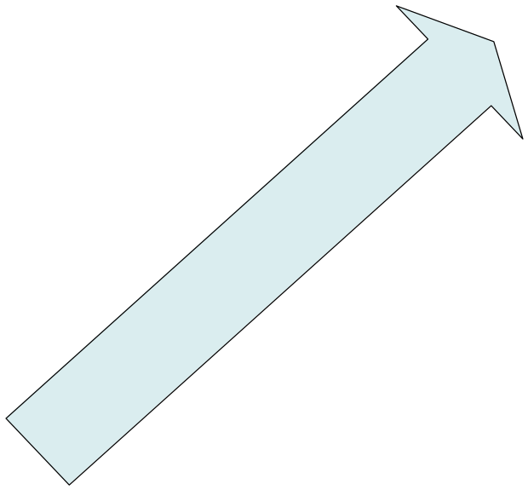
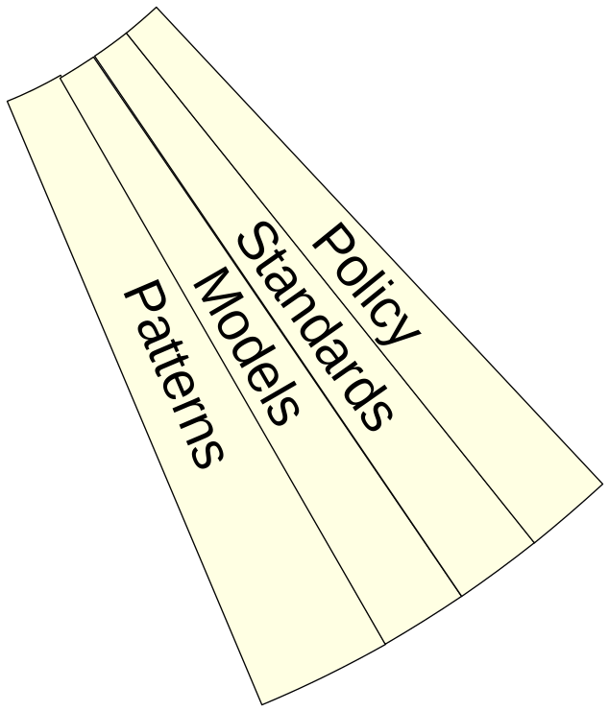
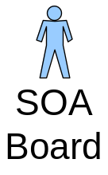
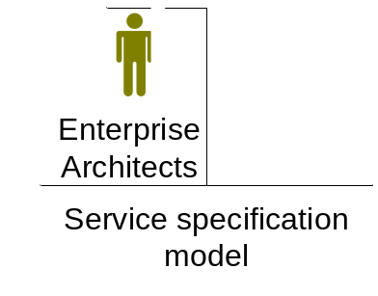
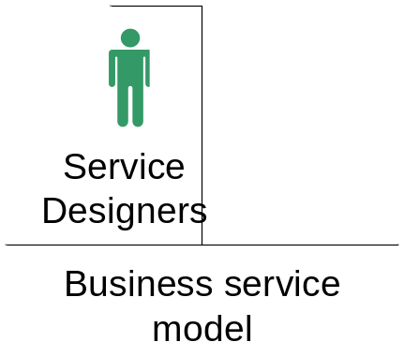
Applying SOA –
Governance

Slide 59
Applying SOA - Challenges
Business functionality has to be made available as services. Service contracts must be fixed
Service Orientation
Reuse
Sharing of Responsibilities
Increased complexity!
Implemented services must be designed with reuse in mind. This creates some overhead.
Potential service users must be involved in the design process and will have influence on the service design
Notes:
Independence from Technology - Dependency on the underlying IT infrastructure is reduced so that business departments can focus on functional requirements.
Shorter Time to Market- Business departments can achieve a shorter time to market for new functionality.
Reduction of Development Costs- The costs for developing new functionality are significantly reduced.
Service Orientation- Business functionality has to be made available as services. Service contracts must be fixed and adhered to.
Reuse- Implemented services must be designed with reuse in mind. This creates some overhead.
Sharing of Responsibilities- Potential service users must be involved in the design process and will have influence on the service design.

Slide 60
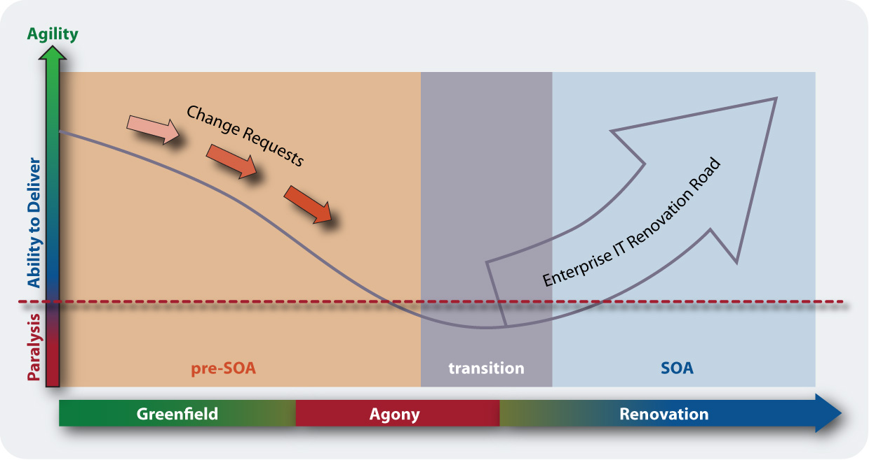
Applying SOA – Renovation Roadmap
(Source: Enterprise SOA: Service Oriented Architecture Best Practices
by Dirk Krafzig, Karl Banke, and Dirk Slama, Prentice Hall 2004)

Slide 61
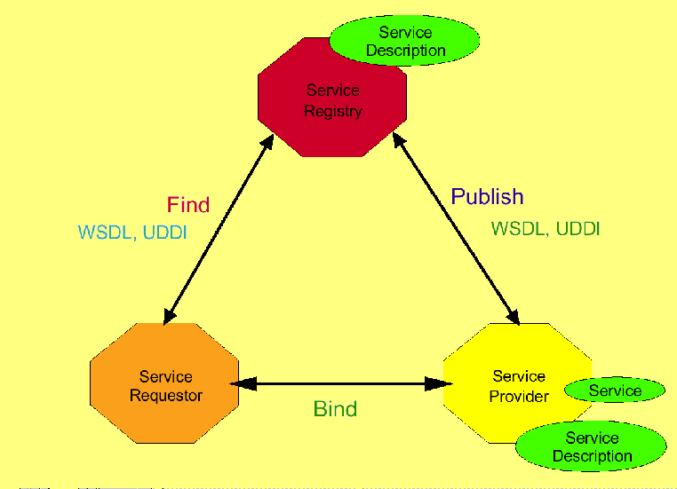
Service Oriented Architecture model

Slide 62
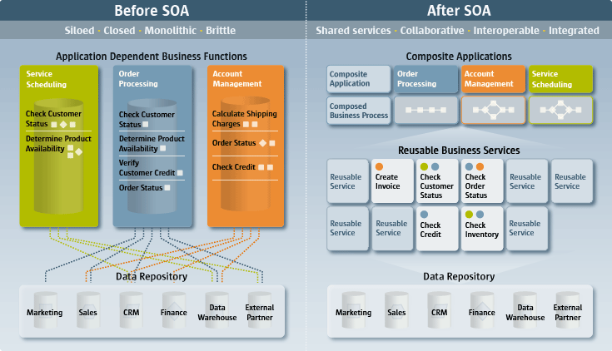
Before SOA – After SOA
source:IBM

Slide 63








Why SOA?
To enable Flexible, Federated Business Processes
Enabling a virtual federation of
participants to collaborate in an
end-to-end business process
Enabling alternative
implementations
Enabling reuse of
Services
Service
Service
Identification
Ticket Collection
Service
Ordering
Ticket Sales
Service
Service
Service
Inventory
Service
Service
Service
Logistics
Service
Manufacturing
Availability
Enabling virtualization of business resources
Enabling aggregation from multiple
providers
source:TietoEnator AB, Kurts Bilder
Notes:
En federation är en sammanslutning av olika självständiga enheter, länder eller organisationer, som tillsammans bildar en enda stor samorganisation eller stat

Slide 64
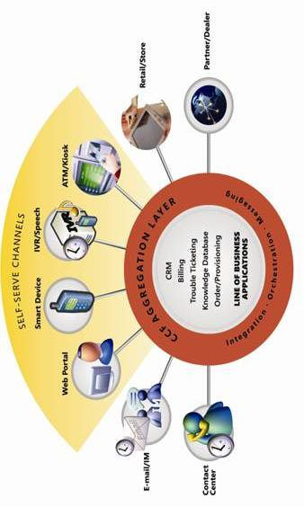




Why SOA? To enable Business Process Optimization and the Real Time Enterprise (RTE)
BPM Expressed in
terms of Services
Provided/Consumed
Seamless End to End Process
Service to Customers
Enterprise
Service from Multiple Suppliers
Smart Clients
Stores POS
Mobile
3rd Party Agents
Portal
Internal Systems
source:TietoEnator AB, Kurts Bilder
SOA Pattern: Standardized Service
provided by multiple suppliers
SOA Patterns: Single, Multi-Channel
Service for consistency

Slide 65
Why SOA?
Enable Structural Improvement
ERP X
Process Z
Partner A
Process Y
Standardizing capabilities
Information Consistency
e.g. Single Customer
Details Service
Service
Policy Consistency
Reducing impact
of change
Consolidation/
Selection
process
Encapsulating
implementation
complexity
ERP Z
CRM
System 2
CRM
System 1
Product
System
e.g. Multiple Sources of Customer Details
Policy Rationalization and Evolution
Resource Virtualization

Slide 66
Service Architecture Organized by Layers
Reasons for Layering
Flexible composition.
Reuse.
Functional standardization in lower levels
Customization in higher layers
Separation of Concerns.
Policies may vary by Layer
Example Layers
Presentation
& workflow
Composed Services
Basic Services
Underlying
API
according to:TietoEnator AB, Kurts Bilder
Notes:
Flexible composition. Services are
composed from many Services in
lower layers
Reuse. Services are used by
many Services in higher layers
Functional standardization and
commoditization in lower levels
Customization in higher layers
Separation of Concerns. Each layer
may reflect different
Purpose and role of Service
Provider of services in that layer
Appropriate Technology or
implementation approach for the
layer
Policies may vary by Layer. E.g.
Different Sourcing permitted
Degree of Standardization/
Differentiation allowed

Slide 67
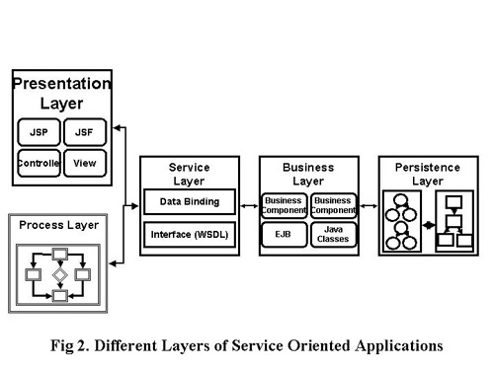
Different layers of SOA

Slide 68
Service Composition Example
Aid Disbursement Process
Is Realized By
Aid Disburse
Service
Orchestrates
Service
Interface
Layer
account info
Debit Account
FA
Award
Service
Registration
Service
Loan
Service
Bursar
Service
Not
Physical
Are Executed In / Controlled By
App
Logic
FA System
Microsoft .NET
Registrar System
Mainframe
Dept of Ed
???
Bursar
Java on Linux

Slide 69
Applying services to the problem
Monolithic
Before
After
The System
S1
S2
S3
S4
System composed of many logical service units (decomposition)
Underlying business logic decoupled as much as possible from other services (autonomy and loose coupling)
System replacement is a total process
System modules are tightly interdependent making change difficult

Slide 70
Goal of SOA
Loosely coupled
The goal for a SOA is a world wide mesh of collaborating services, which are published and available for invocation on the Service Bus.
SOA is not just an architecture of services seen from a technology perspective, but the policies, practices, and frameworks by which we ensure the right services are provided and consumed.

Slide 71
Major service types
Basic Services:
  Data-centric and logic-centric services
  Encapsulate data behavior and data model and ensures data consistency (only on one backend).
  Basic services are stateless services with high degree of reusability.
  Represent fundamental SOA maturity level and usually are build on top existing legacy API (underlying services.

Slide 72
Major service types
Composed Services :
expose harmonized access to inconsistent basic services technology (gateways, adapters, façades, and functionality-adding services).
Encapsulate business specific workflows or orchestrated services.

Slide 73
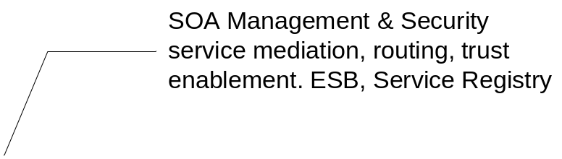
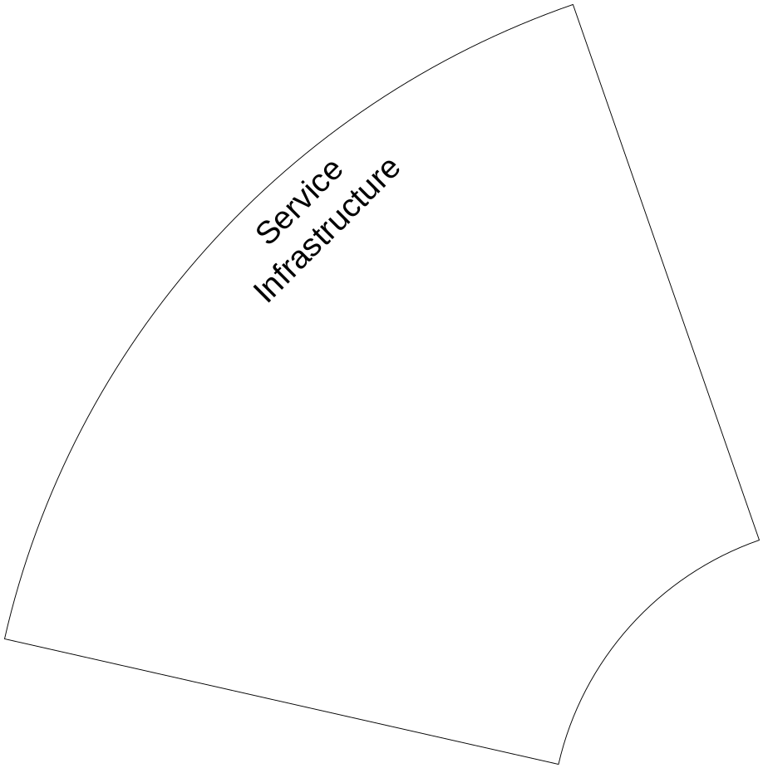
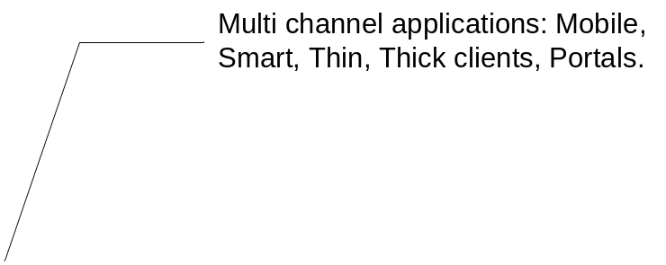
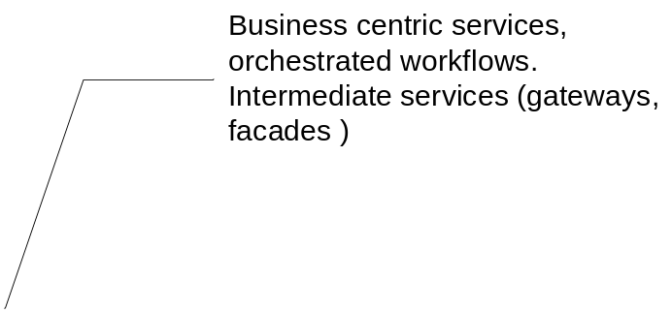
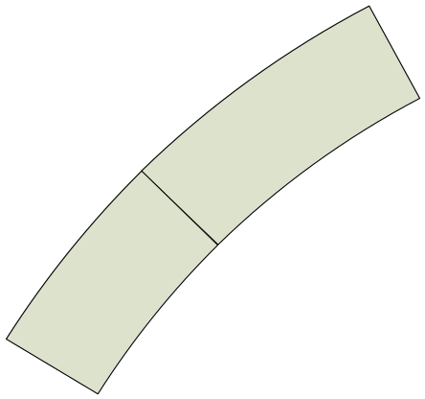
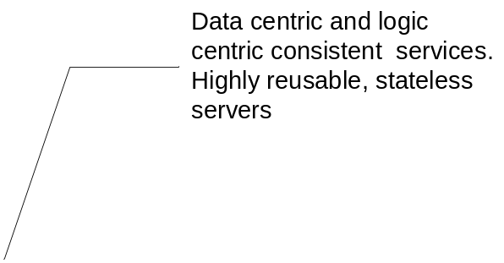
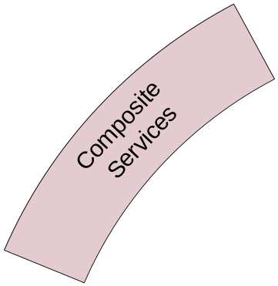
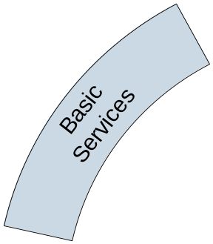
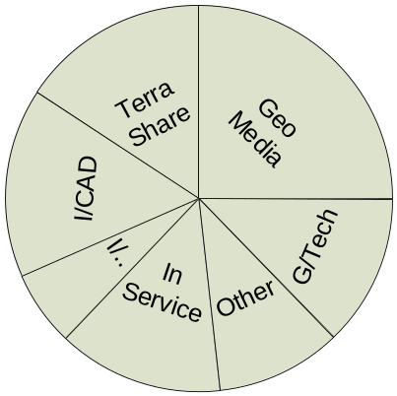
Service Types

Slide 74
SOA Benefits Summary
Allow us to execute complex business processes by composing systems from small, less complex building blocks
Fosters collaborative business and technical environment through sharing and coordination of services
Create outward facing self-service applications not constrained by organizational boundaries
Enables creating adaptive, agile systems that are resilient to changes in the business environment

Slide 75
Conclusions
SOA represents a fundamental change to the way information systems will designed in the future
Long term impact on IT portfolio management is dramatic
Adds a significant dimension to system evaluation process
Undertaking SOA requires commitment from all levels of the organization and significant investments (people, process, and tools)

Slide 76
Conclusion and Summary
If done correct, SOA is “not just another architectural fad”
SOA seeks to bridge the gap between business and technology promoting business agility (its all about managing change)
SOA
  Is complex
  Requires governance
  Requires executive management buy-in
  Requires commitment with resources

Slide 77
References
Coyle, “XML, Web Servcies and Data Revolution”, Pearson Education, 2002.
Chatterjee and Webber, “Developing Enterprise Web Services – An Architect’s Guide”, Pearson Education, 2004.
Liu, “Distributed Computing – Principles and Applications”, Pearson Education, 2004.
http://www.microsoft.comarchitecture/soa
http://www.ibm.com/soa
http://www.sun.com/products/soa

Slide 78
Questions ?

Slide 79
Thank You.

