Slide 1
ASCII and BCD Arithmetic
Chapter 11
S. Dandamudi

Slide 2
Outline
Representation of Numbers
  ASCII representation
  BCD representation
    Unpacked BCD
    Packed BCD
Processing ASCII numbers
    ASCII addition
    ASCII subtraction
    ASCII multiplication
    ASCII division
  Example: Multidigit ASCII addition
Processing packed BCD numbers
  Packed BCD addition
  Packed BCD subtraction
  Example: Multibyte packed BCD addition
Performance: Decimal versus binary arithmetic
2005
To be used with S. Dandamudi, “Introduction to Assembly Language Programming,” Second Edition, Springer, 2005.
S. Dandamudi
Chapter 11: Page <number>

Slide 3
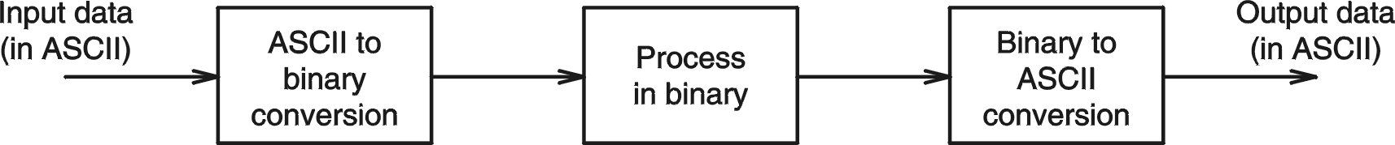
Representation of Numbers
Numbers are in ASCII form
  when received from keyboard
  when sending to the display
Binary form is efficient to process numbers internally
2005
To be used with S. Dandamudi, “Introduction to Assembly Language Programming,” Second Edition, Springer, 2005.
S. Dandamudi
Chapter 11: Page <number>

Slide 4
Representation of Numbers (cont’d)
Requires conversion between these two number representations
    We have used GetInt/GetLint and PutInt/PutLint to perform these two conversions
In some applications, processing of numbers is simple (e.g. a simple addition)
    Does not justify the input and output conversion overheads
    In this case, it is better to process numbers in the decimal form
Decimal numbers can be represented in
    ASCII
    BCD
2005
To be used with S. Dandamudi, “Introduction to Assembly Language Programming,” Second Edition, Springer, 2005.
S. Dandamudi
Chapter 11: Page <number>

Slide 5
Representation of Numbers (cont’d)
ASCII representation
  Numbers are stored as a string of ASCII characters
    Example: 1234 is stored as 31 32 33 34H
        ASCII for 1 is 31H, for 2 is 32H, etc.
BCD representation
  Unpacked BCD
    Example: 1234 is stored as 01 02 03 04H
      Additional byte is used for sign
        Sign byte: 00H for + and 80H for −
  Packed BCD
    Saves space by packing two digits into a byte
      Example: 1234 is stored as 12 34H
2005
To be used with S. Dandamudi, “Introduction to Assembly Language Programming,” Second Edition, Springer, 2005.
S. Dandamudi
Chapter 11: Page <number>

Slide 6
Processing ASCII Numbers
Pentium provides four instructions
      aaa − ASCII adjust after addition
      aas − ASCII adjust after subtraction
      aam − ASCII adjust after multiplication
      aad − ASCII adjust before division
  These instructions do not take any operands
    Operand is assumed to be in AL
2005
To be used with S. Dandamudi, “Introduction to Assembly Language Programming,” Second Edition, Springer, 2005.
S. Dandamudi
Chapter 11: Page <number>

Slide 7
Processing ASCII Numbers (cont’d)
ASCII addition
Example 1 Example 2
  34H = 00110100B 36H = 00110110B
  35H = 00110101B 37H = 00110111B
  69H = 01101001B 6DH = 01101101B
  Should be 09H Should be 13H
  Ignore 6 Ignore 6 and add 9 to D
The aaa instruction performs these adjustments to the byte in AL register
2005
To be used with S. Dandamudi, “Introduction to Assembly Language Programming,” Second Edition, Springer, 2005.
S. Dandamudi
Chapter 11: Page <number>

Slide 8
Processing ASCII Numbers (cont’d)
The aaa instruction works as follows:
  If the least significant four bits in AL are > 9 or
  if AF =1, it adds 6 to AL and 1 to AH.
      Both CF and AF are set
  In all cases, the most significant four bits in AL are cleared
  Example:
    sub AH,AH ; clear AH
    mov AL,'6' ; AL = 36H
    add AL,'7' ; AL = 36H+37H = 6DH
    aaa ; AX = 0103H
    or AL,30H ; AL = 33H
2005
To be used with S. Dandamudi, “Introduction to Assembly Language Programming,” Second Edition, Springer, 2005.
S. Dandamudi
Chapter 11: Page <number>

Slide 9
Processing ASCII Numbers (cont’d)
ASCII subtraction
The aas instruction works as follows:
  If the least significant four bits in AL are > 9 or
  if AF =1, it subtracts 6 from AL and 1 from AH.
      Both CF and AF are set
  In all cases, the most significant four bits in AL are cleared
This adjustment is needed only if the result is negative
2005
To be used with S. Dandamudi, “Introduction to Assembly Language Programming,” Second Edition, Springer, 2005.
S. Dandamudi
Chapter 11: Page <number>

Slide 10
Processing ASCII Numbers (cont’d)
Example 1: Positive result
    sub AH,AH ; clear AH
    mov AL,'9' ; AL = 39H
    sub AL,'3' ; AL = 39H-33H = 6H
    aas ; AX = 0006H
    or AL,30H ; AL = 36H
Example 2: Negative result
    sub AH,AH ; clear AH
    mov AL,'3' ; AL = 33H
    sub AL,'9' ; AL = 33H-39H = FAH
    aas ; AX = FF04H
    or AL,30H ; AL = 34H
2005
To be used with S. Dandamudi, “Introduction to Assembly Language Programming,” Second Edition, Springer, 2005.
S. Dandamudi
Chapter 11: Page <number>

Slide 11
Processing ASCII Numbers (cont’d)
ASCII multiplication
The aam instruction adjusts the result of a mul instruction
  Multiplication should not be performed on ASCII
    Can be done on unpacked BCD
The aam instruction works as follows
  AL is divided by 10(0AH)
  Quotient is stored in AH
  Remainder in AL
aam does not work with imul instruction
2005
To be used with S. Dandamudi, “Introduction to Assembly Language Programming,” Second Edition, Springer, 2005.
S. Dandamudi
Chapter 11: Page <number>

Slide 12
Processing ASCII Numbers (cont’d)
Example 1
  mov AL,3 ; multiplier in unpacked BCD form
  mov BL,9 ; multiplicand in unpacked BCD form
  mul BL ; result 001BH is in AX
  aam ; AX = 0207H
  or AX,3030H ; AX = 3237H
Example 2
  mov AL,'3' ; multiplier in ASCII
  mov BL,'9' ; multiplicand in ASCII
  and AL,0FH ; multiplier in unpacked BCD form
  and BL,0FH ; multiplicand in unpacked BCD form
  mul BL ; result 001BH is in AX
  aam ; AX = 0207H
  or AL,30H ; AL = 37H
2005
To be used with S. Dandamudi, “Introduction to Assembly Language Programming,” Second Edition, Springer, 2005.
S. Dandamudi
Chapter 11: Page <number>

Slide 13
Processing ASCII Numbers (cont’d)
ASCII division
The aad instruction adjusts the numerator in AX before dividing two unpacked decimal numbers
  The denominator is a single unpacked byte
The aad instruction works as follows
  Multiplies AH by 10(0AH) and adds it to AL and sets AH to 0 Example:
    If AX is 0207H before aad
    AX is changed to 001BH after aad
aad instruction reverses the changes done by aam
2005
To be used with S. Dandamudi, “Introduction to Assembly Language Programming,” Second Edition, Springer, 2005.
S. Dandamudi
Chapter 11: Page <number>

Slide 14
Processing ASCII Numbers (cont’d)
Example: Divide 27 by 5
  mov AX,0207H ; dividend in unpacked BCD form
  mov BL,05H ; divisor in unpacked BCD form
  aad ; AX = 001BH
  div BL ; AX = 0205H
aad converts the unpacked BCD number in AX to binary form so that div can be used
Example: Multidigit ASCII addition
  ASCIIADD.ASM
  Adds two 10-digit numbers
    Adds one digit at a time starting with the rightmost digit
2005
To be used with S. Dandamudi, “Introduction to Assembly Language Programming,” Second Edition, Springer, 2005.
S. Dandamudi
Chapter 11: Page <number>

Slide 15
Processing Packed BCD Numbers
Two instructions to process packed BCD numbers
      daa − Decimal adjust after addition
        Used after add or adc instruction
      das − Decimal adjust after subtraction
        Used after sub or sbb instruction
  No support for multiplication or division
    For these operations
      Unpack the numbers
      Perform the operation
      Repack them
2005
To be used with S. Dandamudi, “Introduction to Assembly Language Programming,” Second Edition, Springer, 2005.
S. Dandamudi
Chapter 11: Page <number>

Slide 16
Processing Packed BCD Numbers (cont’d)
Packed BCD addition
Example 1 Example 2
  29H = 00101001B 27H = 00100111B
  69H = 01101001B 34H = 00110100B
  92H = 10010010B 5BH = 01011101B
  Should be 98H (add 6) Should be 61H (add 6)
Example 3
  52H = 01010010B
  61H = 01100001B
  B3H = 10110010B Should be 13H (add 60H)
2005
To be used with S. Dandamudi, “Introduction to Assembly Language Programming,” Second Edition, Springer, 2005.
S. Dandamudi
Chapter 11: Page <number>

Slide 17
Processing Packed BCD Numbers (cont’d)
The daa instruction works as follows:
  If the least significant four bits in AL are > 9 or
  if AF =1, it adds 6 to AL and sets AF
  If the most significant four bits in AL are > 9 or
  if CF =1, it adds 60H to AL and sets CF
Example:
  mov AL,71H
  add AL,43H ; AL = B4H
  daa ; AL = 14H and CF = 1
  The result including the carry (i.e., 114H) is the correct answer
2005
To be used with S. Dandamudi, “Introduction to Assembly Language Programming,” Second Edition, Springer, 2005.
S. Dandamudi
Chapter 11: Page <number>

Slide 18
Processing Packed BCD Numbers (cont’d)
Packed BCD subtraction
The das instruction works as follows:
  If the least significant four bits in AL are > 9 or
  if AF =1, it subtracts 6 from AL and sets AF
  If the most significant four bits in AL are > 9 or
  if CF =1, it subtracts 60H from AL and sets CF
Example:
  mov AL,71H
  sub AL,43H ; AL = 2EH
  das ; AL = 28H
2005
To be used with S. Dandamudi, “Introduction to Assembly Language Programming,” Second Edition, Springer, 2005.
S. Dandamudi
Chapter 11: Page <number>

Slide 19
Processing Packed BCD Numbers (cont’d)
Example: Multibyte packed BCD addition
Adds two 10-digit numbers
  Adds two digits at a time starting from the rightmost pair
2005
To be used with S. Dandamudi, “Introduction to Assembly Language Programming,” Second Edition, Springer, 2005.
S. Dandamudi
Chapter 11: Page <number>

Slide 20
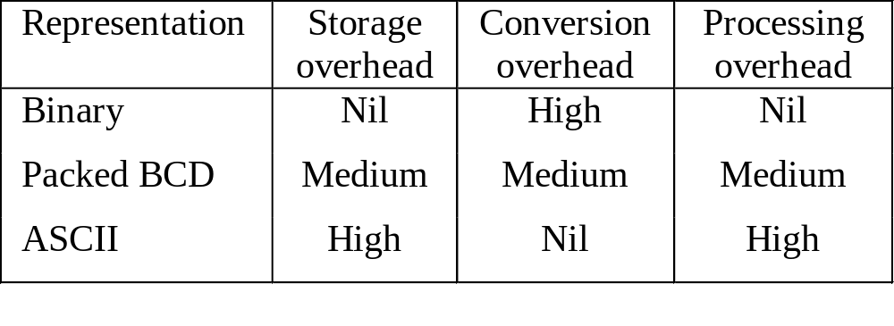
Performance: Decimal vs. Binary Arithmetic
Tradeoffs associated with the three representations
2005
To be used with S. Dandamudi, “Introduction to Assembly Language Programming,” Second Edition, Springer, 2005.
S. Dandamudi
Chapter 11: Page <number>

