Slide 1
LDIC Course Contents
Unit 1 - Operational Amplifier
Unit 2 - Applications of OP-Amp
Unit 3 - Oscillators
Unit 4 - D-A and A-D Converters
Unit 5 - Logic Families
Unit 6 - Memories

Slide 2
Text Books:
1. Linear Integrated Circuits – D. Roy Choudhury
2. Op-Amps & Linear ICs – Ramakanth A. Gayakwad.
3. Digital Fundamentals – Floyd and Jain

Slide 3
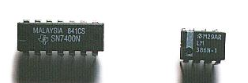
Unit 1- Operational amplifies
What is an Integrated Circuit?
Where do you use an Integrated Circuit?
Why do you prefer an Integrated Circuit to the circuits made by interconnecting discrete components?

Slide 4
Def: The “Integrated Circuit “ or IC is a miniature, low cost electronic circuit consisting of active and passive components that are irreparably joined together on a single crystal chip of silicon.
In 1958 Jack Kilby of Texas Instruments invented first IC

Slide 5
Applications of an Integrated Circuit
Communication
Control
Instrumentation
Computer
Electronics

Slide 6
Advantages:
Small size
Low cost
Less weight
Low supply voltages
Low power consumption
Highly reliable
Matched devices
Fast speed

Slide 7
Classification
Digital ICs
Linear ICs
Integrated circuits
Monolithic circuits
Thick &Thin film
Hybrid circuits
Bipolar
Uni polar
Pn junction
isolation
Dielectric
isolation
JFET
MOSFET
Classification of ICs

Slide 8
Chip size and Complexity
Invention of Transistor (Ge) - 1947
Development of Silicon - 1955-1959
Silicon Planar Technology - 1959
First ICs, SSI (3- 30gates/chip) - 1960
MSI ( 30-300 gates/chip) - 1965-1970
LSI ( 300-3000 gates/chip) -1970-1975
VLSI (More than 3k gates/chip) - 1975
ULSI (more than one million active devices are integrated on single chip)

Slide 9
SSI | MSI | LSI | VLSI | ULSI
< 100 active devices | 100-1000 active devices | 1000-100000 active devices | >100000 active devices | Over 1 million active devices
Integrated resistors, diodes & BJT’s | BJT’s and Enhanced MOSFETS | MOSFETS | 8bit, 16bit Microprocessors | Pentium Microprocessors

Slide 10
IC Package types
Metal can Package
Dual-in-line
Flat Pack

Slide 11
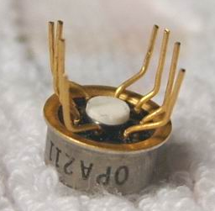
Metal can Packages
The metal sealing plane is at the bottom over which the chip is bounded
It is also called transistor pack

Slide 12
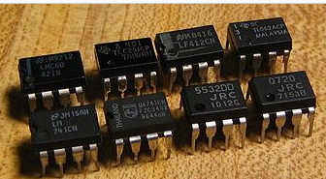
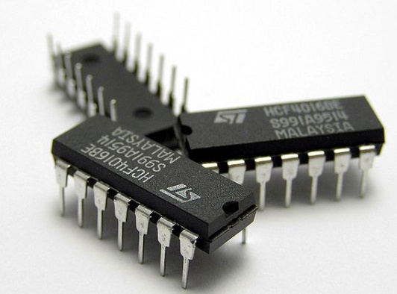
Doul-in-line Package
The chip is mounted inside a plastic or ceramic case
The 8 pin Dip is called MiniDIP and also available with 12, 14, 16, 20pins

Slide 13
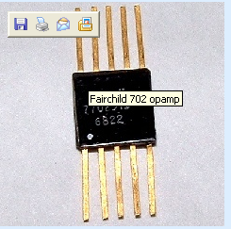
Flat pack
The chip is enclosed in a rectangular ceramic case

Slide 14
Selection of IC Package
Type | Criteria
Metal can package | Heat dissipation is important For high power applications like power amplifiers, voltage regulators etc.
DIP | For experimental or bread boarding purposes as easy to mount If bending or soldering of the leads is not required Suitable for printed circuit boards as lead spacing is more
Flat pack | More reliability is required Light in weight Suited for airborne applications

Slide 15
Packages
The metal can (TO)
Package
The Flat Package
The Dual-in-Line (DIP) Package

Slide 16
Factors affecting selection of IC package
Relative cost
Reliability
Weight of the package
Ease of fabrication
Power to be dissipated
Need of external heat sink

Slide 17
Temperature Ranges
Military temperature range : -55º C to +125º C (-55º C to +85º C)
Industrial temperature range : -20º C to +85º C (-40º C to +85º C )
Commercial temperature range: 0º C to +70º C (0º C to +75º C )

Slide 18
Manufacturer’s Designation for Linear ICs
Fairchild - µA, µAF
National Semiconductor - LM,LH,LF,TBA
Motorola - MC,MFC
RCA - CA,CD
Texas Instruments - SN
Signetics - N/S,NE/SE
Burr- Brown - BB

Slide 19
Operational Amplifier
An “Operational amplifier” is a direct coupled high-gain amplifier usually consisting of one or more differential amplifiers and usually followed by a level translator and output stage.
The operational amplifier is a versatile device that can be used to amplify dc as well as ac input signals and was originally designed for computing such mathematical functions as addition, subtraction, multiplication and integration.

Slide 20
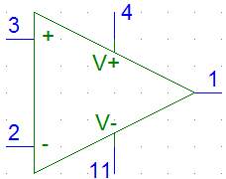
Op Amp
Positive power supply (Positive rail)
Non-inverting
Input terminal
Output terminal
Inverting input
terminal
Negative power supply
(Negative rail)

Slide 21
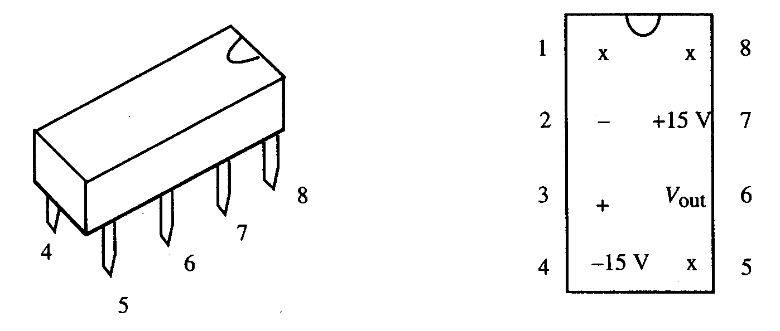
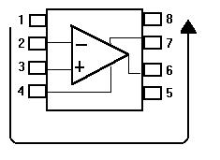
The Op-Amp Chip
741 Op Amp or LM351 Op Amp

Slide 22
Op-amp have 5 basic terminals(ie 2 i/p’s 1 o/p and 2 power supply terminals
The output goes positive when the non-inverting input (+) goes more positive than the inverting (-) input, and vice versa.

Slide 23
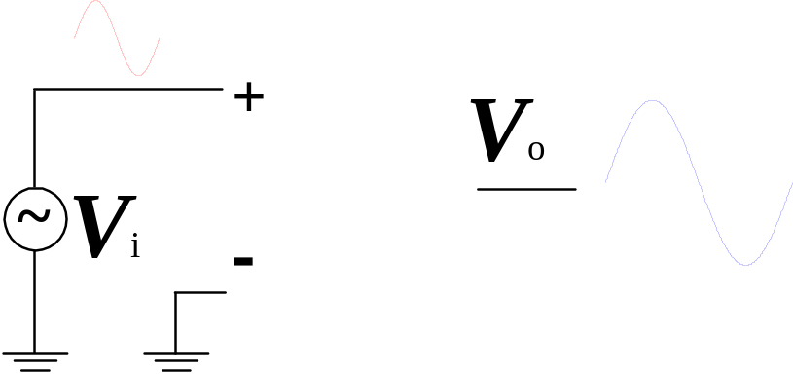
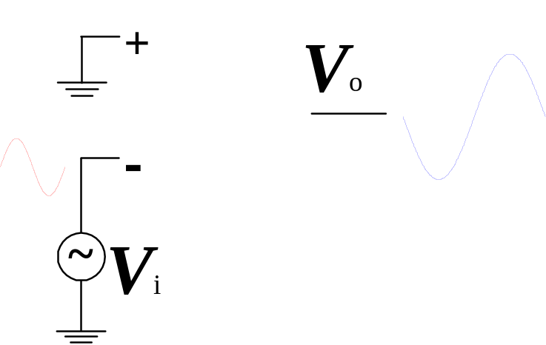
Single-Ended Input
+ terminal : Source
– terminal : Ground
0º phase change
+ terminal : Ground
– terminal : Source
180º phase change
Ref:080114HKN
Operational Amplifier

Slide 24
Basic Information of Op-Amp
Op-amps have five basic terminals, that is, two input terminals, one output terminal and two power supply terminals.

Slide 25
Basic Information of an Op-amp contd…
Power supply connection:
The power supply voltage may range from about + 5V to + 22V.
The common terminal of the V⁺ and V⁻ sources is connected to a reference point or ground.

Slide 26
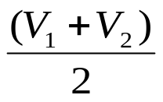
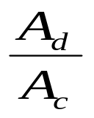
Differential Amplifier
V₀ =A_{d} (V₁ – V₂ )
A_{d} =20 log₁₀ (A_{d} ) in dB
V_{c} =
CMRR= ρ = | |

Slide 27
Characteristics and performance parameters of Op-amp
Input offset Voltage
Input offset current
Input bias current
Differential input resistance
Input capacitance
Open loop voltage gain
CMRR
Output voltage swing

Slide 28
Characteristics and performance parameters of Op-amp
Output resistance
Offset adjustment range
Input Voltage range
Power supply rejection ratio
Power consumption
Slew rate
Gain – Bandwidth product
Equivalent input noise voltage and current

Slide 29
Characteristics and performance parameters of Op-amp
Average temperature coefficient of offset parameters
Output offset voltage
Supply current

Slide 30
1. Input Offset Voltage
The differential voltage that must be applied between the two input terminals of an op-amp, to make the output voltage zero.
It is denoted as V_{ios}
For op-amp 741C the input offset voltage is 6mV

Slide 31
2. Input offset current
The algebraic difference between the currents flowing into the two input terminals of the op-amp
It is denoted as I_{ios} = | I_{b1} – I_{b2}|
For op-amp 741C the input offset current is 200nA

Slide 32
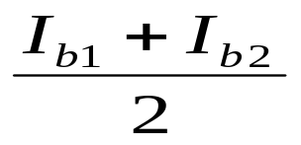
3. Input bias current
The average value of the two currents flowing into the op-amp input terminals
It is expressed mathematically as
For 741C the maximum value of I_{b} is 500nA

Slide 33
4. Differential Input Resistance
It is the equivalent resistance measured at either the inverting or non-inverting input terminal with the other input terminal grounded
It is denoted as R_{i}
For 741C it is of the order of 2MΩ

Slide 34
5. Input capacitance
It is the equivalent capacitance measured at either the inverting or non- inverting input terminal with the other input terminal grounded.
It is denoted as C_{i}
For 741C it is of the 1-4 pF

Slide 35
6. Open loop Voltage gain
It is the ratio of output voltage to the differential input voltage, when op-amp is in open loop configuration, without any feedback. It is also called as large signal voltage gain
It is denoted as A_{OL}
A_{OL}=V_{o} / V_{d}
For 741C it is typically 200,000

Slide 36
7. CMRR
It is the ratio of differential voltage gain A_{d} to common mode voltage gain A_{c}
CMRR = A_{d} / A_{c}
A_{d} is open loop voltage gain A_{OL} and A_{c} = V_{OC} / V_{c}
For op-amp 741C CMRR is 90 dB

Slide 37
8. Output Voltage swing
The op-amp output voltage gets saturated at +V_{cc} and –V_{EE} and it cannot produce output voltage more than +V_{cc} and –V_{EE.} Practically voltages +V_{sat} and –V_{sat} are slightly less than +V_{cc} and –V_{EE} .
For op-amp 741C the saturation voltages are + 13V for supply voltages + 15V

Slide 38
9. Output Resistance
It is the equivalent resistance measured between the output terminal of the op-amp and ground
It is denoted as R_{o}
For op-amp 741 it is 75Ω

Slide 39
10. Offset voltage adjustment range
The range for which input offset voltage can be adjusted using the potentiometer so as to reduce output to zero
For op-amp 741C it is + 15mV

Slide 40
11. Input Voltage range
It is the range of common mode voltages which can be applied for which op-amp functions properly and given offset specifications apply for the op-amp
For + 15V supply voltages, the input voltage range is + 13V

Slide 41
12. Power supply rejection ratio
PSRR is defined as the ratio of the change in input offset voltage due to the change in supply voltage producing it, keeping the other power supply voltage constant. It is also called as power supply sensitivity (PSV)
PSRR= (Δv_{ios} / ΔV_{cc})|constant V_{EE}
PSRR= (Δv_{ios} / ΔV_{EE})|constant V_{cc}
The typical value of PSRR for op-amp 741C is 30µV/V

Slide 42
13. Power Consumption
It is the amount of quiescent power to be consumed by op-amp with zero input voltage, for its proper functioning
It is denoted as P_{c}
For 741C it is 85mW

Slide 43
14. Slew rate
It is defined as the maximum rate of change of output voltage with time. The slew rate is specified in V/µsec
Slew rate = S = dV_{o} / dt |_{max}
It is specified by the op-amp in unity gain condition.
The slew rate is caused due to limited charging rate of the compensation capacitor and current limiting and saturation of the internal stages of op-amp, when a high frequency large amplitude signal is applied.

Slide 44
Slew rate
It is given by dV_{c} /dt = I/C
For large charging rate, the capacitor should be small or the current should be large.
S = I_{max} / C
For 741 IC the charging current is 15 µA and the internal capacitor is 30 pF. S= 0.5V/ µsec

Slide 45
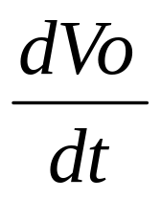
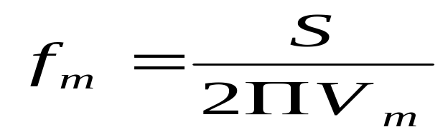
Slew rate equation
V_{s} = V_{m} sinωt
V_{o} = V_{m} sinωt
= V_{m} ω cosωt
S =slew rate =
max
S = V_{m} ω = 2 π f V_{m}
For distortion free output, the maximum allowable input frequency f_{m} can be obtained as
S = 2 π f V_{m} V / sec
This is also called full power bandwidth of the op-amp

Slide 46
15. Gain – Bandwidth product
It is the bandwidth of op-amp when voltage gain is unity (1). It is denoted as GB.
The GB is also called unity gain bandwidth (UGB) or closed loop bandwidth
It is about 1MHz for op-amp 741C

Slide 47
16. Equivalent Input Noise Voltage and Current
The noise is expressed as a power density
Thus equivalent noise voltage is expressed as V² /Hz while the equivalent noise current is expressed as A² /Hz

Slide 48
17. Average temperature coefficient of offset parameters
The average rate of change of input offset voltage per unit change in temperature is called average temperature coefficient of input offset voltage or input offset voltage drift
It is measured in µV/ºC. For 741 C it is 0.5 µV/ºC
The average rate of change of input offset current per unit change in temperature is called average temperature coefficient of input offset current or input offset current drift
It is measured in nA/ºC or pA/ºC . For 741 C it is 12 pA/ºC

Slide 49
18. Output offset voltage ( V_{oos} )
The output offset voltage is the dc voltage present at the output terminals when both the input terminals are grounded.
It is denoted as V_{oos}

Slide 50
19. Supply current
It is drawn by the op-amp from the power supply
For op-amp 741C it is 2.8mA

Slide 51
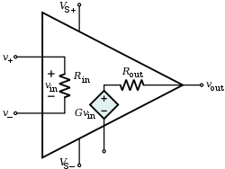
Op amp equivalent circuit

Slide 52
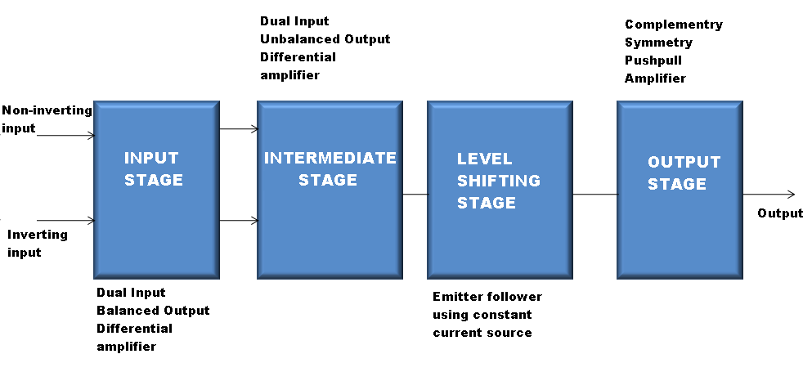
Block diagram of op amp

Slide 53
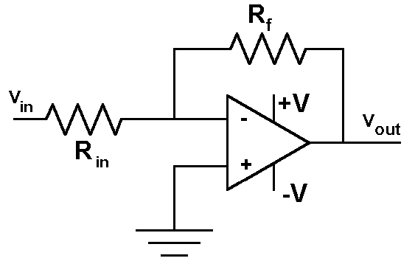
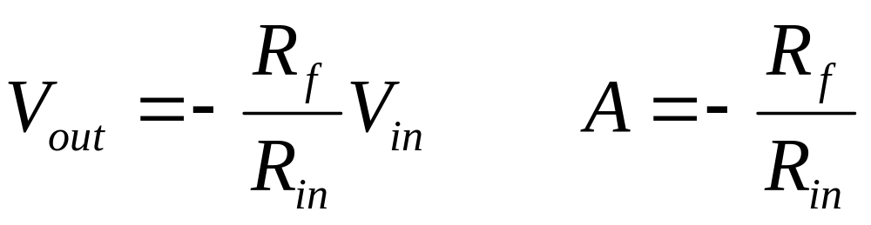
The Inverting Amplifier

Slide 54
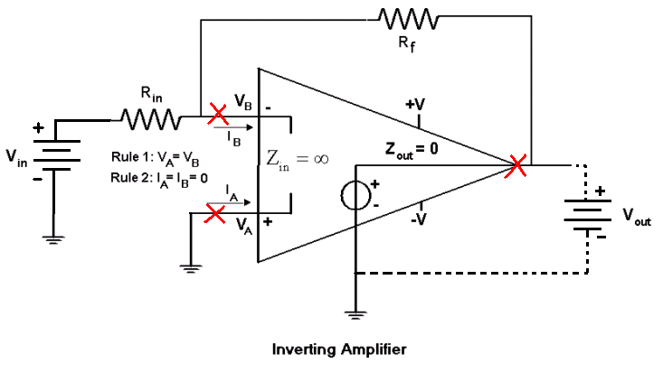
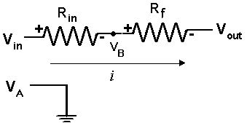
Analyzing the Inverting Amplifier
1)
inverting input (-):
non-inverting input (+):

Slide 55
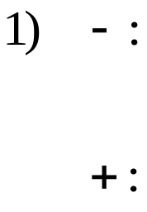
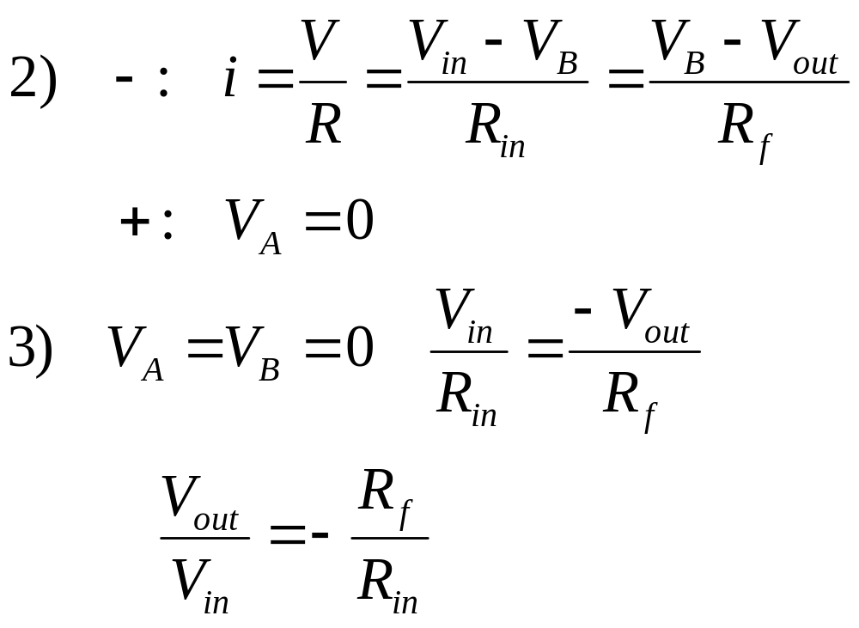
Inverting Amplifier Analysis

Slide 56
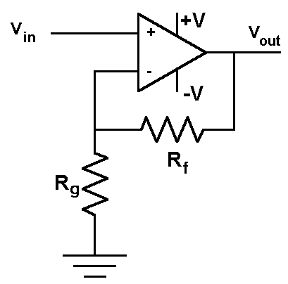
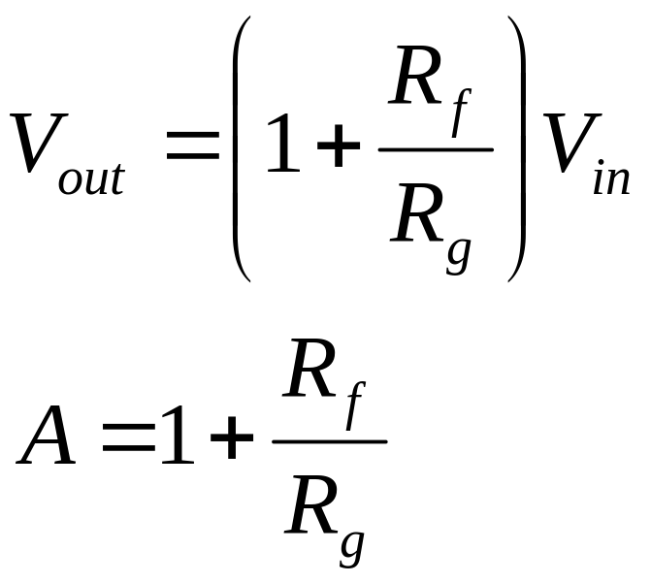
The Non-Inverting Amplifier

Slide 57
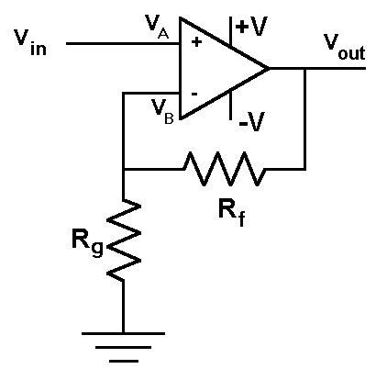
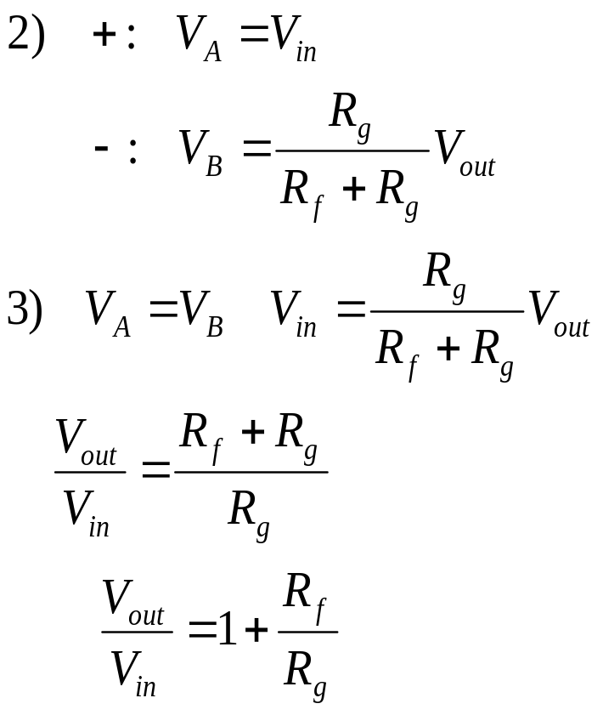
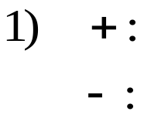
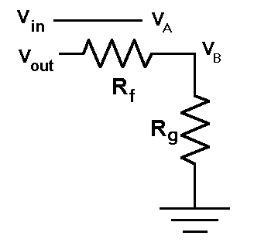
Analysis of Non-Inverting Amplifier
Note that step 2 uses a voltage divider to find the voltage at V_{B} relative to the output voltage.

Slide 58
Comparison of the ideal inverting and non-inverting op-amp
Ideal Inverting amplifier | Ideal non-inverting amplifier
1. Voltage gain=-R_{f}/R₁ | 1. Voltage gain=1+R_{f}/R₁
2. The output is inverted with respect to input | 2. No phase shift between input and output
3. The voltage gain can be adjusted as greater than, equal to or less than one | 3. The voltage gain is always greater than one
4. The input impedance is R₁ | 4. The input impedance is very large

Slide 59
The Ideal Operational Amplifier
Open loop voltage gain A_{OL} = ∞
Input Impedance R_{i} = ∞
Output Impedance R_{o} = 0
Bandwidth BW = ∞
Zero offset (V_{o} = 0 when V₁ = V₂ = 0) V_{ios} = 0
CMRR ρ = ∞
Slew rate S = ∞
No effect of temperature
Power supply rejection ratio PSRR = 0

Slide 60
Ideal Op-amp
An ideal op-amp draws no current at both the input terminals I.e. I₁ = I₂ = 0. Thus its input impedance is infinite. Any source can drive it and there is no loading on the driver stage
The gain of an ideal op-amp is infinite, hence the differential input V_{d} = V₁ – V₂ is essentially zero for the finite output voltage V_{o}
The output voltage V_{o} is independent of the current drawn from the output terminals. Thus its output impedance is zero and hence output can drive an infinite number of other circuits

Slide 61
Op-amp Characteristics
DC Characteristics
        Input bias current
        Input offset current
        Input offset voltage
        Thermal drift
AC Characteristics
        Slew rate
        Frequency response

Slide 62
Ideal Voltage transfer curve
+V_{sat}
A_{OL} = ∞
-V_{d}
+V_{d}
0
+V_{sat} ≈ +V_{cc}
-V_{sat}

Slide 63
Practical voltage transfer curve
If V_{d} is greater than corresponding to b, the output attains +V_{sat}
If V_{d} is less than corresponding to a, the output attains –V_{sat}
Thus range a-b is input range for which output varies linearily with the input. But A_{OL} is very high, practically this range is very small

Slide 64
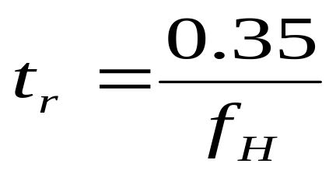
Transient Response Rise time
When the output of the op-amp is suddenly changing like pulse type, then the rise time of the response depends on the cut-off frequency f_{H} of the op-amp. Such a rise time is called cut-off frequency limited rise time or transient response rise time ( t_{r} )

Slide 65
Op-amp Characteristics
DC Characteristics
        Input bias current
        Input offset current
        Input offset voltage
        Thermal drift
AC Characteristics
        Slew rate
        Frequency response

Slide 66
DC Characteristics
Thermal Drift
The op-amp parameters input offset voltage V_{ios} and input offset current I_{ios} are not constants but vary with the factors
Temperature
Supply Voltage changes
Time

Slide 67
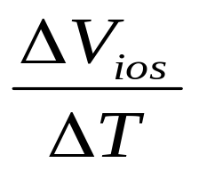
Thermal Voltage Drift
It is defined as the average rate of change of input offset voltage per unit change in temperature. It is also called as input offset voltage drift
Input offset voltage drift =
∆V_{ios} = change in input offset voltage
∆T = Change in temperature

Slide 68
It is expressed in μV/⁰ c. The drift is not constant and it is not uniform over specified operating temperature range. The value of input offset voltage may increase or decrease with the increasing temperature
Slope can be of either polarities
Input Offset Voltage Drift
2
V_{ios} in mv
1
0
-1
-2
T_{A} , ambient temp in ºc
-55
-25
0
25
50
75

Slide 69
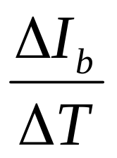
Input bias current drift
It is defined as the average rate of change of input bias current per unit change in temperature
Thermal drift in input bias current =
It is measured in nA/ºC or pA/ºc. These parameters vary randomly with temperature. i.e. they may be positive in one temperature range and negative in another

Slide 70
Input bias current drift
100
80
I_{b} in nA
60
40
T_{A} ambient temp. in ºC
20
-55
-25
0
25
50
75

Slide 71
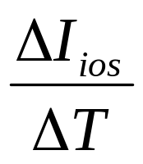
Input Offset current drift
It is defined as the average rate of change of input offset current per unit change in temperature
Thermal drift in input offset current =
It is measured in nA/ºC or pA/ºc. These parameters vary randomly with temperature. i.e. they may be positive in one temperature range and negative in another

Slide 72
Input Offset current Drift
2
Slope can be of either polarities
I_{ios} in nA
1
0
-1
-2
T_{A} , ambient temp in ºc
-55
-25
0
25
50
75

Slide 73
AC Characteristics
Frequency Response
Ideally, an op-amp should have an infinite bandwidth but practically op-amp gain decreases at higher frequencies. Such a gain reduction with respect to frequency is called as roll off.
The plot showing the variations in magnitude and phase angle of the gain due to the change in frequency is called frequency response of the op-amp

Slide 74
When the gain in decibels, phase angle in degrees are plotted against logarithmic scale of frequency, the plot is called Bode Plot
The manner in which the gain of the op-amp changes with variation in frequency is known as the magnitude plot.
The manner in which the phase shift changes with variation in frequency is known as the phase-angle plot.

Slide 75
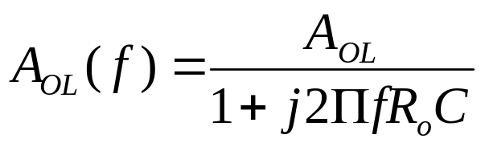
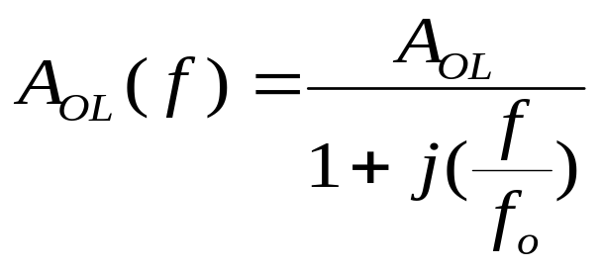
Obtaining the frequency response
To obtain the frequency response , consider the high frequency model of the op-amp with capacitor C at the output, taking into account the capacitive effect present
Where
A_{OL}(f) = open loop voltage gain as a function of frequency
A_{OL} = Gain of the op-amp at 0Hz
F = operating frequency
F_{o =} Break frequency or cutoff frequency of op-amp

Slide 76
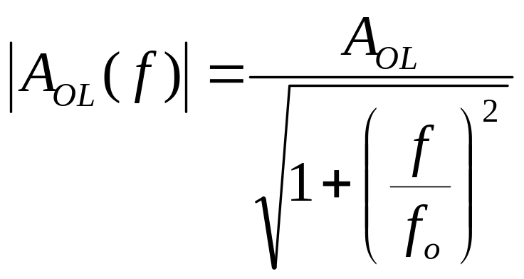
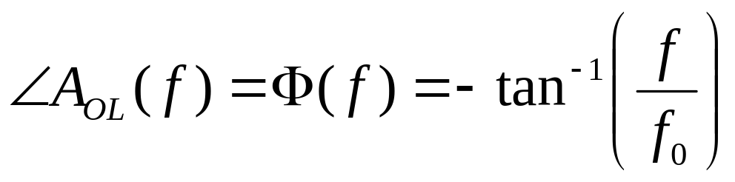
For a given op-amp and selected value of C, the frequency f_{o} is constant. The above equation can be written in the polar form as

Slide 77
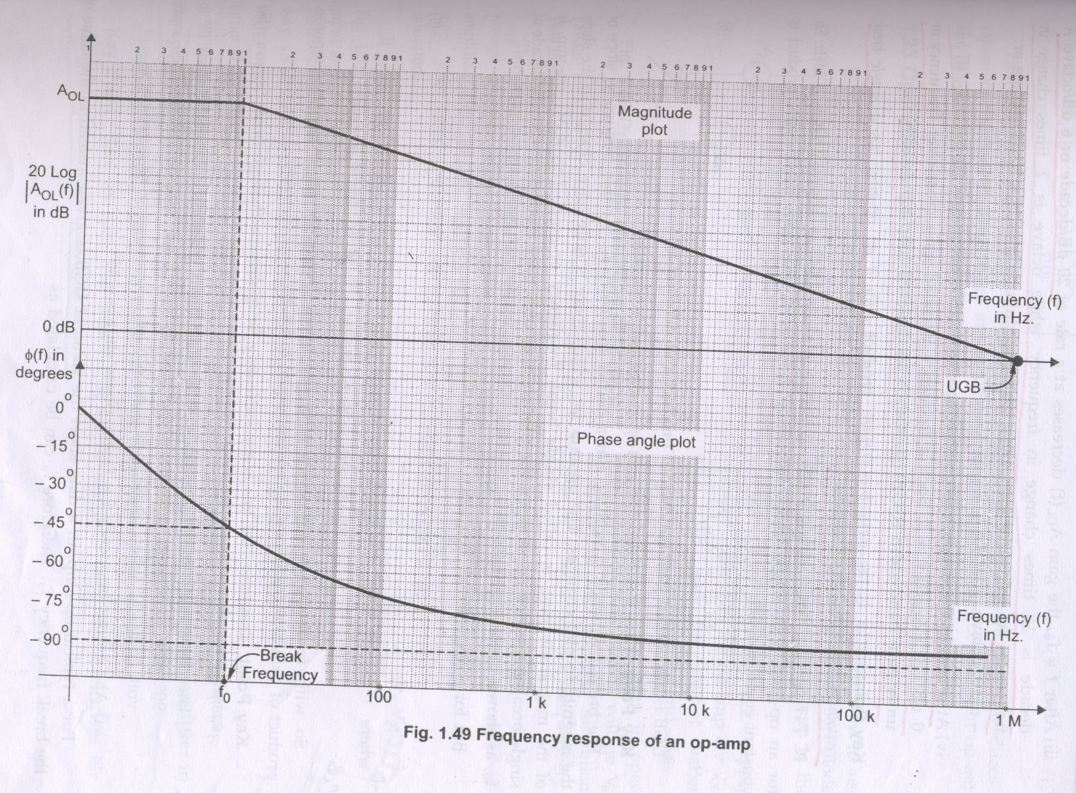
Frequency Response of an op-amp

Slide 78
The following observations can be made from the frequency response of an op-amp
The open loop gain A_{OL} is almost constant from 0 Hz to the break frequency f_{o .}
_{At} f=f_{o} , the gain is 3dB down from its value at 0Hz . Hence the frequency f_{o} is also called as -3dB frequency. It is also know as corner frequency
After f=f_{o} , the gain A_{OL} (f) decreases at a rate of 20 dB/decade or 6dB/octave. As the gain decreases, slope of the magnitude plot is -20dB/decade or -6dB/octave, after f=f_{o} .
At a certain frequency, the gain reduces to 0dB. This means 20log|A_{OL} | is 0dB i.e. |A_{OL} | =1. Such a frequency is called gain cross-over frequency or unity gain bandwidth (UGB). It is also called closed loop bandwidth.
UGB is the gain bandwidth product only if an op-amp has a single breakover frequency, before A_{OL} (f) dB is zero.

Slide 79
For an op-amp with single break frequency f_{o} , after f_{o} the gain bandwidth product is constant equal to UGB
UGB=A_{OL} f_{o}
UGB is also called gain bandwidth product and denoted as f_{t}
Thus f_{t} is the product of gain of op-amp and bandwidth.
The break frequency is nothing but a corner frequency f_{o} . At this frequency, slope of the magnitude plot changes. The op-amp for which there is only once change in the slope of the magnitude plot, is called single break frequency op-amp.

Slide 80
For a single break frequency we can also write
UGB= A_{f} f_{f}
A_{f} = closed loop voltage gain
F_{f} = bandwidth with feedback
v) The phase angle of an op-amp with single break frequency varies between 0⁰ to 90⁰ . The maximum possible phase shift is -90⁰ , i.e. output voltage lags input voltage by 90⁰ when phase shift is maximum
vi) At a corner frequency f=f_{o} , the phase shift is -45^{0.}
^{F}_{o} = UGB / A_{OL}

Slide 81
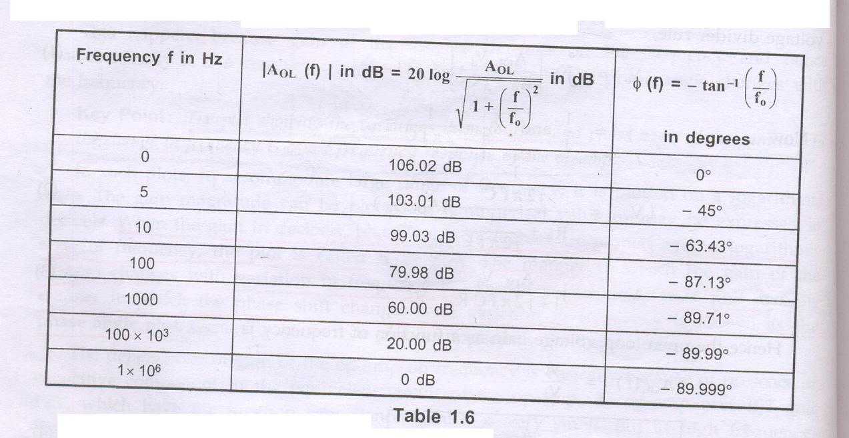

Slide 82
The modes of using an op-amp
Open Loop : (The output assumes one of the two possible output states, that is +V_{sat} or – V_{sat} and the amplifier acts as a switch only).
Closed Loop: ( The utility of an op-amp can be greatly increased by providing negative feed back. The output in this case is not driven into saturation and the circuit behaves in a linear manner).

Slide 83
Open loop configuration of op-amp
The voltage transfer curve indicates the inability of op-amp to work as a linear small signal amplifier in the open loop mode
Such an open loop behaviour of the op-amp finds some rare applications like voltage comparator, zero crossing detector etc.

Slide 84
Open loop op-amp configurations
The configuration in which output depends on input, but output has no effect on the input is called open loop configuration.
No feed back from output to input is used in such configuration.
The opamp works as high gain amplifier
The op-amp can be used in three modes in open loop configuration they are
Differential amplifier
Inverting amplifier
Non inverting amplifier

Slide 85
Differential Amplifier
The amplifier which amplifies the difference between the two input voltages is called differential amplifier.
Key point: For very small V_{d} , output gets driven into saturation due to high A_{OL ,} hence this application is applicable for very small range of differential input voltage.

Slide 86
Inverting Amplifier
The amplifier in which the output is inverted i.e. having 180º phase shift with respect to the input is called an inverting amplifier
V_{o} = -A_{OL} V_{in2}
Keypoint: The negative sign indicates that there is phase shift of 180º between input and output i.e. output is inverted with respect to input.

Slide 87
Non-inverting Amplifier
The amplifier in which the output is amplified without any phase shift in between input and output is called non inverting amplifier
V_{o} = A_{OL} V_{in1}
Keypoint: The positive output shows that input and output are in phase and input is amplified A_{OL} times to get the output.

Slide 88
Why op-amp is generally not used in open loop mode?
As open loop gain of op-amp is very large, very small input voltage drives the op-amp voltage to the saturation level. Thus in open loop configuration, the output is at its positive saturation voltage (+V_{sat} ) or negative saturation voltage (-V_{sat} ) depending on which input V₁ or V₂ is more than the other. For a.c. input voltages, output may switch between positive and negative saturation voltages

Slide 89
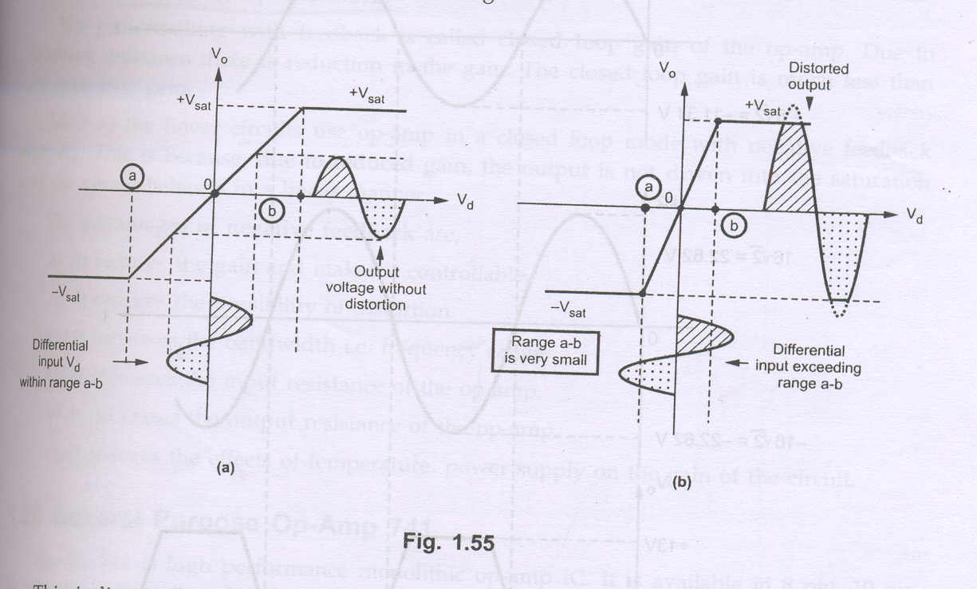
This indicates the inability of op-amp to work as a linear small signal amplifier in the open loop mode. Hence the op-amp in open loop configuration is not used for the linear applications

Slide 90
General purpose op-amp 741
The IC 741 is high performance monolithic op-amp IC. It is available in 8pin, 10pin or 14pin configuration. It can operate over a temperature of -55⁰ C to 125⁰ C.
Features:
No frequency compensation required
Short circuit protection provided
Offset Voltage null capability
Large common mode and differential voltage range
No latch up

Slide 91
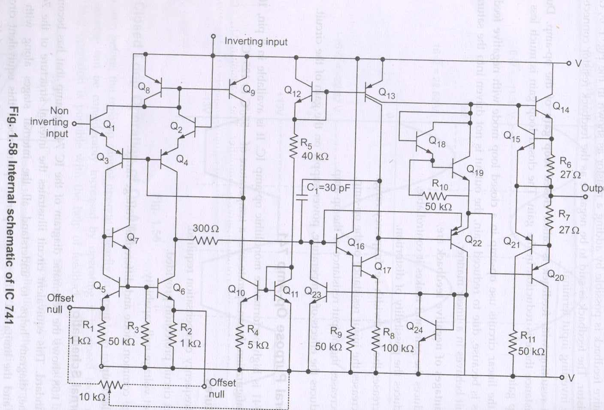
Internal schematic of 741 op-amp

Slide 92
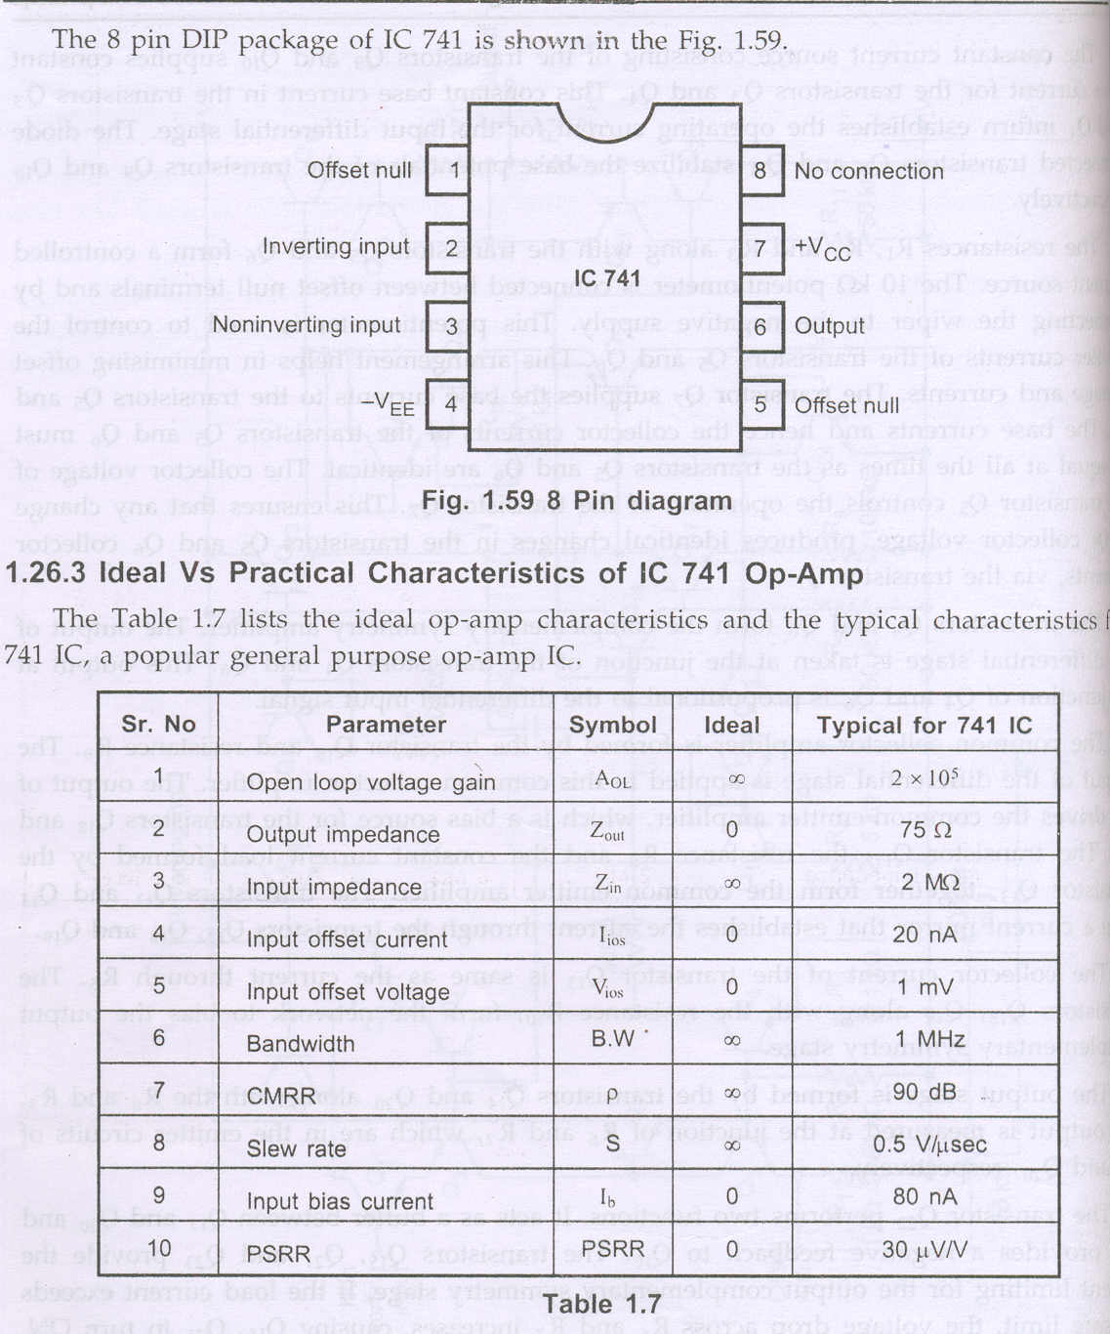
The 8pin DIP package of IC 741

Slide 93
Realistic simplifying assumptions
Zero input current: The current drawn by either of the input terminals (inverting and non-inverting) is zero
Virtual ground :This means the differential input voltage V_{d} between the non-inverting and inverting terminals is essentially zero. (The voltage at the non inverting input terminal of an op-amp can be realistically assumed to be equal to the voltage at the inverting input terminal

Slide 94
Closed loop operation of op-amp
The utility of the op-amp can be increased considerably by operating in closed loop mode. The closed loop operation is possible with the help of feedback. The feedback allows to feed some part of the output back to the input terminals. In the linear applications, the op-amp is always used with negative feedback. The negative feedback helps in controlling gain, which otherwise drives the op-amp out of its linear range, even for a small noise voltage at the input terminals

Slide 95
Ideal Inverting Amplifier
The output is inverted with respect to input, which is indicated by minus sign.
The voltage gain is independent of open loop gain of the op-amp, which is assumed to be large.
The voltage gain depends on the ratio of the two resistances. Hence selecting R_{f} and R₁ , the required value of gain can be easily obtained.
If R_{f} > R_{1,}, the gain is greater than 1
If R_{f} < R_{1,}, the gain is less than 1
If R_{f =} R₁, the gain is unity
Thus the output voltage can be greater than, less than or equal to the input voltage in magnitude

Slide 96
If the ratio of R_{f} and R₁ is K which is other than one, the circuit is called scale changer while for R_{f}/R₁ =1 it is called phase inverter.
The closed loop gain is denoted as A_{VF} or A_{CL} i.e. gain with feedback

Slide 97
Ideal Non-inverting Amplifier
The voltage gain is always greater than one
The voltage gain is positive indicating that for a.c. input, the output and input are in phase while for d.c. input, the output polarity is same as that of input
The voltage gain is independent of open loop gain of op-amp, but depends only on the two resistance values
The desired voltage gain can be obtained by selecting proper values of R_{f} and R₁

Slide 98
Comparison of the ideal inverting and non-inverting op-amp
Ideal Inverting amplifier | Ideal non-inverting amplifier
1. Voltage gain=-R_{f}/R₁ | 1. Voltage gain=1+R_{f}/R₁
2. The output is inverted with respect to input | 2. No phase shift between input and output
3. The voltage gain can be adjusted as greater than, equal to or less than one | 3. The voltage gain is always greater than one
4. The input impedance is R₁ | 4. The input impedance is very large

Slide 99
Parameter consideration for various applications
For A.C. applications | For D.C. applications
Input resistance | Input resistance
Output resistance | Output resistance
Open loop voltage gain | Open loop voltage gain
Slew rate | Input offset voltage
Output voltage swing | Input offset current
Gain- bandwidth product | Input offset voltage and current drifts
Input noise voltage and current
Input offset voltage and current drifts

Slide 100
Factors affecting parameters of Op-amp
Supply Voltage
Frequency
Temperature
Voltage gain
Input resistance
Output resistance
CMRR
Input noise voltage
Input noise current
Input offset current
Input offset voltage
Input bias current
Power consumption
Gain-Bandwidth product
Slew rate
Input resistance
Voltage gain
Output Voltage swing
Input voltage range
Power consumption
Input offset current

Slide 101
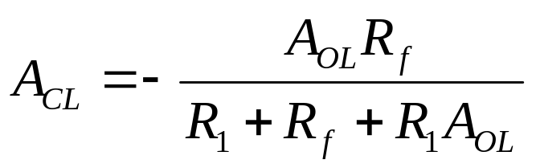
Practical Inverting Amplifier
Closed Loop Voltage gain =

Slide 102

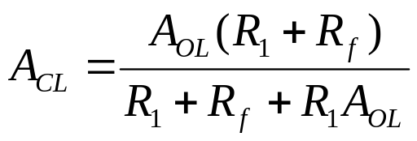
Practical Non-Inverting Amplifier
Closed Loop Voltage gain =

Slide 103
The End

