Slide 1
Practical Phase-Locked Loop Design
2004 ISSCC Tutorial
Dennis Fischette
Email: pll@delroy.com
Website: http://www.delroy.com/pll

Slide 2
Outline
Introduction
Basic Feedback Loop Theory
Circuits
“Spectacular” Failures
Appendices:
  design for test
  writing a PLL Spec
  references
Sorry: no DLL’s in this tutorial

Slide 3
Intended Audience
If you…
Are a novice PLL designer
Specify PLL requirements
Integrate PLL’s on-chip
Test/debug PLL’s
Review PLL designs

Slide 4
Introduction

Slide 5
What is a PLL?
A PLL is a negative feedback system where an oscillator-generated signal is phase and frequency locked to a reference signal.
Analogous to a car’s “cruise control”

Slide 6
How are PLL’s Used?
Frequency Synthesis (e.g. generating a 1 GHz clock from a 100 MHz reference)
Skew Cancellation (e.g. phase-aligning an internal clock to the IO clock) (May use a DLL instead)
Extracting a clock from a random data stream (e.g. serial-link receiver)
Frequency Synthesis is the focus of this tutorial.

Slide 7

Charge-Pump PLL Block Diagram
Ref
Clk
GoFast
Vctl
PFD
CP
VCO
LS
GoSlow
C2
C1
DIV
FbClk
Clk

Slide 8
Charge-Pump PLL Building Blocks
Phase-Frequency Detector (PFD)
Charge-Pump (CP)
Low-Pass Filter (LPF)
Voltage-Controlled Oscillator (VCO)
VCO Level-Shifter (LS)
Feedback Divider (FBDIV)
Power Supply regulator/filter (VREG)?

Slide 9
Components in a Nutshell
PFD: outputs digital pulse whose width is proportional to phase error
CP: converts digital error pulse to analog error current
LPF: integrates (and low-pass filters) error current to generate VCO control voltage
VCO: low-swing oscillator with frequency proportional to control voltage
LS: amplifies VCO levels to full-swing
DIV: divides VCO clock to generate FBCLK clock

Slide 10
PLL Feedback Loop Theory

Slide 11
Is My PLL Stable?
PLL is 2nd-order system similar to mass-spring-dashpot or RLC circuit.
PLL may be stable or unstable depending on phase margin (or damping factor).
Phase margin is determined from linear model of PLL in frequency-domain.
Find phase margin/damping using MATLAB, loop equations, or simulations.
Stability affects phase error, settling, jitter.

Slide 12
What Does PLL Bandwidth Mean?
PLL acts as a low-pass filter with respect to the reference.
Low-frequency reference modulation (e.g.spread-spectrum clocking) is passed to the VCO clock.
High-frequency reference jitter is rejected.
“Bandwidth” is the frequency at which the PLL begins to lose lock with the reference (-3dB).
PLL acts as a high-pass filter wrt VCO noise.
Bandwidth affects phase error, settling, jitter.

Slide 13
Closed-loop PLL Transfer Function
Analyze PLL feedback in frequency-domain
Assumes continuous-time behavior
H(s) = _{fb}/ _{ref} = G(s)/(1+G(s)) →closed-loop gain
G(s) = (K_{vco}/s)I_{cp}F(s)/M → open-loop gain
where
K_{vco} = VCO gain in Hz/V
I_{cp} = charge pump current in Amps
F(s) = loop filter transfer function
M = feedback divisor
C₁ = large loop-filter capacitor

Slide 14
Closed-loop PLL Transfer Function
General Form (ignoring C₂):
H(s) = _{n}² (1+ s/_{z}) / (s²+2s_{n} + _{n}²)
where
_{n} = natural freq = sqrt(K_{vco}I_{cp}/MC₁)
_{z} = stabilizing zero = 1 /RC₁
 = damping = (RC₁/2)*sqrt(K_{vco}I_{cp}/MC₁)
If < 1, complex poles at -n ± jn*sqrt(1- ²)
  Real → exponential delay
  Imag → oscillation

Slide 15
What Determines Stability and Bandwidth?
Damping Factor (measure of stability)
Natural Frequency (measure of bandwidth)
Damping and natural frequency can be set independently by LPF resistor

Slide 16
PLL Loop Equations
Undamped Natural Frequency:
_{n} = sqrt(K_{vco}*I_{cp}/( M*C₁)) in rad/sec
where
K_{vco} = VCO gain in Hz/V
I_{cp} = charge pump current in Amps
M = feedback divisor
C₁ = large LPF capacitor
For stability: _{n}/2 < ~1/20 reference frequency
Typical value: 1 MHz < _{n}/2 < 10MHz.

Slide 17
PLL Loop Equations
Damping Factor: usually 0.45 <  < ~1.5
 = R_{lpf} * C₁ * _{n} /2
Useful Relation:
Phase margin ~ 100 *  (for  < 0.65)
Loop Decay Time Constant = 1/( * _{n})
- used to estimate settling time
- 98% settling in 4 time constants
Decay ~ 1- exp(-t* * _{n})

Slide 18
PLL Loop Eqns: Limits on R_{lpf}
PFD must sample faster than loop can respond to act like continuous-time system
Discrete Time Stability Limit (Gardner,1980):
_{n}² < _{ref}² / (*(R_{lpf}C₁* _{ref} + ))
E.g. _{ref} = 2*125MHz, C₁=75pF,_{n}=2*2MHz
→ R_{max} < 21 kOhm
R_{lpf} < 1/5 R_{max} for good phase margin
For details: see Gardner (1980), Fig. 4

Slide 19
PLL Loop Eqns: Limits on R_{lpf}
Parasitic LPF Pole: R_{lpf}*C₂ ~ T_{ref}/ 
→ if we want V(C₁) ~ V(C₂) by end of T_{ref} (goal)
(Maneatis ISSCC ’03)
Vctl
I = (V_{c2} –V_{c1})/R
I
⧫ = RC₂
C1
C2

Slide 20
Bode Plot Primer
Used to analyze frequency domain behavior
Y-axis: gain in dB. E.g. 20dB=10X gain. 3dB=1.4X
X-axis: frequency. Log scale
Assuming “left-hand-plane” location:
  Pole: -20db/dec magnitude loss and -90° phase shift. Capacitor → pole.
  Zero: +20db/dec magnitude and +90° phase shift. Resistor → zero.

Slide 21
PLL Response vs. Damping

Slide 22
Phase Tracking vs. Damping
Peaking at low and high damping factors → bad
Damping ~ 1 → good compromise
Phase Tracking → think “accumulated” jitter or phase error
VCO frequency peaking (aka period jitter) similar to phase peaking

Slide 23
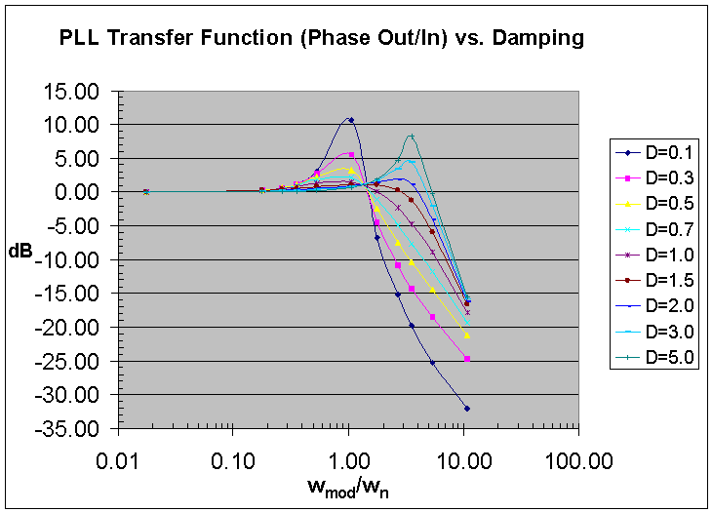

Slide 24
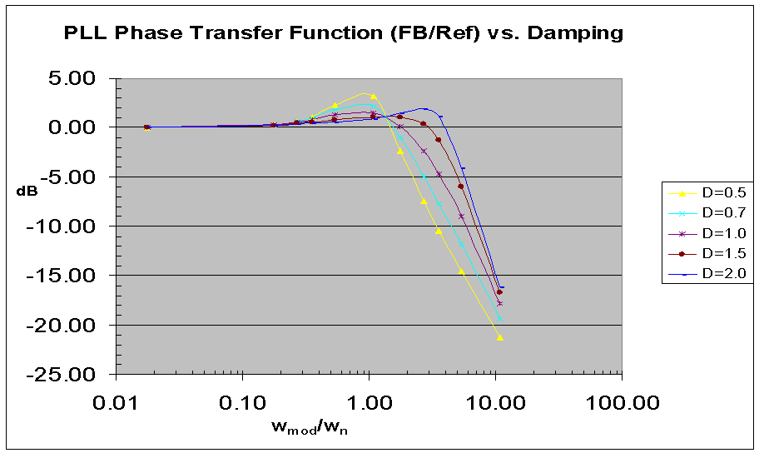

Slide 25
Transient: Phase Error vs.Damping
Less ringing and overshoot as  → 1
Severe overdamping → ringing and overshoot
Ringing at high damping due to low oversampling (large R) – Gardner limit.

Slide 26
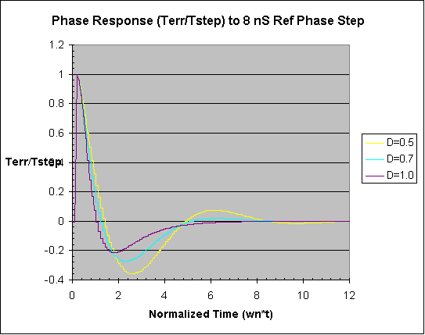

Slide 27
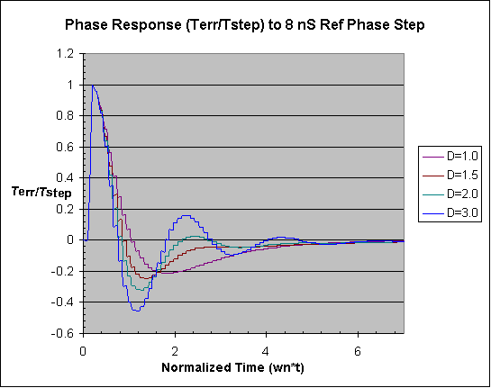

Slide 28
VCO Jitter (df/f) vs. Damping
Low damping → less period jitter, slower response, more phase error
High damping → low oversampling (large R) causes oscillation

Slide 29
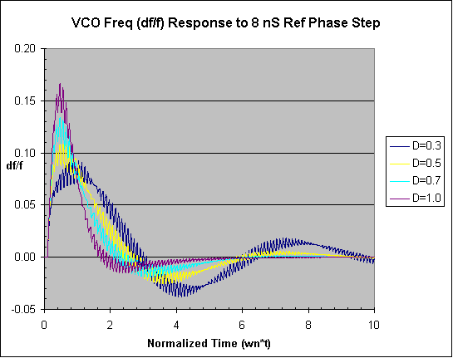

Slide 30
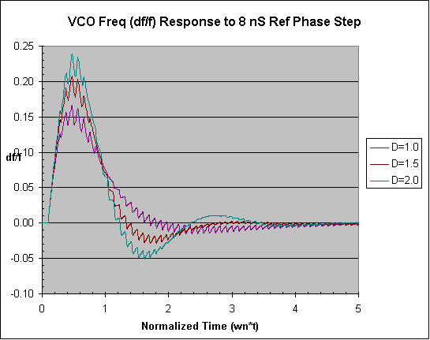

Slide 31
PLL Response vs. Bandwidth

Slide 32
VCO Freq. Overshoot vs. Bandwidth
Lower BW → lower overshoot
Higher OverSamplingRatio (_{ref}/_{n}) → lower bandwidth(BW)
Note:  ~ BW in these simulations

Slide 33
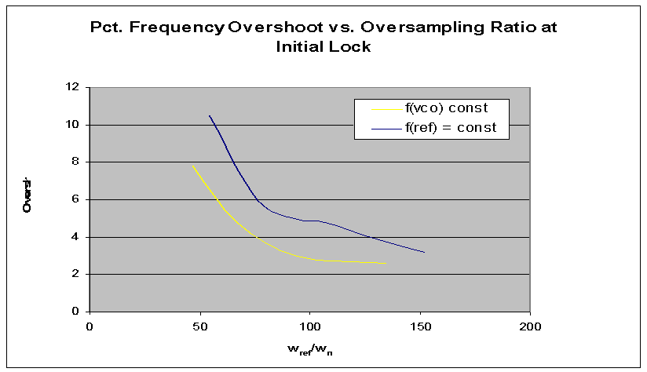

Slide 34
Phase Error (due to VCO Noise) vs. BW
For random VCO noise (I.e. thermal): lower BW → higher accumulated phase error
Why? More jittery VCO cycles before PLL starts to correct:
T_{err} ~ J_{rms} * sqrt(2f_{vco}/_{n})
where
J_{rms} = std dev of VCO period jitter
- valid for damping ~ 1
- assume: J_{rms} ~ 1/f_{vco} → higher f, lower J_{rms}

Slide 35
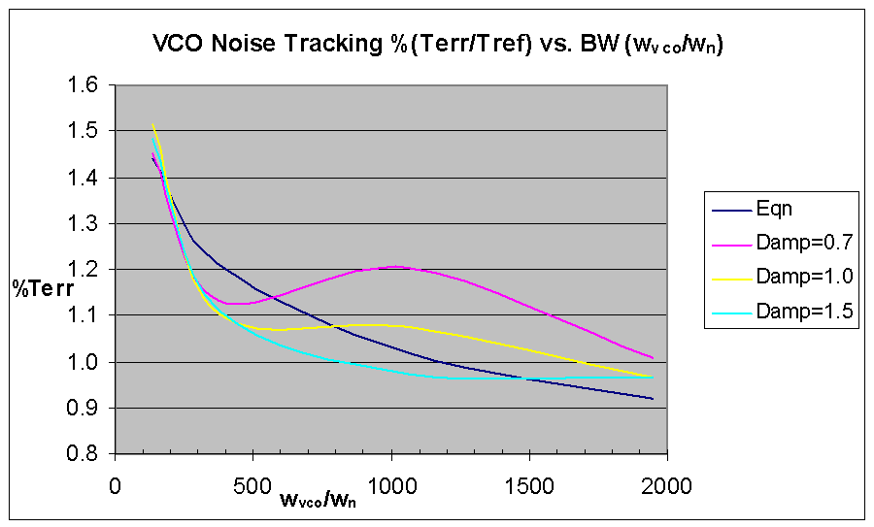

Slide 36
PLL Circuits
Phase-Frequency Detector
Charge-Pump
Low-Pass Filter
Voltage-Controlled Oscillator
Level-Shifter
Voltage Regulator

Slide 37
Phase-Frequency Detector(PFD)

Slide 38
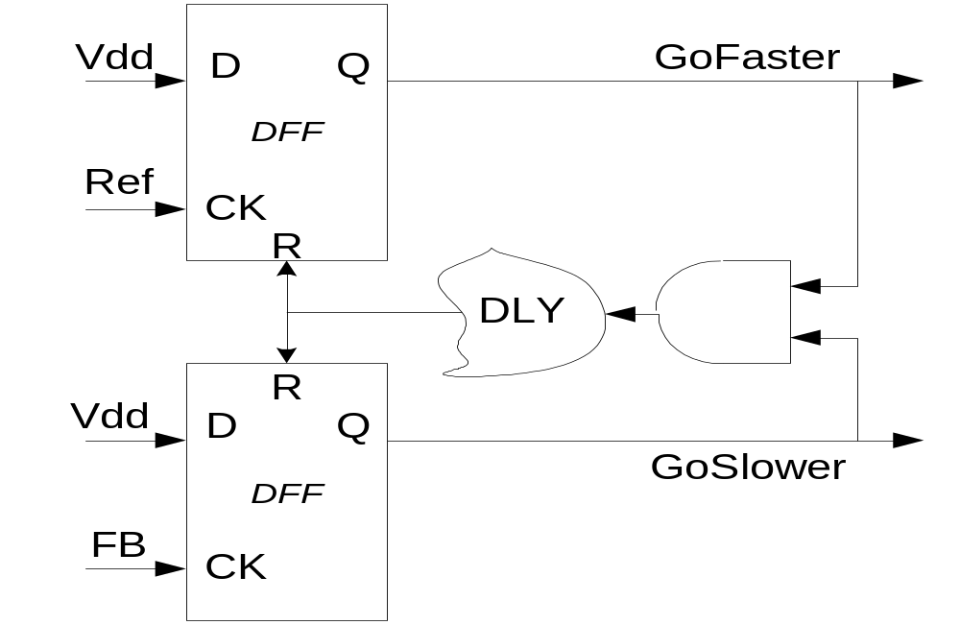
PFD Block Diagram
Edge-triggered - Input duty-cycle doesn’t matter
Pulse-widths proportional to phase error

Slide 39
PFD Logic States
3 and “1/2” Output states
States:
GoFaster | GoSlower | Effect:
0 | 0 | No Change
0 | 1 | Slow Down
1 | 0 | Speed Up
1 | 1 | Avoid Dead-Zone

Slide 40
Example: PFD
Ref
FbClk
GoFaster
GoSlower
Vctl

Slide 41
Avoiding the Dead-Zone
“Dead-zone” occurs when the loop doesn’t respond to small phase errors - e.g. 10 pS phase error at PFD inputs:
  PFD cannot generate 10 pS wide GoFaster and GoSlower pulses
  Charge-pump switches cannot turn on and off in 10 pS
  Solution: delay reset to guarantee min. pulse width (typically > 150 pS)

Slide 42
Charge Pump(CP)

Slide 43
Charge Pump
Converts PFD phase error (digital) to charge (analog)
Charge is proportional to PFD pulse widths
Q_{cp} = I_{up}*t_{faster} – I_{dn}*t_{slower}
Q_{cp} is filtered/integrated in low-pass filter

Slide 44
GoFaster
VDD
D
Q
Charge
I_{cp}
Pump
REF
CK
R
S_{up}
Reset
S_{dn}
DFF
VDD
D
R
Q
GoSlower
I_{cp}
FB
CK

Slide 45
Charge-Pump Wish List
Equal UP/DOWN currents over entire control voltage range - reduce phase error.
Minimal coupling to control voltage during switching - reduce jitter.
Insensitive to power-supply noise and process variations – loop stability.
Easy-to-design, PVT-insensitive reference current.
Programmable currents to maintain loop dynamics (vs. M, f_{ref})?
Typical: 1A (mismatch)< I_{cp} < 50 A (V_{ctl})

Slide 46
Static Phase Error and CP Up/Down Mismatches
Static Phase Error: in lock, net UP and DOWN currents must integrate to zero
  If UP current is 2X larger, then DOWN current source must be on 2X as long to compensate
  Feedback clock must lead reference for DOWN to be on longer
  T_{err} = T_{dn} - T_{up} = T_{reset} * (I_{up}/I_{dn} – 1)

Slide 47
Static Phase Error and CP Up/Down Mismatches
Phase error can be extremely large at low VCO frequencies (esp. if self-biased) due to mismatch in current mirrors (low V_{gs}-V_{t})
Increase V_{gs} or decrease V_{t} (large W*L)
Typical static phase error < 100 pS

Slide 48
VCO Jitter and CP Up/Down Mismatches
PFD-CP correct at rate of reference (e.g. 10nS).
Most phase error correction occurs near reference rising edge and lasts < 200 pS, causing a control voltage ripple.
This ripple affects the VCO cycles near the reference more than VCO cycles later in the ref cycle, causing VCO jitter.
Typ. Jitter << 1% due to Up/Down Mismatches
Avoid ripple by spreading correction over entire ref cycle. (Maneatis JSSC ’03)

Slide 49
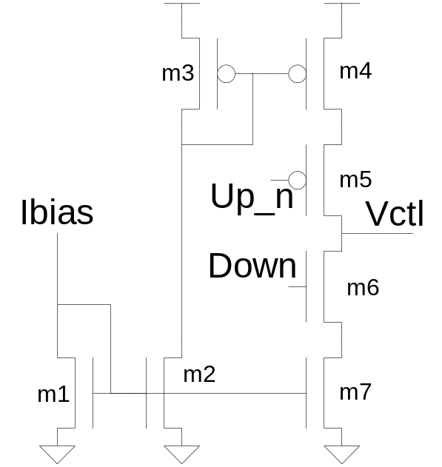
Simple Charge Pump
R(switches) varies with V_{ctl} due to body-effect
Use CMOS pass-gate switches for less V_{ctl} sensitivity
Long-channel current sources for matching and higher R_{out}

Slide 50
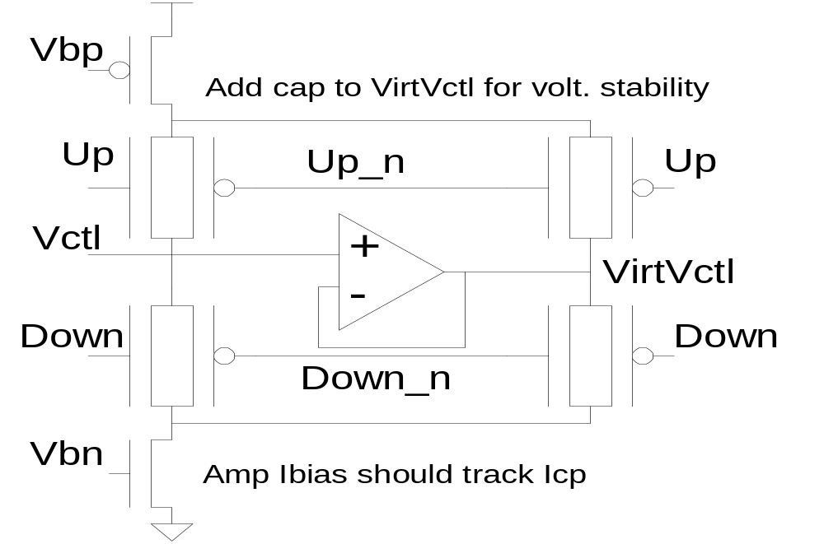
Charge Pump: const I with amp
Amp keeps V_{ds} of current sources constant (Young ’92)
Amp sinks “waste” current when UP, DOWN off

Slide 51
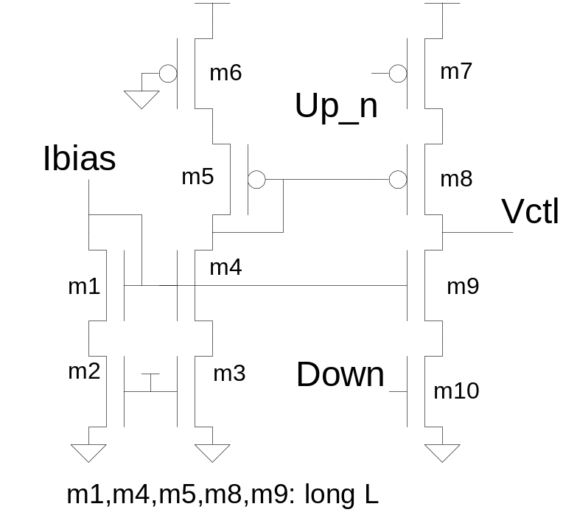
Charge Pump – switches reversed
Switches closer to power rails reduce noise and V_{ctl} dependence → I_{cp} not constant with up/down

Slide 52
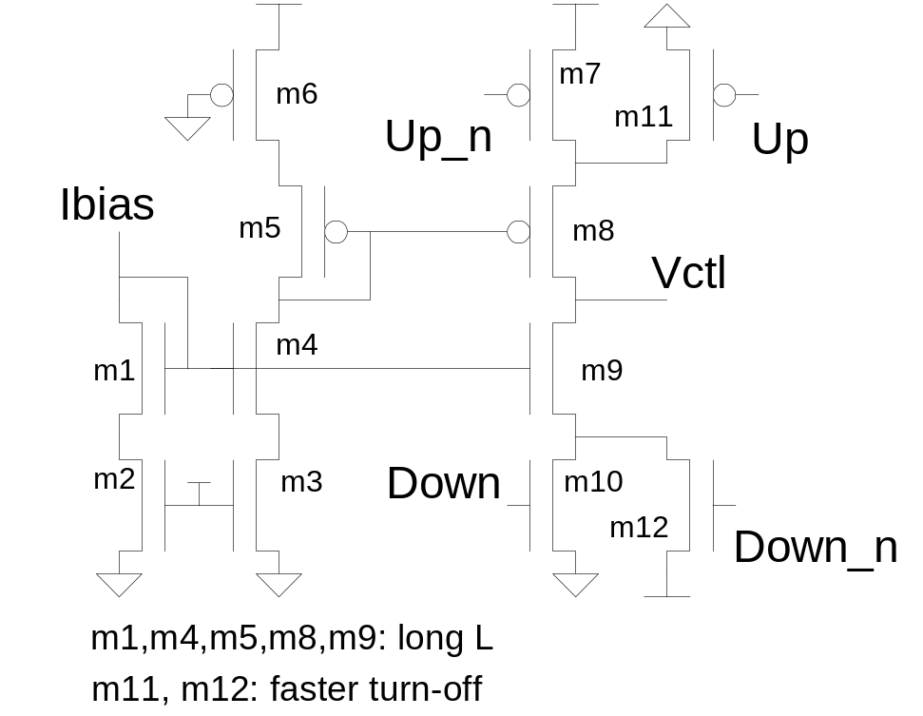
Charge Pump: switches reversed with fast turn-off (Ingino ‘01)

Slide 53
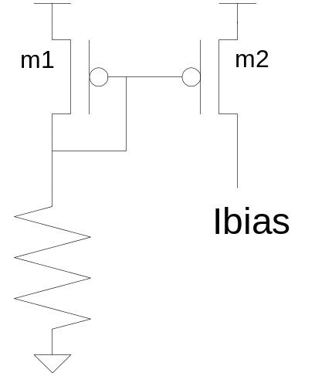
Simple Charge-Pump Bias
I_{b} ~ (V_{dd} – V_{t})/R
I_{b} dependent on PVT
Prefer low-V_{t}, moderate-to-long L for process insensitivity, large W/L for low gate-overdrive
Pro: Simple, stable. Con: Vdd dependence

Slide 54
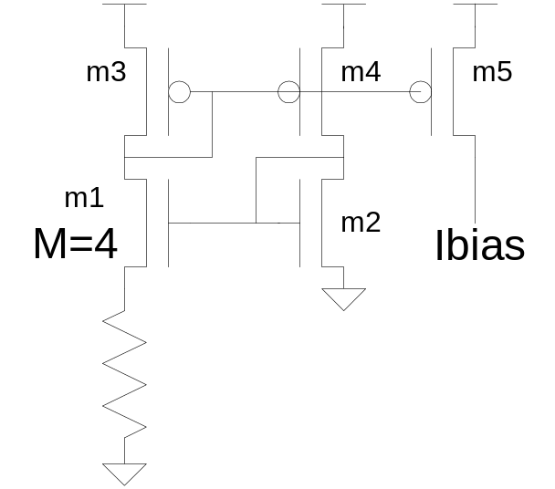
VDD-independent Ibias
I_{b} ~ 1/R²
Con: requires start-up circuit not shown

Slide 55
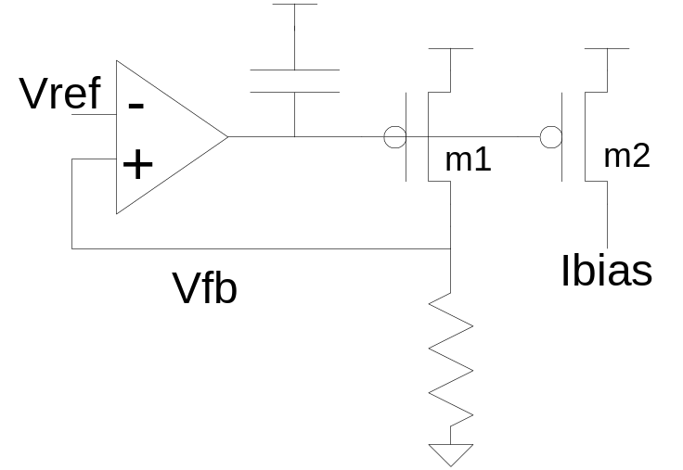
Bandgap-based Ibias
I_{b} ~ V_{ref}/R
Con: feedback loop may oscillate
- cap added to improve stability
Pro: VDD-independent, mostly Temp independent

Slide 56
Low-Pass Filter (LPF)

Slide 57
Low-Pass Filter
Integrates charge-pump current onto C₁ cap to set average VCO frequency (“integral” path).
Resistor provides instantaneous phase correction w/o affecting avg. freq. (“proportional” path).
C₂ cap smoothes large IR ripple on V_{ctl}
Typical value: 0.5k < R_{lpf} < 20kOhm
Vctl
Res
C1
C2

Slide 58
Feed-Forward Zero: eliminate R
Resistor provides an instantaneous IR on the control voltage causing the VCO V2I to generate a current bump on the oscillator input
Eliminate R → Add parallel CP path into V2I
See Maneatis JSSC ’96 or ’03 for example
CP1
Vintegral
V2I
Vproportional
I_{VCO}
CP2
“Res”
RO
Virtual Vctl

Slide 59
Low-Pass Filter Smoothing Cap(C₂)
“Smoothing” capacitor on control voltage filters CP ripple, but may make loop unstable
Creates parasitic pole: _{p} = 1/(R C₂)
C₂ < 1/10*C₁ for stability
C₂ > 1/50*C₁ for low jitter
Smoothing cap reduces “IR”-induced VCO jitter to < 0.5% from 5-10%
f_{vco} = K_{vco}I_{cp}T_{err}/C₂
Larger C₂/C₁ increases phase error slightly

Slide 60
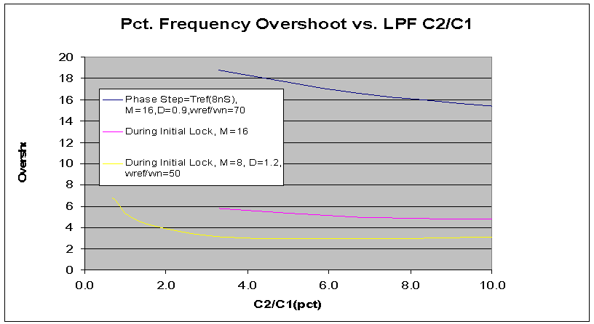

Slide 61
Low-Pass Filter Capacitors
At <= 130nm, thin-gate oxide leakage is huge:
  I_{leak} ~ Vgate ^{4.5}
  NMOS leakier than PMOS
  Weak temperature dependence
  I_{leak} vs. t_{ox} → ~2-3X per Angstrom
Use metal caps or thick-gate oxide caps to reduce leakage
Metal caps use 10X more area than thin gate caps
  Use minimum width/spacing parallel lines
  Hard to LVS - Check extracted layout for correct connectivity

Slide 62
Low-Pass Filter Capacitors
Even thick gate oxide may still leak too much
Large filter cap (C₁) typically ranges from 50pF to 400 pF
C₁ cap BW may be low as ~10X PLL BW for nearly ideal behavior
Min C₂ BW set by T_{ref}
Cap BW ~ 1/RC ~ 1/L²
Gate cap not constant with V_{gs}

Slide 63
Voltage-Controlled Oscillator (VCO)

Slide 64
Voltage-Controlled Oscillator
VCO usually consists of two parts: control voltage- to-control current (V2I) circuit and current-controlled ring oscillator (ICO)
VCO may be single-ended or differential
Differential design allows for even number of oscillator stages if differential-pair amps used for delay cells
V2V may be used instead to generate bias voltages for diff-pair amps

Slide 65
PLL Suppression of VCO Noise
PLL acts like a high-pass filter in allowing VCO noise to reach PLL output
Need noise-immune VCO to minimize jitter
  Feedback loop cannot react quickly.
Power-supply noise is largest source of VCO noise

Slide 66
VCO Design Concerns
Min low-frequency power-supply sensitivity
  < 0.05% per %dVDD → reduce phase error
Min high-frequency power-supply sensitivity
  < 0.1% per %dVDD → reduce period jitter
  Note: this is 10X better than normal INV
Low substrate-noise sensitivity → reduce V_{t}
  unnecessary in SOI
Thermal noise (kT)
  typically < 1% VCO period at high frequency

Slide 67
VCO Design Concerns
Large frequency range to cover PVT variation:
  3-5X typical
Single-ended or differential?
  use differential for 50% duty-cycle
Vco gain (f_{vco} = K_{vco}* V_{ctl}) affects loop stability
Typical VCO gain: K_{vco} ~ 1-3X * f_{max}
More delay stages → easier to initiate oscillation
  Gain(DC) > 2 for 3 stages
  Gain(DC) > sqrt(2) for 4 stages

Slide 68
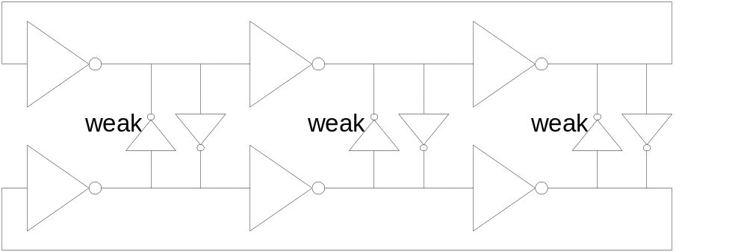
VCO w/“pseudo-differential” current-starved inverters
Need odd # of stages
Feedback INV → usually weaker by ~4X
“Vdd” for inverters is regulated output of V2I

Slide 69
VCO V-to-I Circuits
Converts V_{ctl} to I_{ctl}
May generate additional V_{bias} for oscillator
May use internal feedback to set VCO swing
Provides power-supply rejection → fets in deep saturation or amp-based internal feedback
Filters high-frequency V_{ctl} ripple w/another cap
Adds parasitic pole → BW(V2I) >> BW(PLL)
Digital Range settings allow for control of VCO gain and V_{ctl} range → must overlap ranges

Slide 70
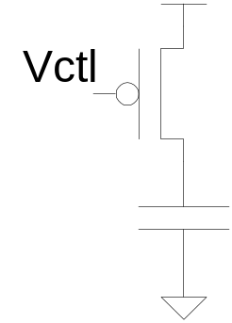
Simple V2I
Minimal filtering of V_{ctl} ripple
Keep long-channel current source in saturation
Cap adds parasitic pole → _{p} = 1/(R_{vco}*C)
Typical Cap Size: 0.5 pF < C < 5 pF
Reference V_{ctl} to same potential as LPF caps

Slide 71
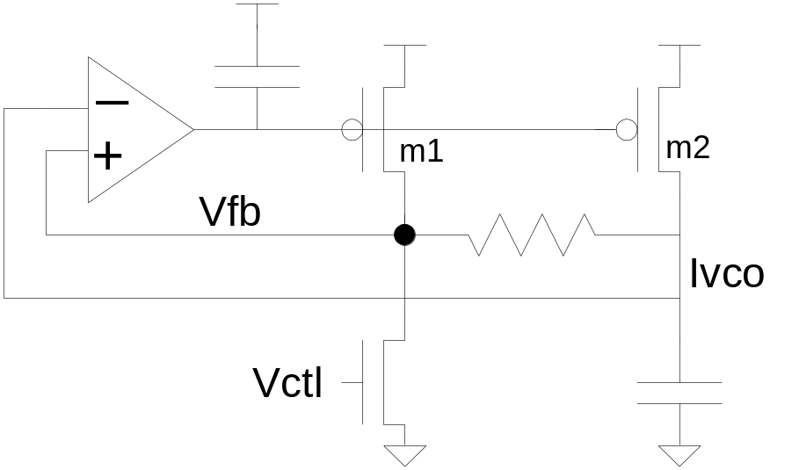
V2I w/Feedback (V. von Kaenel (JSCC ’96)
Feedback → amp provides good low-freq power-supply rejection
Cap to Vdd provides good high-freq rejection
Start-up needed
Stability concern?

Slide 72
Differential VCO’s

Slide 73
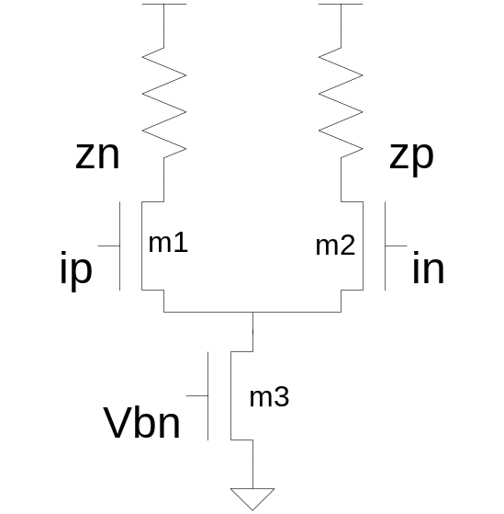
VCO: simple differential delay
DC gain ~ g_{m1}*R
Hard to get enough gain w/o large resistor
Tail current controls delay – V2I needed?

Slide 74
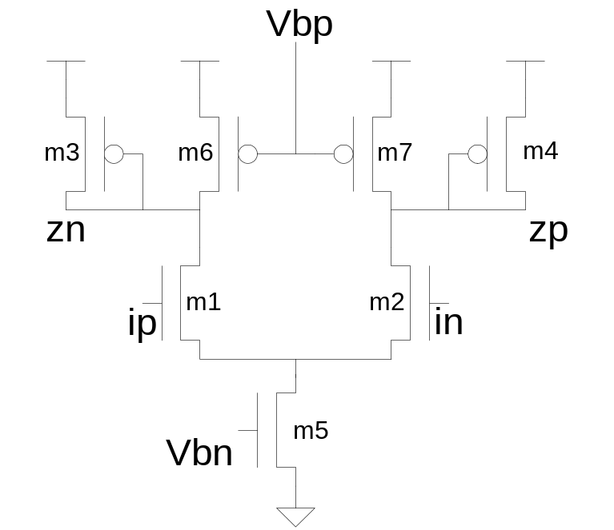
VCO: differential delay w/symmetric load (Maneatis ’96)
Loads acts like resistor over entire voltage swing
Widely used but requires two bias voltages

Slide 75
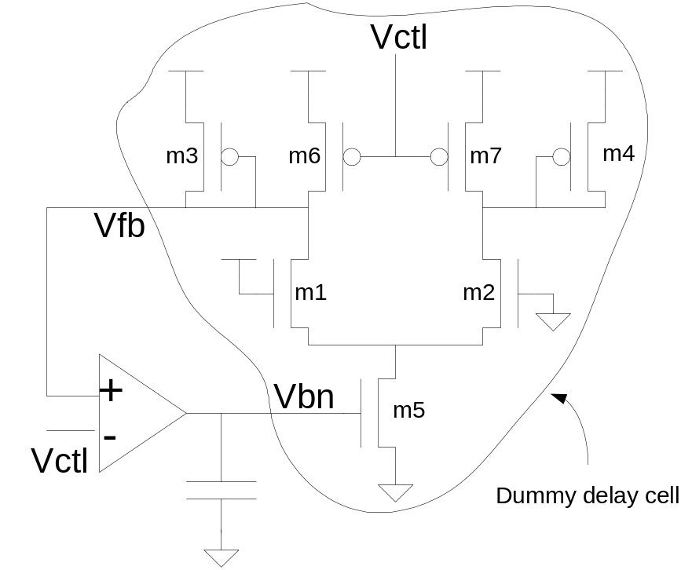
V2I: replica bias - symmetric load
V_{swing} = V_{ctl} (Maneatis ’96)
Amp provides DC power-supply rejection
Stable, but getting high BW and good PSRR tricky

Slide 76
VCO Level-Shifter
Amplify limited-swing VCO signals to full-rail
  typically from 0.4-0.7V to VDD
Maintain 50% duty-cycle
  usually +/- 3%
  difficult to do over PVT and frequency
Insensitive to power-supply noise
  < 0.5 % per % dVDD
Which power-supply? Analog or digital?
  usually digital

Slide 77
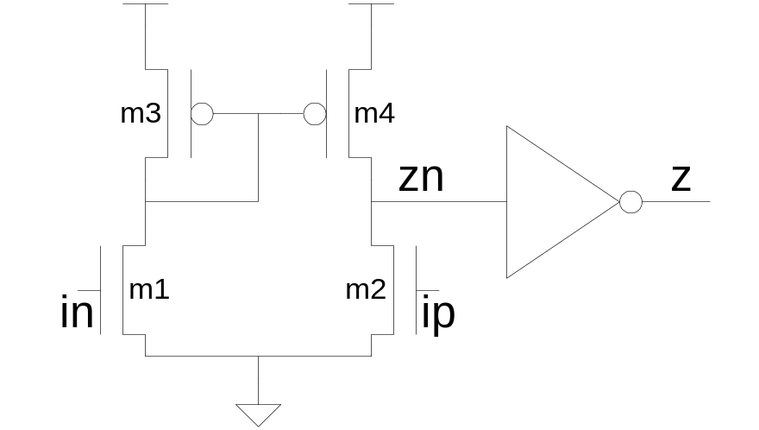
VCO: Level-Shifter
Need sufficient gain at low VCO frequency
Use NMOS input pair if VCO swing referenced to VSS for better power-supply rejection
Net “zn” should swing almost full-rail to switch output inverter

Slide 78
Feedback Divider

Slide 79
Feedback Divider (FBDIV)
Divide VCO by N → f_{ref} = f_{vco}/N
Divider may be internal to PLL or after CPU clock tree
Max FBDIV frequency should be greater than max VCO frequency to avoid “run-away”
Minimize FBDIV latency to reduce VDD-induced jitter seen at phase detector
Loop Phase Margin Degradation ~ _{n}T_{dly}
  usually insignificant

Slide 80
Feedback Divider
Two common types of dividers:
  Asynchronous cascade of div-by-2’s
  Synchronous counter – typically used

Slide 81
Asynchronous Divide-by-2
Pro: fast, simple
Pro: small area
Con: long latency for large divisors
Con: divide by powers of 2 only
Can be used as front-end to synchronous counter divider to reduce speed requirements

Slide 82
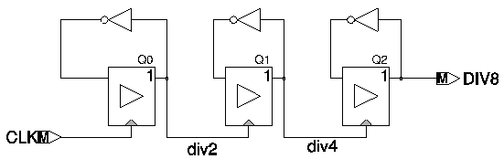
Feedback Divider: cascade of div-by-2’s

Slide 83
Counter-Based Divider
Pro: divide by any integer N
Pro: constant latency vs. N
Pro: low latency
Pro: small area → Binary-encoded.
Con: slow if using ripple counter → don’t
Con: output may glitch → delay (re-sample) output by one cycle to clean up glitch

Slide 84
VDDA Voltage Regulator

Slide 85
Voltage Regulator/Filter
Used to filter power-supply noise
  typically > 20 dB (10x) PSRR over entire frequency range
  desire 30+ dB
Secondary purpose is to set precise voltage level for PLL power supply
  usually set by bandgap reference

Slide 86
Voltage Regulator
Bandgap reference generates a voltage reference (~1.2V) that is independent of PVT
  relies on parasitic diodes (vertical PNP)
Regulator output stage may be source-follower (NFET) or common-source amp (PFET)
  source-follower requires more headroom (and area?) but is more stable
  common-source amp may be unstable without Miller capacitor or other compensation
Beware of large, fast current spikes in PLL load (i.e. when changing PLL frequency range)

Slide 87
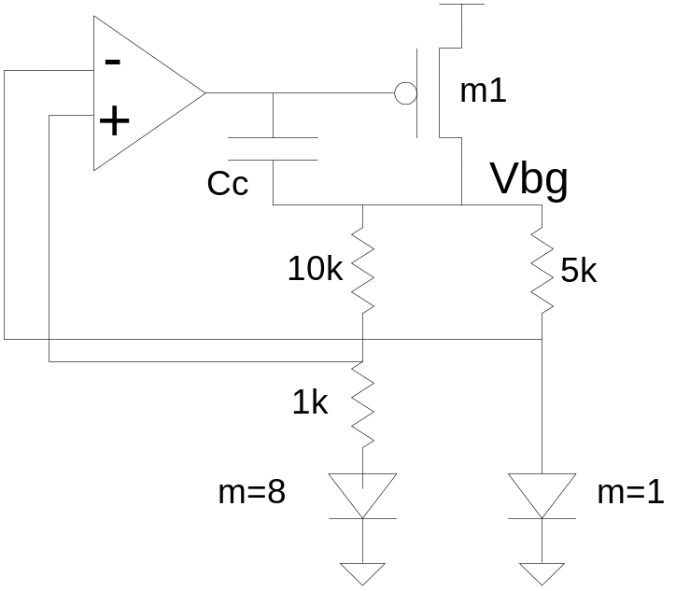
Bandgap Reference w/Miller Cap
Stability and PSRR may be poor w/o Miller cap
Miller cap splits poles. Can also add R in series w/Cc for more stability (Razavi ’00)

Slide 88
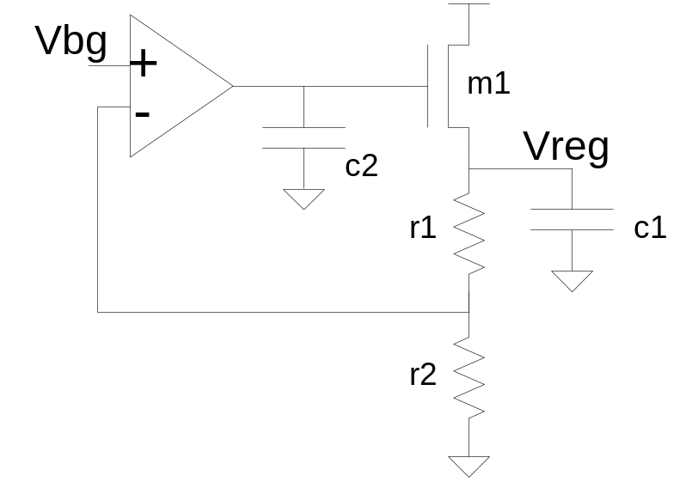
Voltage Regulator for VDDA

Slide 89
Advanced Concepts:
Self-Biased PLL
Conventional PLL: loop dynamics depends on I_{cp}, R_{lpf}, C_{lpf}, K_{vco} and FBDiv. These do not necessarily track.
Why not generate all bias currents from the I(vco) and use a feed-forward zero to eliminate the resistor. Everything tracks. (Maneatis JSCC ‘03)
Con: start-up, stability
Pro: reduces PVT sensitivity

Slide 90
Example Circuit Parameters
VDD=1.2V, f(max)-f(min) = 3 GHz
K_{vco} = 5GHz/V → usable V_{ctl} range (0.6V)
I_{cp} = 20 uA
R_{lpf}=2500 Ohm
C₁=75 pF → Area(metal) ~ 275um x 275um
C₂=5 pF
0.85 <  < 1.2
1.5 MHz < _{n}/2 < 2.1 MHz
T_{acq} ~ 5 uS →T_{aqc} =~ 2CdV/I

Slide 91
Real-world PLL Failures

Slide 92
PLL Problem
Problem: 3-stage PMOS diff-pair VCO wouldn’t oscillate at low frequencies. When VCO finally started up at high Vctl, it outran FBDIV.
Cause: leaky, mis-manufactured loads in delay cell reduced gain of delay element < 2
Solutions:
  increase L of load devices for higher gain
  add more VCO stages to reduce gain requirements

Slide 93
PLL Problem
Problem: VCO stuck at max frequency at power-on.
Cause: PLL tried to lock before VDD was stable. Because VCO couldn’t run fast enough to lock at low VDD, V_{ctl} saturated. When VDD finally stabilized, V_{ctl} = VDD, causing a maxed-out VCO to outrun FBDIV.
Solution: maintain PLL RESET high until VDD is stable to keep V_{ctl} at 0V.

Slide 94
PLL Problem
Problem: VCO stuck at max frequency after changing power-modes.
Cause: Feedback DIV could not run fast enough to handle VCO overshoot when locking to a new frequency or facing a reference phase step.
Solutions:
  limit size of frequency steps
  increase speed of Feedback DIV

Slide 95
PLL Problem
Problem: PLL would not lock.
Cause: Feedback DIV generated glitches causing PFD to get confused.
Solution: add re-sampling flop to output of feedback DIV to remove glitches.

Slide 96
PLL Problem
Problem: PLL output clock occasionally skipped edges at low VCO frequencies
Cause: VCO level-shifter had insufficient gain when VCO swing was close to V_{t}.
Solutions:
  increase W of diff-pair inputs
  use low-V_{t} devices

Slide 97
PLL Problem
Problem: VCO jitter was huge at some divider settings and fine at others.
Cause: Integration team connected programmable current sources backward.
Solution: write accurate verilog model that complains when inputs are out-of-range.

Slide 98
PLL Problem
Problem: PLL jitter was poor at low freq and good at high freq.
Cause: V_{ctl} was too close to V_{t} at low frequency.
Solution: Run VCO at 2X and divide it down to generate slow clocks.

Slide 99
PLL Problem
Problem: RAMDAC PLL had large accumulated phase error which showed up as jitter on CRT screen.
Cause: PLL bandwidth was too low, allowing random VCO jitter to accumulate.
Solution: increase bandwidth so that loop corrects before VCO jitter accumulates.

Slide 100
PLL Problem
Problem: PLL had poor peak-peak jitter, but good RMS jitter.
Cause: digital VDD pin in package adjacent to PLL’s analog VDD coupled digital VDD noise to analog VDD during certain test patterns.
Solution: Remove wirebond for adjacent digital VDD pin.

Slide 101
PLL Problem
Problem: large static offset.
Cause: designer did not account for gate leakage in LPF caps.
Solutions:
  switch to thick-gate oxide caps
  switch to metal caps

Slide 102
PLL Problem
Problem: VCO period jitter = +/- 20%, modulated at a fixed frequency.
Cause: Unstable V2I internal feedback loop caused by incorrect processing of stabilizing caps.
Solutions:
  correct manufacturing of capacitors
  add more caps

Slide 103
PLL Problem
Problem: bandgap reference was stable in one process but oscillated in a different process with similar feature sizes.
Cause: compensation caps for 2-pole feedback system with self-bias were too small.
Solution: make compensation caps 3X larger.

Slide 104
Uncle D’s PLL Top 5 List
5. Maintain damping factor ~ 1
4. VDD-induced VCO noise – loop can’t do the work for you
3. Leaky gate caps will cost you your job
2. Make FBDIV run faster than VCO
1. Observe VCO,FBCLK,REF,clkTree on differential I/O pins – you can’t fix what you can’t see!

Slide 105
Appendices

Slide 106
Appendices
Appendix A: Design for Test
Appendix B: Writing a PLL spec
Appendix C: Additional PLL material
Appendix D: Paper References
Appendix E: Monograph References

Slide 107
Design for Test

Slide 108
Design for Test Overview
Measuring Jitter
Analog Observation
Probing

Slide 109
Measuring Jitter: Power-Supply Noise Sensitivity
Induce noise on-chip with VDD-VSS short
  need off-chip frequency source or on-chip FSM to control noise generator
  How to measure induced noise magnitude?
Induce noise on board
  capacitively couple to VDDA
  hard to get it past filtering and attenuation
  how much makes it to PLL?
  VDDA inductance? – wire-bond, flip-chip

Slide 110
Routing: From PLL to Board
Differential IO outputs highly desirable
Types of IO – use highest-speed available
Divide VCO to reduce board attenuation only if necessary → make divider programmable
Measuring duty-cycle
- Divide-by-odd-integer
- Mux to select either true or inverted clock
Minimize delay on-chip from PLL to IO
Ability to disable neighboring IO when measuring jitter
Avoid coupling in package and board

Slide 111
General Test Hardware
High-bandwidth scope:
  4-6 GHz real-time
  $50-60k
  e.g. Agilent, Tektronix, LeCroy
Differential high-speed probes:
  3-6 GHz BW
  $3-6k
Active pico-probes and passive (DC) probes for micro-probing PLL
Avoid large GND loops on probes

Slide 112
Jitter Hardware/Software
Jitter Analysis tools:
  e.g. Wavecrest, Tek(Jit2), Amherst Design
Jitter measurement types:
  Period jitter histogram
  Long-term jitter
  Cycle-to-adjacent cycle jitter
  Half-period jitter
  Jitter FFT - limited by Nyquist – aliasing
Scope memory depth

Slide 113
Miscellaneous Jitter Measurements
Open-loop vs. Closed-loop Jitter
  disable loop-filter → does PLL jitter change?
Mux Ref into PLL observation path for jitter calibration
  Is Ref jitter worse after coming from PLL compared to before it enters the chip?
Observe “end-of-clock tree” for jitter and duty-cycle distortion
Observe Fbclk for jitter and missing edges

Slide 114
Measuring PLL Loop Dynamics
Modulate reference frequency, measuring long-term PLL jitter. Sweep modulation frequency to determine bandwidth and damping.
  e.g. Wavecrest
Spectrum analyzer
  look for noise suppression in frequency range close to signal peak
  difficult if noisy setup

Slide 115
Measuring Phase Error
Hard to do!
Fbclk available for observation?
Need to acct. for Fbclk delay from PLL to IO –depends on PVT.
Solutions:
  route Fbclk off-chip to pkg and match input delay with Ref. Fbclk/Ref skew at pins ~ Terr at PFD.
  measure Terr on-chip – send out narrow pulses – narrow pulses disappear.
  measure Terr on-chip with A/D. Complex.
  mux Fbclk and ref into same path. Compare both to external reference.

Slide 116
Analog Observation
Analog observation IO pins for debug and characterization
  may force internal analog nets as well if bi-directional pin
  low-bandwidth requirements → low MHz or kHz
  isolate analog nets with unity-gain buffer or resistor and pass-gates w/solid pull-down
  drive analog pins to known value when not in use
  tri-state analog pin for ESD leakage testing
  ESD protection (CDM and HBM) may cause IO leakage

Slide 117
Probing On-chip
If not flip-chip, then put probe pads on top-layer metal.
Probe pad size >1um x 1um. Prefer > 2um x 2um.
Place probe pad on a side-branch of the analog signal to avoid breaking wire with probe.
Separate probe pads to allow room for multiple probes.
FIB: can add probe pad, add or remove wires.
  need room and luck
FIB: can FIB SOI flip-chip from back of wafer if enough room around lower-level wires.

Slide 118
Writing a PLL Spec

Slide 119
Spec Overview
Area, physical integration
Technology issues
Power-supply voltage
Performance metrics
Logic interface

Slide 120
Physical Integration
Area, aspect ratio?
What metal layers are available?
Digital signal routing allowed over PLL?
Where is PLL located on chip?
Wire-bond or flip-chip?

Slide 121
Semiconductor Process
90nm, 130nm, 180nm?
Bulk vs. SOI? SOI body-ties?
Nwell vs. twin-well?
Epi substrate?
Accumulation-mode capacitors?
Gate-oxide thickness? Capacitance density and leakage.
Dual-gate oxide available? Leakage.
Poly density requirements?
Low-V_{t} available?
Resistor types? Poly? Diffusion?

Slide 122
Power-Supply
Separate analog VDDA? What voltage? 1.8V? 2.5V? Higher than core voltage?
Separate analog VSSA?
Wire-bond or flip-chip? Package Type?
What type of VDDA filtering on board? Ferrite bead? What cap sizes?
Min, max VDDA? DC variation? AC variation? Natural frequency (1/LC) of VDDA?

Slide 123
Performance
Reference clock frequency? Range?
Min/Max VCO Frequency?
Duty cycle?
Period Jitter?
Fixed jitter spec or pct of period?
Cycle-to-adjacent cycle jitter spec?
Half-cycle jitter spec?

Slide 124
Performance
Max Frequency overshoot while settling?
Static phase error?
Dynamic phase error?
Loop bandwidth?
Time to acquire initial lock?
Time to re-acquire lock after frequency change?
Power Dissipation?

Slide 125
Logic Interface
Reset available?
PowerOK available?
VCO/CP/R range settings allowed?
Clock glitching allowed when switching VCO frequency ranges?
Level-shift and buffer PLL inputs/outputs?
Different power domains?

Slide 126
Example Design Specs
f(ref) = 125 MHz
8 < FBDiv < 16 → 1 GHz < f(vco) < 2 GHz
 > 0.7 – not constant w/FBDiv
1 MHz < _{n}/2 < f(ref) /20
Pk-Pk Jitter < +/- 2.5% w/dVdd = 50mV
T_{lock} < 10 uS
FreqOvershoot < 15% w/1-ref-cycle phase step
Static Phase Error < +/- 200 pS → Icp mismatch < 50%?

Slide 127
References

Slide 128
Paper References
[1] B. Razavi, Monolithic Phase-Locked Loops and Clock-Recovery Circuits, IEEE Press, 1996. – collection of IEEE PLL papers.
[2] I. Young et al., “A PLL clock generator with 5 to 110 MHz of lock range for microprocessors,” IEEE J. Solid-State Circuits, vol. 27, no. 11, pp. 1599-1607, Nov. 1992.
[3] J. Maneatis, “Low-Jitter Process-Independent DLL and PLL Based on Self-Biased Techniques”, IEEE J. Solid-State Circuits, vol. 31, no. 11, pp. 1723-1732. Nov. 1996.
[4] J. Maneatis, “Self-Biased, High-Bandwidth, Low-Jitter 1-to-4096 Multiplier Clock Generator PLL”, IEEE J. Solid-State Circuits, vol. 38, no.11, pp. 1795-1803. Nov. 2003.
[5] F. Gardner, “Charge-pump phase-lock loops,” IEEE Trans. Commun., vol COM-28, no. 11, pp 1849-1858, Nov. 1980.
[6] V. von Kaenel, “A 32- MHz, 1.5mW @ 1.35 V CMOS PLL for Microprocessor Clock Generation”, IEEE J. Solid-State Circuits, vol. 31, no. 11, pp. 1715-1722. Nov. 1996.

Slide 129
Paper References (cont.)
[7] I. Young, “A 0.35um CMOS 3-880MHz PLL N/2 Clock Multiplier and Distribution Network with Low Jitter for Microprocessors”, ISSCC 1997 Digest of Tech. Papers, session 20.1, pp. 330-331.
[8] J. Ingino et al, “A 4-GHz Clock System for a High-Performance System-on-a-Chip Design”, IEEE J. Solid-State Circuits, vol. 36, no. 11, pp. 1693-1698. Nov. 2001.
[9] A. Maxim, et al., “A Low-Jitter 125-1250 MHz Process-Independent CMOS PLL Based on a Sample-Reset Loop Filter”, 2001 ISSCC Digest Of Tech. Papers, pp. 394-395.
[10] N.Kurd, et al., “A Replica-Biased 50% Duty Cycle PLL Architecture with 1X VCO”, 2003 ISSCC Digest of Tech. Papers, session 24.3, pp.426-427.
[11] K. Wong, et al.,”Cascaded PLL Design fpr a 90nm CMOS High Performance Microprocessor”, 2003 ISSCC Digest of Tech. Papers, session 24.3, pp.422-423.
[12] M. Mansuri, et al., “A Low-Power Adaptive-Bandwidth PLL and Clock Buffer With Supply-Noise Compensation”, IEEE J. Solid-State Circuits, vol. 38, no.11, pp. 1804-1812. Nov. 2003.

Slide 130
Paper References (cont.)
[7] A. Maxim, “A 160-2550 MHz CMOS Active Clock Deskewing PLL Using Analog Phase Interpolation”, ISSCC 2004 Digest of Tech. Papers, session 19.3, pp. 346-347.
[8] Jerry Lin et al, “A PVT Tolerant 0.18MHz to 660MHz Self-Calibrated Digital PLL in 90nm CMOS Process”, ISSCC 2004 Digest of Tech. Papers, session 26.10, pp. 488-489.

Slide 131
Monograph References
[1] B. Razavi, Design of Analog CMOS Integrated Circuits, McGraw-Hill, 2001.
[2] R. Best, Phase-Locked Loops,McGraw-Hill, 1993.
[3] R. Dorf, Modern Control Theory, 4th Edition, Addison-Wesley, 1986.
[4] P.Gray & R. Meyer, Analysis and Design of Analog Integrated Circuits, 3rd Edition, J. Wiley & Sons, 1993.
[5] K. Bernstein & N. Rohner, SOI Circuit Design Concepts, Kluwer Academic Publishers, 2000.
[6] A. Hajimiri & T. Lee, The Design of Low Noise Oscillators, Kluwer Academic Publishers, 1999
[7] T. Lee, The Design of CMOS Radio-Frequency Integrated Circuits, Cambridge University Press, 1998.
[8] F. Gardner, Phaselock Techniques, 2nd Edition, New York, Wiley & Sons, 1979

