Slide 1
Chapter 1
Rosenblatt's Perceptron

Slide 2
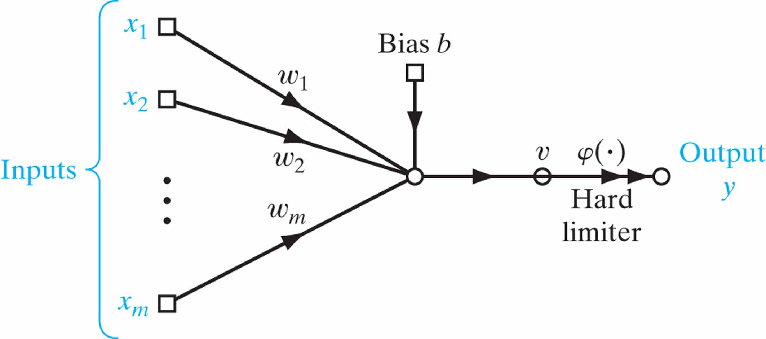
Figure 1.1 Signal-flow graph of the perceptron.

Slide 3
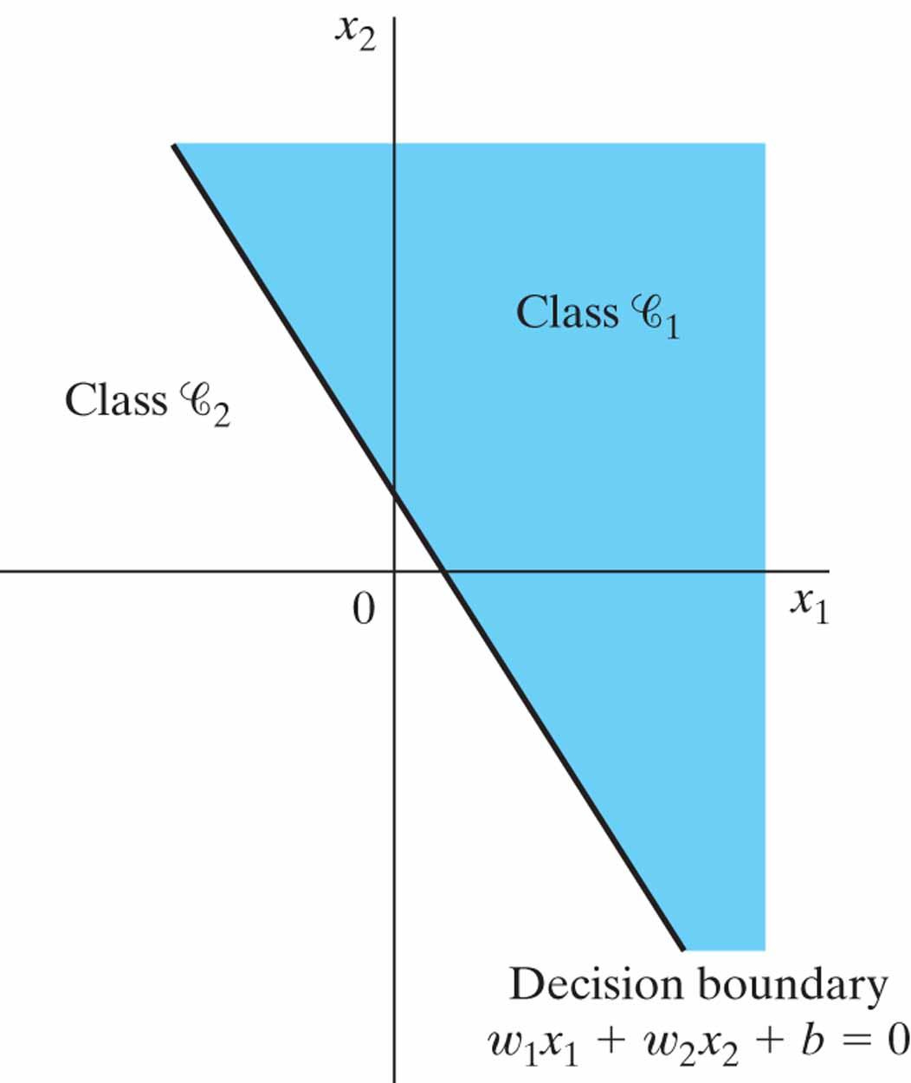
Figure 1.2 Illustration of the hyperplane (in this example, a straight line) as decision boundary for a two-dimensional, two-class pattern-classification problem.

Slide 4
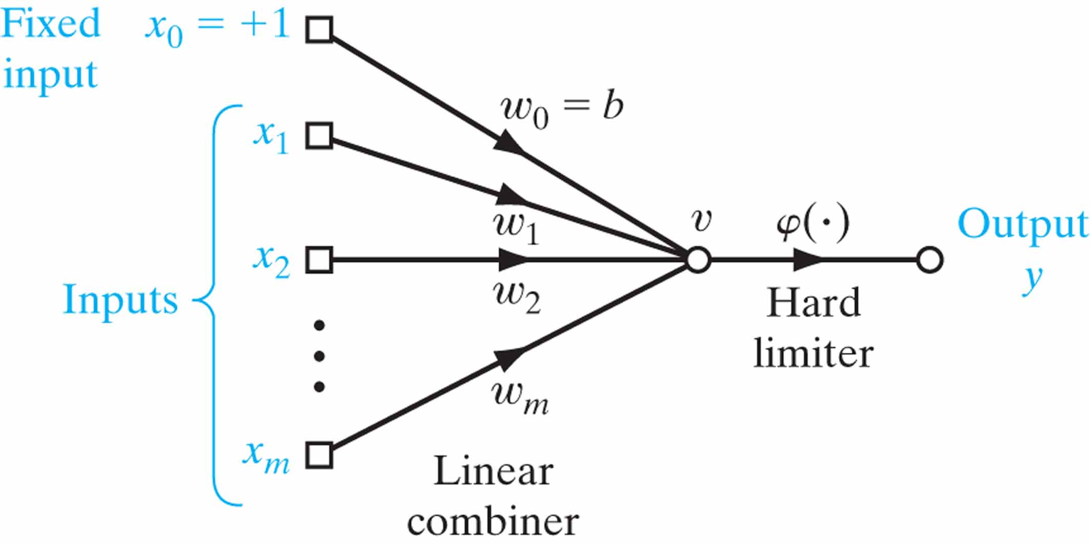
Figure 1.3 Equivalent signal-flow graph of the perceptron; dependence on time has been omitted for clarity.

Slide 5
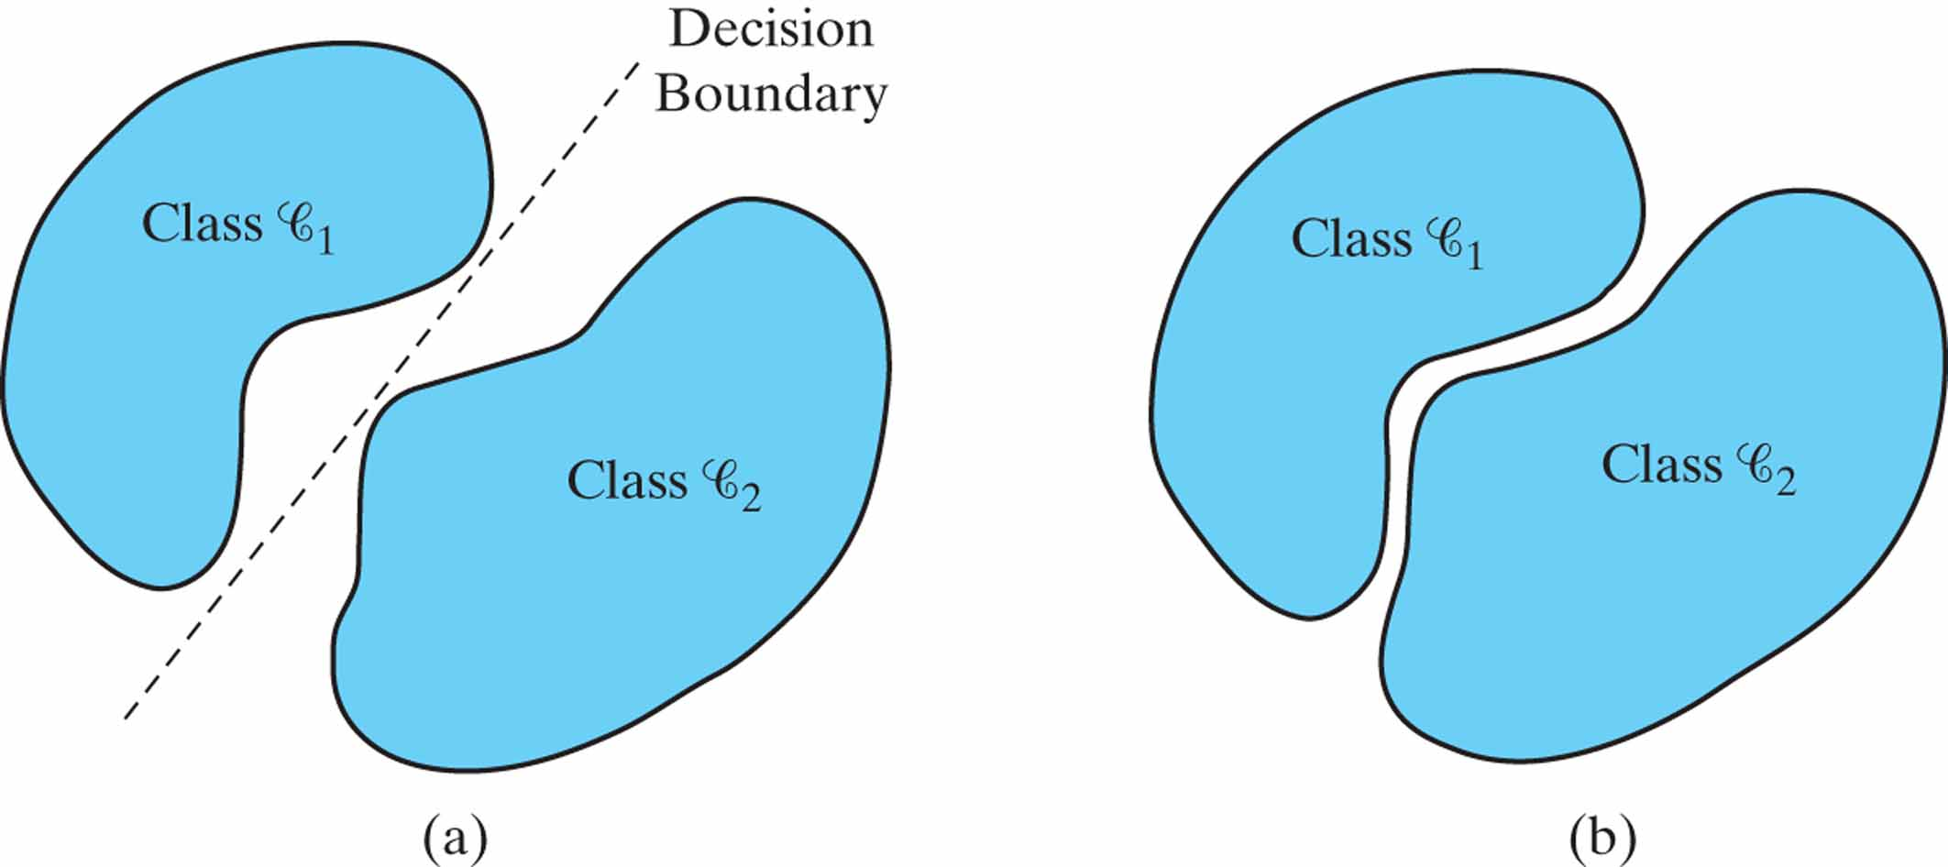
Figure 1.4 (a) A pair of linearly separable patterns. (b) A pair of non-linearly separable.

Slide 6
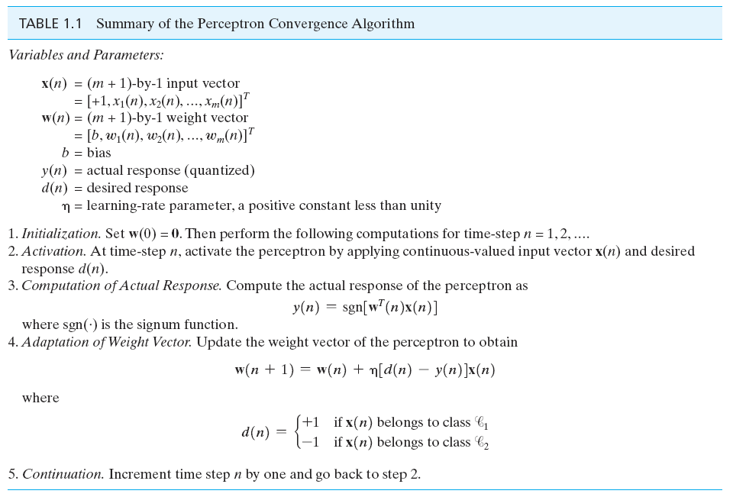
Table 1.1

Slide 7
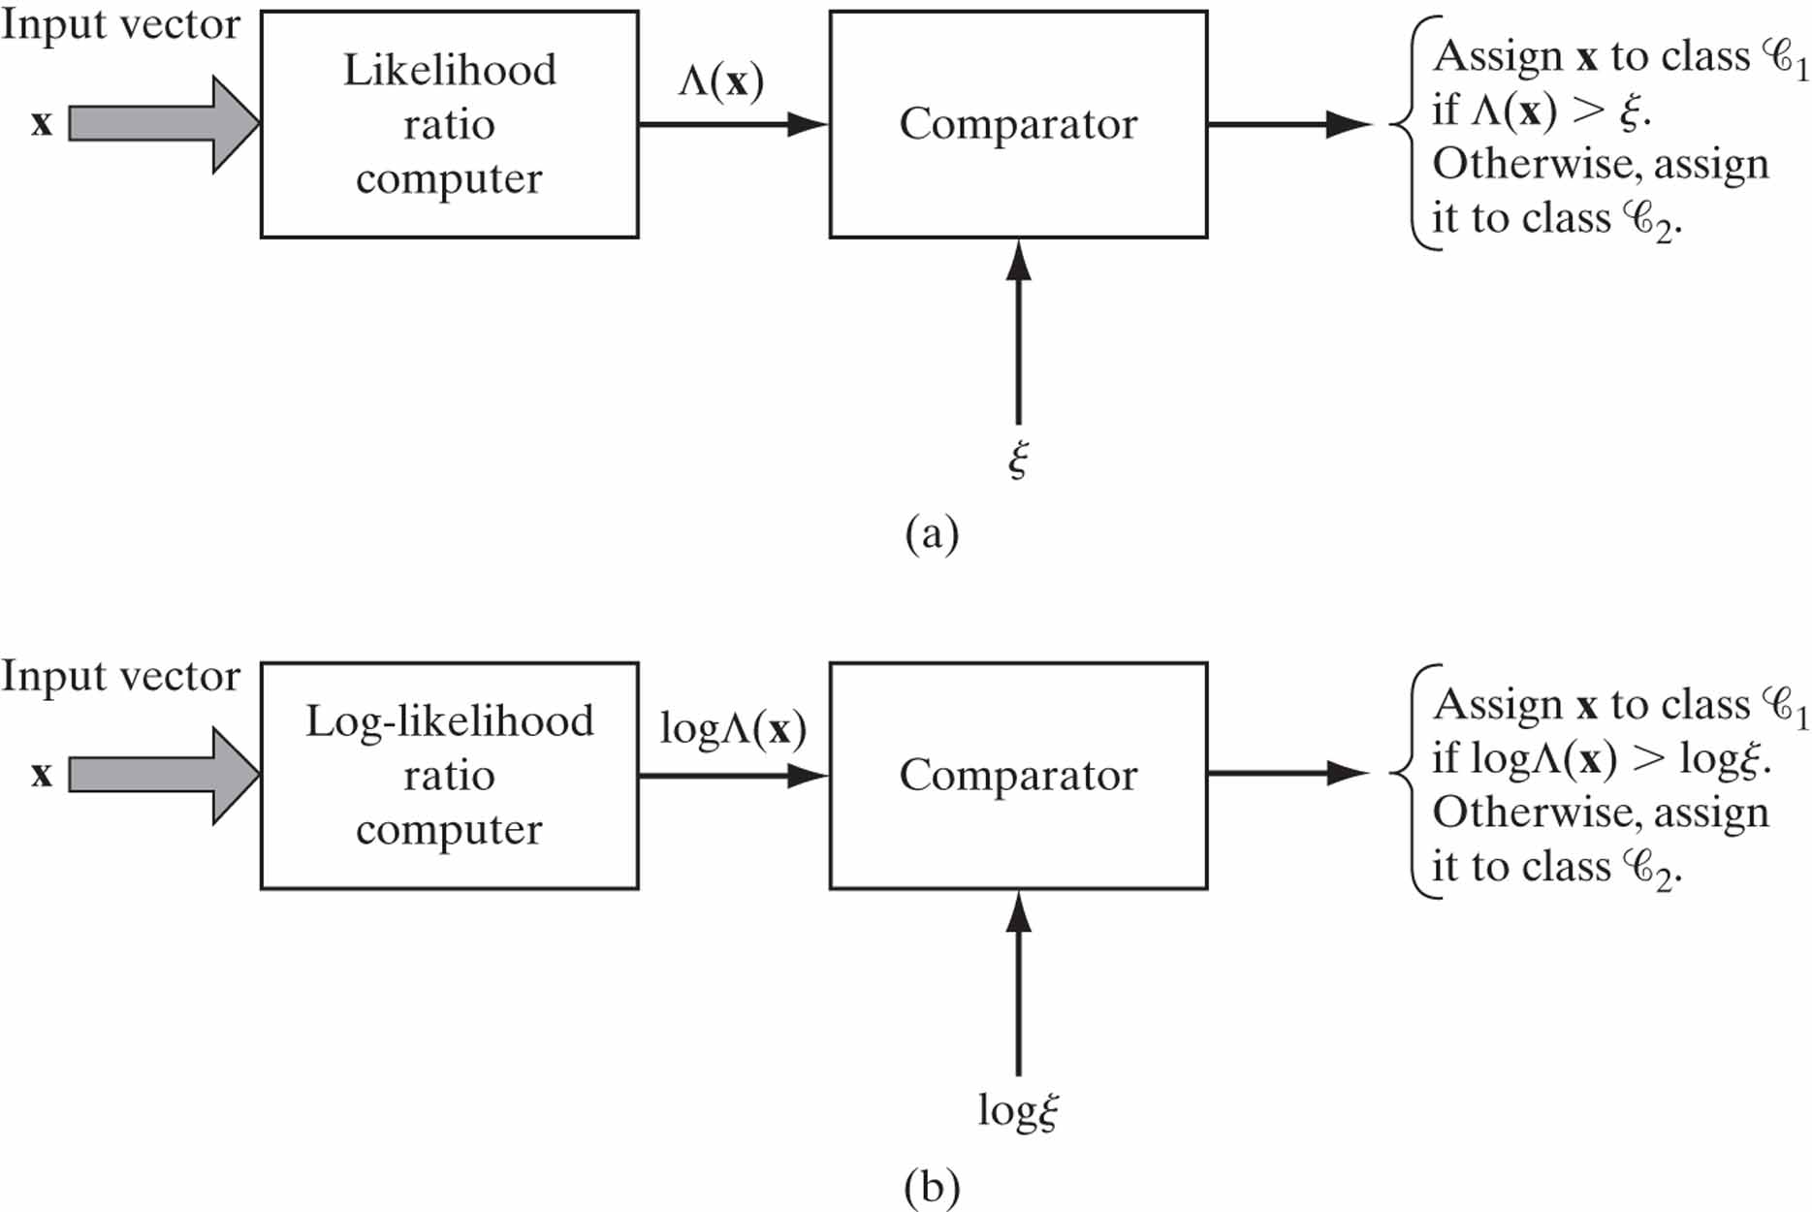
Figure 1.5 Two equivalent implementations of the Bayes classifier: (a) Likelihood ratio test, (b) Log-likelihood ratio test.

Slide 8
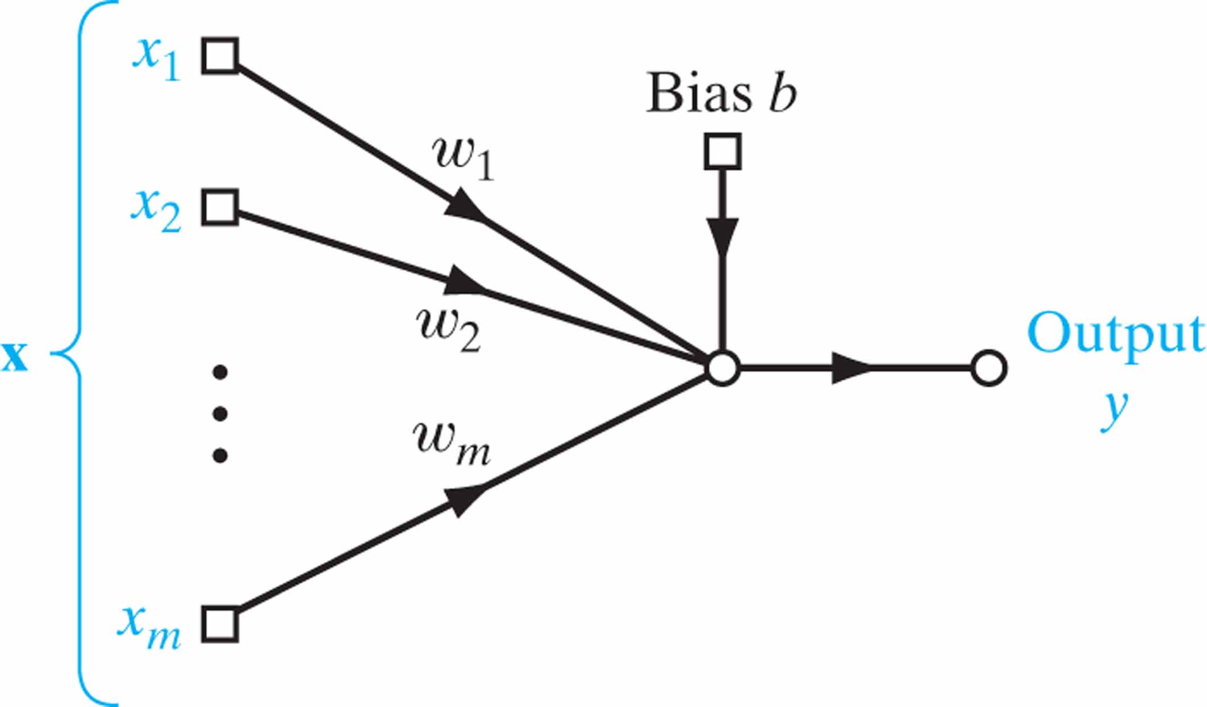
Figure 1.6 Signal-flow graph of Gaussian classifier.

Slide 9
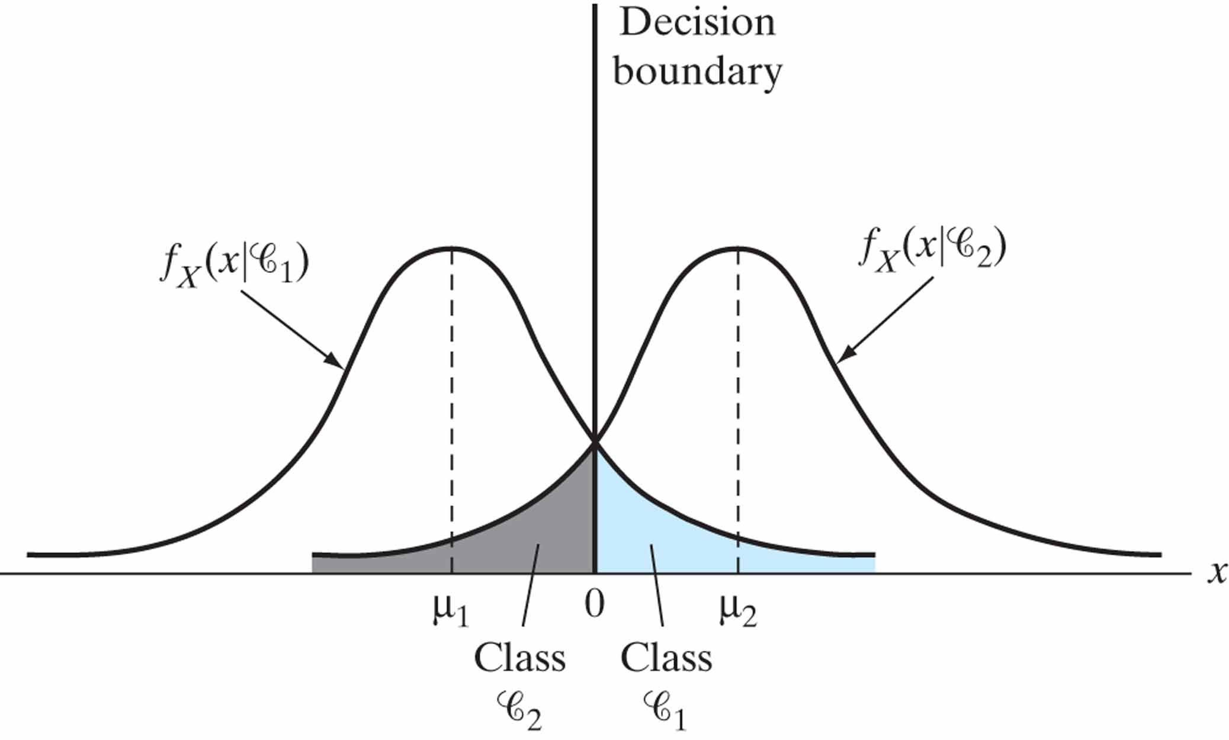
Figure 1.7 Two overlapping, one-dimensional Gaussian distributions.

Slide 10
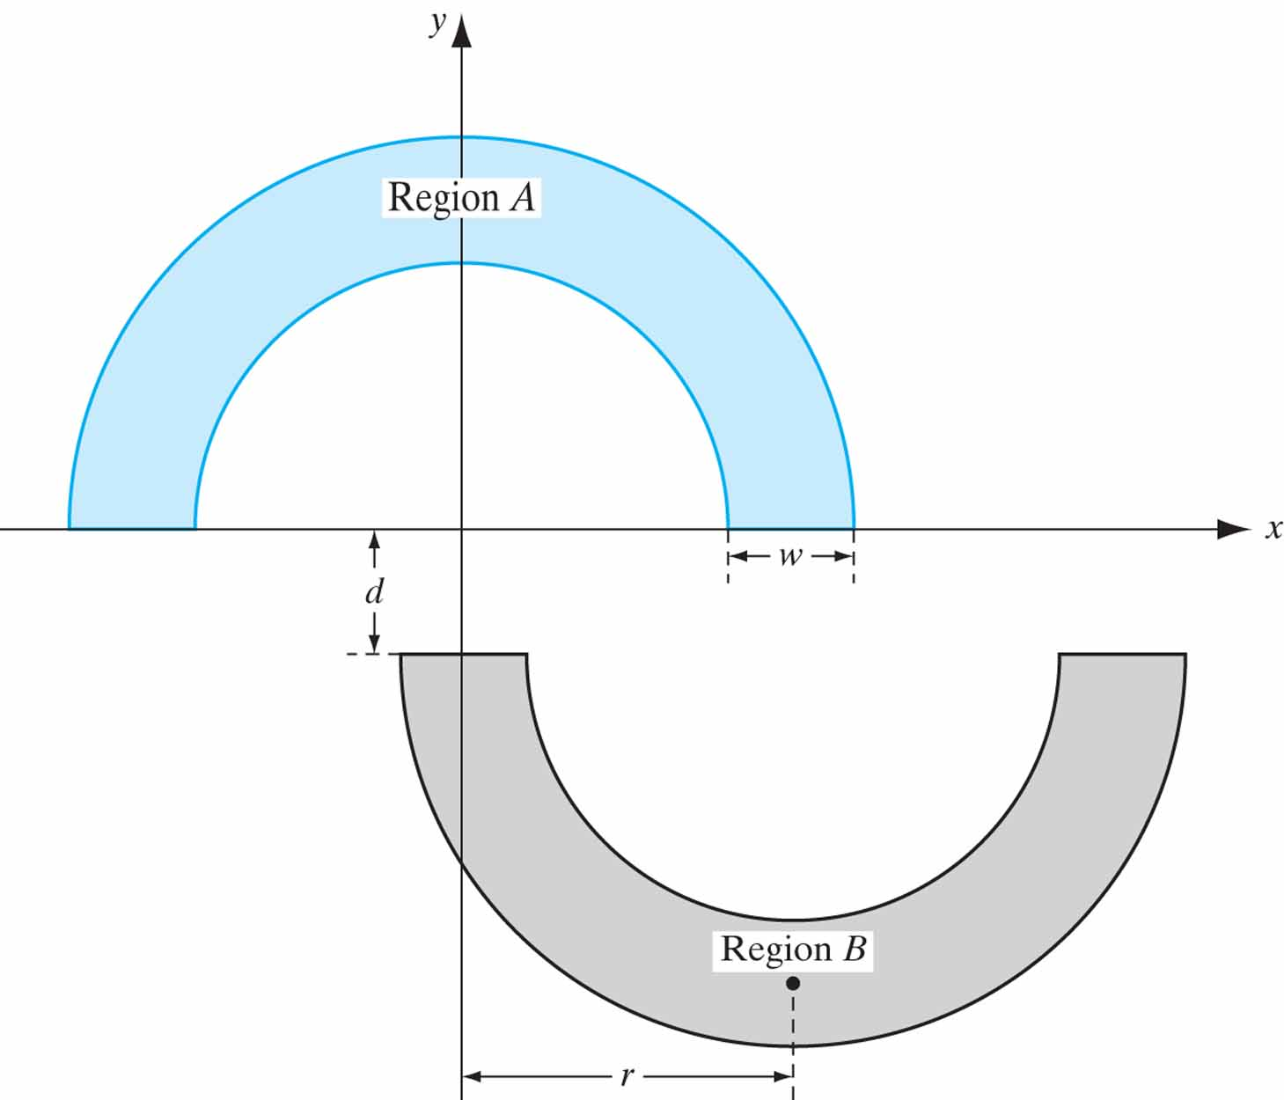
Figure 1.8 The double-moon classification problem.

Slide 11
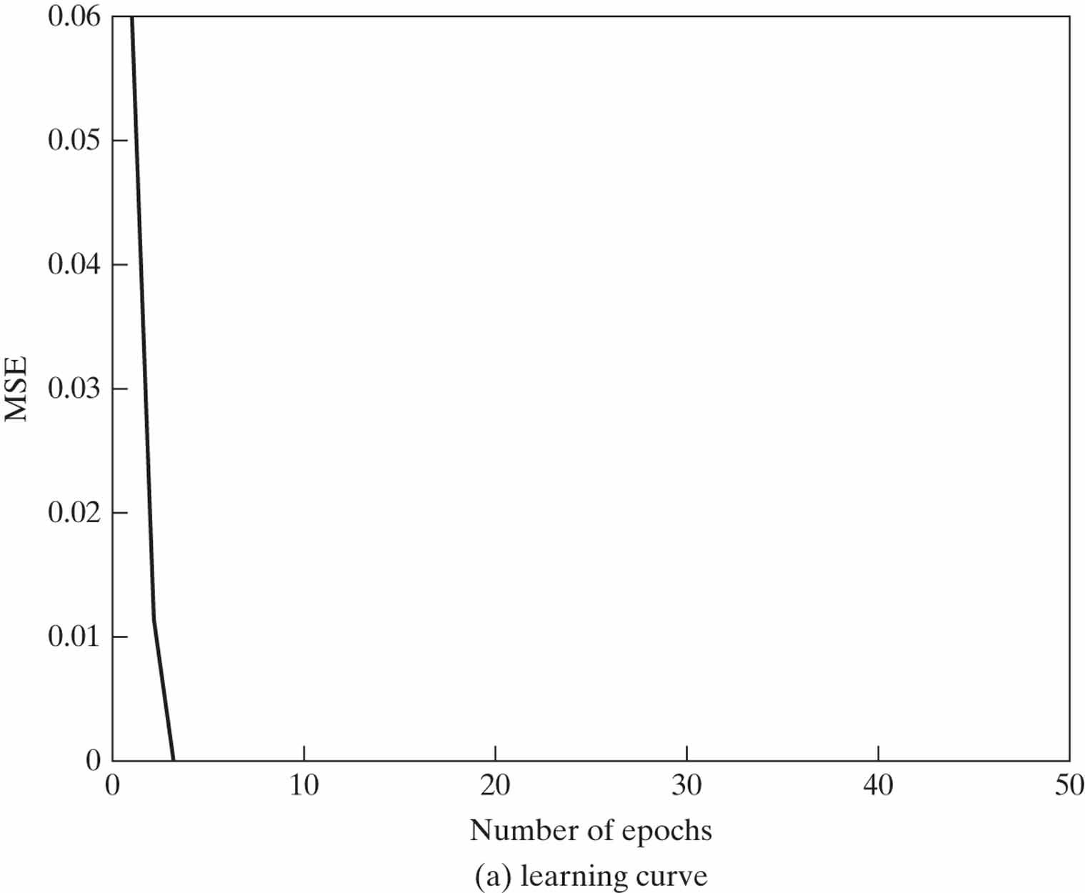
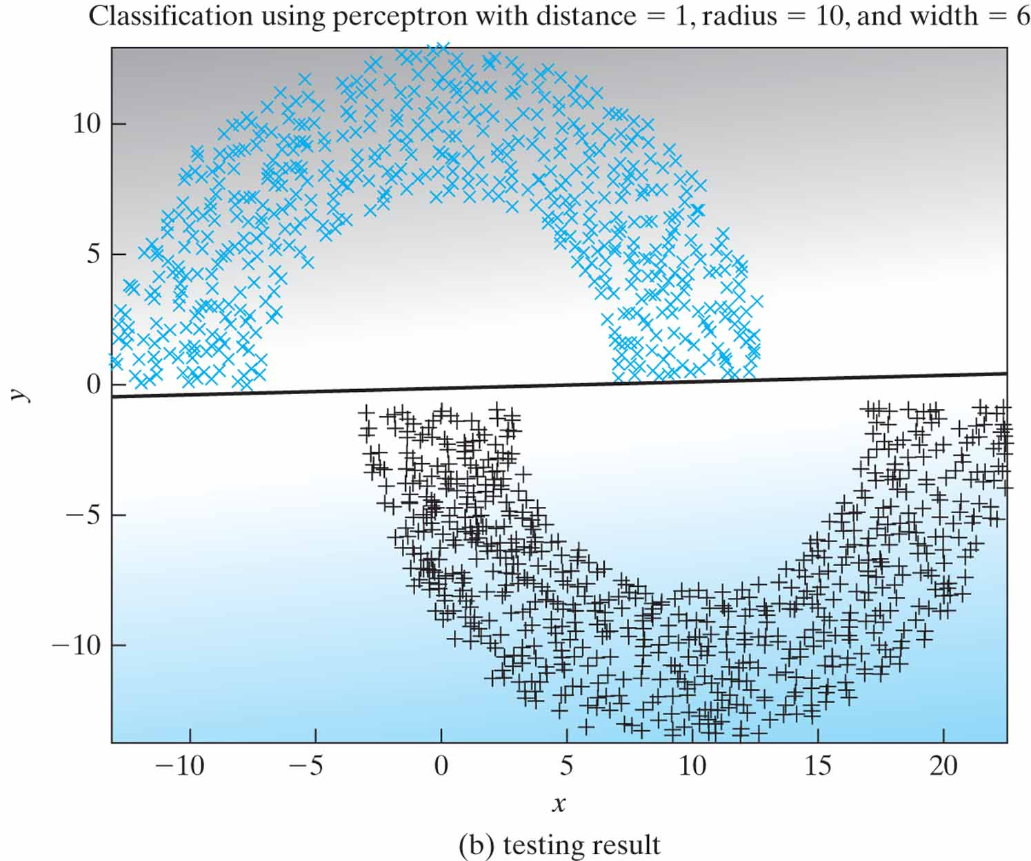
Figure 1.9 Perceptron with the double-moon set at distance d = 1.

Slide 12
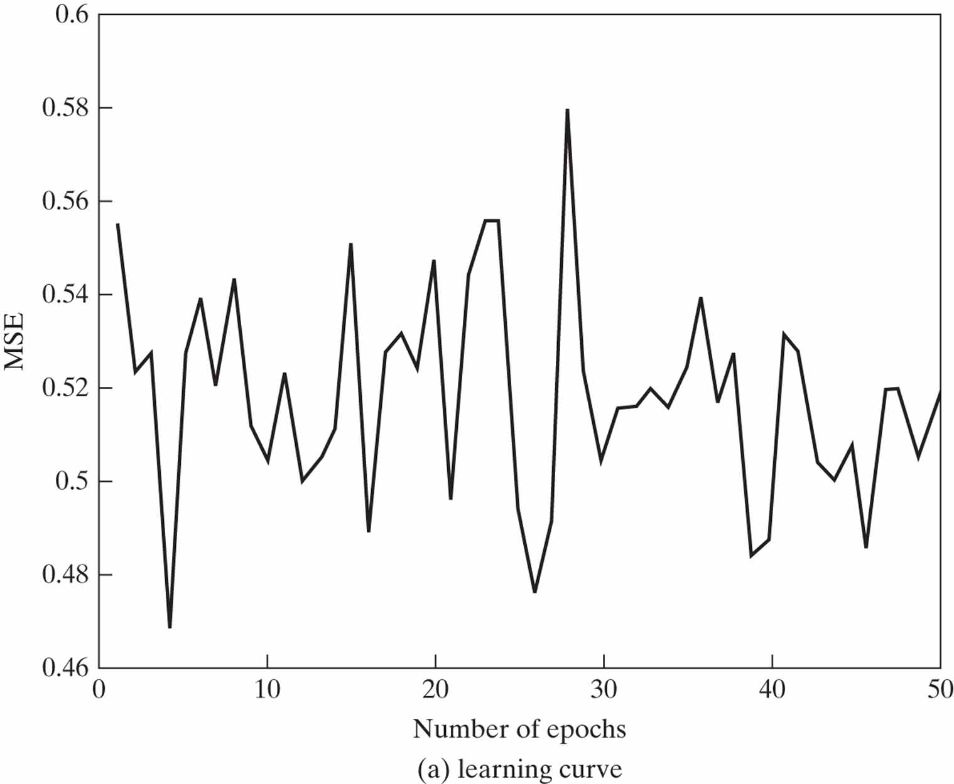
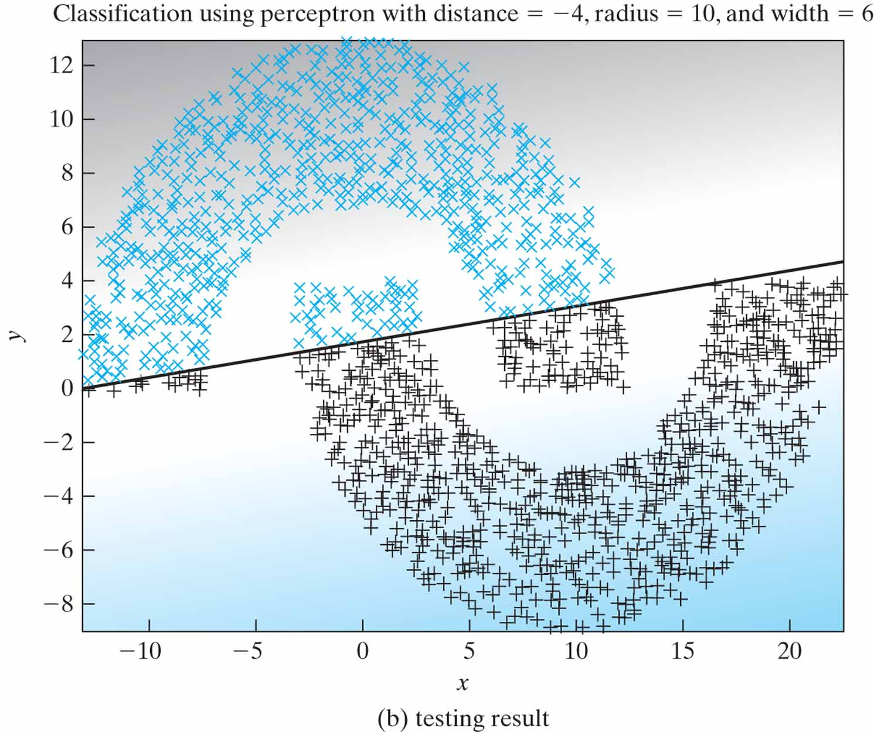
Figure 1.10 Perceptron with the double-moon set at distance d = –4.

