Slide 1
Introduction to Artificial Intelligence and Soft Computing

Slide 2
Goal
This chapter provides brief overview of
Artificial Intelligence
Soft Computing

Slide 3
Artificial Intelligence
Intelligence: “ability to learn, understand and think” (Oxford dictionary)
AI is the study of how to make computers make things which at the moment people do better.
Examples: Speech recognition, Smell, Face, Object, Intuition, Inferencing, Learning new skills, Decision making, Abstract thinking

Slide 4
Artificial Intelligence
The phrase “AI” thus c bane defined as the simulation of human intelligence on a machine, so as to make the machine efficient to identify and use the right piece of “Knowledge” at a given step of solving a problem

Slide 5
Artificial Intelligence
Thinking humanly | Thinking rationally
Acting humanly | Acting rationally

Slide 6
A Brief History of AI
The gestation of AI (1943 − 1956):
− 1943: McCulloch & Pitts: Boolean circuit model of brain.
− 1950: Turing’s “Computing Machinery and Intelligence”.
− 1956: McCarthy’s name “Artificial Intelligence” adopted.
Early enthusiasm, great expectations (1952 − 1969):
− Early successful AI programs: Samuel’s checkers,
Newell & Simon’s Logic Theorist, Gelernter’s Geometry
Theorem Prover.
− Robinson’s complete algorithm for logical reasoning.

Slide 7
A Brief History of AI
A dose of reality (1966 − 1974):
− AI discovered computational complexity.
− Neural network research almost disappeared after
Minsky & Papert’s book in 1969.
Knowledge-based systems (1969 − 1979):
− 1969: DENDRAL by Buchanan et al..
− 1976: MYCIN by Shortliffle.
− 1979: PROSPECTOR by Duda et al..

Slide 8
A Brief History of AI
AI becomes an industry (1980 − 1988):
− Expert systems industry booms.
− 1981: Japan’s 10-year Fifth Generation project.
The return of NNs and novel AI (1986 − present):
− Mid 80’s: Back-propagation learning algorithm reinvented.
− Expert systems industry busts.
− 1988: Resurgence of probability.
− 1988: Novel AI (ALife, GAs, Soft Computing, …).
− 1995: Agents everywhere.
− 2003: Human-level AI back on the agenda.

Slide 9
General Problem Solving Approaches in AI
To understand what exactly AI is, we illustrate some common problems. Problems dealt with in AI generally use a common term called ‘state’
A state represents a status of the solution at a given step of the problem solving procedure. The solution of a problem, thus, is a collection of the problem states.
The problem solving procedure applies an operator to a state to get the next state

Slide 10
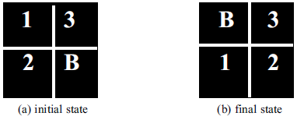
The initial and the final states of the Number Puzzle game

Slide 11
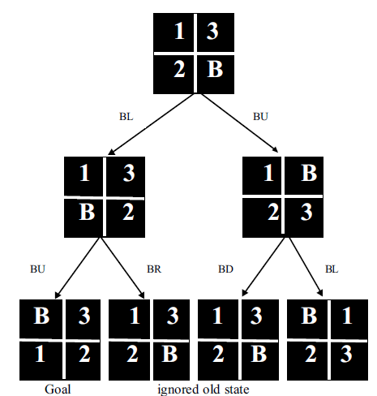
The state-space for the Four-Puzzle problem

Slide 12
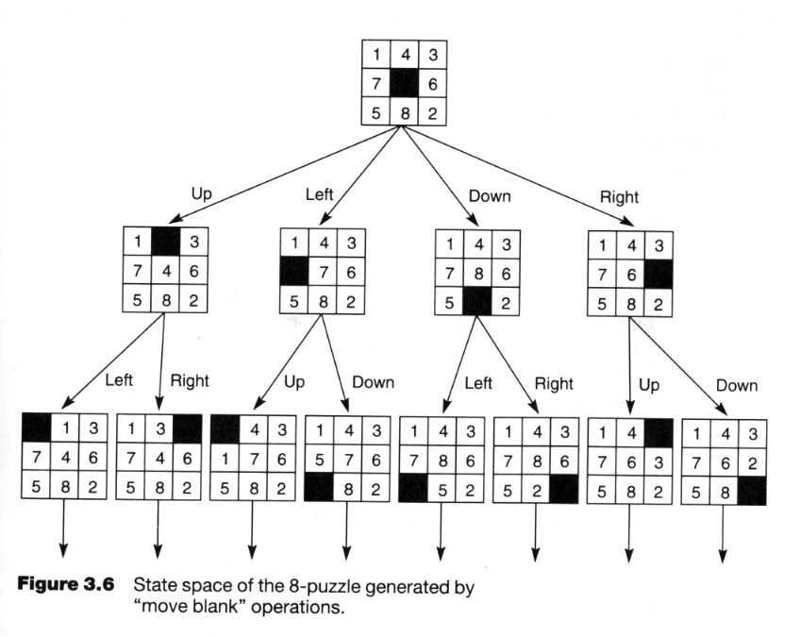
The state-space for the Eight -Puzzle problem

Slide 13
Some of these well-known search algorithms
Generate and Test
Hill Climbing
Heuristic Search
Means and Ends analysis

Slide 14
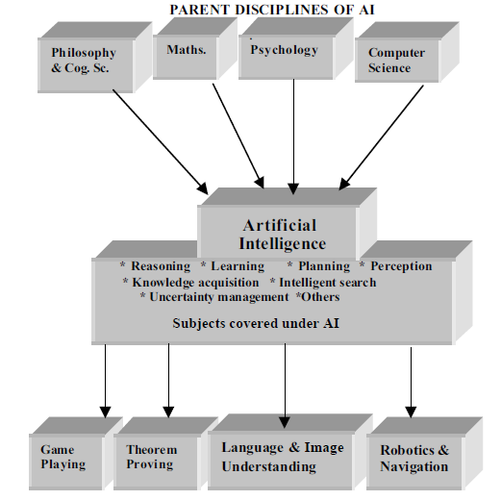

Slide 15
Biological inspiration
Artificial neurons and neural networks
Learning processes
Learning with artificial neural networks

Slide 16
Biological inspiration
Animals are able to react adaptively to changes in their external and internal environment, and they use their nervous system to perform these behaviours.
An appropriate model/simulation of the nervous system should be able to produce similar responses and behaviours in artificial systems.
The nervous system is build by relatively simple units, the neurons, so copying their behavior and functionality should be the solution.

Slide 17
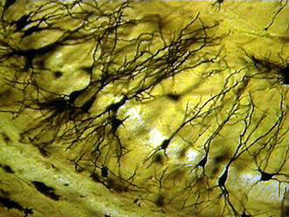
Biological inspiration
Dendrites
Soma (cell body)
Axon

Slide 18
Biological inspiration
dendrites
axon
synapses
The information transmission happens at the synapses.

Slide 19
Biological inspiration
The spikes travelling along the axon of the pre-synaptic neuron trigger the release of neurotransmitter substances at the synapse.
The neurotransmitters cause excitation or inhibition in the dendrite of the post-synaptic neuron.
The integration of the excitatory and inhibitory signals may produce spikes in the post-synaptic neuron.
The contribution of the signals depends on the strength of the synaptic connection.

Slide 20
Artificial neurons
Neurons work by processing information. They receive and provide information in form of spikes.
x₁
x₂
x₃
…
x_{n-1}
x_{n}
w₁
Output
w₂
Inputs
y
w₃
.
.
.
w_{n-1}
w_{n}
The McCullogh-Pitts model

Slide 21
Artificial neurons
The McCullogh-Pitts model:
spikes are interpreted as spike rates;
synaptic strength are translated as synaptic weights;
excitation means positive product between the incoming spike rate and the corresponding synaptic weight;
inhibition means negative product between the incoming spike rate and the corresponding synaptic weight;

Slide 22
Artificial neurons
Nonlinear generalization of the McCullogh-Pitts neuron:
y is the neuron’s output, x is the vector of inputs, and w is the vector of synaptic weights.
Examples:
sigmoidal neuron
Gaussian neuron

Slide 23
Artificial neural networks
Output
Inputs
An artificial neural network is composed of many artificial neurons that are linked together according to a specific network architecture. The objective of the neural network is to transform the inputs into meaningful outputs.

Slide 24
Artificial neural networks
Tasks to be solved by artificial neural networks:
controlling the movements of a robot based on self-perception and other information (e.g., visual information);
deciding the category of potential food items (e.g., edible or non-edible) in an artificial world;
recognizing a visual object (e.g., a familiar face);
predicting where a moving object goes, when a robot wants to catch it.

Slide 25
Learning in biological systems
Learning = learning by adaptation
The young animal learns that the green fruits are sour, while the yellowish/reddish ones are sweet. The learning happens by adapting the fruit picking behavior.
At the neural level the learning happens by changing of the synaptic strengths, eliminating some synapses, and building new ones.

Slide 26
Learning as optimisation
The objective of adapting the responses on the basis of the information received from the environment is to achieve a better state. E.g., the animal likes to eat many energy rich, juicy fruits that make its stomach full, and makes it feel happy.
In other words, the objective of learning in biological organisms is to optimise the amount of available resources, happiness, or in general to achieve a closer to optimal state.

Slide 27
Learning in biological neural networks
The learning rules of Hebb:
synchronous activation increases the synaptic strength;
asynchronous activation decreases the synaptic strength.
These rules fit with energy minimization principles.
Maintaining synaptic strength needs energy, it should be maintained at those places where it is needed, and it shouldn’t be maintained at places where it’s not needed.

Slide 28
Learning principle for artificial neural networks
ENERGY MINIMIZATION
We need an appropriate definition of energy for artificial neural networks, and having that we can use mathematical optimisation techniques to find how to change the weights of the synaptic connections between neurons.
ENERGY = measure of task performance error

Slide 29
Neural network mathematics
Output
Inputs

Slide 30
Neural network mathematics
Neural network: input / output transformation
W is the matrix of all weight vectors.

Slide 31
MLP neural networks
MLP = multi-layer perceptron
Perceptron:
MLP neural network:
x
y_{out}
x
y_{out}

Slide 32
RBF neural networks
RBF = radial basis function
Example:
Gaussian RBF
x
y_{out}

Slide 33
Neural network tasks
control
classification
prediction
approximation
These can be reformulated in general as
FUNCTION APPROXIMATION
tasks.
Approximation: given a set of values of a function g(x) build a neural network that approximates the g(x) values for any input x.

Slide 34
Neural network approximation
Task specification:
Data: set of value pairs: (x^{t}, y_{t}), y_{t}=g(x^{t}) + z_{t}; z_{t} is random measurement noise.
Objective: find a neural network that represents the input / output transformation (a function) F(x,W) such that
F(x,W) approximates g(x) for every x

Slide 35
Learning to approximate
Error measure:
Rule for changing the synaptic weights:
c is the learning parameter (usually a constant)

Slide 36
Learning with a perceptron
Perceptron:
Data:
Error:
Learning:
A perceptron is able to learn a linear function.

Slide 37
Learning with RBF neural networks
RBF neural network:
Data:
Error:
Learning:
Only the synaptic weights of the output neuron are modified.
An RBF neural network learns a nonlinear function.

Slide 38
Learning with MLP neural networks
MLP neural network:
with p layers
y_{out}
x
1 2 … p-1 p
Data:
Error:
It is very complicated to calculate the weight changes.

Slide 39
Learning with backpropagation
Solution of the complicated learning:
calculate first the changes for the synaptic weights of the output neuron;
calculate the changes backward starting from layer p-1, and propagate backward the local error terms.
The method is still relatively complicated but it is much simpler than the original optimisation problem.

Slide 40
Learning with general optimisation
In general it is enough to have a single layer of nonlinear neurons in a neural network in order to learn to approximate a nonlinear function.
In such case general optimisation may be applied without too much difficulty.
Example: an MLP neural network with a single hidden layer:

Slide 41
Learning with general optimisation
Synaptic weight change rules for the output neuron:
Synaptic weight change rules for the neurons of the hidden layer:

Slide 42
New methods for learning with neural networks
Bayesian learning:
the distribution of the neural network parameters is learnt
Support vector learning:
the minimal representative subset of the available data is used to calculate the synaptic weights of the neurons

Slide 43
Summary
Artificial neural networks are inspired by the learning processes that take place in biological systems.
Artificial neurons and neural networks try to imitate the working mechanisms of their biological counterparts.
Learning can be perceived as an optimisation process.
Biological neural learning happens by the modification of the synaptic strength. Artificial neural networks learn in the same way.
The synapse strength modification rules for artificial neural networks can be derived by applying mathematical optimisation methods.

Slide 44
Summary
Learning tasks of artificial neural networks can be reformulated as function approximation tasks.
Neural networks can be considered as nonlinear function approximating tools (i.e., linear combinations of nonlinear basis functions), where the parameters of the networks should be found by applying optimisation methods.
The optimisation is done with respect to the approximation error measure.
In general it is enough to have a single hidden layer neural network (MLP, RBF or other) to learn the approximation of a nonlinear function. In such cases general optimisation can be applied to find the change rules for the synaptic weights.

Slide 45
Soft Computing
Soft computing is a term applied to a field within computer science which is characterized by the use of inexact solutions to computationally-hard tasks such as the solution of problems, for which an exact solution can not be derived in polynomial time

Slide 46
Components of soft computing include
Neural networks (NN)
Fuzzy systems (FS) and its derefative
Evolutionary computation (EC), including:
Evolutionary algorithms
Harmony search
Swarm intelligence
Ideas about probability including:
Bayesian network, Naïve Bayesian
Chaos theory
Perceptron

Slide 47
Problem, Problem Space and Searching
Defining the problem as a State Space Search
Breadth First Search
Depth First Search
Heuristic Search
Problem Characteristics
Hill Climbing

Slide 48
Knowledge Representation
A good knowledge representation naturally represents the problem domain
An unintelligible knowledge representation is wrong
Most artificial intelligence systems consist of:
Knowledge Base
Inference Mechanism (Engine)

Slide 49
Knowledge Representation
Propositional Logic
Decision Trees
Semantics Networks
Frame
Script
Production Rules

Slide 50
Uncertainty
Bayes Theorem
Bayes Rule
Naïve Bayes Classifier
Certainty Factir

Slide 51
Expert System
Defining Expert Systems
Describing uses and components of Expert Systems
Showing an example of an Expert System
Describing the underlying programming used to build an expert system.
Expert System Concept
Knowledge Base
Inference Engine
Case Study

Slide 52
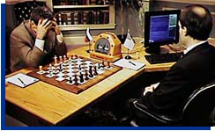
Game Playing
Game Playing – Game Classification
Game Playing has been studied for a long time
Game Playing – Chess
Game Playing – MINIMAX
Evaluation and Searching Methods

Slide 53
Fuzzy Logic
Introduction
Crisp Variables
Fuzzy Variables
Fuzzy Logic Operators
Fuzzy Control
Case Study

Slide 54
Neural Network
What are Neural Networks?
Biological Neural Networks
ANN – The basics
Feed forward net
Training
Applications – Feed forward nets
Hopfield nets
Learning Vector Quantization

Slide 55
Support Vector Machine
Linear Classifier
Non Linear Classifier
Quadratic Programming
QP With Basis Function
Case Study

Slide 56
Genetic Algorithm
Encoding technique (gene, chromosome)
Initialization procedure (creation)
Evaluation function (environment)
Selection of parents (reproduction)
Genetic operators (mutation, recombination)
Parameter settings (practice and art)

