Slide 1
High-Performance Complex Event Processing over Streams
Eugene Wu, Yanlei Diao, ShariqRizvi
Presented by Ming Li and Mo Liu
The material in the talk is adapted from
the slides of this paper’s conference talk at SIGMOD 2006

Slide 2
Outline
Background of Complex Event Processing
SASE Event Language
Query Evaluation
Sequence Scan and Construction
Optimization
Performance Measurement

Slide 3
Preliminaries
Event
An event is defined to be an instantaneous, atomic (happens completely or not at all) occurrence of interest at a point in time.
Event stream
not homogeneous

Slide 4
Complex Event Processing
Sensor technologies are gaining mainstream adoption
Emerging applications: retail management, food & drug distribution, healthcare, library, postal services…
High volume of events with complex processing
•filtered
•correlated for complex pattern detection
•transformed to reach an appropriate semantic level
A new class of queries
•translate data of a physical world to useful information
Notes:
Sensor device----generate high volume of events
Applications require such events to be filtered.(plus)
To address the needs, the authors present SASE, an event processing system that executes complex event queries over real-time streams of RFID readings.
These complex event queries filter and correlate events to match specific patterns, and transform the relevant events into new events for the use of external monitoring applications.

Slide 5
Performance Requirements
Two challenges
•High-volume event streams
•Extracting events from large windows:
Low-Latency
• Time-critical action
Notes:
The authors address two challenges arising in large-scale event processing:
The volume of events generated by large deployments of receptors can reach thousands of events per second or higher.
Event monitoring applications often apply a sliding window (e.g., within the past 12 hours) to a sequence of events of interest. In many scenarios, such windows are large and the events relevant to a query are widely dispersed with others across the window.
------------------------
Stream-based execution of these queries allows a monitoring application to be notified immediately when all relevant events have been received; as a result, time critical actions can be taken to prevent loss in value and mitigate harm

Slide 6
SASE Event Language
Language structure
Event <event pattern>:
structure of an event pattern
[WHERE <qualification>]:
value-based predicates over the pattern
[WITHIN <window>] :
sliding window over the pattern

Slide 7
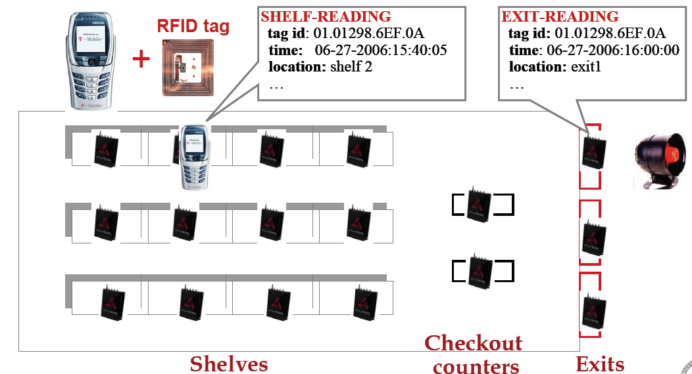
A Retail Management Scenario
Notes:
Shoplifting: an item was first read at a shelf and them at an exit but not at any checkout counter in between.

Slide 8
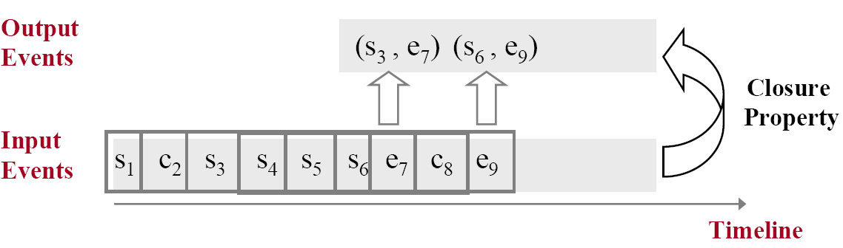
SASE Event Language
Shoplifting Query
EVENT SEQ(SHELF-READING s, !(COUNTER-READING C),EXIT-READING e)
WHERE x.id = y.id ∧ x.id = z.id /* or equivalently, [id] */
WITHIN 12 hours

Slide 9
Formal Semantics
Define the semantics by translating its language constructs to algebraic query expressions.
Operators
ANY operator :
ANY(A1, A2, …, An) (t) ≡ ∃ 1≤i≤ n Ai(t)
SEQ_ operator:
SEQ_(A1, A2, …, An) (t) ≡ ∃ t1<t2<…<tn=t A1(t1)∧A2(t2) ∧…∧An(tn)
SEQ_WITHOUT operator:
SEQ_WITHOUT(S1, {B}, S2) (t) ≡ ∃ t11<…<t1m<t21<…<t2n=t
A11(t11)∧…∧A1m(t1m)∧A21(t21)∧…∧A2n(t2n)∧(∀ti∈(t1m, t21) ¬B(ti))
Selection operator
σ(SEQ_(A1, …, An), Ρ) (t) ≡ ∃ t1< …<tn=t A1(t1)∧…∧An(tn) ∧ (Ρ)
WITHIN_ operator
WITHIN_(SEQ_(A1, …, An), T) (t) ≡ ∃ t-T<t1<…<tn=t A1(t1)∧…∧An(tn)

Slide 10
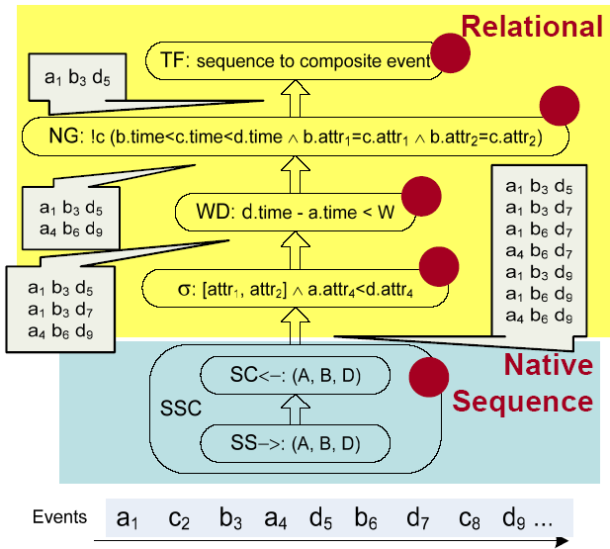
A Basic Query Plan
EVENT SEQ(A a, B b, !(C c), D d)
WHERE[attr1,attr2] ∧a.attr4<d.attr4
WITHIN W

Slide 11
Example
<a(2) b(2) d(2)>
TF: sequence to composite event
a(2) b(2) d(2)
NG: !C (B.time<C.time<D.time Λ B.attr1 = C.attr1)
EVENT SEQ(A, B, !C, D)
WHERE [attr1]
WITHIN 10 seconds
a(2) b(2) d(2)
a(3) b(3) d(3)
WD: D.time – A.time < 10secs
a(2) b(2) d(2)
a(3) b(3) d(3)
a(2) b(2) d(2)
a(2) b(2) d(3)
a(2) b(3) d(3)
a(3) b(3) d(3)
α [attr1]
SSC (A, B, D)
Event Stream
a(2)
c(1)
b(2)
a(3)
d(2)
b(3)
c(3)
d(3)
a(4)
1
2
3
4
5
6
7
8
9
Time
Adapted form Ph.D. Comprehensive Exam Talk September 2006 Luping Ding
Notes:
Occurrence order, don’t have to directly follow each other

Slide 12
Discussions
1 Does SASE support
not (a and b and c)?
2 What is the main difference between the event query and the relational SQL query?

Slide 13
Sequence Scan and Construction (SSC)
Finite Automata are a natural formalism for sequences
Two phases of processing
• Sequence Scan (SS→): scans input stream to detect matches
• Sequence Construction (SC←): searches backward (in a summary of the stream) to create event sequences.

Slide 14
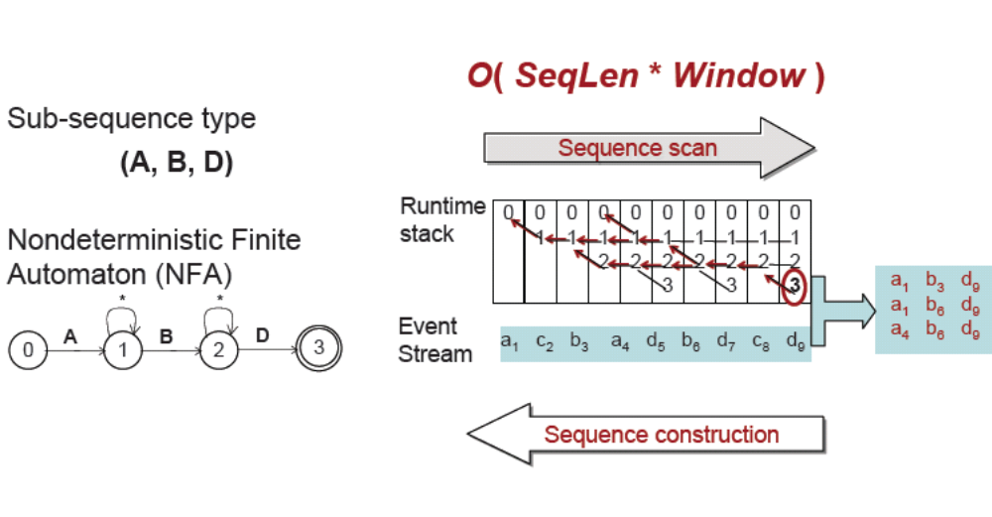
Illustration of SSC
a1 c2 b3 a4 d5 b6 d7 c8 d9
O O O

Slide 15


Illustration of SSC (Cont.)
a1 b3 d5
a1 b3 d7
a1 b6 d7
a1 b3 d9
a1 b6 d9
a1 c2 b3 a4 d5 b6 d7 c8 d9
a4 b6 d9

Slide 16

Illustration of SSC (Cont.)
Should the automaton be this one??
0
0
cx c0 a1 c2 b3 a4 d5 b6 d7 c8 d9

Slide 17
Optimization Issues
What are the key issues for optimization?
• Large sliding windows: e.g., “within past 12 hours”
• Large intermediate result sizes: may cause wasteful work
Intra-operator optimization to expedite SSC
• Cost of sequence construction depends on the window size.
Inter-operator optimizations to reduce intermediate results
• How to evaluate predicates early in SSC?
• How to evaluate windows early in SSC?
Indexing relevant events in SSC both in temporal order and across value-based partitions

Slide 18
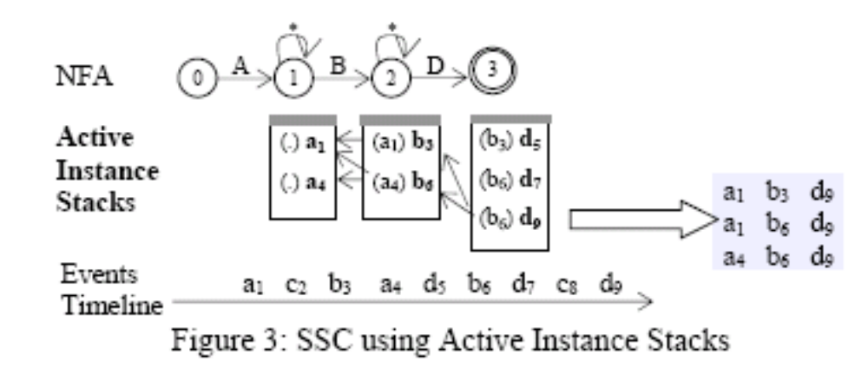
Optimization on SSC: Sequence Index
RIP (most recent instance in the previous stack)
of b6 is set to a4

Slide 19

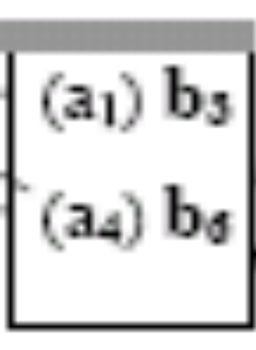
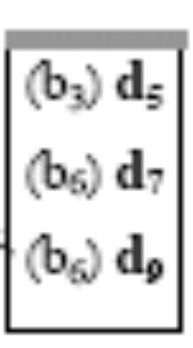
Optimization on SSC: Sequence Index
(Cont.)

Slide 20
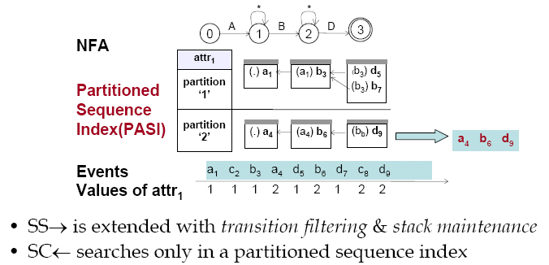
Pushing Down Predicate Evaluations

Slide 21
More Optimizations
Evaluating additional equivalence tests in SSC
• Multi-attribute partitions: high memory overhead
(attr1, attr2…)
• Single-attribute partitions & cross filtering in SS→
Pushing the window operator down to SSC
• Windows in SS→: coarse grained filtering, pruning
• Windows in SC←: precise checking

Slide 22
Discussion
Pushing the window operator down to the SSC
• How to do that?
• Can it really can be counted as one
“optimization technique”?

Slide 23
Discussion (Cont.)
(1) IF b3 – a1 > w
(2) IF d9 – a1 > w
(3) IF d7 – a1 > w
a1 c2 b3 a4 d5 b6 d7 c8 d9
a1 b3 d5
a1 b3 d7
a1 b6 d7
a1 b3 d9
a1 b6 d9
a4 b6 d9

Slide 24
Performance Evaluation
Effectiveness of query processing in SASE
• Sequence index offers an order-of-magnitude improvement with large windows & query result sizes.
• Partitioned sequence index is highly effective. Pushing one equivalence test to SSC is a must!
• Etc.

Slide 25
Questions?

Slide 26
Good night
& Good luck !

