Slide 1
SEDA: An Architecture for Scalable, Well-Conditioned Internet Services
Authors: Matt Welsh, David Culler, and Eric Brewer
UC Berkeley
Presented by: Yang Liu, University of Michigan

Slide 2

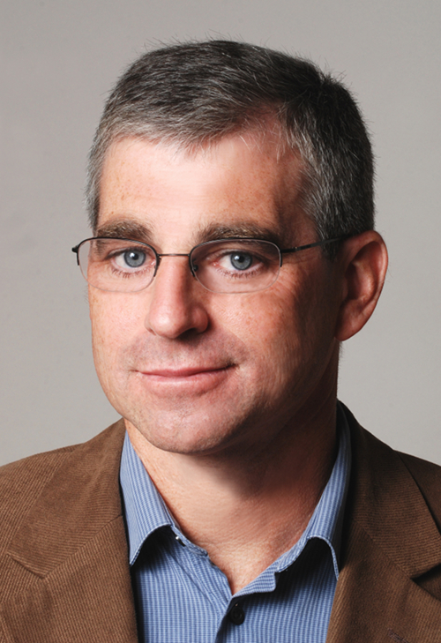
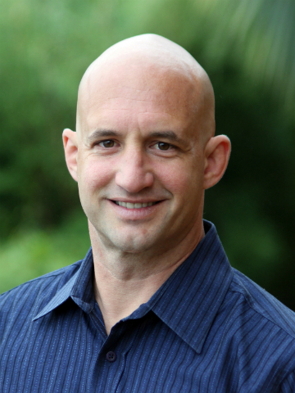

About the Authors
Matt Welsh
Tech Lead of Chrome Cloud team
Previous professor in Harvard University
Alumni including Mark Zuckerberg
David E. Culler
Professor at UC Berkeley
Chair of UC Berkeley EECS
Eric Brewer
Professor at UC Berkeley
Author of CAP theorem
Founder of USA.gov

Slide 3
Internet Services Characteristic
Massive Concurrent Access
2001(paper published)
Yahoo: 1.2 Billion page view/day
AOL: Web service: 10 billions hits/day
Now
Service suffers from peak load (“Slashdot Effect”)
Peak load is orders of magnitude greater than average
Justin Bieber Problem on Instagram
Every time Justin Bieber(56 Million Followers) post on Instagram, it brings the whole service slow
News about 911overloaded many news sites
Peak Load occurs when the service is most valuable
Increasing Dynamic
Majority services based on dynamic content
E-commerce, Social Network, Stream Video, Google Map, Service Oriented Websites/application
Service logic changes rapidly
Facebook push changes twice a day on their website (2012)
Services are hosted on general purpose facilities
PaaS, IaaS

Slide 4
Problem Identification
Supporting Massive Concurrency is hard
Threads/Process designed for timesharing
High overhead and memory footprint
Don’t scale to thousands of tasks
Existing OS design do not provide graceful management of load
Standard OS focus on providing maximum transparency
Transparency prevent application from making informed decision
Dynamic of services exaggerate these problems
As services become more dynamic, this engineering burden is excessive
Replication is not solving the problem
Brings extra complication: Consistency
Cannot gracefully handle peak load on
Notes:
Next, let’s take a further look on what people have tried to solve the grace full degreadation problem

Slide 5
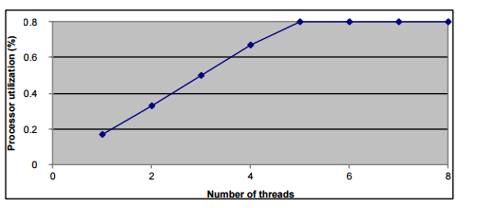
Saturation Point
Saturation Point in the view of thread
Thus, there are two regions of operation:
Before saturation, adding more threads increase processor utilization linearly
After saturation, processor utilization does not improve with more threads, but is limited by the switching overhead
Notes:
Next, let’s take a further look on what people have tried to solve the grace full degreadation problem

Slide 6
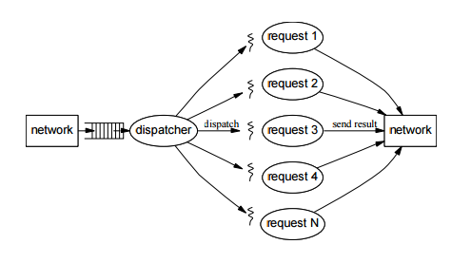
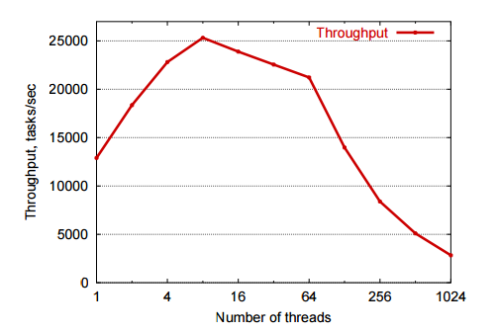
Thread-Based Concurrency
Pros:
Easy multiprogramming paradigm, brings more concurrency
Cons
High resource usage, context switch overhead, Cache misses, contended locks
Too many threads -> throughput meltdown
Traditional solution: Thread pool
Problem: How to decide thread pool size, especially upon different load
Transparency hide resource contention
Notes:
Transparency hide resource contention:
first transparency is from thread itself, which hide many details behind the scene, scheduling policy is based on general purpose may be falsely used, as we saw in EXOkenel and dataplane paper
Secondly, the requests stream is also hided in each thread basis, so we have no control and no knowledge of how many requests are there throughout the system

Slide 7
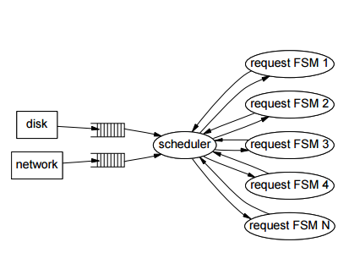
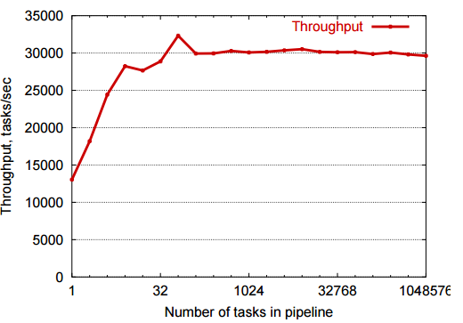
Event-driven Concurrency
Pros:
Yields efficient and scalable concurrency with explicit flow from the event queue
Many examples: click router, Flash web server, etc (Still used in many service-oriented architecture today)
Cons
Little OS and tool support (when the paper is published)
No isolation between FSMs
Assume Non blocking I/O which may not be supported
Hard to implement, hard to modulation, event scheduling is bounded with application logic
Notes:
Little OS and tool support
Now: Signal/Slot in Qt and boost: signals2
Akka and Actor model in Scala/Java: Reactive programming
OS: Not found, but Kafka and Golang channel can view as a support

Slide 8
Call for new architecture
Enable Introspection to handle Peak Load
Dynamic control for self-tuning resource management
Simplify task of building highly concurrent services
Support Massive Concurrency
New Design?

Slide 9
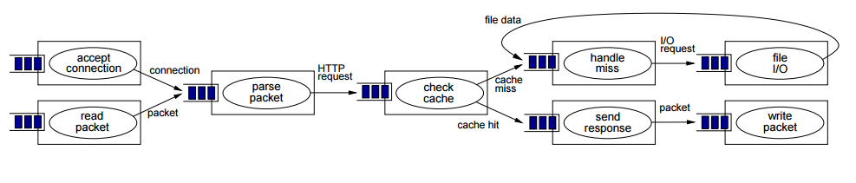
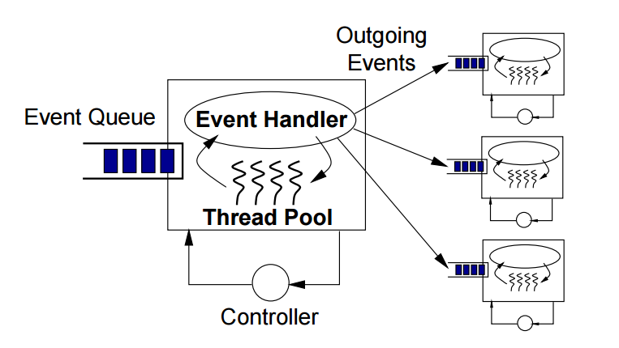
SEDA: Staged Event Driven Architecture
Decompose services into stages
Each stage is a subset of request processing (Micro service)
Each Stage internally contains an incoming queue, an event handler for application logic, a thread pool for stage execution and a controller for resource allocation and scheduling policy
Queue and thread pool are controlled by controller
Dynamic control grows/shrinks can be applied to the service without changing application logic
Best of threads and events
Programmability of threads with explicit flow of event
Notes:
The introduction of a queue between stages decouples their execution by introducing an explicit control boundary. This model constrains the execution of a thread to a given stage, as a thread may only pass data across the control boundary by enqueuing an event

Slide 10
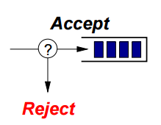

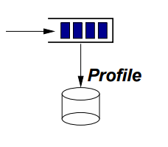
Queues for Control and Composition
Queues are finite
An enqueue behavior may fail
Block on full queue -> backpressure
Drop rejected events -> load shedding
May also do alternative actions, e.g., degraded service
Queue introduces explicit execution boundary
Threads may only execute within a single stage
Performance isolation, modularity, independent load management
Explicit event delivery support inspection
Trace flow of events through application
Monitor queue lengths to detect bottleneck

Slide 11
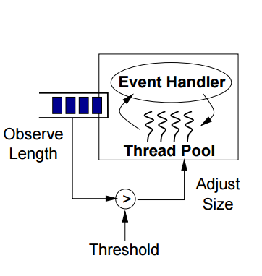
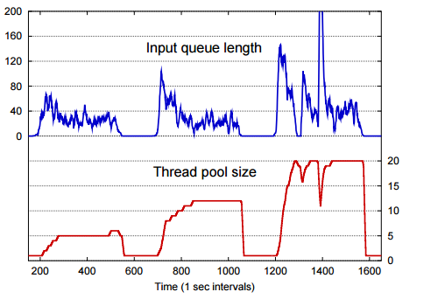
SEDA thread pool controller
Goal: Determine ideal degree of concurrency for a stage
Dynamically adjust number of threads allocated to each stage
Avoid wasting threads when unneeded
Controller operation
Observes input queue length, adds threads if over threshold
Idle threads removed from pool

Slide 12
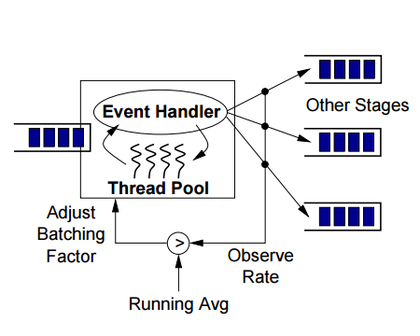
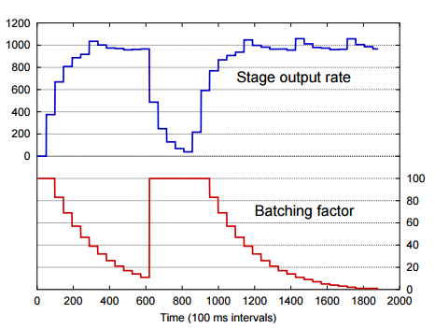
SEDA thread pool controller
Goal: Schedule for low response time and high throughput
Batching factor: number of events consumed by each thread
Large batching factor → more locality, higher throughput
Small batching factor → lower response time
Attempt to find smallest batching factor with stable throughput
Reduces batching factor when throughput high, increases when low

Slide 13
Conclusion on SEDA
Enable Introspection to handle Peak Load
Dynamic control for self-tuning resource management
Simplify task of building highly concurrent services
Support Massive Concurrency
A combination of Event Driven and multi thread
✓
SEDA
Staged
Event
Driven
Architecture
Event queue allow inspection of request streams
Can perform filter, aggregate during peak load
✓
Feed-back control based on event queue
✓
Decouple load management from service complexity
Stages for modulation
✓

Slide 14
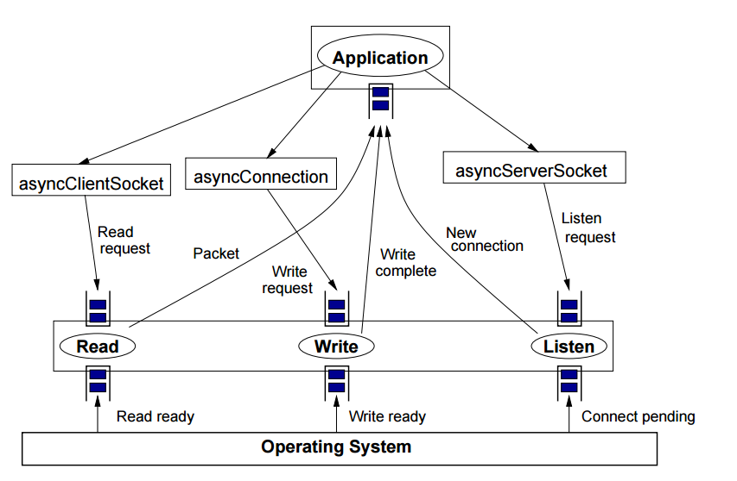
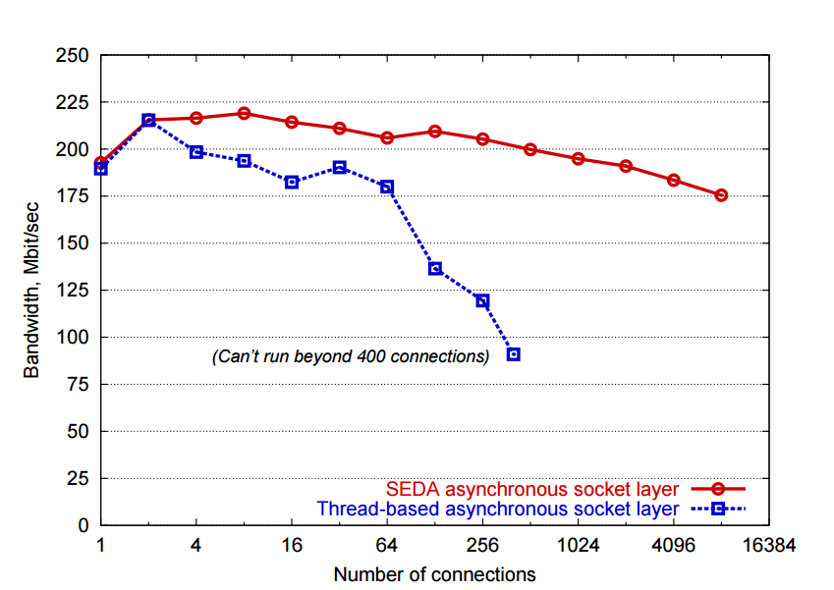
Apply SEDA for Asynchronous Socket I/O: Sandstorm
Asynchronous sockets layer performance
Read stage
Read network packets
Responds to user requests
Write stage
Write packets to network
Established new outgoing connections
Listen stage
Accept new TCP connections
Response to user requests

Slide 15
Apply SEDA for web server design: Haboob
Measured static file load from SpecWEB99 benchmark
Realistic, industry-standard benchmark
1 to 1024 clients making repeated requests, think time 20ms
Total fileset size is 3.31 GB ; page sizes range from 102 Bytes to 940 KB
Maintains memory cache of recently accessed pages (200 MB)
Significant fraction of page accesses require disk I/O
Comparison with Apache and Flash
Apache: Process-based concurrency, 150 processes
Does not accept new TCP connections when all processes busy
Flash (Vivek Pai, Princeton): Event-driven w/ 4 processes .
Accepts only 506 simultaneous connections due to fd limits

Slide 16
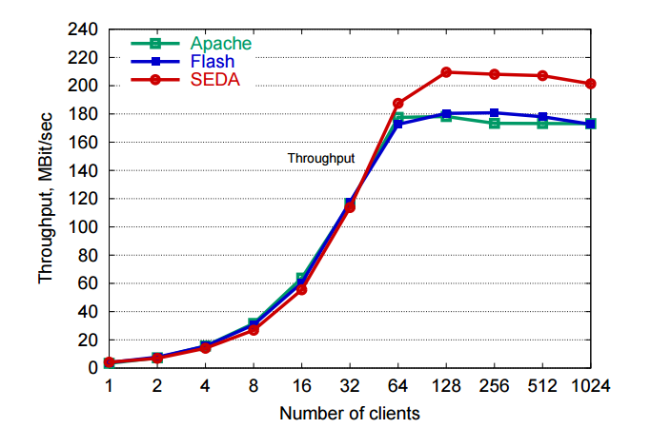
Haboob: measurement
4-way Pentium III 500 MHz, Gigabit Ethernet, 2 GB RAM, Linux 2.2.14, IBM JDK 1.3
SEDA throughput 10% higher than Apache and Flash (which are in C!)
Some degradation due to Linux socket inefficiencies
Apache accepts only 150 clients at once - no overload despite thread model
But as we will see, this penalizes many clients

Slide 17
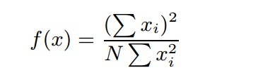
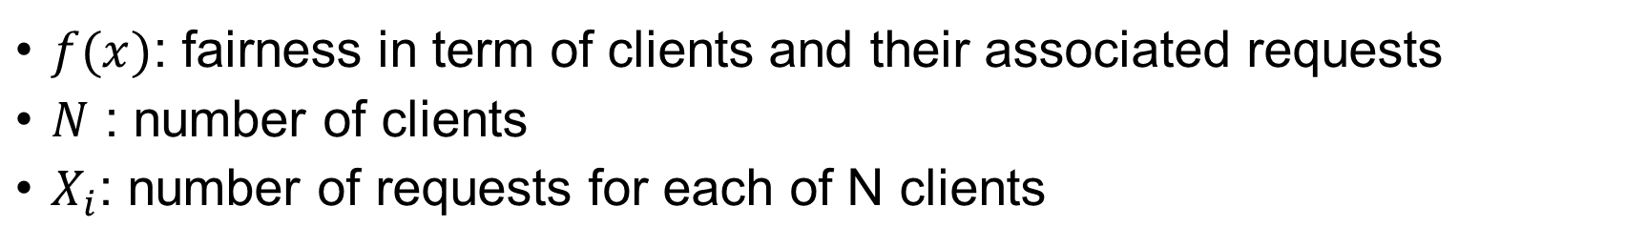
Measure Fairness: Jain Fairness Measurement
$f(x)$: fairness in term of clients and their associated requests
$N$ : number of clients
$X_{i}$: number of requests for each of N clients

Slide 18
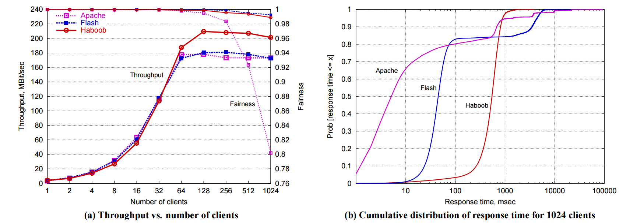
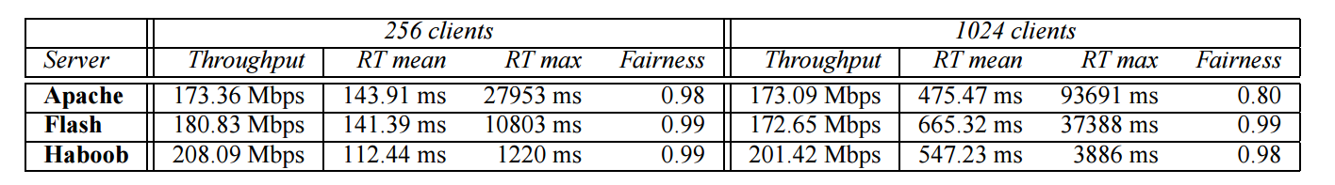
Haboob: measurement
SEDA yields predicated performance, whereas apache and Flash are very unfair

Slide 19
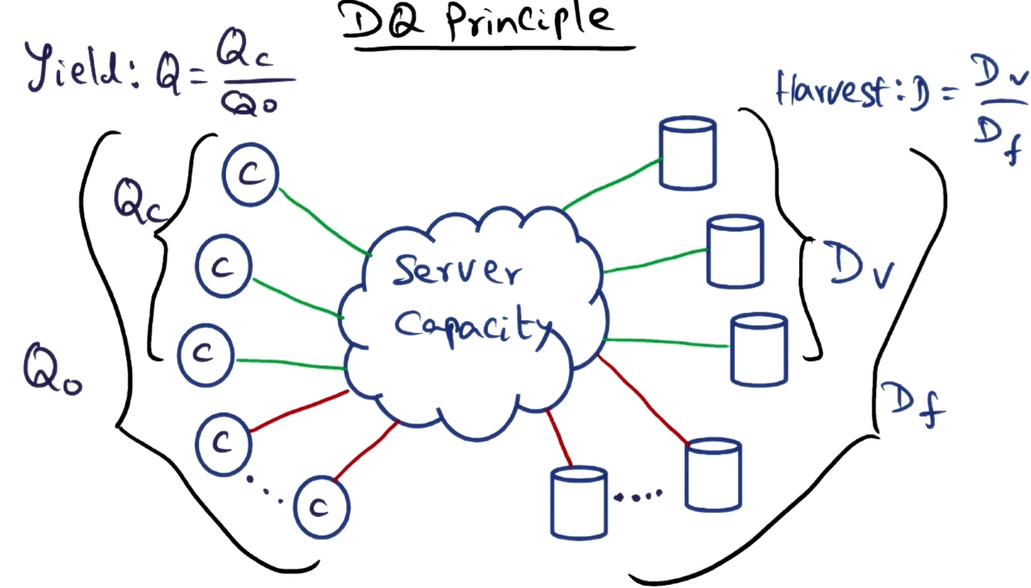
Discussion: Graceful degradation
The DQ Principle from Eric A. Brewer
D*Q == constant
D: data per second
Q: queries per second
Can we apply DQ principle with SEDA?
Notes:
data_per_query * queries_per_second == constant

Slide 20
Discussion: Review from the author
A Retrospective on SEDA by Matt Welsh, 2010 on his blog
Historical limitation
Linux threads were suffering a lot of scalability problems
What SEDA got Wrong
Most critical is the idea of connecting stages through event queues, with each stage having its own separate thread pool.
Solve? Decouple queues and thread pools with stages yet still organized the code into stages
Never satisfied with Non-blocking I/O, spent a lot of time tuning parameters
What SEDA got Right
using Java, instead of C
The most important contribution of SEDA, I think, was the fact that we made load and resource bottlenecks explicit in the application programming model.
Notes:
Linux threads were suffering a lot of scalability problems, so it was best to avoid using too many of them
The most critical is the idea of connecting stages through event queues, with each stage having its own separate thread pool. As a request passes through the stage graph, it experiences multiple context switches, and potentially long queueing at busy stages. This can lead to poor cache behavior and greatly increase response time. Note that under reasonably heavy load, the context switch overhead is amortized across a batch of requests processed at each stage, but on a lightly (or moderately) loaded server, the worst case context switching overhead can dominate.
I probably spent more time tuning the sockets library than any other part of the design. (It did not surprise me to learn that people trying to run Sandstorm on different JVMs and threading libraries had trouble getting the same performance: I found those parameters through trial-and-error.) The fact that SEDA never included proper nonblocking disk I/O was disappointing, but this just wasn't available at the time (and I decided, wisely, I think, not to take it on as part of my PhD.)

Slide 21
Discussions
My thoughts:
SEDA is a useful server design model, can be viewed as a combination of Feedback Controller + staged modulation + event(message) flow + application metrics on load(event queue)
Some aspect of it have been Adapted by message-driven Architecture like AKKA, Distributed Message Queue like Kafka, stream processing like Storm, and dataflow model like MapReduce/Tez/Spark
SEDA + Scale out distributed system design+ load balancer can perform elastic load handling
Controller model with metrics on load is adapted as industrial standard to improve single machine throughput
Tech talk from Facebook, Tencent, Alibaba and Baidu shows they all use PID control for high throughput (citation needed)

Slide 22
Summary
Server Design paradigm
Multi threaded: thread per socket or thread pool
Event Driven Architecture
Staged Event Driven Architecture
Concepts
Saturation point
Jain Fairness Index
DQ principle / Graceful Degradation
Lessons learnt
Modulation is not only ease for programming but can bring flexibility through decoupling
There is always a trade off between Transparency and Performance:
Transparency means hiding information, but this can be avoid through system design

Slide 23
Q & A
Thanks

Slide 24
References
SEDA paper & slides: http://www.eecs.harvard.edu/~mdw/proj/seda/
Instagram Justin Bieber Problem: http://www.wired.com/2015/11/how-instagram-solved-its-justin-bieber-problem/
Facebook push code frequency: http://commencement.umich.edu/spring-commencement/spring-commencement/
Event Driven and SOA: https://msdn.microsoft.com/en-us/library/dd129913.aspx
Event Driven with Akka: https://blog.openshift.com/building-distributed-and-event-driven-applications-in-java-or-scala-with-akka-on-openshift/
Saturation point: http://www.inf.ed.ac.uk/teaching/courses/pa/Notes/lecture09-multithreading.pdf
DQ principle: http://www.cs.berkeley.edu/~brewer/papers/GiantScale-IEEE.pdf
DQ principle Picture: https://www.youtube.com/watch?v=nSwraiJSQj8

Slide 25
References
Blog about SEDA: http://muratbuffalo.blogspot.com/2011/02/seda-architecture-for-well-conditioned.html
SEDA thesis from Matt: http://www.eecs.harvard.edu/~mdw/papers/mdw-phdthesis.pdf
AKKA: http://akka.io/
Kafka: http://kafka.apache.org/
Storm: http://storm.apache.org/
Dataflow: http://googlecloudplatform.blogspot.co.uk/2016/01/Dataflow-and-open-source-proposal-to-join-the-Apache-Incubator.html
Blogs About SEDA: http://www.infoq.com/articles/SEDA-Mule
Blogs About SEDA: http://www.theserverside.com/news/1363672/Building-a-Scalable-Enterprise-Applications-Using-Asynchronous-IO-and-SEDA-Model

