Slide 1
Middleware Systems Overview and Introduction
Hans-Arno Jacobsen

Slide 2
Middleware

Slide 3
Middleware Systems
Middleware systems are comprised of abstractions and services to facilitate the design, development, integration and deployment of distributed applications in heterogeneous networking environments.
  remote communication mechanisms (Web services, CORBA, Java RMI, DCOM - i.e. request brokers)
  event notification and messaging services (COSS Notifications, Java Messaging Service etc.)
  transaction services
  naming services (COSS Naming, LDAP)
  …

Slide 4
Definition by Example
The following constitute middleware systems or middleware platforms
  CORBA, DCE, RMI, J2EE (?), Web Services, DCOM, COM+, .Net Remoting, application servers, …
  some of these are collections and aggregations of many different services
  some are marketing terms

Slide 5
What & Where is Middleware ?
Databases
Programming
Languages
Middleware
Systems
Operating Systems
Distributed
Systems
Networking
middleware is dispersed among many disciplines

Slide 6
What & Where is Middleware ?
Databases
SIGMOD, VLDB, ICDE
Programming
Languages
Middleware
ACM/IFIP/IEEE
Middleware Conference,
DEBS, DOA, EDOC
Operating Systems
SIGOPS
Distributed
Systems
ACM PODC, ICDE
Networking
SIGCOMM,INFOCOM
mobile computing, software engineering, ….

Slide 7
Middleware Research
dispersed among different fields
with different research methodologies
different standards, points of views, and approaches
a Middleware research community is starting to crystallize around conferences such as Middleware, DEBS, DOA, EDOC et al.
  Many other conferences have middleware tracks
many existing fields/communities are broadening their scope
“middleware” is still somewhat a trendy or marketing term, but I think it is crystallizing into a separate field - middleware systems.
in the long term we are trying to identify concepts and build a body of knowledge that identifies middleware systems - much like OS - PL - DS ...

Slide 8
Middleware Systems I
In a nutshell:
  Middleware is about supporting the development of distributed applications in networked environments
This also includes the integration of systems
About making this task easier, more efficient, less error prone
About enabling the infrastructure software for this task

Slide 9
Middleware Systems II
software technologies to help manage complexity and heterogeneity inherent to the development of distributed systems, distributed applications, and information systems
layer of software above the operating system and the network substrate, but below the application
Higher-level programming abstraction for developing the distributed application
higher than “lower” level abstractions, such as sockets provided by the operating system
  a socket is a communication end-point from which data can be read or onto which data can be written

Slide 10
Middleware Systems III
aims at reducing the burden of developing distributed application for developer
informally called “plumbing”, i.e., like pipes that connect entities for communication
often called “glue code”, i.e., it glues independent systems together and makes them work together
it masks the heterogeneity programmers of distributed applications have to deal with
  network & hardware
  operating system & programming language
  different middleware platforms
  location, access, failure, concurrency, mobility, ...
often also referred to as transparencies, i.e., network transparency, location transparency

Slide 11
Middleware Systems IV
an operating system is “the software that makes the hardware usable”
similarly, a middleware system makes the distributed system programmable and manageable
bare computer without OS could be programmed, so could the distributed application be developed without middleware
programs could be written in assembly, but higher-level languages are far more productive for this purpose
however, sometimes the assembly-variant is chosen - WHY?

Slide 12
The Questions
What are the right programming abstractions for middleware systems?
What protocols do these abstractions require to work as promised?
What, if any, of the underlying systems (networks, hardware, distribution) should be exposed to the application developer?
  Views range from
    full distribution transparency to
    full control and visibility of underlying system to
    fewer hybrid approaches achieving both
  With each having vast implications on the programming abstractions offered

Slide 13
Middleware in Practice
Very relevant and wide industry exposure
Subject to market forces and market trends
Subject to marketing jargon
Dominated by standards and de facto standards

Slide 14
Middleware Metaphorically
Host 1
Host 2
Distributed application
Distributed application
Middleware
Middleware
Operating system
Operating system
Network

Slide 15
Categories of Middleware
remote invocation mechanisms
  e.g., DCOM, CORBA, DCE, Sun RPC, Java RMI, Web Services ...
naming and directory services
  e.g., JNDI, LDAP, COSS Naming, DNS, COSS trader, ...
message oriented middleware
  e.g., JMS, MQSI, MQSeries, ...
publish/subscribe systems
  e.g., JMS, various proprietary systems, COSS Notification

Slide 16
Categories II
(distributed) tuple spaces
  (databases) - I do not consider a DBMS a middleware system
  LNDA, initially an abstraction for developing parallel programs
  inspired InfoSpaces, later JavaSpaces, later JINI
transaction processing system (TP-monitors)
  implement transactional applications, e.g.e, ATM example
adapters, wrappers, mediators

Slide 17
Categories III
choreography and orchestration
  Workflow and business process tools (BPEL et al.)
  a.k.a. Web service composition
fault tolerance, load balancing, etc.
real-time, embedded, high-performance, safety critical

Slide 18
Middleware Curriculum
A middleware curriculum needs to capture the invariants defining the above categories and presenting them
A middleware curriculum needs to capture the essence and the lessons learned from specifying and building these types of systems over and over again
We have witnessed the re-invention of many of these abstractions without any functional changes over the past 25 years (see later in the course.)
Due to lack of time and the invited guest lectures, we will only look at a few of these categories

Slide 19
Course Objectives
See and understand some of the current industry trends
  Conveyed through the invited lectures and expert topics
Do some critical thinking and relate trends to what exists and existed in the past
  Conveyed through additional lectures
Try to see some invariants underlying the trends and some of the more fundamental questions
  Conveyed through the additional lectures
Learn about doing research and asking questions
  Conveyed through the discussion leading and, of course, the course project

Slide 20
What’s to Come?

Slide 21
Additional Lectures Outline
Middleware Systems Overview and Introduction
The Role of Middleware Standards
Middleware Architecture Evolution
Service-oriented Architectures
Event-driven Architectures
Publish/Subscribe Middleware
Middleware Research
Course project presentations

Slide 22

Small Digression
Our Middleware Research

Slide 23
The Research We Pursue
Research methodology
  We build systems, applications, and algorithms
  Measure, analyse and improve systems and algorithms
  Mostly above the transport layer and below the application
Current research focus
  Data-centric networking and distributed event-based processing
    Content-based routing
    Publish/Subscribe
    Realization of event-driven and service-oriented architectures
  Aspect-oriented middleware and software product families
    How to do model-driven development
    How to customize software

Slide 24
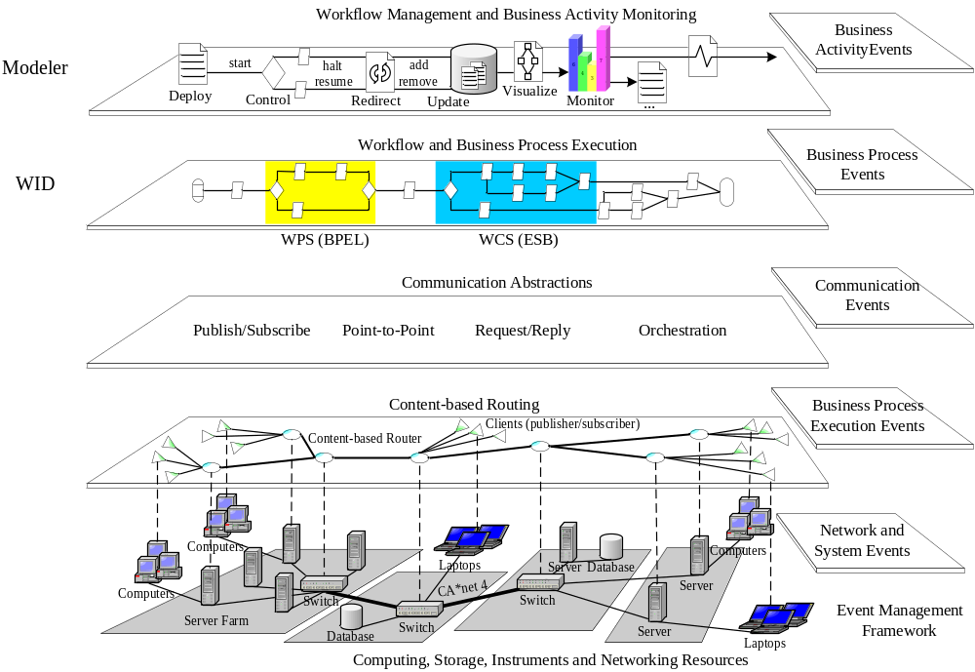
The Enterprise Services Bus
An Event-driven Architecture for a Real-time Enterprise

Slide 25
Applications Enabled
Inter-enterprise supply chain management
E-Health-care support and scalable patient e-record delivery, dissemination, and routing
Distributed event management and event correlation
Business activity monitoring & Business process execution
SLA monitoring and management
Distributed system management and control
Data management in RFID-based systems
Sensor network management
Distributed surveillance and sensor fusion
Network management and event correlation

Slide 26
MicroToPSS
code available under BSD
http://microToPSS.msrg.utoronto.ca/
A middleware for sensor networks enabling
  Sense-and-response applications
  Data management in RFID-based environments
  Factory floor automation
  E-Health care, such as patient care, patient monitoring
Web
service
Web
service
Application
MicroToPSS Middleware Abstraction
query()
subscribe()
notify()
sensor
Environment (e.g., factory production floor)

Slide 27
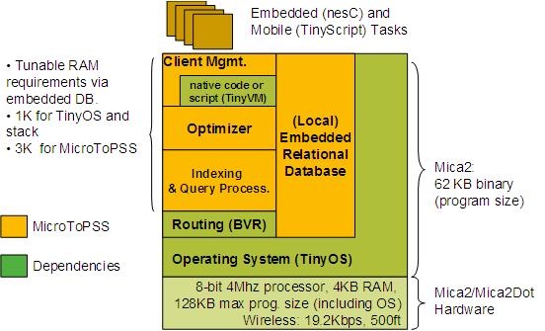
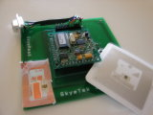
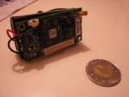
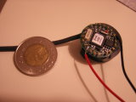
MicroToPSS Details
Sensors, RFID reader,
RFID tags et al. :

Slide 28

Aspect-oriented Middleware and
Enabling Software Product Families

Slide 29
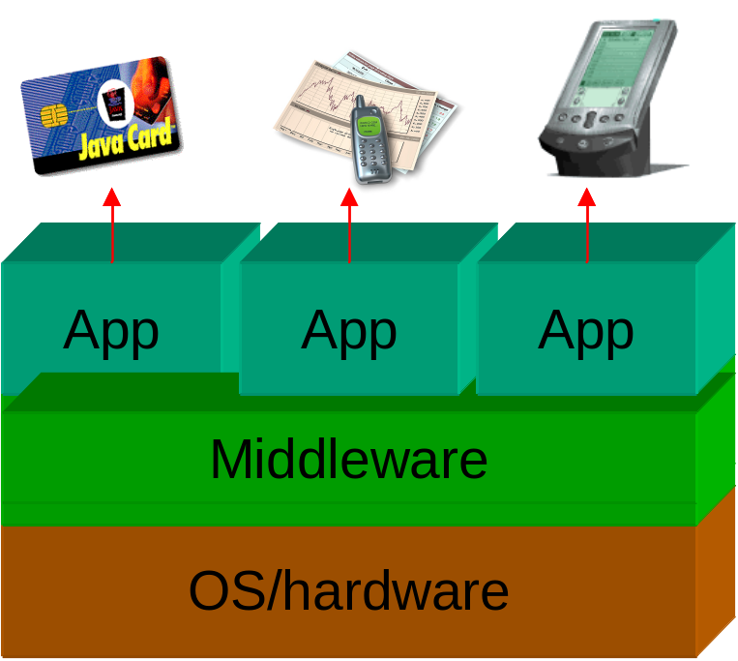
Customizable Middleware Product Families for Embedded Devices et al.
Middleware product families reduce development cost
Proven concepts on Java Card & J2ME
Based on Aspect Orientation
Prove for C-based systems in progress
  Ethernut embedded OS
  http://www.AspectC.net
Aspect-oriented Programming

Slide 30
Expert Topics & Class Projects

Slide 31
Expert Topics
Find 3 relevant papers, reports, specificaitons
Prepare a 15 minute well-focused presentation
  Really a synthesis from what you read
  Your slides will go online, refrain from copy/past
Lead a discussion on the topic
  Prepare a few controversial questions to get the discussion going

Slide 32
Expert Topics List
Web services (1)
Web 2.0 (2-3 students coordinating)
Middleware for
  RFID (1)
  sensor networks (1)
  online gaming (1)
  peer-to-peer networking (1-2)
  overlay networking (1)
  data, computing, et al. Grids (1)

Slide 33
Course Projects
Research-oriented
  Rigorously apply a research methodology
    Design, build, evaluate, experiment, and compare against a baseline, against a know solution
Structure
  Proposal (adapt G. Lee’s proposal)
  Progress report
  Presentation
  Final report (see formatting requirements)

Slide 34
Past Projects
Implementation of Web service Notifications
A large-scale deployment infrastructure
An FPGA-based pub/sub matching accelerator
Aspect-oriented refactoring of an object request broker
Approximate matching algorithm
Mobility protocols for distributed publish/subscribe systems
…

Slide 35
Project Suggestions
See handout

