Slide 1

NinJo Production System
Event Driven Architecture in NinJo
June 2008

Slide 2
Outlook: Production System and EDA
SOA – a definition
EDA - Event driven architecture
NinJo Production System
NinJo Event Services and Production Agents

Slide 3
SOA
Service orientation is an architectural concept that refers to the loose coupling of a service (an abstract resource with a defined job) and its provider (the physical asset(s) that perform the job tasks).
A requestor only knows what the service’s job is and how to request it.
The service is the only one that knows its implementation.
SOA is an IT architecture strategy for business solution (and infrastructure solution) delivery based on the concept of service orientation.

Slide 4
SOA
A composite application typically serves one business domain.
Composite applications are often delivered in a portal.
common SOA implementations are e.g. BEA weblogic application servers, combined with J2EE (JAVA Enterprises) components
sometimes they call it also “enterprises” architecture and mean “SOA”, implemented with WEB services.
Very often there is a database behind the webservice (“persistent objects”)
Services can as well communicate via CORBA

Slide 5
SOA
Most of the service invocations are synchronous in nature.
  so the caller waits for completion
  With a many-to-many communication between several services which we need to control the -> NinJo Production System this would block the data flow
Synchronous service call would be NOT sufficient for NinJo Production System
We need EDA (Event Driven Architecture)

Slide 6
Outlook: Production System and EDA
SOA – a definition
EDA - Event driven architecture
NinJo Production System
NinJo Event Services and Production Agents

Slide 7
Terminology - Event
WHAT IS AN EVENT?
  An event is a notable thing that happens inside or outside your business.
  An event (business or system) may signify a problem or impending problem, an opportunity, a threshold, or a deviation.
  Each event occurrence has an event header and event body
  Event header
    contains elements describing the event occurrence, such as the event specification ID, event type, event name, event timestamp, event occurrence number, and event creator.
    These elements are consistent, across event specifications.
  Event Body. The event body describes what happened.
    must be fully described so any interested party can use the information without having to go back to the source system.

Slide 8
Event Driven Architecture : EDA
“Event” = change of a system state, which can be send as a message
Extremely decoupled, event producers do not know consumers
  event generating processes,
  event storage and transmission = event channel,
  event processing processes
Messaging middleware: good scalability and distribution
Event processors subscribe for certain event types
Event generators and processors can be called “agents”
  It can be services, human, automated processes, sensors,..

Slide 9
Event Driven Architecture definition
An event (see definition on slide 7) happens
It will be disseminated immediately to all interested parties (human or automated).
The interested parties evaluate the event, and optionally take action.
The event-driven action may include the invocation of a service, the triggering of a business process, and/or further information publication/syndication.
the whole service invocation and data/message flow becomes asynchronous and more complex!
SOA + Event Driven Architecture = SOA2.0

Slide 10
EDA + SOA + X (CORBA) + Where goes NinJo??
The most viable, agile architectures will be comprised of a blend of architecture strategies,
  including service-oriented architecture,
  event-driven architecture,
  process-based architecture,
  federated information,
  enterprise integration and
  open source adoption.
The best choices are the ones that match your business!
So let us analyse the NinJo Production System use cases…

Slide 11
Outlook: Production System and EDA
SOA – a definition
EDA - Event driven architecture
NinJo Production System
NinJo Event Services and Production Agents

Slide 12
NinJo workstation system
We have a NinJo workstation system, consisting of:
  The client
  Data servers and import agents
  Automon monitoring (and event service)
  We have NinJo Batch production (is triggered by a web service)
  We have “Science modules” (producing data and products)
  We are developing AutoWARN (automated generation of warn status)
We need more types of science modules
We need intelligent triggering of products

Slide 13
Communication flow
All these processes communicate with each other in certain ways
  Most 1 dimensional: Import->Server->client
  2 way communication: client<->event service<->Automon
  Import->notification->Science module->data server
  Import-> notification- >Automon->Event-service->several clients
Problems:
  Rather static dependencies of processes
  Restart of processes in certain start order
  Multiple connections or information chains of multiple science modules not available
  Data / product availability should be signaled to the client or trigger batch production

Slide 14
Science Service Coupling
What does a NinJo Science Module do?
The Science Module computes new data products given specific input data and stores it on an appropriate data server, example mesocyclon cells, point forecasts
There should be a server side system of communicating (or chained) science modules

Slide 15
Science Service Coupling
Now we started thinking about a “production system”,
  The science modules should be triggered by incoming data and/ or certain rules
  The clients, other science modules and also batch should be informed, if a product is available
  Technically we end up in the definition of a couple of services and processes which communicate with each other – in an asynchronous, decoupled way
  We also considered a common “Service” interface for all processes – so NinJo goes SOA ?(!)
What we need is: ..
….The NinJo Production System

Slide 16
NinJo production system
Characterization :
the NinJo production system is not an independent and self-contained component
it is rather a collection of well coordinated components
with the task of automated product creation, in particular
  graphical products (batch)
  data products (science modules)
  Text products (warnings, reports)
coordination of the involved components is based on events sent between them

Slide 17
Information Flow
the extension of the NinJo server-side to a more powerful production system goes hand in hand with a significant increase of NinJo inter-process communication
control is provided by events
The loose coupling via events is the most powerful and flexible way of controlling complete production chains, distributed over several processes, server hardware and via LAN/WAN
NinJo will go EDA !

Slide 18
Outlook: Production System and EDA
SOA – a definition
EDA - Event driven architecture
NinJo Production System
NinJo Event Services and Production Agents

Slide 19
Event Service (or channel)
Event Service
The Event Service is the component that centrally collects all new issued events and redistributes them to all interested parties.
The event service stores events in a database and delivers them to all registered clients as soon as they are active (online)
Used already in AutoMon, AutoWARN
Clients or server side processes can register to certain event types
Event types can be e.g.
  Automon warnings (when a predefined warning rule has fired)
  incoming data notification
  production trigger events (from data monitor : „model run available“)

Slide 20
Event Service (or channel)
responsibilities
  registration and deregistration of Event Consumers
  reception of new events issued by Event Producers
  distribution of events to Event Consumer that subscribed to that specific event type
  persistent storage of processed events
  management of stored events (e.g. cleanup of outdated events)
  response to queries regarding event history
  publication of implemented interfaces in the NinJo Naming Service (NNS)
  synchronization with optionally running redundant Event Services

Slide 21
Production Agents
Every connected server side component, like import, data or monitoring services, science module, batch,..
  Can be an Event Generating Service (EGS)
  Or an Event Consuming Service (ECS)
  Or both
We call the involved components, which issue events or consume events: “production agents”

Slide 22
Production Agents
Import System
The Import System ingests new data to the data servers and thereby issues 'new data' events to the Event Service.

Slide 23
Production Agents
Data Monitor
  the Data Monitor filters single 'new data' events to an aggregated event that can be used instead.
  Can be used to find out, if “enough” data is available for a certain product
Scheduler
The Scheduler creates time-based events.

Slide 24
Production Agents
Science Service
The Science Service computes new data products given specific input data and stores it on an appropriate data server.
  It can be triggered by ‘new data’ events and produce ‘new data product’ events
Science Service responsibilities
  registration and deregistration with Event Service
  reception of events delivered by the Event Service
  access of required input data from a data server
  computation of the science data, e.g. mesocyclon cells
  storage of the result data on a data server
  submission of a 'new data' event to the Event Service

Slide 25
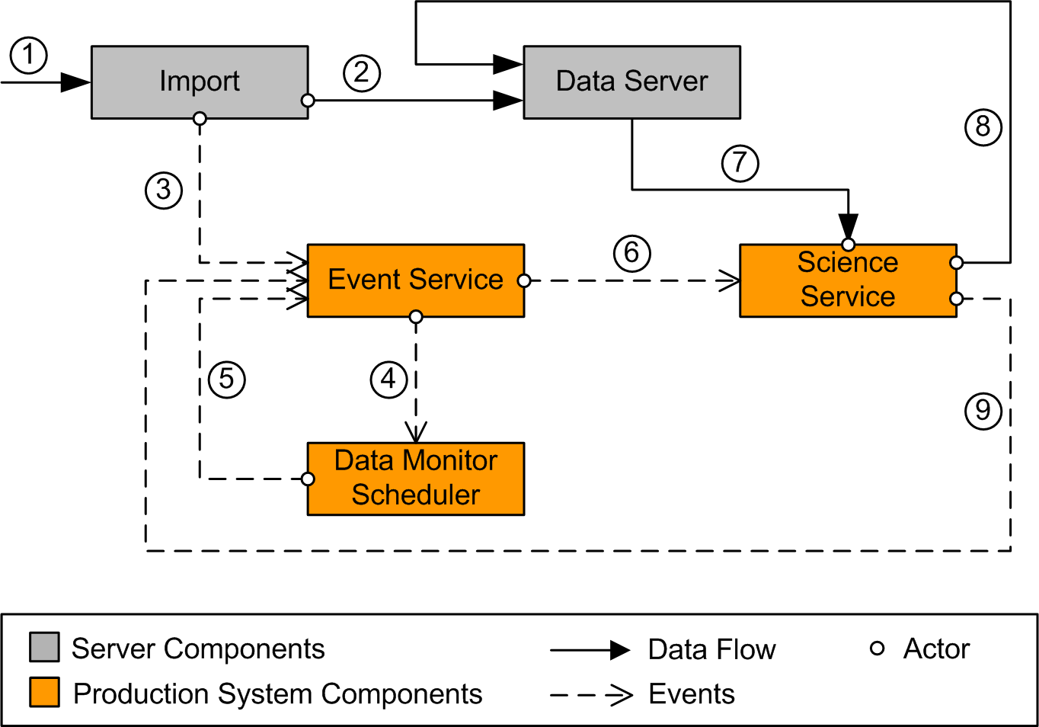
Use Case 1: Science Service
all connections shown in the diagrams are performed by means of a middleware system, in our case by means of CORBA.
the Data Monitor and Scheduler are unified in one component

Slide 26
Production Agents
Batch
The Batch system creates graphical NinJo products and provides them to the interested clients.
  Is triggered by scheduler events or by ProductOnDemand - requests via the Batch-web service
  Can be triggered by “new data” events
  Can be triggered by “new product” events
  Can produce “new data/product” events

Slide 27
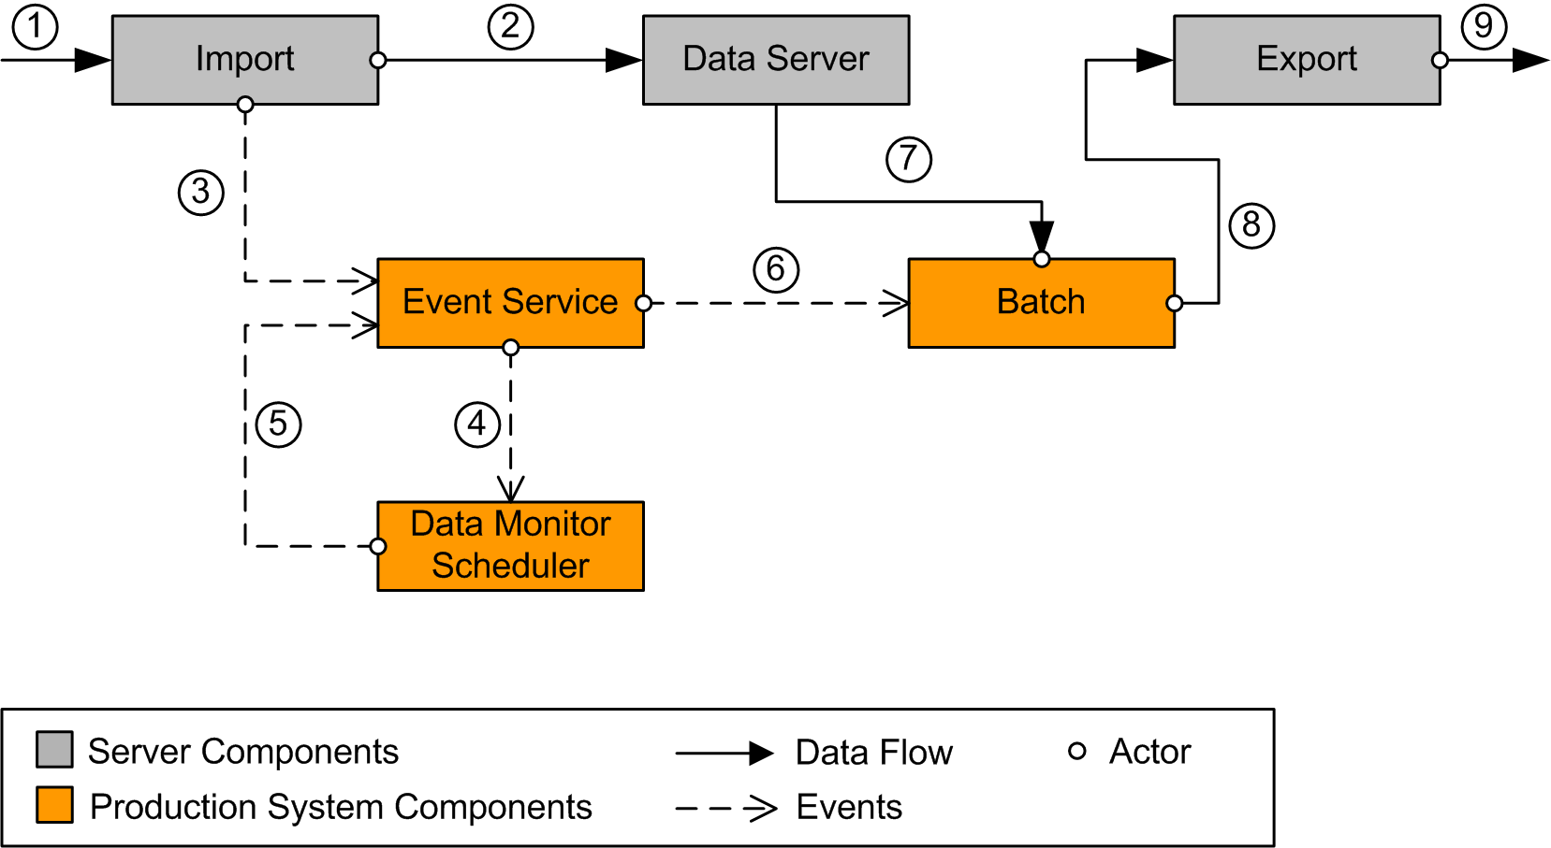
Use Case 2: Batch Production

Slide 28
Production Agents
AutoMON
AutoMON monitors weather events by means of current observations and different NWP models.
In case a rule is fulfilled an event is generated.

Slide 29
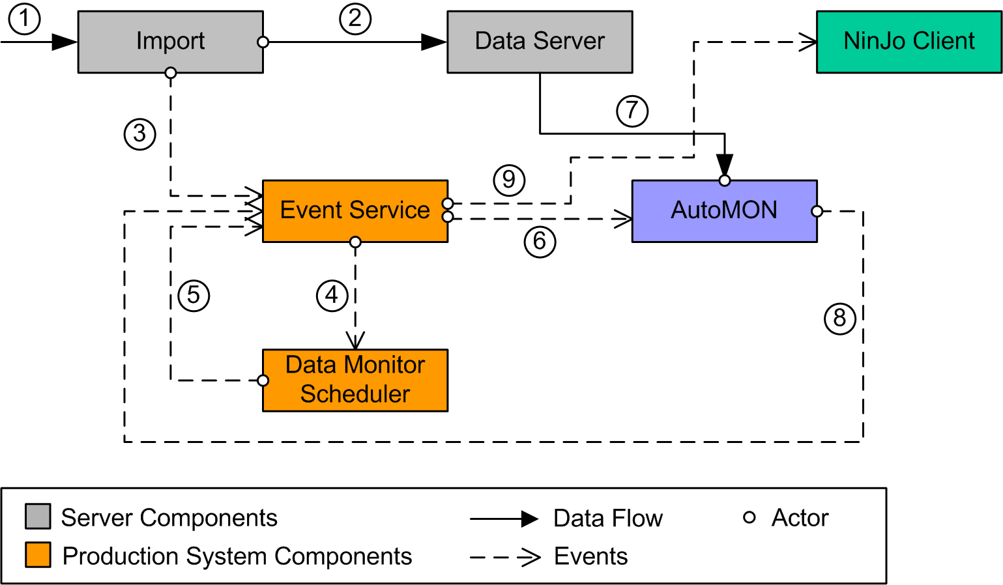
Use Case 3: AutoMON

Slide 30
Outlook
New communication framework under development
Event based communication additional to data based communication
Central event service is there, new event types will be defined
Step by step development of NinJo Production System by
  Adding new communication functionality to existing and upcoming Science/production agents
  Developing additional infrastructure services like DataMonitor
  Coupling (loose, by events) of all concerned services, servers and agents
  Benefit of OO and modular architecture: reusability of all existing software frameworks and components
  (e.g. rather small changes in client components)

Slide 31
Outlook 2
Time frame ?
This will be a big architectural extension
We will only start with small steps and need to prove the concepts before we take final decisions
Good news: we can add new components to NinJo easily
Since still research necessary, the complete solution of that automated production will take years before it is operational
  But partial solutions and infrastructure components might be usable much earlier

