Slide 1

Event-based Programming
Roger Crawfis

Slide 2
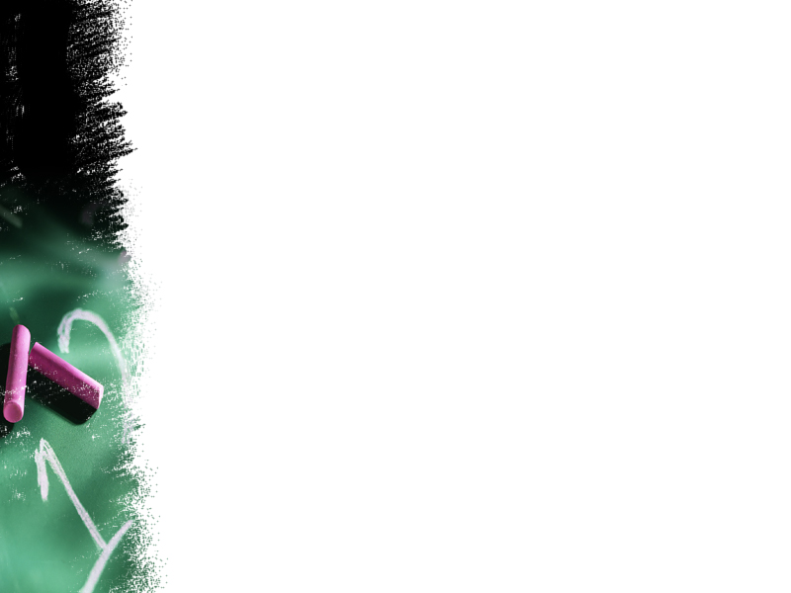
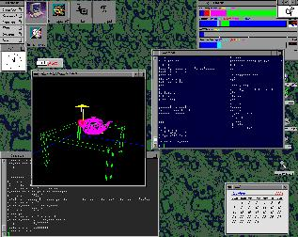
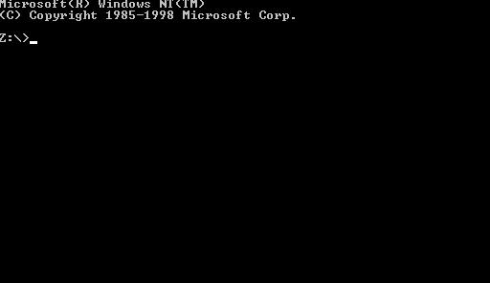

Window-based programming
Most modern desktop systems are window-based.
What location do I use to set this pixel?
Window based environment
Non-window based environment

Slide 3
Event-based Programming
Window-based GUI’s are typically comprised of many independent processes.
These processes sit and wait for the user to do something, to which it can respond.
Moreover, a simple application may be waiting for any of a number of things.

Slide 4
Event-based Programming
Sample main programs:
  C# / managed C++
    static void Main()
    {
    Application.Run( new Form1());
    }
  C++ (MFC Document/View architecture)
    There isn’t one!!
  GLUT
    void main(int argc, char** argv)
    {
    myInit();
    glutMainLoop();
    }

Slide 5
Programming forms
Procedural programming
  code is executed in sequential order.
Event-driven programming
  code is executed upon activation of events.
statement 1
statement 2
statement 3
--------
--------
statement n
method 1
method 2
method 3
--------
--------
method n
Do
method 1
then
method 3
Do
method 2
then
method 1
then
method 3

Slide 6
Procedural programming
Up to now, our control flow model has been pretty straight-forward.
Execution starts at main() and executes statement sequentially branching with if,for,and while statement, and occasional method calls.
When we need user input we call read() on the console stream which waits (blocks) until the user types something, then returns.
One problem with this model is: How do we wait for and respond to input from more than one source (eg keyboard and mouse). If we block on either waiting for input, we may miss input from the other.

Slide 7
Event-driven programming
the system waits for user input events, and these events trigger program methods
Event-based programming addresses the two problems:
  How to wait on multiple input sources (input events)
  How to decide what to do on each type of input event

Slide 8
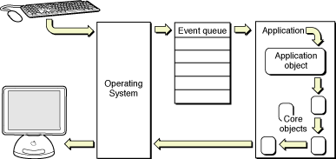
General form of event-driven programming
The operating system and window system process input events from devices (mouse movement, mouse clicks, key presses etc)
The window system decides which window, and hence which frame and program, each input event belongs to.

Slide 9
General form of event-driven programming
A data structure describing the event is produced and placed on an event queue. Events are added to one end of the queue by the window system. Events are removed from the queue and processed by the program. These event data structures hold information including:
  Which of the program's windows this event belongs to.
  The type of event (mouse click, key press, etc.)
  Any event-specific data (mouse position, key code, etc.)

Slide 10
Event loop
main(){
...set up application data structures...
...set up GUI....
// enter event loop
while(true){
Event e = get_event();
process_event(e); // event dispatch routine } }
the event loop is usually hidden from programmer, he/she provides just a process_event() method

Slide 11
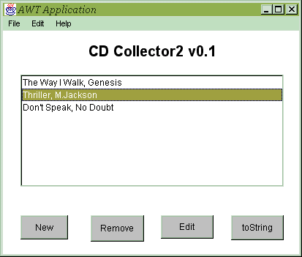
AWT Applications - Frame
Frame is a container for components
Frame with normal window controls
Optional Menu
Three containers in Frame with Border Layout
UI-components inside containers each with own layout

Slide 12
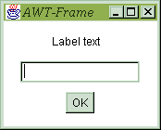
Understanding the GUI
UI-containers
  have list of
  UI-components
Each UI-component
  is a class
  with paint method
  & lists of
  Event listeners
{label}
{Frame}
components
{textfield}
{button}
Notes:
System calls paint method whenever it needs to display on screen (as may be necessary when restoring minimised window or one previously covered by another window.)
Painting is an example of polymorphism in action.
Note: components generally repaint themselves when properties (such as text label or colour) changed, but if you are extending one, eg. Frame, then you may sometimes need to explicitly tell it to repaint itself.

Slide 13
Understanding .NET UI Components
Overview
  Replacement for VB Forms and MFC
    Fully integrated with the .NET framework
    Web Service aware
    Data (ADO.NET and XML) aware
    Secure code and Licensing
  A framework for building Windows application
    “No touch” deployment
      No registration, Versionable, Smart caching
  A RAD environment in Visual Studio .NET
    Windows Form Designer, Property Browser

Slide 14
Overview (cont)
  Rich set of controls
    Standard controls - Label, Button, TextBox, etc.
    Common controls - ProgressBar, StatusBar, etc.
    Data aware controls - ListBox, DataGrid, etc.
    Common dialogs
  ActiveX Interoperability
    Can host ActiveX controls / author ActiveX controls
  Printing Support
  Visual inheritance
    Create a form based on another form by using inheritance
  Advanced layout
    Anchoring and docking

Slide 15
Basic Terms
Component
  Timer, DB Connection
Control (User Control)
  Windows Forms
    Menu
    Button
    etc
  Web Forms
    ASP.NET specific

Slide 16
Using VS.NET
Adding Components and Controls
  Just drag component from the toolbox
Editing properties
  Edit directly in the properties editor
Registering for events
  Also in the properties editor

Slide 17
What actually happens?
Data members for components
For example, after placing timer:
public class FunnyButton : System.Windows.Forms.Button
{
private System.Windows.Forms.Timer timer1;

Slide 18
What actually happens?
Attributes for the properties
For example, after changing Text property:
  private void InitializeComponent()
  {
  …
  this.Text = "ADO Example";

Slide 19
What actually happens?
Delegates for events
  Special type event in .NET (special delegate)
  private void InitializeComponent()
  {
  …
  this->MouseEnter += new System.EventHandler(this.UserControl1_MouseEnter);
  …
  }
  …
  private void UserControl1_MouseEnter(object sender, System.EventArgs e) {}

Slide 20
Names everyone should know
Properties
  Name – data member name
  Text – text shown by control (was Caption)
  ForeColor – current text color
  Dock – docking to the parent
  Enabled – active or not
Events
  Click – mouse click on the control
  SizeChanged - resize

Slide 21
InitializeComponent() method
This method is created by VS.NET
Code generated there represents all the changes done in the design view
Note: if you remove event handler or data member added by VS.NET manually, do not forget to clean the code that uses it from InitializeComponent().
Doing this from the design view is easier!

