Slide 1
Chapter 14
Databases

Slide 2
OBJECTIVES
After reading this chapter, the reader should be able to:
Understand a DBMS and define its components.
Understand the architecture of a DBMS and its levels.
Distinguish between different database models.
Understand the concept of relational database operations
on a relation.
Use Structured Query Language (SQL) to define simple
relations.

Slide 3
14.1
DATABASE
MANAGEMENT
SYSTEM

Slide 4
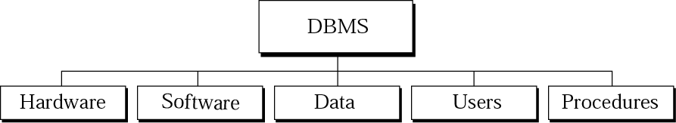
DBMS
Figure 14-1
A database management system (DBMS) defines, creates, and maintains a database.
DBMS components

Slide 5
DBMS components
Hardware
  The physical computer system that allows physical access to data
Software
  The actual program that allows users to access, maintain, and update physical data
Data: stored physically on the storage devices
User: include end users and application programs
Procedure
  A set of procedures (rules) that should be clearly defined and followed by the users of the database

Slide 6
14.2
ARCHITECTURE

Slide 7
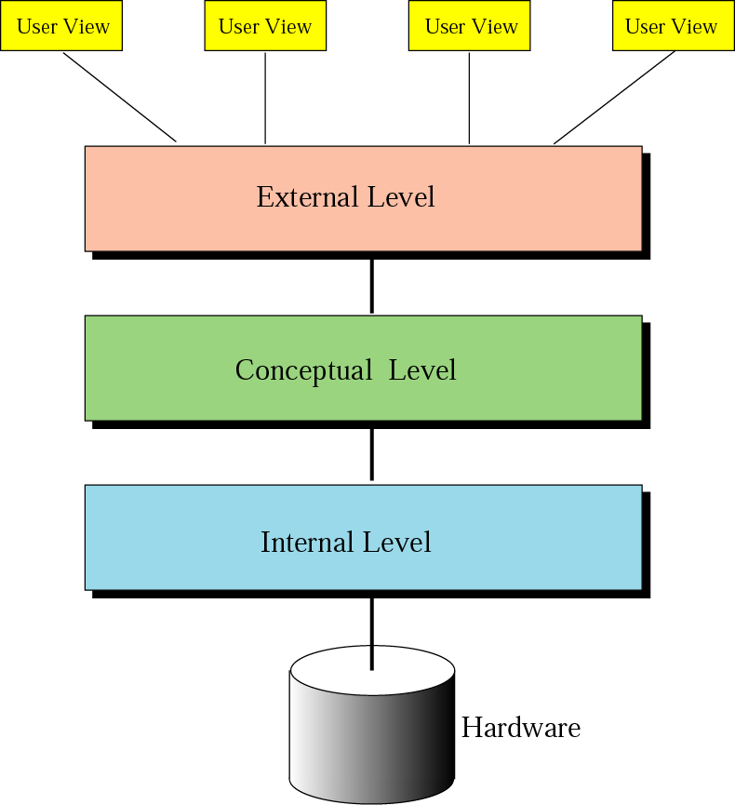
Figure 14-2
Database
architecture

Slide 8
Database architecture
ANSI/SPARC
Internal level
  The internal level determines where data are actually stored on the storage device
Conceptual level
  The conceptual level defines the logical view of the data
External level
  The external level interacts directly with the user

Slide 9
14.3
DATABASE
MODELS

Slide 10
Database models
Hierarchical model: obsolete (過時的)
Network model: obsolete (過時的)
Relational model
  In a relational model, data are organized in two-dimensional tables called relations.
  Fig. 14.5
  Discussed in Sections 14.4, 14.5

Slide 11
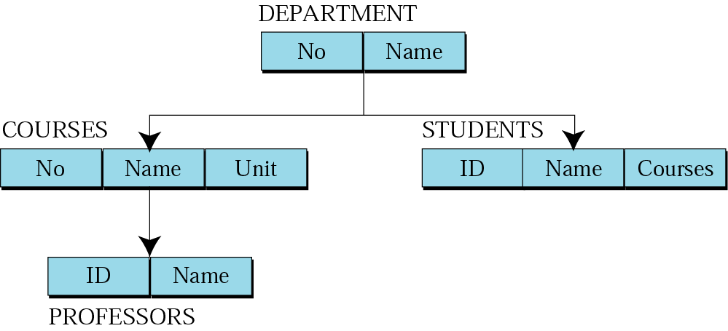
Figure 14-3
Hierarchical model

Slide 12
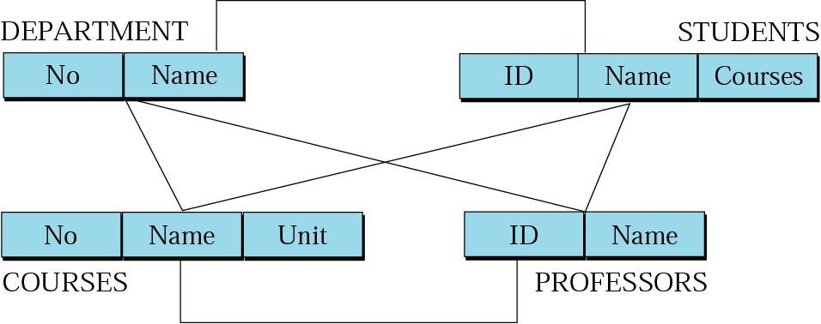
Figure 14-4
Network model: graph

Slide 13
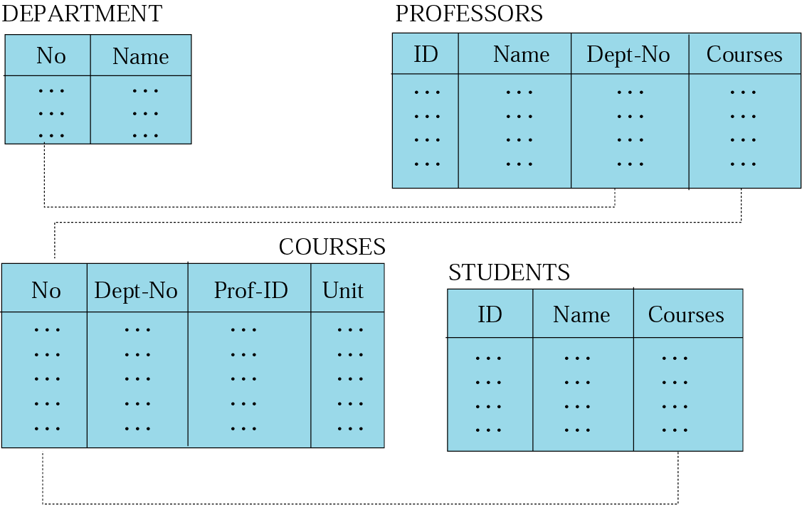
Figure 14-5
Relational model

Slide 14
14.4
RELATIONAL
MODEL

Slide 15
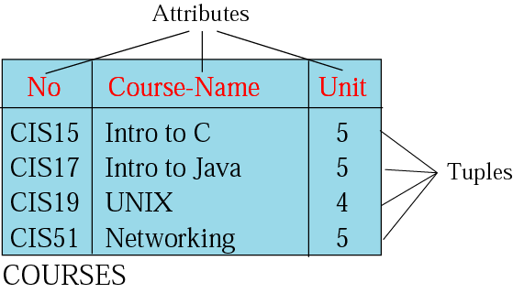
RDBMS
Figure 14-6
RDBMS: the relational database management system (RDBMS)
Relation: a relation is a 2D table has the following features:
  Name
  Attributes
  Tuples

Slide 16
14.5
OPERATIONS
ON
RELATIONS

Slide 17
Operations on relations
Insert : unary operation
Delete : unary operation
Update : unary operation
Select : unary operation
Project : unary operation
Join : binary operation
Union : binary operation
Intersection : binary operation
Difference : binary operation

Slide 18
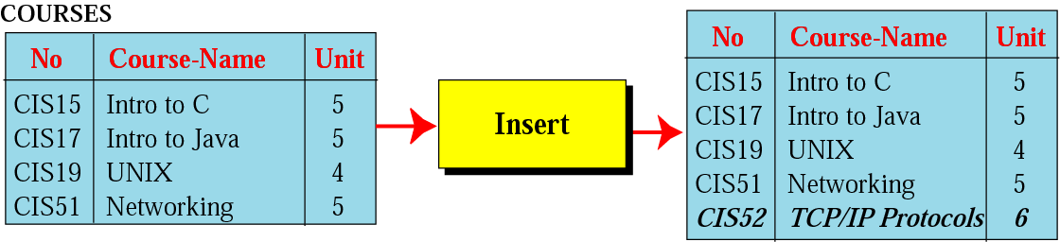
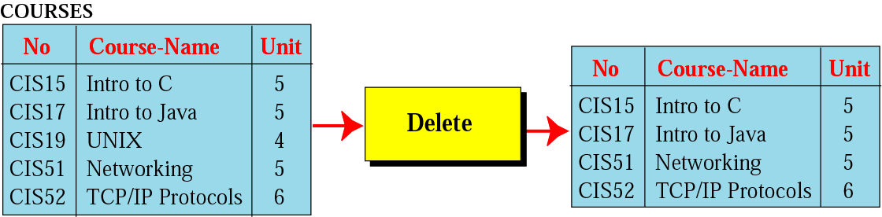
Figure 14-7
Figure 14-8
Insert operation
Delete operation

Slide 19
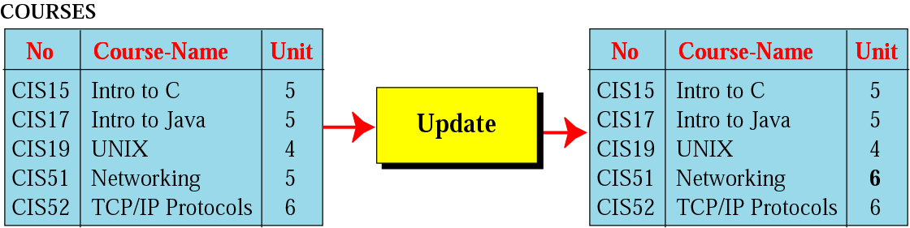
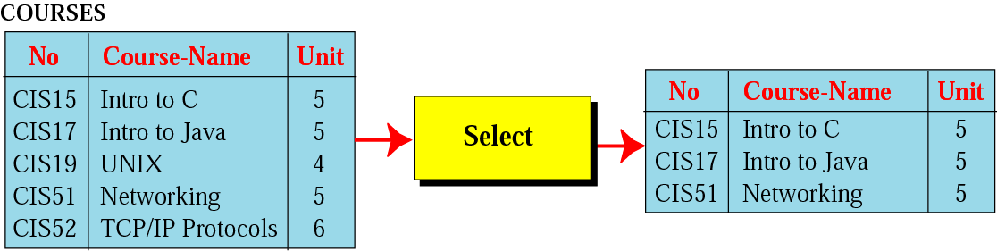
Figure 14-9
Figure 14-10
Update operation
Select operation

Slide 20
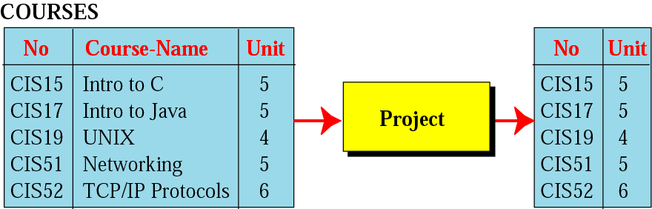
Figure 14-11
Project operation
The project operation creates a relation in which each tuple has fewer attributes.

Slide 21
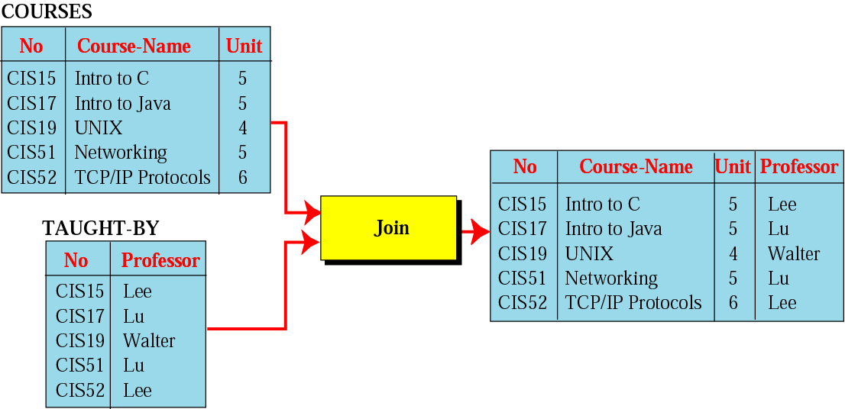
Figure 14-12
Join operation

Slide 22
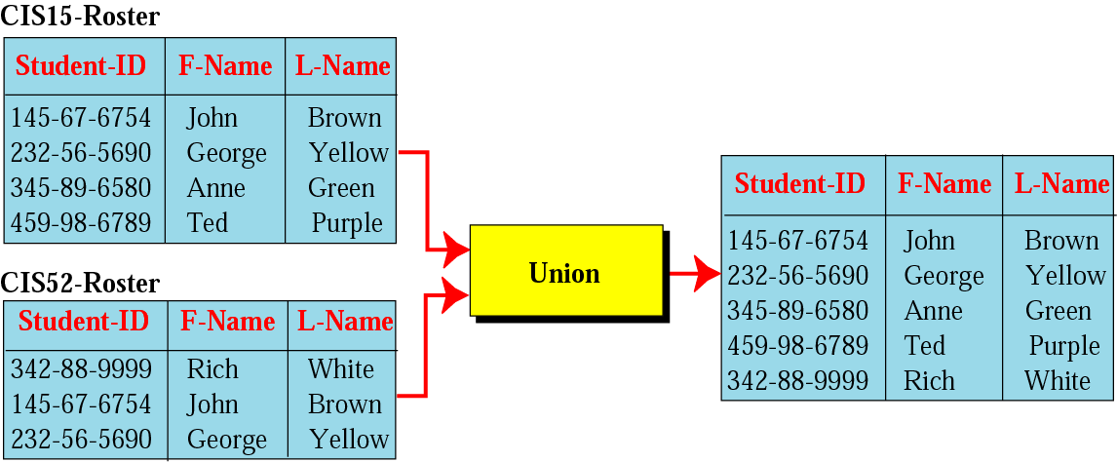
Figure 14-13
Union operation

Slide 23
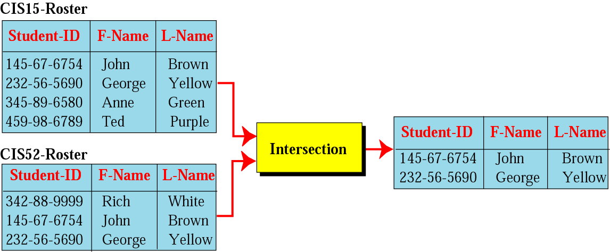
Figure 14-14
Intersection operation

Slide 24
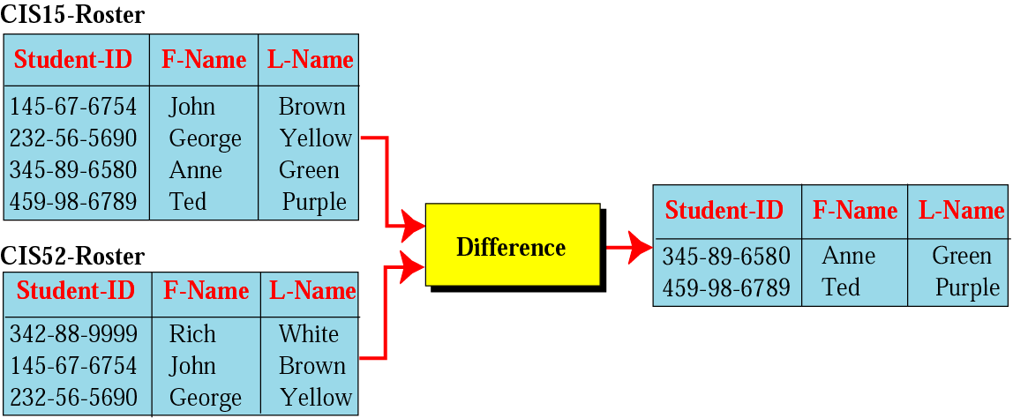
Figure 14-15
Difference operation

Slide 25
14.6
STRUCTURED
QUERY
LANGUAGE
自己回去看即可！！

Slide 26
14.7
OTHER
DATABASE
MODELS

Slide 27
Other database models
Distributed databases
  The data are stored on several computers that communicate through the Internet.
    Fragmented (碎片) distributed databases
    Replicated (複製) distributed databases
Object-oriented databases
  An object-oriented database tries to keep the advantages of the relational model and at the same time allows applications to access structured data.

Slide 28
Key terms
Application program
Cardinality
Conceptual level
Database
DBMS
Difference operation
Distributed database
End user
External level
Hardware
Hierarchical model
Internal level
Intersection operation
Join operation
Network model
Object-oriented database
Procedure
Project operation
Relation
RDBMS
Relational model
Select operation
Software
SQL
Tuple
Union operation
Update operation

