Slide 1
DESIGN OF M-ARY FREQUENCY SHIFT KEYING FOR OFDM

Slide 2
OFDM for the physical high rate data channel.
FSK for the separate low rate signaling channel.
This project presents an ofdm based wireless broadband system using the two physical channels.

Slide 3
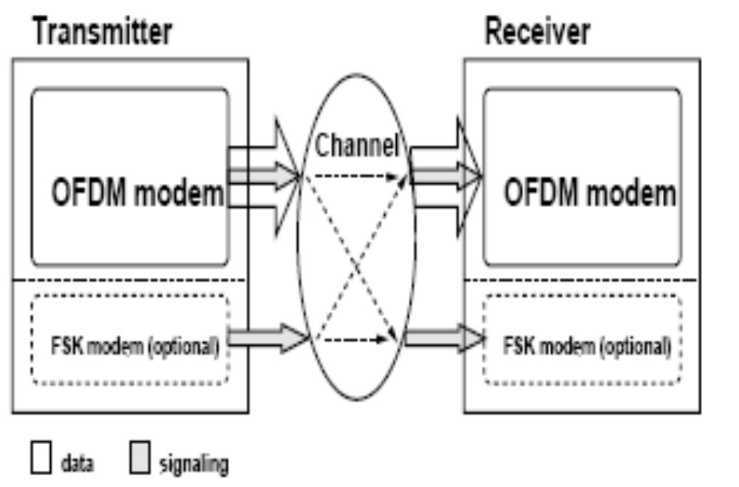
BLOCK DIAGRAM OF M-ARY FSK FOR OFDM

Slide 4
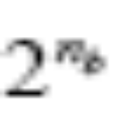
MFSK has proven to be a robust modulation scheme for underwater
communications under various conditions . MFSK uses multiple (M)
frequencies, offset from the carrier frequency, to represent M different symbols, each containing bits so that M =

Slide 5

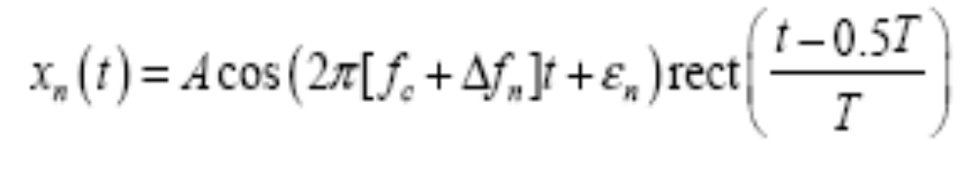
Time domain representation of M-ary fsk

Slide 6
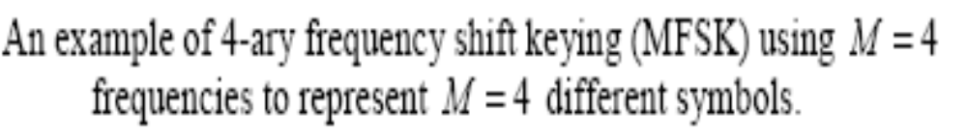
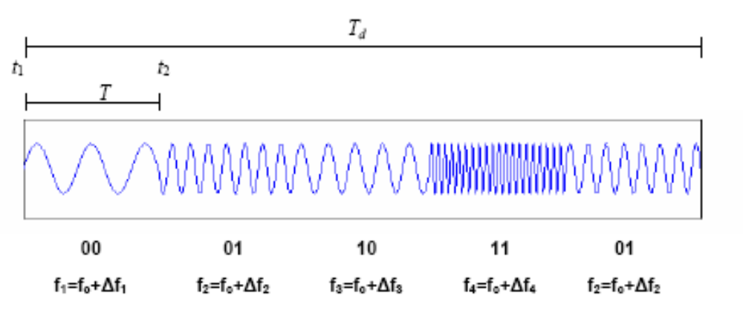

Slide 7
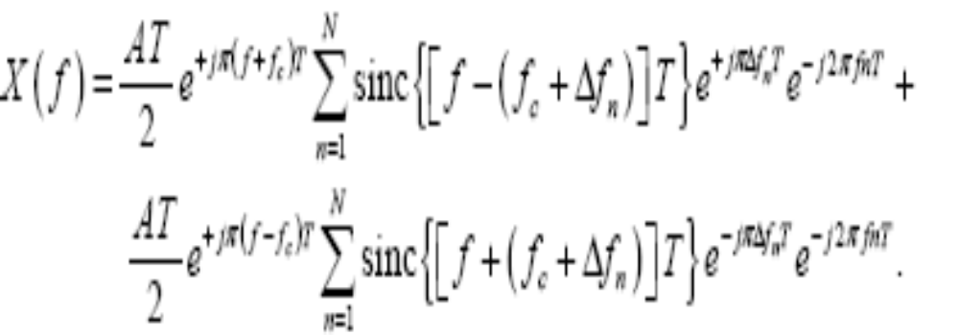
Frequncy domain representation of MFSK

Slide 8
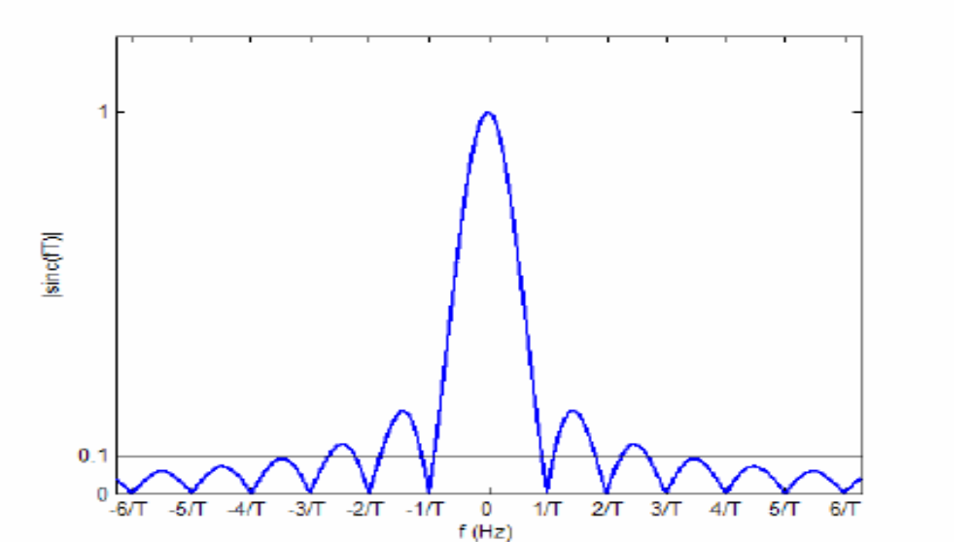
Magnitude spectrum of sinc fuinction

Slide 9
Bandwidth of MFSK

Slide 10
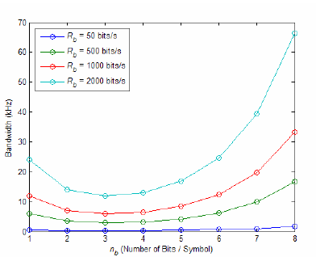
Plot between BW Vs Number of bits/symbol

Slide 11
The OFDM technique has been claimed to be one of the most promising future
communications technologies for achieving high data rate and large system capacity [24]
and is expected to be a valid and robust communications technique for underwater use

Slide 12
OFDM uses a multi-carrier modulation scheme to transmit broadband data in
parallel over N orthogonal carriers which allows spectral efficiency and eliminates the
use of guard bands between the carriers

Slide 13
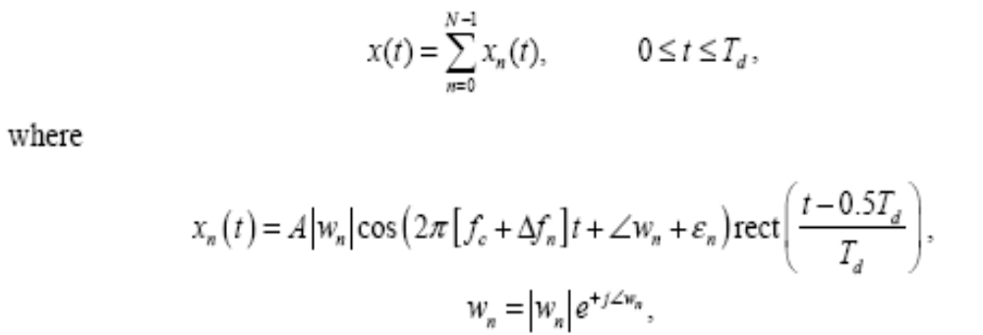
Time domain representation of OFDM

Slide 14
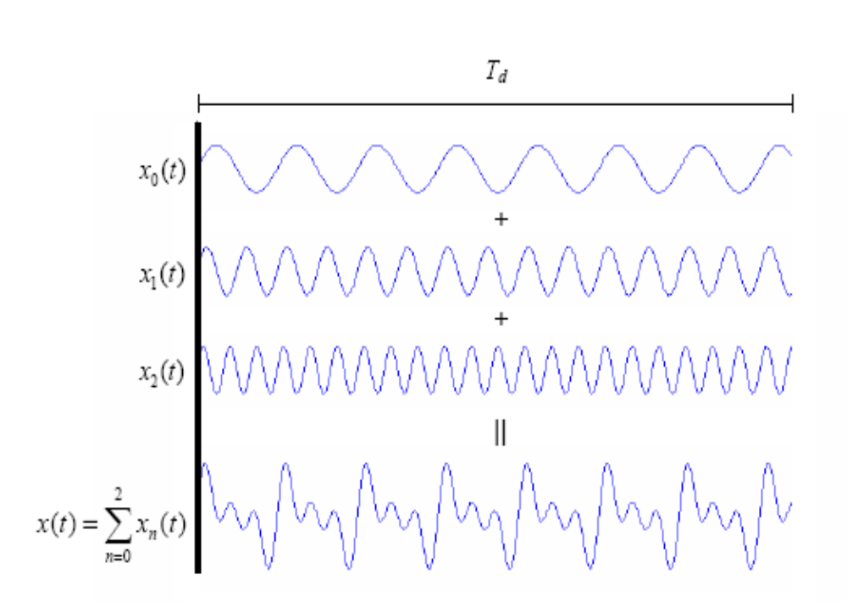

Slide 15
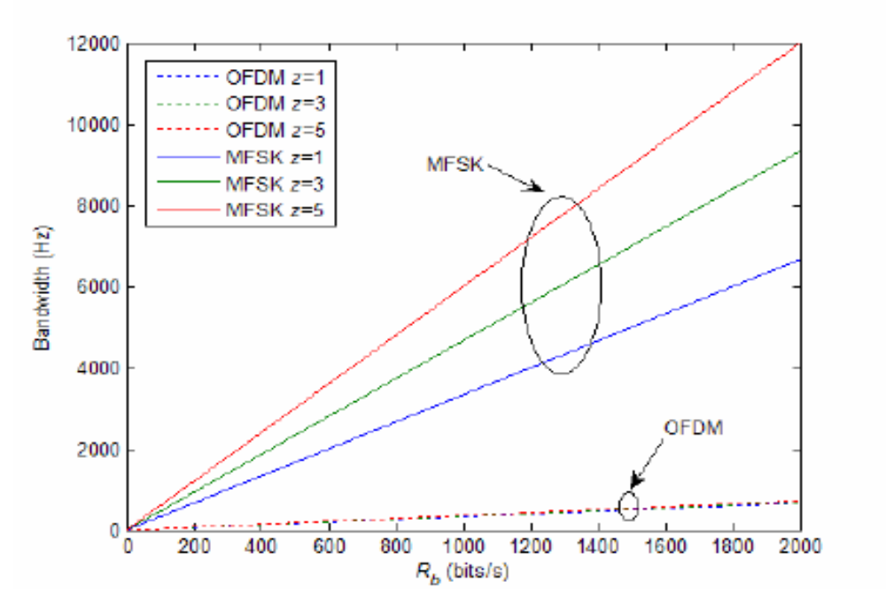

Slide 16
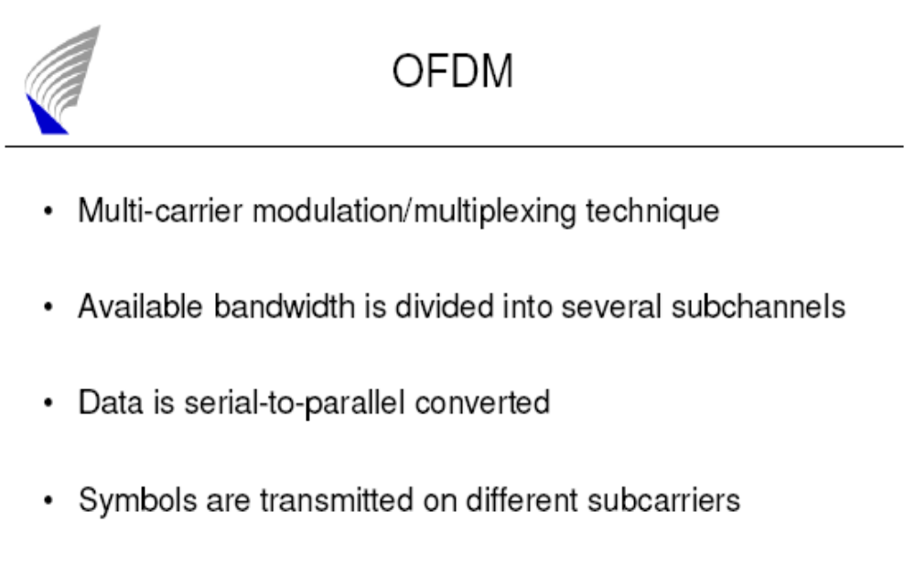

Slide 17
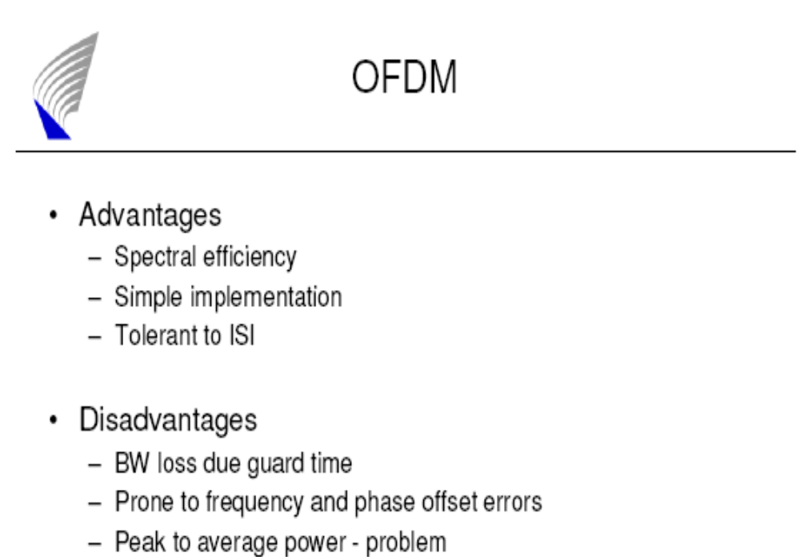

Slide 18
THANK YOU

