Slide 1
UNIT -IV
A.SANGEETHA
ASSISTANT PROFESSOR(SENIOR)
PHOTONICS DIVISION
SCHOOL OF ELECTRONICS ENGINEERING
VIT UNIVERSITY

Slide 2
Optical Receivers
Optical receivers convert optical signal (light) to electrical signal (current/voltage)
  Hence referred ‘O/E Converter’
Photodetector is the fundamental element of optical receiver, followed by amplifiers and signal conditioning circuitry
There are several photodetector types:
  Photodiodes, Phototransistors, Photon multipliers, Photo-resistors etc.

Slide 3
Photodetector Requirements
High sensitivity (responsivity) at the desired wavelength and low responsivity elsewhere
Low noise and reasonable cost
Fast response time → high bandwidth
Insensitive to temperature variations
Compatible physical dimensions
Long operating life

Slide 4
Photodiodes
Due to above requirements, only photodiodes are used as photo detectors in optical communication systems
Positive-Intrinsic-Negative (pin) photodiode
  No internal gain
Avalanche Photo Diode (APD)
  An internal gain of M due to self multiplication
Photodiodes are reverse biased for normal operation

Slide 5
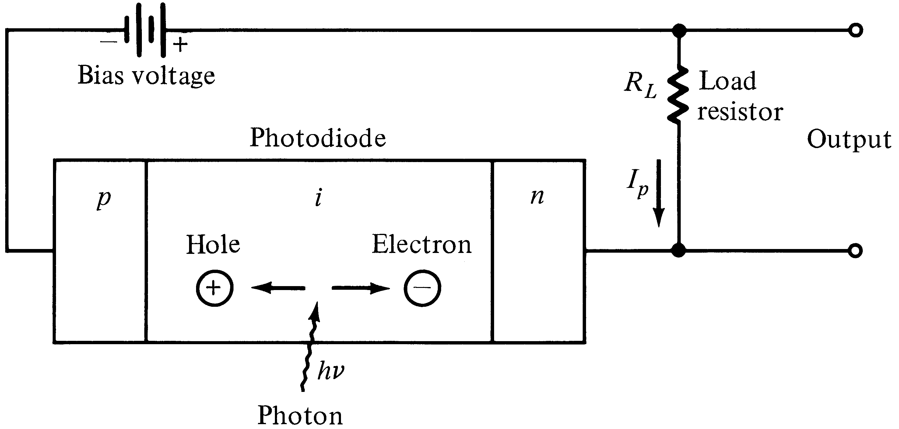
Basic pin photodiode circuit
Incident photons trigger a photocurrent I_{p} in the external circuitry
Photocurrent ∝ Incident Optical Power

Slide 6
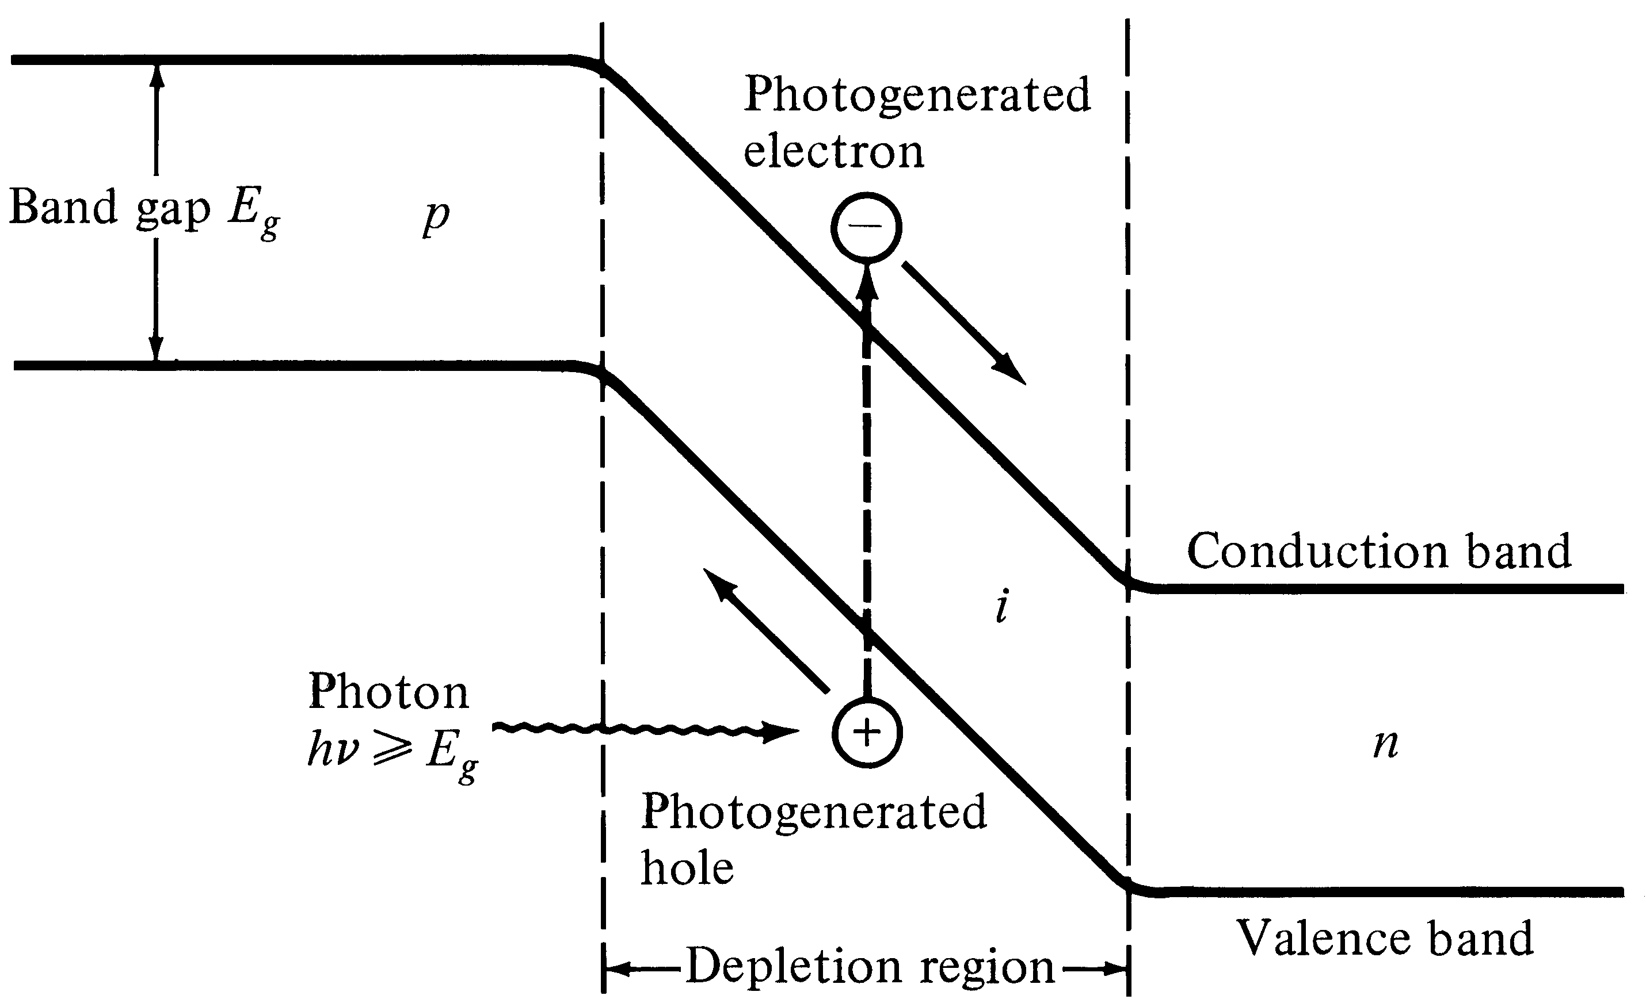
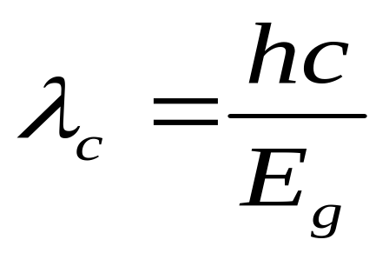
pin energy-band diagram
Cut off wavelength depends on the
bandgap energy
Notes:
2

Slide 7
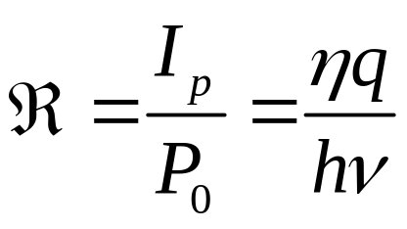
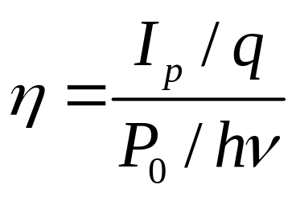
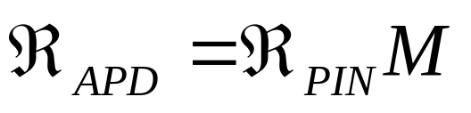
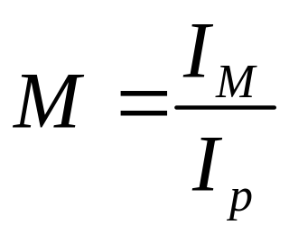
Responsivity (ℜ)
Quantum Efficiency (η) = number of e-h pairs generated / number of incident photons
Avalanche PD’s have an internal gain M
mA/mW
I_{M} : average value of the total multiplied current
M = 1 for PIN diodes

Slide 8
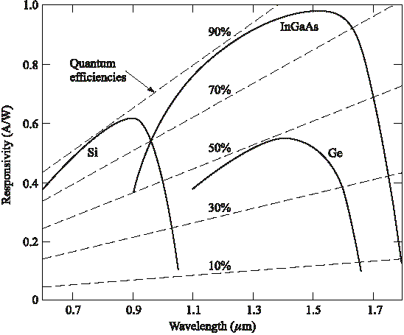
Responsivity
Notes:
3

Slide 9
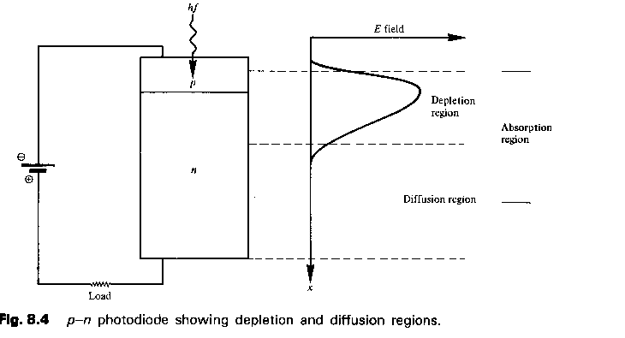
P-N photodiode

Slide 10
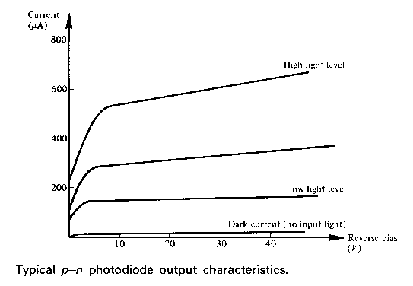
Pn pd o/p characteristics

Slide 11
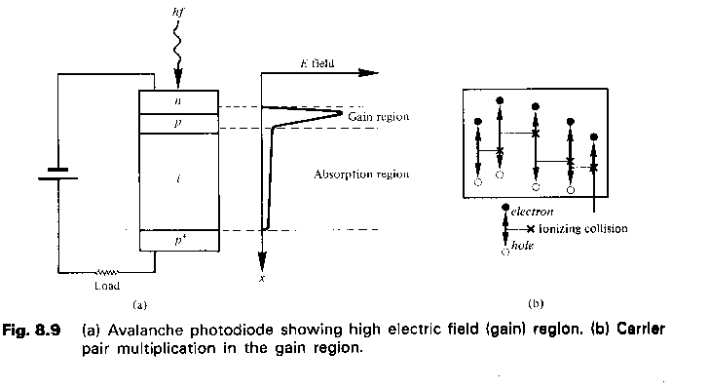
AVALANCHE PD

Slide 12
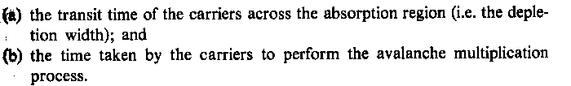

Slide 13
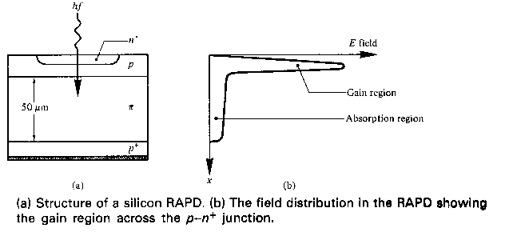
RAPD

Slide 14
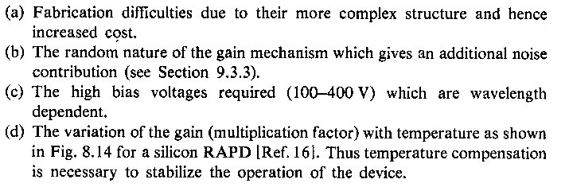
DRAWBACKS

Slide 15
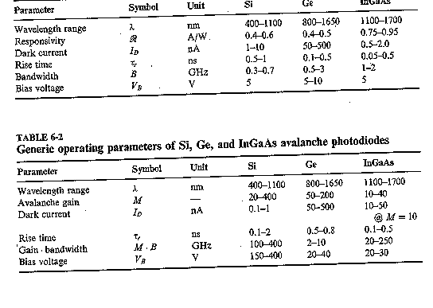

Slide 16
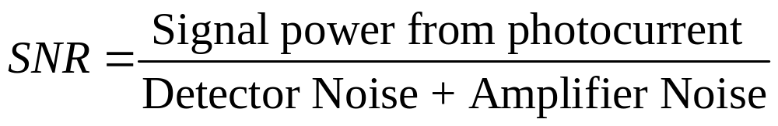
Signal to Noise Ratio
For high SNR
The Photodetector must have a large quantum efficiency (large responsivity or gain) to generate large signal current
Detector and amplifier noise must be low
SNR Can NOT be improved by amplification

Slide 17
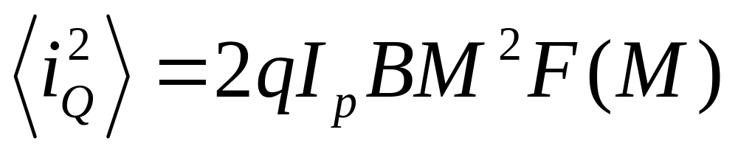
Quantum (Shot Noise)
Due optical power fluctuation because light is made up of
discrete number of photons
F(M): APD Noise Figure
F(M) ~= M^{x} (0 ≤ x ≤ 1)
I_{p}: Mean Detected Current
B = Bandwidth

Slide 18
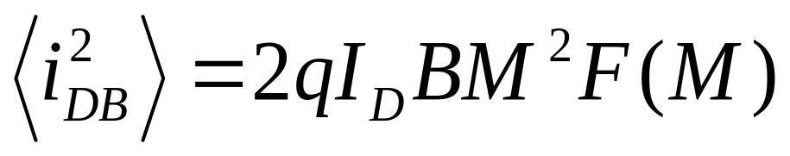
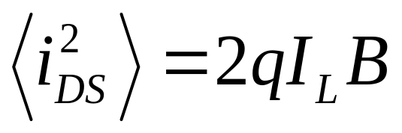
Dark/Leakage Current Noise
There will be some (dark and leakage ) current without any
incident light. This current generates two types of noise
Bulk Dark Current Noise
I_{D}: Dark Current
Surface Leakage
Current Noise
(not multiplied by M)
I_{L}: Leakage Current

Slide 19
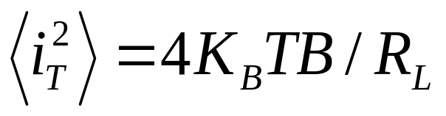
Thermal Noise
The photodetector load resistor R_{L} contributes a mean-square
thermal (Johnson) noise current
K_{B}: Boltzmann’s constant = 1.38054 X 10⁽⁻²³⁾ J/K
T is the absolute Temperature
Quantum and Thermal are the important noise
mechanisms in all optical receivers
RIN (Relative Intensity Noise) will also appear in analog
links

Slide 20
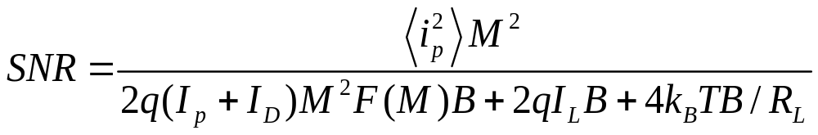
Signal to Noise Ratio
Detected current = AC component (i_{p}) + DC component (I_{p})
Signal Power = <i_{p}²>M²
Typically not all the noise terms will have equal weight

Slide 21
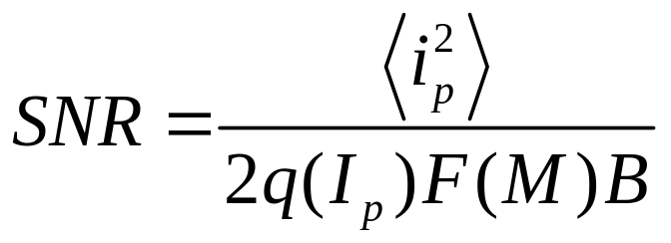
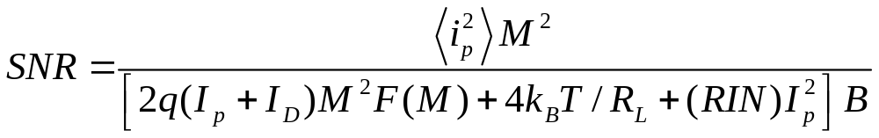
SNR
Dark current and surface leakage current noise are typically negligible, If thermal noise is also negligible
For analog links, (RIN= Relative Intensity Noise)

Slide 22
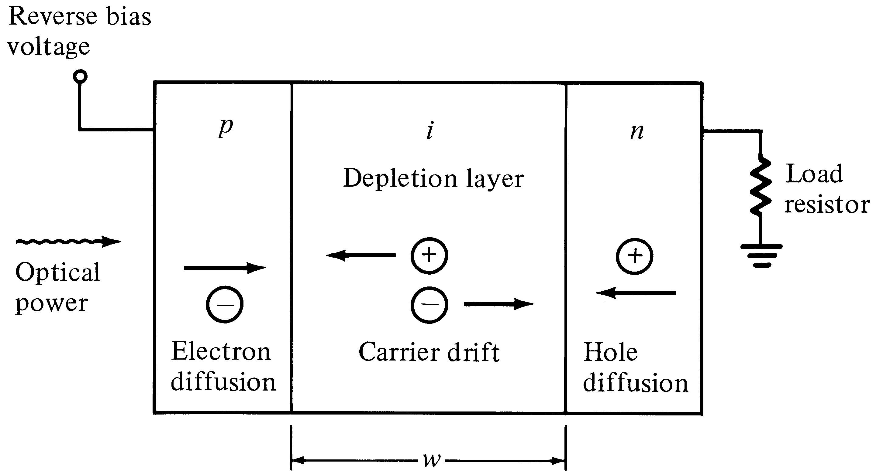
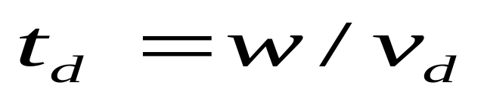
Response Time in pin photodiode
Transit time, t_{d} and carrier drift velocity v_{d} are related by
For a high speed Si PD, t_{d} = 0.1 ns
Notes:
4

Slide 23
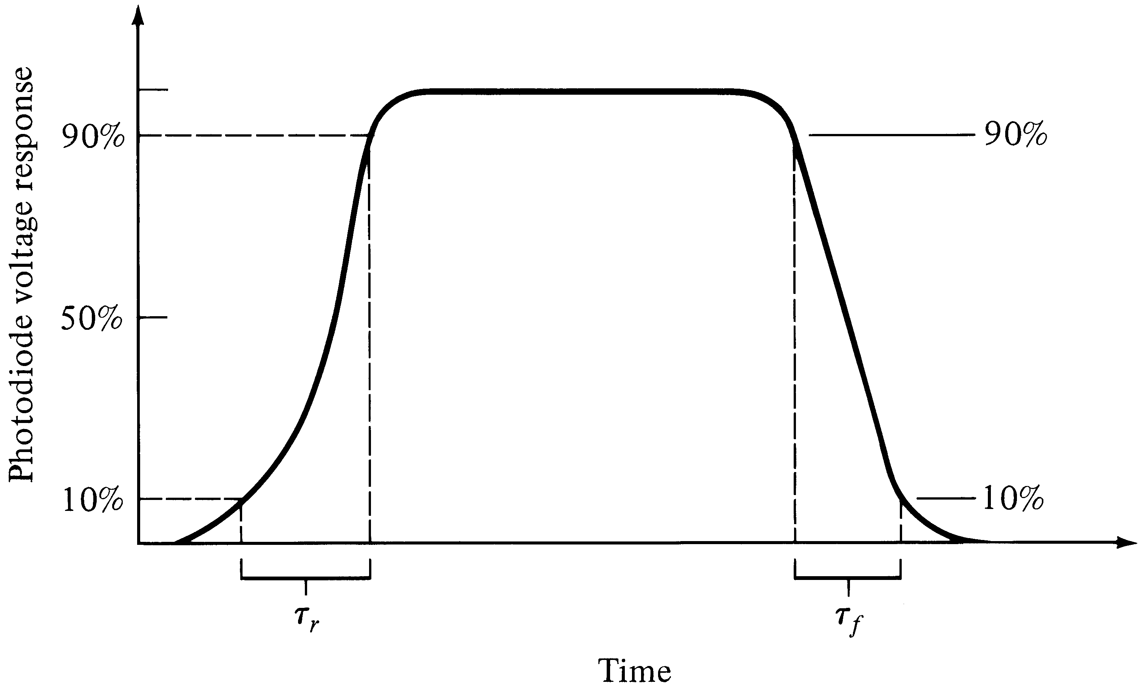
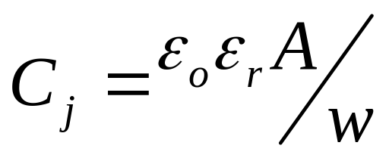
Rise and fall times
Photodiode has uneven rise and fall times depending on:
Absorption coefficient α_{s}(λ) and
Junction Capacitance C_{j}
Notes:
5

Slide 24
Junction Capacitance
ε_{o} = 8.8542 x 10(-12) F/m; free space permittivity ε_{r} = the semiconductor dielectric constant
A = the diffusion layer (photo sensitive) area
w = width of the depletion layer
Large area photo detectors have large junction capacitance hence small bandwidth (low speed)
→ A concern in free space optical receivers

Slide 25
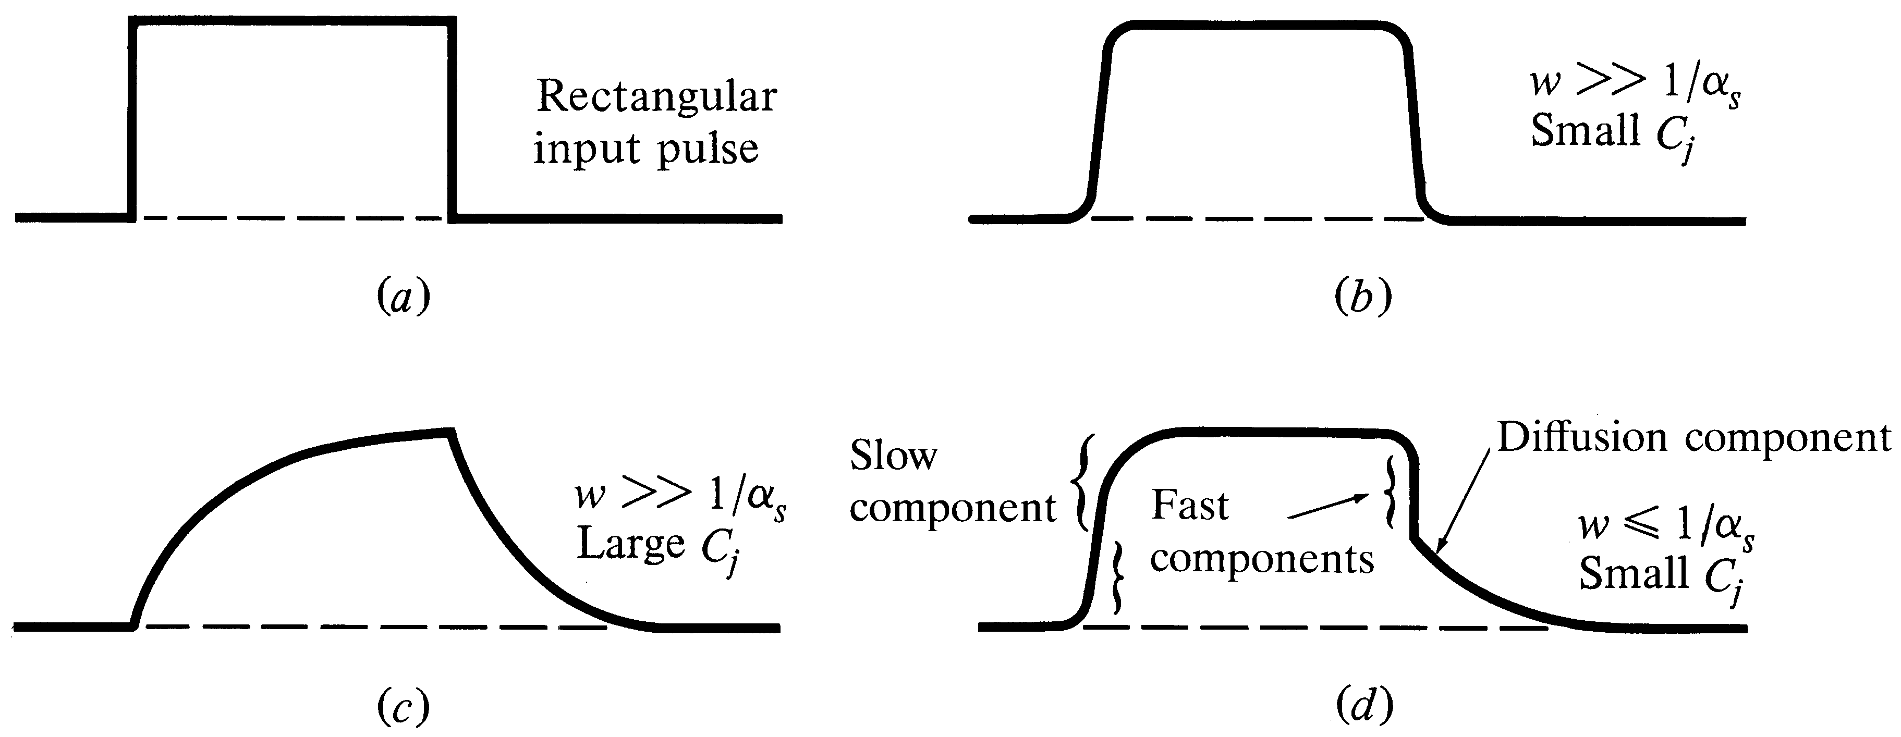
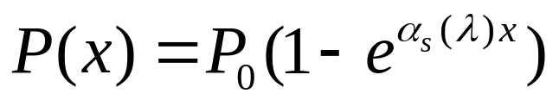
Various pulse responses
Absorbed optical power at
distance x exponentially decays
depending on α_{s}
Notes:
7

Slide 26
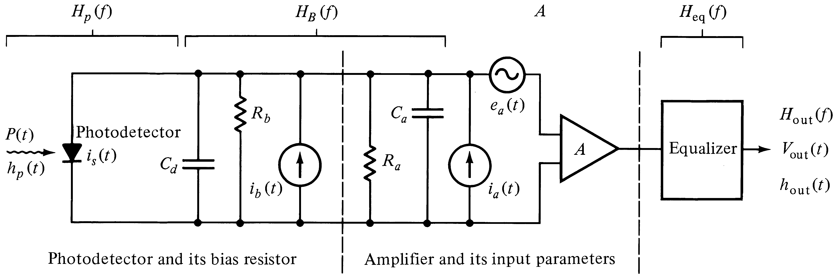
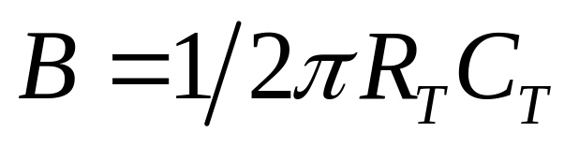
Optical receiver schematic
Bandwidth of the front end:
C_{T}: Total Capacitance = C_{d}+C_{a}
R_{T}: Total Resistance = R_{b} // R_{a}
Try Example 6.7
Notes:
4

Slide 27
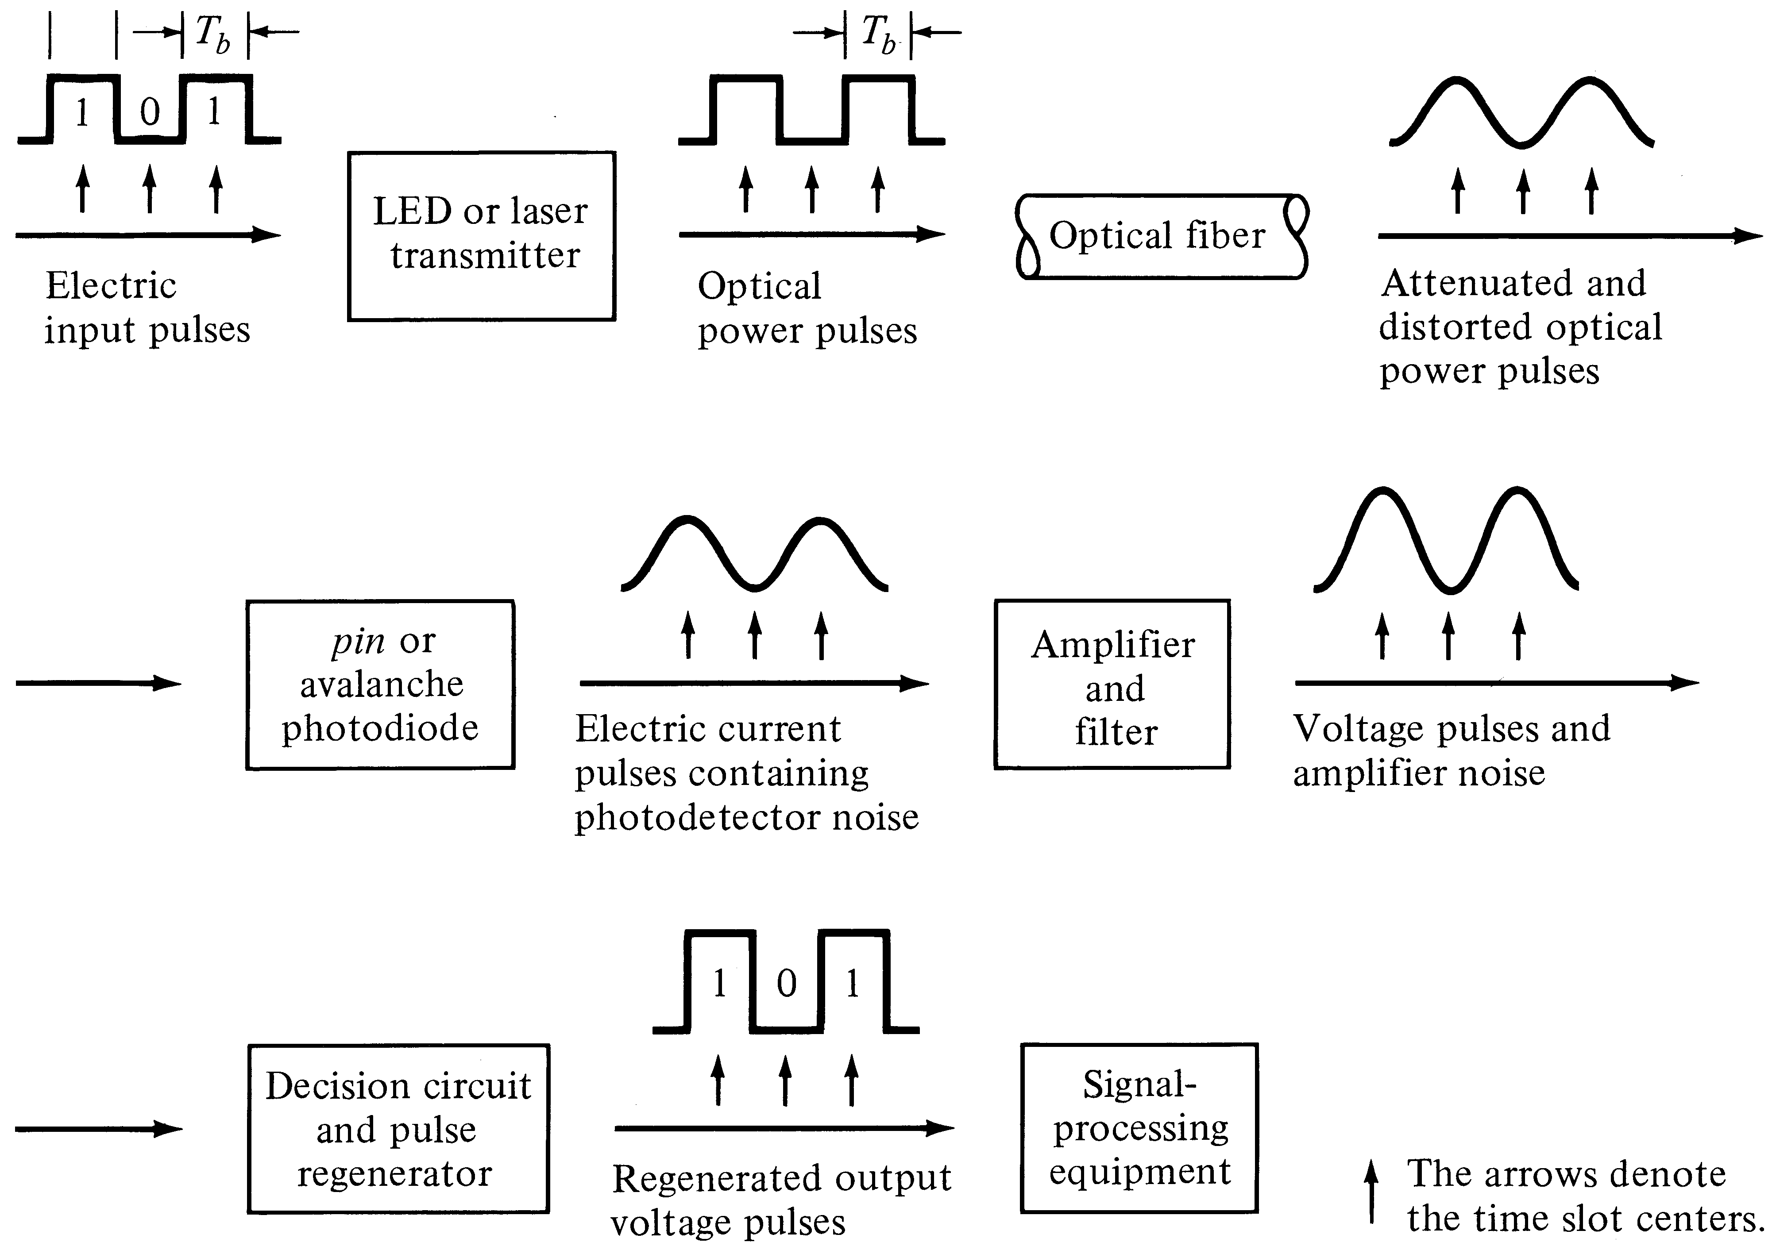
Signal Path through an Optical Link
Notes:
1

Slide 28
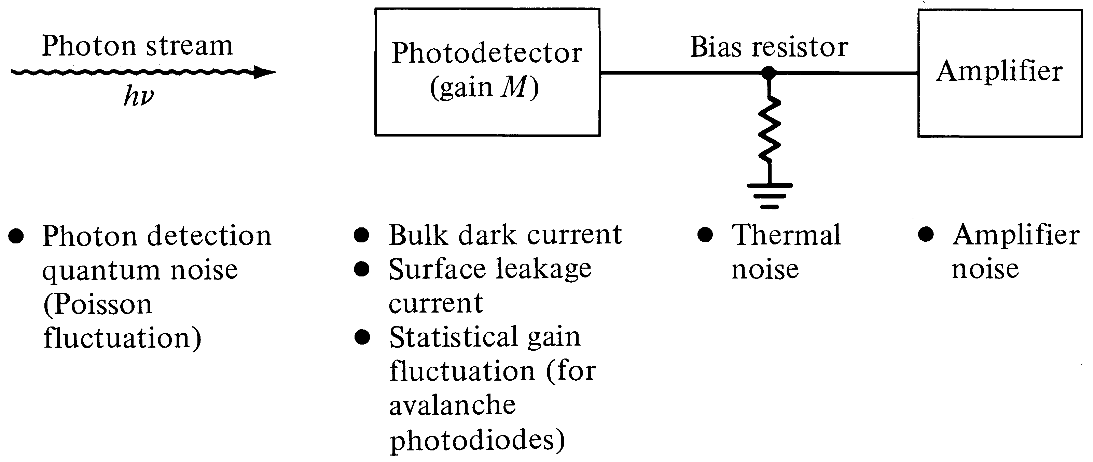
Noise sources and disturbances at an optical receiver
Notes:
2

Slide 29
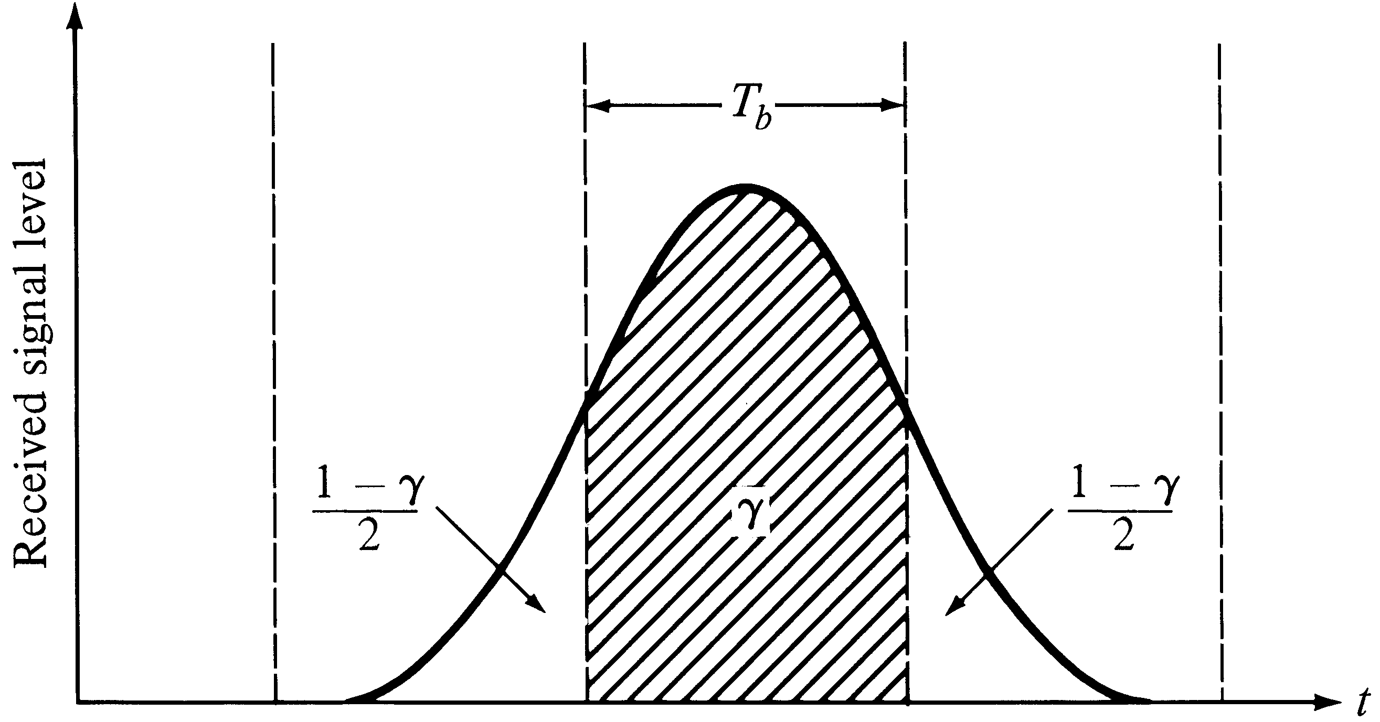
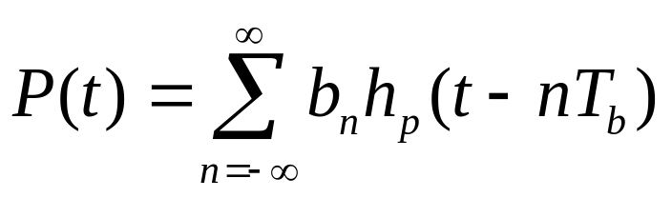
Pulse spreading in digital links that leads to Inter Symbol Interference (ISI)
b_{n} = Data bit (1,0)
T_{b} = Bit period
h_{p} = Received pulse shape
Notes:
3

Slide 30
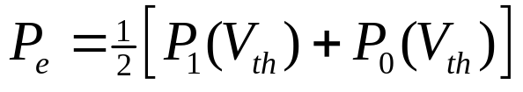
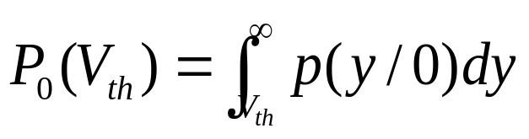
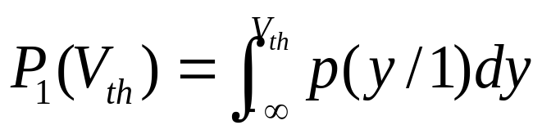
Digital Receiver Performance
Probability of error assuming
Equal ones and zeros
Where,
Depends on the noise variance at on/off levels and the
Threshold voltage V_{th} that is decided to minimize the P_{e}
Question: Do you think V_{th} = ½ [V_{on} + V_{off}] ?

Slide 31
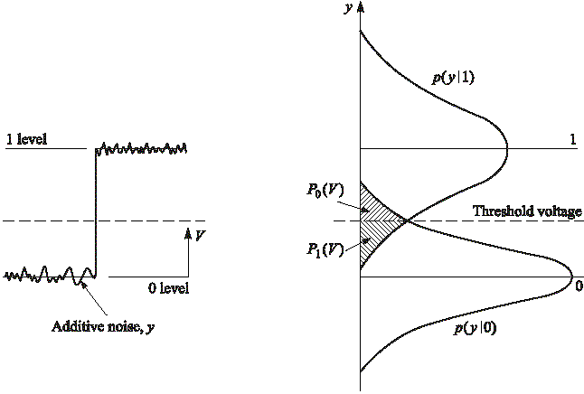
Logic 0 and 1 probability distributions
Asymmetric distributions
Select V_{th} to minimize P_{e}
Notes:
5

Slide 32
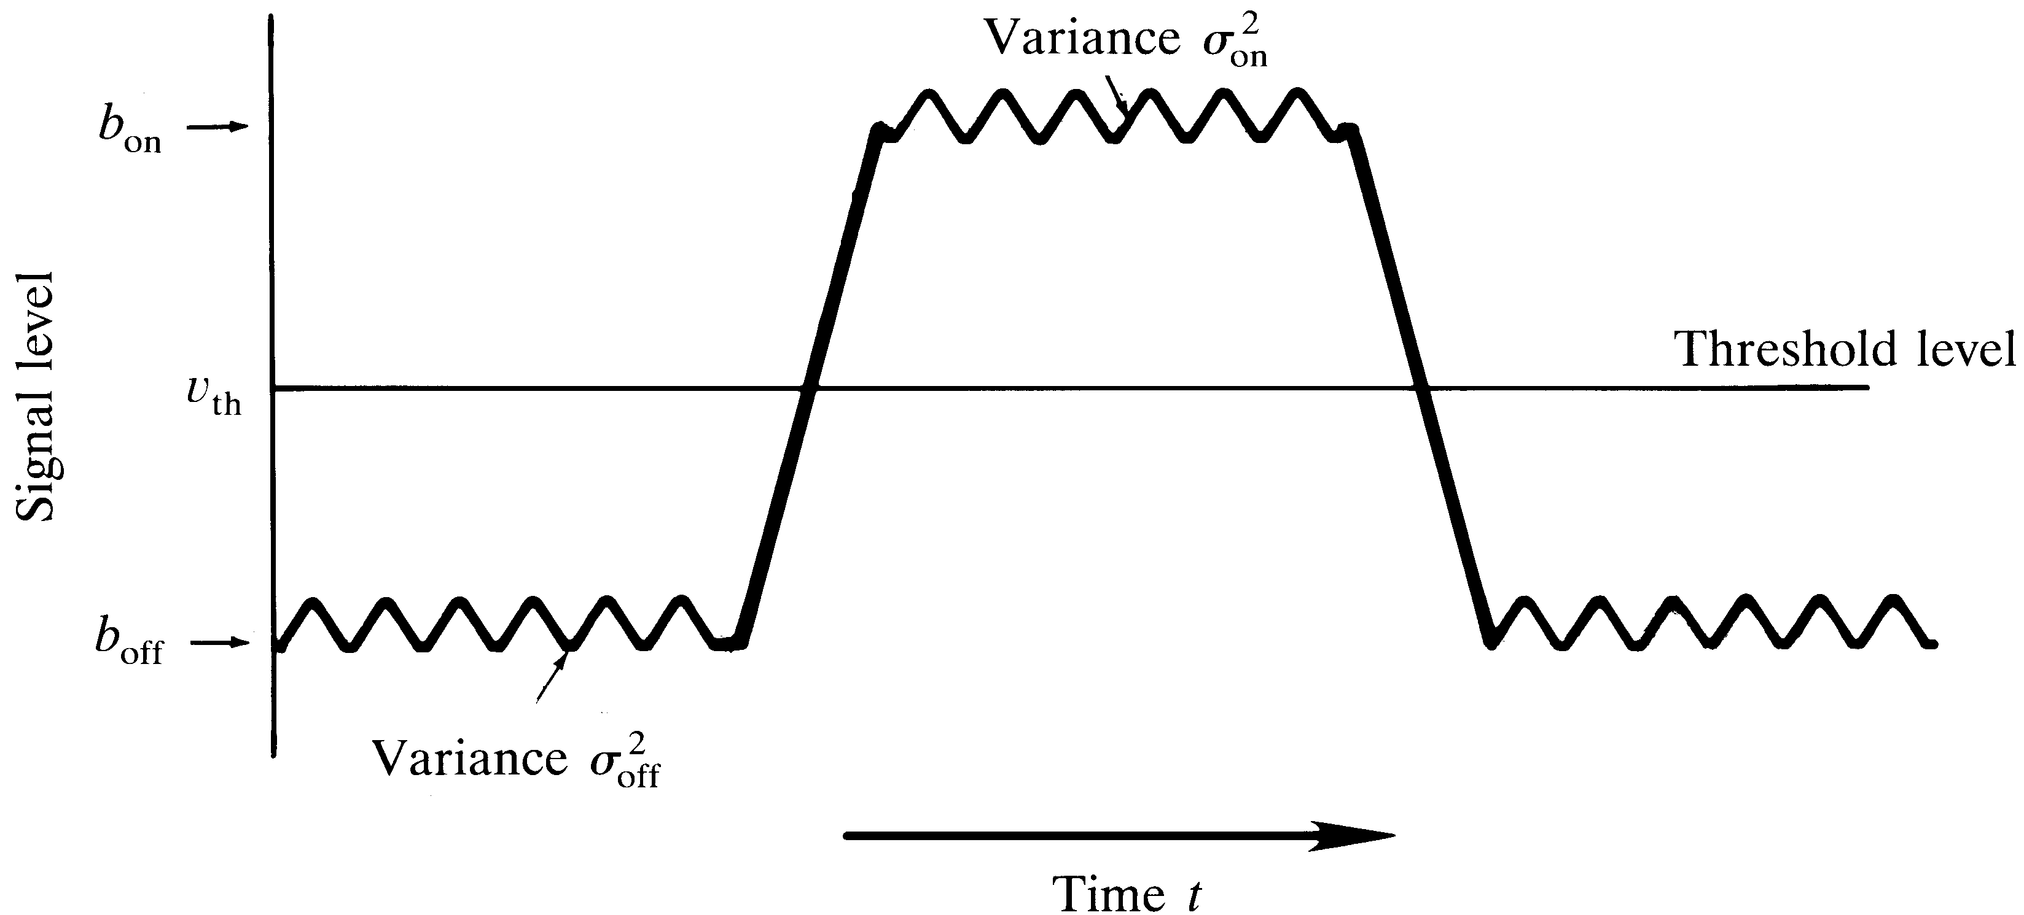
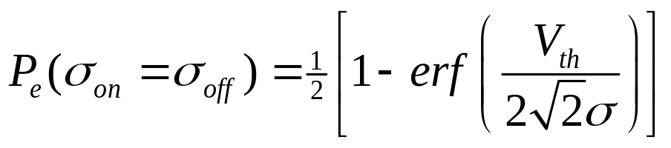
Noise variances
Probability of error depends on V_{th} and noise power
Notes:
6

Slide 33
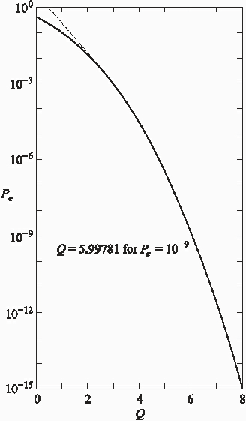
Fig. 7-7:
BER (P_{e}) versus
Q factor
Notes:
7

Slide 34
BER vs SNR
(equal standard deviations and b_{off} = 0)
Notes:
8

Slide 35
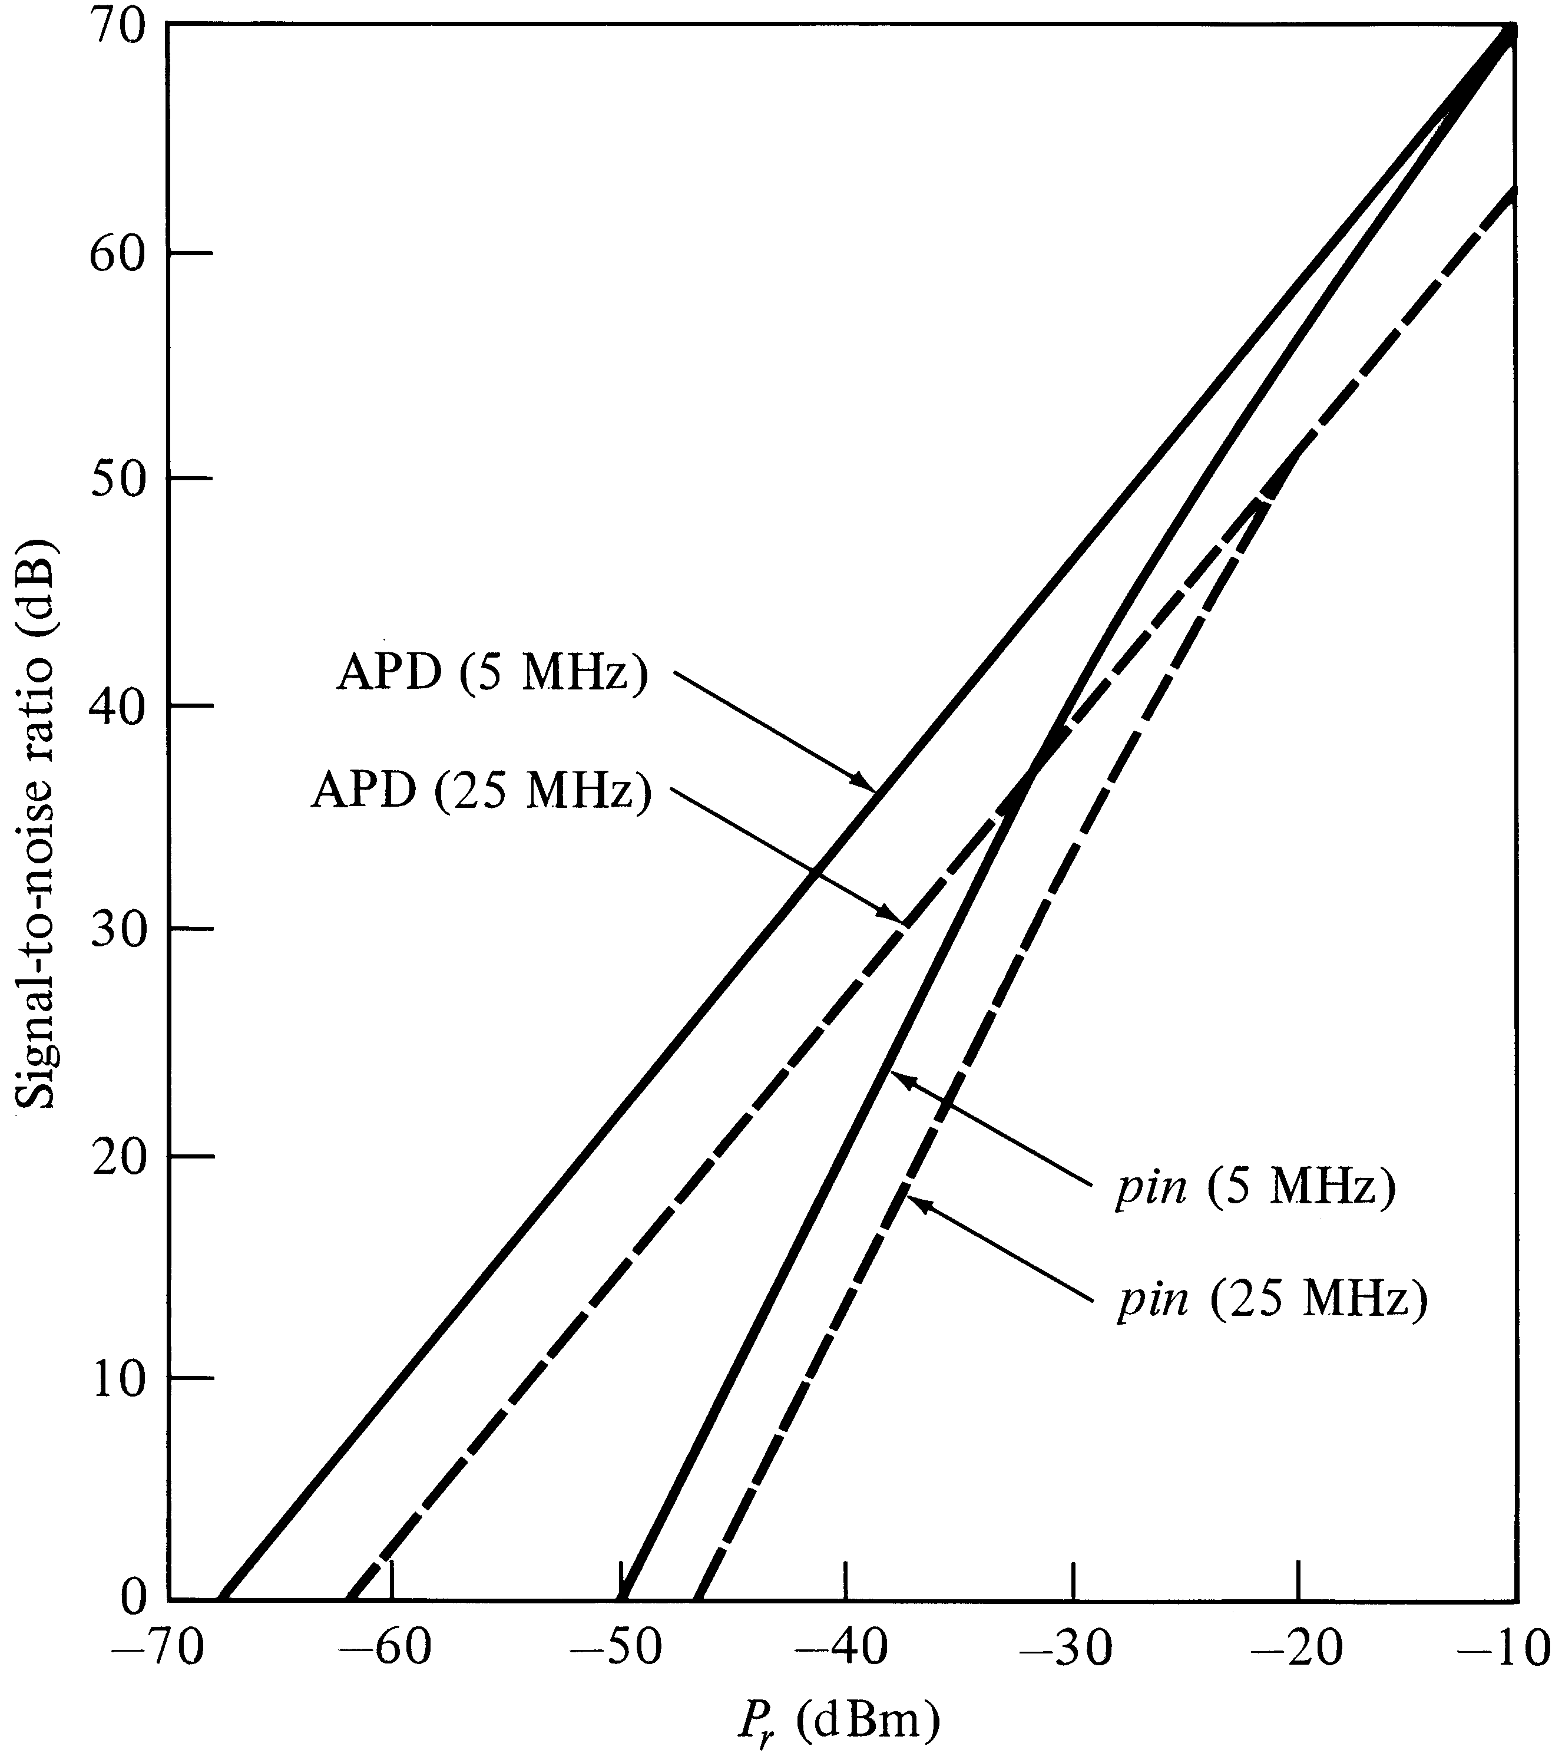
SNR vs. received power
Notes:
10

