Slide 1
LOSS MECHANISM IN OPTICAL FIBERS
A.SANGEETHA
ASSISTANT PROFESSOR(SENIOR)
PHOTONICS DIVISION
SCHOOL OF ELECTRONICS ENGINEERING
VIT UNIVERSITY

Slide 2
MATERIAL ABSORPTION
Loss mechanism
material composition
fabrication
Optical power- dissipated as heat
Intrinsic – interaction with one or more of
major components of glass
Extrinsic – impurities within the glass

Slide 3
Intrinsic Absorption (minimised by suitable choice of core and clad comp)
Low intrinsic absorption in 0.8-1.7μm(pure glass)
Fundamental absorption peaks in UV region
  Stimulation of electron transitions within the glass by higher energy excitations.
  In IR and far IR - interaction of photons with molecular vibrations within the glass
  Strong absorption due to oscillations of structural units
  SiO - 9.2 μm
  PO - 8.1 μm
  BO - 7.2 μm
  GeO - 11.0 μm

Slide 4
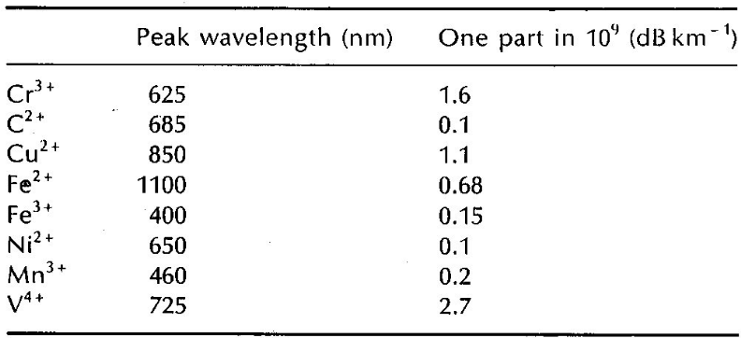
Extrinsic Absorption
Extrinsic absorption is much more significant than intrinsic
Caused by impurities introduced into the fiber material during manufacture
– Iron, nickel, and chromium
Caused by transition of metal ions to a higher energy level
Modern fabrication techniques can reduce impurity levels below 1 part in 10¹⁰.
For some of the more common metallic impurities in silica fibre the table shows the peak attenuation wavelength and the attenuation caused by an impurity concentration of 1 in 10⁹
For a pure (no impurities) silica fibre a
low loss window exists between 800 nm and 1600 nm.

Slide 5
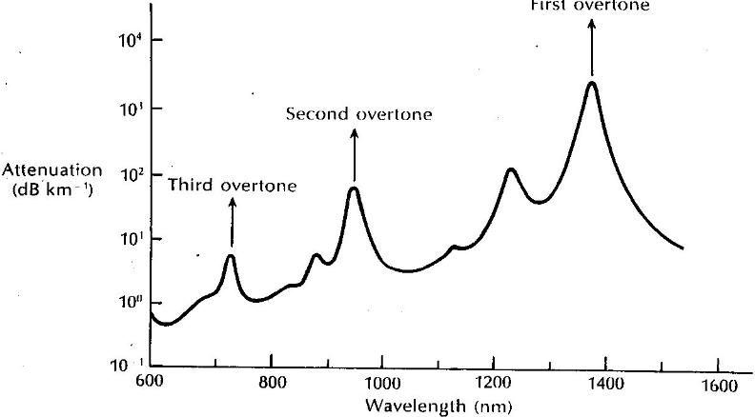
Extrinsic Absorption(OH ions)
Extrinsic absorption caused by dissolved water in the glass, as the hydroxyl or OH ion.
In this case absorption due to the same fundamental processes (between 2700 nm and 4200 nm) gives rise to so called absorption overtones at 1380,950 and 720 nm.
Typically a 1 part per million impurity level causes 1 dB/km of attenuation at 950 nm. Typical levels are a few parts per billion
Absorption Spectrum for OH in
Silica
Narrow windows circa 800, 1300 nm
and 1550 nm exist which are
unaffected by
this type of absorption.

Slide 6
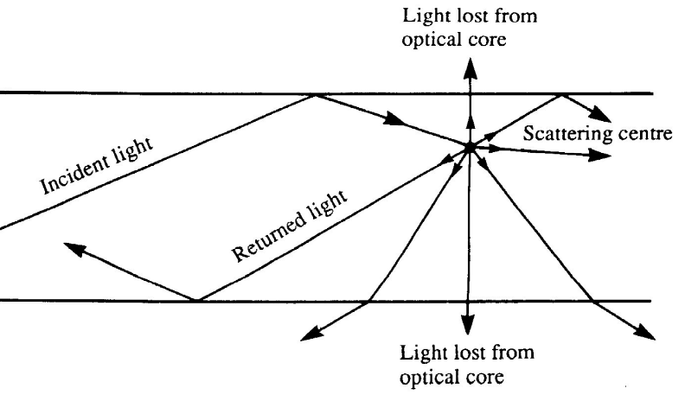
Scattering Losses in Fibre
Scattering is a process whereby all or some of the optical power in a mode is transferred into another mode.
Frequently causes attenuation, since the transfer is often to a mode which does not propagate well. (also called a leaky or
radiation mode).

Slide 7
Types of Scattering Loss in Fibre
􀁹Two basic types of scattering exist:
Linear scattering:
Rayleigh and Mie
Non-linear scattering:
Stimulated Brillouin and Stimulated Raman.
Rayleigh is the dominant loss mechanism in the low loss silica window between 800 nm and 1700 nm.
Raman scattering is an important issue in Dense WDM systems

Slide 8
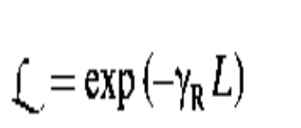
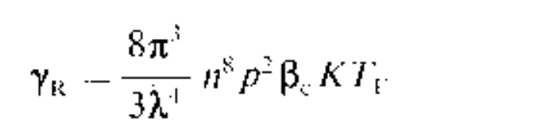
Rayleigh Scattering
Transmission loss factor
Dominant scattering mechanism in silica fibres
Scattering causes by inhomogeneities in the glass, of a size
smaller than the wavelength.
Inhomogeneities manifested as refractive index variations, present in the glass after manufacture.
Difficult to eliminate with present manufacturing methods
Rayleigh loss falls off as a function of the fourth power of wavelength:
λ in this empirical formula is expressed in microns (μm)

Slide 9
Mie Scattering
(inhomogeneities comparable to wavelength)
Irregulaties at core clad interface
Δ variations along the length of the fiber
Diameter fluctuations ,strains and bubbles
Can be reduced by
Careful extrusion
Removing imperfections
Increase Δ

Slide 10
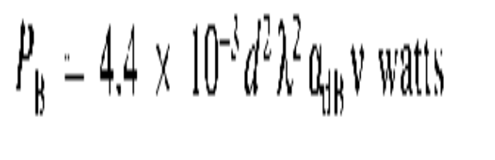
Stimulated Brillouin Scattering
(backward process)
Modulation of light due to thermal molecular vibrations within the fiber.
USB and LSB separated from the incident light by the modulation frequency .
Produces acoustic phonon and a scattered photon in a single mode fiber.

Slide 11
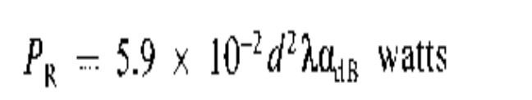
Stimulated Raman scattering
(forward scattering)
Optical power threshold-3 times than brillouin scattering threshold.
Produces optical phonon and scattered photon in single mode fiber

Slide 12
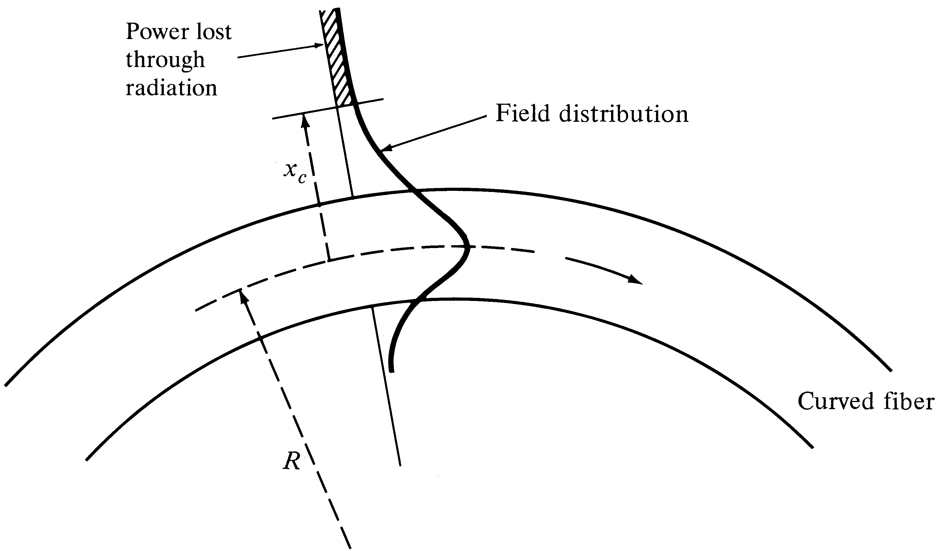
Bending Loss (Macrobending &
Microbending)
Macrobending Loss: The curvature of the bend is much larger than fiber diameter. Lightwave suffers sever loss due to radiation of the evanescent field in the cladding region. As the radius of the curvature decreases, the loss increases exponentially until it reaches at a certain critical radius. For any radius a bit smaller than this point, the losses suddenly becomes extremely large. Higher order modes radiate away faster than lower order modes.
Optical Fiber communications, 3rd ed.,G.Keiser,McGrawHill, 2000

Slide 13
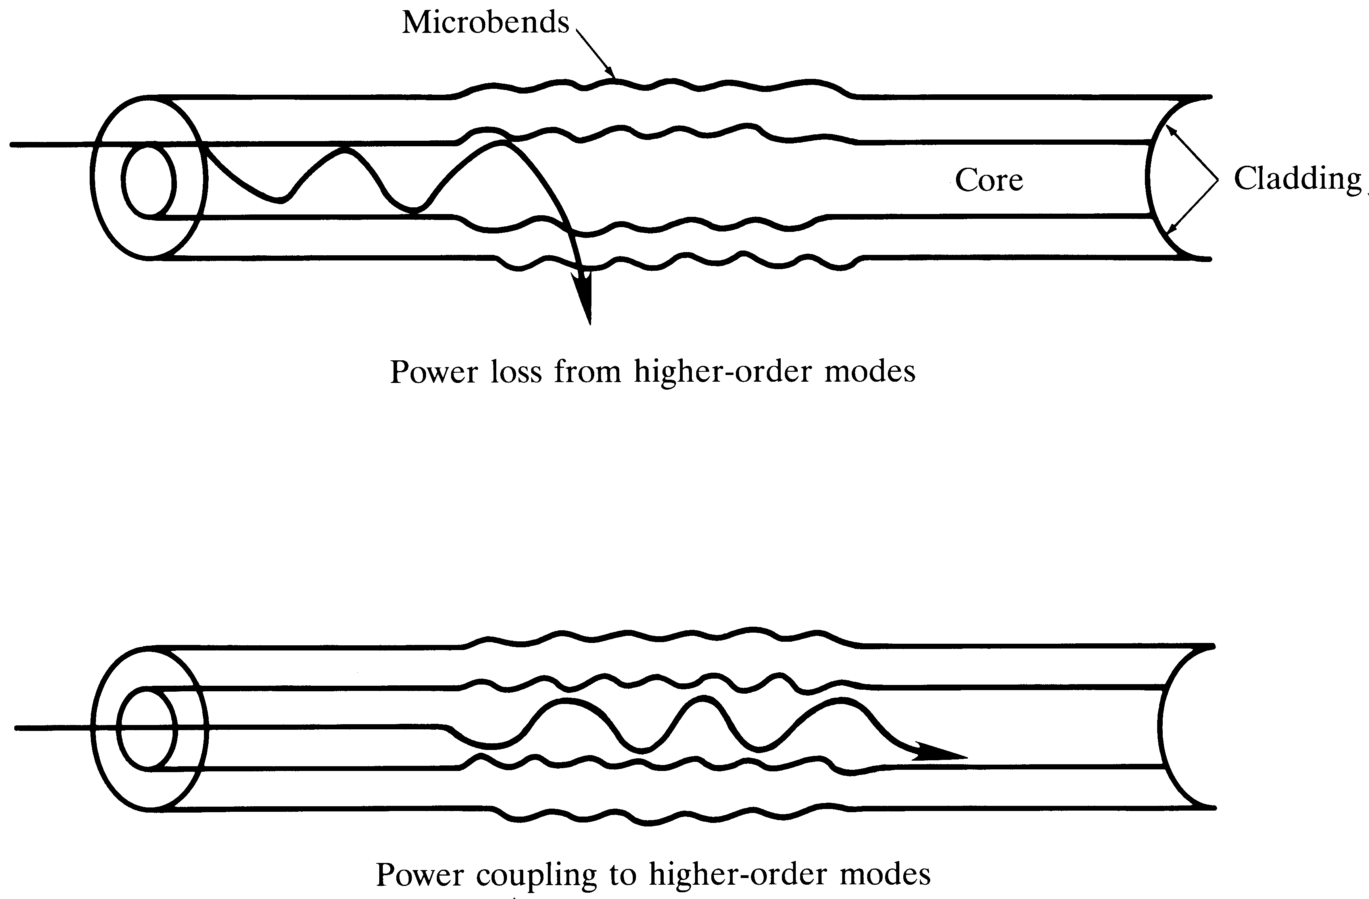
Microbending Loss
Microbending Loss: microscopic bends of the fiber axis that can arise when the fibers are incorporated into cables. The power is dissipated through the microbended fiber, because of the repetitive coupling of energy between guided modes & the leaky or radiation modes in the fiber.
Optical Fiber communications, 3rd ed.,G.Keiser,McGrawHill, 2000

