Slide 1
SONET
A.SANGEETHA

Slide 2
Asynchronous Systems
Electrical signals which are used in transmission use system clocks which are very accurate.
Generally, they use clocks which are based on natural frequency of vibration of some crystals, such as quartz crystals.
Though such clocks are accurate, there can be differences between different clocks used by different systems and such clocks are not synchronised. Such systems are called asynchronous .

Slide 3
Plesiochronous Digital Hierarchy (PDH)
A plesiochronous system also uses different clocks but they are accurate to within a specified tolerance. Thus the clocks have phase differences.
Plesiochronous Digital Hierarchy (PDH) was the most commonly used digital transmission system before the advantage of SDH.
To accommodate delays between different clocks, extra bit(s), known as justification bits may be added to the multiplexed stream. This is known as bit stuffing . These bits will have to discarded while demultiplexing.

Slide 4
Disadvantage
At higher speeds, it does not allow adding or dropping channels without having to first demultiplexing the channels.
For instance, consider a service provider who has to provide a 2 Mbps line to a customer from his bandwidth of 155 Mbps.
He has to locate and identify frames in the 2 Mb line. For this, the service provider will have to first demultiplex the line into its 64 kbps constituents, add the customer and remultiplex the system.
The Digital telephone hierarchy for the North America and Europe is shown in the following table. Japan uses a scheme which is close to that of Europe but is not identical with it. The data rates are in Mbit/sec.

Slide 5
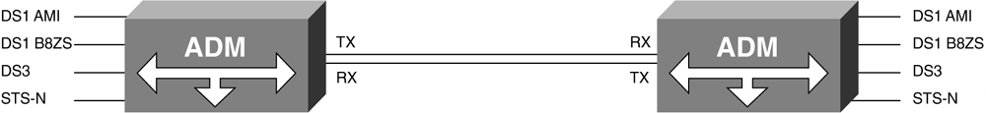
SONET Integration of TDM Signals
Figure 5-1. SONET Integration of TDM
[View full size image]

Slide 6
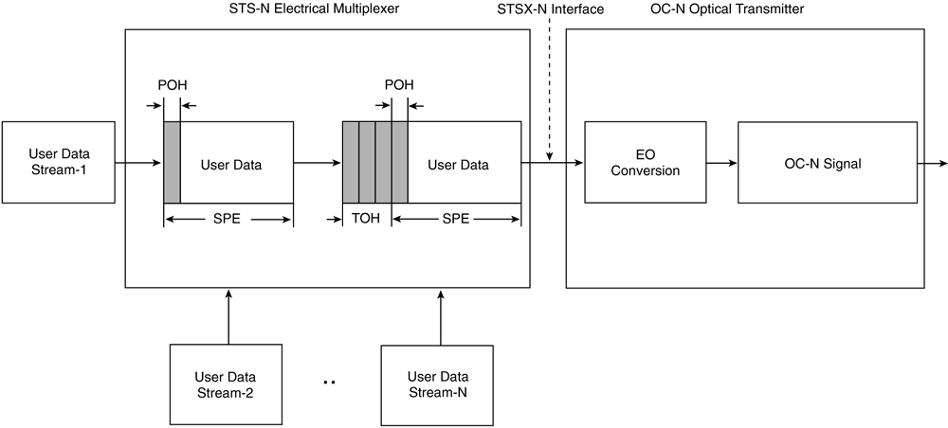
SONET Electrical and Optical Signals
The STSX-1 interface rating permits a distance of 450 feet or 137 meters, whereas the STSX-3 interface rating permits a distance of 225 feet or 69 meters between the electrical and optical devices.
The transmitter performs the EO conversion of the STS-N signal and converts the STS-N to an OC-N.
The OC-N signal is scrambled before being launched over the fiber-optic media.

Slide 7
SONET Synchronization
Five methods are typically used in obtaining synchronous timing in a SONET network:
Internal timing from a free-running onboard internal oscillator (Stratum 3E or Stratum 3 clock).
Line timing derived from a scrambled incoming SONET signal on a high-speed interface.
Through timing derived from signal input, but clocks the signal in a different outbound direction.
Loop timing is similar to line timing, but is used with customer premises equipment (CPE) or terminal multiplexer equipment rather than ADMs.
External timing from an external source such as a Stratum 1 global positioning system (GPS) or atomic clock source.

Slide 8
The SONET network is organized with a master-slave relationship with clocks of the higher-level nodes feeding timing signals to clocks of the lower-level nodes.
All nodes can be traced up to a primary reference source, a Stratum 1 GPS or atomic clock with extremely high stability and accuracy.
Lower-stratum or less-stable clocks are adequate to support the lower nodes. The internal clock of a SONET terminal can derive its timing signal from a building-integrated timing supply (BITS) used by switching systems and other equipment.
Thus, this terminal serves as a master for other SONET nodes, providing timing on its outgoing OC–N signal. Other SONET nodes operate in a slave mode called loop timing, with their internal clocks timed by the incoming OC–N signal. Current standards specify that a SONET network must be able to derive its timing from a Stratum 3 or higher clock.

Slide 9
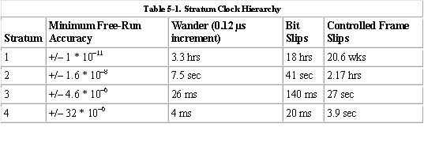
Jitter is defined as short-term phase variations above 10 Hz. Wander is defined as long-term phase variations below 10 Hz. In digital networks, jitter and wander are handled by buffers found in the interfaces within different network devices. One example is a slip buffer. The slip buffer is used to handle frequency differences between read and write operations. To prevent against write operations happening faster than read operations, read operations are handled at a slightly higher rate. On a periodic basis, read operations are paused, while a bit is stuffed into a stream to account for any timing differences between the read and write operations. This bit-stuffing scheme is referred to as a controlled slip (frame). The stratum clocking accuracy timing requirements are also defined in Table 5-1 for wander, bit slips, and controlled slips. The timing accuracy requirements increase as the stratum hierarchy increases.

Slide 10
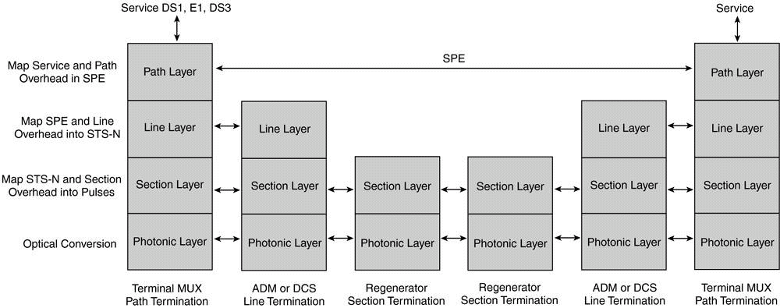
SONET Layers
SONET Layers Path Line Section Photonic

Slide 11
Path Layer
The path layer deals with the transport of services between the path-terminating equipment (PET) NEs.
The main function of the path layer is to map the signals into a format required by the line layer.
Its functions include reading, interpreting, and modifying the POH for performance and automatic protection switching
Path-Terminating Equipment (PTE)
The STS PTE is an NE that multiplexes or demultiplexes the STS payload. As an example, STS-1 PTE assembles 28 ,1.544-Mbps DS1 signals and inserts POH to form a 51.84-Mbps STS-1 signal.

Slide 12
Line Layer
The line layer deals with the transport of the path layer payload and its overhead across the physical medium.
The main function of the line layer is to provide synchronization and to perform multiplexing for the path layer.
Its functions include protection switching, synchronization, multiplexing, line maintenance, and error monitoring.
Line-Terminating Equipment (LTE)
The line-terminating equipment (LTE) is the NE that originates or terminates the line signal

Slide 13
Section Layer
The section layer deals with the transport of an STS-N frame across the physical medium. Its main functions are framing, scrambling, error monitoring, and section maintenance.
Section-Terminating Equipment (STE)
The section-terminating equipment (STE) is the NE that can acts as a termination device or a regenerator. The element is able to access, modify, originate, or terminate its overhead.

Slide 14
Photonic Layer
The photonic layer mainly deals with the transport of bits across the physical fiber medium.
Its main function is the conversion between STS-N and OC-N signals.
Its functions include wavelength launching, pulse shaping, and modulation of power levels

Slide 15
STANDARDS
Europe | North America
0.064 | 0.064 (DS0)
2.048 (E1) | 1.544 (DS1)
8.448 (E2) | 6.312 (DS2)
34.368 (E3) | 44.736 (DS3)
139.264 (E4) | 139.264 (DS4)

Slide 16
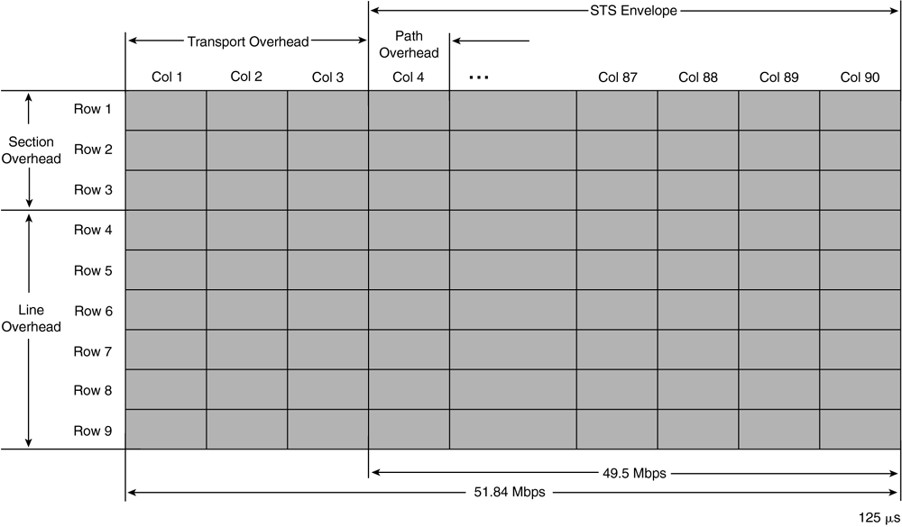
SONET FRAME FORMAT

Slide 17
The SONET STS-1 frame has an actual line rate of 51.84 Mbps that can be computed as follows: Line rate = 90 columns * 9 rows * 8 bits/byte * 8000 Frames/sec = 51.84 Mbps Columns 4 to 90 constitute the SPE that provides an actual data rate of 50.112 Mbps.
The actual data rate of the SPE can be computed as follows: Data Rate = 87 columns * 9 rows * 8 bits/byte * 8000 frames/sec= 50.112 Mbps

Slide 18
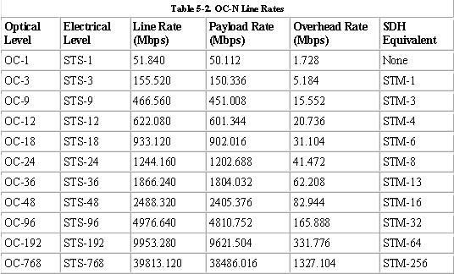
SONET LINE RATES

Slide 19
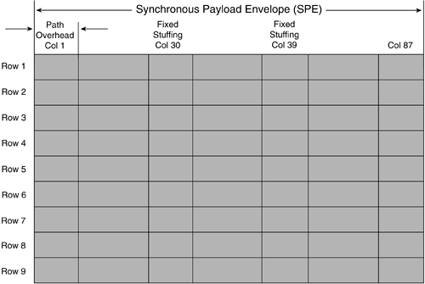
SPE

Slide 20
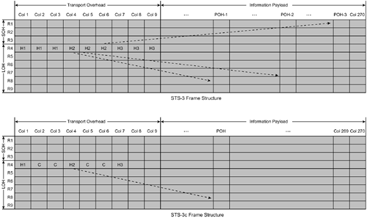
STS-3 OC-3 line rate = 2430 bytes/frame * 8000 frames/sec * 8 bits/byte = 155.52 Mbps 90*9*8*8000=155.52 Mbps

Slide 21
Path overhead
Out of the 783 bytes of payload, which occupy 87 columns, only 756 bytes in 84 columns actually carry payload capacity of STS-1. The first column, consisting of 9 bytes, is known as Path overhead (POH) .
POH is transported point to point with the payload till the latter is demultiplexed. It carries service provider information and monitors end-to-end transport of the payload. Columns 30 and 59 are not used for payload.

Slide 22
Transport overhead
Out of the 27 transport overheads, 9 bytes are section overhead and the remaining 18 bytes are line overhead . Transport overhead provides transport information.
The section overhead contains information required for communicating between successive network elements in the network, such as, repeaters.It also provides a voice communication channel for maintenance personnel. The line overhead contains information to monitor line performance. This overhead provides for the following functions:
line performance monitoring and line maintenance
automatic protection switching
multiplexing signals

Slide 23
Section Overhead
The section overhead (SOH) of the SONET STS-1 frame consists of 9 bytes found in the first 3 rows of columns 1, 2, and 3 of the SONET frame. The SOH is responsible for performance monitoring of the STS-N signal, carrying local orderwire communications, carrying OAM&P information over the Data Communication Channels, and for framing.

Slide 24
Line Overhead
The line overhead (LOH) of the SONET STS-1 frame consists of 18 bytes found in rows 4 to 9 of columns 1, 2, and 3 of the SONET frame. The LOH is processed by all SONET NEs except for regenerators or repeaters.
The LOH is responsible for performance monitoring of the individual STS-1s, carrying express orderwire communications information, data channels for OAM&P, pointers to indicate the start of the SPE, protection switching information, a line alarm indication signal (AIS), and line far-end receive failure (FERF) indication.

Slide 25
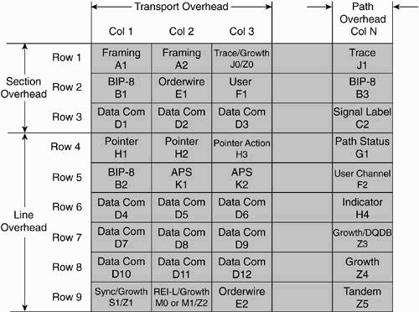
TOH

Slide 26
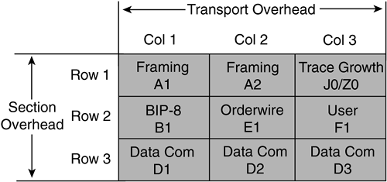
SOH

Slide 27
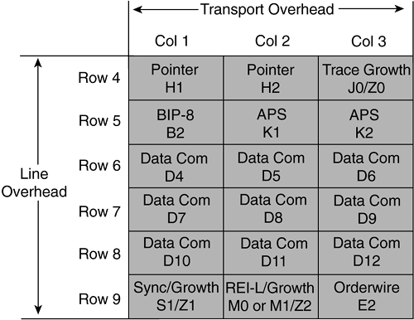
LOH

Slide 28
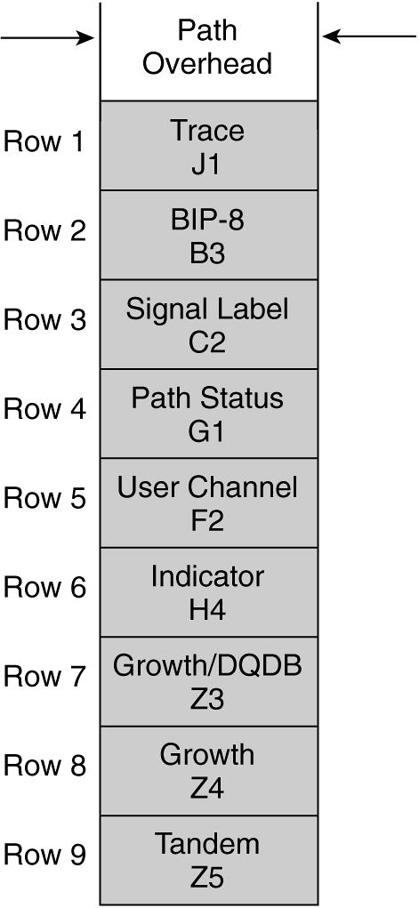
POH

Slide 29
SONET Alarms
Loss-of-Signal (LOS) Alarm
The loss-of-signal (LOS) alarm is raised when the synchronous signal (STS-STS-N) level drops below the threshold at which a bit error rate (BER) of 1 in 10³ is predicted.
This can be the result of excessive attenuation of the signal, receiver saturation, cable cut, or equipment fault.
The LOS state clears when two consecutive framing patterns are received and no new LOS condition is detected. The LOS alarm condition is configurable in certain SONET NEs.
Out-of-Frame (OOF) Alignment
The OOF state occurs when four or five consecutive SONET frames are received with invalid (errored) framing patterns (A1 and A2 bytes).
The maximum time to detect OOF is 625 microseconds. OOF state clears when two consecutive SONET frames are received with valid framing patterns.
Loss-of-Frame (LOF) Alignment
The LOF state occurs when the OOF state exists for a specified time in milliseconds. LOF state clears when an in-frame condition exists continuously for a specified time in milliseconds.

Slide 30
Loss-of-Pointer (LOP)
The LOP state occurs when N consecutive invalid pointers are received or N consecutive new data flags (NDFs) are received (other than in a concatenation indicator), where N = 8, 9, or 10.
LOP state clears when three equal valid pointers or three consecutive AIS indications are received. The LOP can also be identified as the STS path loss of pointer (SP-LOP) or VT path loss of pointer (VP-LOP).
Alarm Indication Signal (AIS)
The AIS is an all-1s characteristic or adapted information signal. It is generated to replace the normal traffic signal when that signal contains a defect condition to prevent consequential downstream failures being declared or alarms being raised.
The AIS can be identified as the line alarm indication signal (AIS-L), STS path alarm indication signal (SP-AIS), or the VT path alarm indication signal (VP-AIS).
Remote Error Indication (REI)
The REI is an indication returned to a transmitting node (source) that an errored block has been detected at the receiving node (sink).
This indication was formerly known as FEBE(far-end block error). The REI can also be identified as the line remote error indication (REI-L), STS path remote error indication (REI-P), or the VT path remote error indication (REI-V).

Slide 31
Remote Defect Indication (RDI)
The RDI is a signal returned to the transmitting terminating equipment on detection of a LOS, LOF, or AIS defect.
RDI was previously known as FERF(far-end receive failure). The RDI can also be identified as the line remote defect indication (RDI-L), STS path remote defect indication (RDI-P), or VT path remote defect indication (RDI-V).
Remote Failure Indication (RFI)
A failure is a defect that persists beyond the maximum time allocated to the transmission system protection mechanisms.
When this situation occurs, an RFI is sent to the far end and initiates a protection switch if this function has been enabled. The RFI can be identified as the line remote failure indication (RFI-L), STS path remote failure indication (RFI-P), or the VT path remote failure indication (RFI-V).

Slide 32
B1 Error
Parity errors evaluated by byte B1 (BIP-8(bit-interleaved parity)) of an STS-N are monitored. If any of the eight parity checks fail, the corresponding block is assumed to be in error.
B2 Error
Parity errors evaluated by byte B2 (BIP-24 * N) of an STS-N are monitored. If any of the N * 24 parity checks fail, the corresponding block is assumed to be in error.
B3 Error
Parity errors evaluated by byte B3 (BIP-8) of a VT-N (N = 3, 4) are monitored. If any of the eight parity checks fail, the corresponding block is assumed to be in error.
BIP-2 Error
Parity errors contained in bits 1 and 2 (BIP-2: bit-interleaved parity 2) of byte V5 of a VT-N (N = 11, 12, 2) are monitored.
If any of the two parity checks fail, the corresponding block is assumed to be in error.
Loss of Sequence Synchronization (LSS)
Sequence synchronization is considered to be lost and resynchronization is started if the BER is greater than or equal to 0.20 during an integration interval of 1 second.

Slide 33
Virtual Tributaries
The STS SPE can be subdivided into smaller structures, known as virtual tributaries (VTs).
VTs are used for transporting and switching payloads smaller than the STS-1 rate. All services below the DS3, such as DS1 signals, are transported in the VT structure.
The various sub-DS3 TDM payloads that can be carried over VTs are shown in Table. An individual VT containing a DS1 can be added or dropped without multiplexing or demultiplexing the entire STS-1.
This improved accessibility improves switching and grooming at VT or STS levels. The STS-1 payload can be subdivided into VTs that are synchronous signals used to transport lower-speed transmissions. There are four sizes of VTs: VT1.5 (1.728 Mbps), VT2 (2.304 Mbps), VT3 (3.456 Mbps), and VT6 (6.912 Mbps).

Slide 34
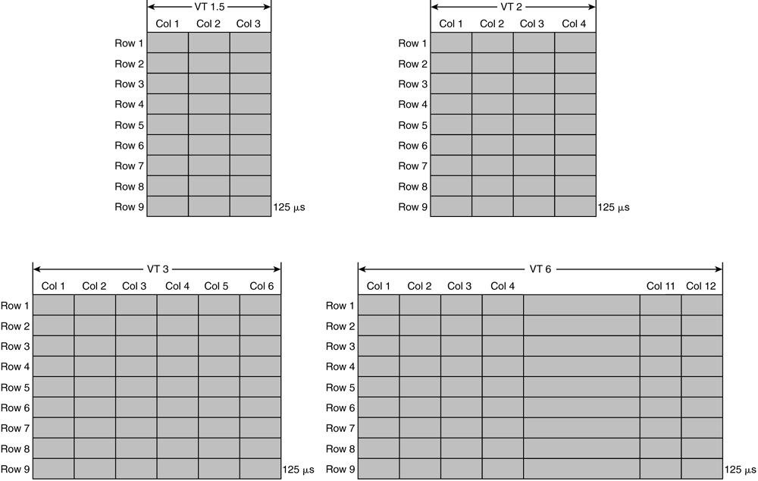
VT Types and Structures

Slide 35
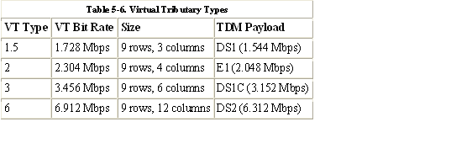

Slide 36
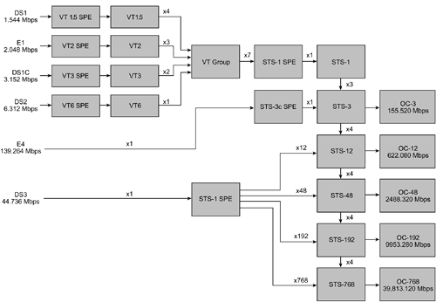
SONET Multiplexed Hierarchy

Slide 37
SONET Multiplexing
Various TDM PDH services can be natively accepted by SONET systems. These signals are mapped into the SONET payload envelope through service adapters.
All inputs are eventually converted to a base format of a synchronous STS-1 signal, with the exception of concatenated signals.
DS1 inputs are mapped into VT1.5 SPEs and consequently into VT1.5s.
Other low-speed signals, such as E1, DS1C, and DS2, are also mapped into their respective VTs. The VTs combine to form a virtual group (VG). Seven VGs are then mapped into an STS-1 SPE. The STS-SPE is then provided with its appropriate overhead and converted into an electrical STS-1.
Several synchronous STS-1s are then multiplexed together in either a single- or two-stage process to form an electrical STS-N signal. STS-N multiplexing is performed along with byte interleaving in such a way that the low-speed signals are visible.
The signal is then scrambled. Scrambling is the process of encoding digital 1s and 0s onto a line in such a way that provides an adequate number for a 1s density requirement. The ANSI standard for T1 transmission requires an average density of 1s of 12.5 percent. The primary reason for enforcing a 1s density requirement is for timing recovery or network synchronization. However, other factors, such as automatic-line-build-out (ALBO), equalization, and power usage are also affected by 1s density.

