Slide 1
SYNCHRONOUS DIGITAL HIERARCHY
A.SANGEETHA

Slide 2
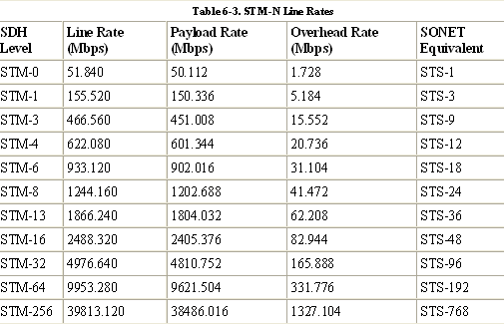
SDH line rates

Slide 3
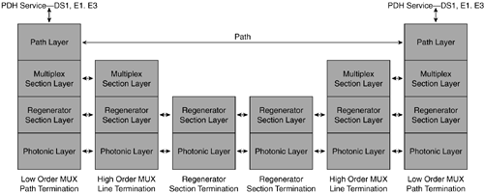
SDH LAYERS

Slide 4
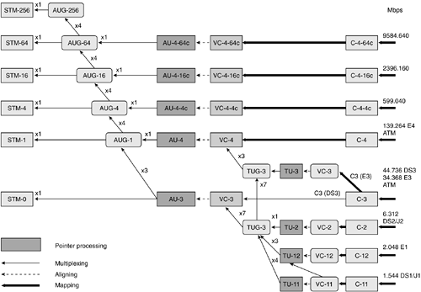
SDH Multiplexing

Slide 5
SDH Multiplexing
Multiplexing follows a rigid hierarchy in SDH. From an extremely high-level perspective, it is safe to say that low-level PDH signals are mapped to an SDH entity known as a container (C).
The C is mapped along with POH bytes to form another entity known as a lower-order virtual container (VC).
The lower-order VCs are aligned with tributary unit (TU) pointers to form entities known as tributary units (TUs).
The TUs are multiplexed to form tributary unit groups (TUGs). The TUGs are further multiplexed to form higher-order VCs.
These higher-order VCs are aligned with fixed stuff to form administration units (AUs).
The AUs are further multiplexed to form administrative unit groups (AUGs).
The AUGs are finally multiplexed along with RSOH and MSOH bytes to form the STM-N signal.

Slide 6
multiplexing principles of SDH
Mapping— A process used when tributaries are adapted into VCs by adding justification bits and POH information.
Aligning— This process takes place when a pointer is included in a TU or an AU, to allow the first byte of the VC to be located
Multiplexing— This process is used when multiple lower-order path layer signals are adapted into a higher-order path signal, or when the higher-order path signals are adapted into a multiplex section.
Stuffing— As the tributary signals are multiplexed and aligned, some spare capacity has been designed into the SDH frame to provide enough space for all the various tributary rates. Therefore, at certain points in the multiplexing hierarchy, this space capacity is filled with fixed stuffing bits that carry no information, but are required to fill up the particular frame.

Slide 7
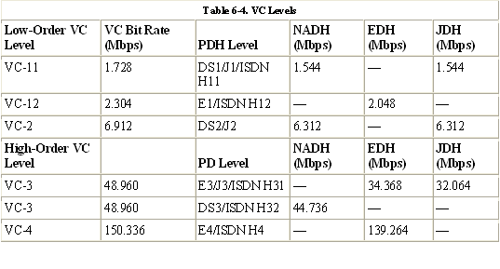
VC Levels

Slide 8
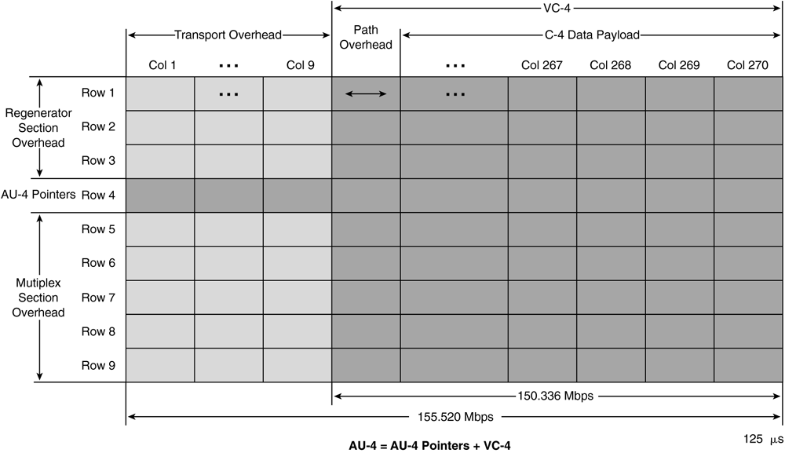
SDH Framing

Slide 9
SDH adopts a frame rate of 8000 frames per second.
The STM-1 frame is the basic transmission format for SDH.
each two-dimensional frame has 9 rows and 270 columns of bytes with a total of 2430 bytes (9 rows * 270 columns = 2430 bytes).
The STM-1 frame consists of an transport overhead plus a virtual container (VC-4) capacity.
The first 9 columns of each frame make up the transport overhead, and the remaining 261 columns make up the virtual container (VC-4). The VC-4 plus the nine pointer bytes (H1 * 3, H2 * 3, H3 * 3) in row 4 is known as the administrative unit (AU-4).
The first column of the VC-4 is the POH. Actually, the POH floats within the STM-1 frame and can occupy any column from column 10 to column 270 of the STM-1 frame.
The STM-1 can accommodate a single VC-4 or three VC-3s. The AU-N pointer bytes indicate the position of the VC-4 POH or VC-3 POHs within the STM-1 frame.
VCs can have any phase alignment within the AU, and this alignment is indicated by the AU pointer in row 4. Within the transport overhead, the first three rows are used for the RSOH, and the last five rows are used for the MSOH.

Slide 10
The SDH line rate is synchronous and is flexible enough to support many different signals. The SDH STM-1 line rate of 155.520 Mbps can be computed as follows:
Line rate = 270 columns * 9 rows * 8 bits/byte * 8000 frames/sec = 155.520 Mbps
Columns 10 to 270 constitute the VC with the POH that provides a payload data rate of 150.336 Mbps. The actual data rate of the payload can be computed as follows:
Data rate = 261 columns * 9 rows * 8 bits/byte * 8000 frames/sec = 150.336 Mbps

Slide 11
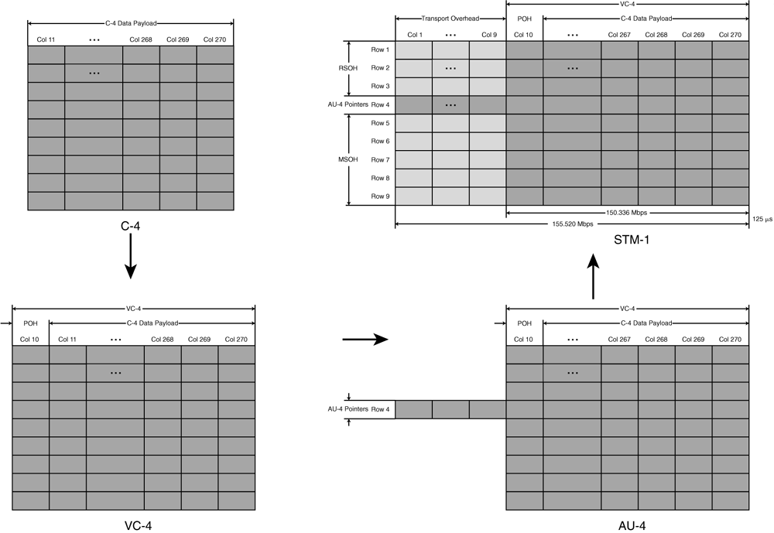

Slide 12
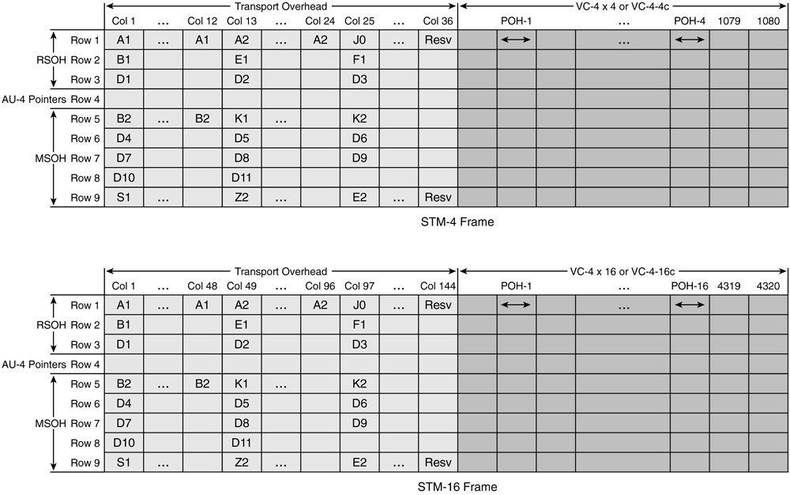
Higher order framing

Slide 13
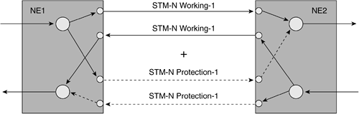
1+1 Protection

Slide 14
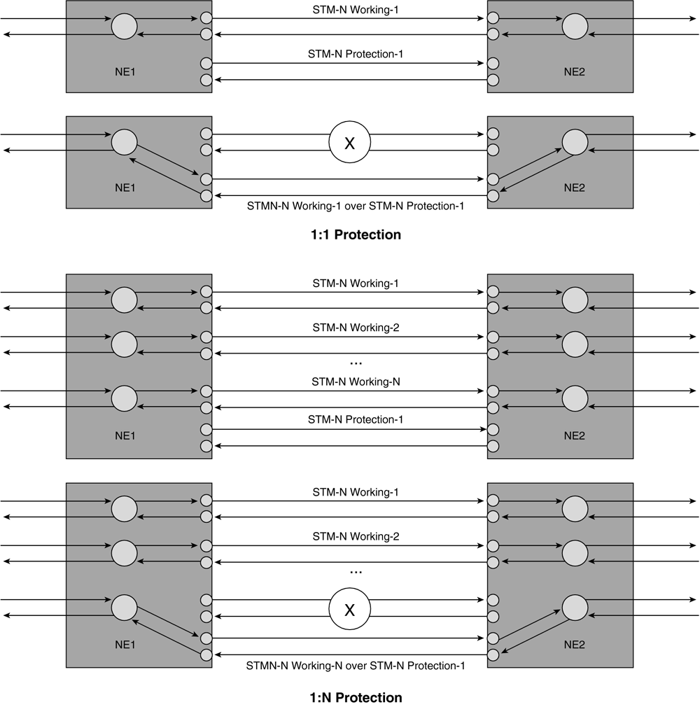
1:1 and 1:N Protection

Slide 15
Regenerator
The regenerator is an RSTE that regenerates attenuated signals. A regenerator or amplifier is needed when, due to the long distance between multiplexers, the signal level in the fiber gets attenuated and becomes too low to drive a receiver. The regenerator is sometimes called a repeater. Regenerators can be cascaded to extend the reach of the optical-fiber system.
However, nonlinear impairments must be taken into consideration while cascading regenerators.
The regenerator clocks itself off of the received signal and replaces the RSOH bytes before retransmitting the signal. The MSOH, POH, and payload are not altered.

Slide 16
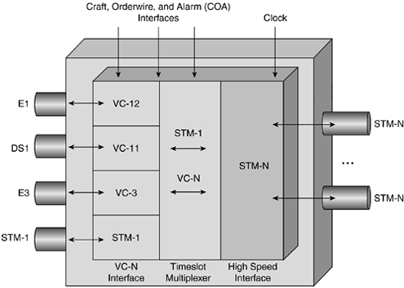
SDH Terminal Multiplexer

Slide 17
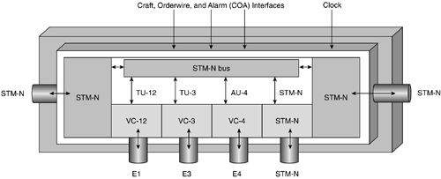
SDH ADM

Slide 18
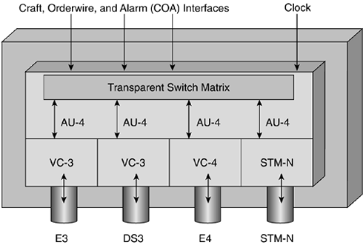
Broadband Digital Cross-Connect

Slide 19
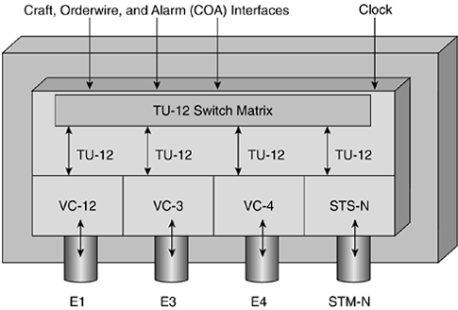
Wideband Digital Cross-Connect

Slide 20
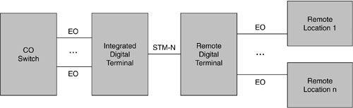
Digital Loop Carrier

Slide 21
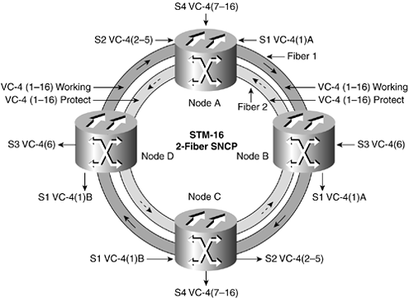
Two-Fiber SNCP

Slide 22
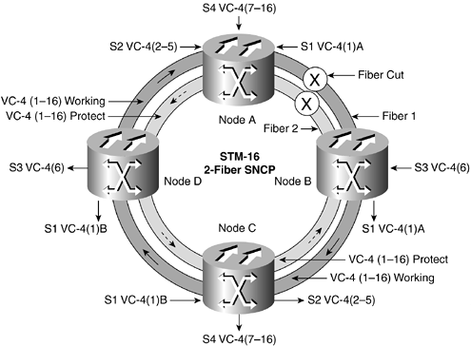
Fiber cut

Slide 23
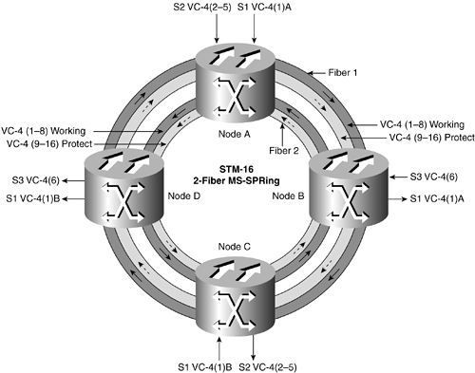
Multiplex Section-Shared Protection Rings

Slide 24
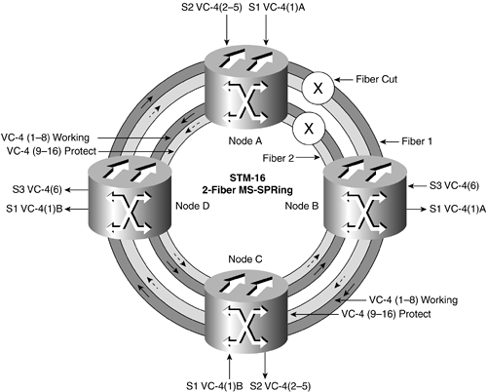
Fiber cut

Slide 25
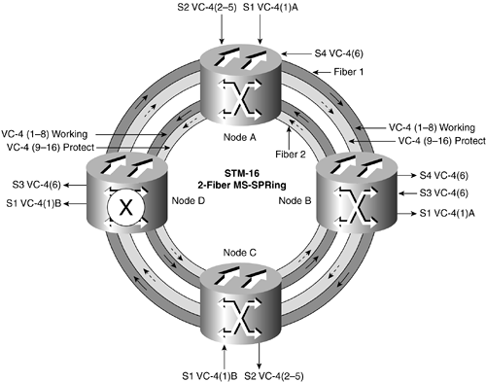
Node failure

Slide 26
