Slide 1
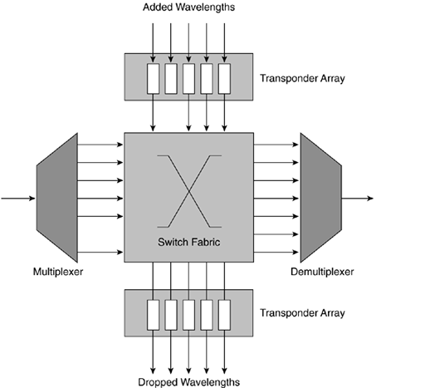
WDM
WDM SYSTEM

Slide 2
WDM SYSTEMS
Four kinds of WDM systems are available:
Metro WDM (<200 km)
Long-haul or regional WDM (200 km to 800 km)
Extended long-haul WDM (800 km to 2000 km)
Ultra-long-haul WDM (>2000 km)

Slide 3
Coarse Wavelength-Division Multiplexing
the short-haul transport of data, voice, video, storage, and multimedia services
CWDM systems use lasers that have a bit rate of up to 2.5 Gbps (OC-48/STM-16) and can multiplex up to 18 wavelengths. This provides a maximum of 45 Gbps over a single fiber.
channel spacing of 20 nm or 2500 GHz as specified by the ITU standard G.694.2( 1270 nm to 1610 nm)

Slide 4
Dense Wavelength-Division Multiplexing
metro or long-haul core where capacity demands are extremely high.
Typical DWDM systems use lasers that have a bit rate of up to 10 Gbps (OC-192/STM-64) and can multiplex up to 240 wavelengths. This provides a maximum of 2.4 Tbps over a single fiber.
use 100-GHz or 200-GHz frequency spacing
ITU grid DWDM products operate in the C-band between 1530 and 1565 nm or L-band between 1565 and 1625 nm

Slide 5
Band-Separation Method
Interleaving-Filter Method
Circulator Method

Slide 6
optical frequency bands used with various WDM systems
O-band (original)— A range from 1260 nm to 1360 nm
E-band (extended)— A range from 1360 nm to 1460 nm
S-band (short wavelength)— A range from 1460 nm to 1530 nm
C-band (conventional)— A range from 1530 nm to 1565 nm
L-band (long wavelength)— A range from 1565 nm to 1625 nm
U-band (ultra-long wavelength)— A range from 1625 nm to 1675 nm

Slide 7
WDM COMPONENTS
WDM optical networks consist of five main components:
Transmitters
Optical multiplexers and demultiplexers
Amplifiers
Optical-fiber media
Receivers

Slide 8
Distributed Feedback Lasers (1st generation) Arrayed DFB-1 to 10 milliseconds (ms) of tuning time
DFB lasers are edge emitting lasers currently used for both CWDM and DWDM
DFB lasers are edge emitting lasers currently used for both CWDM and DWDM
Temperature effects:
CWDM-No cooling
DWDM-COOLING REQUIRED
thermistor - coarse temperature control
external wavelength locker -for finer wavelength control

Slide 9
Distributed Bragg Reflector Lasers (1st generation)
The change of current over the grating also changes the Bragg's wavelength and the associated feedback.
DBR and DFB lasers are temperature dependent and need temperature-controlling elements for stable uniform operations.
The temperature-controlling elements add a significant cost to the laser transmitters used in C-band applications.

Slide 10
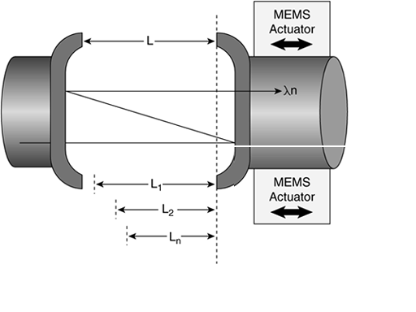
Mechanical Tunable Lasers
MEMS actuators can physically vary the length between the cavity walls resulting in a variation of the output wavelength.
The physical distance between cavity walls is carefully calibrated to emitted ITU-T wavelengths.
Mechanical lasers have a tuning range of 10 to 20 nm and require 100 to 500 ms of tuning time

Slide 11
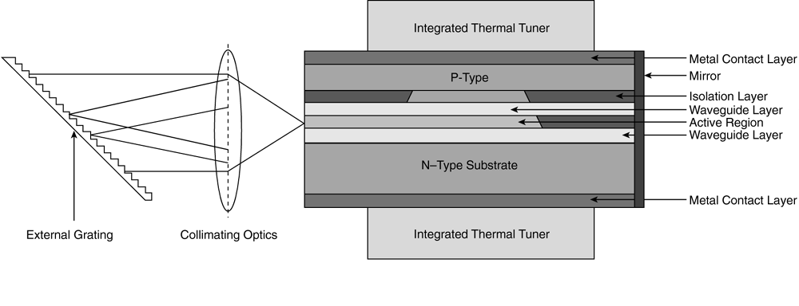
External Cavity Tunable Lasers
excess of 20 milliwatts (mW)
switch from one wavelength to another in the order of nanoseconds, and this makes them potential candidates for building optical switches that could route traffic on a wavelength basis
integrated thermal tuner

Slide 12
Vertical Cavity Surface Emitting Lasers
Gigabit Ethernet and 10 Gigabit Ethernet WDM LAN applications with 850-nm/1310-nm and single-mode or multimode options.
VCSELs are capable of fast direct modulation speeds up to 2.5 Gbps.

Slide 13
Chirp
Chirp is an abrupt change of the center wavelength of a laser, caused by laser instability.
Chirp is the phenomenon of the rising edge of a pulse having a slightly different frequency than the falling edge.
Chirp can be defined as the change in frequency of the transmitted optical signal with respect to time.

Slide 14
Direct Modulation
Direct modulation -laser diode switches between on and off for a logical 1 and logical 0
drawbacks –cannot be used at bit rates that are greater than 2.5 Gbps.
Direct modulation creates nonlinearity, such as self-phase modulation (SPM), and also increases the laser chirp.
Directly modulated lasers are limited by distance and are suited for metro application

Slide 15
External Modulation
A DC-biased laser producing a continuous wave (CW) feeds an external modulator, which modulates the CW signal into desired optical bit streams.
avoids nonlinearity and excessive chirp
electro-absorption modulators (smaller)
Mach-Zehnder interferometer (MZI) modulators (twice the bit rate as their bandwidth)
RZ format is preferred in long-haul and ultra-long-haul systems

Slide 16
Optical Multiplexers and Multiplexers
Thin film filters
Fiber Bragg gratings (FBGs)
Arrayed waveguide gratings (AWGs)
FP cavity filter
Acousto optical tunable filters
Mach-Zehnder interferometers
Interleavers, periodic filters, and frequency slicers

Slide 17
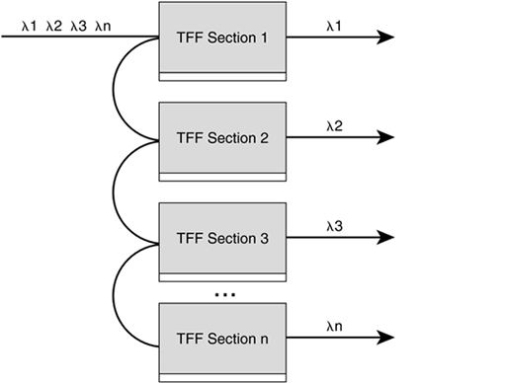
Thin film filters metro DWDM products, whereas there are only 50 layers in a 20-nm filter
The cavity is formed by the thin films with interfaces that act as reflectors.
The wavelength or group of wavelengths that is selected depends on the length of this cavity.
TFFs are typically made of quarter wavelength (LAMDA/4n)-thick layers of alternating high- and low-refractive index materials.
TFFs use many ultra-thin layers of dielectric material coating deposited on a glass or polymer substrate

Slide 18
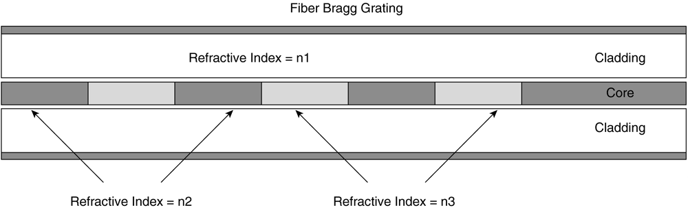
Fiber Bragg Grating (ultraviolet radiation to create periodic changes in the refractive index of the fiber)
The FBG can be characterized by low-loss (0.1-dB) and low-channel cross talk.
FBGs find applications in most WDM systems, such as channel-drop elements, dispersion-compensation devices, and filters.
FBGs have a range of 10 nm and require a tuning time of 1 to 10 seconds with mechanical tuning mechanisms

Slide 19
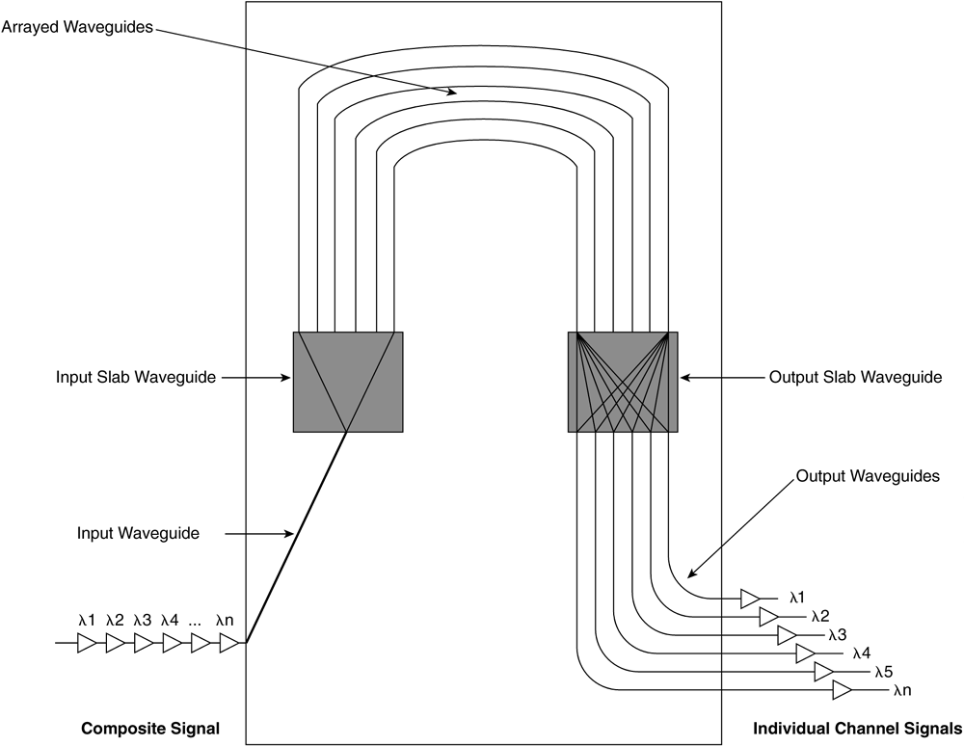
Arrayed Waveguide(multiplexers and switching systems) tuning time -10 ms-thermo-optic tuning mechanisms
In the transmit direction, the AWG mixes individual wavelengths from different lines etched into the AWG substrate (the base material that supports the waveguides) into one etched line called the output waveguide, thereby acting as a multiplexer.
In the opposite direction, the AWG can demultiplex the composite LAMDASs onto individual etched lines.
Signals passing through each of these waveguides interfere with signals passing through their neighboring waveguides at the converging point(s).

Slide 20
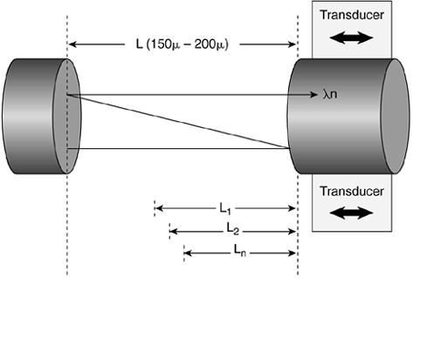
Fabry Perot Cavity Filter
two reflective surfaces separated by a refractive medium
FP cavity mirrors are typically about 150 to 200 mm apart, and common cavities are constructed by using the air gap between the polished surfaces of two fibers.
reflectivity that is a function of the operating wavelength
The reflective surfaces are connected to an electromechanical transducer, and the distance between the reflective surfaces can be changed by varying the current to the transducer

Slide 21
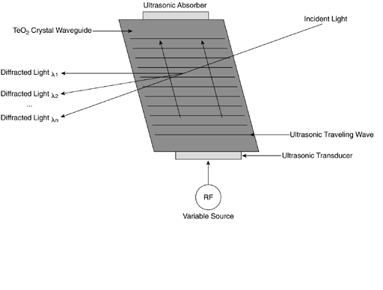
Acousto Optical Tunable Filter
Ultrasound waves are essentially longitudinal waves with propagation based on formation of compression and rarefaction zones, The interaction of light with the acoustic waves is called the photon-phonon interaction and results because of an effect known as the photo-elastic effect
tuning range of 250 nm covering both C- and L-bands.
optical router

Slide 22
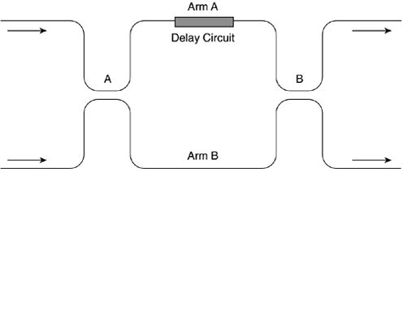
Mach-Zehnder Interferometers
The couplers are connected to the two arms of the MZI. The voltage can be varied across the MZI arm to change the coupling ratio between the two arms.
couplers are equally balanced and the input power is equally split between the two arms. The signals in the two arms interact with each other twice.
The first coupler (A) divides the signal into two AND can be made to obtain different phase shifts by varying the lengths of the two arms.
The signals, upon interfering with each other at the second coupler (B), might have constructive or destructive interference.
The constructive or destructive interference blocks one wavelength.
MZIs can be built on planar silica, indium phosphide, or lithium niobate substrates.
MZIs have a tuning range of 4 nm and have tuning times in the order of tens of nanoseconds.

Slide 23
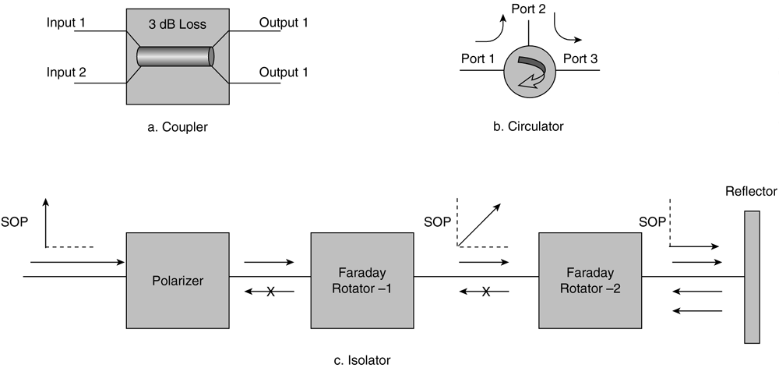
Couple. rs, Circulators, and Isolators(optical power transfer device)
Only the incident light that matches the phase of the polarizer passes through. This light is now subjected to a Faraday rotator, which rotates the state of polarization (SOP) by 45 degrees.
Couplers are passive bidirectional devices that could have multiple inputs and output ports
A signal entering port 1 is directed to port 2, whereas the signal entering port 2 is directed to port 3. The connection between port 3 and port 1 is generally not available. circulator uses polarization beam splitters to separate wavelengths.(0.7dB insertion loss)
Couplers are used for monitoring WDM ports and for passively adding channels into a fiber.
3 Db insertion loss

Slide 24
Amplifiers
Pre-amplifiers boost pulses -transmit side
postamplifiers boost pulses -receive side
In-line amplifiers (ILA) are placed at different distances from the source to provide recovery of the signal before it is degraded by loss.
1R— Re-amplify
2R— Re-amplify and reshape
3R— Re-amplify, reshape, and retime (Note that a multiwavelength 3R repeater is not practical in a high-capacity DWDM network due to the higher number of wavelengths to regenerate and/or the size, power, and cost associated with each wavelength regenerated)

Slide 25
Optical amplifiers
PDFA— Praseodymium-doped fiber amplifier (1310–1380 nm)
EDFA— Erbium-doped fiber amplifier (1530–1565 nm)
GS-EDFA— Gain-shifted EDFA (1565–1625 nm)
EDTFA— Tellurium-based gain-shifted TDFA (1530–1610 nm)
GS-TDFA— Gain-shifted thulium-doped fiber amplifier (1490–1530 nm)
TDFA— Thulium-doped fluoride-based fiber amplifier (1450–1490 nm)
RFA— Raman fiber amplifier (1420–1650 nm or more)

Slide 26
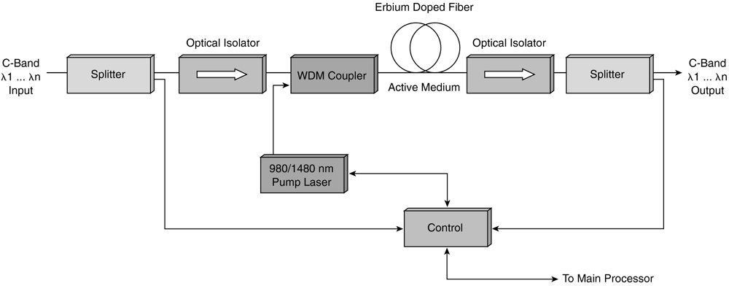
Erbium-Doped Fiber Amplifiers
1530- to 1565-nm range
forward pumping
980 nm and/or 1480 nm (pump laser diode)
reverse pumping
High pump power with short EDFA fiber is used for C-band amplifiers.
Medium pump power with long EDFA fiber is used for L-band amplifiers
Bidirectional pumping

Slide 27
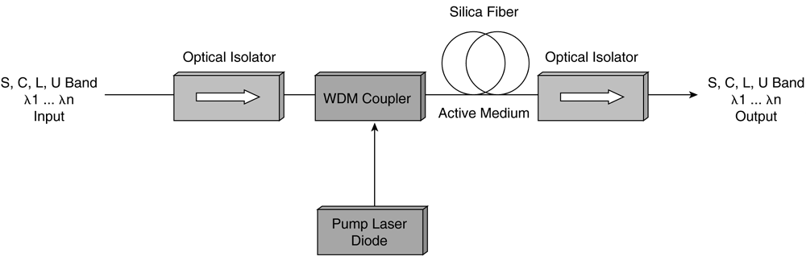
Raman Fiber Amplifiers
The gain spectra for Raman amplification is quite broad (150 to 200 nm) and covers the entire operating S-, C-, L-, and U-bands
The pumping can be done in forward (co-propagating) and in reverse (counter-propagating) direction.
20- to 35-dB gain with 800 mW to 1W pump power

Slide 28
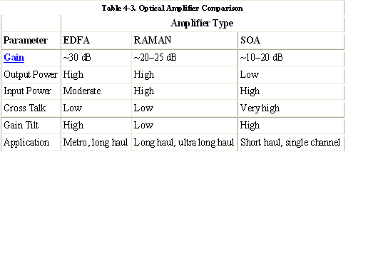
comparison

Slide 29
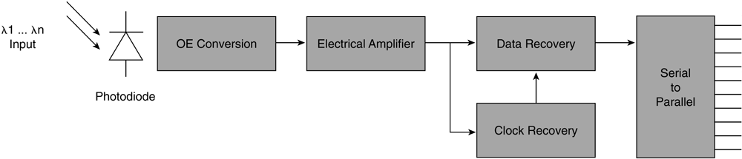
Wdm receivers
PIN photodiodes— Simplest and fastest
Avalanche photodiodes (APDs)— Slower, but are much more sensitive to light as compared to PIN photodiodes

Slide 30
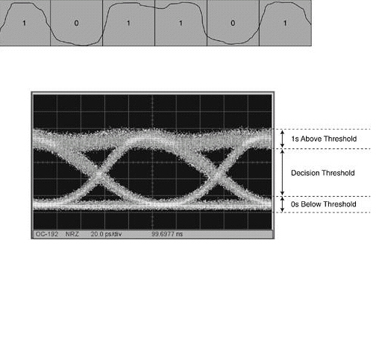
WDM Characteristics and Impairments to Transmission
values are 10^{–12} BER for SONET
and 10^{–15} for next-generation long-haul transport equipment
The Q-factor is a measure of how noisy a pulse is for diagnostic purposes.
An eye pattern is a sampling oscilloscope display in which a pseudorandom optical data signal from a optical receiver is repetitively sampled and applied to the vertical input, while the optical signaling rate is used to trigger the horizontal sweep.

Slide 31
Dispersion and Compensation in WDM
Linear characteristics
Attenuation
chromatic dispersion (CD)
polarization mode dispersion (PMD)
whereas nonlinear characteristics i cross-phase modulation (XPM)
four-wave mixing (FWM)
stimulated Raman scattering (SRS)
stimulated Brillouin scattering (SBS)

Slide 32
The various technologies used in DCUs include the following:
Dispersion-compensating fiber, Fiber Bragg gratings,High-order mode devices,Virtual image phase array (VIPA) is a free-space dispersion device.
The dispersion limit of the system depends on many factors:
Receiver tolerance.
- Depends on pulse type; NRZ is better than RZ pulses.
- Depends on data rate.
- Depends on transmitter chirp.
Variability of fiber dispersion.
- Dispersion of fiber has a range of values.
- Some temperature dependence occurs.
Variability of DCU values-- Includes slope of dispersion and manufacturing tolerances.
Variability of components in network elements.
Receiver dispersion tolerance must be less than the sum of dispersion variances.

