Slide 1
Underwater Communications
Milica Stojanovic
Massachusetts Institute of Technology
millitsa@mit.edu

Slide 2
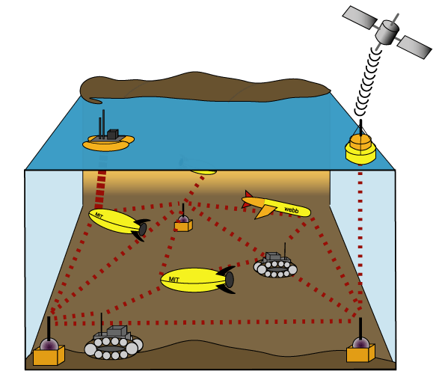
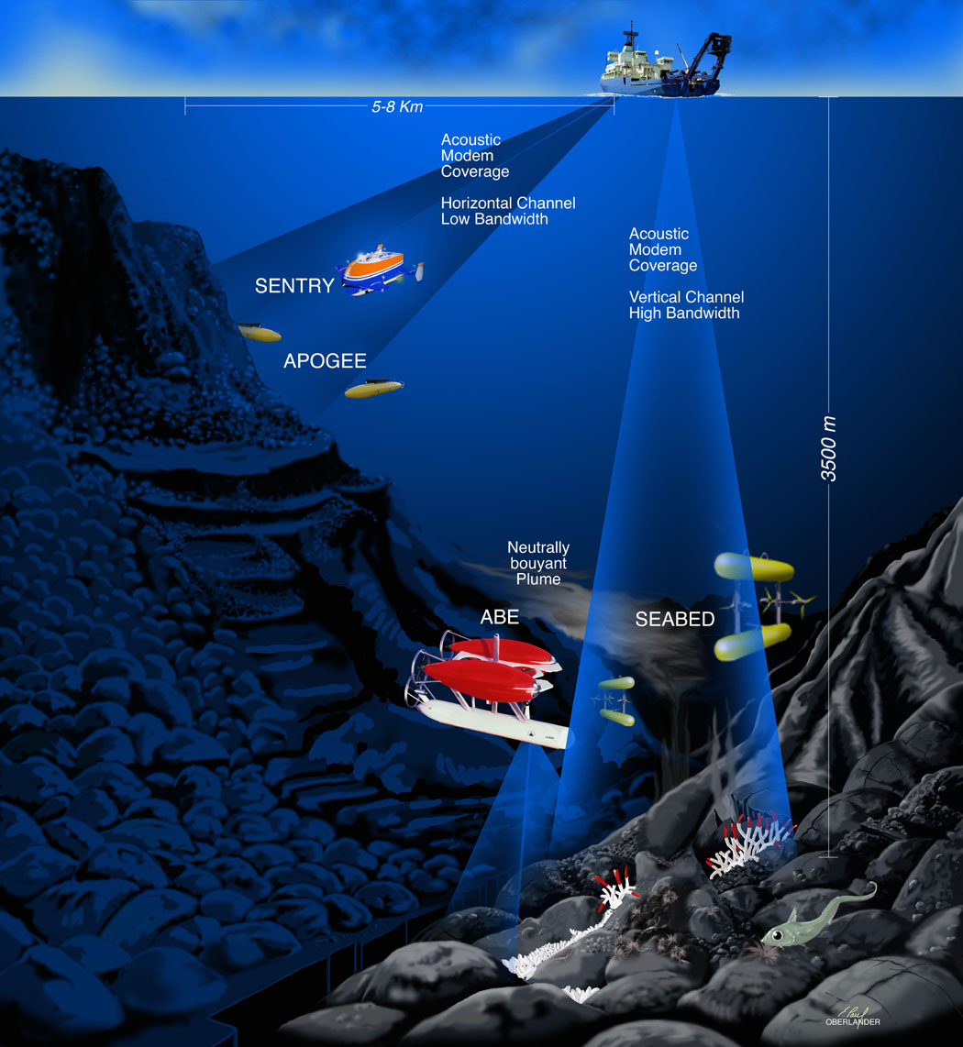
Future systems / requirements
Today: point-to-point acoustic links
Future: autonomous networks for ocean observation
Examples of future networks:
  ad hoc deployable sensor networks
  autonomous fleets of cooperating AUVs
Types of nodes:
  fixed, slowly moving, mobile
  sensors, relays, gateways
Types of signals, system requirements:
  low/high rate (~100 bps-100kbps)
  real-time/non real-time
  high/moderate reliability
Configurations:
  stand alone
  integrated (e.g., cabled observatories)
NSF ITR: “Acoustic networks, navigation and sensing
for multiple autonomous underwater robotic vehicles.”

Slide 3
Overview
Channel characteristics
Signal processing: bandwidth-efficient underwater acoustic communications
Example: application to oil field monitoring
Future research

Slide 4
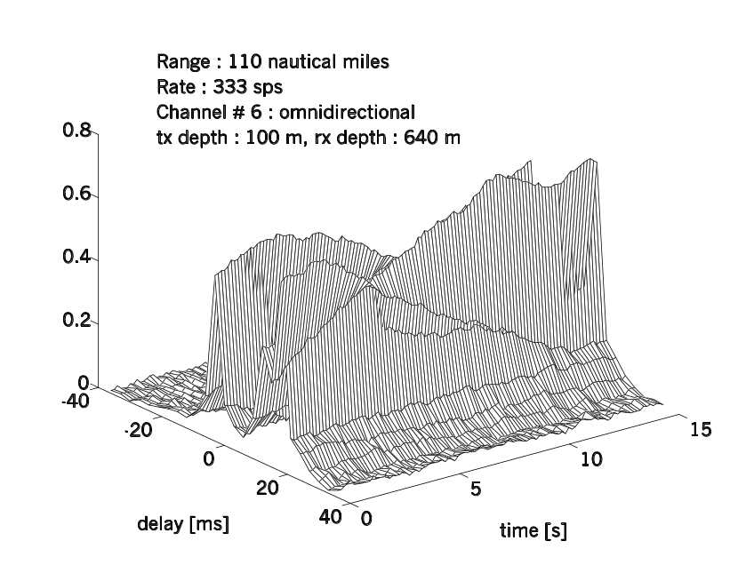
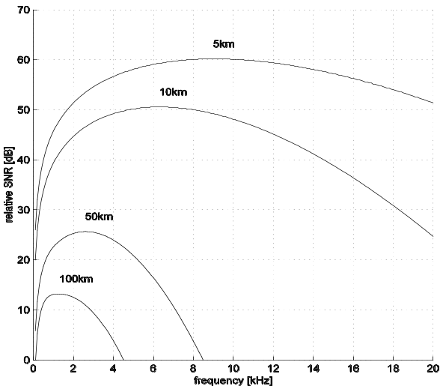
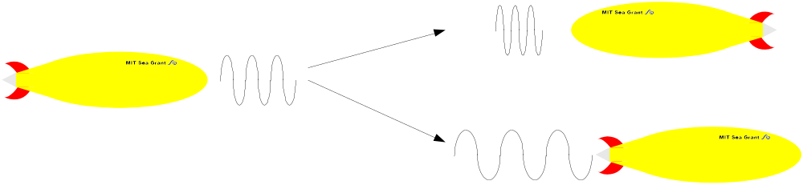
Communication channel / summary
Physical constraints of acoustic propagation:
limited, range-dependent bandwidth
time-varying multipath
low speed of sound (1500 m/s)
B>1/T_{mp}→
frequency-selective
fading
A(d,f)~d^{k}a(f)^{d}
N(f)~Kf^{-b}
Worst of both radio worlds
(land mobile / satellite)
System constraints:
transducer bandwidth
battery power
half-duplex
t→t(1±v/c)
f→f(1±v/c)

Slide 5
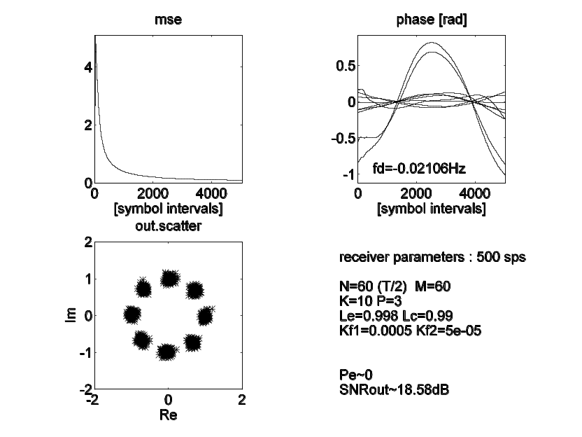
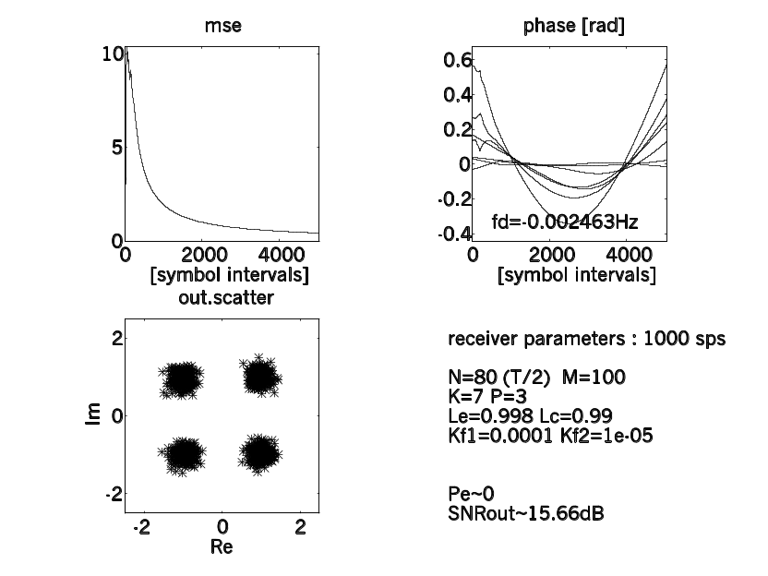
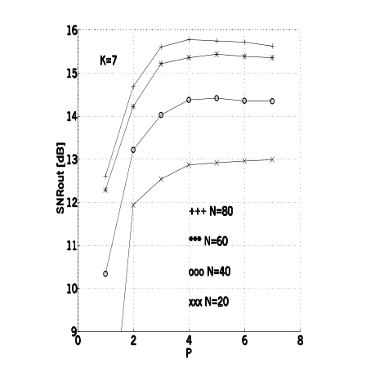
Signal processing
for high rate
acoustic
communciations
inp.1
com-
biner
data est.
inp.2
forward
data out
+
_
decision
forward
Bandwidth-efficient modulation (PSK, QAM)
phase-coherent detection:
synchronization
equalziation
multichannel combining
feedback
inp. K
filter
coefficients
sync.
adaptation algorithm
(JASA ‘95, with J.Proakis, J.Catipovic)
Ex. New England Continental Shelf, 50 n.mi, 1 kHz
training data
Example:
New England Continental Shelf

Slide 6

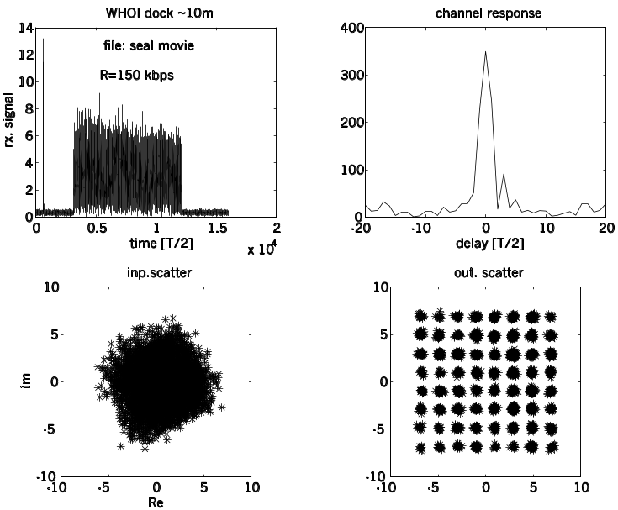
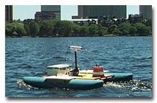
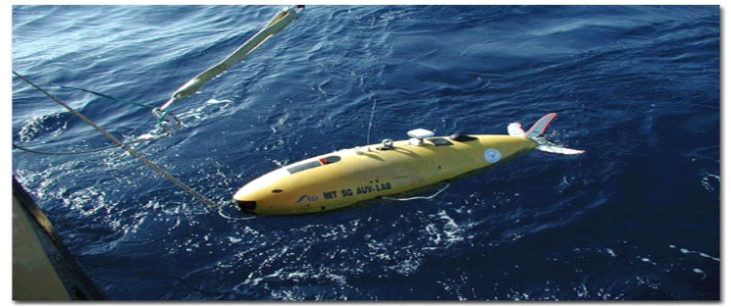
Real-time underwater video?
Underwater image transmission: sequence of images (JPEG) at < 1 frame/sec
  MPEG-4 : 64 kbps (video conferencing)
Can we achieve 100 kbps over an acoustic channel?
Compression to reduce bit rate needed for video representation
High-level modulation to increase the bit rate supported by acoustic channel
Experiment:
Woods Hole, 2002
6 bits/symbol (64 QAM)
150 kbps in 25 kHz bandwidth
?
( IEEE Oceans ’03, with C.Pelekanakis)

Slide 7
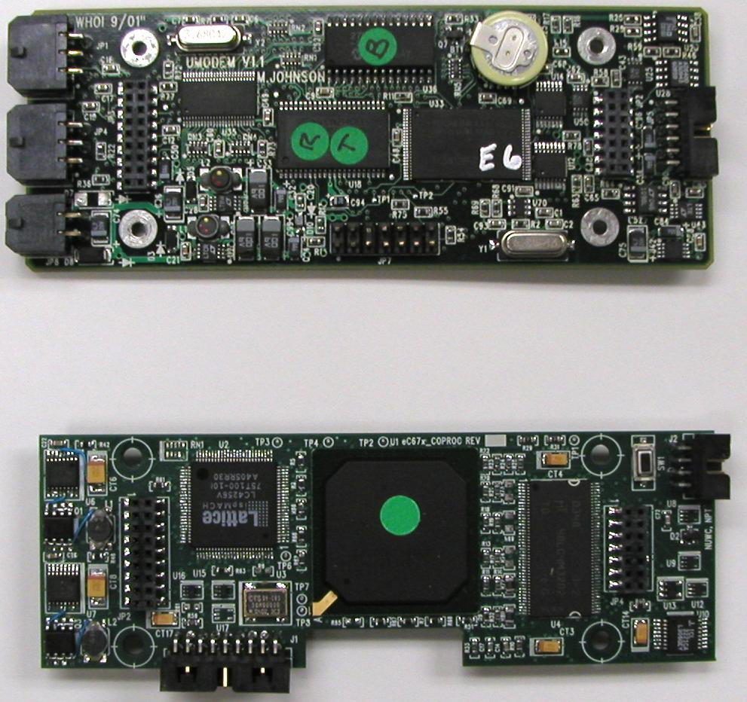
Current achievements
Point-to-point (2/4/8PSK;8/16/64QAM)
medium range (1 km-10 km ~ 10 kbps)
long range (10 km – 100 km ~1 kbps)
basin scale (3000 km ~ 10 bps)
vertical (3 km~15kbps, 10 m~150 kbps)
Mobile communications
AUV to AUV at 5 kbps
Multi-user communications
five users, each at 1.4 kbps in 5 kHz band
WHOI micro-modem:
Fixed point DSP
low rate FSK (~100 bps) w/noncoherent detection
Floating point co-processor
high rate PSK (~5000 bps) w/coherent detection
(adaptive DFE, Doppler tracking, coding)
4-channel input
10-50 W tx / 3W rx (active)
1.75 in x 5 in.
Commercial modems: Benthos, LinkQuest.
Research in signal processing
Goals:
low complexity processing
improved performance
better bandwidth utilization
Specific topics:
spread spectrum communications (CDMA, LPD)
multiple tx/rx elements (MIMO)
multi-carrier modulation (OFDM)

Slide 8
Example: Application to oil-field monitoring
Example:
AUV to base range ~ 60 m.
acoustic link delay = 40 ms
cabled link delay = negligible
acoustic band ~ several 100 kHz
bit rate > 100 kbs : well within
current video compression technology
alternative: optical communciation
high rate (Mbps)
low distance ~ 10 m
Q: Is real-time supervisory control of the AUV possible?
A:Not over long distances, where the propagation delay is many seconds, but possibly over short distances.
Bonus: The available acoustic bandwidth is much greater
over short distances.
short distance
high bandwidth
acoustic link
platform
sea level
AUV
base
station
power, communications, oil
base
station
base
station

Slide 9
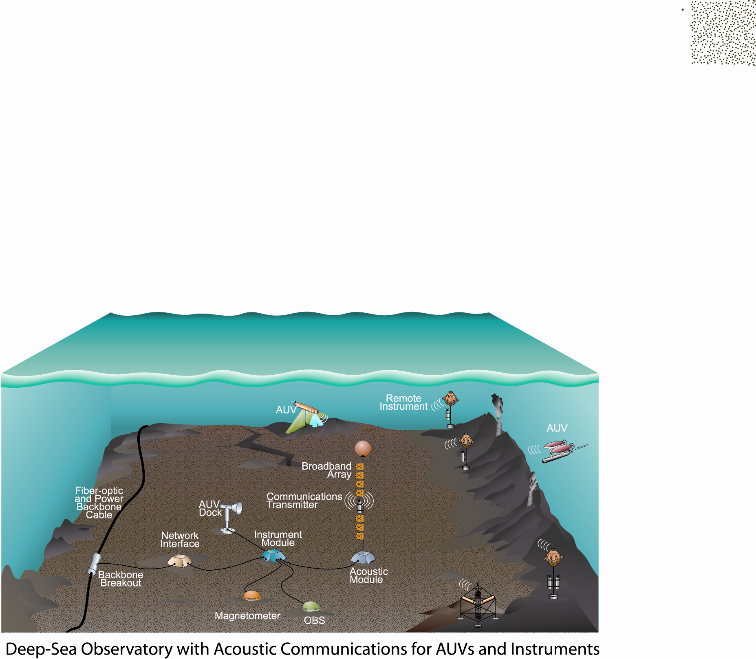
Open problems and future research
Experimental networks:
System specification:
typical vs. application-specific (traffic patterns, performance requirements)
optimization criteria (delay, throughput, reliability, energy efficiency)
Concept demonstration:
simulation
in-water
prototypes
Fundamental questions:
Statistical channel modeling
Network capacity
Research areas:
Data compression
Signal processing for communications:
adaptive modulation / coding
channel estimation / prediction
multiple in/out channels (tx/rx arrays)
multi-user communications
communications in hostile environment
Communication networks:
network layout / resource allocation and reuse
network architecture / cross layer optimization
network protocols: all layers
System integration:
Cabled observatories
Integration of wireless communications:
cabled backbone + mobile nodes = extended reach
Wireless extension: acoustical and optical
Underwater optical communications:
blue-green region (450-550 nm)
+much higher bandwidth (~Mbps)
+negligible delay
-short distance (<100 m)
complementary
to acoustics

Slide 10
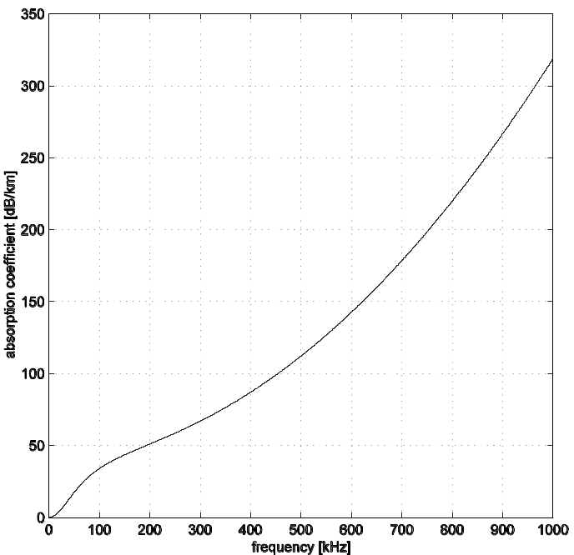
Channel characteristics: Attenuation and noise
Attentuation (path loss): A(d,f)=d^{k}a(f)^{d}
10logA(d,f)=10klog d + d 10 log a(f)
Absorption coefficient increases rapidly with
frequency: fundamental bandwidth limitation.
spreading
loss
absorption
loss
Only very low frequencies propagate over long distances
2 spherical spreading
1.5 practical spreading
1 cylindrical spreading
k =
Thorp’s formula for absorption coefficient (empirical):
10 log a(f) = 0.11 f²/(1+f²)+44 f²/(4100+f²)+0.000275 f²+0.003 dB/km, for f [kHz]
absorption→ fundamental limitation of maximal frequency

Slide 11
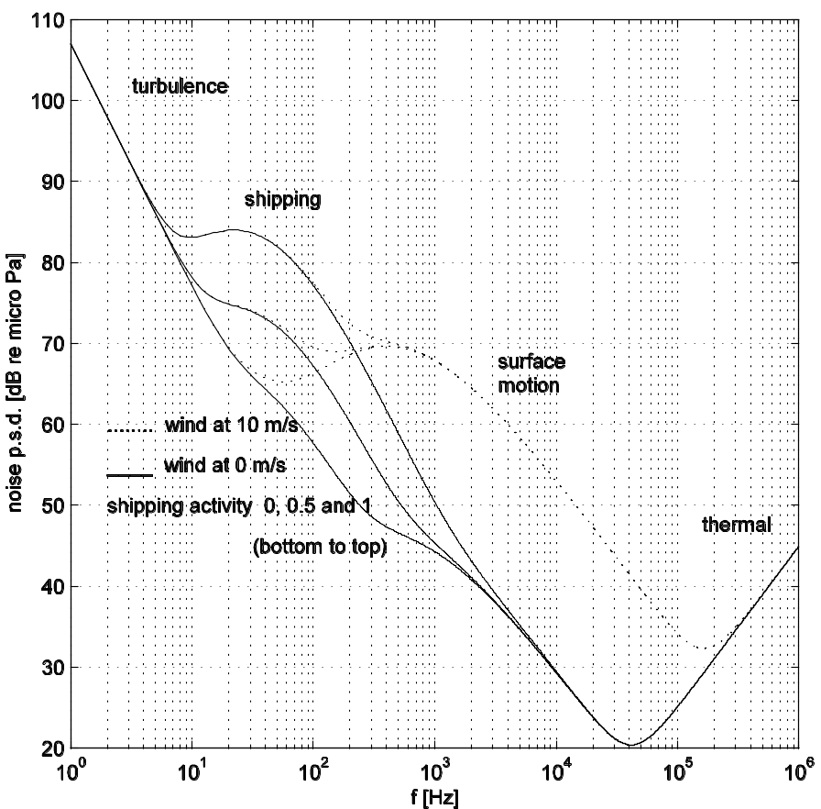
Noise
Ambient (open sea): p.s.d. [dB re μPa], f[kHz]
turbulence: 17 -30 log f
shipping: 40+20(s-0.5)+26log f-60log(f+0.03)
surface: 50+7.5w^{0.5}+20log f-40 log (f+0.4)
thermal: -15+20 log f
Site-specific:
man-made
biological (e.g., shrimp)
ice cracking, rain
seismic events
Majority of ambient noise sources:
continuous p.s.d.
Gaussian statistics
Approximation: N(f)=Kf^{-b} →
noise p.s.d. decays at b=18 dB/dec
Notes:
Turb 1-10 Hz
Ship 10-100 Hz
Surf 100 Hz-100 kHz
Therm above 100 kHz

Slide 12

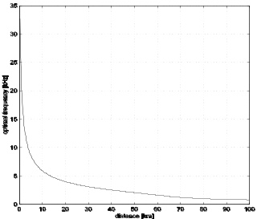
Signal to noise ratio (SNR)
P_{R}(d,f)~P_{T}/A(d,f)
P_{N}(f)~N(f)Δf
SNR(d,f) ~ - 10∙klog d - d∙10 log a(f) - b∙10log f
There exists an optimal center frequency
for a given distance.
Bandwidth is limited: lower end by noise, upper end by absorption.
Additional limitation:
transducer bandwidth.
Bandwidth-efficient modulation needed for high-rate communications.
Many short hops offer larger bandwidth than one long hop (as well as lower energy consumption).

Slide 13
Multipath propagation
Multipath structure depends on the channel geometry, signal frequency, sound speed profile.
Sound pressure field at any location, time, is given by the solution to the wave equation.
Approximations to this solution represent models of sound propagation (deterministic).
Models are used to obtain a more accurate prediction of the signal strength.
Ray model provides insight into the mechanisms of multipath formation:
  deep water—ray bending
  shallow water—reflections from surface, bottom, objects.
c
sea
land
surface layer (mixing)
const. temperature (except under ice)
continental shelf (~100 m)
main thermocline
temperature decreases rapidly
continental slice
deep ocean
constant temperature (4 deg. C)
pressure increases
continental rise
abyssal
plain
depth
Sound speed increases with temperature, pressure, salinity.
surf shallow deep

Slide 14
Mechanisms of multipath formation
Deep water: a ray, launched at some angle, bends towards
the region of lower sound speed (Snell’s law).
Continuous application of Snell’s law → ray diagram (trace).
Shallow water: reflections at surface have little loss;
reflection loss at bottom depends on the type
(sand,rock, etc.), angle of incidence, frequency.
c
distance
tx
tx
rx
Multipath gets attenuated because of
repeated reflection loss, increased path length.
depth
Deep sound channeling:
-rays bend repeatedly towards the depth at which the
sound speed is minimal
-sound can travel over long distances in this manner
(no reflection loss).
Length of each path can be calculated
from geometry:
l_{p}: p^{th} path length
τ_{p}= l_{p} /c: p^{th} path delay
A_{p}=A(l_{p},f): p^{th} path attenuation
Γ_{p}: p^{th} path reflection coefficient
G_{p}= Γ_{p}/A_{p}^{1/2}: path gain

Slide 15
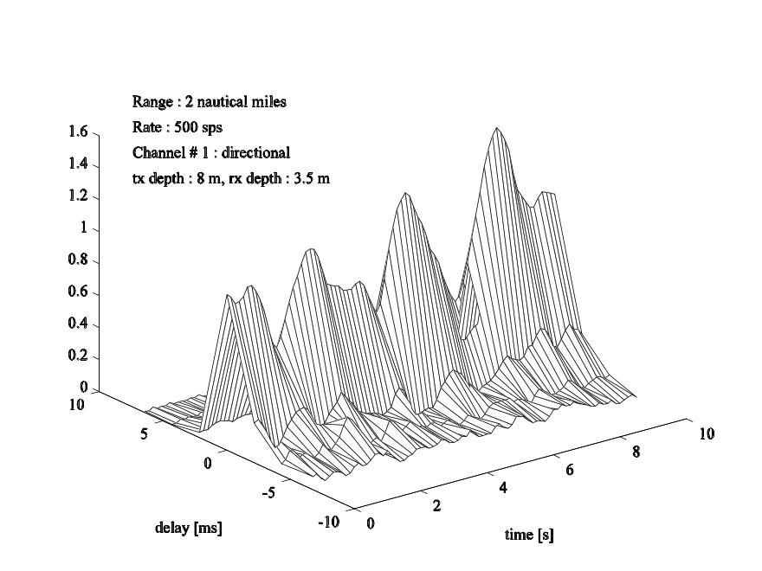

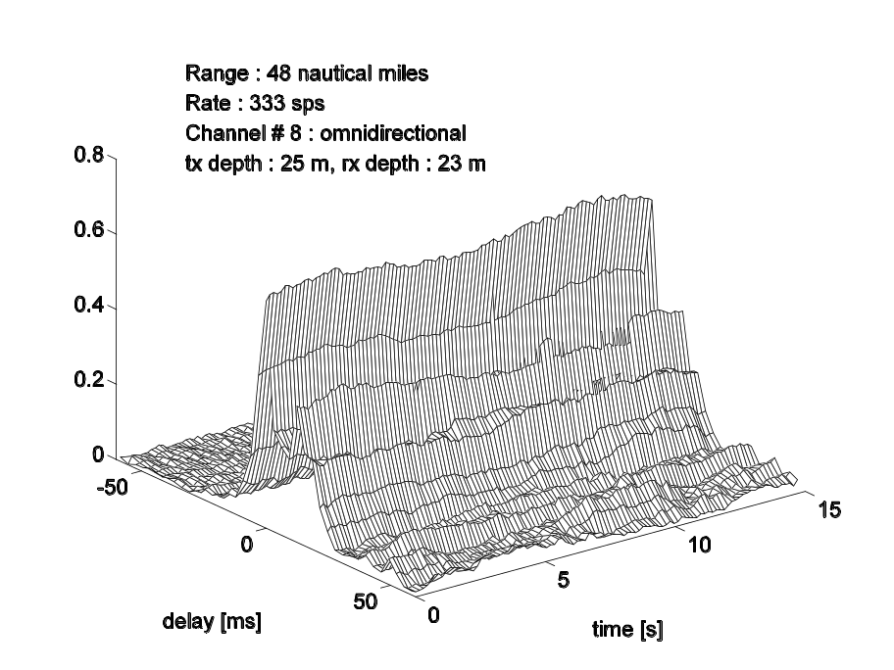
Examples: ensembles of
measured channel responses
Time variability:
Inherent: internal waves, changes in fine vertical structure of water, small-scale turbulence, surface motion
Motion-induced: v/c~10-3 at v~few knots, c=1500 m/s!

Slide 16
Propagation speed
Nominal: c=1500 m/s (compare to 3∙10⁸ m/s!)
Two types of problems:
-motion-induced Doppler distortion (v~ few m/s for an AUV)
-long propagation delay / high latency
t→t(1±v/c)
f→f(1±v/c)

