Slide 1
CLASSIFICATION OF SIGNALS

Slide 2
Signals & Systems Concepts
(1) Systems, signals, Continuous-time and discrete-time signals and systems. Energy and power signals. Linear systems. Examples for use throughout the course
Specific Objectives:
Introduce, using examples, what is a signal and what is a system
What are continuous-time and discrete-time representations and how are they related

Slide 3
What is a Signal?
A signal is a pattern of variation of some form
Signals are variables that carry information
Examples of signal include:
Electrical signals
  Voltages and currents in a circuit
Acoustic signals
  Acoustic pressure (sound) over time
Mechanical signals
  Velocity of a car over time
Video signals
  Intensity level of a pixel (camera, video) over time

Slide 4
How is a Signal Represented?
Mathematically, signals are represented as a function of one or more independent variables.
For instance a black & white video signal intensity is dependent on x, y coordinates and time t f(x,y,t)
On this course, we shall be exclusively concerned with signals that are a function of a single variable: time
f(t)
t

Slide 5
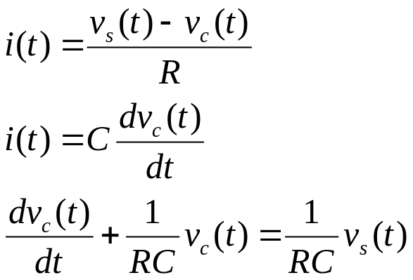
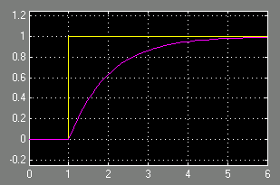
Example: Signals in an Electrical Circuit
R
v_{s}
+
-
i
C
v_{c}
The signals v_{c} and v_{s} are patterns of variation over time
Note, we could also have considered the voltage across the resistor or the current as signals
Step (signal) v_{s} at t=1
RC = 1
First order (exponential) response for v_{c}
v_{s}, v_{c}
t

Slide 6
Continuous & Discrete-Time Signals
Continuous-Time Signals
Most signals in the real world are continuous time, as the scale is infinitesimally fine.
Eg voltage, velocity,
Denote by x(t), where the time interval may be bounded (finite) or infinite
Discrete-Time Signals
Some real world and many digital signals are discrete time, as they are sampled
E.g. pixels, daily stock price (anything that a digital computer processes)
Denote by x[n], where n is an integer value that varies discretely
Sampled continuous signal x[n] =x(nk) – k is sample time
x(t)
t
x[n]
n

Slide 7
Signal Properties
On this course, we shall be particularly interested in signals with certain properties:
Periodic signals: a signal is periodic if it repeats itself after a fixed period T, i.e. x(t) = x(t+T) for all t. A sin(t) signal is periodic.
Even and odd signals: a signal is even if x(-t) = x(t) (i.e. it can be reflected in the axis at zero). A signal is odd if x(-t) = -x(t). Examples are cos(t) and sin(t) signals, respectively.
Exponential and sinusoidal signals: a signal is (real) exponential if it can be represented as x(t) = Ce^{at}. A signal is (complex) exponential if it can be represented in the same form but C and a are complex numbers.
Step and pulse signals: A pulse signal is one which is nearly completely zero, apart from a short spike, δ(t). A step signal is zero up to a certain time, and then a constant value after that time, u(t).
These properties define a large class of tractable, useful signals and will be further considered in the coming lectures

Slide 8
What is a System?
Systems process input signals to produce output signals
Examples:
  A circuit involving a capacitor can be viewed as a system that transforms the source voltage (signal) to the voltage (signal) across the capacitor
  A CD player takes the signal on the CD and transforms it into a signal sent to the loud speaker
  A communication system is generally composed of three sub-systems, the transmitter, the channel and the receiver. The channel typically attenuates and adds noise to the transmitted signal which must be processed by the receiver

Slide 9
How is a System Represented?
A system takes a signal as an input and transforms it into another signal
In a very broad sense, a system can be represented as the ratio of the output signal over the input signal
  That way, when we “multiply” the system by the input signal, we get the output signal
  This concept will be firmed up in the coming weeks
Input signal
x(t)
System
Output signal
y(t)

Slide 10
Properties of a System
On this course, we shall be particularly interested in signals with certain properties:
Causal: a system is causal if the output at a time, only depends on input values up to that time.
Linear: a system is linear if the output of the scaled sum of two input signals is the equivalent scaled sum of outputs
Time-invariance: a system is time invariant if the system’s output is the same, given the same input signal, regardless of time.
These properties define a large class of tractable, useful systems and will be further considered in the coming lectures

Slide 11
How Are Signal & Systems Related (i)?
How to design a system to process a signal in particular ways?
Design a system to restore or enhance a particular signal
  Remove high frequency background communication noise
  Enhance noisy images from spacecraft
Assume a signal is represented as
  x(t) = d(t) + n(t)
Design a system to remove the unknown “noise” component n(t), so that y(t) ≈ d(t)
x(t) = d(t) + n(t)
System
?
y(t) ≈ d(t)

Slide 12
How Are Signal & Systems Related (ii)?
How to design a system to extract specific pieces of information from signals
  Estimate the heart rate from an electrocardiogram
  Estimate economic indicators (bear, bull) from stock market values
Assume a signal is represented as
  x(t) = g(d(t))
Design a system to “invert” the transformation g(), so that y(t) = d(t)
x(t) = g(d(t))
System
?
y(t) = d(t) = g⁻¹(x(t))

Slide 13
How Are Signal & Systems Related (iii)?
How to design a (dynamic) system to modify or control the output of another (dynamic) system
  Control an aircraft’s altitude, velocity, heading by adjusting throttle, rudder, ailerons
  Control the temperature of a building by adjusting the heating/cooling energy flow.
Assume a signal is represented as
  x(t) = g(d(t))
Design a system to “invert” the transformation g(), so that y(t) = d(t)
x(t)
dynamic
system ?
y(t) = d(t)

Slide 14
Signals Concepts & Properties
Systems, signals, Continuous-time and discrete-time signals. Energy and power signals. Linear systems. Examples for use throughout the course.
Specific objectives for this lecture include
General properties of signals
Energy and power for continuous & discrete-time signals
Signal transformations
Specific signal types

Slide 15
Reminder: Continuous & Discrete Signals
Continuous-Time Signals
Most signals in the real world are continuous time, as the scale is infinitesimally fine.
E.g. voltage, velocity,
Denote by x(t), where the time interval may be bounded (finite) or infinite
Discrete-Time Signals
Some real world and many digital signals are discrete time, as they are sampled
E.g. pixels, daily stock price (anything that a digital computer processes)
Denote by x[n], where n is an integer value that varies discretely
Sampled continuous signal
x[n] =x(nk)
x(t)
t
x[n]
n

Slide 16
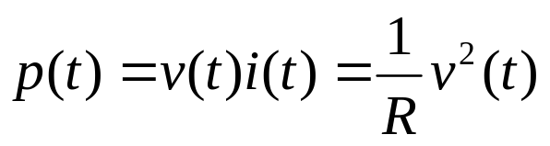
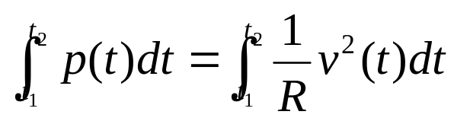
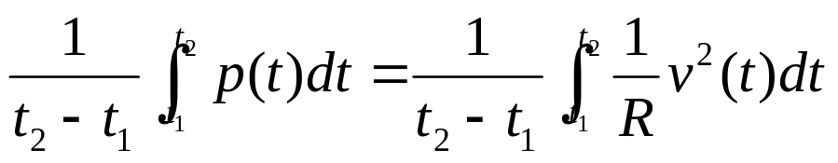
“Electrical” Signal Energy & Power
It is often useful to characterise signals by measures such as energy and power
For example, the instantaneous power of a resistor is:
and the total energy expanded over the interval [t₁, t₂] is:
and the average energy is:
How are these concepts defined for any continuous or discrete time signal?

Slide 17
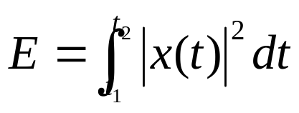
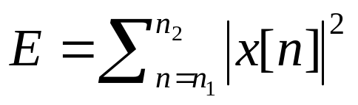
Generic Signal Energy and Power
Total energy of a continuous signal x(t) over [t₁, t₂] is:
where |.| denote the magnitude of the (complex) number.
Similarly for a discrete time signal x[n] over [n₁, n₂]:
By dividing the quantities by (t₂-t₁) and (n₂-n₁+1), respectively, gives the average power, P
Note that these are similar to the electrical analogies (voltage), but they are different, both value and dimension.

Slide 18
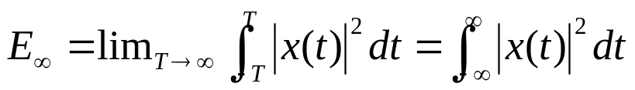
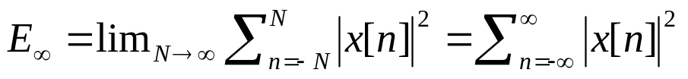
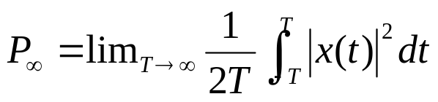
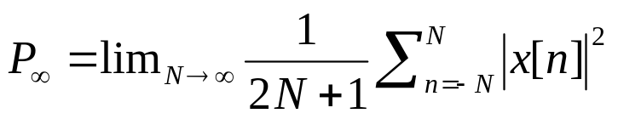
Energy and Power over Infinite Time
For many signals, we’re interested in examining the power and energy over an infinite time interval (-∞, ∞). These quantities are therefore defined by:
If the sums or integrals do not converge, the energy of such a signal is infinite
Two important (sub)classes of signals
  Finite total energy (and therefore zero average power)
  Finite average power (and therefore infinite total energy)
Signal analysis over infinite time, all depends on the “tails” (limiting behaviour)

Slide 19

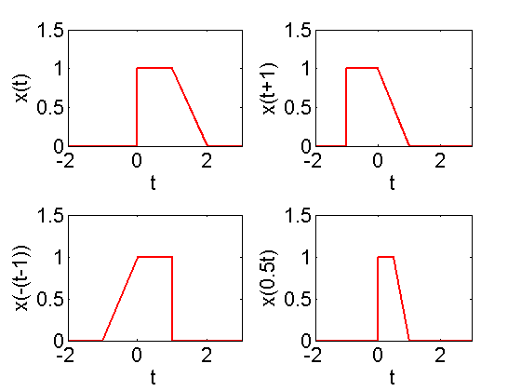
Time Shift Signal Transformations
A central concept in signal analysis is the transformation of one signal into another signal. Of particular interest are simple transformations that involve a transformation of the time axis only.
A linear time shift signal transformation is given by:
where b represents a signal offset from 0, and the a parameter represents a signal stretching if |a|>1, compression if 0<|a|<1 and a reflection if a<0.

Slide 20

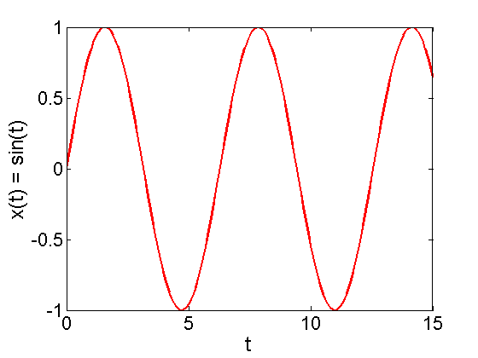
Periodic Signals
An important class of signals is the class of periodic signals. A periodic signal is a continuous time signal x(t), that has the property
where T>0, for all t.
Examples:
  cos(t+2π) = cos(t)
  sin(t+2π) = sin(t)
  Are both periodic with period 2π
NB for a signal to be periodic, the relationship must hold for all t.
2π

Slide 21

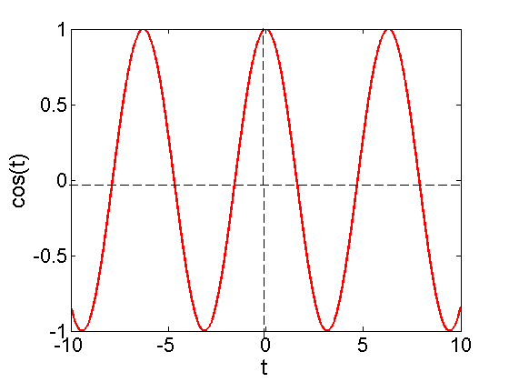

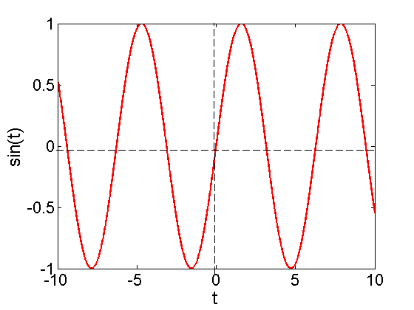
Odd and Even Signals
An even signal is identical to its time reversed signal, i.e. it can be reflected in the origin and is equal to the original:
Examples:
x(t) = cos(t)
x(t) = c
An odd signal is identical to its negated, time reversed signal, i.e. it is equal to the negative reflected signal
Examples:
x(t) = sin(t)
x(t) = t
This is important because any signal can be expressed as the sum of an odd signal and an even signal.

Slide 22
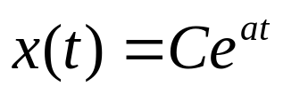
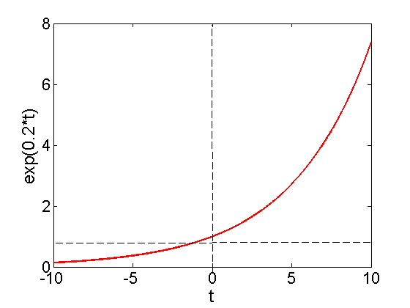
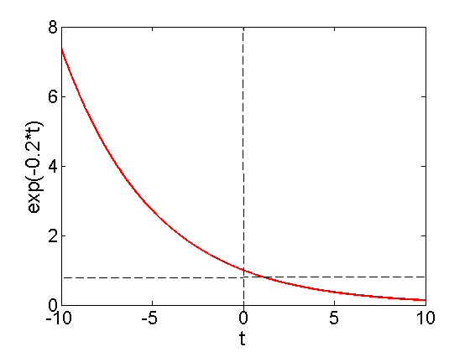
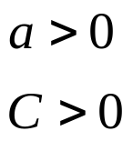
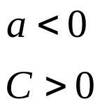
Exponential and Sinusoidal Signals
Exponential and sinusoidal signals are characteristic of real-world signals and also from a basis (a building block) for other signals.
A generic complex exponential signal is of the form:
where C and a are, in general, complex numbers. Lets investigate some special cases of this signal
Real exponential signals
Exponential growth
Exponential decay

Slide 23

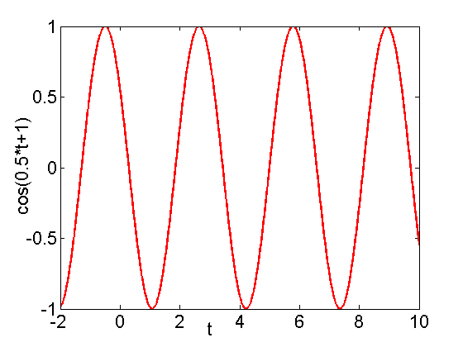

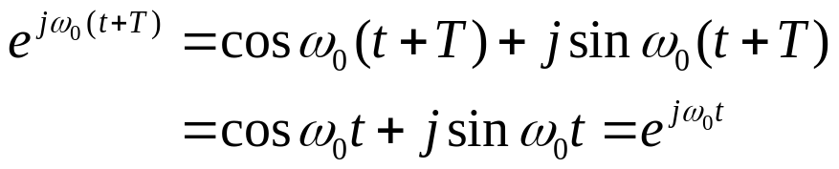


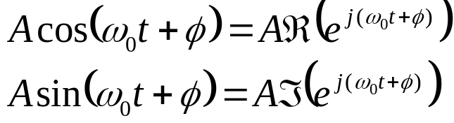
Periodic Complex Exponential & Sinusoidal Signals
Consider when a is purely imaginary:
By Euler’s relationship, this can be expressed as:
This is a periodic signals because:
when T=2π/ω₀
A closely related signal is the sinusoidal signal:
We can always use:
cos(1)
T₀ = 2π/ω₀
= π
T₀ is the fundamental time period
ω₀ is the fundamental frequency

Slide 24
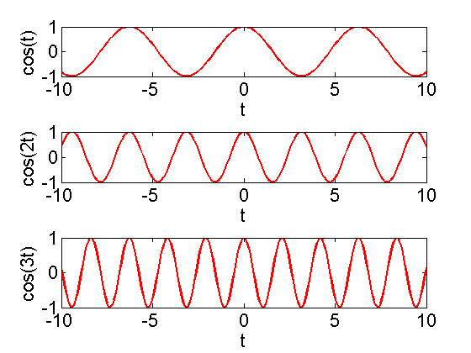
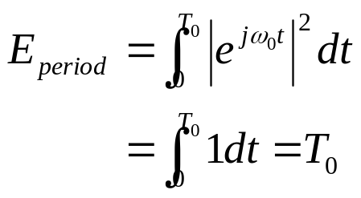

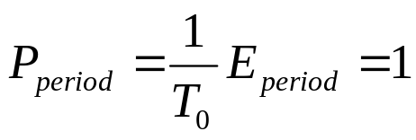
Exponential & Sinusoidal Signal Properties
Periodic signals, in particular complex periodic and sinusoidal signals, have infinite total energy but finite average power.
Consider energy over one period:
Therefore:
Average power:
Useful to consider harmonic signals
Terminology is consistent with its use in music, where each frequency is an integer multiple of a fundamental frequency

Slide 25
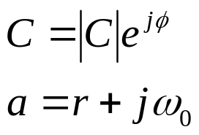

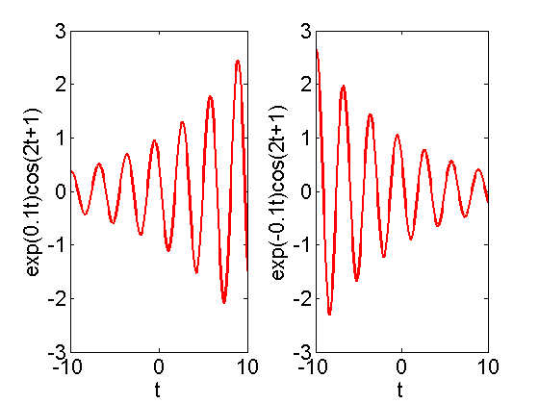
General Complex Exponential Signals
So far, considered the real and periodic complex exponential
Now consider when C can be complex. Let us express C is polar form and a in rectangular form:
So
Using Euler’s relation
These are damped sinusoids

Slide 26
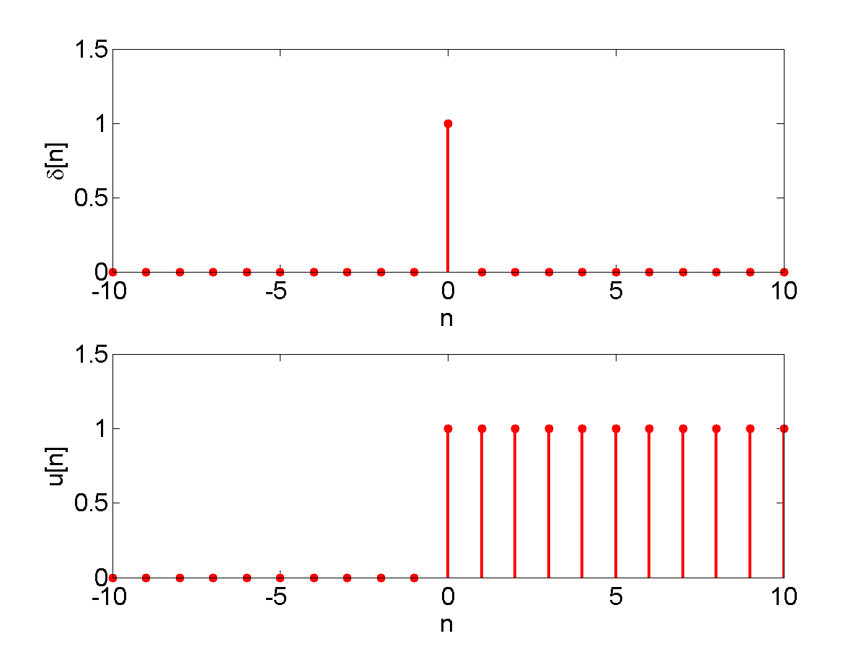
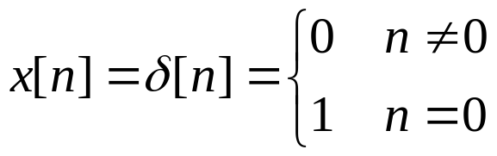
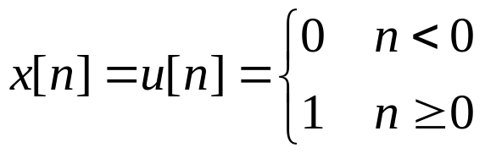

Discrete Unit Impulse and Step Signals
The discrete unit impulse signal is defined:
Useful as a basis for analyzing other signals
The discrete unit step signal is defined:
Note that the unit impulse is the first difference (derivative) of the step signal
Similarly, the unit step is the running sum (integral) of the unit impulse.

Slide 27
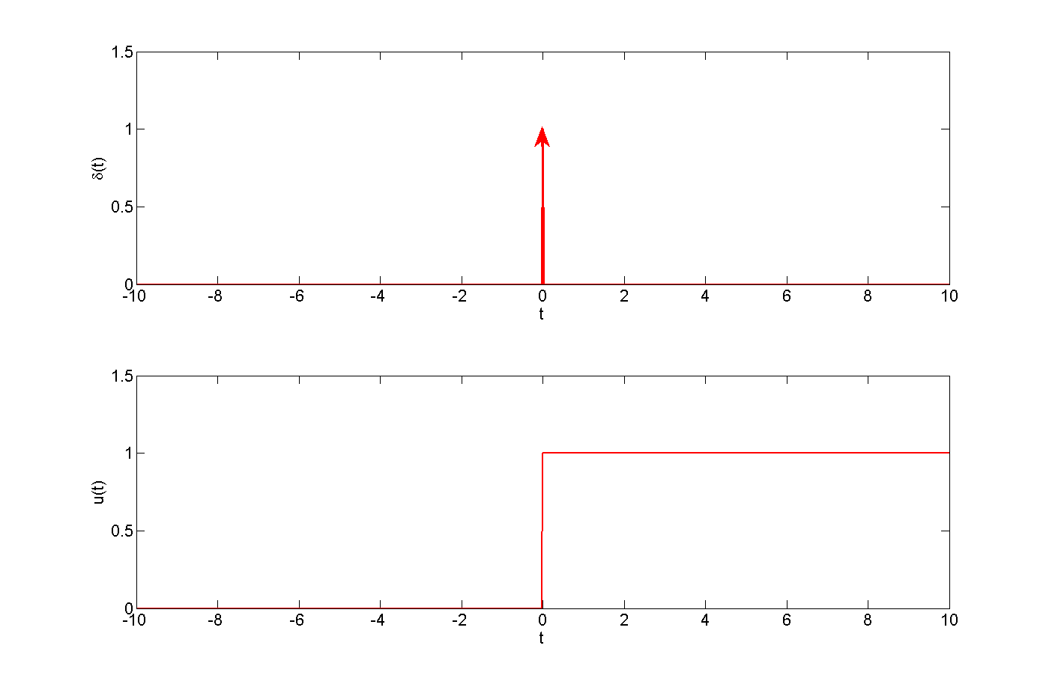
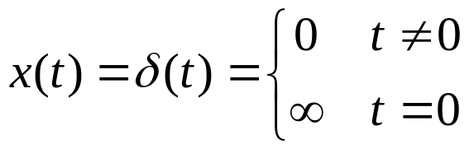
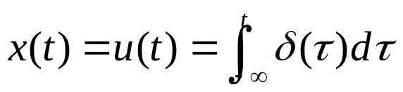
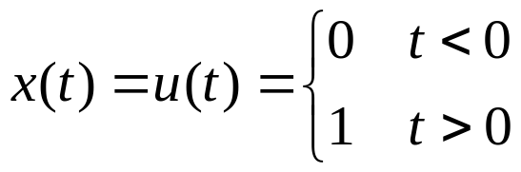
Continuous Unit Impulse and Step Signals
The continuous unit impulse signal is defined:
Note that it is discontinuous at t=0
The arrow is used to denote area, rather than actual value
Again, useful for an infinite basis
The continuous unit step signal is defined:

