Slide 1
FOURIER SERIES

Slide 2
Basis Functions & Fourier Series
Basis functions :Concept of basis function. Fourier series representation of time functions.
Specific objectives for today:
Introduction to Fourier series (& transform)
Eigen functions of a system
  Show sinusoidal signals are eigen functions of LTI systems
Introduction to signals and basis functions
Fourier basis & coefficients of a periodic signal

Slide 3
Why is Fourier Theory Important (i)?
For a particular system, what signals φ_{k}(t) have the property that:
Then φ_{k}(t) is an eigenfunction with eigenvalue λ_{k}
If an input signal can be decomposed as
x(t) = Σ_{k} a_{k}φ_{k}(t)
Then the response of an LTI system is
y(t) = Σ_{k} a_{k}λ_{k}φ_{k}(t)
For an LTI system, φ_{k}(t) = e^{st} where s∈C, are eigenfunctions.
x(t) = φ_{k}(t)
y(t) = λ_{k}φ_{k}(t)
System

Slide 4
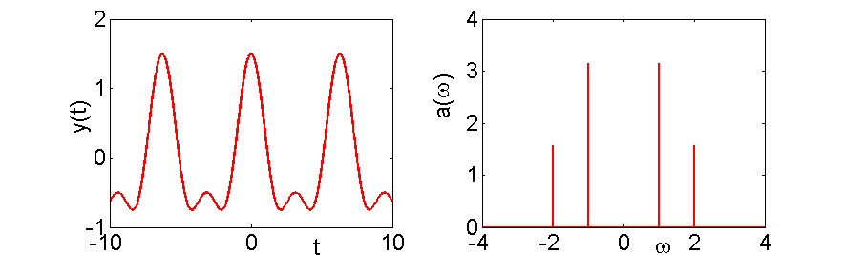
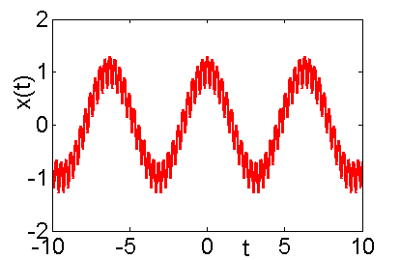
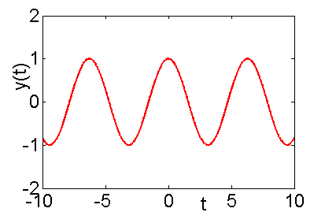
Why is Fourier Theory Important (ii)?
Fourier transforms map a time-domain signal into a frequency domain signal
Simple interpretation of the frequency content of signals in the frequency domain (as opposed to time).
Design systems to filter out high or low frequency components. Analyse systems in frequency domain.
Invariant to high frequency signals

Slide 5
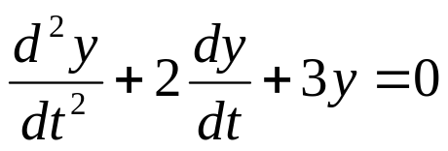

Why is Fourier Theory Important (iii)?
If F{x(t)} = X(jω) ω is the frequency
Then F{x’(t)} = jωX(jω)
So solving a differential equation is transformed from a calculus operation in the time domain into an algebraic operation in the frequency domain (see Laplace transform)
Example
becomes
and is solved for the roots ω (N.B. complementary equations):
and we take the inverse Fourier transform for those ω.

Slide 6
Introduction to System Eigenfunctions
Lets imagine what (basis) signals φ_{k}(t) have the property that:
i.e. the output signal is the same as the input signal, multiplied by the constant “gain” λ_{k} (which may be complex)
For CT LTI systems, we also have that
Therefore, to make use of this theory we need:
1) system identification is determined by finding {φ_{k},λ_{k}}.
2) response, we also have to decompose x(t) in terms of φ_{k}(t) by calculating the coefficients {a_{k}}.
This is analogous to eigenvectors/eigenvalues matrix decomposition
x(t) = φ_{k}(t)
System
y(t) = λ_{k}φ_{k}(t)
x(t) = Σ_{k} a_{k}φ_{k}(t)
LTI
System
y(t) = Σ_{k} a_{k}λ_{k}φ_{k}(t)

Slide 7
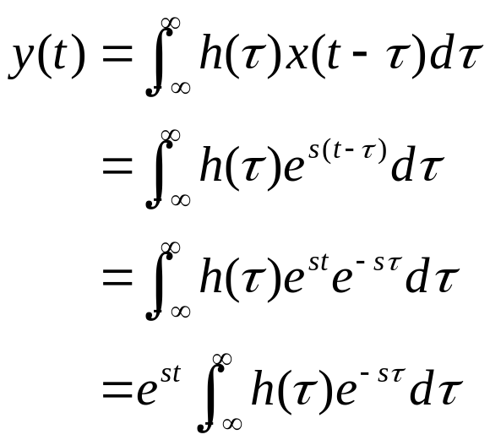
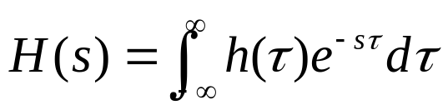

Complex Exponentials are Eigenfunctions of any CT LTI System
Consider a CT LTI system with impulse response h(t) and input signal x(t)=φ(t) = e^{st}, for any value of s∈C:
Assuming that the integral on the right hand side converges to H(s), this becomes (for any value of s∈C):
Therefore φ(t)=e^{st} is an eigenfunction, with eigenvalue λ=H(s)

Slide 8



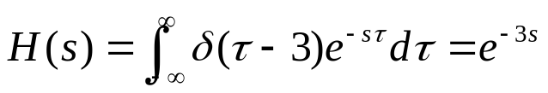
Example 1: Time Delay & Imaginary Input
Consider a CT, LTI system where the input and output are related by a pure time shift:
Consider a purely imaginary input signal:
Then the response is:
e^{j2t} is an eigenfunction (as we’d expect) and the associated eigenvalue is H(j2) = e^{-j6}.
The eigenvalue could be derived “more generally”. The system impulse response is h(t) = δ(t-3), therefore:
So H(j2) = e^{-j6}!

Slide 9
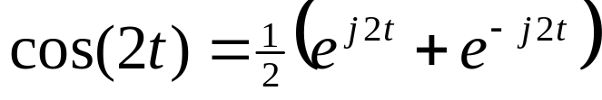
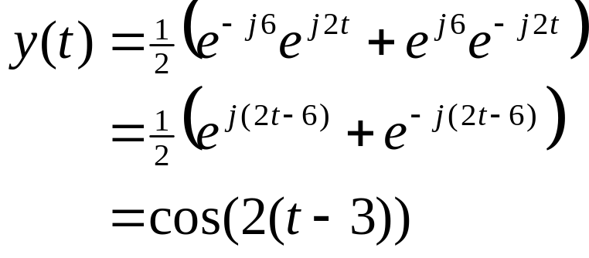
Example 1a: Phase Shift
Note that the corresponding input e^{-j2t} has eigenvalue e^{j6}, so lets consider an input cosine signal of frequency 2 so that:
By the system LTI, eigenfunction property, the system output is written as:
So because the eigenvalue is purely imaginary, this corresponds to a phase shift (time delay) in the system’s response. If the eigenvalue had a real component, this would correspond to an amplitude variation

Slide 10

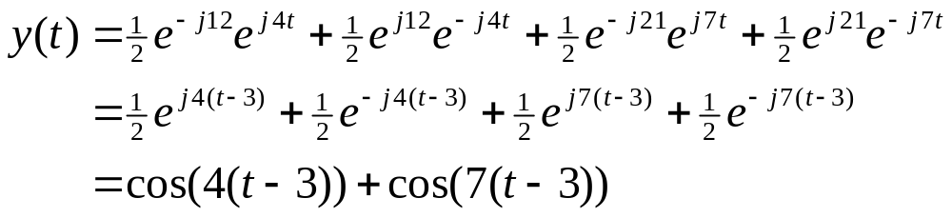
Example 2: Time Delay & Superposition
Consider the same system (3 time delays) and now consider the input signal x(t) = cos(4t)+cos(7t), a superposition of two sinusoidal signals that are not harmonically related. The response is obviously:
Consider x(t) represented using Euler’s formula:
Then due to the superposition property and H(s) =e^{-3s}
While the answer for this simple system can be directly spotted, the superposition property allows us to apply the eigenfunction concept to more complex LTI systems.

Slide 11
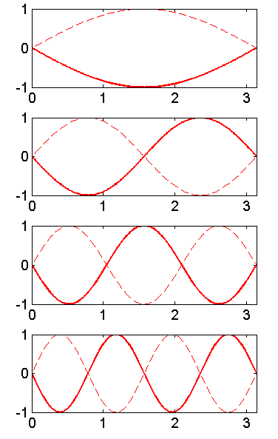
History of Fourier/Harmonic Series
The idea of using trigonometric sums was used to predict astronomical events
Euler studied vibrating strings, ~1750, which are signals where linear displacement was preserved with time.
Fourier described how such a series could be applied and showed that a periodic signals can be represented as the integrals of sinusoids that are not all harmonically related
Now widely used to understand the structure and frequency content of arbitrary signals
ω=1
ω=2
ω=3
ω=4

Slide 12
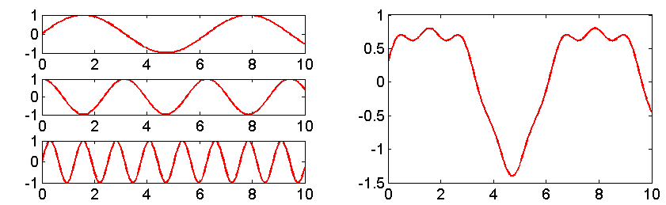
Fourier Series and Fourier Basis Functions
The theory derived for LTI convolution, used the concept that any input signal can represented as a linear combination of shifted impulses (for either DT or CT signals)
We will now look at how (input) signals can be represented as a linear combination of Fourier basis functions (LTI eigenfunctions) which are purely imaginary exponentials
These are known as continuous-time Fourier series
The bases are scaled and shifted sinusoidal signals, which can be represented as complex exponentials
x(t) = sin(t) +
0.2cos(2t) +
0.1sin(5t)
e^{jωt}
x(t)

Slide 13
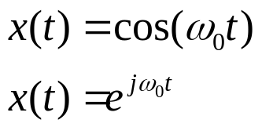
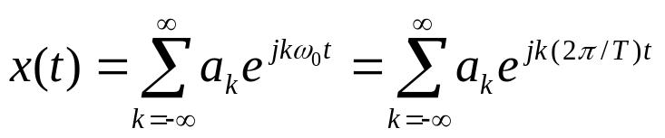
Periodic Signals & Fourier Series
A periodic signal has the property x(t) = x(t+T), T is the fundamental period, ω₀ = 2π/T is the fundamental frequency. Two periodic signals include:
For each periodic signal, the Fourier basis the set of harmonically related complex exponentials:
Thus the Fourier series is of the form:
k=0 is a constant
k=+/-1 are the fundamental/first harmonic components
k=+/-N are the N^{th} harmonic components
For a particular signal, are the values of {a_{k}}_{k}?

Slide 14

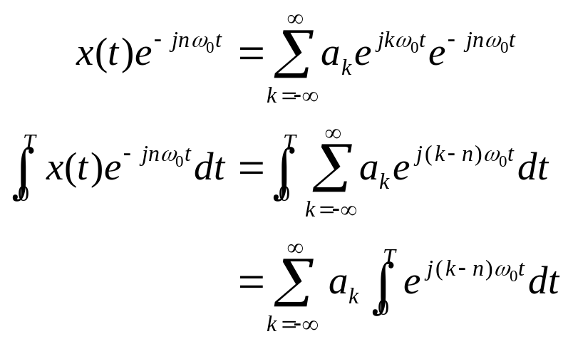
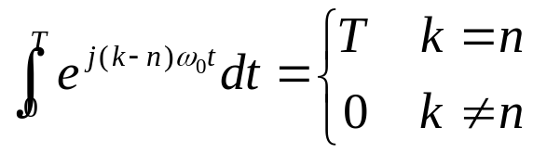
Fourier Series Representation of a CT Periodic Signal (i)
Given that a signal has a Fourier series representation, we have to find {a_{k}}_{k}. Multiplying through by
Using Euler’s formula for the complex exponential integral
It can be shown that
T is the fundamental period of x(t)

Slide 15
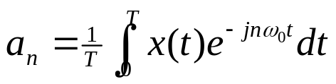

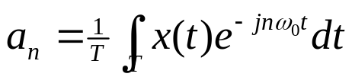
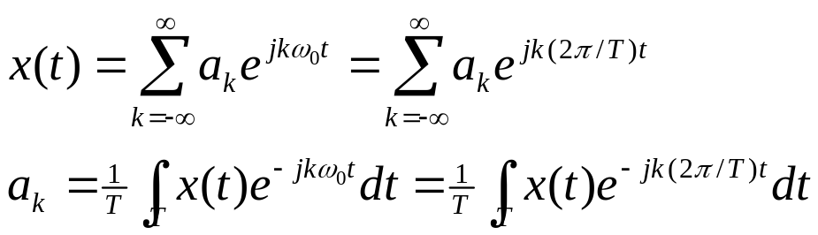
Fourier Series Representation of a CT Periodic Signal (ii)
Therefore
which allows us to determine the coefficients. Also note that this result is the same if we integrate over any interval of length T (not just [0,T]), denoted by
To summarise, if x(t) has a Fourier series representation, then the pair of equations that defines the Fourier series of a periodic, continuous-time signal:

Slide 16
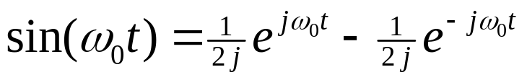
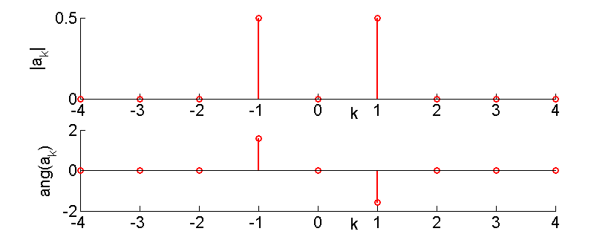
Example 1: Fourier Series sin(ω₀t)
The fundamental period of sin(ω₀t) is ω₀
By inspection we can write:
So a₁ = 1/2j, a₋₁ = -1/2j and a_{k} = 0 otherwise
The magnitude and angle of the Fourier coefficients are:

Slide 17
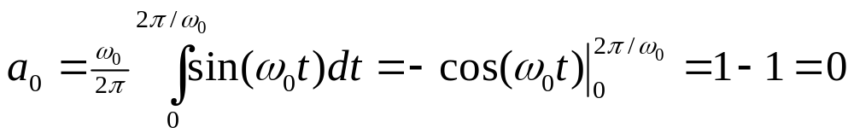
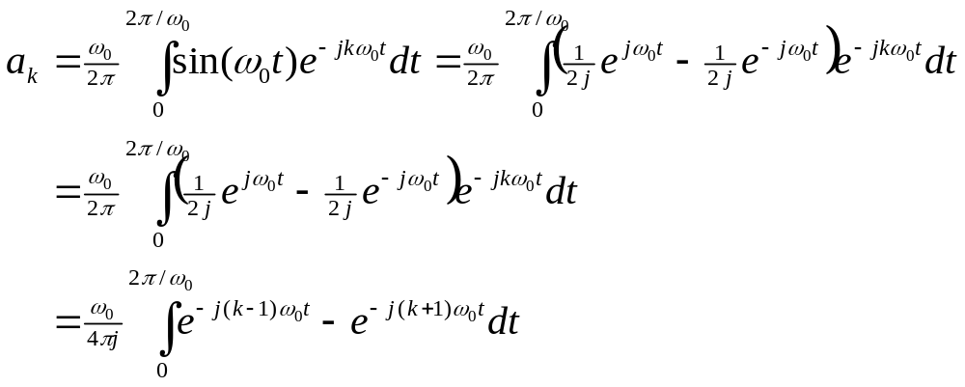
Example 1a: Fourier Series sin(ω₀t)
The Fourier coefficients can also be explicitly evaluated
When k = +1 or –1, the integrals evaluate to T and –T, respectively. Otherwise the coefficients are zero.
Therefore a₁ = 1/2j, a₋₁ = -1/2j

Slide 18
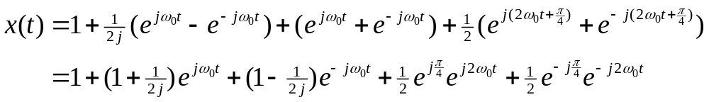
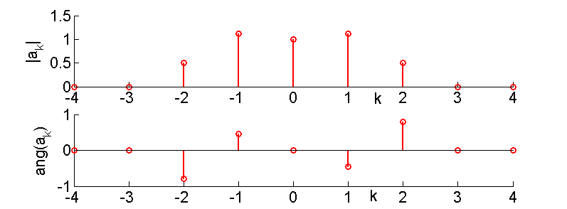
Example 2: Additive Sinusoids
Consider the additive sinusoidal series which has a fundamental frequency ω₀:
Again, the signal can be directly written as:
The Fourier series coefficients can then be visualised as:

Slide 19
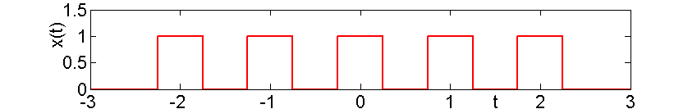
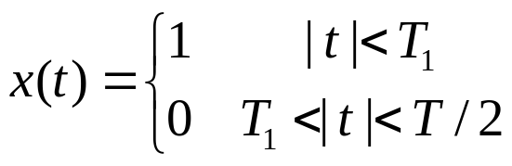
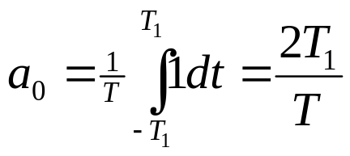
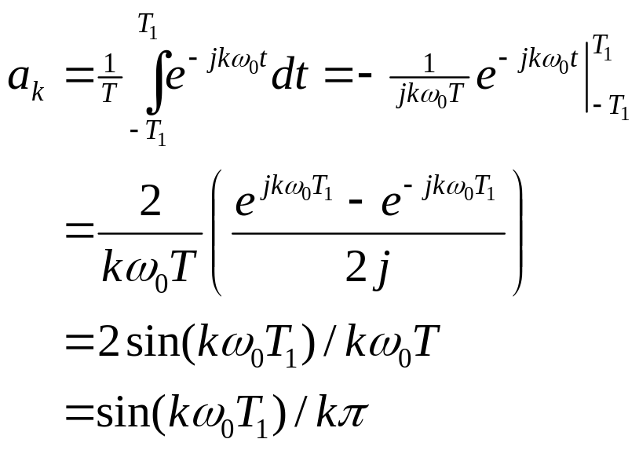
Example 3: Periodic Step Signal
Consider the periodic square wave, illustrated by:
and is defined over one period as:
Fourier coefficients:
NB, these coefficients are real

Slide 20
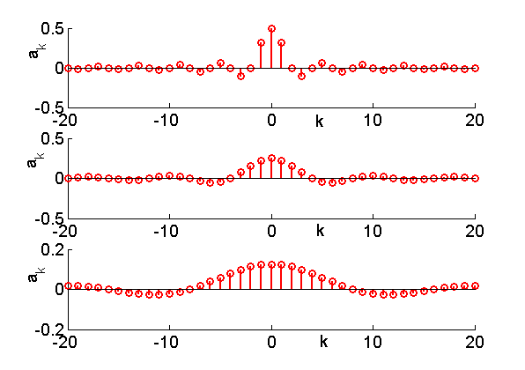
Example 3a: Periodic Step Signal
Instead of plotting both the magnitude and the angle of the complex coefficients, we only need to plot the value of the coefficients.
Note we have an infinite series of non-zero coefficients
T=4T₁
T=8T₁
T=16T₁

Slide 21
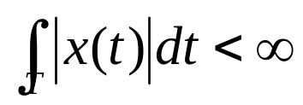
Convergence of Fourier Series
Not every periodic signal can be represented as an infinite Fourier series, however just about all interesting signals can be (note that the step signal is discontinuous)
The Dirichlet conditions are necessary and sufficient conditions on the signal.
Condition 1. Over any period, x(t) must be absolutely integrable
Condition 2. In any finite interval, x(t) is of bounded variation; that is there is no more than a finite number of maxima and minima during any single period of the signal
Condition 3. In any finite interval of time, there are only a finite number of discontinuities. Further, each of these discontinuities are finite.

Slide 22
Summary
Fourier bases, series and transforms are extremely useful for frequency domain analysis, solving differential equations and analysing invariance for LTI signals/systems
For an LTI system
e^{st} is an eigenfunction
H(s) is the corresponding (complex) eigenvalue
This can be used, like convolution, to calculate the output of an LTI system once H(s) is known.
A Fourier basis is a set of harmonically related complex exponentials
Any periodic signal can be represented as an infinite sum (Fourier series) of Fourier bases, where the first harmonic is equal to the fundamental frequency
The corresponding coefficients can be evaluated

