Slide 1
Laplace Transform
Laplace transform as Fourier transform with convergence factor. Properties of the Laplace transform
Specific objectives
Introduce Laplace transform
Understand the relationship to Fourier transform
Investigate Laplace transform of exponential signals
Derive region of convergence of Laplace transform

Slide 2
Introduction to the Laplace Transform
Fourier transforms are extremely useful in the study of many problems of practical importance involving signals and LTI systems.
  purely imaginary complex exponentials e^{st}, s=jω
A large class of signals can be represented as a linear combination of complex exponentials and complex exponentials are eigenfunctions of LTI systems.
However, the eigenfunction property applies to any complex number s, not just purely imaginary (signals)
This leads to the development of the Laplace transform where s is an arbitrary complex number.
Laplace and z-transforms can be applied to the analysis of un-stable system (signals with infinite energy) and play a role in the analysis of system stability

Slide 3

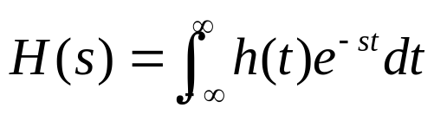
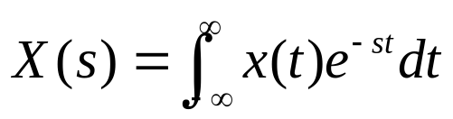
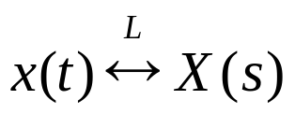
The Laplace Transform
The response of an LTI system with impulse response h(t) to a complex exponential input, x(t)=e^{st}, is
where s is a complex number and
when s is purely imaginary, this is the Fourier transform, H(jω)
when s is complex, this is the Laplace transform of h(t), H(s)
The Laplace transform of a general signal x(t) is:
and is usually expressed as:

Slide 4
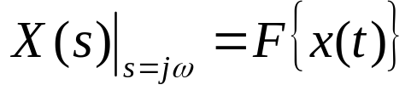
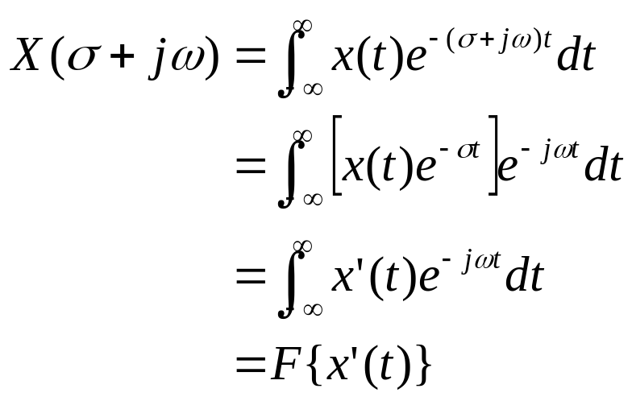
Laplace and Fourier Transform
The Fourier transform is the Laplace transform when s is purely imaginary:
An alternative way of expressing this is when s = σ+jω
The Laplace transform is the Fourier transform of the transformed signal x’(t) = x(t)e^{-σt}. Depending on whether σ is positive/negative this represents a growing/negative signal

Slide 5

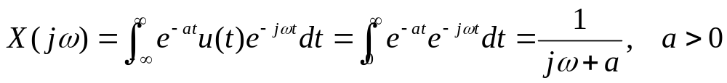
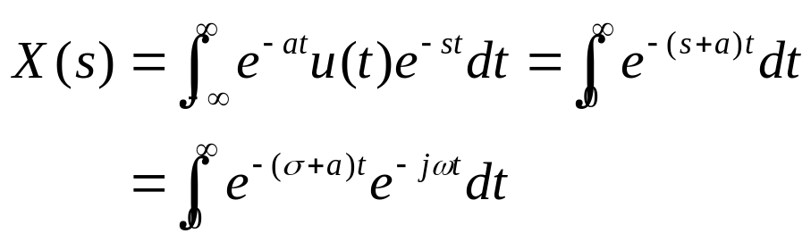
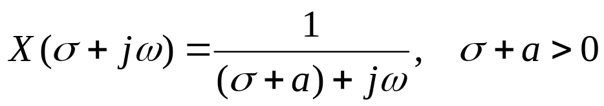
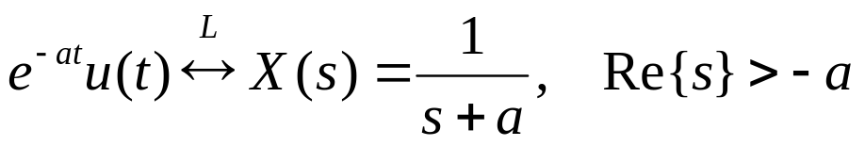
Example 1: Laplace Transform
Consider the signal
The Fourier transform X(jω) converges for a>0:
The Laplace transform is:
which is the Fourier Transform of e^{-(σ+a)t}u(t)
Or
If a is negative or zero, the Laplace Transform still exists

Slide 6

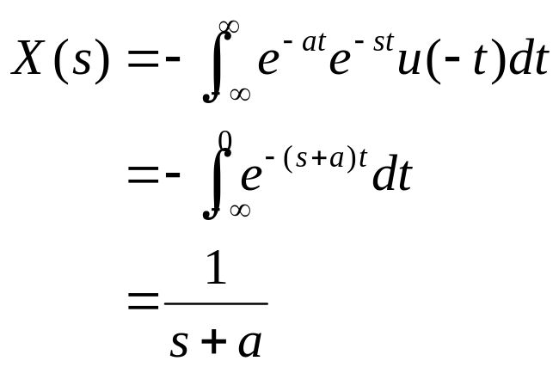
Example 2: Laplace Transform
Consider the signal
The Laplace transform is:
Convergence requires that Re{s+a}<0 or Re{s}<-a.
The Laplace transform expression is identical to Example 1 (similar but different signals), however the regions of convergence of s are mutually exclusive (non-intersecting).
For a Laplace transform, we need both the expression and the Region Of Convergence (ROC).

Slide 7
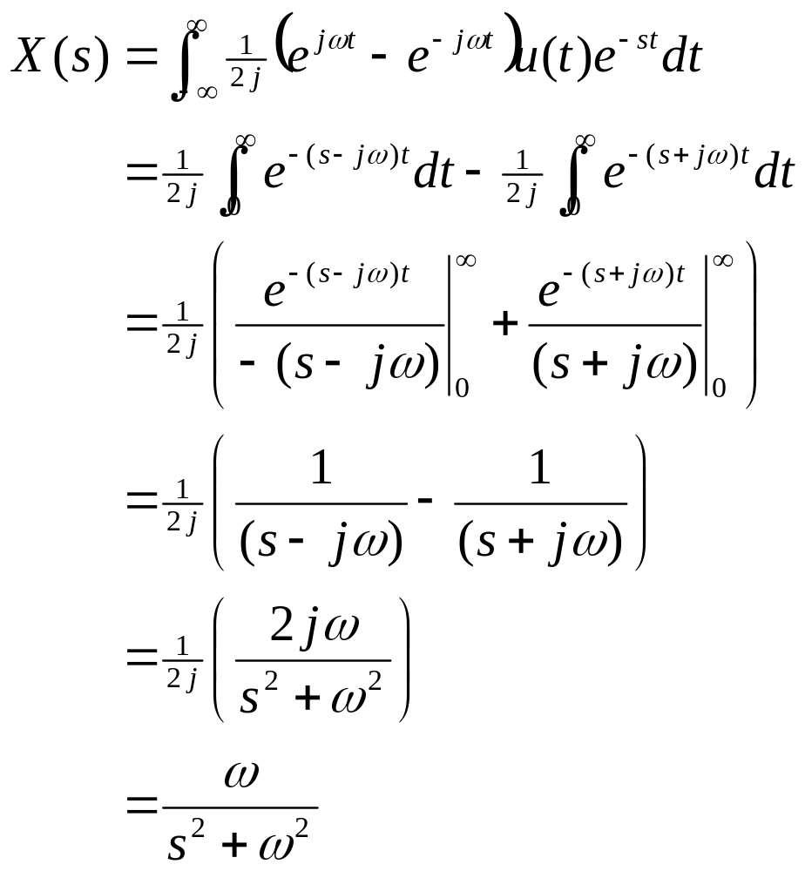


Example 3: sin(ωt)u(t)
The Laplace transform of the signal x(t) = sin(ωt)u(t) is:

Slide 8
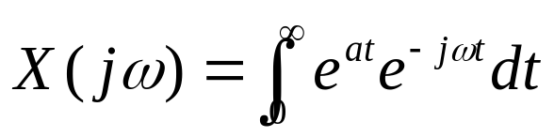
Fourier Transform does not Converge …
It is worthwhile reflecting that the Fourier transform does not exist for a fairly wide class of signals, such as the response of an unstable, first order system, the Fourier transform does not exist/converge
E.g. x(t) = e^{at}u(t), a>0
does not exist (is infinite) because the signal’s energy is infinite
This is because we multiply x(t) by a complex sinusoidal signal which has unit magnitude for all t and integrate for all time. Therefore, as the Dirichlet convergence conditions say, the Fourier transform exists for most signals with finite energy

Slide 9


Region of Convergence
The Region Of Convergence (ROC) of the Laplace transform is the set of values for s (=σ+jω) for which the Fourier transform of x(t)e^{-σt} converges (exists).
The ROC is generally displayed by drawing separating line/curve in the complex plane, as illustrated below for Examples 1 and 2, respectively.
The shaded regions denote the ROC for the Laplace transform
Im
Im
-a
Re
-a
Re

Slide 10

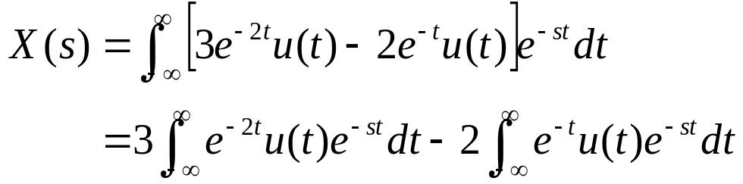
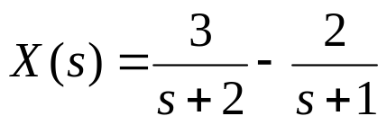
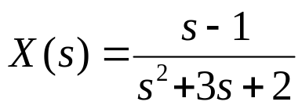
Example 4: Laplace Transform
Consider a signal that is the sum of two real exponentials:
The Laplace transform is then:
Using Example 1, each expression can be evaluated as:
The ROC associated with these terms are Re{s}>-1 and Re{s}>-2. Therefore, both will converge for Re{s}>-1, and the Laplace transform:

Slide 11
Laplace Transform Properties
Laplace transform as Fourier transform with convergence factor. Properties of the Laplace transform
Specific objectives
Linearity and time shift properties
Convolution property
Time domain differentiation & integration property
Transforms table

Slide 12
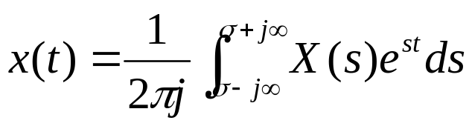
Reminder: Laplace Transforms
Equivalent to the Fourier transform when s=jω
Associated region of convergence for which the integral is finite
Used to understand the frequency characteristics of a signal (system)
Used to solve ODEs because of their convenient calculus and convolution properties (today)
Laplace transform
Inverse Laplace transform

Slide 13
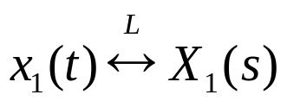
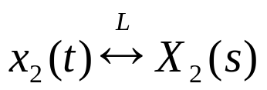
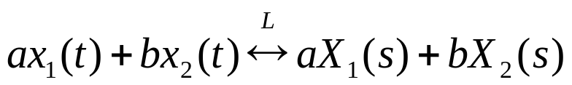
Linearity of the Laplace Transform
If
and
Then
This follows directly from the definition of the Laplace transform (as the integral operator is linear). It is easily extended to a linear combination of an arbitrary number of signals
ROC=R₁
ROC=R₂
ROC= R₁∩R₂

Slide 14
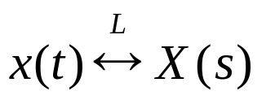
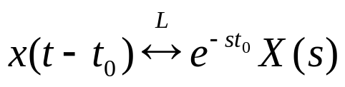
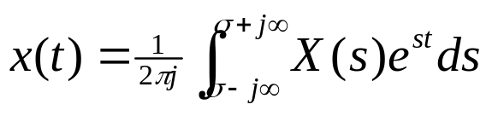
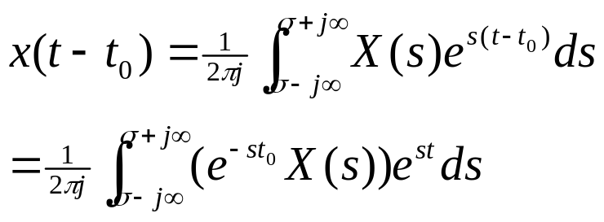

Time Shifting & Laplace Transforms
If
Then
Proof
Now replacing t by t-t₀
Recognising this as
A signal which is shifted in time may have both the magnitude and the phase of the Laplace transform altered.
ROC=R
ROC=R

Slide 15
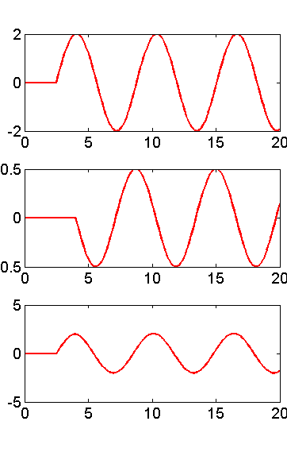

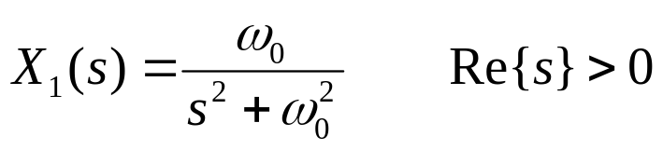
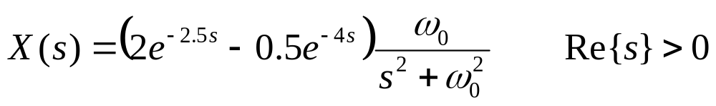
Example: Linear and Time Shift
Consider the signal (linear sum of two time shifted sinusoids)
where x₁(t) = sin(ω₀t)u(t).
Using the sin() Laplace transform example
Then using the linearity and time shift Laplace transform properties

Slide 16
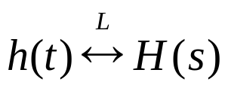
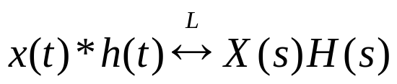
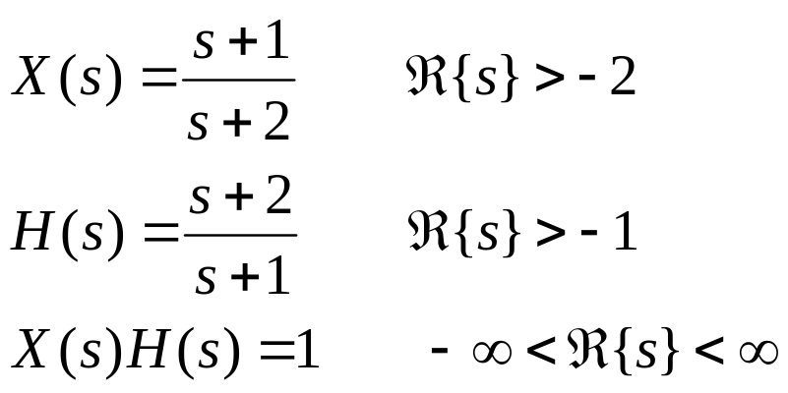
Convolution
The Laplace transform also has the multiplication property, i.e.
Proof is “identical” to the Fourier transform convolution
Note that pole-zero cancellation may occur between H(s) and X(s) which extends the ROC
ROC=R₁
ROC=R₂
ROC⊇R₁∩R₂

Slide 17
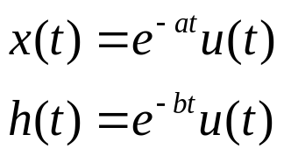
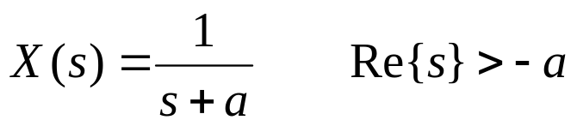
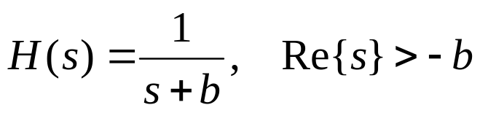
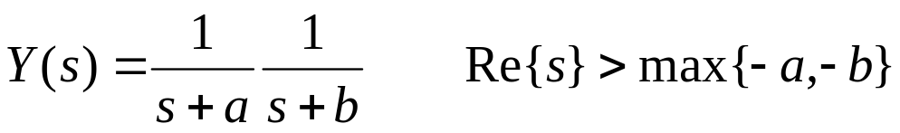
Example 1: 1st Order Input & First Order System Impulse Response
Consider the Laplace transform of the output of a first order system when the input is an exponential (decay?)
Taking Laplace transforms
Laplace transform of the output is
Solved with Fourier transforms when a,b>0

Slide 18
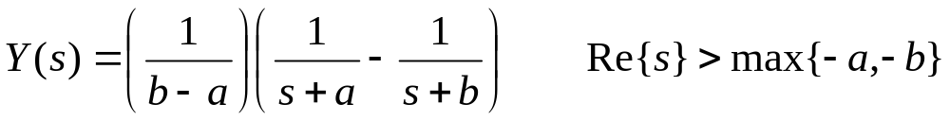
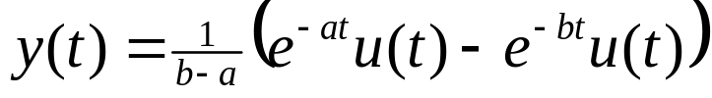
Example 1: Contd..
Splitting into partial fractions
and using the inverse Laplace transform
Note that this is the same as was obtained earlier, expect it is valid for all a & b, i.e. we can use the Laplace transforms to solve ODEs of LTI systems, using the system’s impulse response

Slide 19
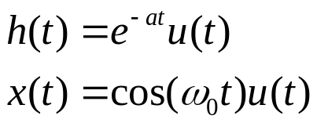
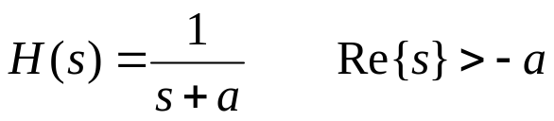
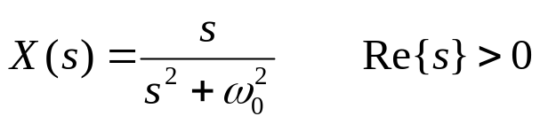
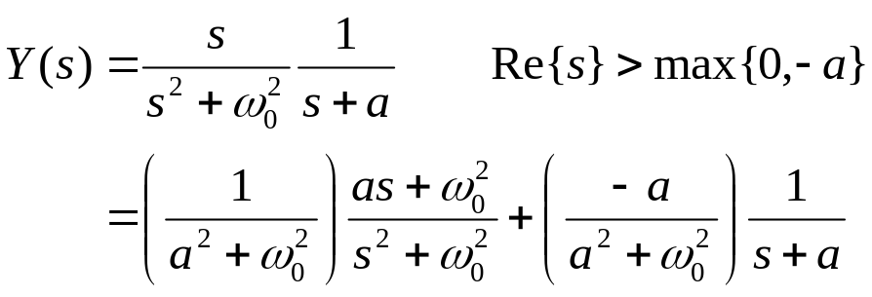
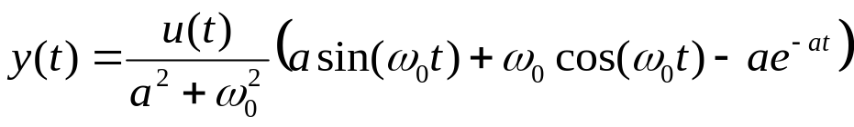
Example 2: Sinusoidal Input
Consider the 1st order (possible unstable) system response with input x(t)
Taking Laplace transforms
The Laplace transform of the output of the system is therefore
and the inverse Laplace transform is

Slide 20

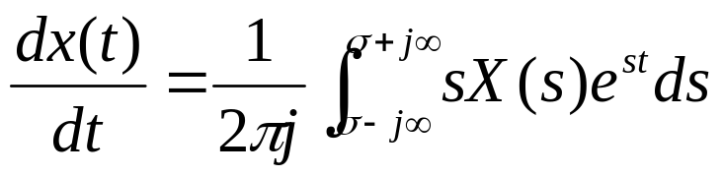
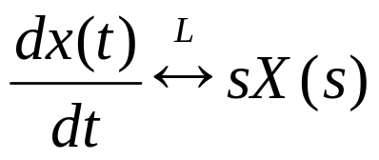
Differentiation in the Time Domain
Consider the Laplace transform derivative in the time domain
sX(s) has an extra zero at 0, and may cancel out a corresponding pole of X(s), so ROC may be larger
Widely used to solve when the system is described by LTI differential equations
ROC=R
ROC⊇R

Slide 21
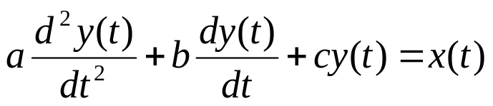
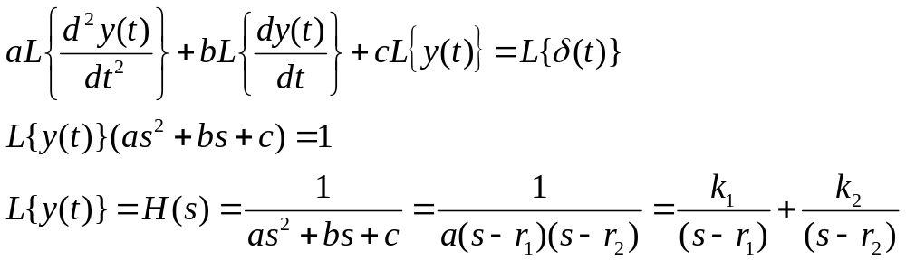

Example: System Impulse Response
Consider trying to find the system response (potentially unstable) for a second order system with an impulse input x(t)=δ(t), y(t)=h(t)
Taking Laplace transforms of both sides and using the linearity property
where r₁ and r₂ are distinct roots, and calculating the inverse transform
The general solution to a second order system can be expressed as the sum of two complex (possibly real) exponentials

Slide 22
Inverse Laplace Transform
Laplace transform (3 lectures):
Laplace transform as Fourier transform with convergence factor. Properties of the Laplace transform
Specific objectives for today:
Poles and zeros of a Laplace transfer function
Rational polynomial transfer functions
Inverse Laplace transform

Slide 23
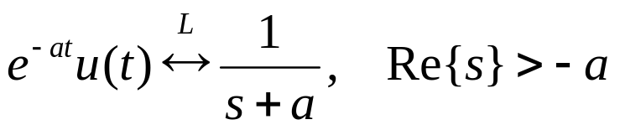
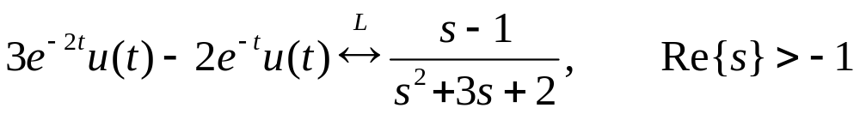
Reminder: Laplace Transforms
Equivalent to the Fourier transform when s=jω
There is an associated region of convergence for s where the (transformed) signal has finite energy. The Laplace transform is only defined for these values
Laplace transform is linear (easy!)
Examples for the Laplace transforms include

Slide 24
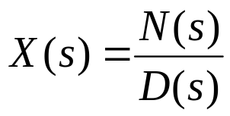
Ratio of Polynomials
In each of these examples, the Laplace transform is rational, i.e. it is a ratio of polynomials in the complex variable s.
where N and D are the numerator and denominator polynomial respectively.
In fact, X(s) will be rational whenever x(t) is a linear combination of real or complex exponentials. Rational transforms also arise when we consider LTI systems specified in terms of linear, constant coefficient differential equations.
We can mark the roots of N and D in the s-plane along with the ROC
Example 3:
Im
s-plane
– roots of N(s)
x
x
-2
-1
1
Re
x – roots of D(s)

Slide 25
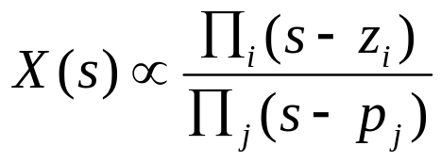
Poles and Zeros
The roots of N(s) are known as the zeros. For these values of s, X(s) is zero.
The roots of D(s) are known as the poles. For these values of s, X(s) is infinite, the Region of Convergence for the Laplace transform cannot contain any poles, because the corresponding integral is infinite
The set of poles and zeros completely characterise X(s) to within a scale factor (+ ROC for Laplace transform)
The graphical representation of X(s) through its poles and zeros in the s-plane is referred to as the pole-zero plot of X(s)

Slide 26
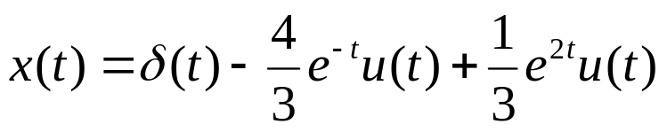
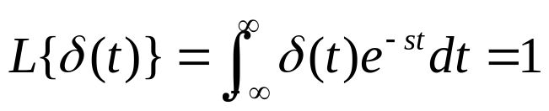

Example: Poles and Zeros
Consider the signal:
By linearity (& last lecture) we can evaluate the second and third terms
The Laplace transform of the impulse function is:
which is valid for any s. Therefore,
Im
x
x
-1
1
2
Re

Slide 27
ROC Properties for Laplace Transform
Property 1: The ROC of X(s) consists of strips parallel to the jω-axis in the s-plane
Because the Laplace transform consists of s for which x(t)e^{-σt} converges, which only depends on Re{s} = σ
Property 2: For rational Laplace transforms, the ROC does not contain any poles
Because X(s) is infinite at a pole, the integral must not converge.
Property 3: if x(t) is finite duration and is absolutely integrable then the ROC is the entire s-plane.
Because x(t) is magnitude bounded, multiplication by any exponential over a finite interval is also bounded. Therefore the Laplace integral converges for any s.

Slide 28



Inverse Laplace Transform
The Laplace transform of a signal x(t) is:
We can invert this relationship using the inverse Fourier transform
Multiplying both sides by e^{σt}:
Therefore, we can recover x(t) from X(s), where the real component is fixed and we integrate over the imaginary part, noting that ds = jdω

Slide 29






Inverse Laplace Transform Interpretation
Just about all real-valued signals, x(t), can be represented as a weighted, X(s), integral of complex exponentials, e^{st}.
The contour of integration is a straight line (in the complex plane) from σ-j∞ to σ+j∞ (we won’t be explicitly evaluating this, just spotting known transformations)
We can choose any σ for this integration line, as long as the integral converges
For the class of rational Laplace transforms, we can express X(s) as partial fractions to determine the inverse Fourier transform.

Slide 30



Example 1: Inverting the Laplace Transform
Consider when
Like the inverse Fourier transform, expand as partial fractions
Pole-zero plots and ROC for combined & individual terms
Im
x
x
-2
-1
Re

Slide 31


Example 2
Consider when
Like the inverse Fourier transform, expand as partial fractions
Pole-zero plots and ROC for combined & individual terms
Im
x
x
-2
-1
Re

Slide 32
Summary
The Laplace transform is a superset of the Fourier transform – it is equal to it when s=jω i.e. F{x(t)} = X(jω)
Laplace transform of a continuous time signal is defined by:
And can be imagined as being the Fourier transform of the signal x’(t) = x(t)e^{σt}, when s=σ+jω
The region of convergence (ROC) associated with the Laplace transform defines the region in s (complex) space for which the Laplace transform converges.
In simple cases it corresponds to the values for s (σ) for which the transformed signal has finite energy

Slide 33
Contd..
Like the Fourier transform, the Laplace transform is linear and represents time shifts (t-T) by multiplying by e^{-sT}
Convolution
Convolution in the time domain is equivalent to multiplying the Laplace transforms
Laplace transform of the system’s impulse response is very important H(s) = ∫h(t)e^{-st}dt. Known as the transfer function.
Differentiation
Very important for solving ordinary differential equations
ROC⊇R₁∩R₂
ROC⊇R

Slide 34
Contd..
For many signals that are made up of a linear combination of complex exponentials and CT LTI systems that are described by differential equations, the Laplace transform is rational, i.e. it is a ratio of polynomials in s: N(s)/D(s)
The roots of N(s) and D(s) are known as the zeros and poles of the transfer function, respectively.
The Region of Convergence does not contain any poles
The inverse Laplace transform is given by
It is usually calculated by expressing the Laplace transform as partial fractions, and then spotting known relationships (rather than directly evaluating the inverse transform)

