Slide 1
Signals & Systems Concepts
Systems, signals, mathematical models. Continuous-time and discrete-time signals. Energy and power signals. Linear systems. Examples for use throughout the course
Specific objectives:
Introduction to systems
Continuous and discrete time systems
Properties of a system
Linear (time invariant) LTI systems

Slide 2
Linear Systems
A system takes a signal as an input and transforms it into another signal
Linear systems play a crucial role in most areas of science
  Closed form solutions often exist
  Theoretical analysis is considerably simplified
  Non-linear systems can often be regarded as linear, for small perturbations, so-called linearization
For the remainder of the lecture/course we’re primarily going to be considering Linear, Time Invariant systems (LTI) and consider their properties
x(t)
continuous
time (CT)
y(t)
x[n]
discrete
time (DT)
y[n]

Slide 3
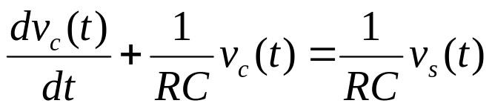

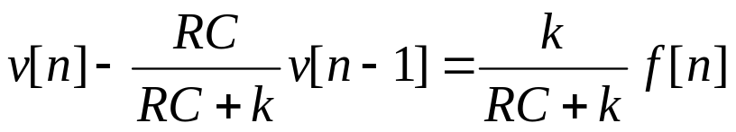
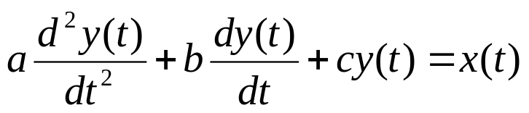
Examples of Simple Systems
To get some idea of typical systems (and their properties), consider the electrical circuit example:
which is a first order, CT differential equation.
Examples of first order, DT difference equations:
where y is the monthly bank balance, and x is monthly net deposit
which represents a discretised version of the electrical circuit
Example of second order system includes:
System described by order and parameters (a, b, c)

Slide 4
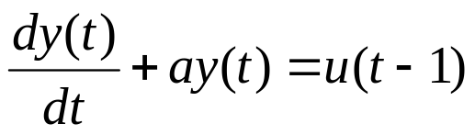

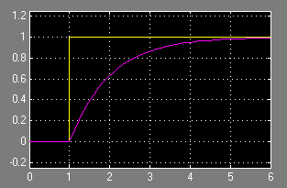
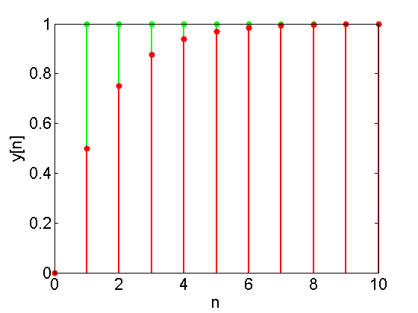
First Order Step Responses
People tend to visualise systems in terms of their responses to simple input signals (see Lecture 4…)
The dynamics of the output signal are determined by the dynamics of the system, if the input signal has no dynamics
Consider when the input signal is a step at t, n = 1, y(0) = 0
First order CT differential system
First order DT difference system
u(t)
y(t)
t

Slide 5
System Linearity
The most important property that a system possesses is linearity
It means allows any system response to be analysed as the sum of simpler responses (convolution)
Simplistically, it can be imagined as a line
y
x
Specifically, a linear system must satisfy the two properties:
1 Additive: the response to x₁(t)+x₂(t) is y₁(t) + y₂(t)
2 Scaling: the response to ax₁(t) is ay₁(t) where a∈C
Combined: ax₁(t)+bx₂(t)  ay₁(t) + by₂(t)
E.g. Linear y(t) = 3*x(t) why?
Non-linear y(t) = 3*x(t)+2, y(t) = 3*x²(t) why?
(equivalent definition for DT systems)

Slide 6
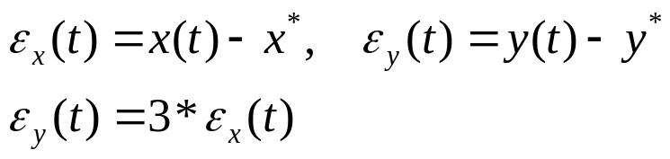

Bias and Zero Initial Conditions
Intuitively, a system such as:
y(t) = 3*x(t)+2
is regarded as being linear. However, it does not satisfy the scaling condition.
There are several (similar) ways to transform it to an equivalent linear system
Perturbations around operating value x*, y*
Linear System Derivative
Locally, these ideas can also be used to linearise a non-linear system in a small range

Slide 7
Linearity and Superposition
Suppose an input signal x[n] is made of a linear sum of other (basis/simpler) signals x_{k}[n]:
then the (linear) system response is:
The basic idea is that if we understand how simple signals get affected by the system, we can work out how complex signals are affected, by expanding them as a linear sum
This is known as the superposition property which is true for linear systems in both CT & DT
Important for understanding convolution (next lecture)

Slide 8


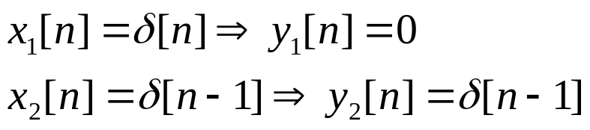
Definition of Time Invariance
A system is time invariant if its behaviour and characteristics are fixed over time
We would expect to get the same results from an input-output experiment, if the same input signal was fed in at a different time
E.g. The following CT system is time-invariant
because it is invariant to a time shift, i.e. x₂(t) = x₁(t-t₀)
E.g. The following DT system is time-varying
Because the system parameter that multiplies the input signal is time varying, this can be verified by substitution

Slide 9

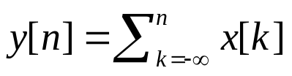

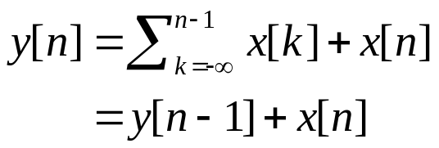
System with and without Memory
A system is said to be memoryless if its output for each value of the independent variable at a given time is dependent on the output at only that same time (no system dynamics)
e.g. a resistor is a memoryless CT system where x(t) is current and y(t) is the voltage
A DT system with memory is an accumulator (integrator)
and a delay
Roughly speaking, a memory corresponds to a mechanism in the system that retains information about input values other than the current time.

Slide 10
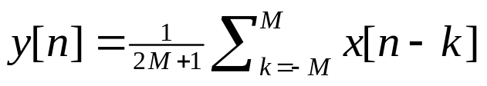
System Causality
A system is causal if the output at any time depends on values of the output at only the present and past times. Referred to as non-anticipative, as the system output does not anticipate future values of the input
If two input signals are the same up to some point t₀/n₀, then the outputs from a causal system must be the same up to then.
E.g. The accumulator system is causal:
because y[n] only depends on x[n], x[n-1], …
E.g. The averaging/filtering system is non-causal
because y[n] depends on x[n+1], x[n+2], …
Most physical systems are causal

Slide 11
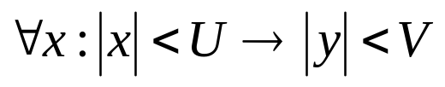
System Stability
Informally, a stable system is one in which small input signals lead to responses that do not diverge
If an input signal is bounded, then the output signal must also be bounded, if the system is stable
To show a system is stable we have to do it for all input signals. To show instability, we just have to find one counterexample
E.g. Consider the DT system of the bank account
when x[n] = δ[n], y[0] = 0
This grows without bound, due to 1.01 multiplier. This system is unstable.
E.g. Consider the CT electrical circuit, is stable if RC>0, because it dissipates energy

Slide 12
Invertible and Inverse Systems
A system is said to be invertible if distinct inputs lead to distinct outputs (similar to matrix invertibility)
If a system is invertible, an inverse system exists which, when cascaded with the original system, yields an output equal to the input of the first signal
E.g. the CT system is invertible:
  y(t) = 2x(t)
because w(t) = 0.5*y(t) recovers the original signal x(t)
E.g. the CT system is not-invertible
y(t) = x²(t)
because distinct input signals lead to the same output signal
Widely used as a design principle:
  Encryption, decryption
  System control, where the reference signal is input

Slide 13
System Structures
Systems are generally composed of components (sub-systems).
We can use our understanding of the components and their interconnection to understand the operation and behaviour of the overall system
Series/cascade
Parallel
Feedback
x
y
System 1
System 2
System 1
x
y
+
System 2
x
System 1
y
+
System 2

Slide 14
Linear Systems and Convolution
Linear systems, Convolution (3 lectures): Impulse response, input signals as continuum of impulses. Convolution, discrete-time and continuous-time. LTI systems and convolution
Specific objectives for today:
We’re looking at discrete time signals and systems
Understand a system’s impulse response properties
Show how any input signal can be decomposed into a continuum of impulses
DT Convolution for time varying and time invariant systems

Slide 15
Introduction to Convolution
Definition Convolution is an operator that takes an input signal and returns an output signal, based on knowledge about the system’s unit impulse response h[n].
The basic idea behind convolution is to use the system’s response to a simple input signal to calculate the response to more complex signals
This is possible for LTI systems because they possess the superposition property (lecture 3):
x[n] = δ[n]
System
y[n] = h[n]
x[n]
System: h[n]
y[n]

Slide 16
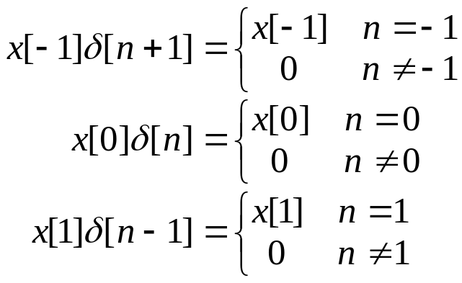

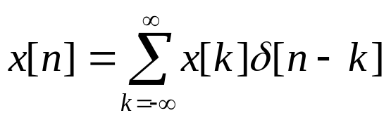
Discrete Impulses & Time Shifts
Basic idea: use a (infinite) set of of discrete time impulses to represent any signal.
Consider any discrete input signal x[n]. This can be written as the linear sum of a set of unit impulse signals:
Therefore, the signal can be expressed as:
In general, any discrete signal can be represented as:
actual value
Impulse, time shifted signal
The sifting property

Slide 17
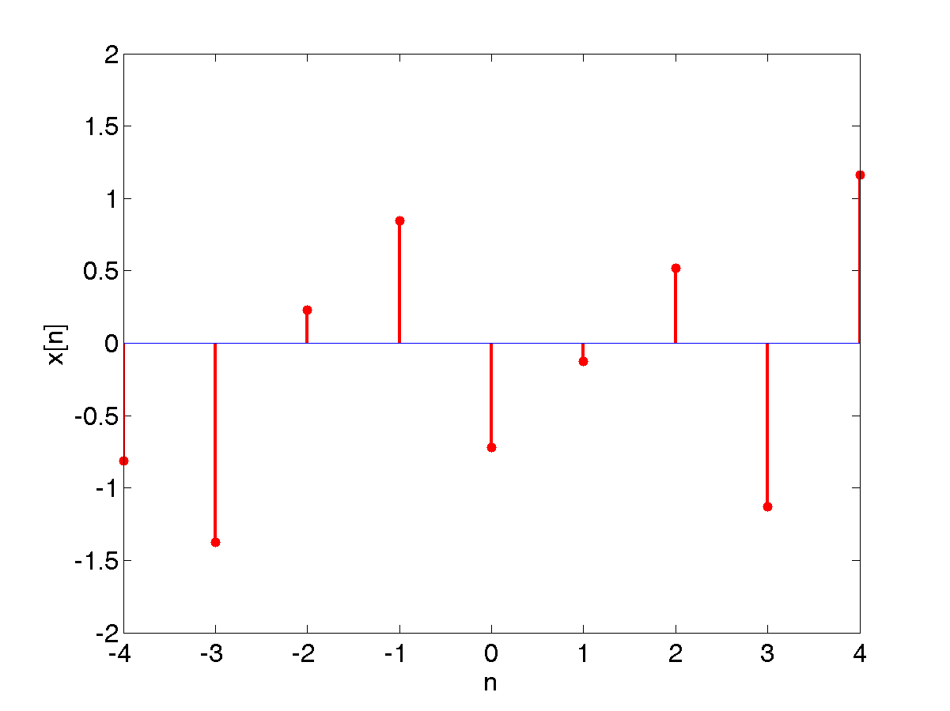
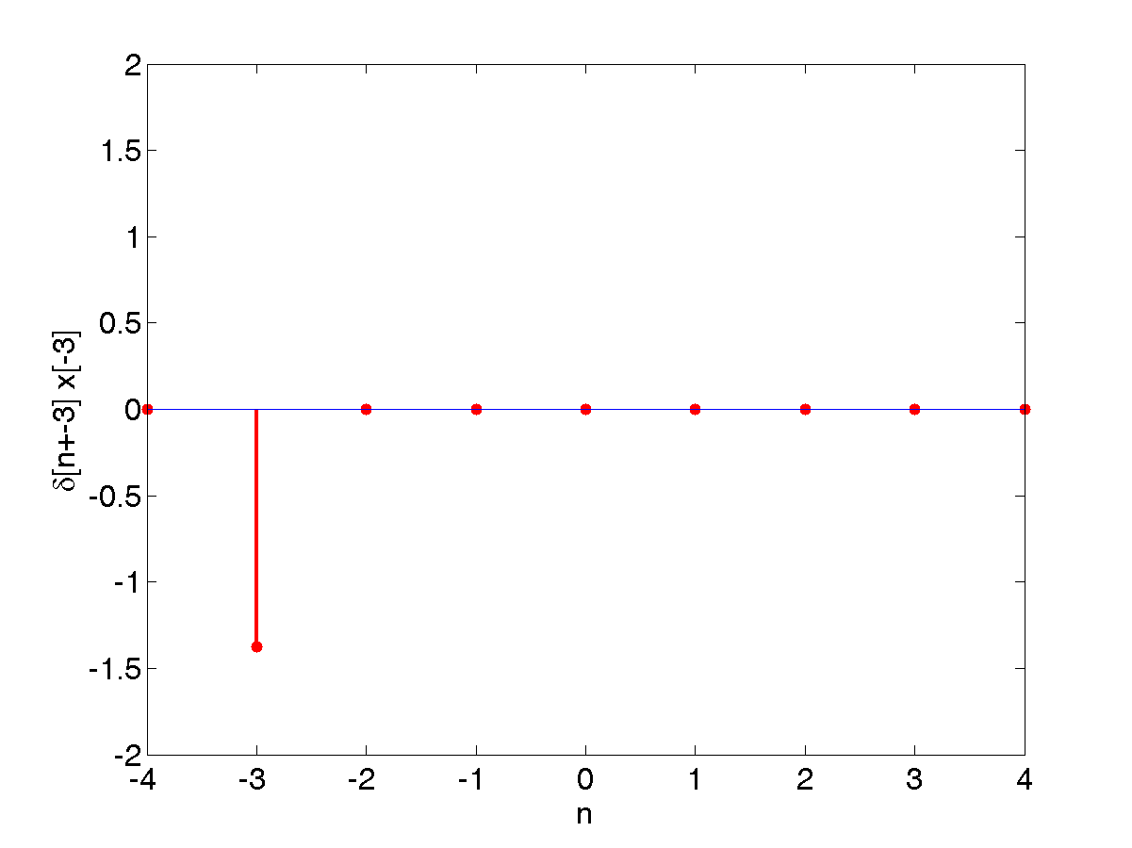
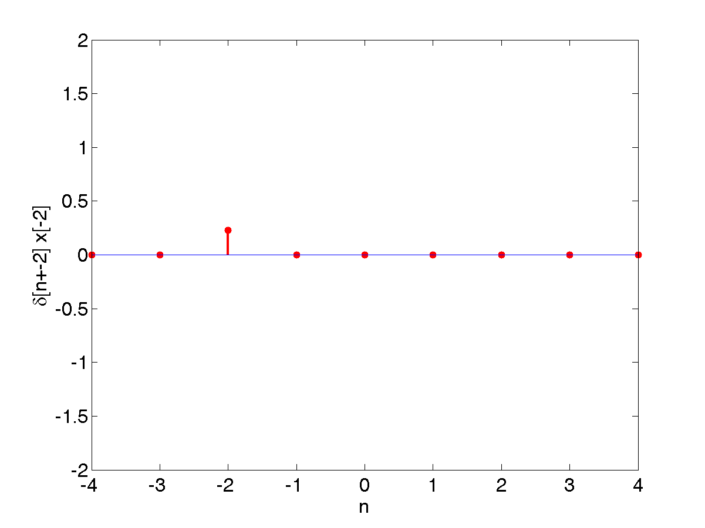
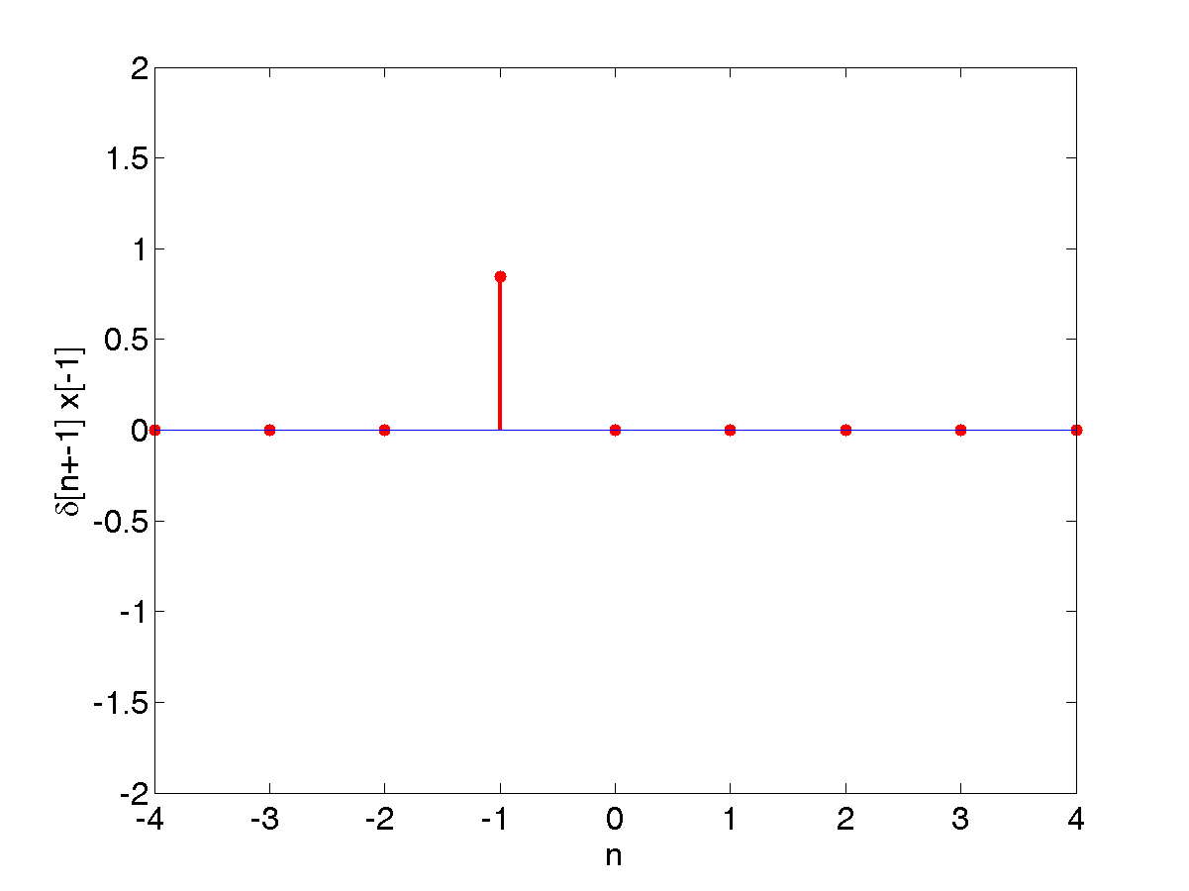
Example
The discrete signal x[n]
Is decomposed into the following additive components
  x[-4]δ[n+4] +
x[-3]δ[n+3] +
x[-2]δ[n+2] +
x[-1]δ[n+1] + …

Slide 18
Discrete, Unit Impulse System Response
A very important way to analyse a system is to study the output signal when a unit impulse signal is used as an input
Loosely speaking, this corresponds to giving the system a kick at n=0, and then seeing what happens
This is so common, a specific notation, h[n], is used to denote the output signal, rather than the more general y[n].
The output signal can be used to infer properties about the system’s structure and its parameters θ.
δ[n]
System: θ
h[n]

Slide 19
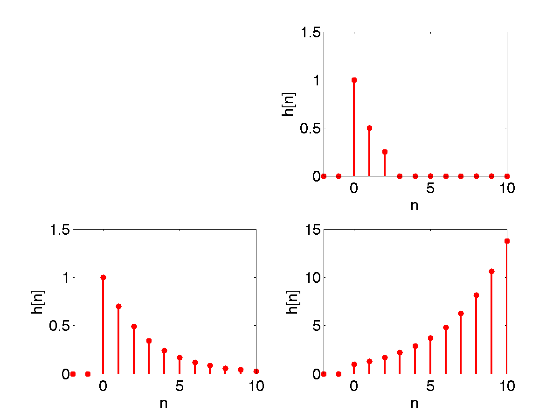
Types of Unit Impulse Response
Causal, stable, finite impulse response
y[n] = x[n] + 0.5x[n-1] + 0.25x[n-2]
Looking at unit impulse responses, allows you to determine certain system properties
Causal, stable, infinite impulse response
y[n] = x[n] + 0.7y[n-1]
Causal, unstable, infinite impulse response
y[n] = x[n] + 1.3y[n-1]

Slide 20

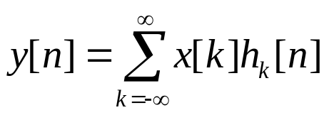
Linear, Time Varying Systems
If the system is time varying, let h_{k}[n] denote the response to the impulse signal δ[n-k] (because it is time varying, the impulse responses at different times will change).
Then from the superposition property (Lecture 3) of linear systems, the system’s response to a more general input signal x[n] can be written as:
Input signal
System output signal is given by the convolution sum
i.e. it is the scaled sum of impulse responses

Slide 21
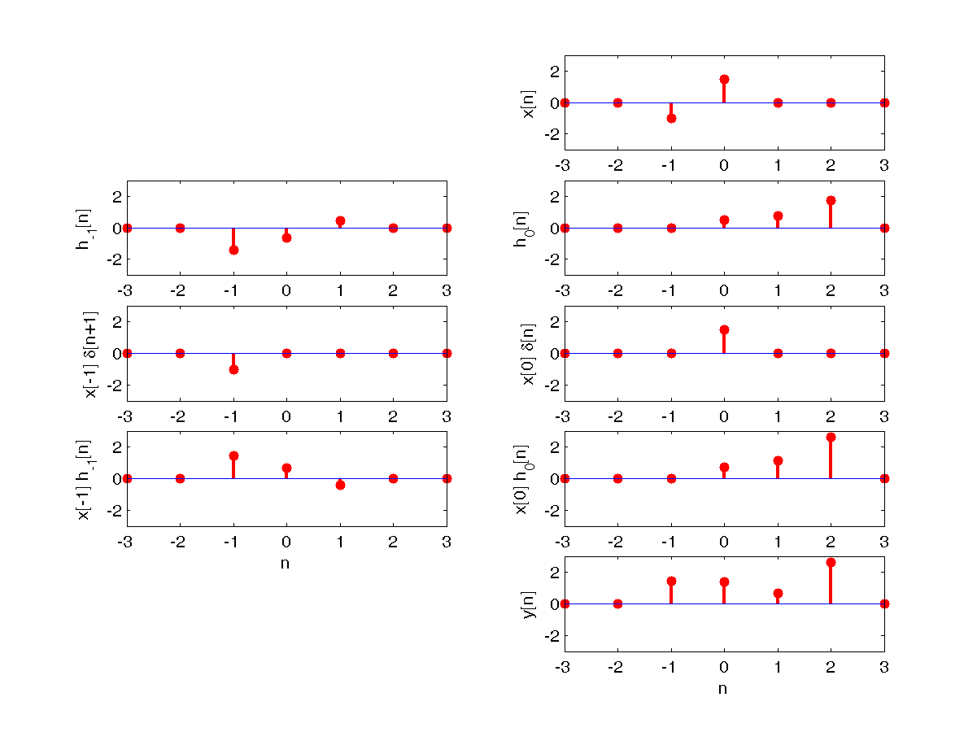
Example: Time Varying Convolution
x[n] = [0 0 –1 1.5 0 0 0]
h₋₁[n] = [0 0 –1.5 –0.7 .4 0 0]
h₀[n] = [0 0 0 0.5 0.8 1.7 0]
y[n] = [0 0 1.4 1.4 0.7 2.6 0]

Slide 22
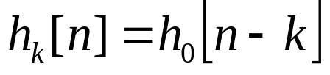
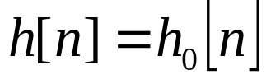
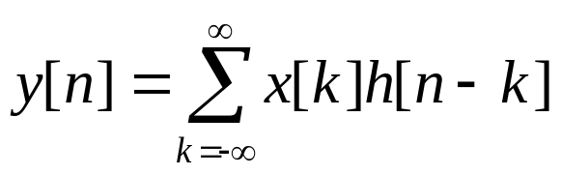

Linear Time Invariant Systems
When system is linear, time invariant, the unit impulse responses are all time-shifted versions of each other:
It is usual to drop the 0 subscript and simply define the unit impulse response h[n] as:
In this case, the convolution sum for LTI systems is:
It is called the convolution sum (or superposition sum) because it involves the convolution of two signals x[n] and h[n], and is sometimes written as:

Slide 23
System Identification and Prediction
Note that the system’s response to an arbitrary input signal is completely determined by its response to the unit impulse.
Therefore, if we need to identify a particular LTI system, we can apply a unit impulse signal and measure the system’s response.
That data can then be used to predict the system’s response to any input signal
Note that describing an LTI system using h[n], is equivalent to a description using a difference equation. There is a direct mapping between h[n] and the parameters/order of a difference equation such as:
y[n] = x[n] + 0.5x[n-1] + 0.25x[n-2]
x[n]
y[n]
System: h[n]

Slide 24
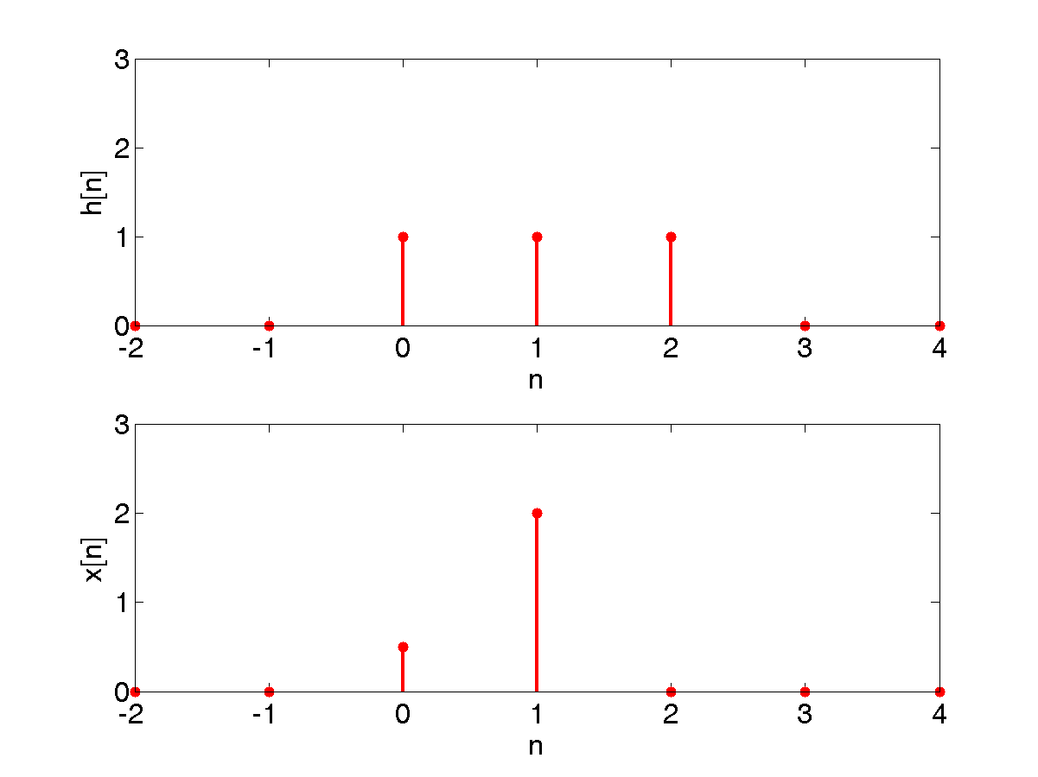
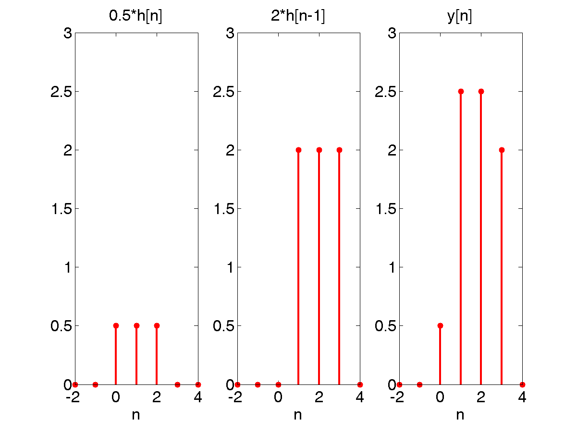
Example 1: LTI Convolution
Consider a LTI system with the following unit impulse response:
h[n] = [0 0 1 1 1 0 0]
For the input sequence:
x[n] = [0 0 0.5 2 0 0 0]
The result is:
y[n] = … + x[0]h[n] + x[1]h[n-1] + …
= 0 +
0.5*[0 0 1 1 1 0 0] +
2.0*[0 0 0 1 1 1 0] +
0
= [0 0 0.5 2.5 2.5 2 0]

Slide 25
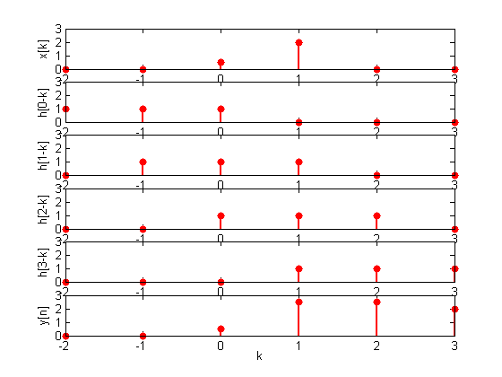
Example 2: LTI Convolution
Consider the problem described for example 1
Sketch x[k] and h[n-k] for any particular value of n, then multiply the two signals and sum over all values of k.
For n<0, we see that x[k]h[n-k] = 0 for all k, since the non-zero values of the two signals do not overlap.
y[0] = Σ_{k}x[k]h[0-k] = 0.5
y[1] = Σ_{k}x[k]h[1-k] = 0.5+2
y[2] = Σ_{k}x[k]h[2-k] = 0.5+2
y[3] = Σ_{k}x[k]h[3-k] = 2
As found in Example 1

Slide 26
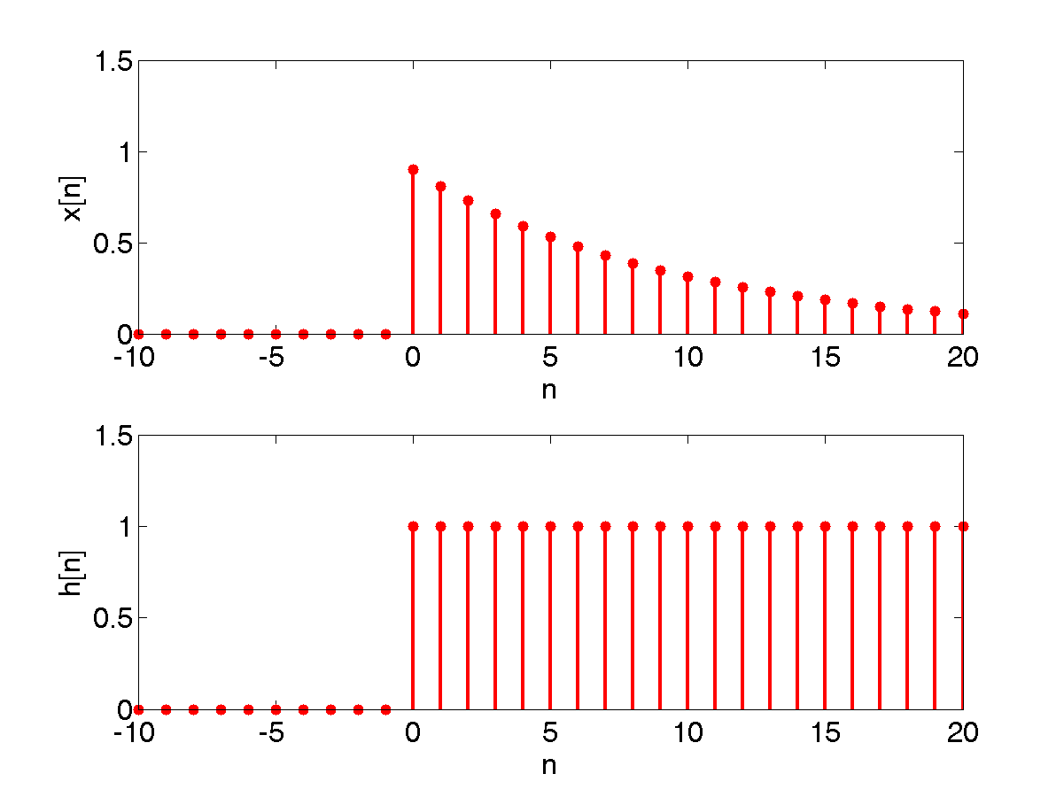
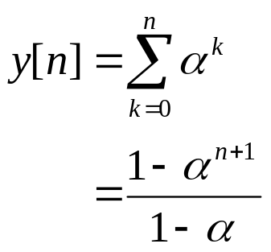
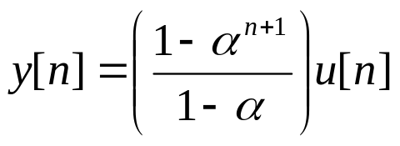
Example 3: LTI Convolution
Consider a LTI system that has a step response h[n] = u[n] to the unit impulse input signal
What is the response when an input signal of the form
x[n] = α^{n}u[n]
where 0<α<1, is applied?
For n≥0:
Therefore,

Slide 27
Discrete LTI Convolution in Matlab
In Matlab to find out about a command, you can search the help files or type:
>> lookfor convolution
at the Matlab command line. This returns all Matlab functions that contain the term “convolution” in the basic description
These include:
conv()
To see how this works and other functions that may be appropriate, type:
>> help conv
at the Matlab command line
Example:
>> h = [0 0 1 1 1 0 0];
>> x = [0 0 0.5 2 0 0 0];
>> y = conv(x, h)
>> y = [0 0 0 0 0.5 2.5 2.5 2 0 0 0 0 0]

Slide 28
Linear Systems and Convolution
Linear systems, Convolution (3 lectures): Impulse response, input signals as continuum of impulses. Convolution, discrete-time and continuous-time. LTI systems and convolution
Specific objectives for today:
We’re looking at continuous time signals and systems
Understand a system’s impulse response properties
Show how any input signal can be decomposed into a continuum of impulses
Convolution

Slide 29
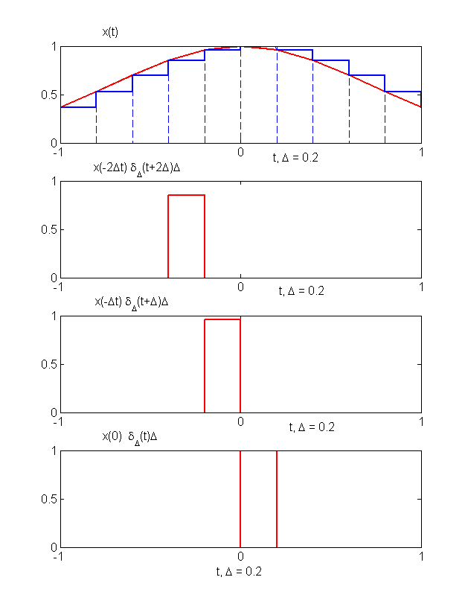
Introduction to “Continuous” Convolution
In this lecture, we’re going to understand how the convolution theory can be applied to continuous systems. This is probably most easily introduced by considering the relationship between discrete and continuous systems.
The convolution sum for discrete systems was based on the sifting principle, the input signal can be represented as a superposition (linear combination) of scaled and shifted impulse functions.
This can be generalised to continuous signals, by thinking of it as the limiting case of arbitrarily thin pulses

Slide 30
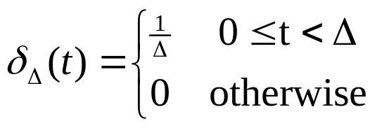
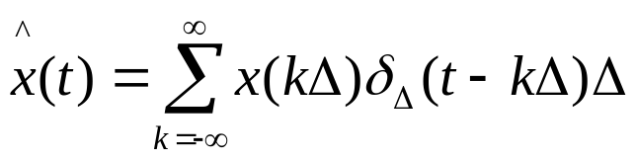
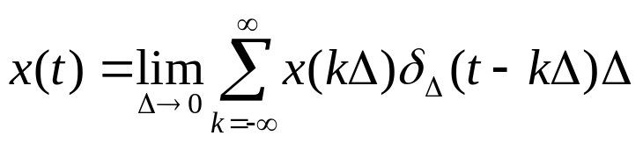
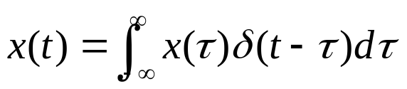
Signal “Staircase” Approximation
As previously shown, any continuous signal can be approximated by a linear combination of thin, delayed pulses:
Note that this pulse (rectangle) has a unit integral. Then we have:
Only one pulse is non-zero for any value of t. Then as Δ→0
When Δ→0, the summation approaches an integral
This is known as the sifting property of the continuous-time impulse and there are an infinite number of such impulses δ(t-τ)
δ_{Δ}(t)
1/Δ
Δ

Slide 31
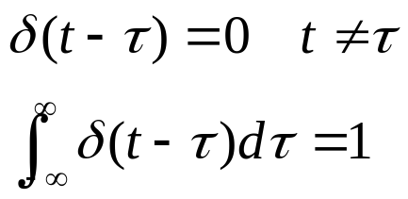

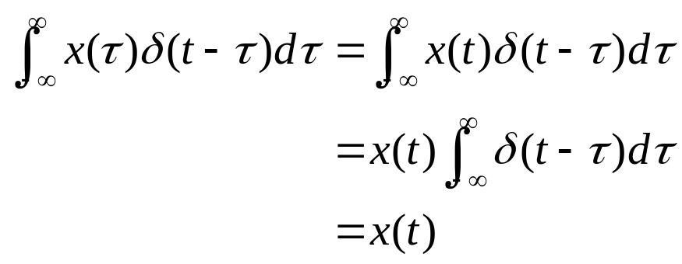
Alternative Derivation of Sifting Property
The unit impulse function, δ(t), could have been used to directly derive the sifting function.
Therefore:
The previous derivation strongly emphasises the close relationship between the structure for both discrete and continuous-time signals

Slide 32
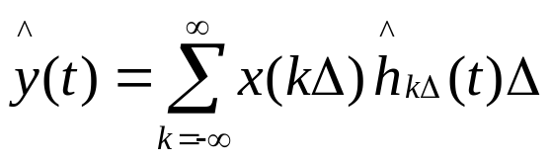
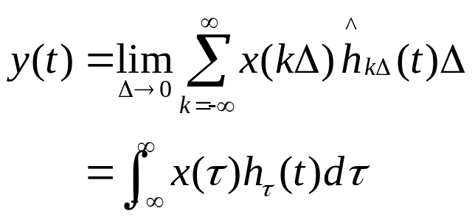
Continuous Time Convolution
Given that the input signal can be approximated by a sum of scaled, shifted version of the pulse signal, δ_{Δ}(t-kΔ)
The linear system’s output signal y is the superposition of the responses, h_{kΔ}(t), which is the system response to δ_{Δ}(t-kΔ).
From the discrete-time convolution:
What remains is to consider as Δ→0. In this case:
^
^

Slide 33
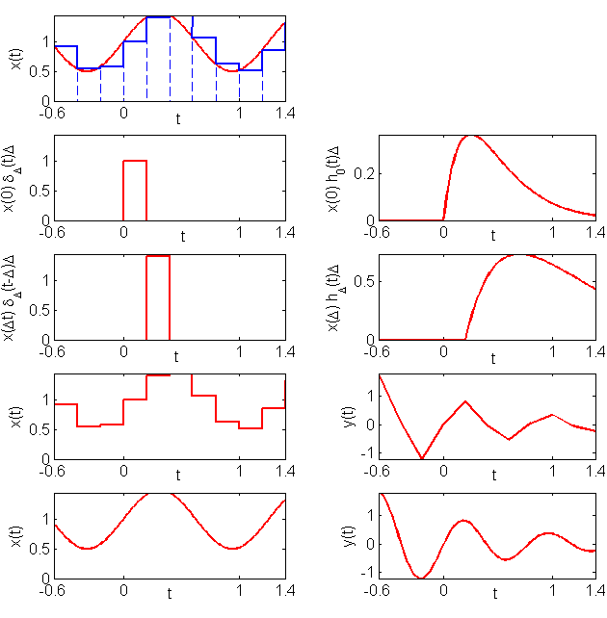
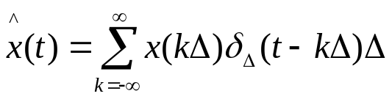

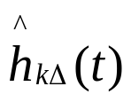
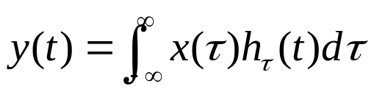
Example: Discrete to Continuous Time Linear Convolution
The CT input signal (red) x(t) is approximated (blue) by:
Each pulse signal
generates a response
Therefore the DT convolution response is
Which approximates the CT convolution response

Slide 34

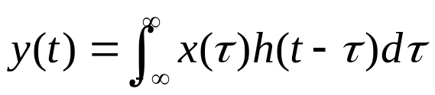

Linear Time Invariant Convolution
For a linear, time invariant system, all the impulse responses are simply time shifted versions:
Therefore, convolution for an LTI system is defined by:
This is known as the convolution integral or the superposition integral
Algebraically, it can be written as:
To evaluate the integral for a specific value of t, obtain the signal h(t-τ) and multiply it with x(τ) and the value y(t) is obtained by integrating over τ from –∞ to ∞.
Demonstrated in the following examples

Slide 35
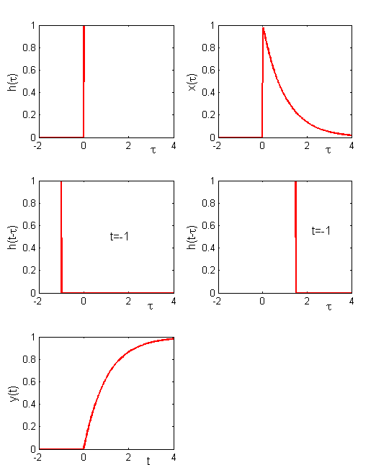
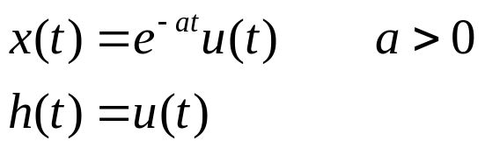
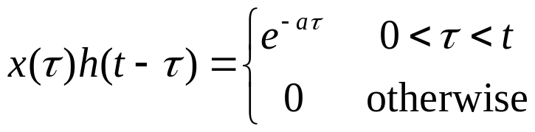
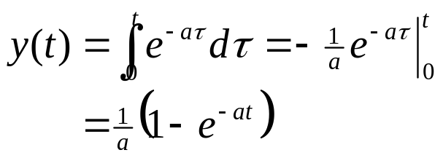

Example 1: CT Convolution
Let x(t) be the input to a LTI system with unit impulse response h(t):
For t>0:
We can compute y(t) for t>0:
So for all t:
In this example
a=1

Slide 36
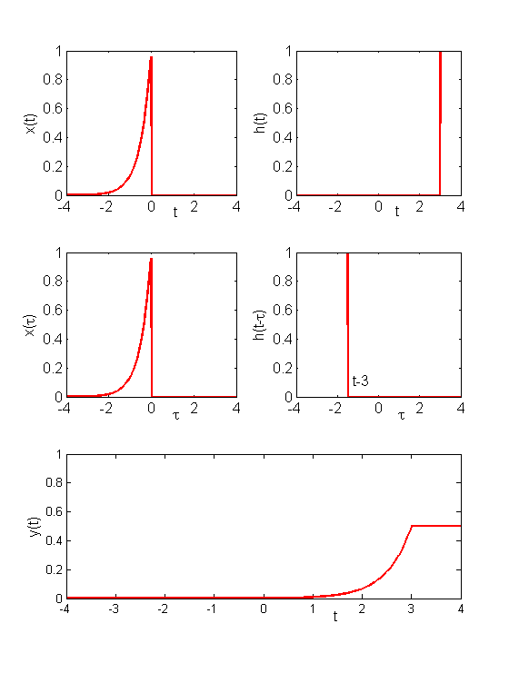
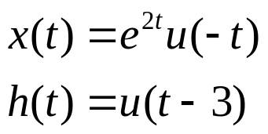


Example 2: CT Convolution
Calculate the convolution of the following signals
The convolution integral becomes:
For t-3≥0, the product x(τ)h(t-τ) is non-zero for -∞<τ<0, so the convolution integral becomes:

Slide 37
Linear Systems and Convolution
Linear systems, Convolution : Impulse response, input signals as continuum of impulses. Convolution, discrete-time and continuous-time. LTI systems and convolution
Specific objectives for today:
Properties of an LTI system
Differential and difference systems
Rather than concentrate on the mechanics of how to calculate discrete/continuous-time convolution, we’re looking at the impact on the system specification.

Slide 38




LTI Systems and Impulse Response
Any continuous/discrete-time LTI system is completely described by its impulse response through the convolution:
This only holds for LTI systems as follows:
Example: The discrete-time impulse response
Is completely described by the following LTI
However, the following systems also have the same impulse response
Therefore, if the system is non-linear, it is not completely characterised by the impulse response

Slide 39


Commutative Property
Convolution is a commutative operator (in both discrete and continuous time), i.e.:
For example, in discrete-time:
and similar for continuous time.
Therefore, when calculating the response of a system to an input signal x[n], we can imagine the signal being convolved with the unit impulse response h[n], or vice versa, whichever appears the most straightforward.

Slide 40

Distributive Property (Parallel Systems)
Another property of convolution is the distributive property
This can be easily verified
Therefore, the two systems:
are equivalent. The convolved sum of two impulse responses is equivalent to considering the two equivalent parallel system (equivalent for discrete-time systems)
y₁(t)
h₁(t)
x(t)
y(t)
x(t)
y(t)
+
h₁(t)+h₂(t)
h₂(t)
y₂(t)

Slide 41





Example: Distributive Property
Let y[n] denote the convolution of the following two sequences:
x[n] is non-zero for all n. We will use the distributive property to express y[n] as the sum of two simpler convolution problems. Let x₁[n] = 0.5^{n}u[n], x₂[n] = 2^{n}u[-n], it follows that
and y[n] = y₁[n]+y₂[n], where y₁[n] = x₁[n]*h[n], y₁[n] = x₁[n]*h[n].
From Lecture 3 - example 3, and O&W example 2.5

Slide 42

Associative Property (Serial Systems)
Another property of (LTI) convolution is that it is associative
Again this can be easily verified by manipulating the summation/integral indices
Therefore, the following four systems are all equivalent and y[n] = x[n]*h₁[n]*h₂[n] is unambiguously defined.
This is not true for non-linear systems (y₁[n] = 2x[n], y₂[n] = x²[n])
x(t)
w(t)
y(t)
x(t)
y(t)
h₁(t)
h₂(t)
h₁(t)*h₂(t)
x(t)
v(t)
y(t)
x(t)
y(t)
h₂(t)
h₁(t)
h₂(t)*h₁(t)

Slide 43


LTI System Memory
An LTI system is memoryless if its output depends only on the input value at the same time, i.e.
For an impulse response, this can only be true if
Such systems are extremely simple and the output of dynamic engineering, physical systems depend on:
Preceding values of x[n-1], x[n-2], …
Past values of y[n-1], y[n-2], …
for discrete-time systems, or derivative terms for continuous-time systems

Slide 44

System Invertibility
Does there exist a system with impulse response h₁(t) such that y(t)=x(t)?
Widely used concept for:
control of physical systems, where the aim is to calculate a control signal such that the system behaves as specified
filtering out noise from communication systems, where the aim is to recover the original signal x(t)
The aim is to calculate “inverse systems” such that
The resulting serial system is therefore memoryless
x(t)
w(t)
y(t)
h(t)
h₁(t)

Slide 45




Example: Accumulator System
Consider a DT LTI system with an impulse response
h[n] = u[n]
Using convolution, the response to an arbitrary input x[n]:
As u[n-k] = 0 for n-k<0 and 1 for n-k≥0, this becomes
i.e. it acts as a running sum or accumulator. Therefore an inverse system can be expressed as:
A first difference (differential) operator, which has an impulse response

Slide 46

Causality for LTI Systems
Remember, a causal system only depends on present and past values of the input signal. We do not use knowledge about future information.
For a discrete LTI system, convolution tells us that
h[n] = 0 for n<0
as y[n] must not depend on x[k] for k>n, as the impulse response must be zero before the pulse!
Both the integrator and its inverse in the previous example are causal
This is strongly related to inverse systems as we generally require our inverse system to be causal. If it is not causal, it is difficult to manufacture!

Slide 47




LTI System Stability
Remember: A system is stable if every bounded input produces a bounded output
Therefore, consider a bounded input signal
|x[n]| < B for all n
Applying convolution and taking the absolute value:
Using the triangle inequality (magnitude of a sum of a set of numbers is no larger than the sum of the magnitude of the numbers):
Therefore a DT LTI system is stable if and only if its impulse response is absolutely summable, ie
Continuous-time system

Slide 48






Example: System Stability
Are the DT and CT pure time shift systems stable?
Are the discrete and continuous-time integrator systems stable?
Therefore, both the CT and DT systems are stable: all finite input signals produce a finite output signal
Therefore, both the CT and DT systems are unstable: at least one finite input causes an infinite output signal

Slide 49


Differential and Difference Equations
Two extremely important classes of causal LTI systems:
1) CT systems whose input-output response is described by linear, constant-coefficient, ordinary differential equations with a forced response
2) DT systems whose input-output response is described by linear, constant-coefficient, difference equations
Note that to “solve” these equations for y(t) or y[n], we need to know the initial conditions
Examine such systems and relate them to the system properties just described
RC circuit with: y(t) = v_{c}(t), x(t) = v_{s}(t), a = b = 1/RC.
Simple bank account with: a = -1.01, b = 1.

Slide 50



Continuous-Time Differential Equations
A general N^{th}-order LTI differential equation is
If the equation involves derivative operators on y(t) (N>0) or x(t), it has memory.
The system stability depends on the coefficients a_{k}. For example, a 1st order LTI differential equation with a₀=1:
If a₁>0, the system is unstable as its impulse response represents a growing exponential function of time
If a₁<0 the system is stable as its impulse response corresponds to a decaying exponential function of time

Slide 51



Discrete-Time Difference Equations
A general N^{th}-order LTI difference equation is
If the equation involves difference operators on y[n] (N>0) or x[n], it has memory.
The system stability depends on the coefficients a_{k}. For example, a 1st order LTI difference equation with a₀=1:
If a₁>1, the system is unstable as its impulse response represents a growing power function of time
If a₁ <1 the system is stable as its impulse response corresponds to a decaying power function of time

Slide 52
Summary
The standard notions of commutative, associative and distributive properties are valid for convolution operators. These can be used to simplify evaluating convolution, by decomposing the input system/signal into simpler parts, and then solving the transformed problem.
Standard system notations of
Memory
Causality
Invertibility
Stability
Can be given specific definitions in terms of representing a system via its convolution response or in terms of the derivative/differential equation

Slide 53
Contd..
A continuous signal x(t) can be represented via the sifting property:
Any continuous LTI system can be completely determined by measuring its unit impulse response h(t)
Given the input signal and the LTI system unit impulse response, the system’s output can be determined via convolution via
Note that this is an alternative way of calculating the solution y(t) compared to an ODE. h(t) contains the derivative information about the LHS of the ODE and the input signal represents the RHS.

Slide 54
Contd..
Any discrete LTI system can be completely determined by measuring its unit impulse response h[n]
This can be used to predict the response to an arbitrary input signal using the convolution operator:
The output signal y[n] can be calculated by:
Sum of scaled signals – example 1
Non-zero elements of h – example 2
The two ways of calculating the convolution are equivalent
Calculated in Matlab using the conv() function (but note that there are some zero padding at start and end)

Slide 55
Contd..
Whenever we use an equation for a system:
CT – differential
DT – difference
The parameters, order and structure represent the system
There are a large class of systems that are linear, time invariant (LTI), these will primarily be studied on this course.
Other system properties such as causality, stability, memory and invertibility will be dealt with on a case by case basis
Matlab and Simulink are standard tools for analysing, designing, simulating complex systems.
Used for system modelling and control design

