Slide 1
Sampling Theorem and its Reconstruction
Sampling Theorem
Reconstruction of a Signal

Slide 2



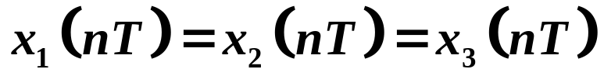
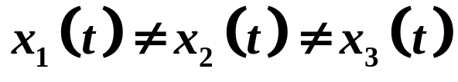
Continuous
Signal
sampling
Discrete
Signal
Code
Digital
Signal
Continuous
Signal
D/A
DSP
-T 0 T 2T t

Slide 3


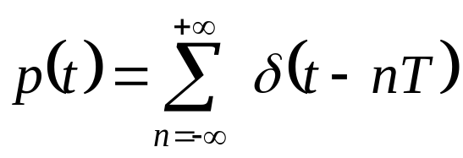



1.1 The Sampling Theorem
Impulse-Train Sampling
-3T -2T -T 0 T 2T 3T 4T t

Slide 4
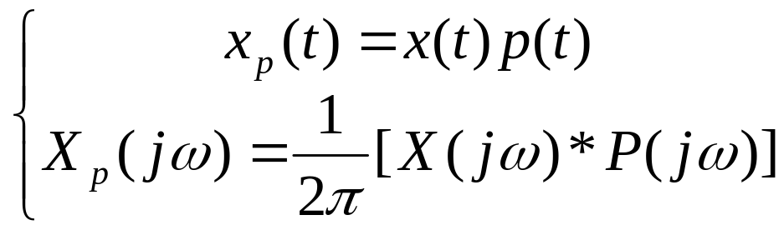
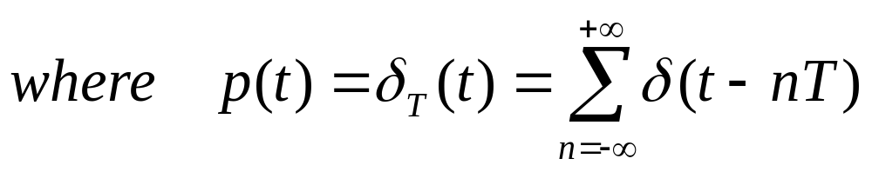
Sampling
p(t)
x(t)
x_{p}(t)

Slide 5
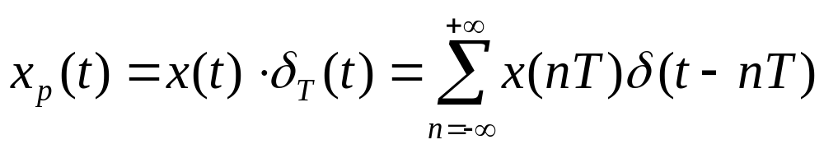
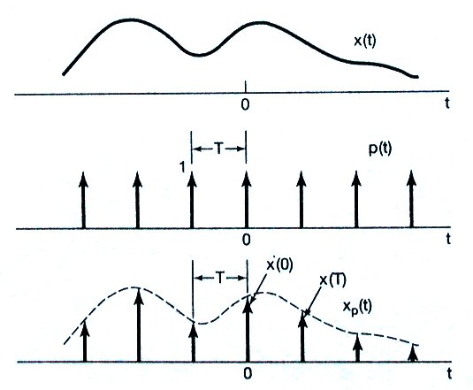
Time domain:

Slide 6
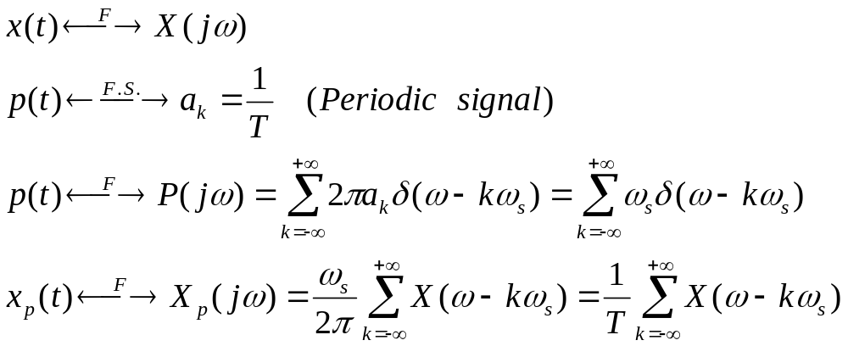
Frequency domain:

Slide 7
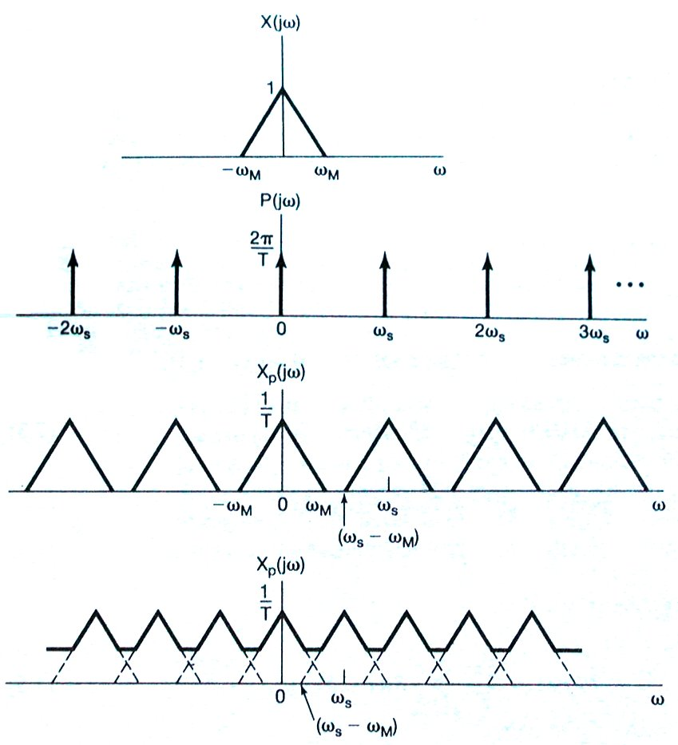



Slide 8
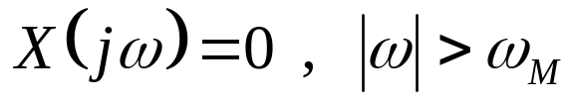

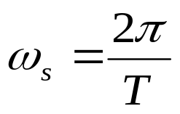

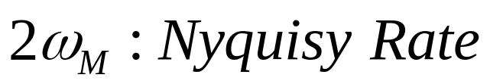
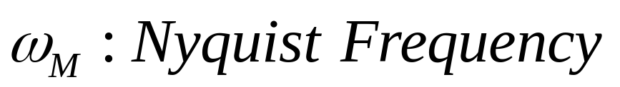
Sampling Theorem:
Let be a band-limited signal with
then is uniquely determined by its samples
if where
( Minimum distortionless sampling frequency )
( Maximum distortionless sampled signal frequency )
Excise: 7.3, 7.4

Slide 9


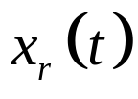





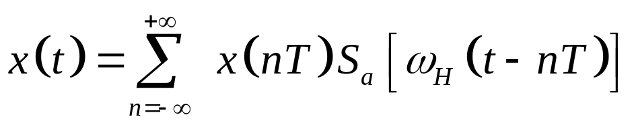
The reconstruction of the signal

Slide 10
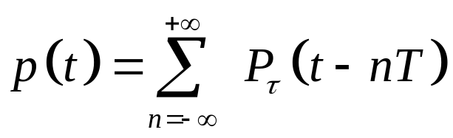
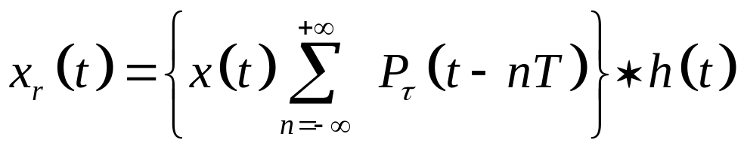
1.2 Natural Sampling
Difficult:
1 ILPF is unpractical;
2 narrow, large-amplitude pulses are difficult to generate and transmit.

Slide 11

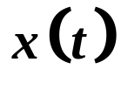
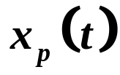
1.3 Sampling with a Zero-Order Hold
Zero-Order
Hold
-3T -2T -T 0 T 2T 3T 4T t

Slide 12




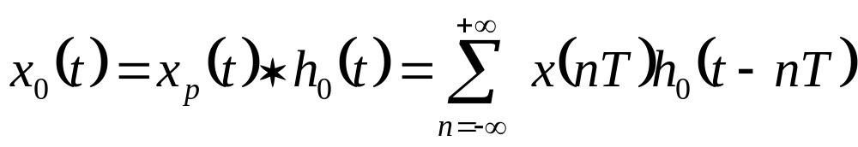
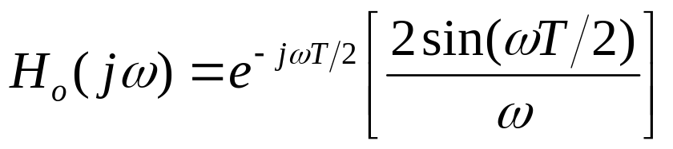
Zero-Order Hold

Slide 13



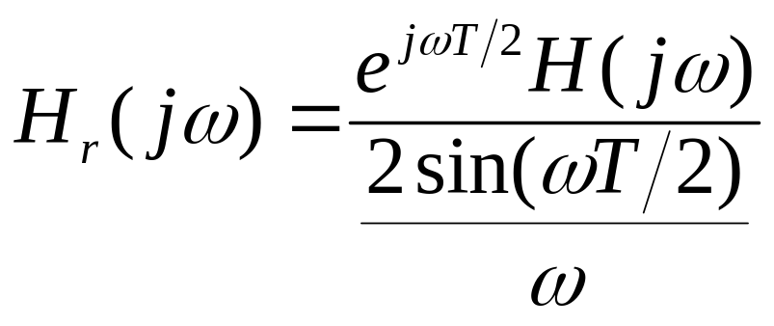
Reconstruction
Filter
Zero-Order
Hold
LPF
Impulse-Train
Sampling

Slide 14
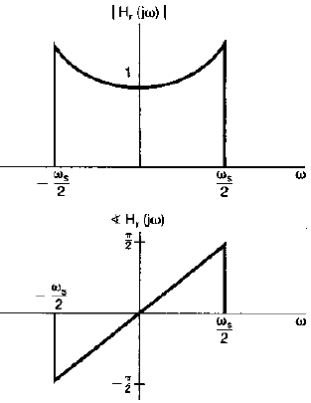

Slide 15
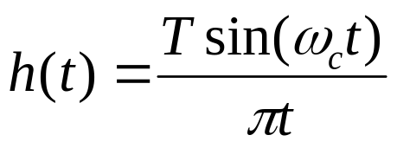
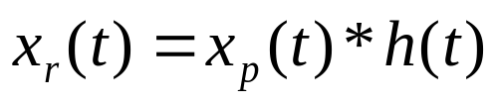
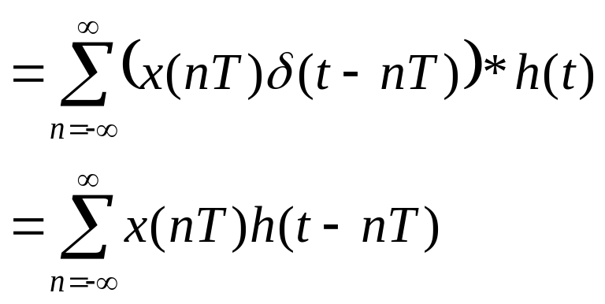
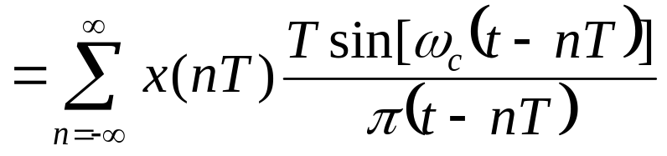
2 Reconstruction
Band-limited interpolation

Slide 16
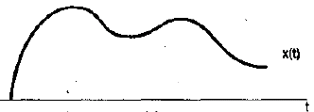
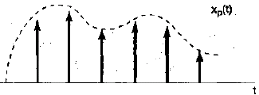
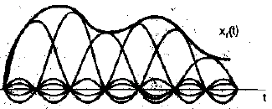
Original CT Signal
After sampling
After passing LPF
The LPF smoothes out shape and fill in the gaps

Slide 17
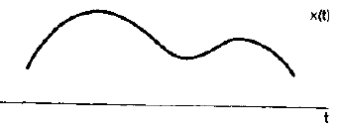
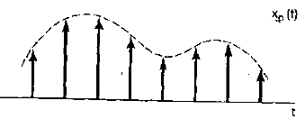
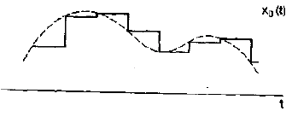
Zero-order hold
Original CT Signal
After sampling
After passing
zero-order hold

Slide 18
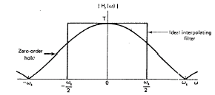
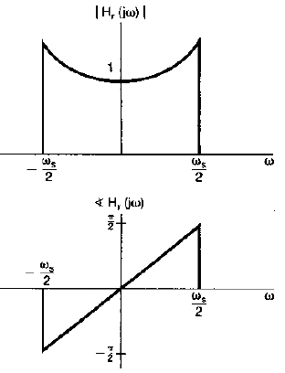
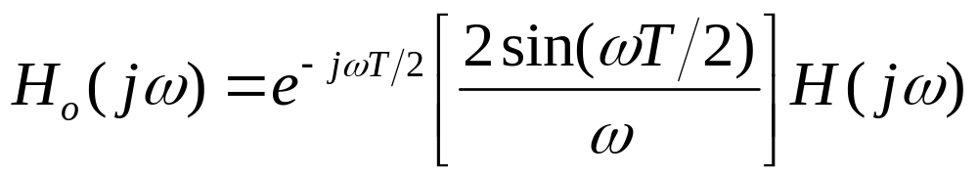
Zero-Order Hold
Zero-Order Hold
Recover Filter

Slide 19
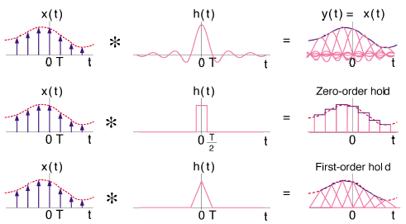
Excise: 7.5, 7.7

Slide 20
Summary
Sampling Theorem
Sampling and Reconstruction of Signal

