Slide 1
The Z-Transform

Slide 2
Contents
Introduction
z-Transform
Zeros and Poles
Region of Convergence
Important z-Transform Pairs
Inverse z-Transform
z-Transform Theorems and Properties
System Function

Slide 3
The Z-Transform
Introduction

Slide 4
Why Z-Transform?
A generalization of Fourier transform
Why generalize it?
  FT does not converge on all sequence
  Notation good for analysis
  Bring the power of complex variable theory deal with the discrete-time signals and systems

Slide 5
The Z-Transform
Z-Transform

Slide 6
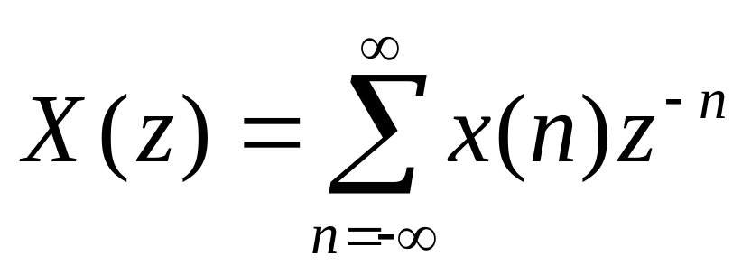
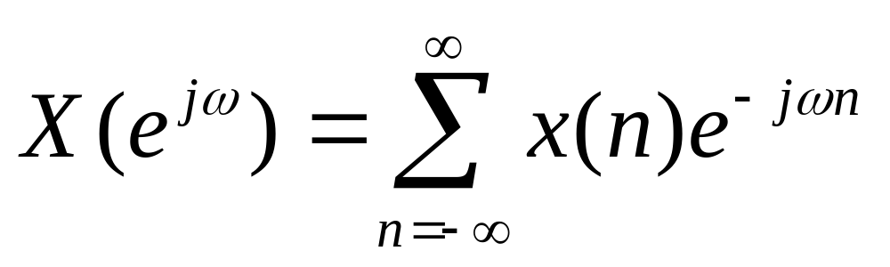
Definition
The z-transform of sequence x(n) is defined by
Fourier Transform
Let z = e^{−jω}.

Slide 7
Z-Plane
Im
z = e^{−jω}
ω
Re
Fourier Transform is to evaluate z-transform on a unit circle.

Slide 8
Z-Plane
Im
X(z)
z = e^{−jω}
ω
Re
Im
Re

Slide 9
Periodic Property of FT
X(e^{jω})
X(z)
−π
π
ω
Im
Re
Can you say why Fourier Transform is a periodic function with period 2π?

Slide 10
The Z-Transform
Zeros and Poles

Slide 11
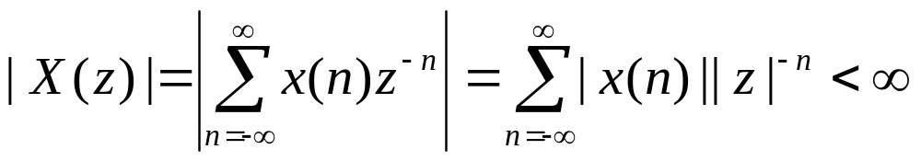
Definition
Give a sequence, the set of values of z for which the z-transform converges, i.e., |X(z)|<∞, is called the region of convergence.
ROC is centered on origin and consists of a set of rings.

Slide 12
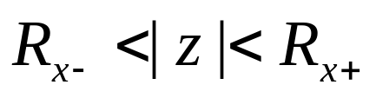
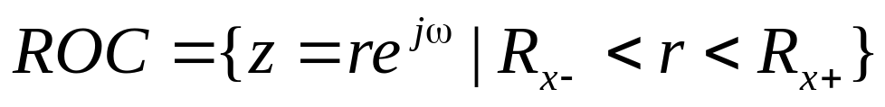
Example: Region of Convergence
Im
ROC is an annual ring centered on the origin.
r
Re

Slide 13
Stable Systems
A stable system requires that its Fourier transform is uniformly convergent.
Im
Fact: Fourier transform is to evaluate z-transform on a unit circle.
A stable system requires the ROC of z-transform to include the unit circle.
1
Re

Slide 14
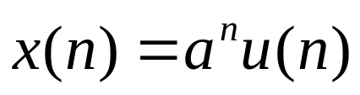
Example: A right sided Sequence
x(n)
. . .
n
-8
-7
-6
-5
-4
-3
-2
-1
1
2
3
4
5
6
7
8
9
10

Slide 15
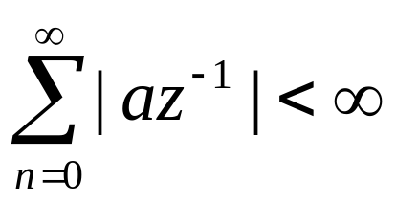
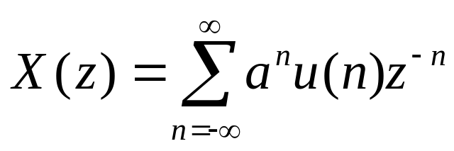
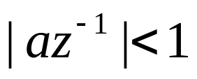
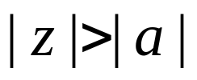
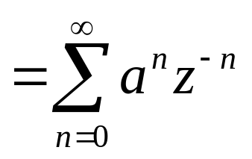
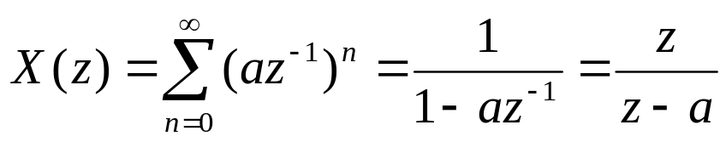
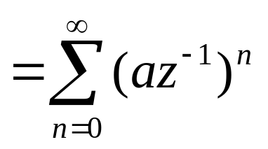

Example: A right sided Sequence
For convergence of X(z), we require that

Slide 16
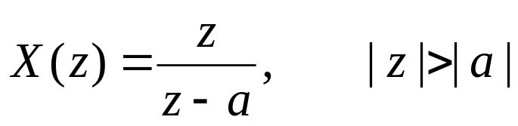
Example: A right sided Sequence ROC for x(n)=a^{n}u(n)
Which one is stable?
Im
Im
1
1
−a
a
−a
a
Re
Re

Slide 17
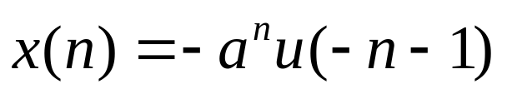
Example: A left sided Sequence
-8
-7
-6
-5
-4
-3
-2
-1
1
2
3
4
5
6
7
8
9
10
n
. . .
x(n)

Slide 18
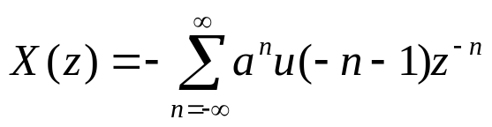
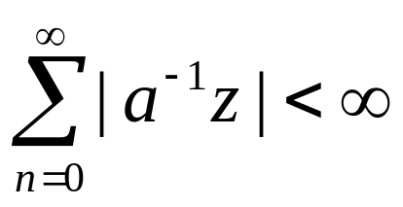
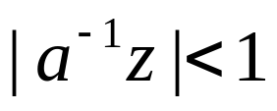
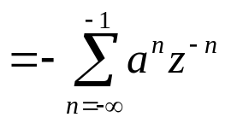
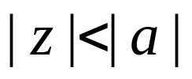
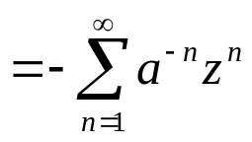
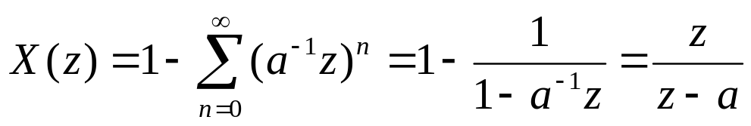
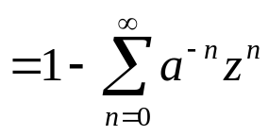

Example: A left sided Sequence
For convergence of X(z), we require that

Slide 19
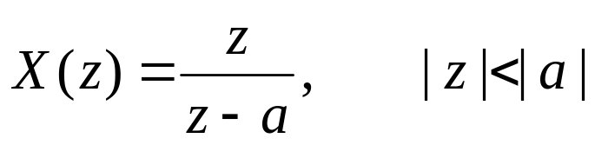
Example: A left sided Sequence ROC for x(n)=−a^{n}u(− n−1)
Which one is stable?
Im
Im
1
1
−a
a
−a
a
Re
Re

Slide 20
The Z-Transform
Region of Convergence

Slide 21
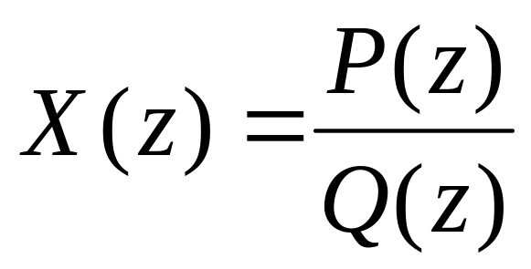
Represent z-transform as a Rational Function
where P(z) and Q(z) are polynomials in z.
Zeros: The values of z’s such that X(z) = 0
Poles: The values of z’s such that X(z) = ∞

Slide 22
Example: A right sided Sequence
Im
ROC is bounded by the pole and is the exterior of a circle.
a
Re

Slide 23
Example: A left sided Sequence
Im
ROC is bounded by the pole and is the interior of a circle.
a
Re

Slide 24
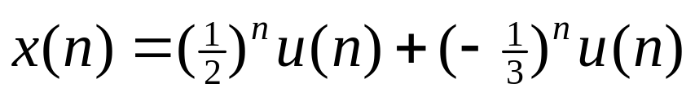
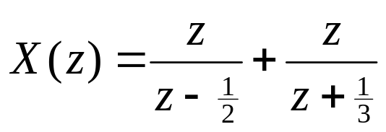
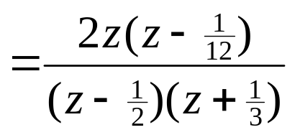
Example: Sum of Two Right Sided Sequences
Im
ROC is bounded by poles and is the exterior of a circle.
1/12
−1/3
1/2
Re
ROC does not include any pole.

Slide 25
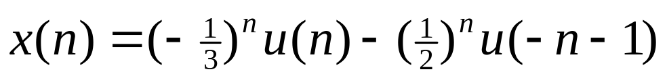
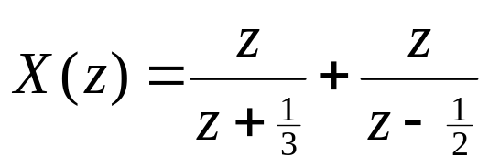
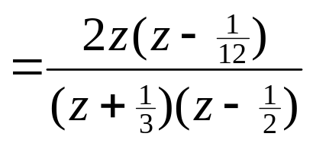
Example: A Two Sided Sequence
Im
ROC is bounded by poles and is a ring.
1/12
−1/3
1/2
Re
ROC does not include any pole.

Slide 26
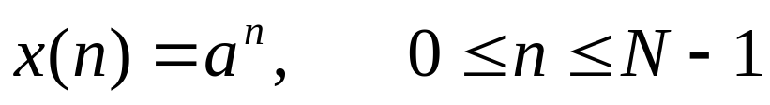
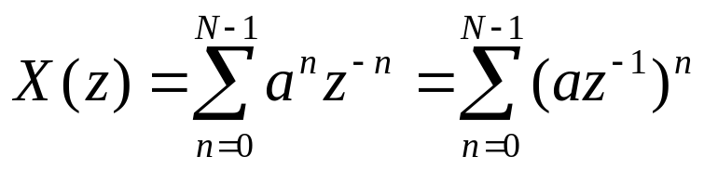
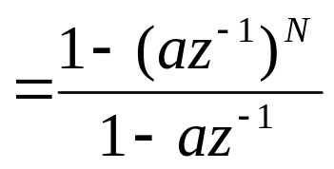
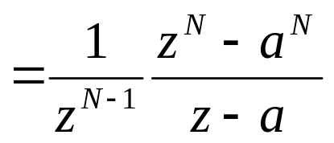
Example: A Finite Sequence
Im
N-1 zeros
ROC: 0 < z < ∞
ROC does not include any pole.
N-1 poles
Re
Always Stable

Slide 27
Properties of ROC
A ring or disk in the z-plane centered at the origin.
The Fourier Transform of x(n) is converge absolutely iff the ROC includes the unit circle.
The ROC cannot include any poles
Finite Duration Sequences: The ROC is the entire z-plane except possibly z=0 or z=∞.
Right sided sequences: The ROC extends outward from the outermost finite pole in X(z) to z=∞.
Left sided sequences: The ROC extends inward from the innermost nonzero pole in X(z) to z=0.

Slide 28
More on Rational Z-Transform
Consider the rational z-transform
with the pole pattern:
Im
Find the possible ROC’s
a
b
c
Re

Slide 29
More on Rational Z-Transform
Consider the rational z-transform
with the pole pattern:
Im
Case 1: A right sided Sequence.
a
b
c
Re

Slide 30
More on Rational Z-Transform
Consider the rational z-transform
with the pole pattern:
Im
Case 2: A left sided Sequence.
a
b
c
Re

Slide 31
More on Rational Z-Transform
Consider the rational z-transform
with the pole pattern:
Im
Case 3: A two sided Sequence.
a
b
c
Re

Slide 32
More on Rational Z-Transform
Consider the rational z-transform
with the pole pattern:
Im
Case 4: Another two sided Sequence.
a
b
c
Re

Slide 33
The Z-Transform
Important
z-Transform Pairs

Slide 34



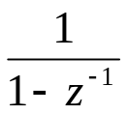




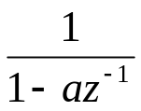




Z-Transform Pairs
Sequence
z-Transform
ROC
All z
All z except 0 (if m>0)
or ∞ (if m<0)

Slide 35
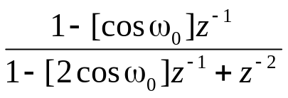

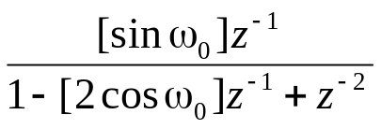

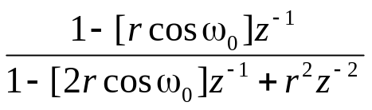


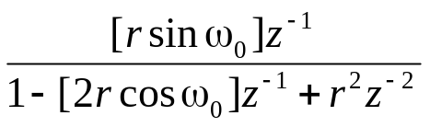

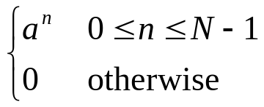
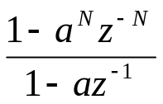

Z-Transform Pairs
Sequence
z-Transform
ROC

Slide 36
The Z-Transform
Inverse Z-Transform

Slide 37
The Z-Transform
Z-Transform Theorems and Properties

Slide 38
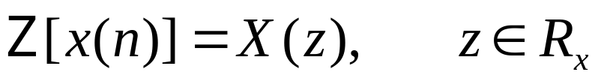
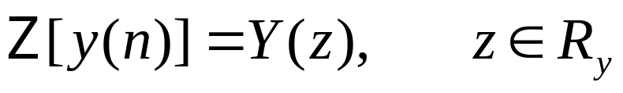
Linearity
Overlay of
the above two
ROC’s

Slide 39
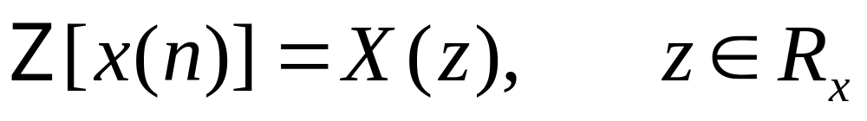
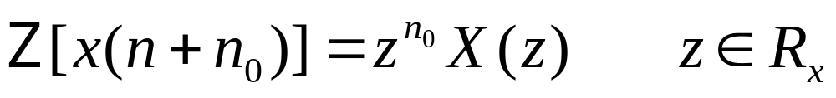
Shift

Slide 40
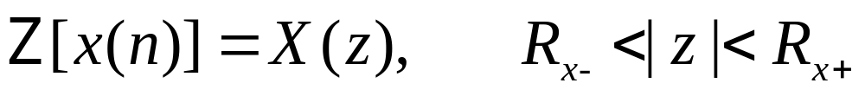
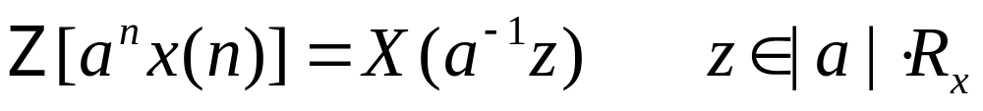
Multiplication by an Exponential Sequence

Slide 41
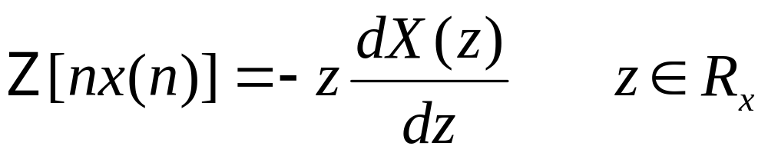
Differentiation of X(z)

Slide 42

Conjugation

Slide 43

Reversal

Slide 44
Real and Imaginary Parts

Slide 45


Initial Value Theorem

Slide 46

Convolution of Sequences

Slide 47





Convolution of Sequences

Slide 48
The Z-Transform
System Function

Slide 49
Shift-Invariant System
x(n)
y(n)=x(n)*h(n)
h(n)
H(z)
X(z)
Y(z)=X(z)H(z)

Slide 50

Shift-Invariant System
H(z)
X(z)
Y(z)

Slide 51



N^{th}-Order Difference Equation

Slide 52

Representation in Factored Form
Contributes poles at 0 and zeros at c_{r}
Contributes zeros at 0 and poles at d_{r}

Slide 53
Stable and Causal Systems
Causal Systems : ROC extends outward from the outermost pole.
Im
Re

Slide 54
Stable and Causal Systems
Stable Systems : ROC includes the unit circle.
Im
1
Re

Slide 55



Example
Consider the causal system characterized by
Im
1
a
Re

Slide 56



Determination of Frequency Response from pole-zero pattern
A LTI system is completely characterized by its pole-zero pattern.
Im
Example:
p₁
z₁
Re
p₂

Slide 57
Determination of Frequency Response from pole-zero pattern
|H(e^{jω})|=?
∠H(e^{jω})=?
A LTI system is completely characterized by its pole-zero pattern.
Im
Example:
p₁
z₁
Re
p₂

Slide 58
Determination of Frequency Response from pole-zero pattern
|H(e^{jω})|=?
∠H(e^{jω})=?
A LTI system is completely characterized by its pole-zero pattern.
Im
Example:
p₁
| |
φ₂
|H(e^{jω})| =
| |
| |
z₁
φ₁
φ₃
Re
∠H(e^{jω}) = φ₁−(φ₂+ φ₃ )
p₂

Slide 59

Example
dB
Im
a
Re

