Slide 1
Result Analysis
Louis-Benjamin Durocher (40045719)
Patricia Nunes (40006956)
Alan Giamatti (40041674)

Slide 2
database 1 results
Results (weighted avg) | GNB | Base MLP | Best MLP | PER | Base DT | Best DT
Precision | 0.75 | 0.39 | 0.88 | 0.80 | 0.55 | 0.56
Recall | 0.69 | 0.46 | 0.86 | 0.78 | 0.51 | 0.51
F1-Score | 0.69 | 0.38 | 0.86 | 0.77 | 0.50 | 0.51

Slide 3
database 2 results
Results (weighted avg) | GNB | Base MLP | Best MLP | PER | Base DT | Best DT
Precision | 0.75 | 0.83 | 0.87 | 0.84 | 0.78 | 0.75
Recall | 0.67 | 0.83 | 0.86 | 0.84 | 0.78 | 0.75
F1-Score | 0.68 | 0.82 | 0.86 | 0.83 | 0.78 | 0.75

Slide 4
Gaussian Naïve Bayes
Database 1:
The Gaussian Naïve Bayes is one of the fastest algorithms.
It had an average performance with the first database, with its 80 samples across 26 categories. This decent performance (3rd highest weighted average F1 score) is due to the fact the GNB is a very quick learning algorithm, often relying on less samples than its competing algorithms to produce good results.
However, it is the worst performer in the second database (the lowest weighted average F1-score). The weakness in performance is more comparative as anything, as the GNB does roughly the same across both databases. It highlights the fact that with fewer samples, the Naïve Bayes can do relatively more, but when there are enough samples, it is outperformed by other algorithms.
Results (weighted avg) | GNB | Ranking
Precision | 0.75 | 3rd
Recall | 0.69 | 3rd
F1-Score | 0.69 | 3rd
Database 2:
Results (weighted avg) | GNB | Ranking
Precision | 0.75 | 5/6th
Recall | 0.67 | 6th
F1-Score | 0.68 | 6th

Slide 5
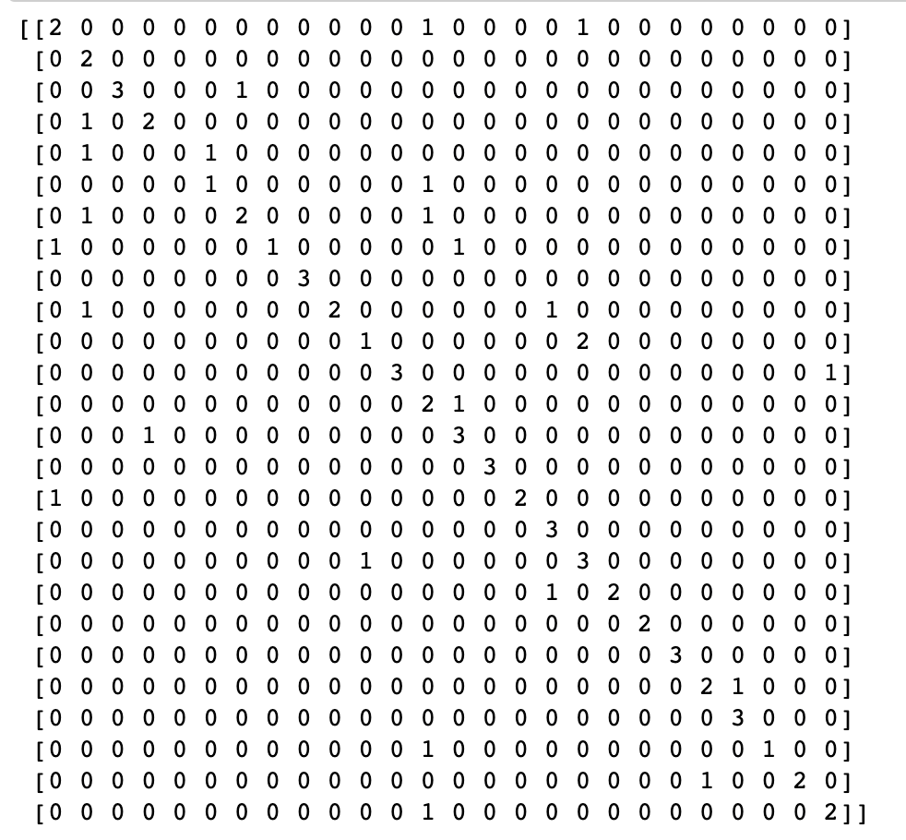
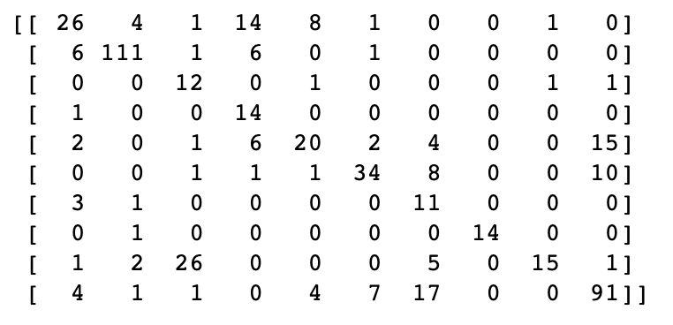
Gaussian Naïve Bayes
Confusion matrices
Database 2
Database 1

Slide 6
Gaussian Naïve Bayes
Overall, the mediocre level of general classification of the GNB originates from its assumption that all the attributes are mutually independent. While this basis often works decently, it must be highlighted that in the real-world, features are often quite dependent of each other. This is particularly true for character recognition.

Slide 7
baseline Decision Tree
From the results of the decision tree models created, the second model seems to have much better predictions, and overall has better performance in terms of recall, precision and f1-measure. This is most likely due to the high number of classes in DS1, as it has 26 classes in comparison to DS2, that only has 9. The decision tree will grow with a much higher complexity for DS1 because of the possible leaf nodes. Another thing to note is the training set for DS2 (7800) has much more instances in comparison to DS1 (1197). The larger amount of training instances enables the model to have a better prediction, and thus better performance overall.
Data Set 1:
The avg recall and avg precision is fairly low (~50%), therefore very few of the model's positive predictions are true and many of the positive values are never predicted.
Data Set 2:
Both the avg recall and avg precision were high (~80%).
Database 1:
Results (weighted avg) | GNB | Ranking
Precision | 0.55 | 4/5th
Recall | 0.51 | 5/6th
F1-Score | 0.50 | 5/6th
Database 2:
Results (weighted avg) | GNB | Ranking
Precision | 0.78 | 4th
Recall | 0.78 | 4th
F1-Score | 0.78 | 4th

Slide 8
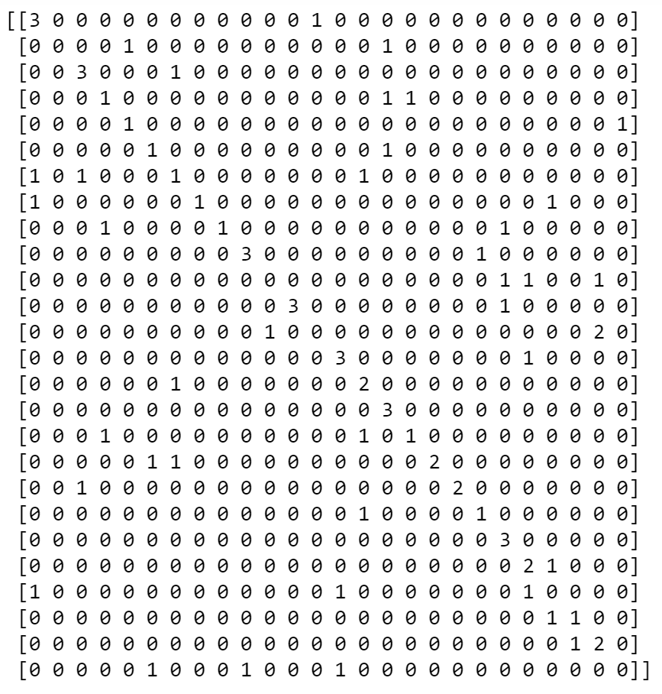
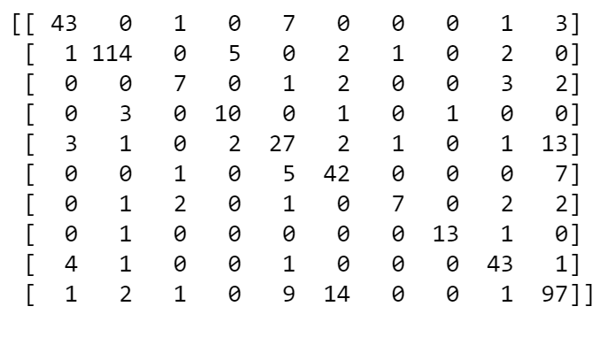
Base Decision trees
Confusion matrices
Database 2
Database 1

Slide 9
best Decision Tree
Database 1:
Results (weighted avg) | GNB | Ranking
Precision | 0.56 | 4/5th
Recall | 0.51 | 6th
F1-Score | 0.51 | 6th
The Best-DT models both performed worse in comparison to the Base-DT models
A possible reason that the Best-DT didn’t perform as well was because of the grid search with specific parameters, since it essentially computes the best tree with all the combinations provided by the parameters given to the classifier. Perhaps the parameters passed were not optimal vs the default parameters.
Database 2:
Results (weighted avg) | GNB | Ranking
Precision | 0.75 | 5/6th
Recall | 0.75 | 5th
F1-Score | 0.75 | 5th

Slide 10
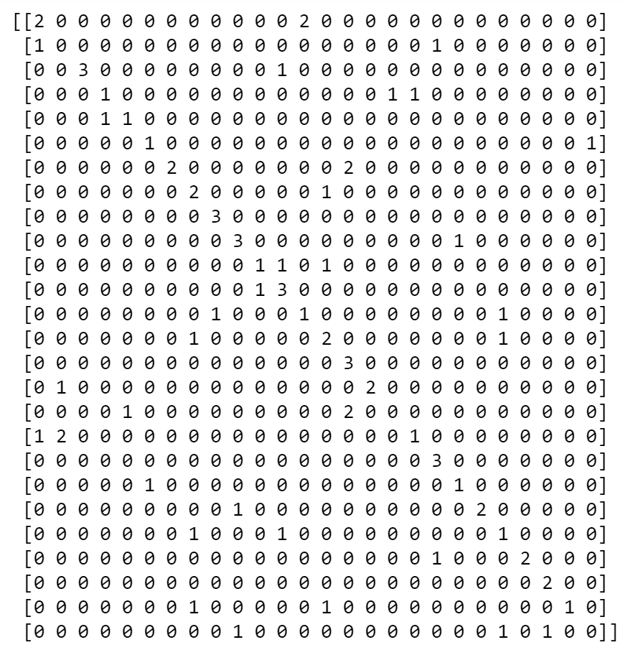
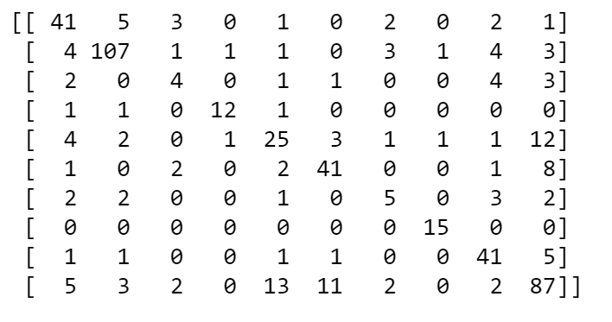
Best Decision trees
Confusion matrices
Database 2
Database 1

Slide 11
Perceptron
Database 1:
The Perceptron is one of the better performing algorithms across both databases (the 2nd best performing in fact). The default version of it as implemented in scikit-learn is a simple classification algorithm suited for smaller and larger databases as it showed across our first and second database. This default perceptron does not require a learning rate, it is not regularized and it only updates on mistakes.
The success of the Perceptron comes from the elegance of its simple weight correcting algorithm as well as the scalable power of using neural networks. The efficient implementation of the default perceptron in scikit-learn is also an important factor.
Results (weighted avg) | GNB | Ranking
Precision | 0.80 | 2nd
Recall | 0.78 | 2nd
F1-Score | 0.77 | 2nd
Database 2:
Results (weighted avg) | GNB | Ranking
Precision | 0.84 | 2nd
Recall | 0.84 | 2nd
F1-Score | 0.83 | 2nd

Slide 12
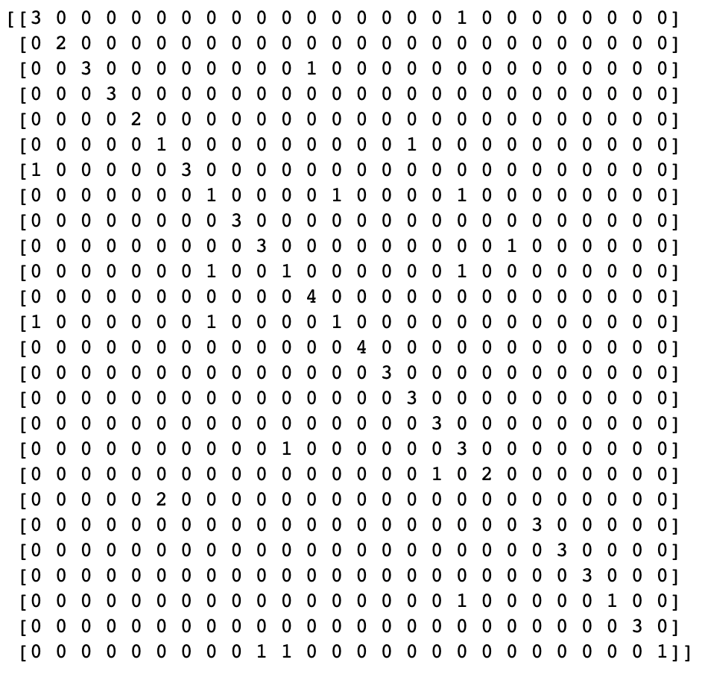
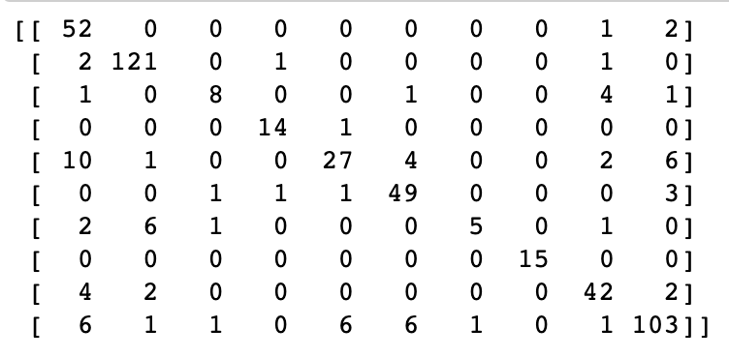
Perceptron
Confusion matrices
Database 2
Database 1

Slide 13
BASE Multi-Layered Perceptron
Database 1:
In terms of performance, the Base MLP were a mixed bag. The weighted F1 score was among the best with database 2, but by far the worst with database 1. This outlying value is likely due to very few cases given in the learning data set with this first database.
Results (weighted avg) | Base MLP | Ranking
Precision | 0.39 | 6th
Recall | 0.46 | 6th
F1-Score | 0.38 | 6th
Database 2:
Results (weighted avg) | Base MLP | Ranking
Precision | 0.83 | 3rd
Recall | 0.83 | 3rd
F1-Score | 0.82 | 3rd

Slide 14
BEST Multi-Layered Perceptron
Database 1:
The Best MLP, however, had by far the highest weighted average F1 score with both databases.
Finally, using parameter values, the best combination for the hyper-parameters was found for both datasets are as follows:
DS1: {'activation': 'identity', 'hidden_layer_sizes': (30, 50), 'solver': 'adam'}
DS2: {'activation': 'tanh', 'hidden_layer_sizes': (30, 50), 'solver': 'sgd'}
Aside from the suggested number of layers, the activation function and solver are completely different from another. For DS1, having the identity function is an appropriate activation function given the number of possible outcomes and having the Adam solver is perfect for this kind of dataset. For DS2, its chosen activation function is an interesting case since tanh activation function works best between two classes. However, it rejects any potential mis-labeled value. In DS2, the better solver was stochastic gradient descent due to its high variance in finding the local minima and efficiency memory wise.
Results (weighted avg) | Best MLP | Ranking
Precision | 0.88 | 1st
Recall | 0.86 | 1st
F1-Score | 0.86 | 1st
Database 2:
Results (weighted avg) | GNB | Ranking
Precision | 0.87 | 1st
Recall | 0.86 | 1st
F1-Score | 0.86 | 1st

Slide 15
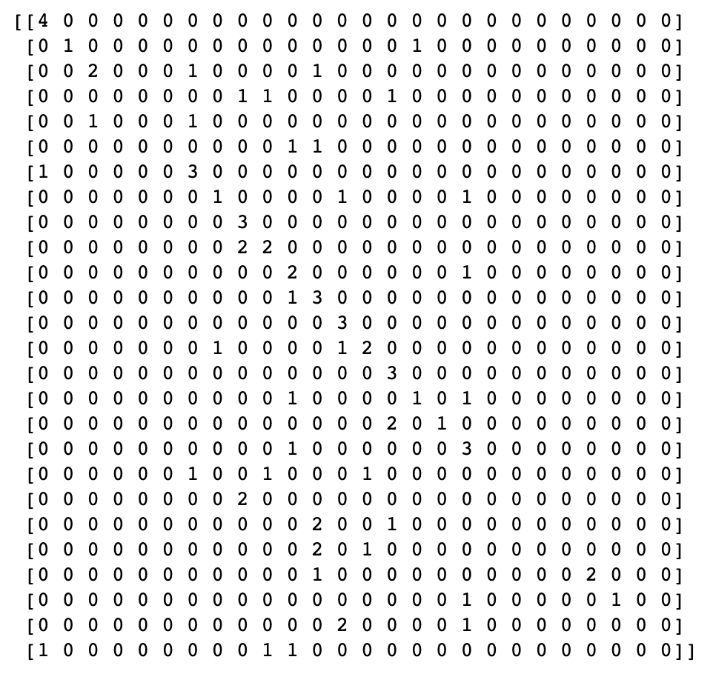
BEST Multi-Layered Perceptron
Confusion matrices
In the confusion matrices, our model made very few errors detecting alphabetical number given how no confused entry was greater than 1. However, it had a much harder time figuring the difference for the Greek letters. Indeed, the model confused the Greek letters delta (5) and Xi (9) with 15 total missed cases. This can be due to how these values share a familiar shape. This applies to the base-MLP as well.
Database 1

Slide 16
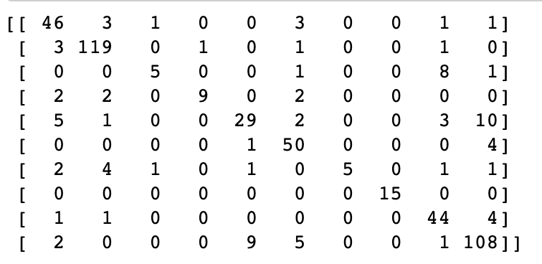
BEST Multi-Layered Perceptron
Confusion matrices
In the confusion matrices, our model made very few errors detecting alphabetical number given how no confused entry was greater than 1. However, it had a much harder time figuring the difference for the Greek letters. Indeed, the model confused the Greek letters delta (5) and Xi (9) with 15 total missed cases. This can be due to how these values share a familiar shape. This applies to the base-MLP as well.
Database 2

