Slide 1
Result Analysis
Louis-Benjamin Durocher (40045719)
Patricia Nunes (40006956)
Alan Giamatti (40041674)

Slide 2
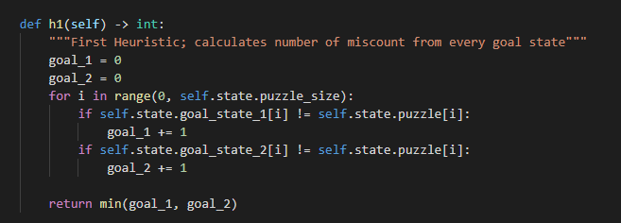
Heuristics
HEURISTIC ONE:
Modified Hamming Distance
Check two goal states vs. one
Admissible, never overestimates h(n) from beginning to end
Consistent (Monotonic), it never overestimates the h(n) for any state

Slide 3
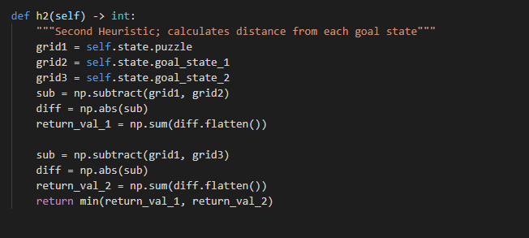
Heuristics
HEURISTIC TWO:
Modified Manhattan Distance
Instead of calculating the distance, we calculate the difference between the tiles
Admissible: underestimates the actual cost
Not Consistent (Not Monotonic)

Slide 4
Analysis of algorithms
Analysis Parameters | Uniform Cost | GBFS H1 | GBFS H2 | A* H1 | A* H2
Total length of search | 251367 | 2443 | 16546 | 4144 | 15884
Total length of solution | 476 | 1573 | 3133 | 643 | 737
Total number of no solution | 38 | 0 | 0 | 0 | 0
Total cost | 58 | 1686 | 3877 | 110 | 154
Total execution time | 2440 | 0.715 | 14.7 | 3.45 | 36.8
Avg length of search | 5027.34 | 48.86 | 330.92 | 82.88 | 317.68
Avg length of solution | 9.52 | 31.46 | 62.66 | 12.86 | 14.74
Avg number of no solution | 0.76 | 0.0 | 0.0 | 0.0 | 0.0
Average cost | 1.16 | 33.72 | 77.54 | 2.2 | 3.08
Average execution time | 48.7 | 0.0143 | 0.294 | 0.0689 | 0.736

Slide 5
Analysis of algorithms scaled up
Analysis Parameters | 3x3 | 4x4 | 3x5
Total length of search | 322 | 9693 | 9972
Total length of solution | 158 | 2063 | 1815
Total number of no solution | 0 | 0 | 0
Total cost | 70 | 638 | 382
Total execution time | 0.230 | 53.5 | 64.6
Avg length of search | 64.4 | 1938.6 | 1994.4
Avg length of solution | 31.6 | 412.6 | 363.0
Avg number of no solution | 0.0 | 0.0 | 0.0
Average cost | 14.0 | 127.6 | 76.4
Average execution time | 0.0460 | 10.7 | 12.9

