Slide 1
Assignment 3 Presentation
COMP 472
Louis-Benjamin Durocher (40045719)
Patricia Nunes (40006956)
Alan Giamatti (40041674)

Slide 2
Architecture
DataSet:
Contains the Tweets (documents) and individual TweetWords as well as vital data set statistics
Tweet:
Contains tweet information: ID, text and label
Main Classes:
DataSet
Tweet
TestingTweet
TweetWord
TweetWord:
Contains unique word statistics such as the string, its reoccurrences in the training set and the word’s probabilities
TestingTweet:
The class for the testing tweet/document.
Also the tweet document’s estimated yes/no probabilities

Slide 3
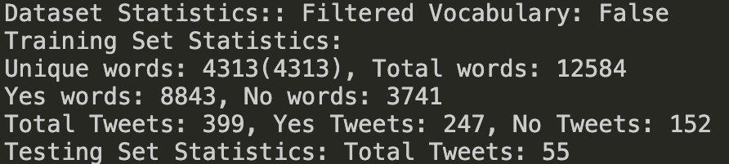
Create a DataSet Object
Load training data into the DataSet by creating a Tweet Object for every line of the training document (representing the Tweet ID, Tweet string and Tweet label)
The append_training_set() method will split the string based on spaces, and transform it to lower-case
If a word is new, a new TweetWord object is created for it; otherwise, an existing TweetWord object is updated
The TweetWord set is held by the DataSet object
Load the testing data into the DataSet object by creating a TestingTweet Object for every line of the testing document
The TestingTweet object holds a TweetWord list and yes/no probabilities in addition to parameters inherited from its parent (Tweet)
These are necessary for making label predictions
The append_testing_set() method will detect known words and add it to the TestingTweet’s TweetWord list.
The DataSet’s calc_total_cond_probability() calculates all of the yes/no probabilities for the entire vocabulary by going through its TweetWord list of unique_words, and passing down the known number of x class documents, and the total vocabulary size.
Architecture In Action
DataSet object printed after Step 3

Slide 4
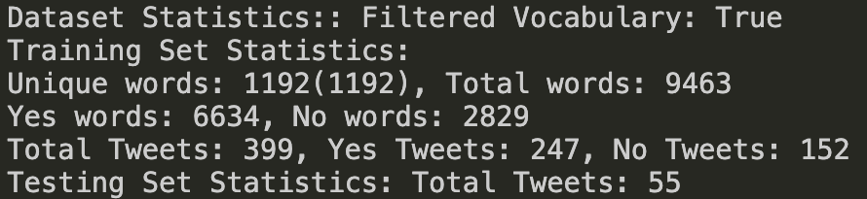
5. calc_testing_prob() DataSet method uses the previously calculated word probabilities to go through the testing documents list, and passing down the yes/no class priors and going through the TestingTweet word list to calculate the yes/no probabilities of a TestingTweet.
6. write_trace_and_eval_files() function traverses the DataSet’s testing documents list and the highest yes/no probability determines the predicted label.
7. determine_correctness() function compares the predicted label to the true label and updates the true positive, false positive, true negative and false negative accordingly.
8. The trace file is generated during this traversal.
9. Once the traversal is finished, the true positive, false positive, true negative and false negative are used to generate the statistics for the evaluation file.
10. Filtered vocabulary is implemented through the DataSet’s implement_filtered_vocabulary() method which goes through the unique_words list and deletes words with less than 2 usage, and updates all the other metrics correctly.
11. Steps 4-9 are repeated for the filtered vocabulary.
Architecture In Action
DataSet object printed after Step 10

Slide 5
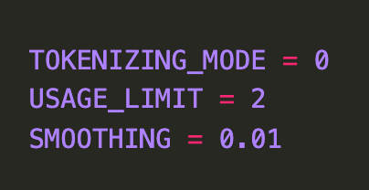
Architecture: Additional parameters

Slide 6

Initial data set
Since Naïve Bayes Model is heavily based on probability, this skew of the training set will influence its testing performance through the priors

Slide 7
Analysis of ov and fV
 | Original Vocabulary | Filtered Vocabulary
Total Words | 12584 | 9463
Unique Words (Vocabulary) | 4313 | 1192
Yes Words | 8843 | 6634
No Words | 3741 | 2829

Slide 8
Analysis of the difference between vocabulary
 | NB-BOW-OV | NB-BOW-FV
Accuracy | 0.6727 | 0.7455
Per-Class Precision (Yes-P) | 0.6666 | 0.7209
Per-Class Precision (No-P) | 0.7 | 0.8333
Per-Class Recall (Yes-P) | 0.9091 | 0.9394
Per-Class Recall (No-P) | 0.3182 | 0.4545
F1-measure (Yes-P) | 0.7692 | 0.8158
F1-measure (No-P) | 0.4375 | 0.5882

Slide 9
Results of the three models
 | NB-BOW-OV | NB-BOW-FV | LSTM-W2V
Accuracy | 0.6727 | 0.7455 | 0.7778
Per-Class Precision (Yes-P) | 0.6666 | 0.7209 | 0.7561
Per-Class Precision (No-P) | 0.7 | 0.8333 | 0.8462
Per-Class Recall (Yes-P) | 0.9091 | 0.9394 | 0.9394
Per-Class Recall (No-P) | 0.3182 | 0.4545 | 0.5238
F1-measure (Yes-P) | 0.7692 | 0.8158 | 0.8378
F1-measure (No-P) | 0.4375 | 0.5882 | 0.6471

Slide 10
EFFECT of IGNORING PUNCTUATION
 | NB-BOW-FV | NB-BOW-FV (better tokenization)
Accuracy | 0.7455 | 0.7636
Per-Class Precision (Yes-P) | 0.7209 | 0.7632
Per-Class Precision (No-P) | 0.8333 | 0.7647
Per-Class Recall (Yes-P) | 0.9394 | 0.8788
Per-Class Recall (No-P) | 0.4545 | 0.5909
F1-measure (Yes-P) | 0.8158 | 0.8169
F1-measure (No-P) | 0.5882 | 0.6667
Note:
Ignoring punctuation also had better effects with OV

Slide 11
EFFECTs of Harsher Filtering
 | NB-BOW-FV (filter words with less than 2 usage) | NB-BOW-FV+ (filter words with less than 3 usage)
Accuracy | 0.7455 | 0.7091
Per-Class Precision (Yes-P) | 0.7209 | 0.7073
Per-Class Precision (No-P) | 0.8333 | 0.7143
Per-Class Recall (Yes-P) | 0.9394 | 0.8788
Per-Class Recall (No-P) | 0.4545 | 0.4545
F1-measure (Yes-P) | 0.8158 | 0.7838
F1-measure (No-P) | 0.5882 | 0.5555
Note:
Harsher filtering also had slightly negative effects with OV

Slide 12
EFFECTs of Different Smoothing
 | NB-BOW-OV (with 0.01 smoothing) | NB-BOW-OV (with 0.1 smoothing)
Accuracy | 0.6727 | 0.7273
Per-Class Precision (Yes-P) | 0.6666 | 0.7143
Per-Class Precision (No-P) | 0.7 | 0.7692
Per-Class Recall (Yes-P) | 0.9091 | 0.9091
Per-Class Recall (No-P) | 0.3182 | 0.4545
F1-measure (Yes-P) | 0.7692 | 0.8
F1-measure (No-P) | 0.4375 | 0.5714
Note:
0.1 smoothing with FV had slightly negative effects (compared to 0.01 smoothing)

Slide 13
Division of tasks
Component logic: aLAN
I/o and probabilities: Louis-Benjamin and patricia
Presentation: all
Analysis: All

