Slide 1
GPRO
Oven Automation System(OASYS)

Slide 2
Key Feature
Automated Oven Temperature Measurement, Tracking & Display.
  1 measurement point per chamber
  Automated real-time temperature profile comparison with preset profile based on Lot ID Type and etc
  Alarm Triggering for excursions. Excursions are defined by :
a. Guard Band for desired temperature profile.
b. Time limit for each segment of temperature profile.
  Alarm Output : Lamp for each oven and one central buzzer
  Email or SMS alarm (Optional)
Lot ID tracking using Hand Held Data Collector barcode, for lots loaded/unloaded into ovens.
Oven Door Inter-Lock System
Oven Over Temperature Heating Cut-Off
Maintenance Scheduling Capabilities
24/7 system running
Connect to IFBT protocol for easy monitoring

Slide 3
Added Feature
Other feature, base on cutomer requierement can be added during Software Design

Slide 4
Features/Capabilities
Web-based graphical user interfaces for
  Oven Status Live Monitoring (Running, Standby, Shut-Down)
  Plotting each oven’s current temperature profile
  Current Lots/Magazines loaded into each oven
  Etc.
Oven Chamber START/STOP Times Tracking.
Remote View
Database of Temperature Profile
Available for database tracking

Slide 5
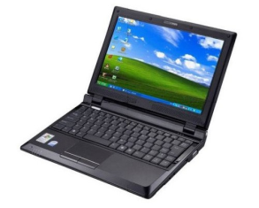

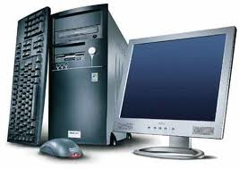


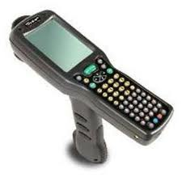
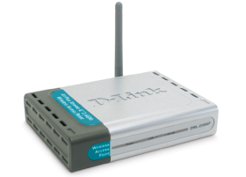

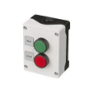
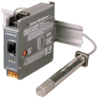
Graphical Display
‘Live Status Monitor”
Alarm :
Lamp, Buzzer, Email Allert
PC Monitoring System and Event Display.
Database logger and Webserver
Hand Held Data Collector
Ethernet Switch
Oven Control and Data Acquistion Box:
Include :
DAQ Module and sensor
I/O Box for :
Door Lock System
Over Temperature Cutting Off
Maintenance Scheduler
Oven 1
Oven 2
Oven 3
Oven 4
Oven N

Slide 6
Key Components
Infrastructure
Data Storage
Oven Monitoring/Display System
Production Report
Interface to MES

Slide 7
Infrastructure
Proven, Reliable Network, Based on Ethernet
Supports interfaces to
  Ovens
  I/O Devices (Include door lock, or customer request
Extensible for
  Longer Distances
  Additional connection points (nodes)

Slide 8
Data Storage (Oven Database)
Temperature readings from each oven chamber sampled at K samples/minute & stored in a database
User defined temperature profile for each material type is also stored accordingly.
  Includes profile with guard band.
  Includes time limit for each profile segment.
The LOT ID (and optionally Magazine ID) data will also be stored in a central database for access by other factory systems.
Available for Database Tracking
Power backup for PC System monitoring and database

Slide 9
Oven Monitoring System
Each oven chamber will be monitored for
  START/STOP of program (pattern)
  Temperature Profile (Curve)
Alarms will be triggered for the following conditions
  Deviation of Product Temp. from Profile Range.
  Overtemp, Overcure
Capture of Operator ID, Lot ID, Magazine ID, etc. from barcode scanners.
Interface to Oven Database, MES (Optional)

Slide 10
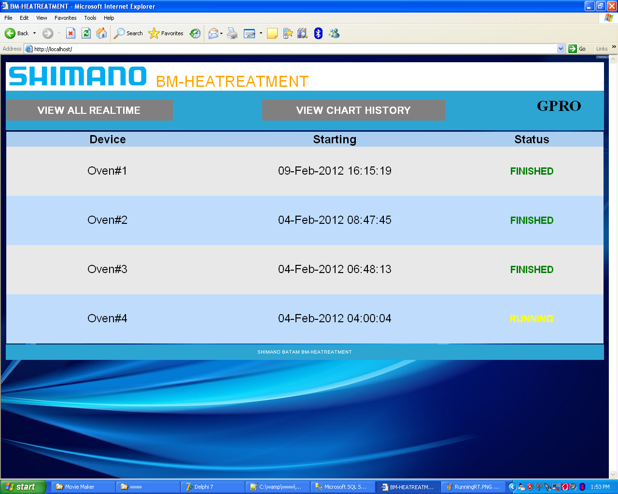
Sample Project
Home Page of Client Monitoring
(Can be customized base on customer request

Slide 11
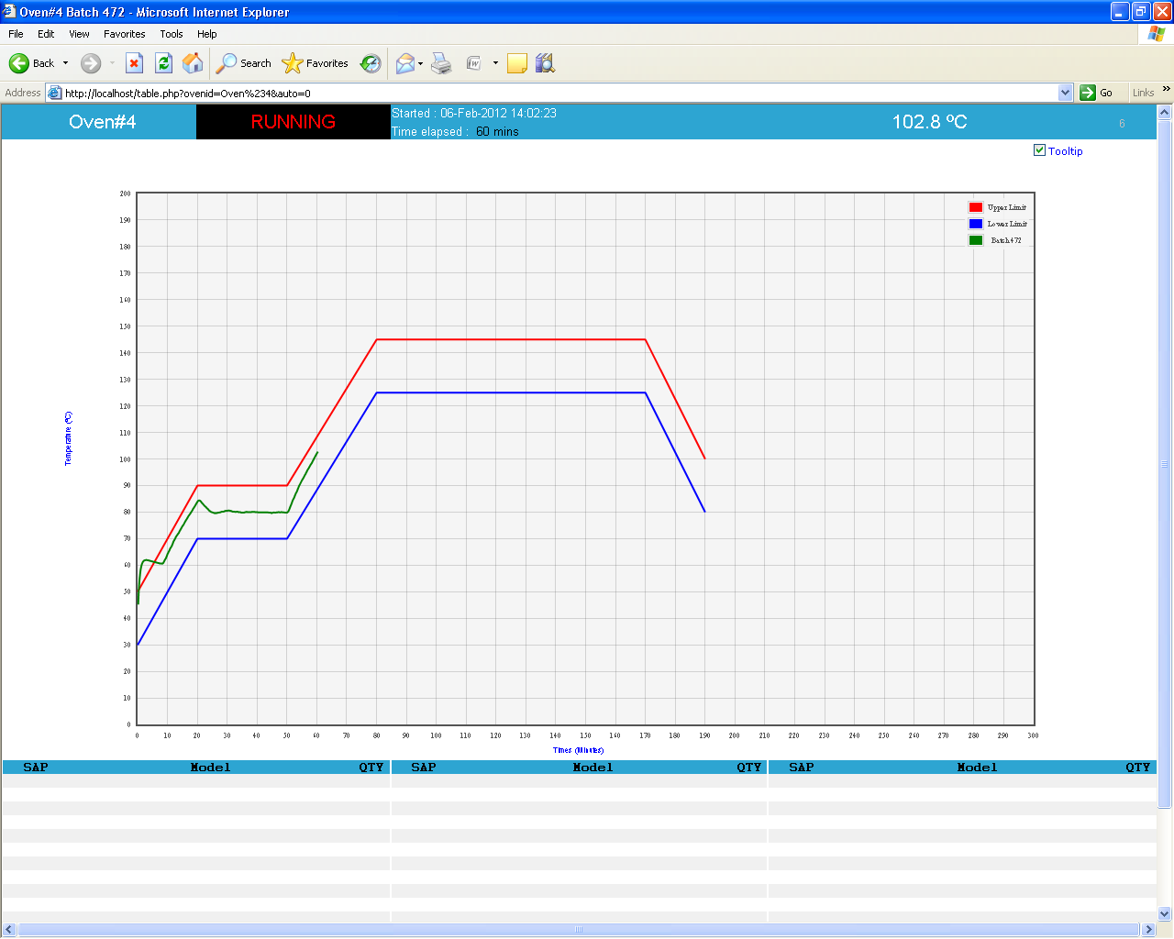
Temperature Logging Process (seen at Server or Client PC)

Slide 12

Temperature Logging FINISH

Slide 13
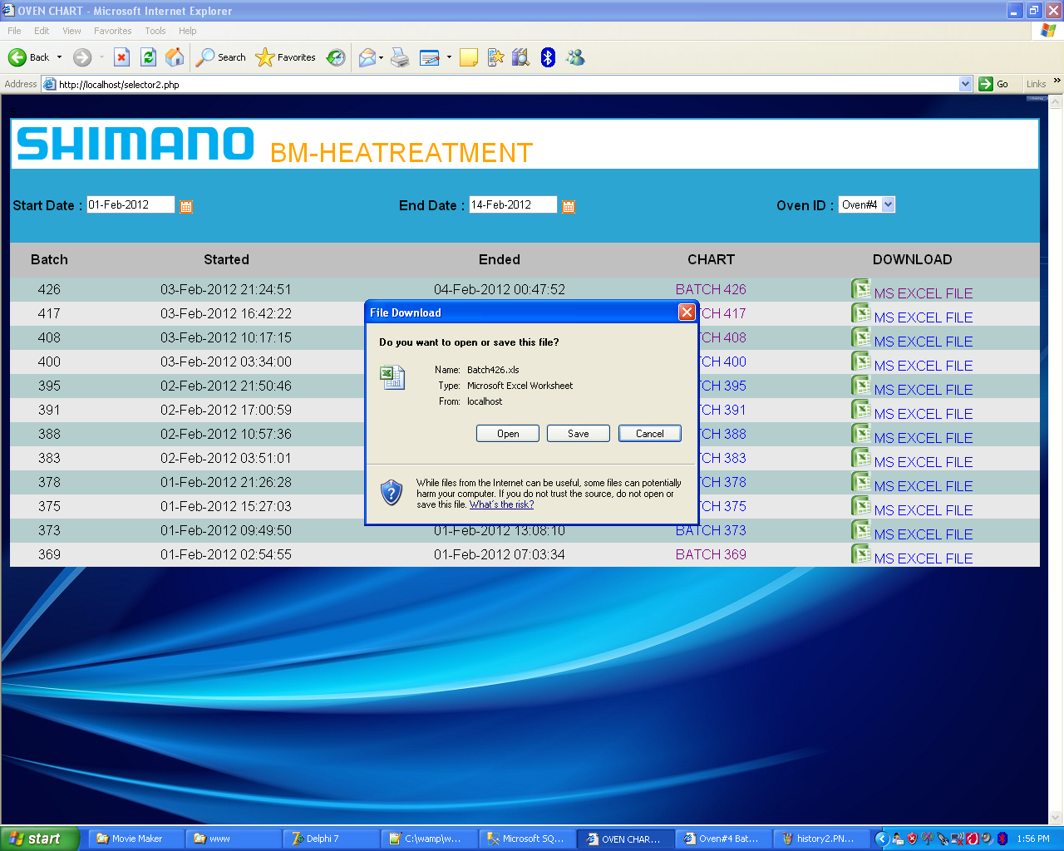
History Data Download Option

Slide 14
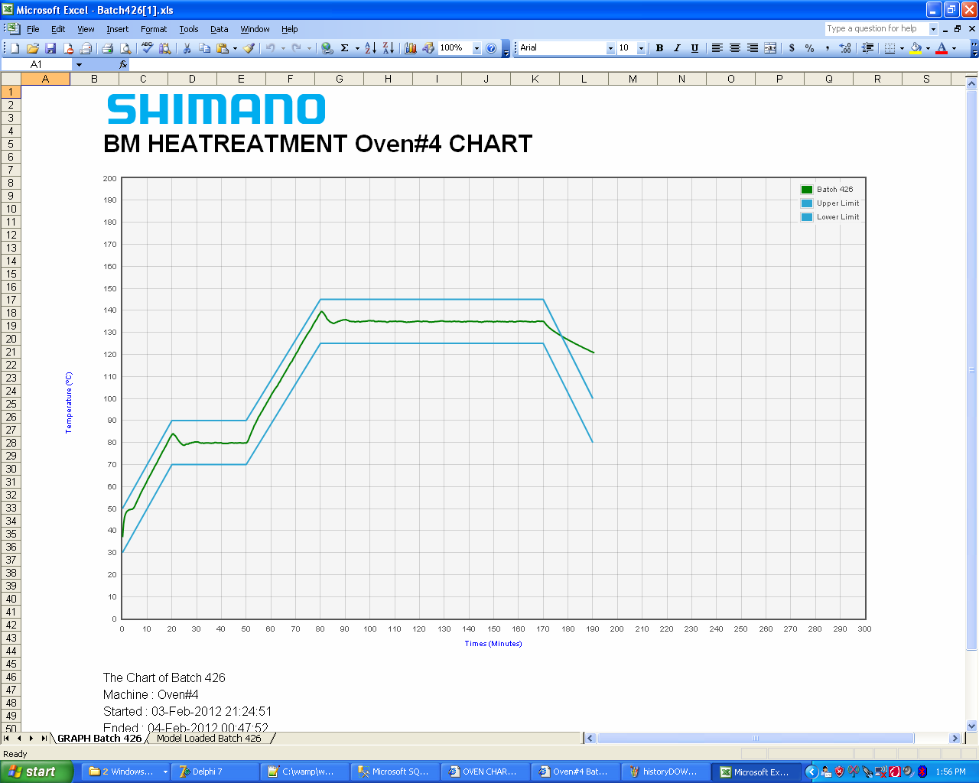
History Data View

Slide 15
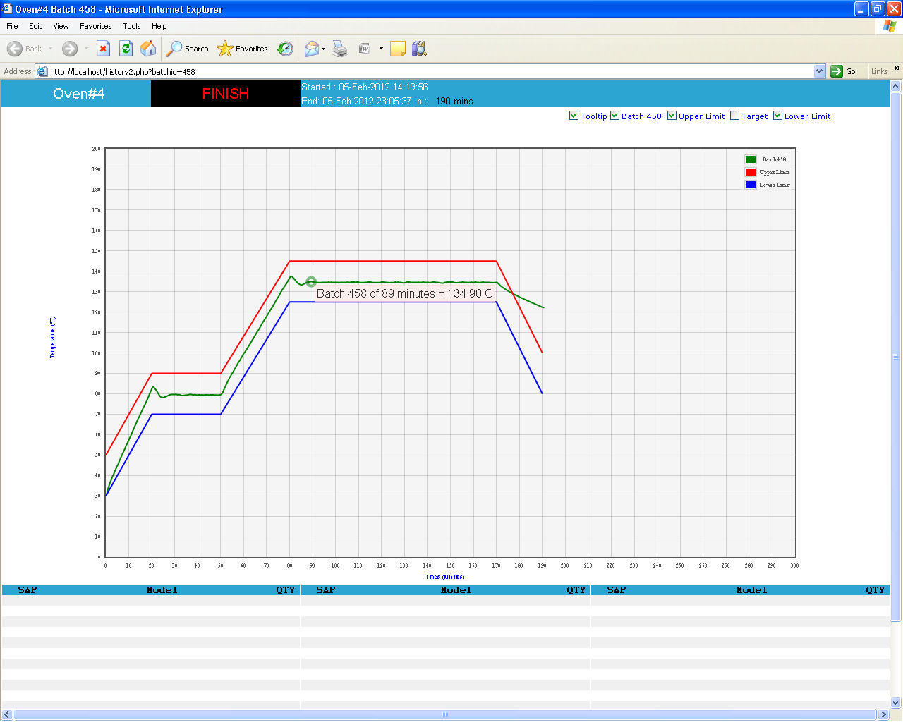
History Data Tool Tips

Slide 16
Production Report
Production Report will be provided base on customer requirement.
This is our sample feature
A temperature profile (curve) graphing and plotting tool will be provided to enable the profile for each oven chamber to be viewed and printed as necessary, along with relevant information such as epoxy type & Lot IDs in that chamber.
(Optional) Printing of report on a label for sticking to traveler, with the following info:
  Date
  Employe number (If ID Card using barcode system)
  Lot Number
  Oven ID

Slide 17
Project Implementation
Ethernet Network Setup
  Installation of hardware on oven:
  Thermocouple
  Interface Box(es)
  Interface to START/STOP Switches
Software Development/Customization
Installation & Training

