Slide 1
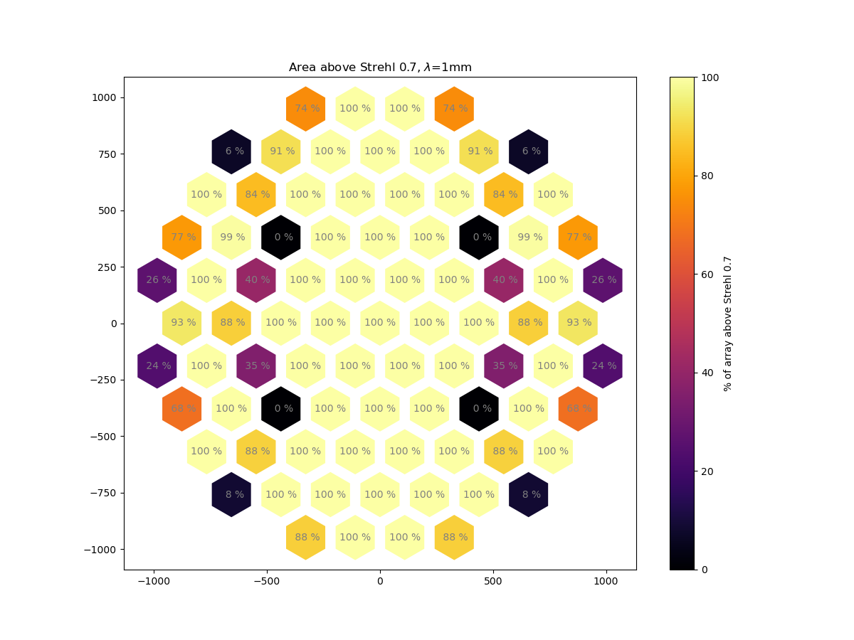
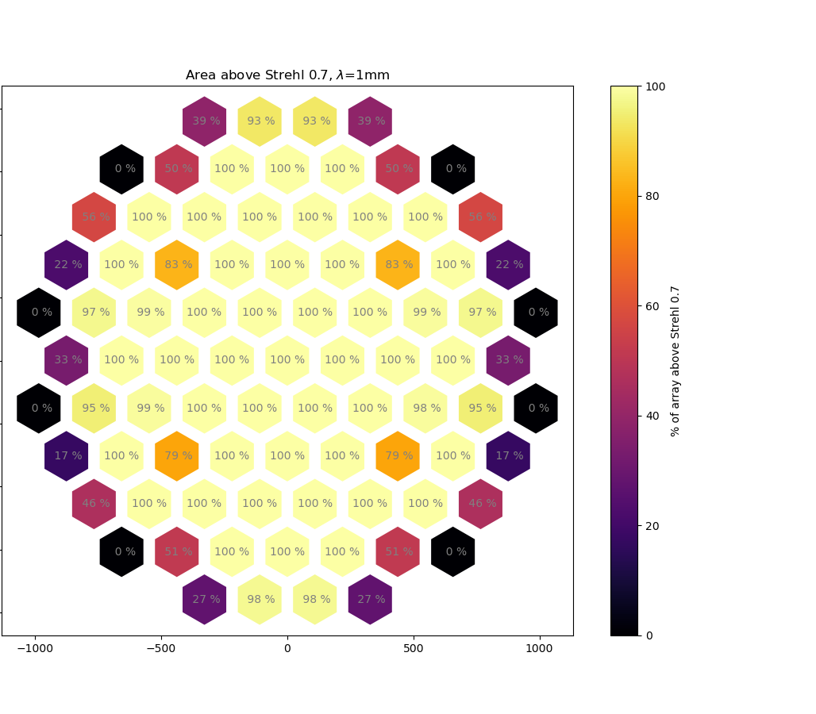
Xy_symmetric_alternative.zmx
Xy_symmetric.zmx
*
*
*
*
*
*
*
*
*
*
*
*
*
*
*
*

