Slide 1
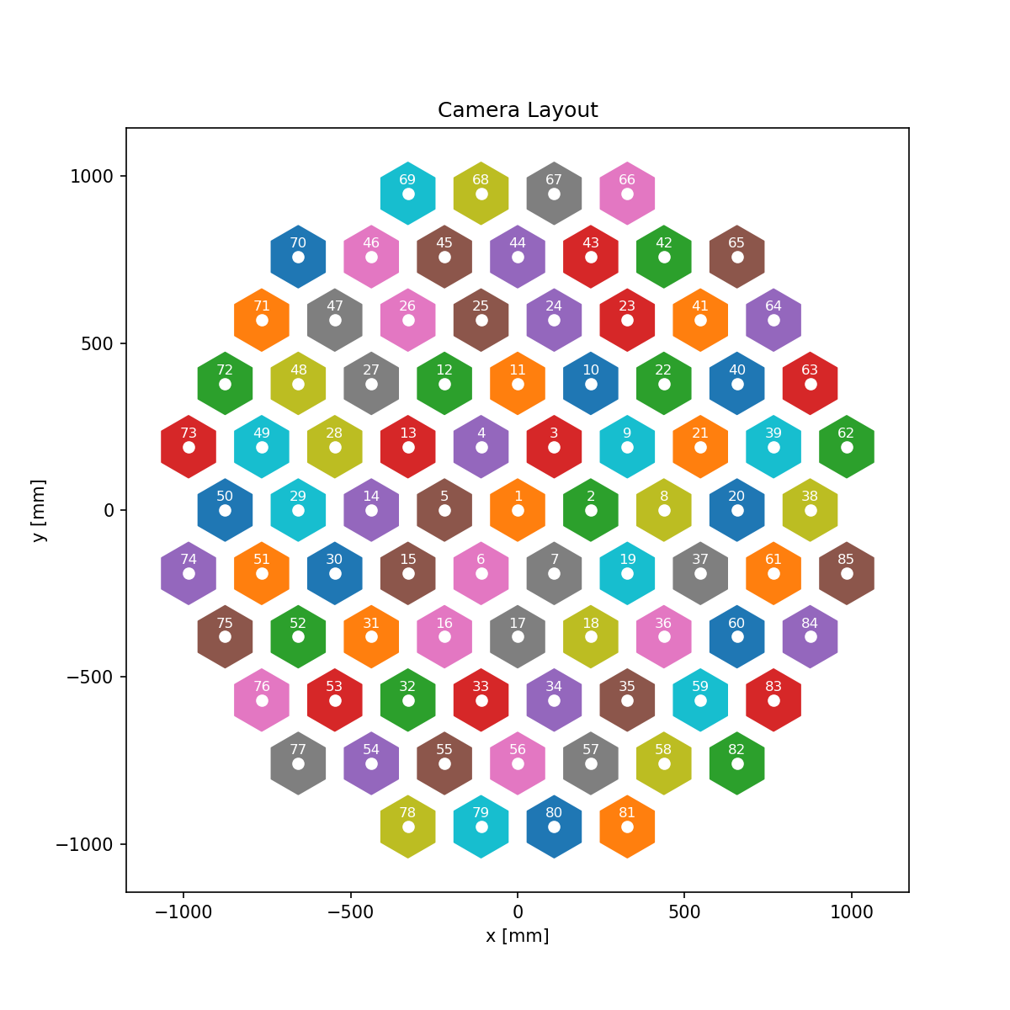
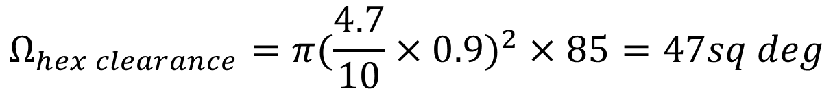


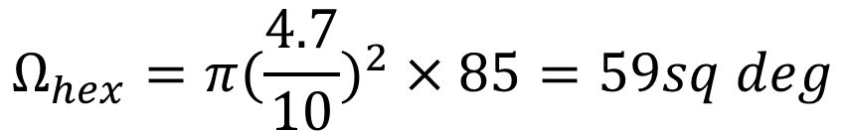

$$Ω_{TMA}=π{4.7}^{2}=69.4sq deg$$
$$Ω_{hex}=π(\frac{4.7}{10})^{2}×85=59sq deg$$
$$Ω_{hex clearance}=π(\frac{4.7}{10}×0.9)^{2}×85=47sq deg$$
$$Ω_{TMP cam beta1}=π(0.38)^{2}×85=38.5sq deg$$
$$R$$
$$r$$
 | Camera semi-fov [deg]
Hex (no clearance) | 0.47
Hex (clearance) | 0.42
TMP cam beta 1 | 0.38
$$10r$$

