Slide 1
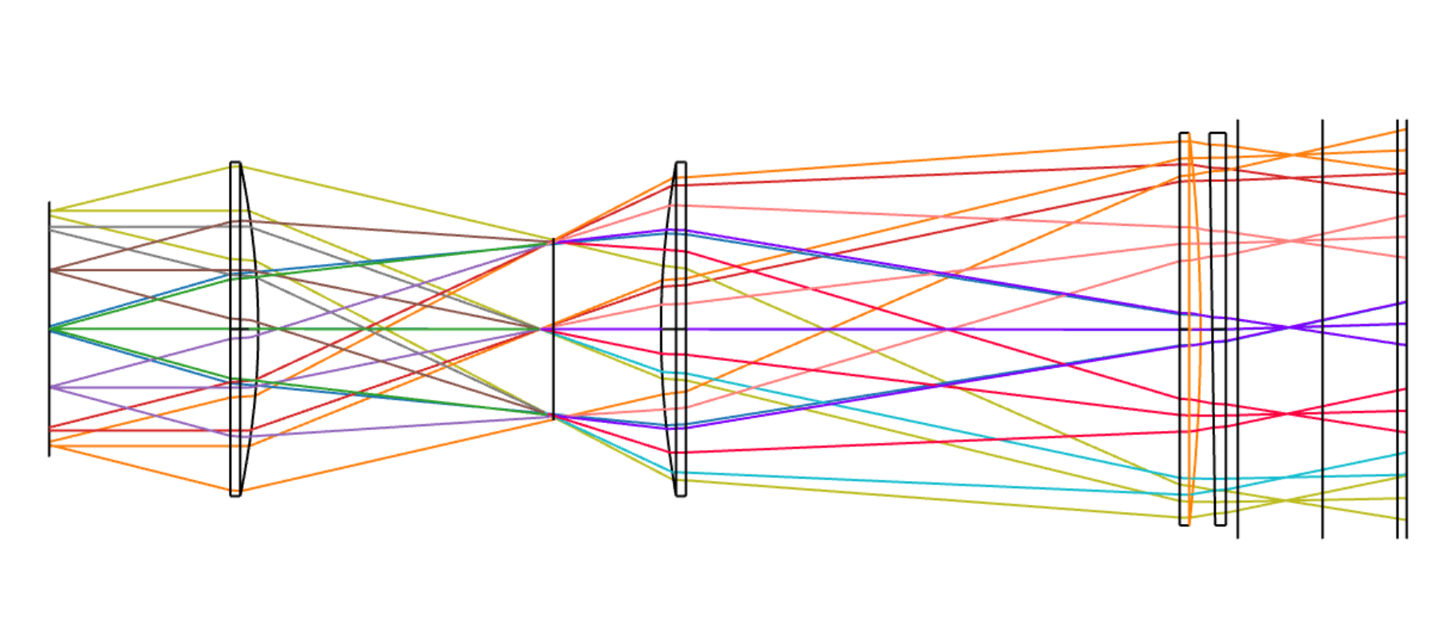
Prism
L3
L1
L2
Zotefoam stack
Window
Metal plate

