Slide 1

INVESTIGATING HOW CHANGES IN ELECTRODERMAL ACTIVITY AFFECT THE PERCEPTION OF ELECTROTACTILE STIMULATION
Patrick Kiehlmann 2623719k

Slide 2
Topics of discussion
Motivation and Aims for this project
What is electrotactile feedback, why should we research this
What is Electrodermal activity, how does it relate to electrotactile feedback
Design of the experiment
Demonstration of the experiment
Findings from the User study
Areas for future research

Slide 3
Motivation and aims
Electrotactile feedback is hard to calibrate / recalibrate when skin conditions change, research has been done into real time calibration by measuring skin impedence. However this is clunky and not very portable.
EDA measuring has been around for a while and can be made portable.
Can we align changes in perceived electrotactile feedback to changes in EDA

Slide 4
What is electrotactile feedback?
Involves stimulating the mechanoreceptors using a controlled current to elicit a sensation in the skin.
Can be administered in different ways, bare metal electrodes vs hydrogel electrodes, different ways of aligning a number of electrodes
Can be customized to create distinct cues, called electrotactons. (Alotaibi, Yousef, 2023)

Slide 5
What is Electrodermal Activity
It is the measure of skin conductivity
Occurs because of the Sympathetic nervous system,
Consists of two signals a tonic and phasic, SCL and SCR
Is measured by sending a very small current (imperceptible) through the surface of the skin, and measuring the voltage drop between electrodes.

Slide 6
Experiment design
Within-subjects where participants experienced four different conditions
Taking a baseline calibration, then conducting a task that should lower electrodermal activity
Choosing both a mental stressor and a physical stressor
Recording data on non-dominant hand, stimulating on right, as users needed to interact with the laptop

Slide 7
Demonstration

Slide 8
Findings from User study
The majority (7/11) experienced EMS before hitting their pain threshold
3 participants hit their pain threshold
1 participant reached the max input comfortably
We were able to elicit a change in EDA using our study design
Participants max and min calibration values changed.

Slide 9
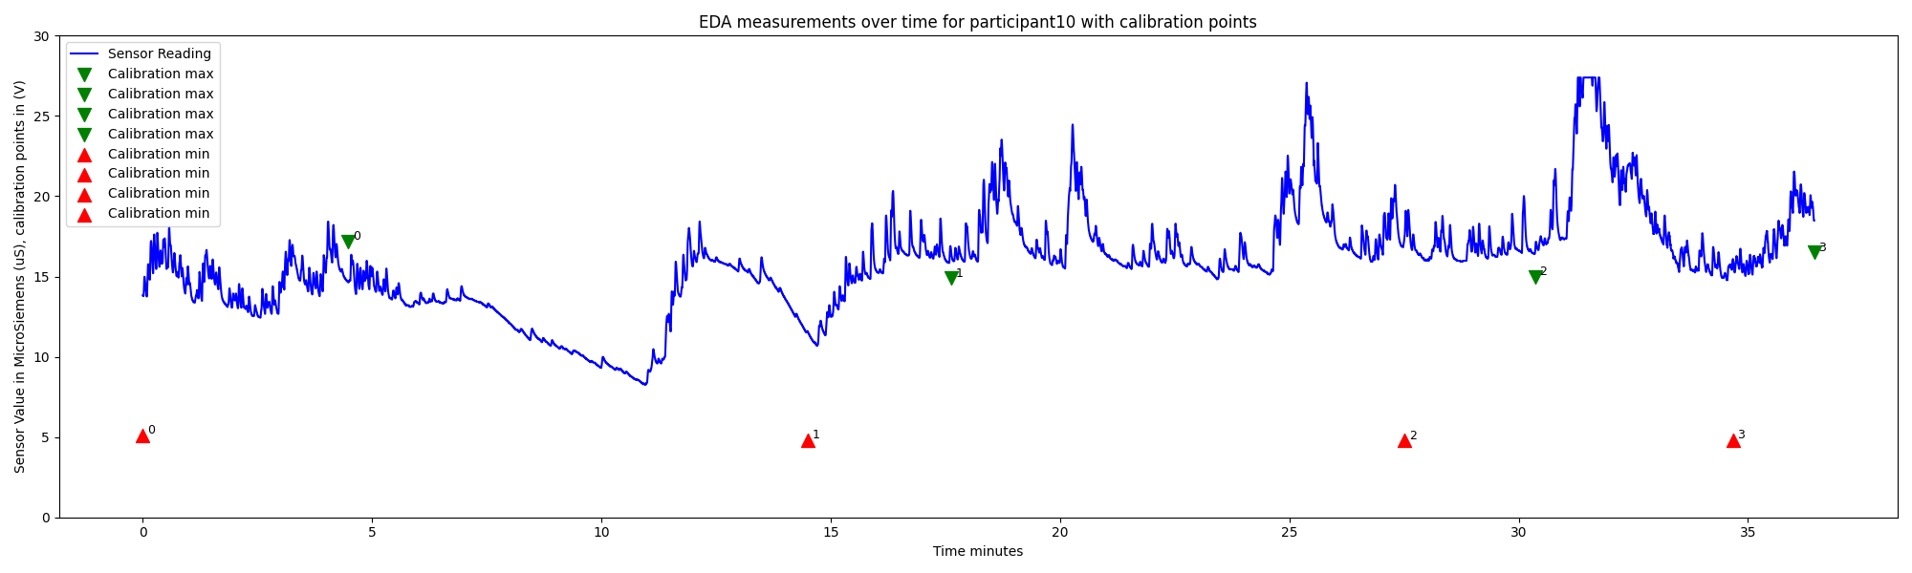
Graph of EDA over time with Calibrations plotted sweaty participant

Slide 10
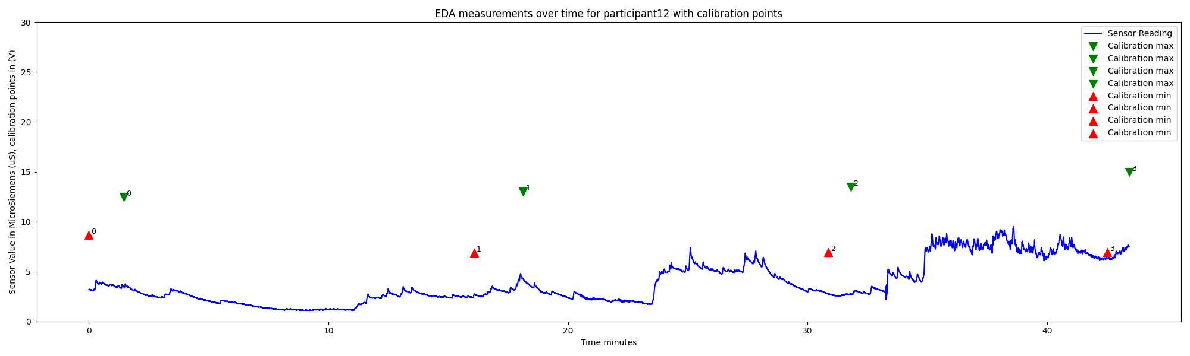
Graph of EDA over time for non-sweaty participant

Slide 11
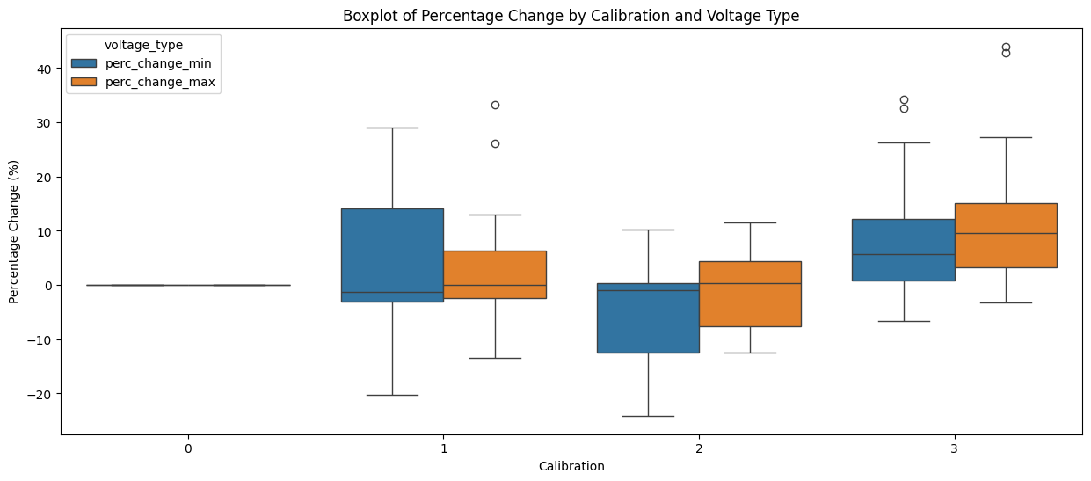
Percentage change Box Plot

Slide 12
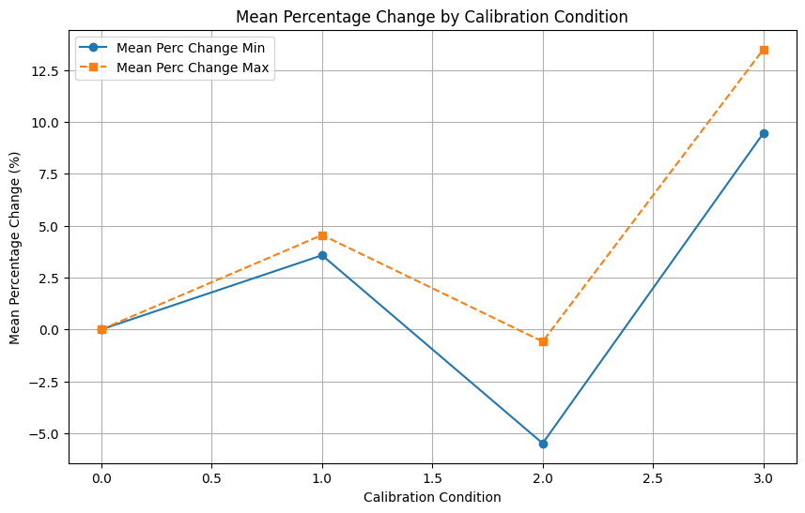
Percentage Bar chart

Slide 13
Areas for future research
A possible inflexion point around the data
Limitations – lack of qualitative data
Lack of ability to smooth out EDA data
Lack of ability to empirically compare EDA data to calibration points.
Does hand thickness, roughness play a factor

Slide 14
Concluding
Thank you very much for your help and support

