Slide 1
Compilers Lab
150101045, 150101046,150101068,150101072

Slide 2
Assignment 2
Contents:
Grammar
Salient Features
Examples

Slide 3

Grammar
stmtlist → stmt stmtlist| ϵ
stmt → If (exprc) { Stmtlist }elsestmt
|while (exprc) {stmtlist}
| for (exprfor) {stmtlist}
|switch(arithexpr) switchstmt
|expression;
elsestmt → else If (exprc) {stmtlist } elsestmt| else {stmtlist} | $ϵ$
exprc → arithexpr A
A → [‘<‘ / ‘>’ / ‘==‘ / ‘>=’ ‘<=’ ] arithexpr B | $ϵ$
B → || exprc
| && exprc
| $ϵ$
stmtlist denotes the whole source program and each line by stmt.
exprc denotes conditional expression that is checked in “If” and “while” statement.
exprc can have multiple conditions combined using “AND” and “OR”.
elsestmt is for multiple “elseif and else” part after “If” in code. It is optional for If statement to follow with “elseif and else”.
“else” here matches with the last unmatched “If”.

Slide 4

Grammar
switchstmt → case (arithexpr) : {stmtlist } switchstmt| default {stmtlist} | $ϵ$
exprfor→ expression; exprc ; expression
expression→ Id.Function
| Constructor.Function
|init | mathexpr
init →Id= Constructor init|$ϵ$
mathexpr → assignexpr|arithexpr
assignexpr → Id=mathexpr |Id+=mathexpr | Id-=mathexpr |Id*=mathexpr | Id/=mathexpr |Id -- |Id ++
switchstmt is for switch statement, which can have multiple case statements and followed by an optional default condition.
expfor denotes expression inside “for”. Eg- for( i =1;i<10; i++)
expression can be of several types as mentioned.
Constructor Non terminal is for various constructors and Function for their respective functions.
mathexpr is for general expressions ,involving assignment expressions and arithmetic expressions.

Slide 5

Grammar
arithexpr→ expr1 arithexpr’
arithexpr’→ || expr1 arithexpr’ | $ϵ$
expr1→ expr2 expr1’
expr1’→ && expr2 expr1’ | $ϵ$
expr2→ expr3 expr2’
expr2’→ +/- expr3 expr2’ | $ϵ$
expr3→ expr4 expr3’
expr3’→ */ / expr4 expr3’ | $ϵ$
expr4 → ! factor | factor
factor → num_or_id | (arithexpr)
arithexpr is for arithmetic expressions which can have OR,AND ,(+,-,*,/) and NOT operators.
Precedence order among operators is implemented using similar to logic given in assignment1 tutorial.
We can similarly add other operators like Modulo, exponent etc.
Precedence order is as follows:
NOT > *,/ > +,- > AND > OR .

Slide 6

Grammar
Constructor → Processor ( proc_parameter_list)
| Link ( link_parameter_list)
| Memory( memory_parameter_list)
| Job ( job_parameter_list)
| Cluster ( cluster_parameter_list)
| Scheduler ( scheduler_parameter_list)
Proc_parameter_list →proc_parameter C | $ϵ$
C → , proc_parameter_list | $ϵ$

Slide 7

Grammar
link_parameter_list →link_parameter D | $ϵ$
D → , link_parameter_list | $ϵ$
memory_parameter_list →memory_parameter E | $ϵ$
E → , memory_parameter_list | $ϵ$
job_parameter_list →job_parameter F | $ϵ$
F → , job_parameter_list | $ϵ$
cluster_parameter_list →cluster_parameter G | $ϵ$
G → , cluster_parameter_list | $ϵ$

Slide 8

Grammar
Proc_parameter→ isa = value
| clock_speed = value
| L1_memory= value
| L2_memory = value
| name = value
| argument
argument → value | [ valuearray ]
valuearray → value H | $ϵ$
H → , valuearray |$ϵ$
Proc_parameter denotes various parameters that Processor Constructor will take.
Valuearray is for array of values given as argument to a constructor or its function.
Similarly for other constructors .

Slide 9
Grammar
Link_parameter→ start_point = value
| end_point = value
| bandwidth= value
| channel_capacity = value
| name = value
| value
Memory_parameter→ memory_type= value
| mem_size = value
| name = value
|value

Slide 10
Grammar
Job_parameter → job_id= value
| flops_required= value
| deadline= value
| mem_required = value
|value
Cluster_parameter→ processors = argument
| topology= value
| link_bandwidth= value
| link_capacity= value
| name= value | argument

Slide 11

Grammar
Function → is_running( func_arg_list )
| submit_jobs(func_arg_list)
| …
func_arg_list →argument I | $ϵ$
I → , func_arg_list | $ϵ$
value → num_or_ID
|Constructor

Slide 12
Scheduler
The scheduling is activity of the process manager that handles the removal of the running job from the processors and the selection of another job on the basis of a particular strategy.
The scheduler has 2 types: local and global.
Global scheduler schedules given n jobs to m no of processors. We can think of it as distributor of jobs to the processors.
Local Scheduler allocates jobs to a single processors using time sharing methods.

Slide 13
Functions of Scheduler
Constructors for this scheduler
Scheduler(processor_array/cluster,job_array);
Set_job_affinity(job_array,affinity,proc_type,proc_id)
Some jobs can run better on particular types of processor.
Proc_type and proc_id are optional parameters,in absence of both it will set general affinity of job.
Max_jobs(proc_id,no_of_jobs);
It sets the max no of jobs that can be in waiting list of a processor. Remaining would be swapped out of main memory.

Slide 14
Functions of Scheduler
Get_load(proc_id);
It will return CPU load which can be used by global scheduler for scheduling
Set_algo(proc_id,algo);
Algo can be {“FIFO”, “SJF”, “RoundRobin”, “SecondChance”}. It sets algo for local scheduler of Proc_id.
Proc_id parameter Is optional. If absent it sets algo for global scheduler.

Slide 15

Grammar Rules for Scheduler
scheduler_parameter_list →scheduler_parameter H | $ϵ$
H → , scheduler_parameter_list | $ϵ$
scheduler_parameter → cluster = value
| job_array = valuearray
|processor_array=valuearray
| argument
Function → Set_job_affinity(func_arg_list)
|Max_jobs(func_arg_list)
|Get_load(func_arg_list)
|Set_algo(func_arg_list)
|Get_load(func_arg_list)

Slide 16
Salient Features
It supports multiple conditions joined using logical “AND” and “OR”.
Constructors and their functions can take single values or array as parameters.
Parameters can be passed in any order like a dictionary in python. Functions can have default values for their parameters.
Correct precedence of operators is ensured in Arithmetic expressions. They can also have Binary operators.
Its rules are self explanatory and new operators and their hierarchy in precedence can be added easily.
Expressions like i++; , i--; , i+=5; etc. are also accepted.
General statements like If,else,while ,for , switch case etc are implemented as in C language.

Slide 17
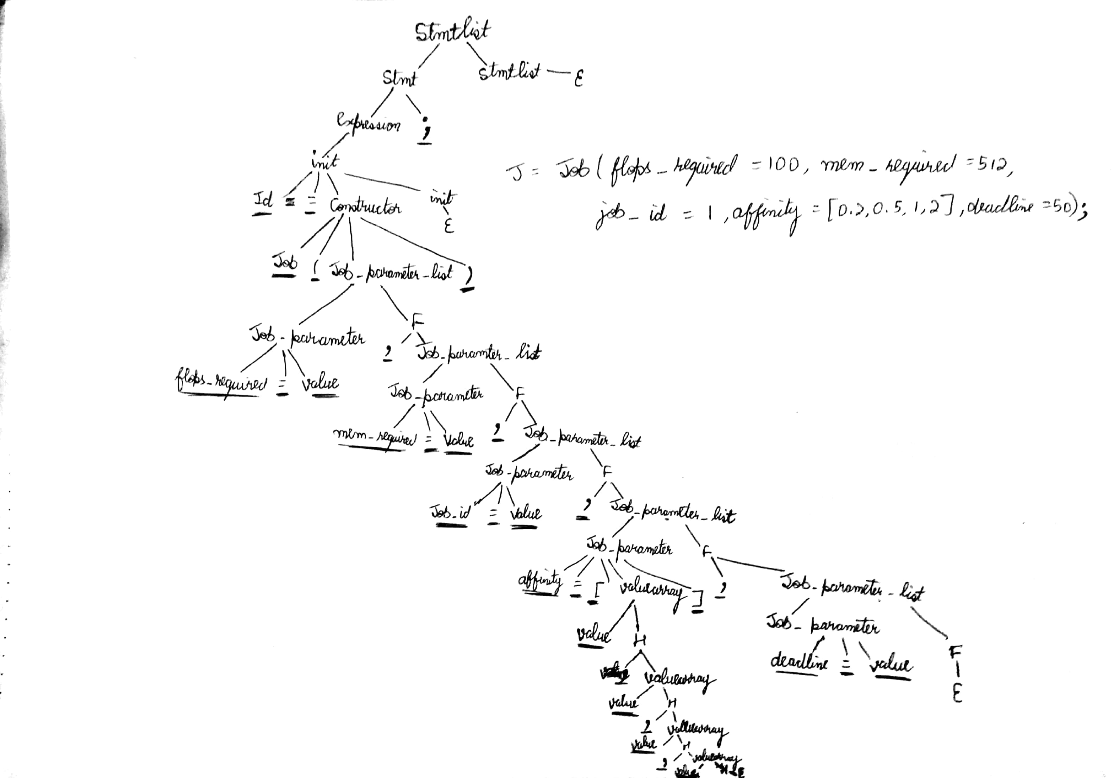
Examples

Slide 18
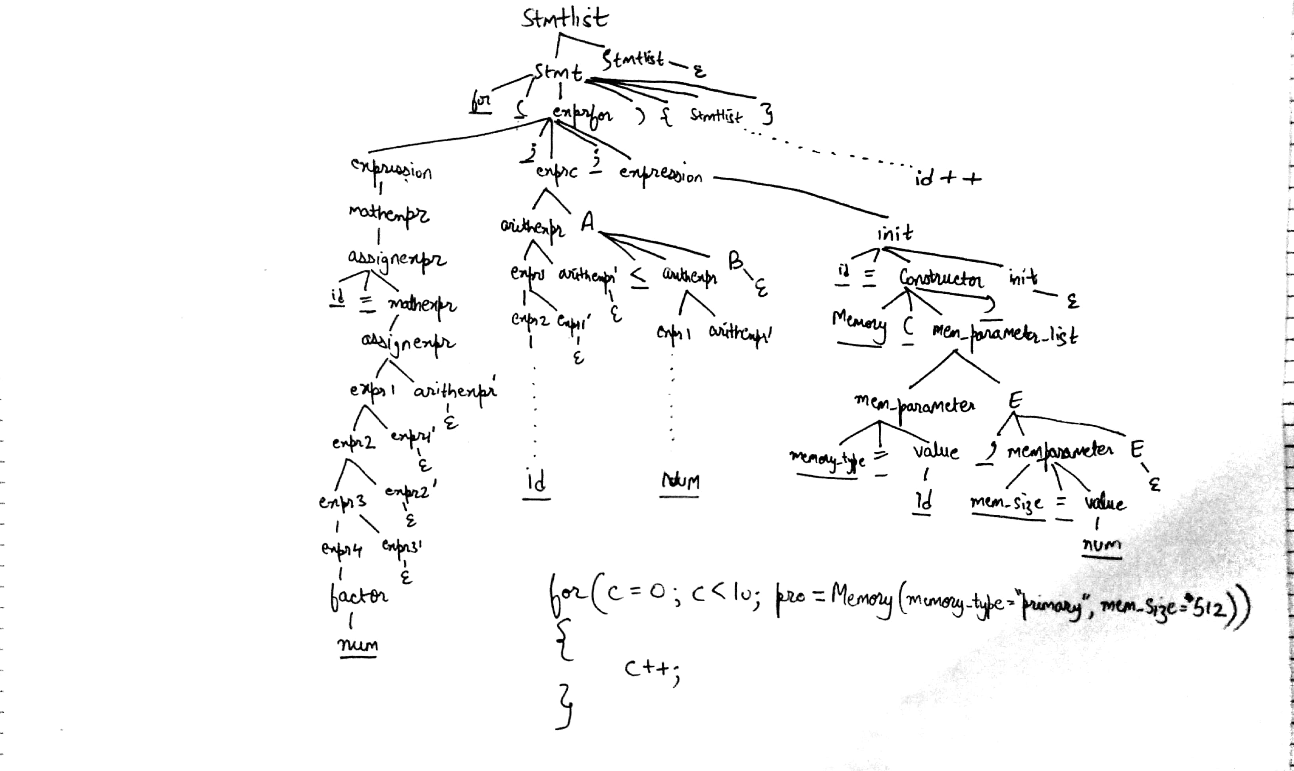
Examples

Slide 19
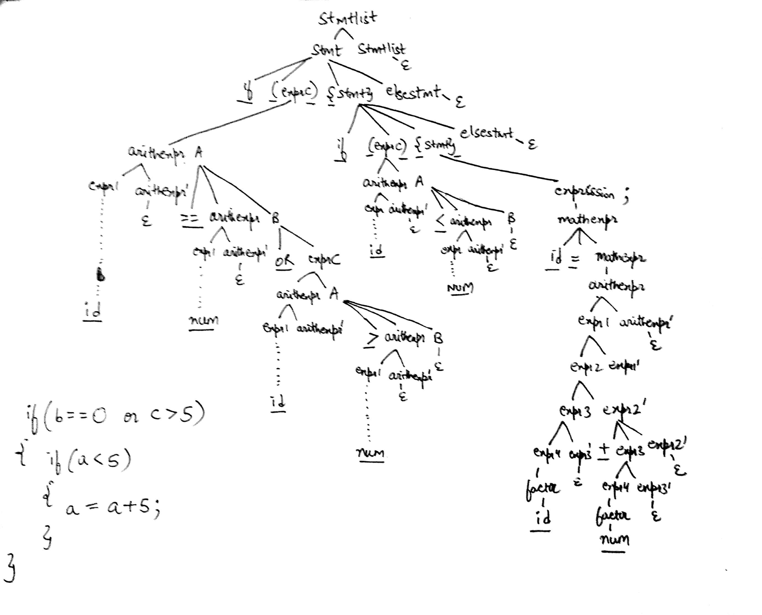
Examples

Slide 20
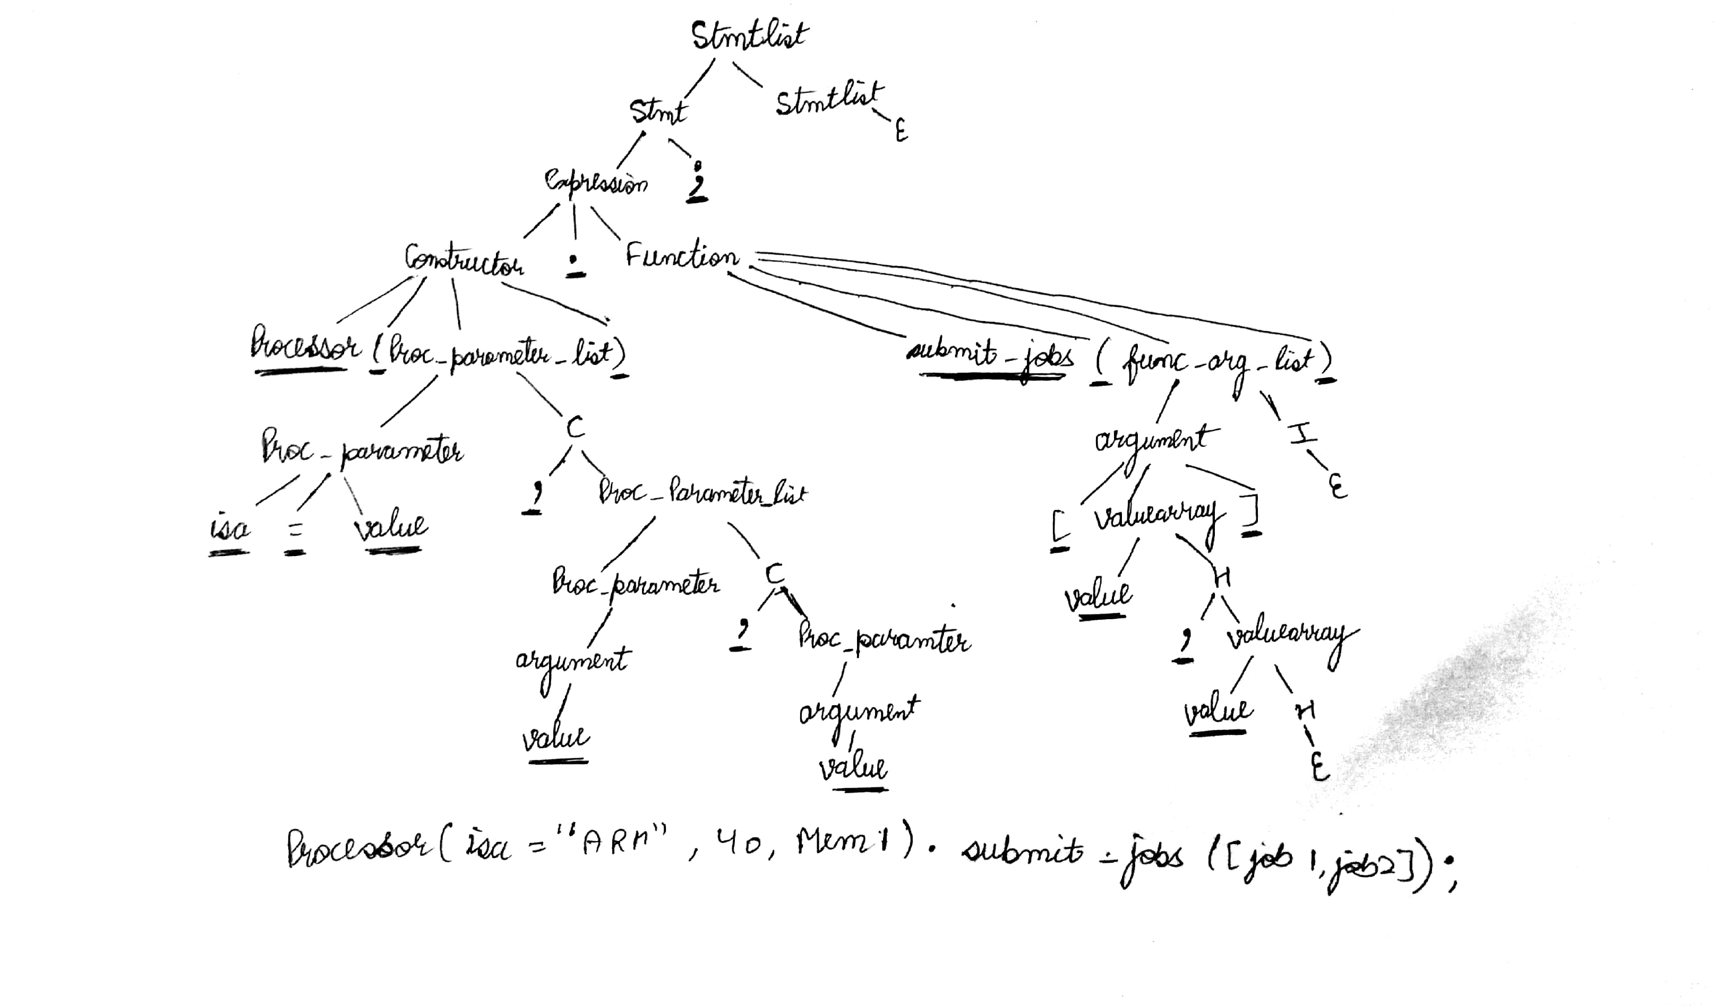

Slide 21
Thank You

