Slide 1
Patoloji Atlası
Atlastaki resimleri sunumlarınızda kullanmak için

Slide 2
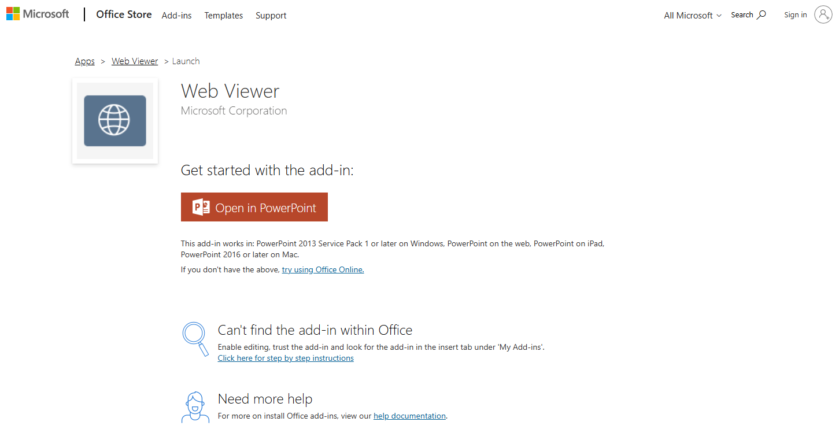
https://store.office.com/addinsinstallpage.aspx?rs=en-001&assetid=WA104295828

Slide 3

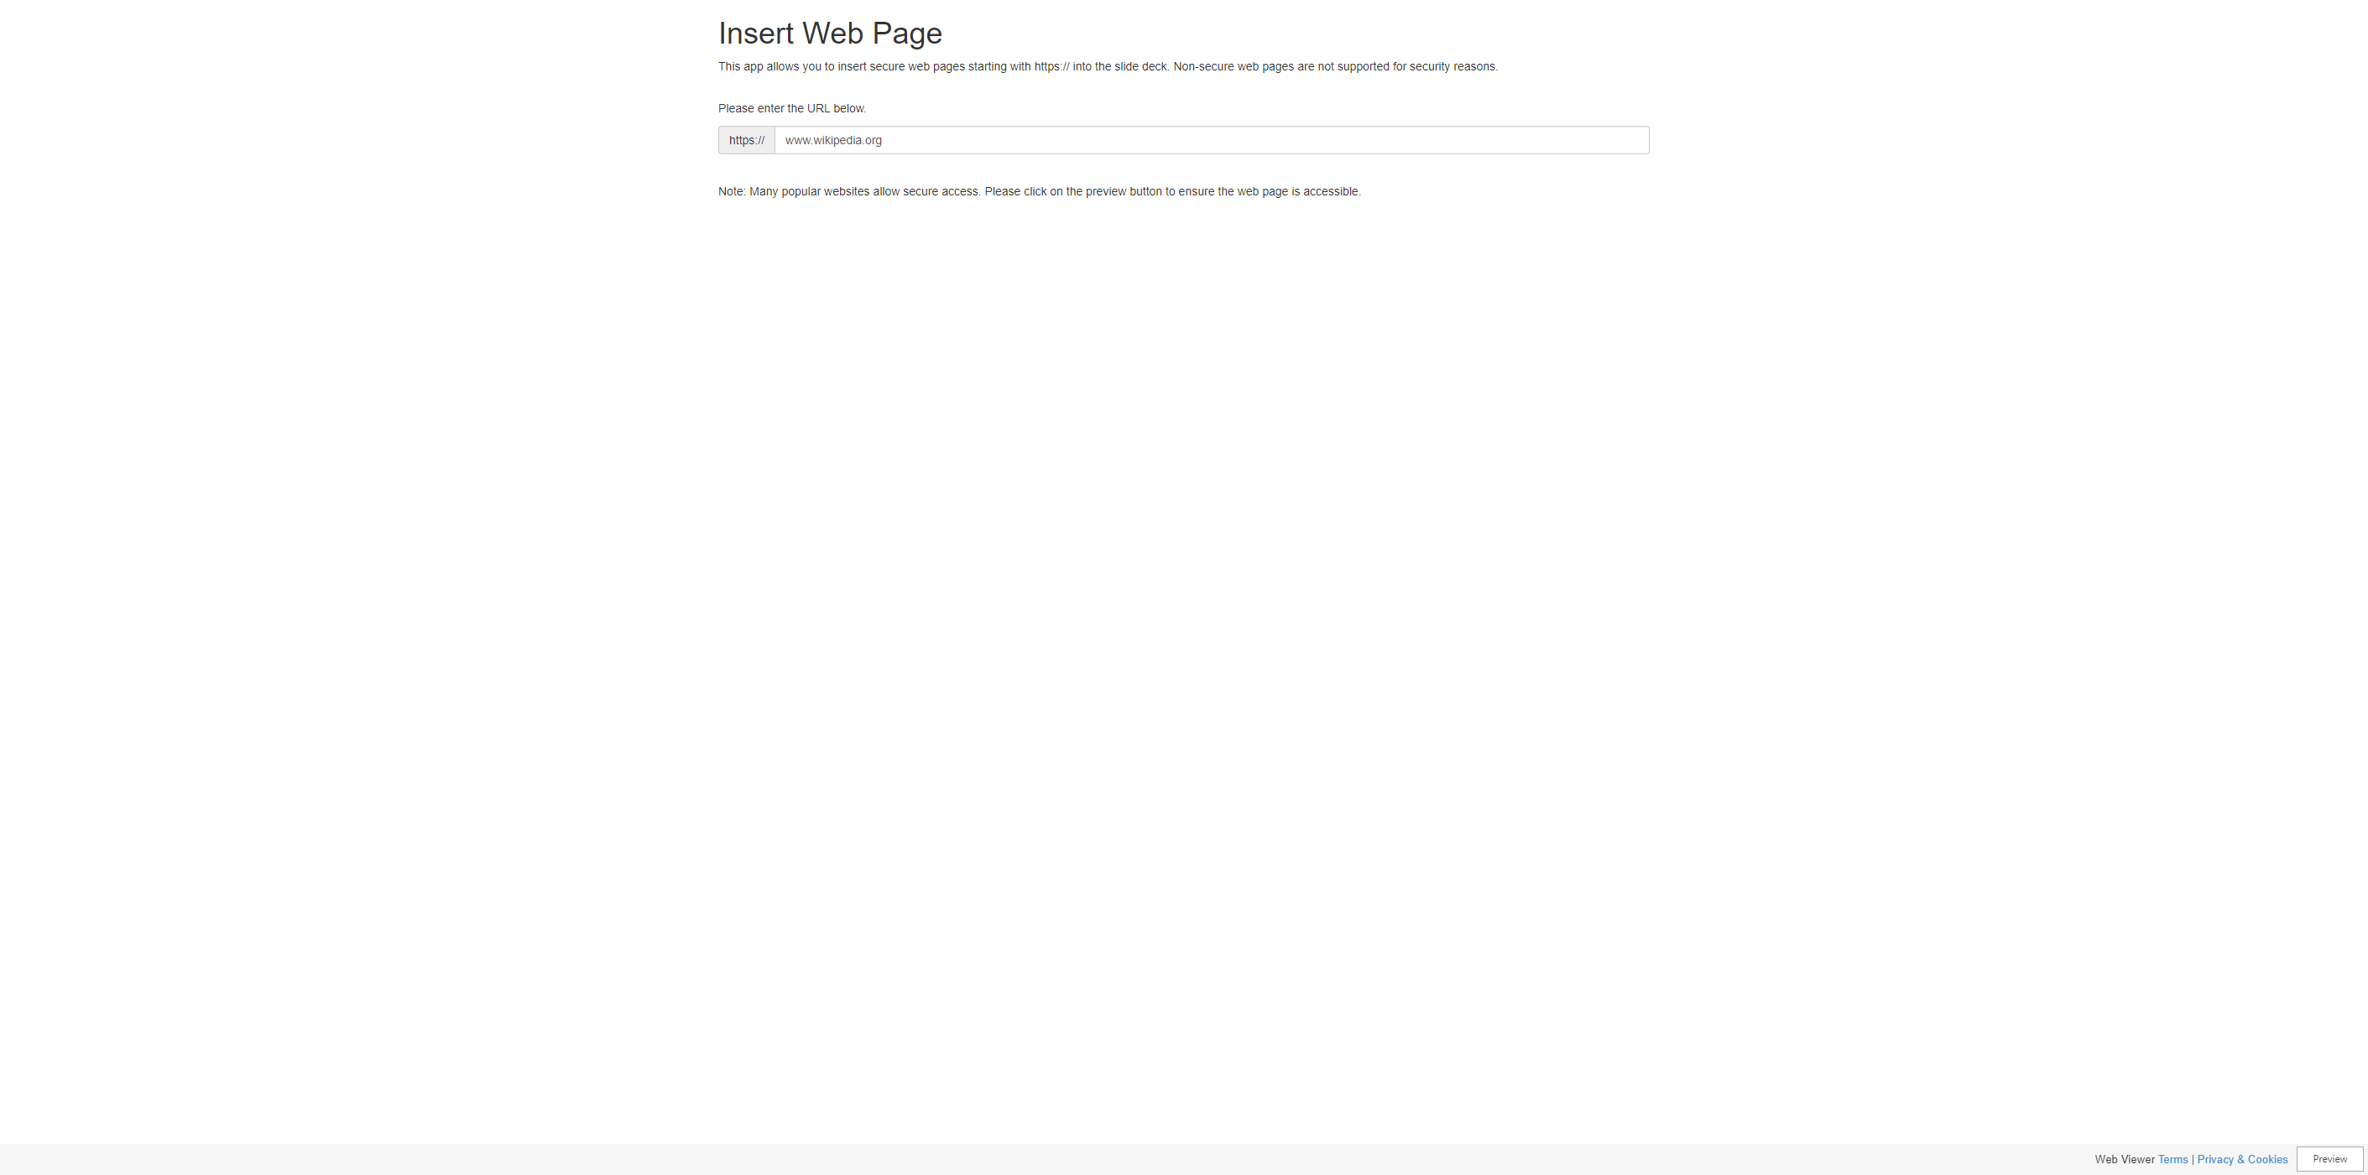
Web Viewer

Slide 4

Relaunch the add-in
Web Viewer
After you install the add-in, you can launch it by choosing the add-in button on the Insert tab
On the Insert tab
Insert
My Add-ins
Need more help?
Return to your internet browser or copy this link into your browser:
https://pages.store.office.com/addinsinstallpage.aspx?rs=en-001&assetid=WA104295828&isWac=True&ui=en-US&ad=US

Slide 5
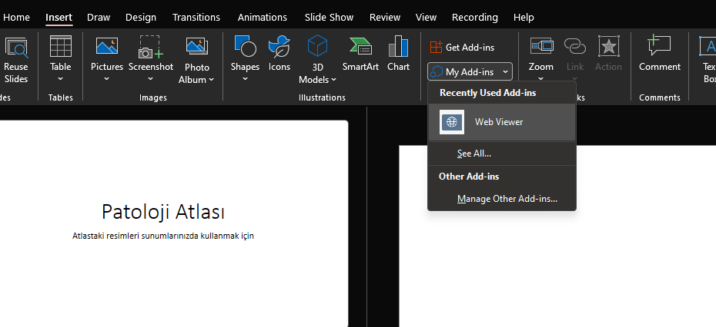
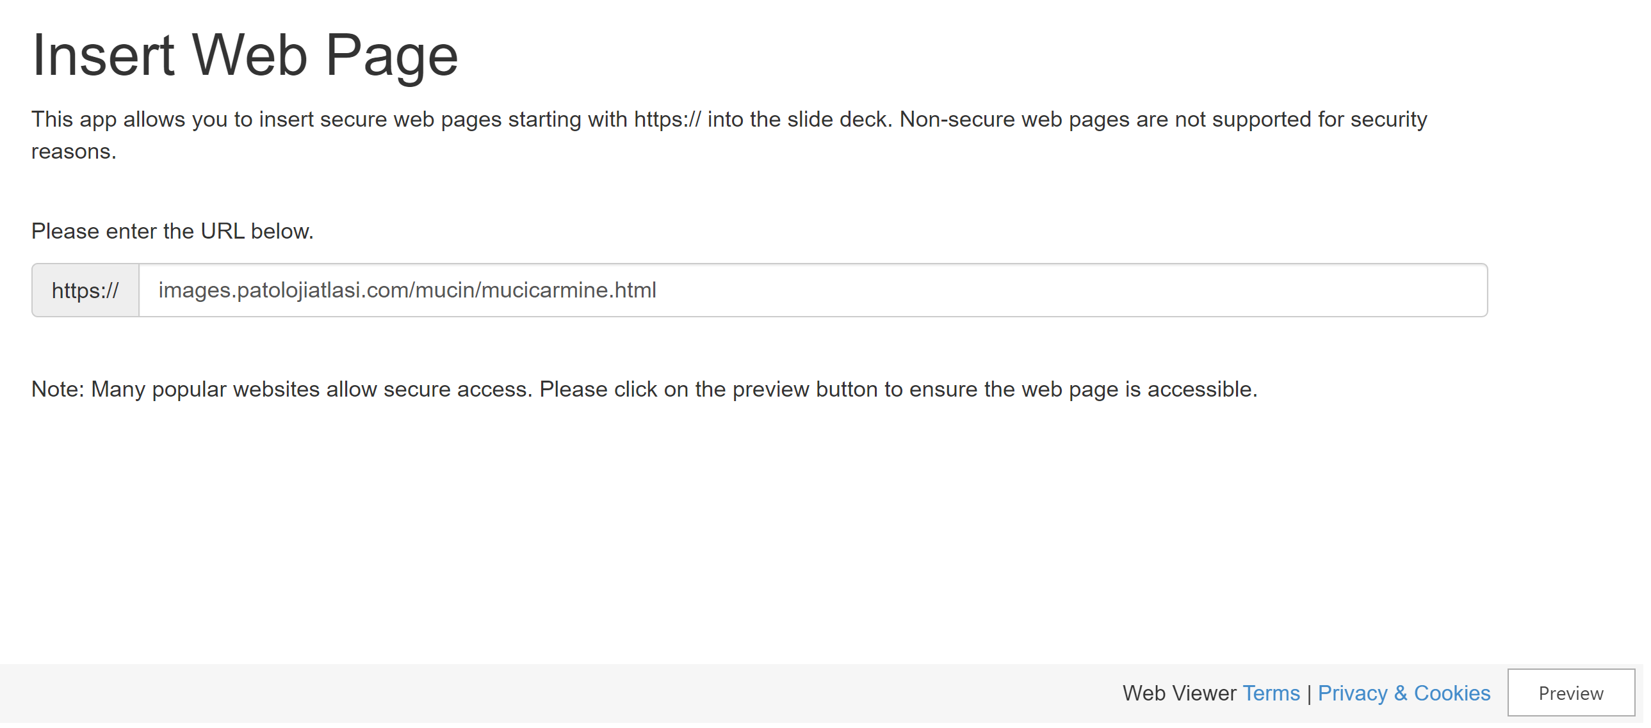

Slide 6
