Slide 1



Project 3
CLOUD COMPUTING
GEIGER Sebastian
GRYGORENKO Dmytro
PATONAI Peter
REKABSAZ Navid
ROHNER Andreas
WILHELM Jakob
ZASLAVSKA Kateryna

Slide 2
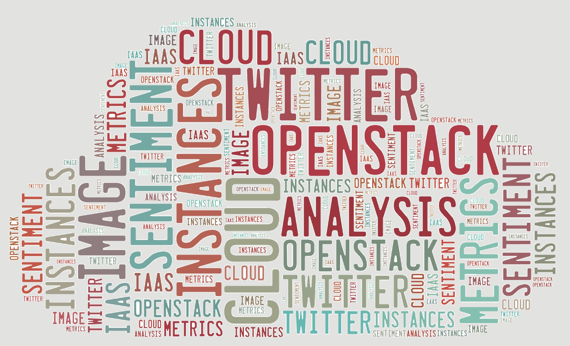
Task
Use OpenStack to implement the solution in a private IaaS cloud
Build Business Logic, implement Sentiment Analysis (use Google Code Project)
Use Twitter data from TUWEL or use library Twitter4J
Define and monitor sensible performance metrics
Define when service is overloaded (in order to scale app and maintain elasticity)
Advanced Internet Computing, Project 3. CLOUD COMPUTING

Slide 3

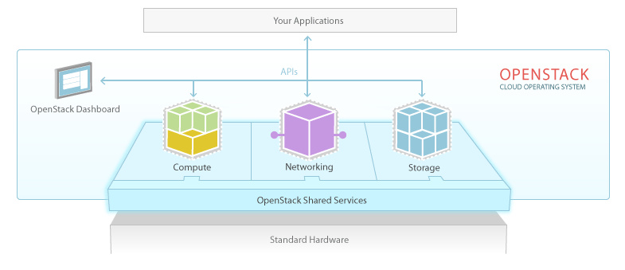
OpenStack(1)
OpenStack is an IaaS cloud computing Project started by Rackspace Cloud and NASA in 2010. It is an open source software to set up and run cloud computing and storage infrastructure
There are 3 main service families under OpenStack:
Compute Infrastructure (Nova), Storage Infrastructure (Swift), Imaging Service (Glance)
Advanced Internet Computing, Project 3. CLOUD COMPUTING
http://www.openstack.org/software/

Slide 4
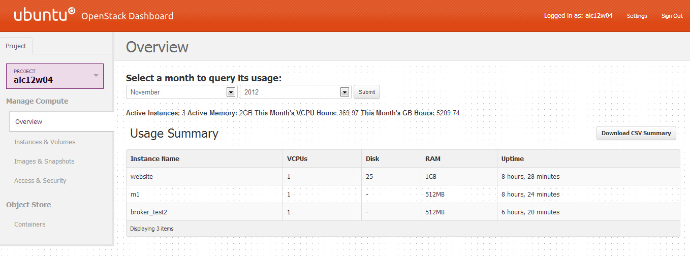
OpenStack(2)
Use OpenStack Horizon dashboard
Advanced Internet Computing, Project 3. CLOUD COMPUTING

Slide 5
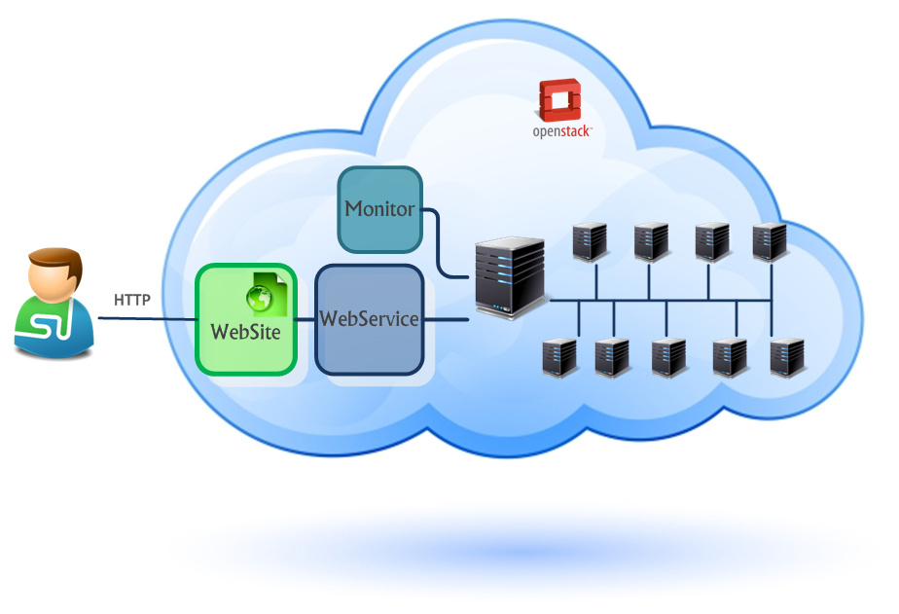
Architecture
Advanced Internet Computing, Project 3. CLOUD COMPUTING

Slide 6

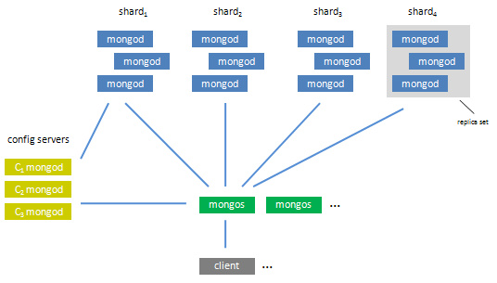
Database Mongo
Mongo DB is a relational DB, part of NoSQL family, stores structure data at JSON-like documents with dynamic schemas
Mongo DB focus on 4 things: flexibility (JSON), power, speed/scaling, easy of use
Mongo DB scales horizontally using sharding
Use MapReduce algorithm
Advanced Internet Computing, Project 3. CLOUD COMPUTING
http://api.mongodb.org/wiki/
current/Introduction.html

Slide 7
Specialties
Website is implemented via Spring and Roo
Database is Mongo DB
Monitor uses Openstack Java API to manage the Cloud instances
SSH based metric collection
Advanced Internet Computing, Project 3. CLOUD COMPUTING

Slide 8
Algorithm
Precalculated sentiments
Use of Map/Reduce feature in MongoDB
Sharding distributes the work to instances
But:
MongoDB write operations or rebalancing of shards takes more time than we expected
I/O Operations are very slow
Migrating 100MB takes 1 hour
Suspected reason is the use of sparse files for volumes
Suggested solution: Use Swift block storage next time
Advanced Internet Computing, Project 3. CLOUD COMPUTING

Slide 9
Monitor Strategies
Use of 5 min Average Workload (avgLoad)
Strategies:
Self-Based Threshold
Utilization
Utilization with avoiding violations
Advanced Internet Computing, Project 3. CLOUD COMPUTING

Slide 10

Thank you for attention!
Many thanks to Philipp Leitner for his quick responses when we had problems.
Advanced Internet Computing, Project 3. CLOUD COMPUTING

