Slide 1



Project 3
CLOUD COMPUTING
GEIGER Sebastian
GRYGORENKO Dmytro
PATONAI Peter
REKABSAZ Navid
ROHNER Andreas
WILHELM Jakob
ZASLAVSKA Kateryna

Slide 2
Task
Register an account with Google AppEngine
Use PaaS services of AppEngine to deploy sentiment analysis services
Compare Openstack and Google AppEngine
Advanced Internet Computing, Project 3. CLOUD COMPUTING

Slide 3
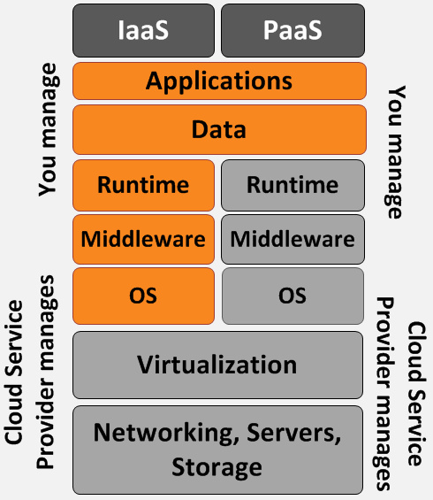
PaaS/IaaS
Advanced Internet Computing, Project 3. CLOUD COMPUTING

Slide 4
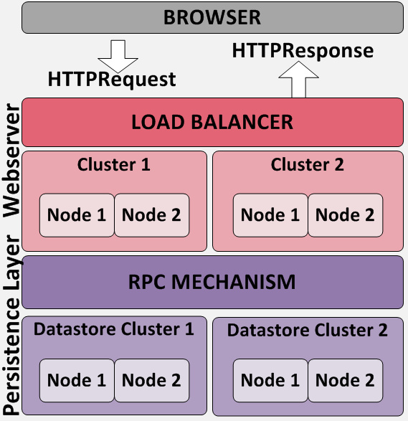
AppEngine/Overview
Advanced Internet Computing, Project 3. CLOUD COMPUTING
http://upload.wikimedia.org/wikipedia/
commons/1/1f/Google-app-engine-archi.png

Slide 5
AppEngine/Overview
Google AppEngine is a web application hosting service
Supported Runtimes: JVM (Java), Python, Go
Core runtime environment provided but restricted
Different backends for storing data:
Datastore, Memcache, Blobstore, URLFetch
Datastore is a NoSQL based data storage with queries and atomic transactions
Advanced Internet Computing, Project 3. CLOUD COMPUTING
http://upload.wikimedia.org/wikipedia/
commons/1/1f/Google-app-engine-archi.png

Slide 6
AppEngine
App Engine Application Environment:
Supports many 3rd party libraries
Automatic scaling and load balancing
APIs for authenticating users and sending email using Google Accounts
Queues perform work outside of the scope of a web request
Scheduled tasks for triggering events at specified times and regular intervals

Slide 7


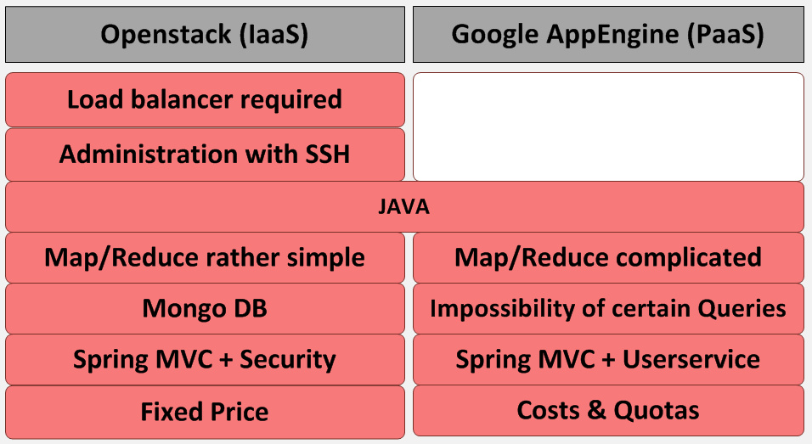
IaaS vs PaaS 1
Advanced Internet Computing, Project 3. CLOUD COMPUTING

Slide 8
IaaS vs PaaS 2
Experiences with AppEngine:
1 map/reduce run with 50k+ tweets costs about $1
We managed to hack a wrapper job into the map/reduce pipeline to run the map/reduce part as a background job
No asynchronous notifications, only busy waiting possible
We paid about 30$ for some very short testing, then started to test locally.
Advanced Internet Computing, Project 3. CLOUD COMPUTING

Slide 9

Thank you for attention!
Advanced Internet Computing, Project 3. CLOUD COMPUTING

