Slide 1

Maroš Zubrický, Oliver Košiba, Patrik Lech PREŠOVČATA

Slide 2
Maroš Zubrický, Oliver Košiba, Patrik Lech PREŠOVČATA

Slide 3
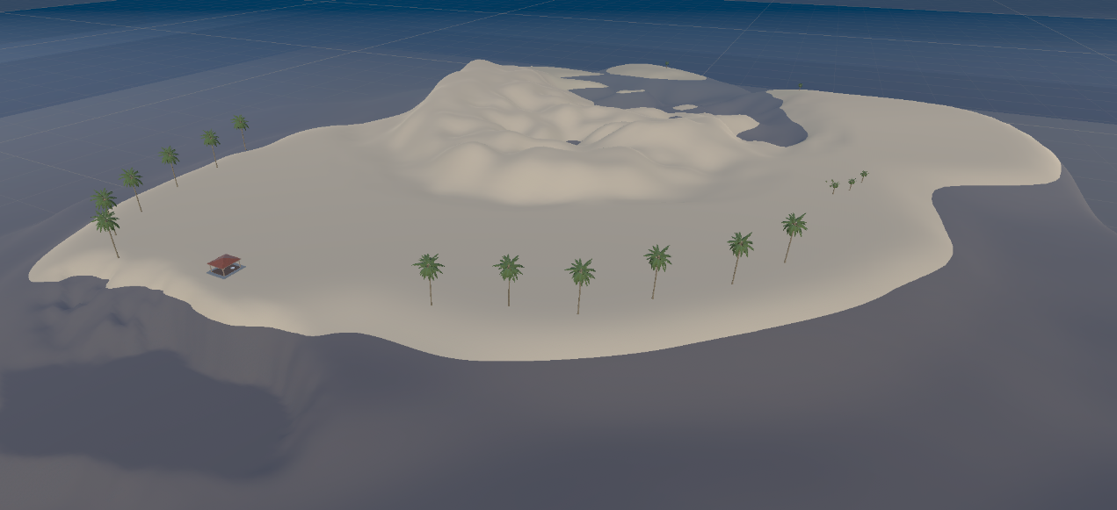
Common Informations
Team name: Prešovčata( Team number 6)
Goal: Obtain the treasure chest hidden in the sea .
Type of game: 3D finding treasure game
Game engine: UNITY
We are school team from Secondary Industrial School of Electrical Engineering.

Slide 4
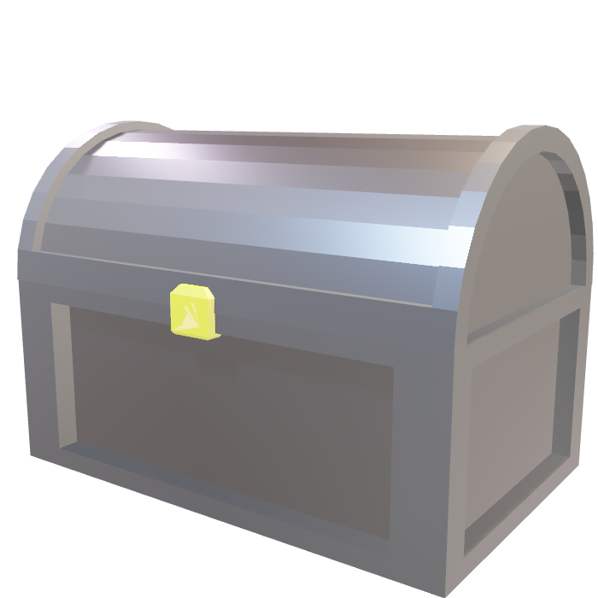
Game development roles
Maroš Zubrický- Main programmer and, UNITY development
Oliver Košiba- 3D model development.
Patrik Lech- visual and sound development, presentation maker

Slide 5
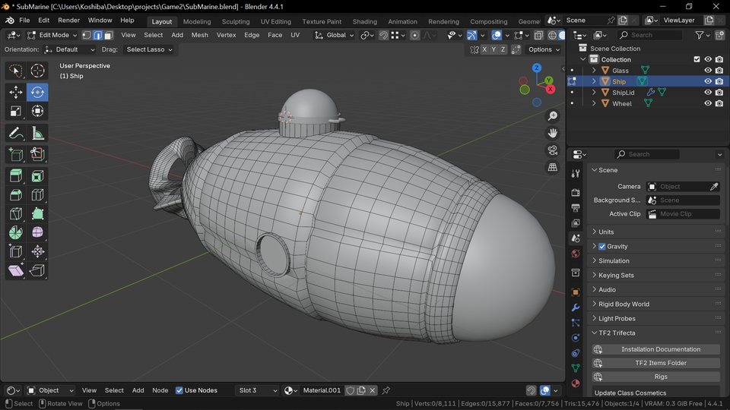
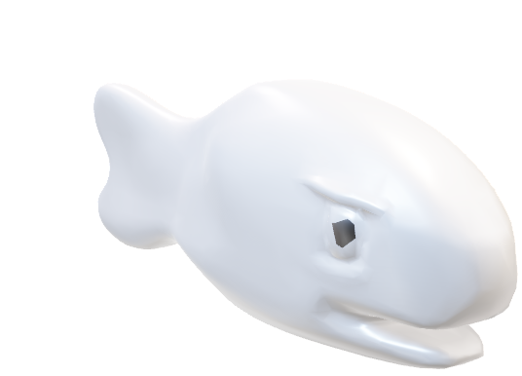
The basic theme of Game:
You are an fisherman hunting fishes to buy your dream submarine.
With submarine you can explore mystery of dark waters of island sea.

Slide 6
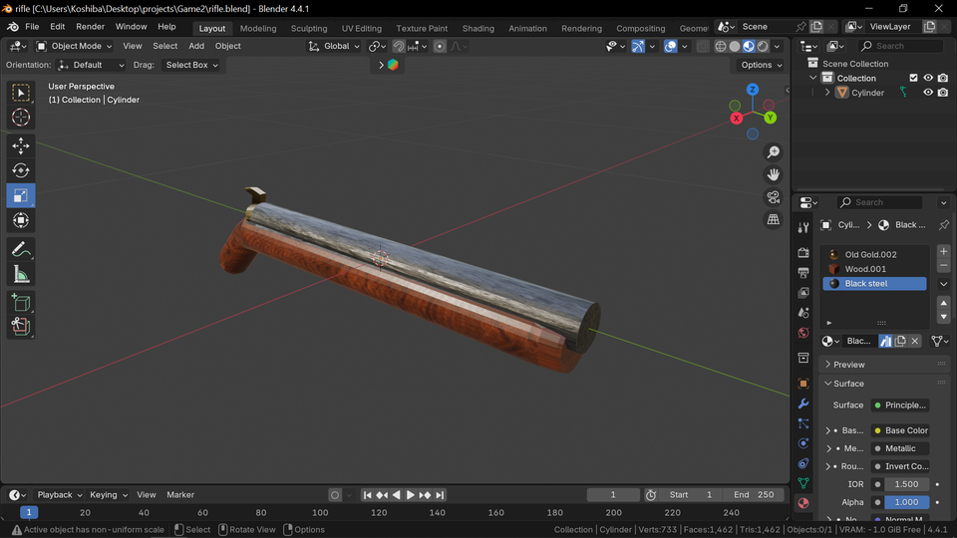
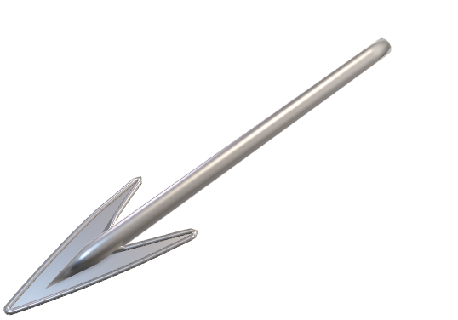
The basic theme of Game:
85% of assets have been made by us and most of downloaded ones have been changed for our needs.
For preparing assets we used blender, piskel, krita, LLMS, Mix Pad, WavePad, Audacity and switchsound

Slide 7
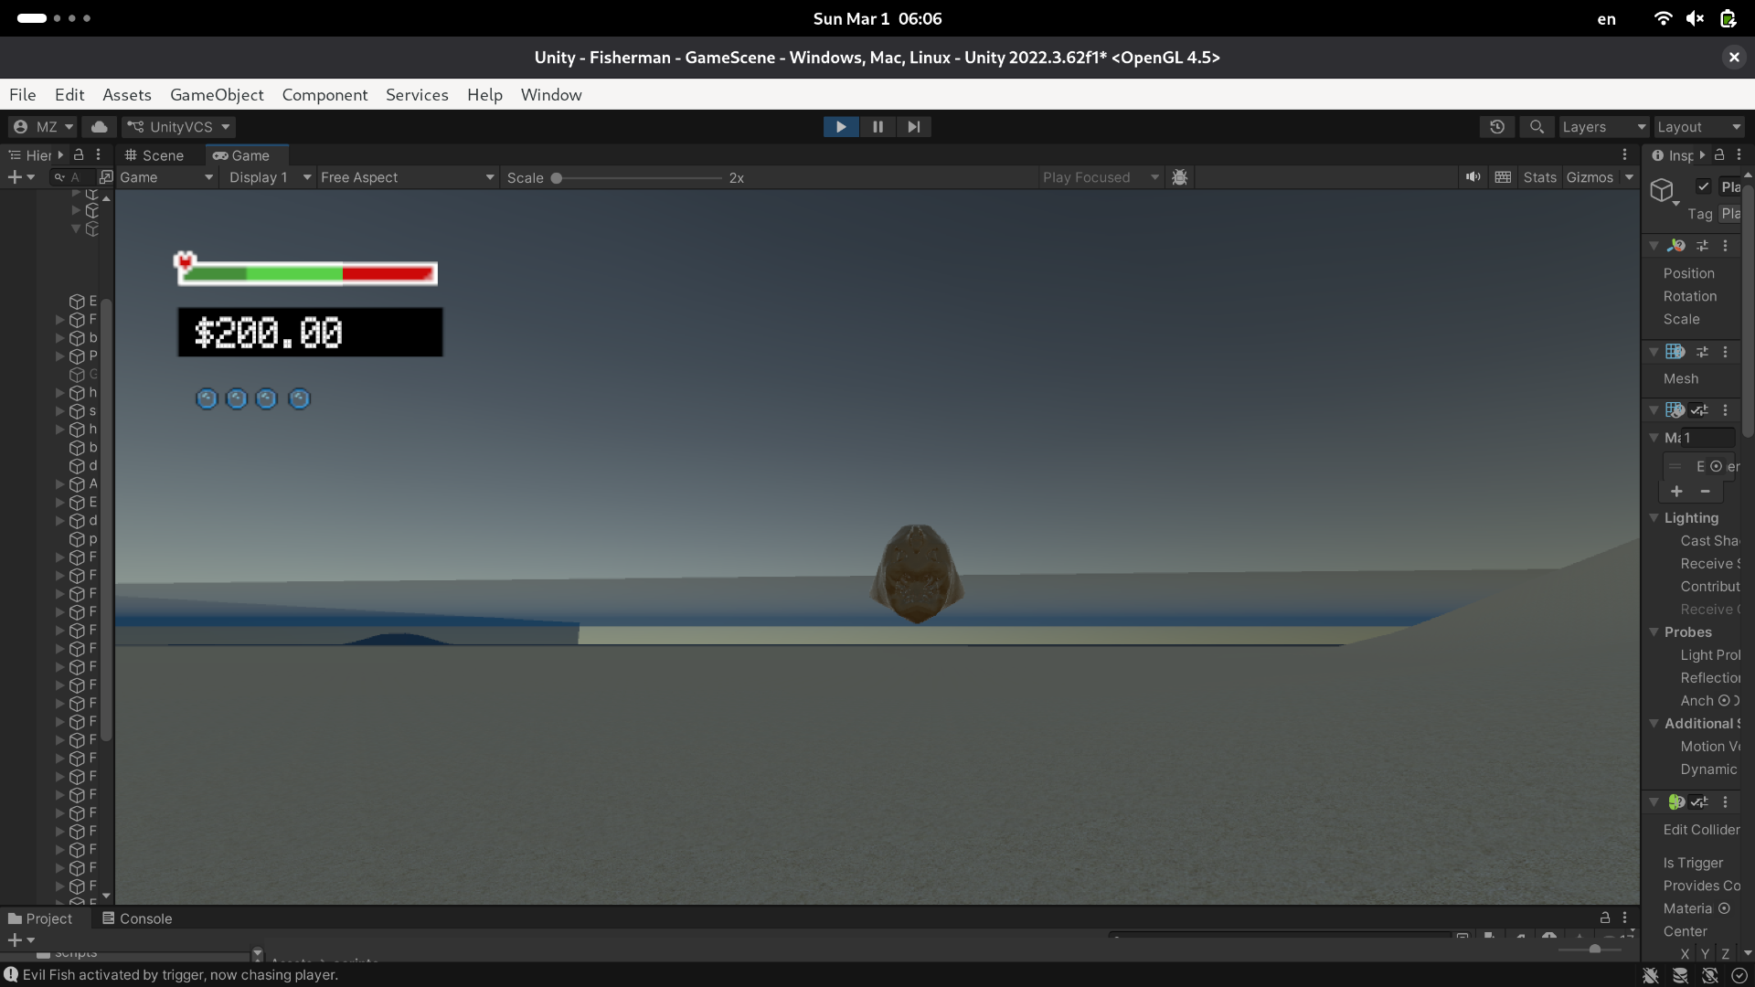
Game mechanics:
Player Heath Bar- player has a bar that is showing him about his health condition- he is able to die.
Player oxygen Bar- player have to be careful because he can drown!
Harpoon mechanics- player is able to shoot fishes with harpoon.
Submarine - You can buy harpoon or submarine which you can ride to explore deeper sea.

Slide 8
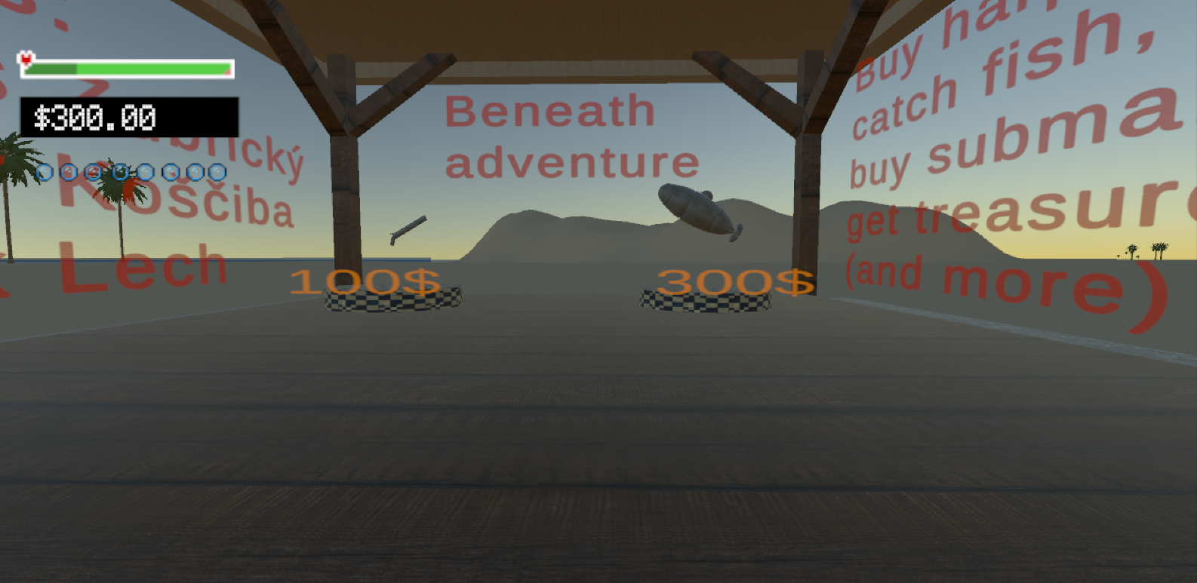
Game mechanics:
If you go to deep into the sea area went dark .
You can walk, jump ride submarine if you have one, swim, dive drown and fight for treasure and your life!
Game also include signs to navigate you what ae you supposed to do in the game and how are you able to win it.

Slide 9

Game mechanics:
The game principe of game is upgrading and preparing to explore deeper ocean, you hunt fish and after it you buy better equipments and submarine.
Game is built by many programmed scripts and assets.

Slide 10
Thanks for your attention!
Let us suprise you ;)

