Slide 1
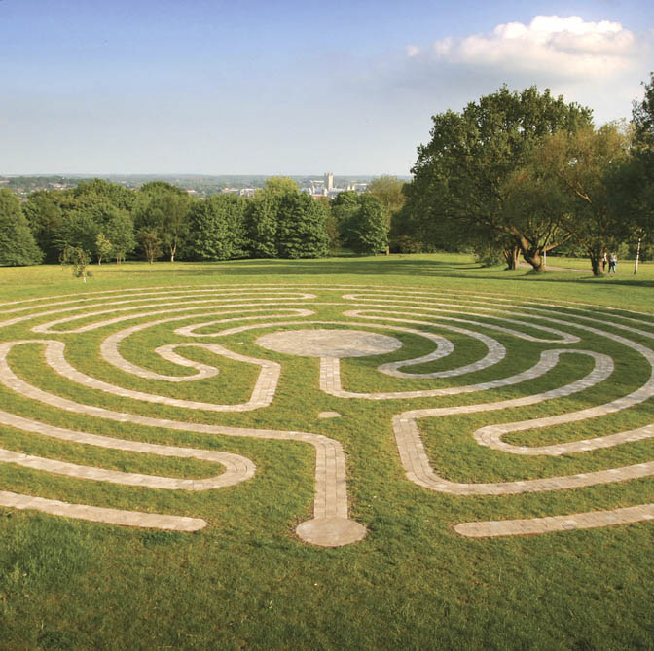
Ai systems
Lecture 9
Genetic algorithms and Neuroevolution

Slide 2
Outline
Neuroevolution
Genetic Algorithms
NEAT
Extensions
OpenGym

Slide 3
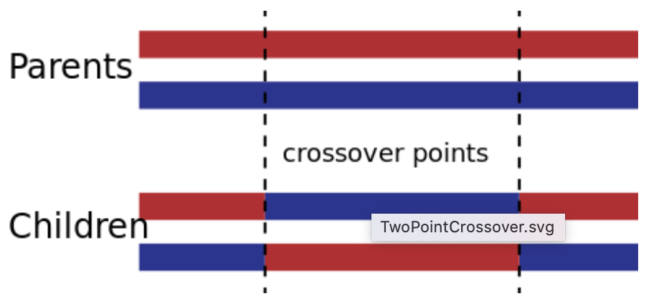
Genetic algorithms
Optimisation technique inspired by theory of evolution
Population composed of N individuals (candidate solutions)
Quality of each solution is measured by a fitness function (phenotype)
Each solution is composed by a set of genes
Natural selection and replication
Good gene combinations ('building blocks') becomes more prevalent as they make reproduction more likely
Selection: individual with higher fitness are more likely to be selected for reproduction
Roulette-wheel selection: selection probability is proportional to fitness
Tournament-based selection selects best individual among k randomly selected ones
Truncation-based selection: top x percent of individuals are selected
Replication: pairs of selected individuals generate two offspring, then recombined with a given probability
One-point crossover: pick one point in the gene sequence, genes to the left are swapped in the two children
Multipoint crossover: k points are picked and children gets alternating intervals of genes from each parent
Uniform crossover: each gene is selected randomly from parents
Mutation
With a given probability genes are perturbed in resulting individuals
This can (re-) introduce diversity that was lost due to selection pressure
Elitism
Top k individuals are propagated to the next generation without modifications, especially useful if crossover and mutation probability are high
Notes:
Long-term adaptation to environment (evolution) is the result of replication
Replication is not perfect (mutation) leading to diversity
Replication more likely for individuals with better fitness to the environment
Replication (in sexual species) combine genes from different individuals

Slide 4
Evolving nn with genetic algorithms
GA can be applied to evolve neural networks weights
Define a network topology
Represent the weights of the network as genes (direct encoding)
Evolve weights using mutation and crossover
Crossover of network weights is problematic due to the problem of competing conventions: different networks can have concepts (e.g. hidden neurons) in different position of the network
GA network evolution is an alternative to backpropagation based on gradients
Can be less efficient but can be used outside of supervised-learning, i.e. when direct input-output examples are not available
E.g. in reinforcement learning: action = network(observations), but direct action,observation pairings are not available (it is not known which is the best action given an observation), the quality (fitness) of a network is determined by the total reward obtained by the network over multiple actions, without knowing exactly which action was responsible for good reward, i.e. reward is delayed and sparse
NeuroEvolution of Augmenting Topologies (NEAT)
Evolves the network topology in addition to the weights
Challenges
How to crossover network with different topologies?
How to manage the evolution of topologies and weights at the same time?
How to grow topologies incrementally, i.e. avoiding unecessarily complex topologies?

Slide 5
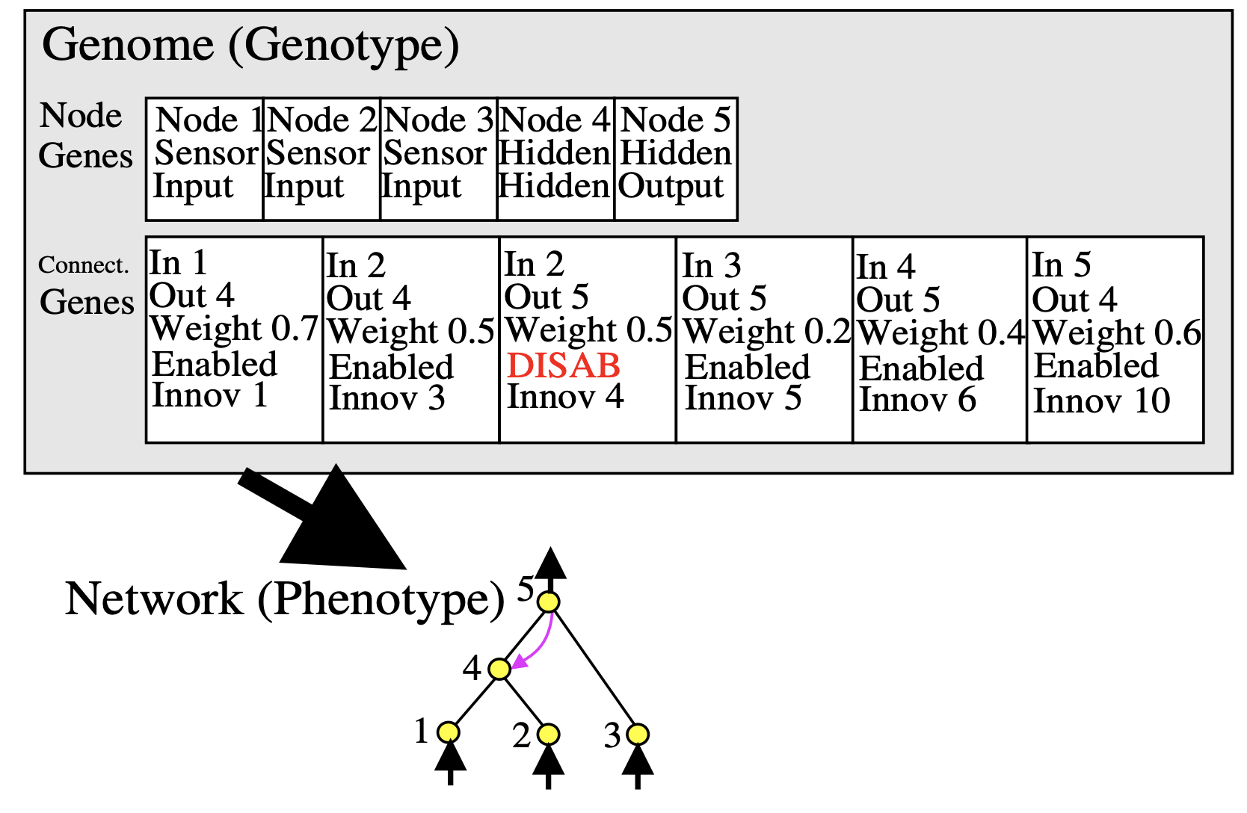
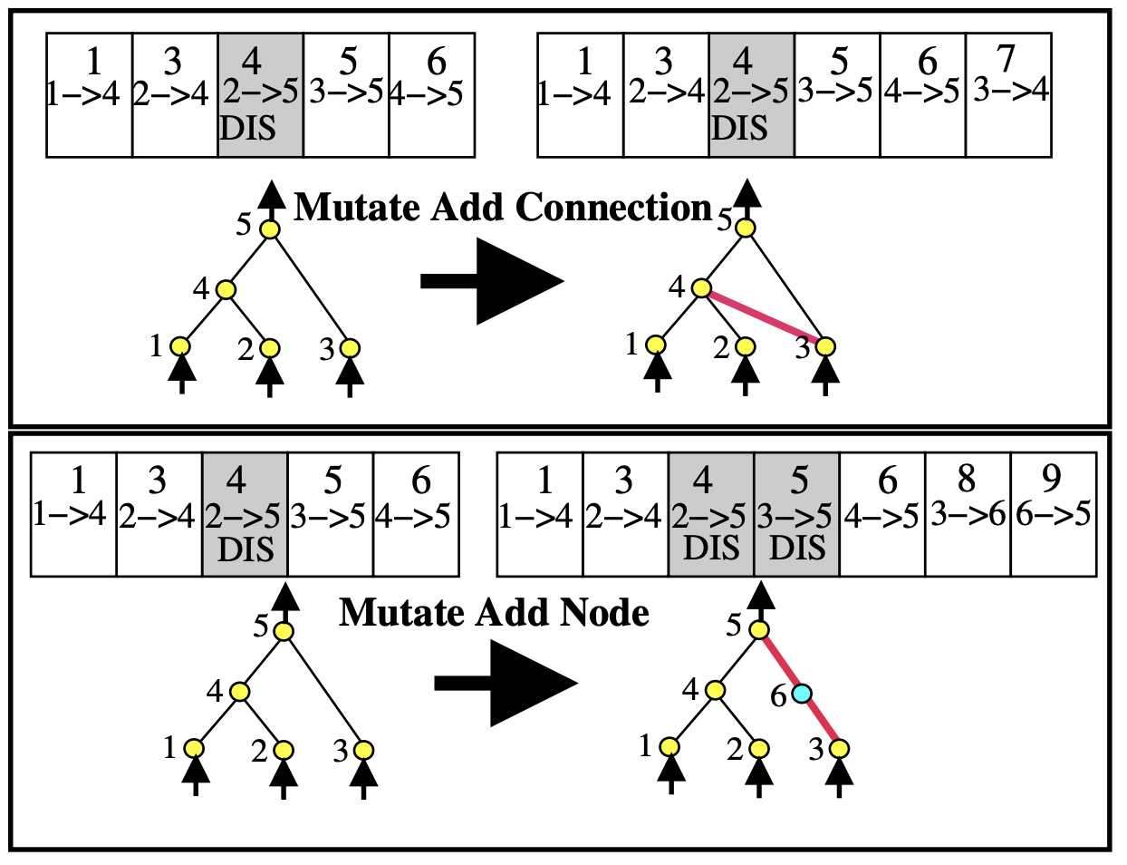
NEAT encoding
Genome composed of
Node genes (can be input, hidden or output)
Connection genes
in_node, out_node, weight, enabled, innovation_ID (discussed later)
Mutation
Weight mutation perturbs the weight
Add connection mutation
adds a new connection between two existing nodes (e.g. 3 and 4 in figure)
Add node mutation
Splits an existing connection by adding a node "in the middle"

Slide 6
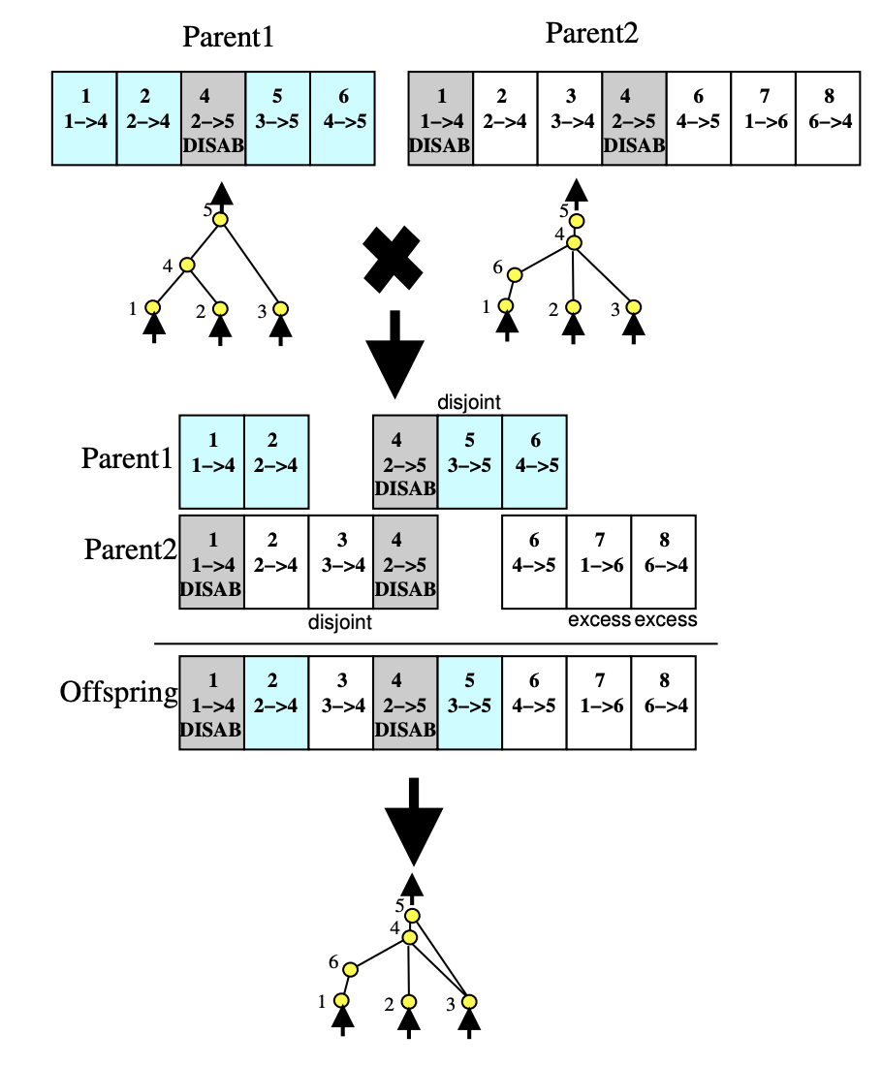
NEAT Crossover
How to crossover networks with different topologies?
Crossover needs to identify "corresponding" parts of the network in the two parents to mix them effectively (avoiding competing conventions)
Corresponding means that they were introduced in a common ancestor of the two parents
How to know that? Simple idea:
Every connection is identified by an innovation ID, assigned incrementally every time a connection is created
Crossover lines up genes by innovation ID and selects genes at random by either parents

Slide 7
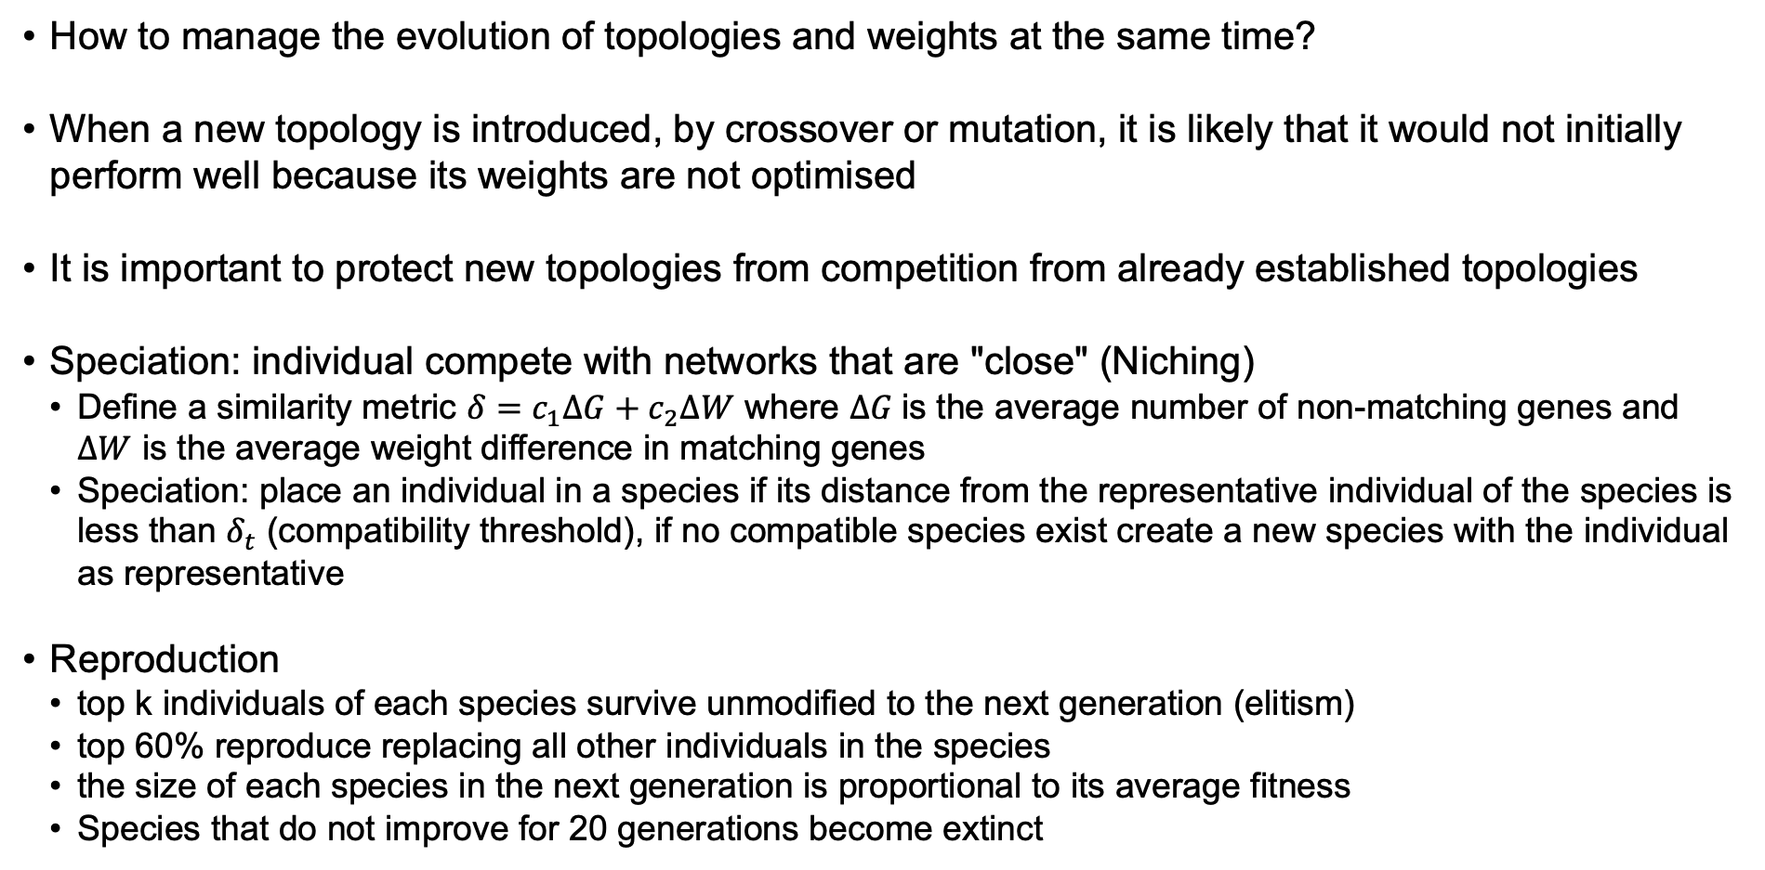
NEAT niching
How to manage the evolution of topologies and weights at the same time?
When a new topology is introduced, by crossover or mutation, it is likely that it would not initially perform well because its weights are not optimised
It is important to protect new topologies from competition from already established topologies
Speciation: individual compete with networks that are "close" (Niching)
Define a similarity metric $δ=c_{1}∆G+c_{2}∆W$ where $∆G$is the average number of non-matching genes and $∆W$ is the average weight difference in matching genes
Speciation: place an individual in a species if its distance from the representative individual of the species is less than $δ_{t}$ (compatibility threshold), if no compatible species exist create a new species with the individual as representative
Reproduction
top k individuals of each species survive unmodified to the next generation (elitism)
top 60% reproduce replacing all other individuals in the species
the size of each species in the next generation is proportional to its average fitness
Species that do not improve for 20 generations become extinct
Notes:
The original paper and code divide the fitness by the number of individual of each species. Then each species gets offsprings equal to the sum of adj_fitness/average_adj_fitness of each member. This is equivalent to say that each species gets a number of offspring equal to the average (non-adjusted) fitness of its members
Colin Green's version at https://github.com/colgreen/sharpneat/blob/master/src/SharpNeatLib/EvolutionAlgorithms/NeatEvolutionAlgorithm.cs computes the mean fitness of each species (not adjusted) and then each species gets offspring proportional to the species mean fitness i.e. N_s = meanfitness(s) / sum(minfitness(s) for all species)

Slide 8
NEAT initialisation
How to grow topologies incrementally, i.e. avoiding unnecessarily complex topologies?
Previous techniques start with a population of random topologies but this increases the size of the search space, potentially unnecessarily.
Neat instead starts with topologies which are the simplest possible topologies (no hidden nodes) and grows them as incrementally as they are found useful, protecting new topologies through speciation.
Thanks to the reduction in the search space NEAT can evolve good networks quickly and these are more likely to be minimal, which also gives an advantage during inference.

Slide 9
NEAT example
"""
2-input XOR example -- this is most likely the simplest possible example.
"""
import os
import neat
# 2-input XOR inputs and expected outputs.
xor_inputs = [(0.0, 0.0), (0.0, 1.0), (1.0, 0.0), (1.0, 1.0)]
xor_outputs = [ (0.0,), (1.0,), (1.0,), (0.0,)]
def eval_genomes(genomes, config):
for genome_id, genome in genomes:
genome.fitness = 4.0
net = neat.nn.FeedForwardNetwork.create(genome, config)
for xi, xo in zip(xor_inputs, xor_outputs):
output = net.activate(xi)
genome.fitness -= (output[0] - xo[0]) ** 2
def run(config_file):
# Load configuration.
config = neat.Config(neat.DefaultGenome, neat.DefaultReproduction,
neat.DefaultSpeciesSet, neat.DefaultStagnation,
config_file)
# Create the population, which is the top-level object for a NEAT run.
p = neat.Population(config)
# Add a stdout reporter to show progress in the terminal.
p.add_reporter(neat.StdOutReporter(True))
stats = neat.StatisticsReporter()
p.add_reporter(stats)
p.add_reporter(neat.Checkpointer(5))
# Run for up to 300 generations.
winner = p.run(eval_genomes, 300)
# Display the winning genome.
print('\nBest genome:\n{!s}'.format(winner))
# Show output of the most fit genome against training data.
print('\nOutput:')
winner_net = neat.nn.FeedForwardNetwork.create(winner, config)
for xi, xo in zip(xor_inputs, xor_outputs):
output = winner_net.activate(xi)
print("input {!r}, expected output {!r}, got {!r}".format(xi, xo, output))
run('config-feedforward')

Slide 10
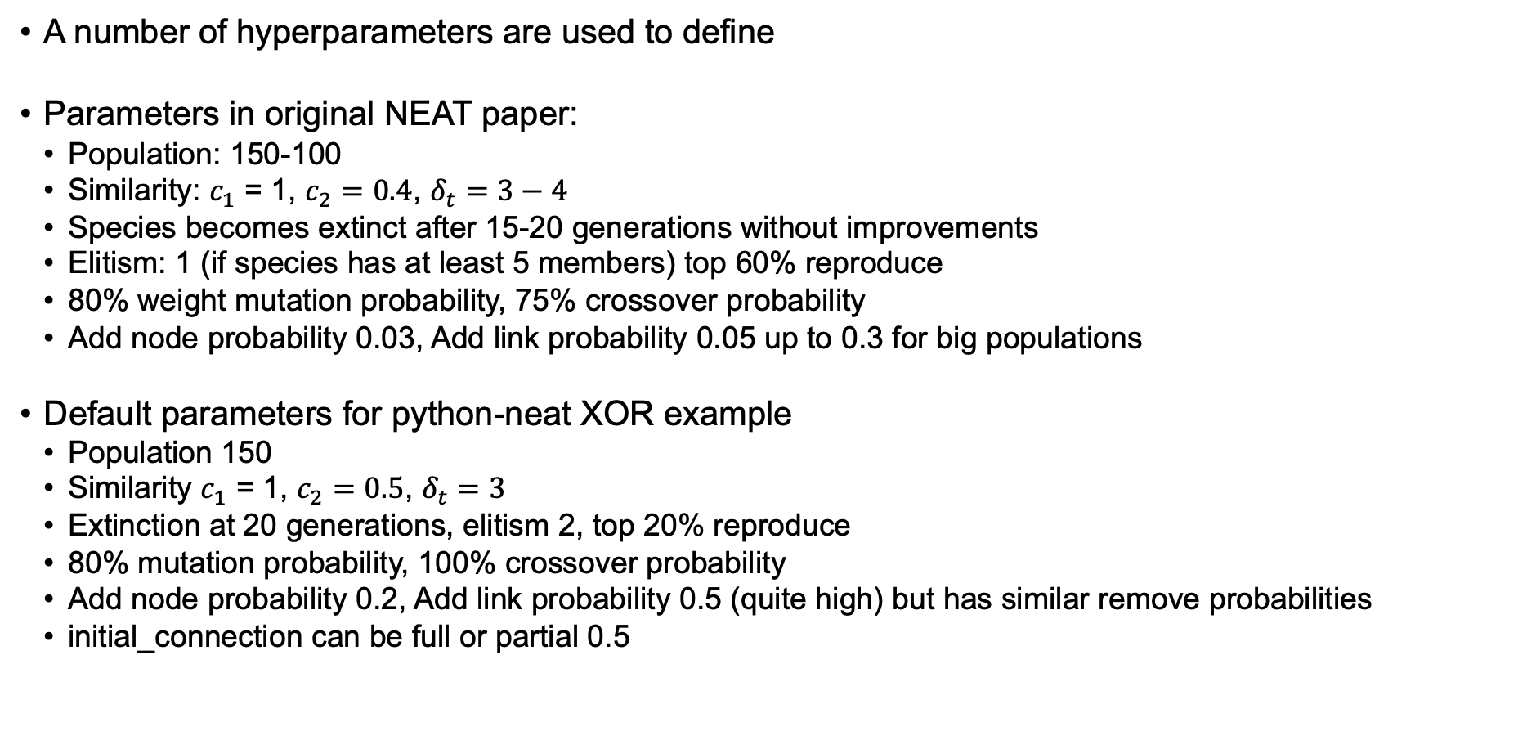
NEAT HYPER-PARAMETES
A number of hyperparameters are used to define
Parameters in original NEAT paper:
Population: 150-100
Similarity: $c_{1}$ = 1, $c_{2}=0.4$, $δ_{t}=3−4$
Species becomes extinct after 15-20 generations without improvements
Elitism: 1 (if species has at least 5 members) top 60% reproduce
80% weight mutation probability, 75% crossover probability
Add node probability 0.03, Add link probability 0.05 up to 0.3 for big populations
Default parameters for python-neat XOR example
Population 150
Similarity $c_{1}$ = 1, $c_{2}=0.5$, $δ_{t}=3$
Extinction at 20 generations, elitism 2, top 20% reproduce
80% mutation probability, 100% crossover probability
Add node probability 0.2, Add link probability 0.5 (quite high) but has similar remove probabilities
initial_connection can be full or partial 0.5

Slide 11
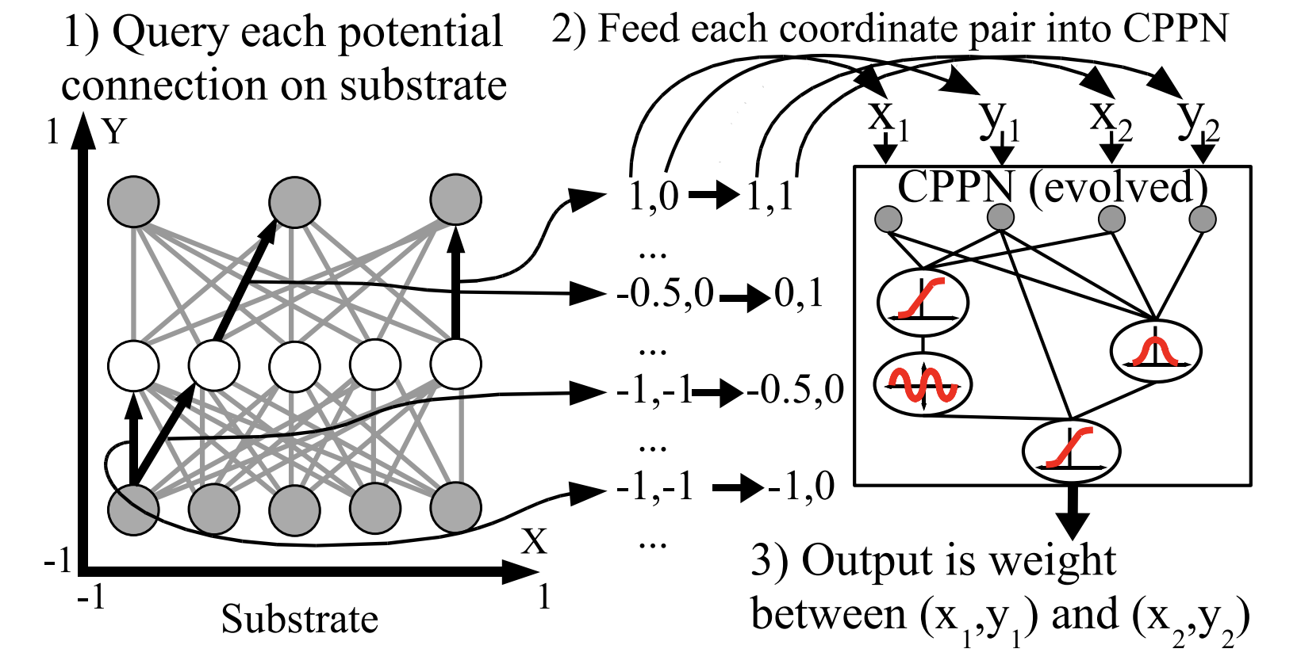
HYPER-NEAT and ES-HYperneat
Standard NEAT works well for control problems where the number of inputs is rather limited
When the number of input is high (such as images) a direct network encoding in terms of neurons and connection is too big to be handled efficiently by neuroevolution
Indirect encoding: Instead of evolving a NN directly we evolve a more compact (less dimensions) representation that can be translated into a NN. This representation is actually a special type of neural network called compositional pattern-producing network (CPPN)
CPPN can create patterns (of weights) with regularities and repetitions (https://nbenko1.github.io/#/) similarly to how e.g. CNN operate, they are much more compact (a change in a single CPPN-weight can affect multiple NN-weights)
Location of hidden nodes can be manual or sampled automatically from CPNN (ES-HyperNeat)

Slide 12
OPENAI-GYM
Environments
Key class of Gym used to simulate the world experienced by the agent
Environments are created by using the make method, and initialised using the reset method import gym env = gym.make('MountainCar-v0')
Environments evolve step by step
agents observe the state of the environment to decide which action to apply to the world and receive a reward, typical loop: obs, info = env.reset() #reset env to random state, returns initial obs done = False; total_reward = 0 while (not terminated and not truncated): action = agent(obs) obs, reward, terminated, truncated, info = env.step(agent) total_reward +=reward
Observation and Action Spaces can be continuous (Box) or discrete
E.g. MountainCar observation is continuous (position, velocity); action is discrete 0=left, 1=nothing, 2=right print(env.observation_space) print(env.action_space) Box([-1.2 -0.07], [0.6 0.07], (2,), float32) Discrete(3)

Slide 13
GYM example (JUPYTER)
from pyvirtualdisplay import Display
virtual_display = Display(visible=0, size=(1400, 900))
virtual_display.start()
import matplotlib.pyplot as plt
%matplotlib inline
from IPython import display
def jrender(env, step=None, info=""):
plt.figure(3,(5,5))
plt.clf()
plt.imshow(env.render())
if (step!=None):
info="step:{}|{}".format(step,info)
plt.title("%s | %s"%(env.spec.id, info))
plt.axis('off')
display.clear_output(wait=True)
display.display(plt.gcf())
plt.close()
import gym
env = gym.make('MountainCar-v0', render_mode= 'rgb_array')
print(env.observation_space)
print(env.observation_space)
print(env.observation_space.low)
print(env.observation_space.high)
obs, info = env.reset()
done = False; total_reward = 0; step = 0;
while (not done):
action = 2 if obs[1]>0 else 0
obs, reward, terminated, truncated, info = env.step(action)
done = terminated or truncated
total_reward += reward
step +=1
jrender(env,step,"Reward:{}".format(total_reward))

Slide 14
REFERENCES
ES-HyperNEAT and HyperNEAT http://eplex.cs.ucf.edu/papers/risi_alife12.pdf
Neuroevolution on Atari games https://www.cs.utexas.edu/~mhauskn/papers/atari.pdf
Deep Neuroevolution at UBER https://eng.uber.com/deep-neuroevolution/
Notes:
https://direct.mit.edu/evco/article/29/1/1/97341/A-Systematic-Literature-Review-of-the-Successors
232 papers based on Neat!

