Slide 1
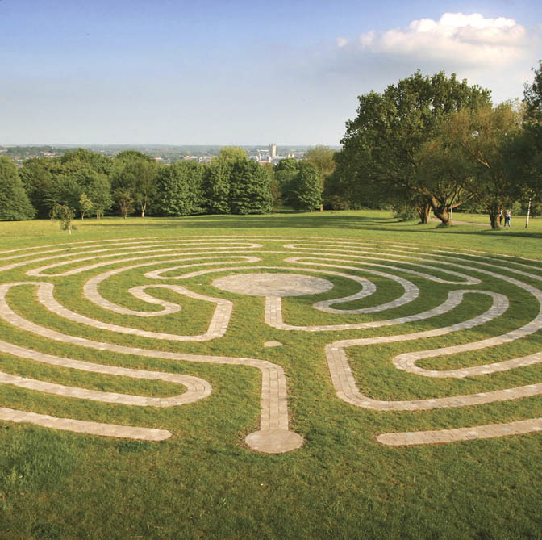
Ai Systems
Lecture 6
Scalability and parallelism

Slide 2
Outline
Motivation
Hyperparameter search
Successive HAlving (SHA and Hyperband)
Asynchronosus SHA
Neural networks training
Backpropagation (Gradient descent)
Mini-batches, Stocastic gradient descent
Model and Data parallelism
Parallel SGD

Slide 3
Motivation
Training ML can take a long time
Large training datasets (Big Data, terabytes to petabyte scale)
Large number of parameter to optimise (Deep NN can have billions of parameters)
Hyperparameters Optimisation (e.g. 10 hyperparameters with 5 values each = 10 millions configurations)
Reduce cost
use less financial resources (energy or cloud costs) to obtain same/similar results
e.g. use approximate methods, simpler models or more efficient training algorithms or hw
Reduce time
obtain results faster (reduce latency), or train more models in the same amount of time (improve throughput) e.g., finding best hyper-parameter configurations
e.g. using parallelism to distribute the work among multiple workers (same or slightly higher total cost)
Improve scalability
increase the ability of the ML system to handle bigger models/datasets

Slide 4
Hyperparameter search
Hyperparameter grid search is trivially parallelisable:
Assuming training of a single model is fast (X,y and w not too big)
Train each model using a combination of hyperparameters on a separate node/cluster
Smart hyperparameter optimisation strategies adapts the search introducing dependencies between runs:
Adaptive configuration evaluation: early-stop poor configurations and divert training resources to more promising ones
Need to know which parameter combinations are best performing at increasing level of resources
Examples: Successive Halving, also implemented in sklearn Halving(Random/Grid)SearchCV
Adaptive configuration selection: decide which region of the hyperparameter space to investigate
Also called Bayesian Optimisation techiniques, difficult to parallelise as require complete results from previous runs
Notes:
Before discussing parallelism models let's tackle a simple case where parallelism is easy
A System for Massively Parallel Hyperparameter Tuning
https://arxiv.org/abs/1810.05934
https://www.researchgate.net/publication/334715381_Taming_Hyper-parameters_in_Deep_Learning_Systems
This works well for hyperparameters that are not related to performance or performance/accuracy tradeoffs
- model averaging
- dynamic policies

Slide 5
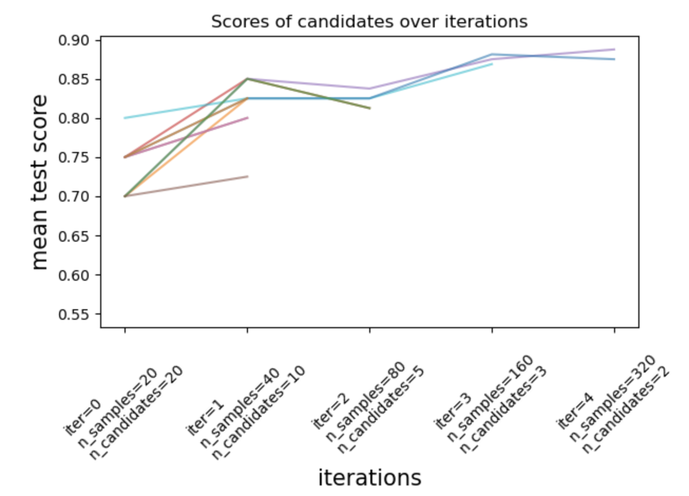
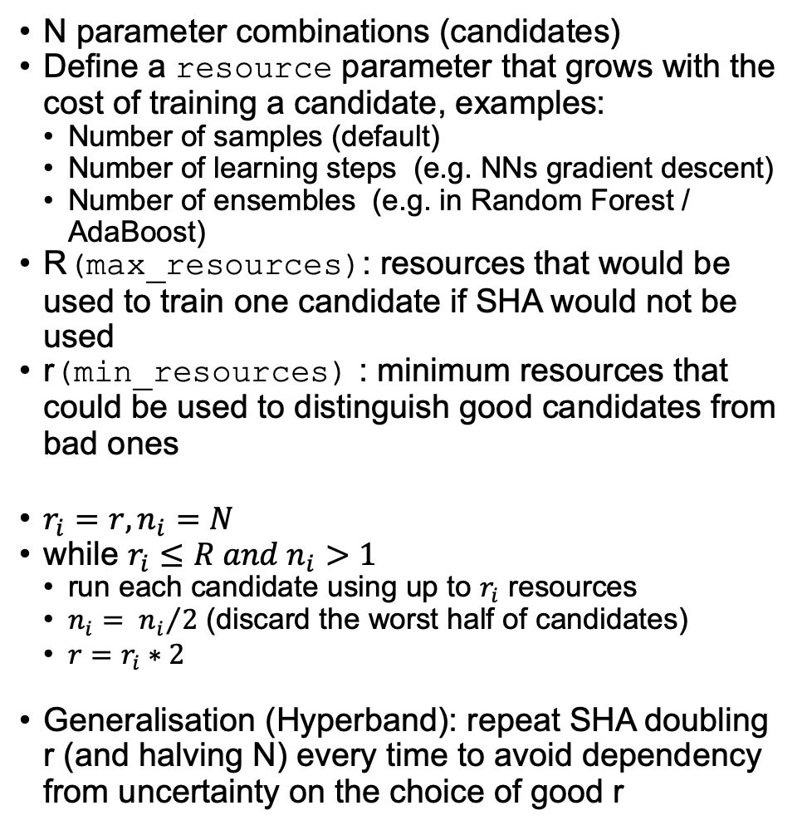
Successive halving (SHA)
N parameter combinations (candidates)
Define a resource parameter that grows with the cost of training a candidate, examples:
Number of samples (default)
Number of learning steps (e.g. NNs gradient descent)
Number of ensembles (e.g. in Random Forest / AdaBoost)
R(max_resources): resources that would be used to train one candidate if SHA would not be used
r(min_resources) : minimum resources that could be used to distinguish good candidates from bad ones
$r_{i}=r,n_{i}=N$
while $r_{i}≤R and n_{i}>1$
run each candidate using up to $r_{i}$ resources
$n_{i}= {n_{i}}/2$ (discard the worst half of candidates)
$r=r_{i}∗2$
Generalisation (Hyperband): repeat SHA doubling r (and halving N) every time to avoid dependency from uncertainty on the choice of good r

Slide 6
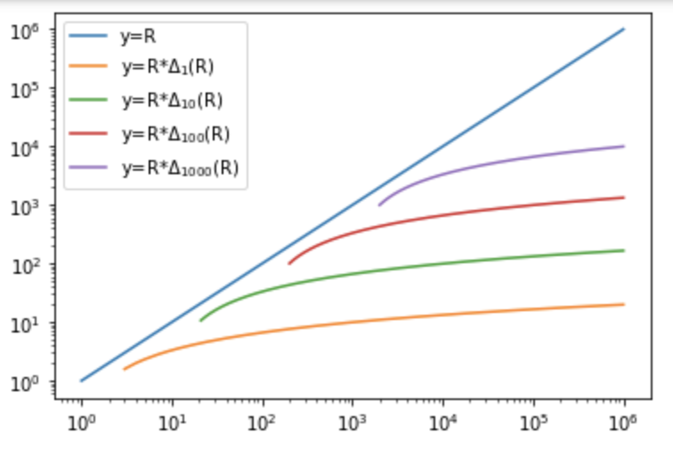
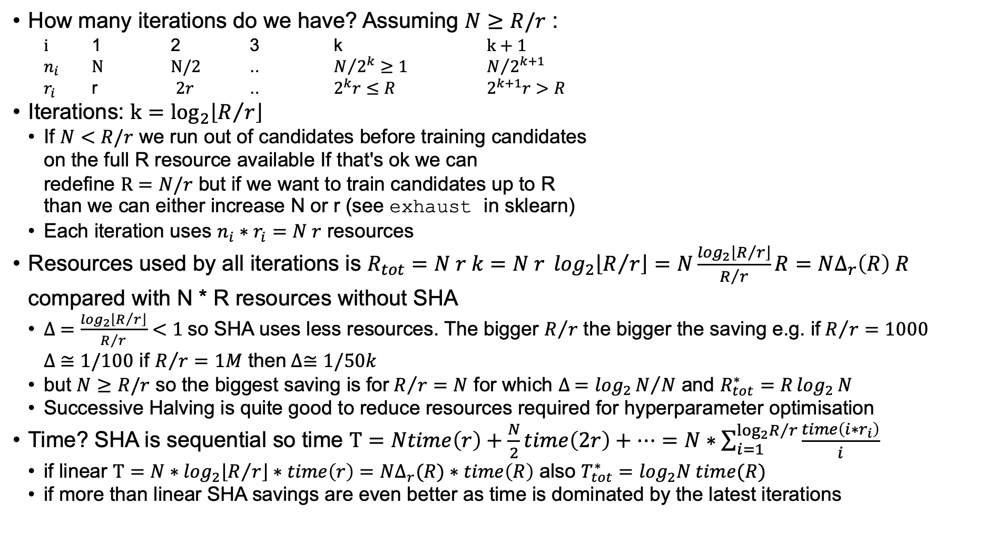
successive halving: ANALYSIS
How many iterations do we have? Assuming $N≥R/r$ :
$i$ 1 2 3 k $k+1$
$n_{i}$ $N$ $N/2$ .. $N/{2^{k}}≥1$ $N/{2^{k+1}}$
$r_{i}$ r $2r$ .. $2^{k}r≤R$ $2^{k+1}r>R$
Iterations: $k=\log_{2}\left\lfloor R/r\right\rfloor$
If $N<R/r$ we run out of candidates before training candidates on the full R resource available If that's ok we can redefine $R=N/r$ but if we want to train candidates up to R than we can either increase N or r (see exhaust in sklearn)
Each iteration uses $n_{i}∗r_{i}=N r$ resources
Resources used by all iterations is $R_{tot}=N r k=N r \log_{2}\left\lfloor R/r\right\rfloor =N\frac{\log_{2}\left\lfloor R/r\right\rfloor }{R/r}R=N∆_{r}\left(R\right) R$ compared with N * R resources without SHA
$∆ =\frac{\log_{2}\left\lfloor R/r\right\rfloor }{R/r}<1$so SHA uses less resources. The bigger $R/r$ the bigger the saving e.g. if$R/r=1000$ $∆ ≅1/100$ if $R/r=1M$ then$∆≅1/50k$
but $N≥R/r$ so the biggest saving is for$R/r=N$ for which $∆ ={\log_{2}{N}}/N$ and $R_{tot}^{∗}=R\log_{2}{N}$
Successive Halving is quite good to reduce resources required for hyperparameter optimisation
Time? SHA is sequential so time $T=Ntime\left(r\right)+\frac{N}{2}time\left(2r\right)+…=N∗\sum_{i=1}^{\log_{2}{R/r}}{\frac{time\left(i∗r_{i}\right)}{i}}$
if linear $T=N∗\log_{2}\left\lfloor R/r\right\rfloor ∗time\left(r\right)=N∆_{r}(R)∗time\left(R\right)$ also $T_{tot}^{∗}=\log_{2}N time(R)$
if more than linear SHA savings are even better as time is dominated by the latest iterations

Slide 7
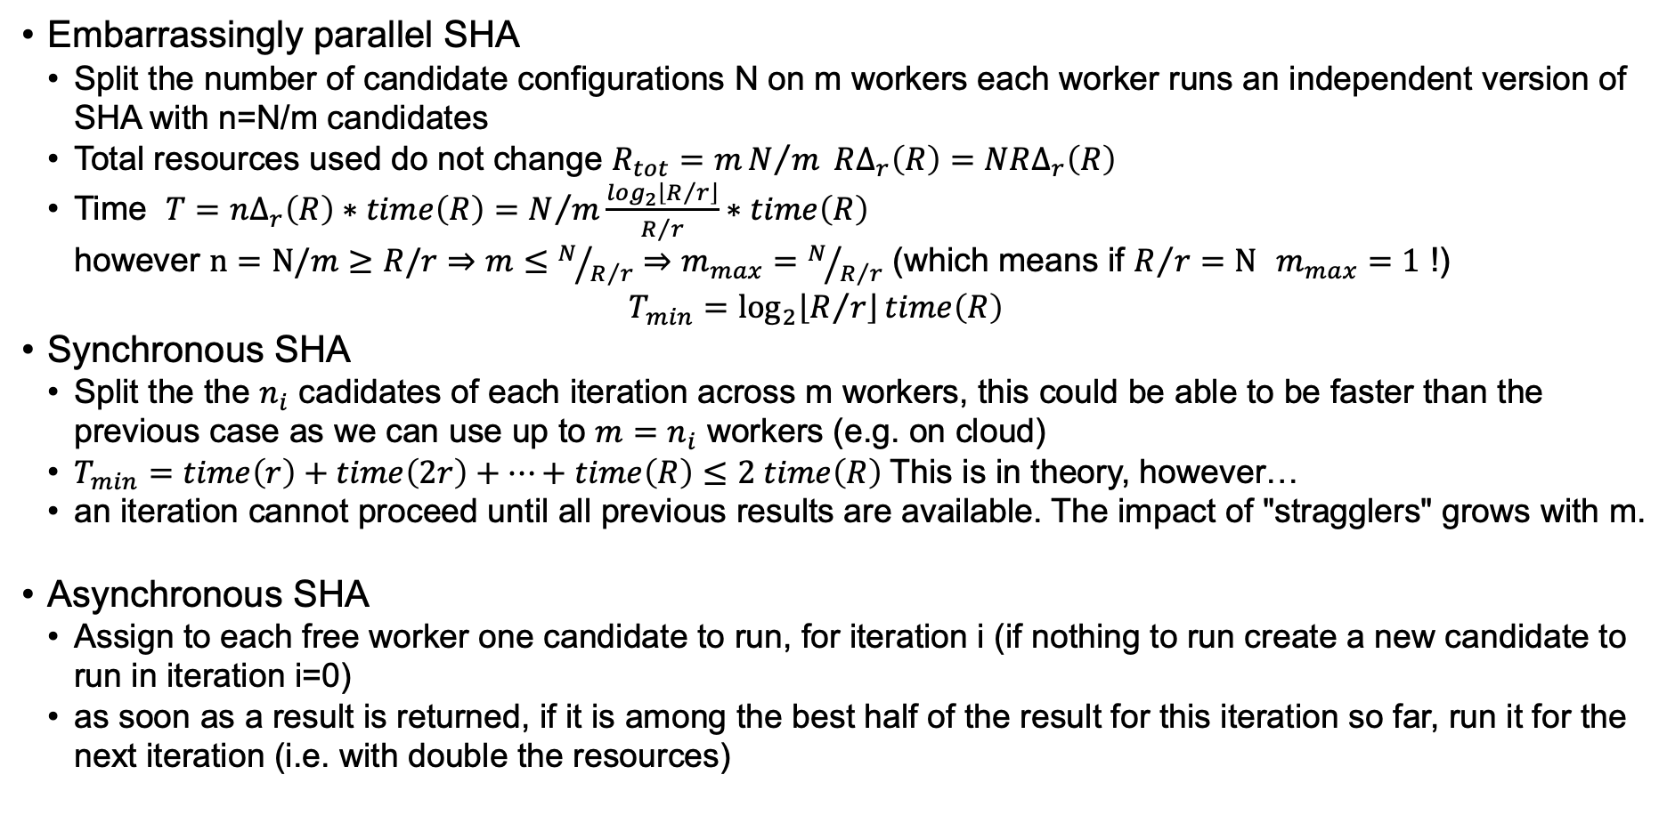
Parallel successive halving
Embarrassingly parallel SHA
Split the number of candidate configurations N on m workers each worker runs an independent version of SHA with n=N/m candidates
Total resources used do not change $R_{tot}=mN/m R∆_{r}\left(R\right)=NR∆_{r}\left(R\right)$
Time $T={n∆_{r}\left(R\right)∗time\left(R\right)=N}/m\frac{\log_{2}\left\lfloor R/r\right\rfloor }{R/r}∗time\left(R\right)$ however $n=N/m≥R/r⇒m≤N/{R/r}⇒m_{max}=N/{R/r}$ (which means if $R/r=N$ $m_{max}=1$ !) $T_{min}=\log_{2}\left\lfloor R/r\right\rfloor time\left(R\right)$
Synchronous SHA
Split the the $n_{i}$ cadidates of each iteration across m workers, this could be able to be faster than the previous case as we can use up to $m=n_{i}$ workers (e.g. on cloud)
$T_{min}=time\left(r\right)+time\left(2r\right)+…+time\left(R\right)≤2 time\left(R\right)$This is in theory, however…
an iteration cannot proceed until all previous results are available. The impact of "stragglers" grows with m.
Asynchronous SHA
Assign to each free worker one candidate to run, for iteration i (if nothing to run create a new candidate to run in iteration i=0)
as soon as a result is returned, if it is among the best half of the result for this iteration so far, run it for the next iteration (i.e. with double the resources)
Notes:
It takes r_i=min_resources*2^i resources over n_candidates_i=N/2^I

Slide 8
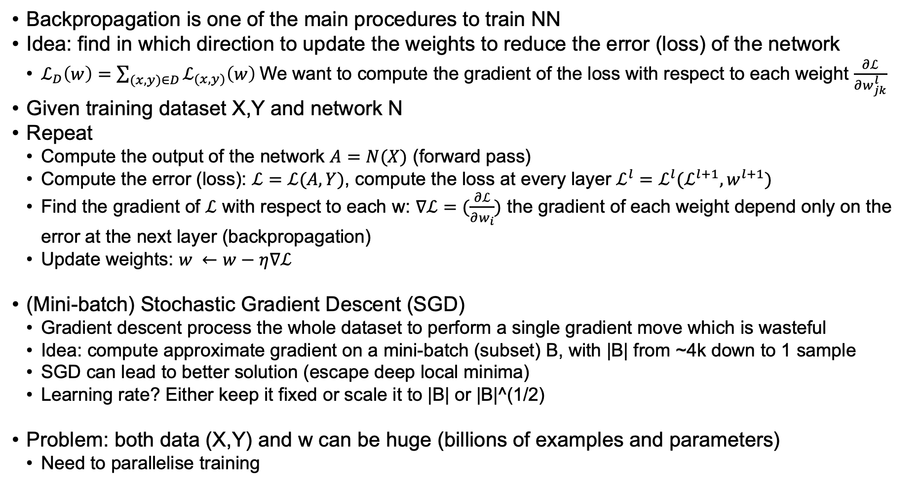
Backpropagation (Gradient descent)
Backpropagation is one of the main procedures to train NN
Idea: find in which direction to update the weights to reduce the error (loss) of the network
$ℒ_{D}\left(w\right)=\sum_{(x,y)∈D}{ℒ_{(x,y)}\left(w\right)}$We want to compute the gradient of the loss with respect to each weight $\frac{∂ℒ}{∂w_{jk}^{l}}$
Given training dataset X,Y and network N
Repeat
Compute the output of the network $A=N(X)$ (forward pass)
Compute the error (loss): $ℒ=ℒ(A,Y)$, compute the loss at every layer $ℒ^{l}=ℒ^{l}(ℒ^{l+1},w^{l+1})$
Find the gradient of $ℒ$ with respect to each w: $∇ℒ=(\frac{∂ℒ}{∂w_{i}})$ the gradient of each weight depend only on the error at the next layer (backpropagation)
Update weights: $w ←w−η∇ℒ$
(Mini-batch) Stochastic Gradient Descent (SGD)
Gradient descent process the whole dataset to perform a single gradient move which is wasteful
Idea: compute approximate gradient on a mini-batch (subset) B, with |B| from ~4k down to 1 sample
SGD can lead to better solution (escape deep local minima)
Learning rate? Either keep it fixed or scale it to |B| or |B|^(1/2)
Problem: both data (X,Y) and w can be huge (billions of examples and parameters)
Need to parallelise training
Notes:
https://mathinsight.org/directional_derivative_gradient_introduction#gradient
Applet to show gradients
Probably the best (a bit long) explanation of backpropagation
http://neuralnetworksanddeeplearning.com/chap2.html
If you want to see some numbers or a picture
https://mattmazur.com/2015/03/17/a-step-by-step-backpropagation-example/
https://en.wikipedia.org/wiki/Backpropagation
https://medium.com/@14prakash/back-propagation-is-very-simple-who-made-it-complicated-97b794c97e5c
https://en.wikipedia.org/wiki/Total_derivative#Example:_Differentiation_with_direct_dependencies
ON LARGE-BATCH TRAINING FOR DEEP LEARNING: GENERALIZATION GAP AND SHARP MINIMA
https://arxiv.org/pdf/1609.04836.pdf
Large batches do not generalise well, get stuck in deep local minima
Train longer, generalize better: closing the generalization gap in large batch training of neural networks
https://arxiv.org/pdf/1705.08741.pdf
Accurate, Large Minibatch SGD: Training ImageNet in 1 Hour
https://arxiv.org/pdf/1706.02677.pdf
You can use large batches, PAPER1: (1) Use SGD with momentum, gradient clipping, and a decreasing learning rate schedule; (2) adapt the learning rate with batch size (we used a square root scaling); (3) compute batch-norm statistics over several partitions ("ghost batch-norm"); and (4) use a sufficient number of high learning rate training iterations; PAPER2 linear learning with adaptive ramp-up during warm-up phase
https://ruder.io/optimizing-gradient-descent/index.html
Quite good summary of Gradient descent with variants, has something about parallelisation but not quite good and outdated.
https://cs231n.github.io/optimization-1/
Simple and clear introduction to Gradient descent
https://cs231n.github.io/optimization-2/
All you ever wanted to know about backpropagation

Slide 9
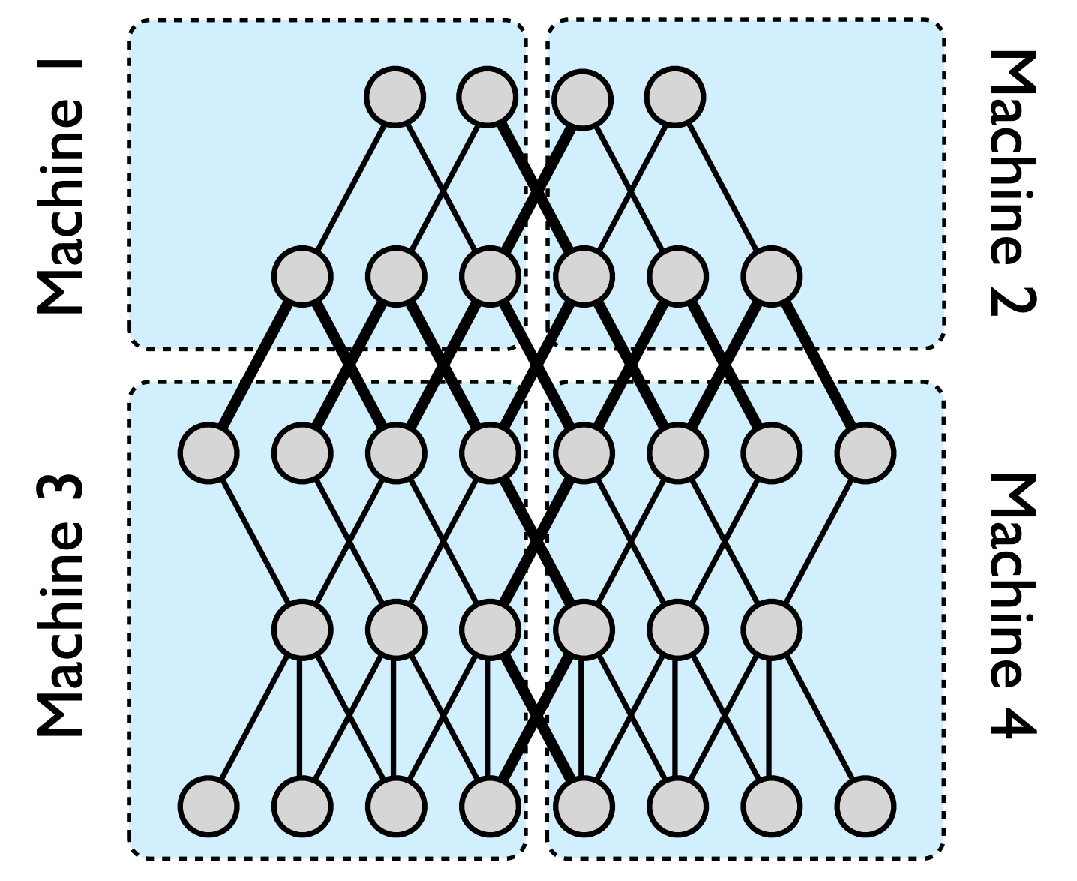
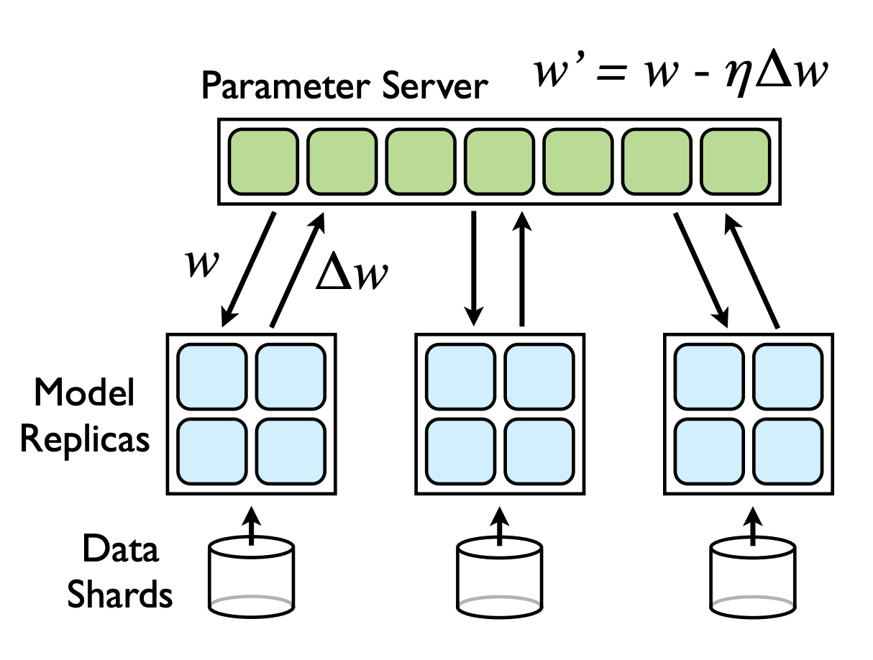
PARALLEL Training models
So we have large networks (w) and big data (X,Y) how do we handle them?
Model-based parallelism: Partition the model (weights) across nodes
models with local connectivity work better than fully connected networks
often sub-linear scalability due to variance in processing times leading to many machines waiting for the single slowest machine to finish a given phase
DistBelief (Google 2012) e.g. up to 128 machines with speedup up to 12 (1.7 billion parameters)
Data parallelism: Partition the data across nodes
Ensemble approach: each node train a full replica of the model on the local partition, then use soft/hard voting during inference
Parallel SGD
weights stored in main memory in case of multicore/GPUs workers or a parameter server if training is distributed over multiple machines
workers get the current weights then compute gradients of weights based on local data
Notes:
https://arxiv.org/pdf/1604.00981.pdf
Synchronous parallel SGD with faster k out of m gradients from the workers. They say that asynchronous SGD has poor convergence

Slide 10
PARALLEL SGD
Batch size
Small batch size means that there is little work to parallelise between retrieving the current parameters and computing the gradients. Note (global) batch size is per-worker batch size * num workers
e.g. in a system with 2 servers and 4GPUs/server with a batch size of 256, each GPU would need to access external memory every 32 samples.
Bigger batch sizes allow for more efficient parallelisation reducing communication/synchronization costs
However very large batches are less statistically efficient as they pay a high cost per model update which can be compensated up to a given point by increasing the learning rate. Warm-up: initial rate usually lower.
Synchronous SGD
When all workers have completed computing gradients, model is updated with the average of the gradients
Synchronisation costs due to stragglers in particular at high parallelism level
Fastest k out of m: update model as soon as k gradients are available, the rest are discarded
Asynchronous SGD
Each gradients is applied to the model as soon as it is available
Stale gradients: worker gradient is applied to model that is different (ahead) from the one used to compute it
To prevent models of worker to diverge each worker gets new weights after it sent the gradient to the model
Local SGD
Each worker apply the gradient to the local model parameters, thus model diverge
Periodically the master average the models and reset workers to the central model
Notes:
Luo et al CROSSBOW on small batch sizes and model averaging:
http://www.vldb.org/pvldb/vol12/p1399-koliousis.pdf
Local SGD
https://arxiv.org/pdf/1808.07217.pdf

Slide 11
Summary
Two most time-consuming factors in ML training
Hyperparameter Optimisation (i.e., training many ML models)
Backpropagation (when training NN on big datasets)
Two ways to reduce these training cost and thus increase scalability
Successive Halving (SHA) approximates the quality of a model using a lower-fidelity model (less data or simpler model)
Stochastic/Mini-batch Gradient Descent approximate the gradient using a sample
Ways to obtain results faster by parallelising computation on multiple worker nodes
Parallel SHA (Synch or Asynch) reduces the time to find hyper-parameters
Parallel SGD (Synch/Asynch or Local) reduces the time to complete training

Slide 12
References
Successive Halving, Hyperband and Asynchronous versions:
A SYSTEM FOR MASSIVELY PARALLEL HYPERPARAMETER TUNING https://arxiv.org/pdf/1810.05934.pdf
Sklearn Successive Halving user guide
https://scikit-learn.org/stable/modules/grid_search.html#successive-halving-user-guide
Review of other hyper-parmeter optimisation approaches (including Bayesion optimisation and population-based strategies)
https://arxiv.org/pdf/2003.05689.pdf
Gradient descent
https://cs231n.github.io/optimization-1/
Backpropagation
https://cs231n.github.io/optimization-2/
http://neuralnetworksanddeeplearning.com/chap2.html
Model parallelism (Distbelief)
https://www.cs.toronto.edu/~ranzato/publications/DistBeliefNIPS2012_withAppendix.pdf
Synchronous SGD
https://arxiv.org/pdf/1604.00981.pdf
Local SGD
https://arxiv.org/pdf/1808.07217.pdf
http://www.vldb.org/pvldb/vol12/p1399-koliousis.pdf

