Slide 1

AI Systems
Lecture 2
Classification and Trees

Slide 2
Overview
Classification
Classification Algorithms
Data preparation
Scikit-Learn
Model evaluation
Overfitting and underfitting
Hyperparameters and Cross-Validation
Metrics
Decision Trees

Slide 3
Classification
Cornerstone of supervised learning
Learns to predict any categorical (multiple-choice) target feature from examples
E.g. predict delinquency in 2 years from individual credit features (credit-g dataset)
Differs from regression problems which predict a numerical feature of the data
This example delinquency has only two possible values (0 or 1): binary classification
When target attribute has multiple possible values the problem is called multi-class (e.g. MNIST)
In some special cases we might be trying to predict multiple attributes at the same time in which case the problem is called multi-label or multi-output
age | debt_ratio | montly_income | loans | … | delinquency in 2yr
38 | 0.3 | 5440 | 4 | … | 0
63 | 0.47 | 8000 | 9 | … | 0
45 | 0.76 | 9120 | 13 | … | 1
…

Slide 4
Data preparation
Splitting data into train set and test set
Test set should be used sparingly, or it would not be representative of "unseen" data
Data cleaning/imputation
Some attributes could be missing (np.nan or pd.NA). Some algorithms work naturally with missing values, others would require missing values to be filled in (or dropping instance / attributes)
Data preparation
categorical values often need to be encoded using ordinal or one-hot encoding, some algorithms work directly with categorical data e.g. Decision Trees (even if sklearn's implementation does not support that)
Scaling/Standardisation of numerical features is often helpful for numerical methods (e.g. PCA, SVM etc..) but not necessary for Decision Trees
For classification problems which are imbalanced it is possible to consider undersampling, oversampling e.g. using the imbalanced-learn package
Pipelines
Often data preparation tasks are organised into pipelines so that processing can be easily repeated and tuned
A pipeline is normally composed by a sequence of transformers that transform the input for the next transformer or for the final predictor

Slide 5
Scikit-learn (sklearn) design
Estimators
fit() method learns parameters from data
E.g. fit(X) for unsupervised learning, fit(X,y) for supervised learning
Hyperparameters normally set in constructors, can be accessed with set_params() and get_params()
Hyperparameters can also be accessed by public instance variables
Transformers
Estimators that can transform data using the transform(X) method
E.g. pca.fit(X) identifies PCA's projection hyperplane and X_transf = pca.transform(X) will apply PCA projection to X. fit_transform() would apply both steps and can be more efficient
Predictors
Estimators that provide a predict(X) method that provides predictions from observations
Pipelines
Allows to concatenate a set of transformers and final predictors
pipeline.fit(X) invokes fit_transform on each intermediate step and fit on the last estimator
pipeline.predict(X) invokes transform on each step and predict on the last predictor
Allows optimisation of hyperparameters of different estimators across the whole pipeline

Slide 6
Classification Algorithms
Binary algorithms
Support Vector Machine
Logistic Regression
Stochastic Gradient Descent
Multiclass algorithms
Naïve Bayes
Decision Trees
from sklearn.datasets import fetch_openml
credit = fetch_openml(name="credit",version=1)
from sklearn.linear_model import LogisticRegression
classifier = LogisticRegression()
classifier.fit(credit.data,credit.target)
classifier.predict([[.9,40,0,.9,5000,5,0,3,0,4]])
> array([1.])
Some algorithms can provide an indication of the confidence of the prediction (e.g. producing a probability for each class instead of just the class value)
classifier.predict_proba([[.9,40,0,.9,5000,5,0,3,0,4]])
> array([[0.48360708, 0.51639292]])
Binary algorithms can be used for multiclass problems with M labels
one-vs-one strategy: trains one binary predictor to distinguish every couple of labels
M(M-1)/2 predictors each trained on N/M*2 instances (for a balanced problem with N instances)
final prediction is the class that wins most "duels"
one-vs-all strategy: trains one binary predictor to distinguish class a from non-class a
M predictors each trained on full dataset
final prediction is the class that has highest score (requires model to output a probability/score)

Slide 7
Model evaluation
How good is the resulting model?
We can try a model on the training examples as we know the label for to see how accurate it is
from sklearn.tree import DecisionTreeClassifier
tree = DecisionTreeClassifier()
tree.fit(credit.data,credit.target)
tree.score(credit.data,credit.target)
>1.0
This is called training accuracy and is often not very representative of the performance on new data. We can split the data into a training set and a test set:
from sklearn.model_selection import train_test_split
X_train, X_test, y_train, y_test = train_test_split(credit.data, credit.target)
tree.fit(X_train,y_train)
print(tree.score(X_train,y_train))
print(tree.score(X_test,y_test))
>1.0
0.67647762622637
this shows that the model is overfitting the data as the training accuracy is quite higher than the testing accuracy
Notes:
Tree.score => 1 // 100% correct -> the model just memory the answer

Slide 8
Overfitting and underfitting
Models which performs worse on unseen data are overfitting the training data, i.e. they are memorising the training set and not good at generalising to new inputs
Possible ways to combat overfitting
choose a simpler model or constrain the model (called regularisation)
get more data
The opposite problem i.e., underfitting can happen when the model is not powerful enough to learn / explain the training data, (low training accuracy)
Ways to combat underfitting
choose a more powerful (complex) model or reduce regularisation
add/improve features to make it easier for the model to fit the data (feature engineering)
A model generalisation error can be separated into three components:
bias: due to wrong assumptions about the model (e.g. trying to fit a quadratic relationship with a linear model). Causes underfitting.
variance: excessive sensitivity to small variation in training data. Typical of complex models such as high degree polynomials or NNs with many hidden neurons. Causes overfitting.
irreducible error: due to noise in the data
Increasing the model complexity will in general reduce bias and increase variance hence there is a bias-variance tradeoff

Slide 9
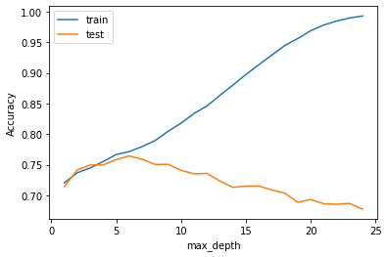

Hyperparameters and cross-validation
E.g. In Decision Tree Models we can fix a maximum depth or number of leaves
tree.max_depth = 3
tree.fit(X_train,y_train)
print(tree.score(X_train,y_train))
print(tree.score(X_test,y_test))
>0.7447945751894695
0.7497008853792774
this is an example of a hyperparameter (notice the testing accuracy is now higher!)
However test data should not be used to train hyperparameters!
Hyperparameters should be evaluated using a portion of the training dataset called validation set
To avoid wasting a big portion of the training set for validation we can keep the validation set small (e.g. 10% of training) and perform training 10 times each time with a different 10% as validation (10-fold cross validation)

Slide 10
metrics
Accuracy: correct decisions/total number of decisions
For a binary classifier accuracy = (TP+TN)/(TP+TN+FP+FN)
Not always the best metric:
Some classes might be more important than others
E.g. in self-driving recognizing a pedestrian vs recognizing a warning sign
Some type of errors might be more costly than others
E.g. in medical tests cost of false positive vs false negative
Some datasets might be quite imbalanced
E.g. a classifier that always predict negative has 99% accuracy on a dataset that has 99% negative
Alternative metrics:
Precision: how often the classifier is correct when it predicts a class
Normally in binary classification we focus on positive class so TP/(TP+FP)
Recall: how often instances belonging to a class are picked up by the classifier
For positive class (Sensitivity): TP/P = TP/(TP+FN) // high positive position
For negative class (Specificity): TN/N = TN/(TN+FP)
F1 score: harmonic mean of precision and recall, TP/(TP+(FP+FN)/2)
Balanced accuracy: average recall across classes (unweighted), for balanced classes it is the same as accuracy, for binary problems average of sensitivity and specificity

Slide 11
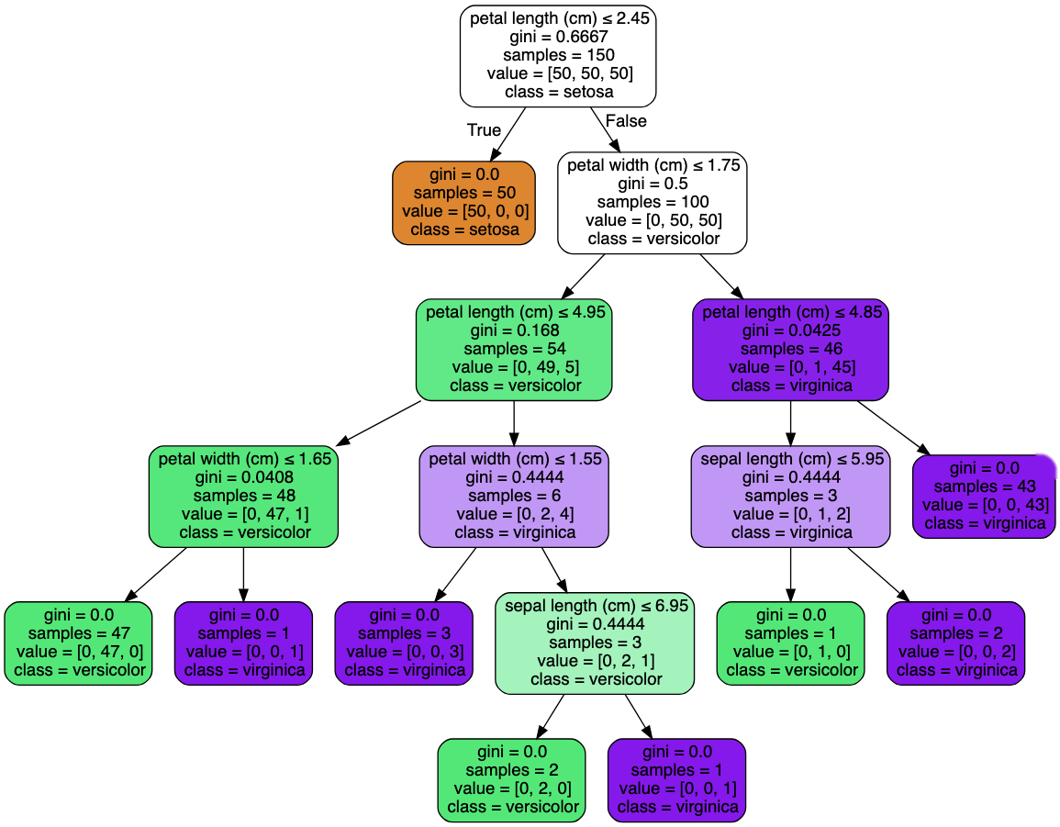
Decision Trees
Decision Tree: “swiss army knife” of classification
Idea: recursively split dataset on an attribute-condition-value so that the resulting sub-spaces are more homogeneous (“pure”) than the starting dataset
Each split represent an internal node of the DT
Prediction associated to the most common class in a leaf
Fast to compute: greedy (locally optimal) decisions made at each split. Result can be sensitive to specific elements in dataset
Easy to interpret
Non-parametric: tree can adapt to the complexity of decision boundary, but can overfit
can specify max depth/leaves or min instances/gain to split
Orthogonal decision boundaries
Constant piece-wise prediction (poor extrapolators)
Can support missing values and categorical data
but sklearn implementations do not
Most of the above drawbacks can be solved by using DT as base learner in an ensemble

Slide 12
END

